Slide 1
Bank Analytics & Dashboard
Analytics for Stake-Holders
Created By :
Monish G | Phurba Doma Sherpa | B. Sahithi | Mehwish Ahmed | Avin paula

Slide 2
OBJECTIVE
The objective of this project is to analyze banking data and create an interactive dashboard that helps stakeholders monitor bank performance, customer behavior, loan trends, and financial risks for better decision-making

Slide 3
PROBLEM STATEMENT
Banks generate large volumes of customer and transaction data daily. However, without proper analysis, it becomes difficult for stakeholders to identify:
Loan default trends
Customer segmentation
Revenue performance
Branch-wise efficiency
Risky customers and loans
Overall business growth patterns
This project aims to transform raw banking data into meaningful insights through analytics and dashboards.

Slide 4
CONTEXT
Bank Loan Dashboard
Bank Debit And Credit Dashboard
Project And Dataset Overview
Excel Dashboard
Tableau Dashboard
KPI list
Power Bi Dashboard
SQL Queries And Results
Challenges and Key Takeaways

Slide 5
TOOLS USED
Excel
SQL
Tableau
Power BI
- Data Preparation, Pivot Tables, Power Query, Data Model & KPI Dashboard
- MySQL Workbench : Database setup, KPI Queries using Clauses, Joins
- Multi page Dashboard with page navigators, interactive visuals with filters
- Interactive Dashboard with KPI cards & dynamic visuals

Slide 6
BANK LOAN ANALYTICS
PROJECT OVERVIEW :
This project analyzes the bank's active lending habits to see how well it distributes money and where it might be taking on too much risk. By building an interactive dashboard based on 18 key metrics, the project allows management to track exactly how much capital is funded across different branches and states , while keeping a close eye on dangerous default and delinquency trends. It also helps audit internal safety compliance by exposing exactly how many loans were handed out to high-risk customers without proper document verification.
DATASET OVERVIEW :
The dataset keeps track of the bank's loan history to help monitor lending capacity and credit risk. It uses categories like branch name, customer age group, loan status, and verification check marks as filters so you can slice and dice the data easily. Meanwhile, it uses numbers like loan amounts, interest profits, and late-payment counts to calculate the dashboard's 18 key metrics. In short, it takes a massive spreadsheet of raw loan files and turns it into a simple, visual guide for safer banking decisions

Slide 7
KPI LIST
Core Performance Metrics :
Categorical & Branch Performance Metrics :
Total Loan Funded: The total monetary value of all disbursed loans.
Total Loans Count: The total number of loans issued, including active and closed loans.
Total Collection: The total amount collected from borrowers, including principal and interest.
Total Interest: The total revenue generated from interest on loans.
Disbursement Trend: The historical trend of loan disbursements tracked over specific periods.
Branch Performance: Revenue breakdown by branch, including interest income, fees, and combined revenue.
State-Wise Loan: Distribution of loans across different states to analyze geographic trends.
Religion-Wise Loan: Loan distribution categorized by clients’ religious demographics.
Product Group Loan: Loan categorization by product types, such as personal, mortgage, or auto loans.
Grade-Wise Loan: Classification of loans based on borrower credit grades to measure the risk profile.
Status-Wise Loan: Distribution of loans based on their current status, such as active, closed, delinquent, or defaulted.
Age Group Loan: Loan allocation segmented by borrowers’ age groups to analyze customer demographics.
Loan Maturity: The duration until loans are fully repaid, assessing the structure and timeline of the portfolio.

Slide 8
KPI LIST
Risk & Compliance Metrics :
Default Loan Count: The total number of loans that have defaulted, highlighting credit risk.
Delinquent Clients: The number of clients who have missed payments or are overdue.
Delinquent Loan Rate: The percentage of loans in delinquency status compared to the total loan portfolio.
Default Loan Rate: The percentage of defaulted loans relative to the total loan portfolio to evaluate long-term risk.
No Verified Loans: The number of loans issued without full verification or documentation, identifying compliance gaps.

Slide 9
Excel DASHBOARD

Slide 11
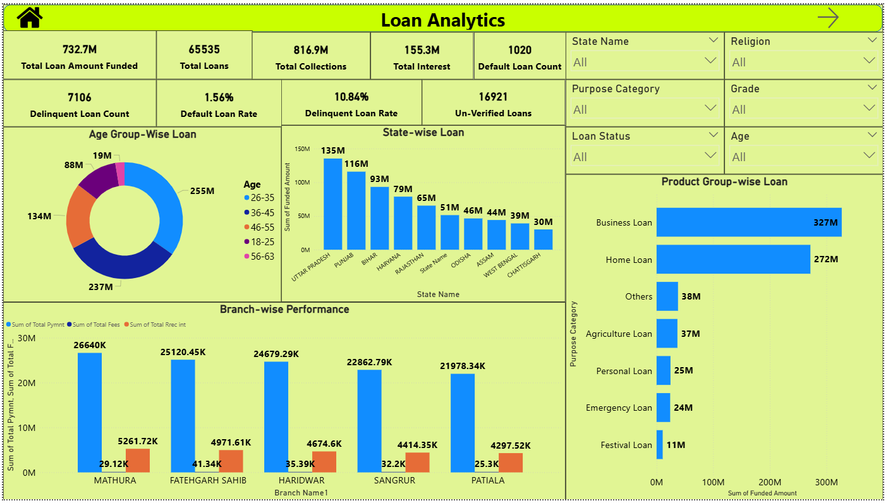
POWER BI DASHBOARD

Slide 12
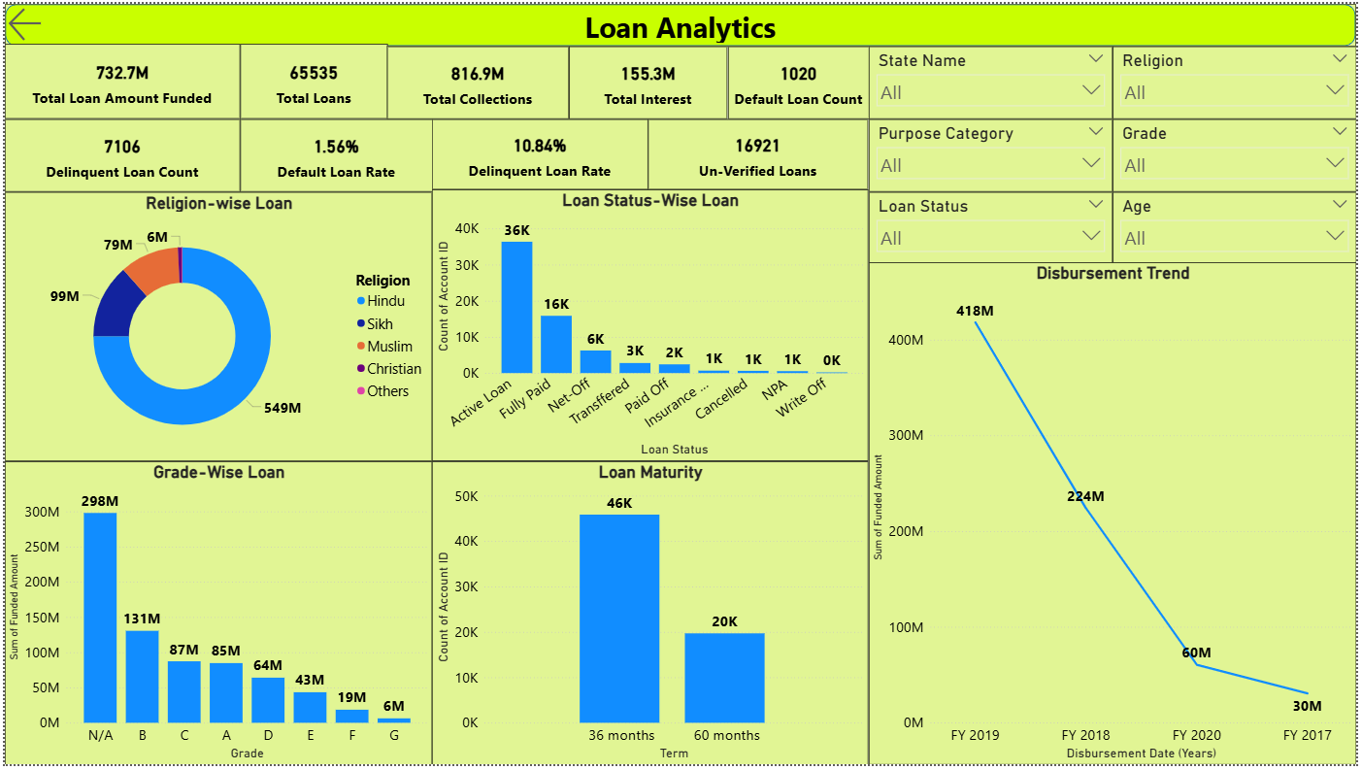

Slide 13
SQL QUERIES AND RESULTS
Total_Funded_Loan_Amount
SELECT ROUND(SUM(Funded Amount)/1000000,2)
AS Total_Funded_Loan_Amount FROM banking_data;
Total_Loans
SELECT COUNT(Account ID)
AS Total_Loans FROM banking_data;
Total_Collection
SELECT ROUND(SUM(Total Collection)/1000000,2)
AS Total_Collection FROM banking_data;
Total_Interest
SELECT ROUND(SUM(Total Rrec int)/1000000,2)
AS Total_Interest FROM banking_data;
Default_Loan_Count
SELECT COUNT(Account ID)
AS Default_Loan_Count FROM banking_data
WHERE Is Default Loan='Y';
Total_Funded_Loan_Amount
732.70
Total_Loans
65535
Total_Collection
816.90
Total_Interest
155.30
Default_Loan_Count
1020

Slide 14
Branch-Wise Performance
SELECT `Branch Name`,
ROUND(SUM(`Total Collection`)/1000000,2) AS Collection_M,
ROUND(SUM(`Total Fees`)/1000000,2) AS Fees_M,
ROUND(SUM(`Total Rrec int`)/1000000,2) AS Interest_M
FROM banking_data
GROUP BY `Branch Name`
ORDER BY Collection_M DESC;
Product Group-Wise Loan
SELECT `Purpose Category`,
ROUND(SUM(`Funded Amount`)/1000000,2)
AS Funded_Loan_M FROM banking_data
GROUP BY `Purpose Category`
ORDER BY Funded_Loan_M DESC;
State-Wise Loan
SELECT `State Name`,
ROUND(SUM(`Funded Amount`)/1000000,2) AS Funded_Loan_M
FROM banking_data
GROUP BY `State Name`
ORDER BY Funded_Loan_M DESC;
Branch Name | Collection_M | Fees_M | Interest_M
MATHURA | 26.64 | 0.03 | 5.26
FATEHGARH SAHIB | 25.12 | 0.04 | 4.97
HARIDWAR | 24.68 | 0.04 | 4.67
SANGRUR | 22.86 | 0.03 | 4.41
PATIALA | 21.98 | 0.03 | 4.30
Purpose Category | Funded_Loan_M
Business Loan | 327.00
Home Loan | 272.00
Others | 38.00
Agriculture Loan | 37.00
Personal Loan | 25.00
Emergency Loan | 24.00
Festival Loan | 11.00
State Name | Funded_Loan_M
UTTAR PRADESH | 135.00
PUNJAB | 116.00
BIHAR | 93.00
HARYANA | 79.00
RAJASTHAN | 65.00
ODISHA | 46.00
ASSAM | 44.00
WEST BENGAL | 39.00
CHATTISGARH | 30.00

Slide 15
Disbursement Trend (Year-Wise)
SELECT
YEAR(STR_TO_DATE(`Disbursement Date`, '%d-%m-%Y')) AS Year_,
ROUND(SUM(`Funded Amount`) / 1000000, 1) AS Funded_Amount_M
FROM banking_data
GROUP BY Year_
ORDER BY Year_;
Loan Status-Wise Loan
SELECT `Loan Status`, COUNT(`Account ID`) AS Loan_Count
FROM banking_data
GROUP BY `Loan Status`
ORDER BY Loan_Count DESC;
Loan Maturity
SELECT Term,
ROUND(SUM(`Funded Amount`)/1000000,2) AS Funded_Loan_M
FROM banking_data
GROUP BY Term
ORDER BY Funded_Loan_M DESC;
Year_ | Funded_Amount_M
2017 | 30.0
2018 | 224.0
2019 | 418.0
2020 | 60.0
Loan Status | Loan_Count
Active Loan | 36351
Fully Paid | 15850
Net-Off | 6252
Transferred | 2776
Paid Off | 2411
Insurance ... | 668
Cancelled | 612
NPA | 530
Write Off | 85
Term | Funded_Loan_M
36 months | 431.60
60 months | 301.10

Slide 16
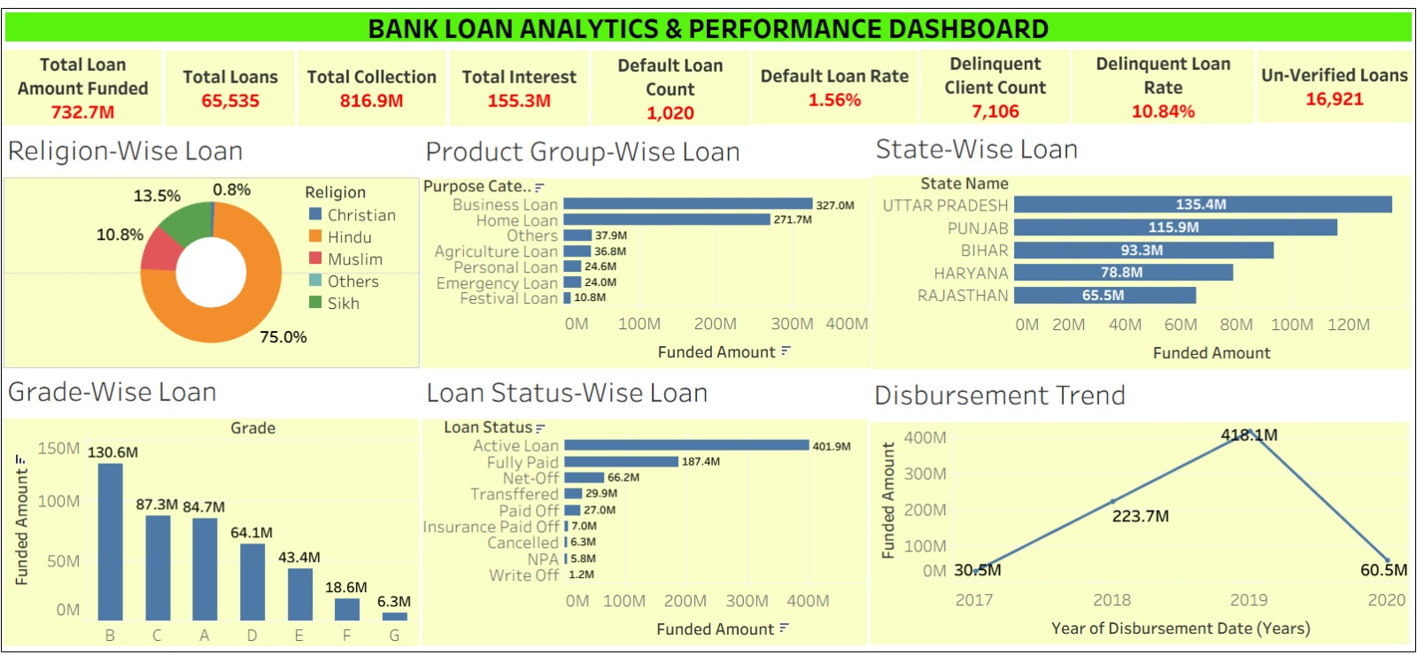
TABLEAU DASHBOARD

Slide 17
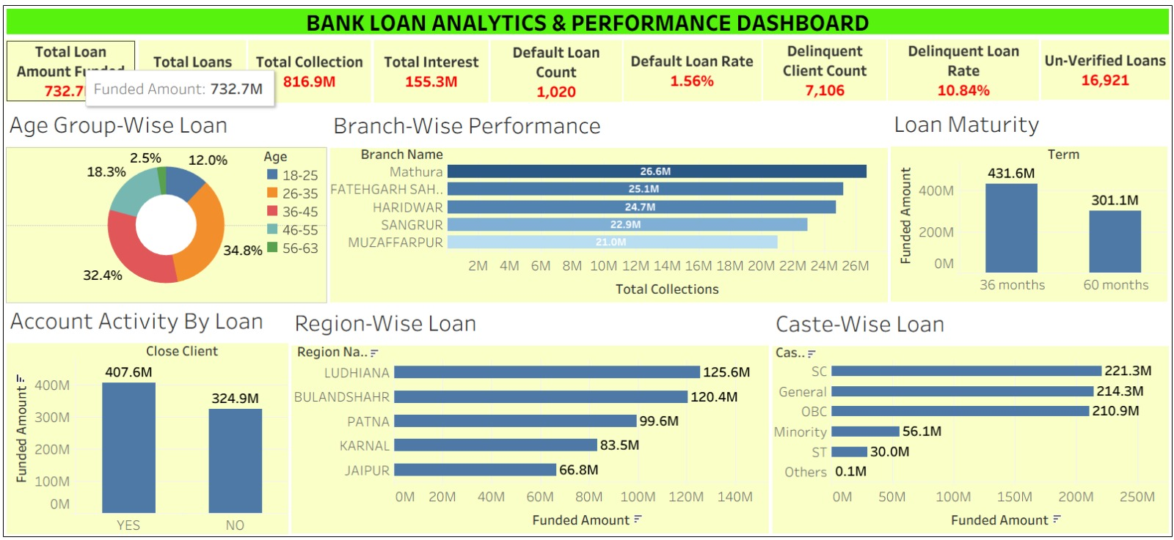

Slide 18
Key Takeaways
Strong Loan Portfolio Performance :
The bank successfully funded ₹732.7M across 65,535 loan accounts, demonstrating a strong lending presence and consistent customer demand.
Healthy Revenue Generation :
Total collections reached ₹816.9M, while interest income contributed ₹155.3M, indicating effective loan recovery and sustainable profitability.
Product Performance Insights :
Business Loans (₹327M) and Home Loans (₹272M) are the largest contributors to the loan portfolio, making them the most significant revenue-generating products.
Geographic Concentration :
Uttar Pradesh, Punjab, and Bihar account for the highest funded loan amounts, highlighting these regions as key growth markets for the bank.

Slide 19
Key Takeaways
Risk Monitoring & Portfolio Quality :
The bank maintains a relatively low Default Rate (1.56%), indicating good portfolio quality. However, the Delinquency Rate (10.84%) suggests that overdue accounts require continuous monitoring and follow-up actions.
Customer Demographic Insights :
Customers in the 26–45 age group contribute the highest share of funded loans, making them the primary target segment for future lending strategies.
Loan Tenure Preference :
Customers show a stronger preference for 36-month loans (₹431.6M) compared to 60-month loans (₹301.1M), indicating demand for shorter repayment periods.
Data-Driven Decision Making :
The integration of SQL, Excel, Tableau, and Power BI transformed raw banking data into actionable insights, enabling better decision-making in lending, risk management, and business growth.

Slide 20
BANK DEBIT AND CREDIT ANALYTICS
PROJECT OVERVIEW :
This project delivers a comprehensive operational view of the bank’s ledger system to track cash liquidity and transaction health. By transforming raw ledger entries into 12 actionable KPIs, the dashboard enables treasury managers to instantly monitor net cash flows, assess the stability of deposits versus withdrawals, and evaluate branch-level performance. Beyond standard reporting, the project integrates automated risk-detection logic to flag high-value or irregular transaction patterns, providing security and compliance teams with the real-time intelligence needed to mitigate fraud risks effectively.
DATASET OVERVIEW :
The dataset acts as a central financial ledger, capturing everyday cash movements across customer checking and savings accounts. It breaks raw transaction rows into categories like location (branch and bank entity) , methodology (transfers, debit, or credit cards) , and entry type (deposits vs. withdrawals) to give you clean filters for the dashboard. At the same time, the numerical values serve as the math engine to compute your 12 core KPIs, dynamically tracking net cash flow positions, credit-to-debit stability ratios, and account activity speeds while instantly flagging high-value transaction alerts. This simple structure effortlessly changes a massive sheet of daily ledger details into an organized visual workspace for smart cash management and fraud auditing.

Slide 21
KPI LIST
Cash Flow & Liquidity Metrics :
Operational & Activity Metrics :
Total Credit Amount: The sum of all inbound ledger entries (deposits).
Total Debit Amount: The sum of all outbound ledger entries (withdrawals).
Credit-to-Debit Ratio: The ratio of inbound credits to outbound debits, used to measure core deposit stability.
Net Transaction Amount: The net cash flow position (Total Credits minus Total Debits).
Account Activity Ratio: The frequency of transactions relative to average account balances to gauge customer engagement.
Daily/Weekly Volume Trends: Analysis of transaction frequencies over time to identify peak processing periods.
Total Transaction Amount by Branch: The aggregate volume of transactions per branch, used to compare regional performance.
Transaction Volume by Bank: Comparison of total transaction activity across different bank entities.
Transaction Method Distribution: A breakdown of volume by payment type (Bank Transfer, Debit Card, Credit Card, etc.) to optimize service offerings.
Branch Transaction Growth: The percentage growth (or decline) in transaction volume per branch over a specific period.

Slide 22
KPI LIST
Risk & Security Metrics :
High-Risk Transaction Flag: Identifies transactions that exceed a specific amount threshold or show irregular patterns (e.g., unusually large transfers).
Suspicious Transaction Frequency: The count of flagged high-risk transactions over a set timeframe to support security audits.

Slide 23
Excel DASHBOARD

Slide 24
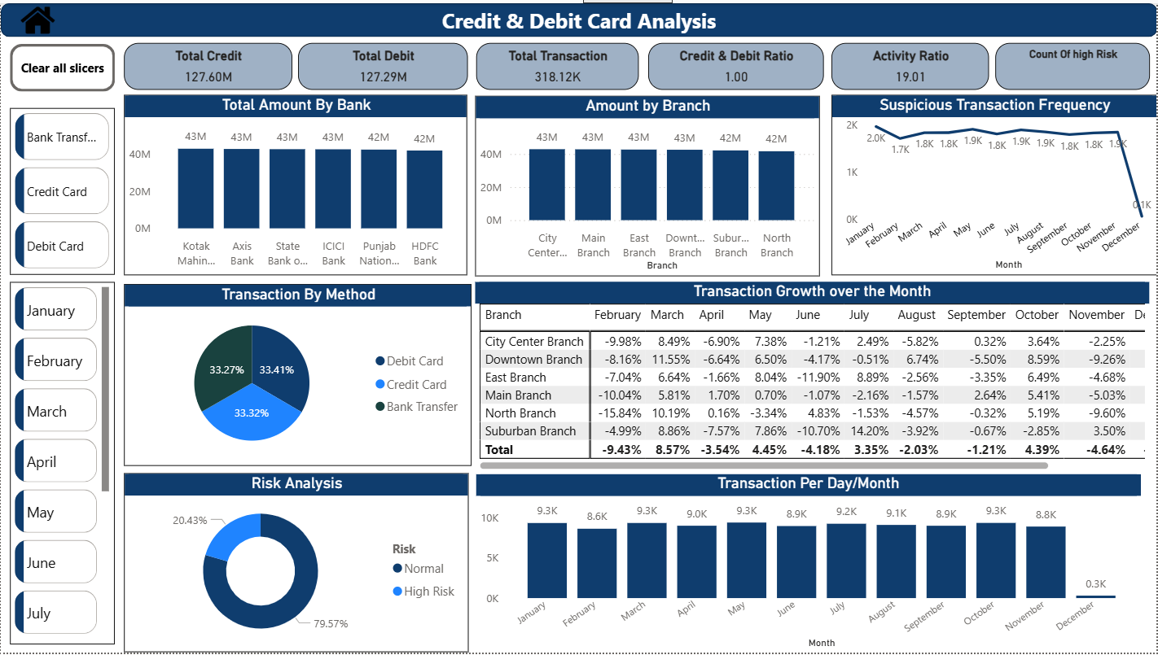
POWER BI DASHBOARD

Slide 25
SQL QUERIES AND RESULTS
Total Credit Amount
select TransactionType, concat(round(sum(Amount)/1000000,2),'M’) from Credit_Debitwhere TransactionType="Credit";
Total Debit Amount
select TransactionType, concat(round(sum(Amount)/1000000,2),'M’) from Credit_Debitwhere TransactionType="Debit";
Credit to Debit Ratio
With ratio as (
Select sum (case when TransactionType = 'Credit’ then amount else 0 end) as total_credit_amount,
sum(case when TransactionType = 'Debit’ then amount else 0 end)
as total_debit_amount from Credit_Debit)
Select round(total_credit_amount / total_debit_amount, 2) as credit_to_debit_ratio from ratio;
Account Activity Ratio
Select count(*) / NULLIF(avg(Balance), 2)
as ratio from Credit_Debit;
Total_Credit_Amount
127.60M
Total_Debit_Amount
127.29M
Credit_to_Debit_Ratio
1.00
Account_Activity_Ratio
318117.19

Slide 26
Total Transaction Amount by Branch
select Branch,round(sum(Amount) / 1000000, 2)
as Total_Transaction from Credit_Debit
group by Branch order by Total_Transaction desc;
Transaction Volume by Bank
select BankName,concat(round(sum(Amount) / 1000000, 2),'M’)
as Total_Transaction from Credit_Debit
group by BankName order by Total_Transaction desc;
Transaction Method Distribution
select TransactionMethod, sum(Amount) as Total_Transaction,
concat(round(sum(Amount) * 100.0 /
(select sum(Amount) from Credit_Debit ), 2 ),’%’)
as Percent_Of_Transaction from Credit_Debit
group by TransactionMethod;
Branch | Total_Transaction
City Center Branch | 42.91
Main Branch | 42.84
East Branch | 42.70
Downtown Branch | 42.59
Subarban Branch | 42.18
North Branch | 41.68
Bank_Name | Total_Transaction
Kotak Mahindra Bank | 42.83M
Axis Bank | 42.71M
State Bank Of India | 42.59M
Icici Bank | 42.52M
Punjab National Bank | 42.37M
Hdfc Bank | 41.87M
Transaction_Method | Total_Transaction | Transaction %
Credit Card | 84929361.03 | 33.32%
Bank Transfer | 84800788.42 | 33.27%
Debit Card | 85158506.18 | 33.41%

Slide 27
Month | Total_Transactions
01 | 9285
02 | 8578
03 | 9289
04 | 8950
05 | 9344
06 | 8911
07 | 9196
08 | 9050
09 | 8947
10 | 9298
11 | 8847
12 | 305
Transaction Per Day/Week/Month
SELECT
DATE(TransactionDate) AS transaction_day,
WEEK(TransactionDate, 1) AS week_number,
DATE_FORMAT(TransactionDate, '%m') AS month,
COUNT(*) AS total_transactions
FROM Credit_Debit
GROUP BY
DATE(TransactionDate),
YEAR(TransactionDate),
WEEK(TransactionDate, 1),
DATE_FORMAT(TransactionDate, '%m')
ORDER BY transaction_day;
High-Risk Transaction Flag
select Risk,count(Risk) from Credit_Debit
group by Risk
order by count(Risk) limit 1 ;
Risk | Count
High Risk | 20426

Slide 28
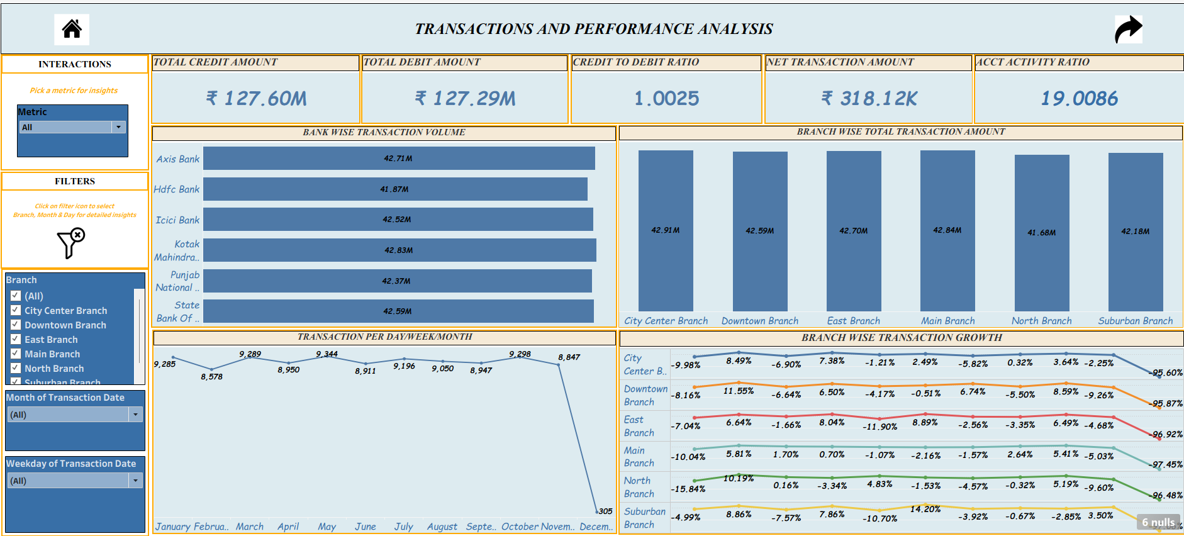
TABLEAU DASHBOARD

Slide 29
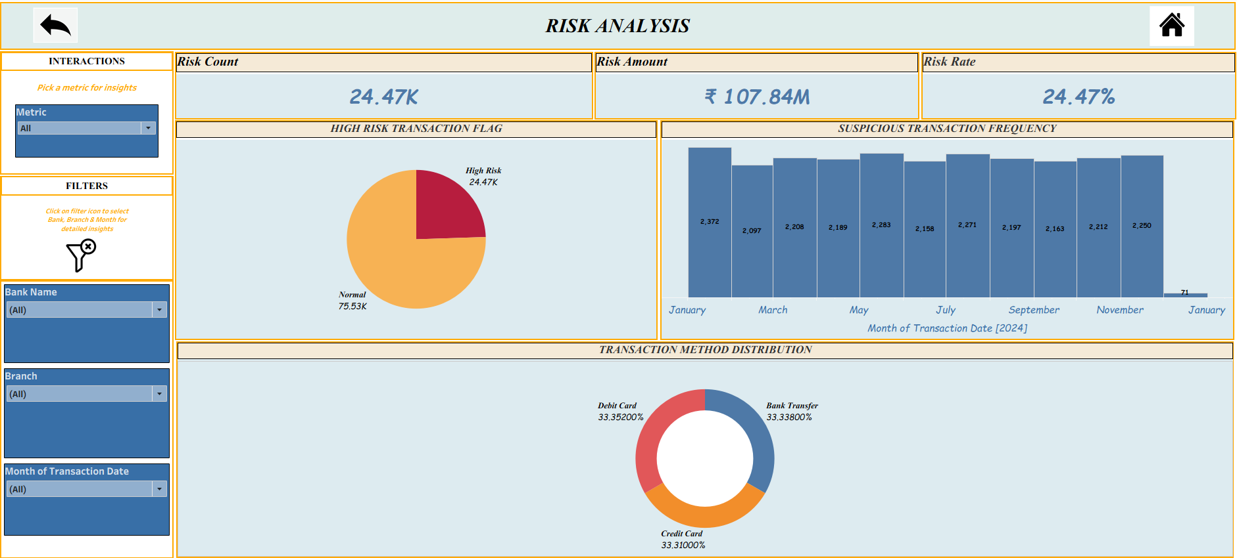

Slide 30
Key Takeaways
Stable Cash Flow Position : The bank maintains a balanced cash flow with ₹127.6M in credits and ₹127.3M in debits, resulting in a Credit-to-Debit Ratio of approximately 1.0.
Balanced Branch Performance : Transaction volumes are distributed relatively evenly across branches, with City Center Branch leading at ₹42.9M, indicating consistent customer activity across locations.
Equal Usage of Transaction Methods : Customers use Credit Cards, Debit Cards, and Bank Transfers almost equally (around 33% each), demonstrating diversified transaction behavior.
Consistent Banking Activity : Monthly transaction volumes remain relatively stable throughout the year, reflecting steady customer engagement and operational consistency.
Risk Detection Capability : More than 20,000 transactions were flagged as High Risk, emphasizing the importance of continuous monitoring and fraud prevention mechanisms.
Operational Visibility : The dashboard provides stakeholders with real-time visibility into transaction trends, branch performance, customer activity, and potential risk areas.
Business Value Creation : The solution enables better liquidity monitoring, fraud detection, transaction analysis, and operational decision-making across the banking network.

Slide 31
Thank you !

