Slide 1
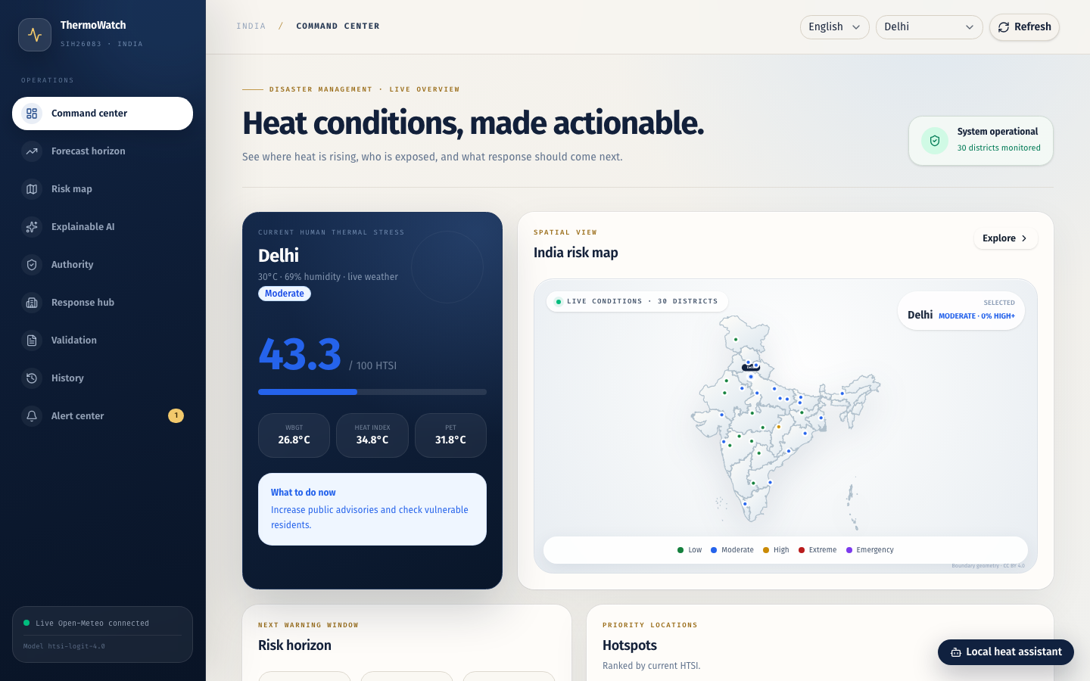
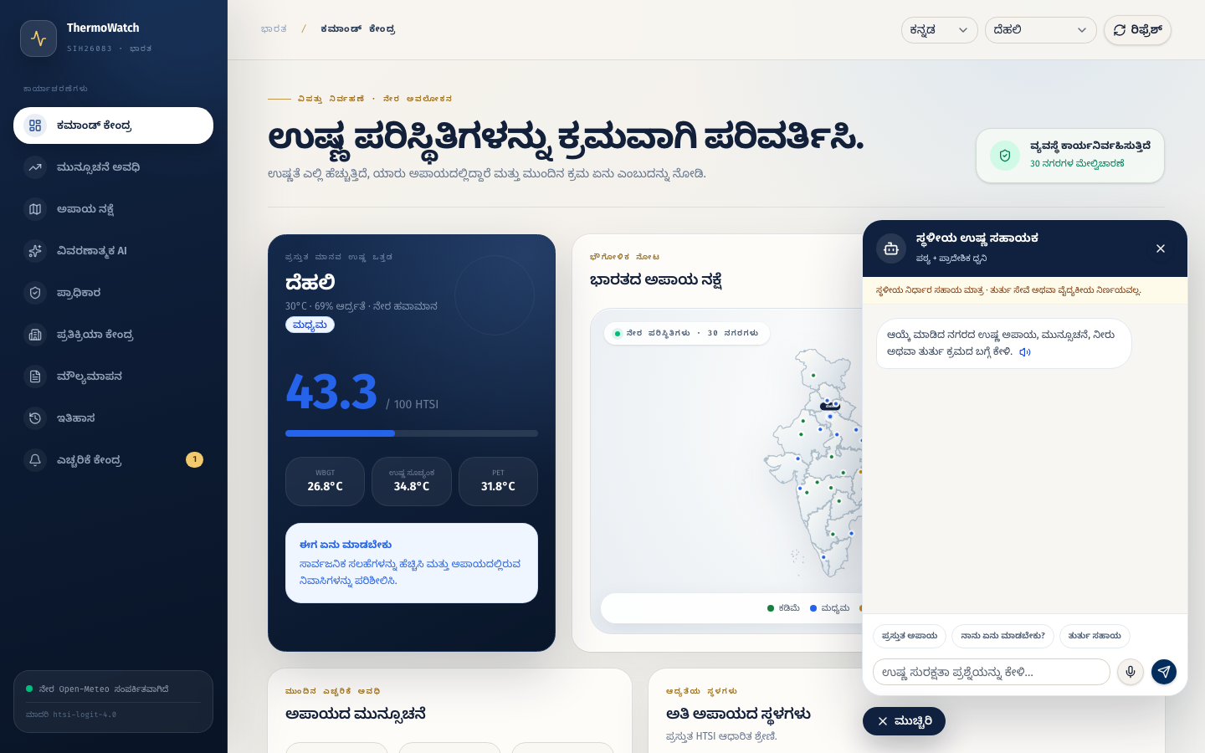
SMART INDIA HACKATHON
ThermoWatch
Extreme heatwave early warning
Live risk prediction, spatial priority and response support
PROBLEM STATEMENT ID
SIH26083
PROBLEM STATEMENT TITLE
Extreme Heatwave Early Warning
THEME
Disaster Management
PS CATEGORY
Software
TEAM ID
__________________
TEAM NAME
ThermoWatch
WORKING PROTOTYPE
Notes:
ThermoWatch addresses SIH26083 with a working software prototype for extreme heatwave early warning. Before submission, replace the blank Team ID with the registered portal ID.
Source: SIH idea presentation format supplied by the team. Product evidence: ThermoWatch live application.

Slide 2
PROPOSED SOLUTION
TEAM THERMOWATCH
Live weather becomes a clear district risk and response plan
1
Predict risk
HTSI and a trained ML model classify current and forecast heat stress.
2
Prioritize people and places
The India map ranks districts and highlights vulnerable groups.
3
Turn warning into action
Alerts, facilities, incident records and history support the response.
4
Reach local users
Kannada interface and a regional text and voice assistant improve access.
UNIQUE VALUE
One platform connects prediction, explanation and response.
Live today. SMS and WhatsApp remain clearly labelled demo previews.
02
Notes:
Proposed solution: ThermoWatch gathers live weather, calculates transparent HTSI, runs the trained risk classifier, and displays current and forecast risk. The same interface ranks districts, identifies vulnerable groups, suggests actions and records alerts or incidents. Kannada and the local assistant improve access. Browser notification works today. SMS and WhatsApp are demonstration previews and do not contact real recipients.
Source: ThermoWatch live application and project guide.

Slide 3
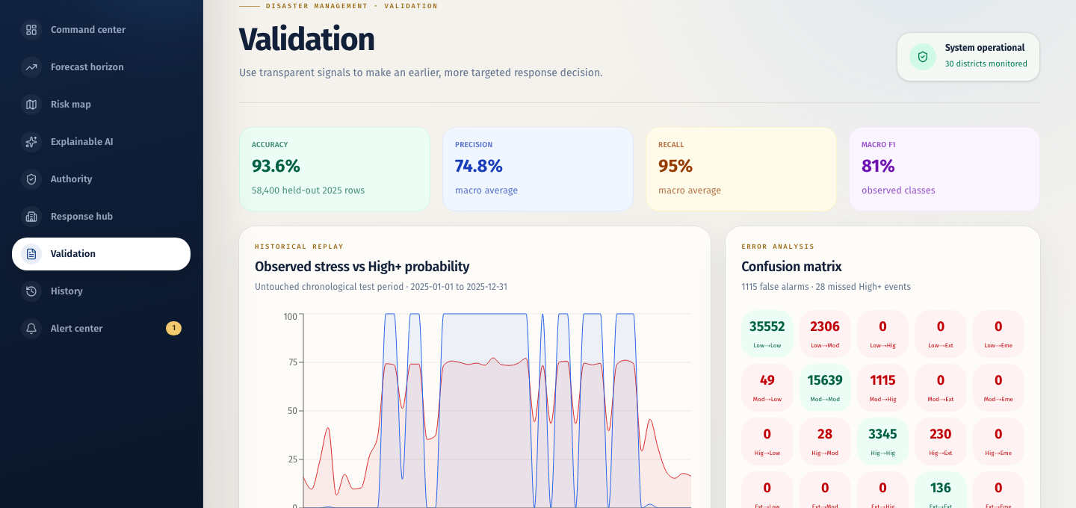
TECHNICAL APPROACH
TEAM THERMOWATCH
Data and implementation flow
LIVE DATA
FEATURES
RISK ENGINE
OUTPUT
Open-Meteo
current and forecast
Temperature, humidity,
wind, radiation and time
HTSI plus 14-feature
logistic regression
Map, explanation,
warning and audit history
233,760
93.6%
historical weather rows
untouched 2025 accuracy
95.0%
58,400
High+ recall
held-out test hours
STACK
React 19 · TypeScript · Cloudflare D1 · Vercel · OpenStreetMap
Labels are HTSI-derived proxies. Production validation needs verified IMD or health outcomes.
03
Notes:
Technical approach: Open-Meteo supplies current weather and forecasts. The system derives fourteen features, calculates HTSI, and runs a class-balanced multinomial logistic regression model. It returns a risk class, calibrated confidence, High-plus probability and feature contributions. We trained on 2022 and 2023, calibrated on 2024, and tested on untouched 2025 data. The model reached 93.6 percent accuracy and 95 percent High-plus recall across 58,400 test hours. Proxy labels remain an explicit limitation.
Sources: ml/artifacts/data-manifest.json and validation-report.json.

Slide 4
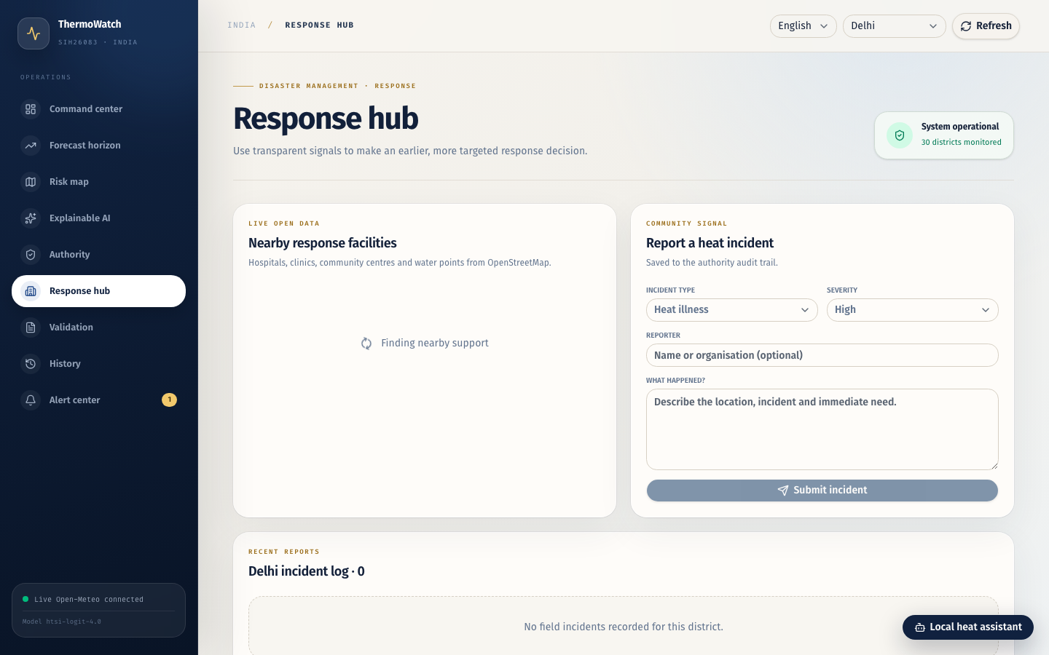
FEASIBILITY AND VIABILITY
TEAM THERMOWATCH
The core workflow already runs as a public web application.
RISKS AND CONTROLS
External APIs may fail
Validated fallback data keeps the demo usable.
Proxy labels limit claims
The interface states the limitation and preserves reproducible evidence.
Public demo could be misused
Rate limits apply. SMS and WhatsApp never contact real recipients.
WORKING NOW
Live weather and forecast risk
30-city India map
Persistent alert and incident history
Browser notification and offline shell
Field testing is incomplete
Browser delivery and audit history demonstrate the workflow safely.
Deployment path: Vercel entry point with the hosted application and Cloudflare data layer.
04
Notes:
Feasibility: The working prototype already covers the core flow from weather data to response. It runs in a browser, monitors thirty cities, stores operational history, and can display a local browser notification. The main risks are external API availability, proxy labels, public demo misuse and the lack of field testing. Fallback data, honest disclosures, rate limiting and demo-only external channels reduce these risks. Production deployment would add verified official labels, authority approval and field testing.
Source: ThermoWatch live application, project guide and source code.

Slide 5
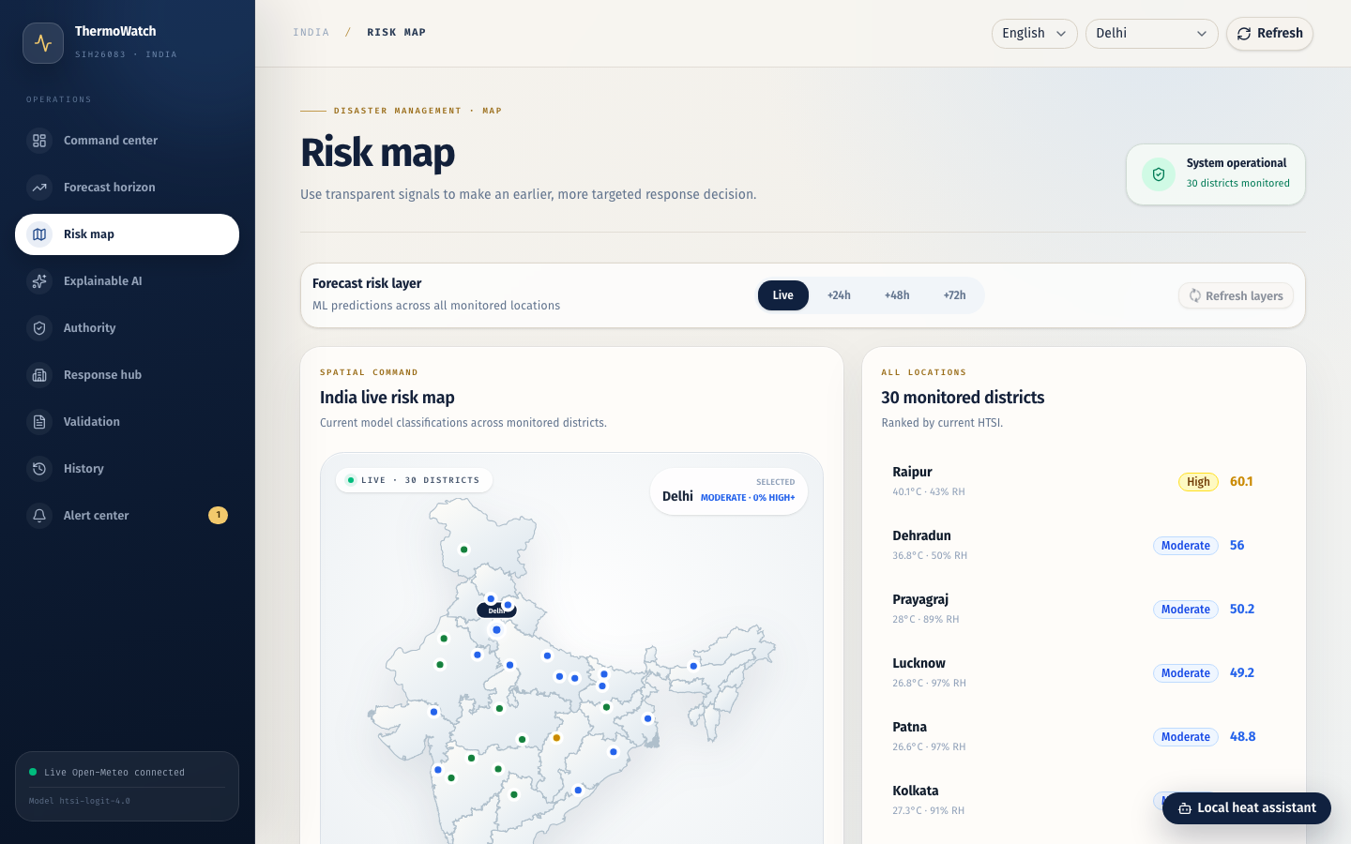
IMPACT AND BENEFITS
TEAM THERMOWATCH
Earlier, clearer decisions for heatwave response
TARGET USERS
District authorities
Health and emergency teams
Field workers and community groups
Residents needing local guidance
1
Social benefit
Prioritizes vulnerable people and gives simple regional guidance.
2
Operational benefit
Combines forecast, map, alert and history in one workflow.
3
Economic benefit
Helps target limited response resources before conditions worsen.
Scale path: add official data, more districts and verified notification partners.
05
Notes:
Impact: ThermoWatch supports district authorities, health and emergency teams, field workers, community groups and residents. It can improve the timing of heat-risk decisions, focus attention on vulnerable people, and give responders one view of forecasts, locations and recorded actions. The system can scale by adding official labels, more districts, approved notification partners and field-validated response protocols. We present these as expected benefits of the prototype, not measured public-health outcomes.
Source: ThermoWatch problem framing and working prototype.

Slide 6
RESEARCH AND REFERENCES
TEAM THERMOWATCH
Evidence used in the prototype
01
Open-Meteo Forecast API
Live current weather and forecast variables
PROJECT EVIDENCE
https://open-meteo.com/en/docs
Reproducible model artifacts
02
Open-Meteo Historical Weather API
Model coefficients, scaler, calibration and checksum are saved in the repository.
ERA5-Seamless data used for reproducible training and replay
https://open-meteo.com/en/docs/historical-weather-api
Chronological validation
03
OpenStreetMap and Overpass API
Train: 2022–2023
Calibrate: 2024
Test once: 2025
Nearby hospitals, clinics, community centres and water points
https://www.openstreetmap.org
04
India boundary geometry
Map geometry distributed under CC BY 4.0
Public prototype
https://github.com/VictorCazanave/svg-maps
https://thermowatch-sih26083.vercel.app
Limitation: historical labels are HTSI-derived proxies, not verified IMD events or health outcomes.
06
Notes:
References: Open-Meteo supplies live and historical weather. OpenStreetMap and Overpass supply nearby facility locations. The India boundary source uses CC BY 4.0 geometry. The repository contains the model coefficients, validation report, replay cases, data manifest and checksums required to reproduce the engineering evidence. The core limitation remains visible: model labels are HTSI-derived proxy classes and do not represent official IMD events or medical outcomes.
Source URLs are shown on the slide. SIH structure follows the supplied six-slide idea presentation format.

