Slide 1

House Price Prediction
Monish Joshy
MSDS 692 Data Science practicum 1
June 27, 2021

Slide 2
Index
Introduction to the Problem
Dataset Source
Exploratory Data Analysis
Data Preparation Methodology
Baseline Models
Feature Engineering
Feature Selection
Hyper-Parameter Tuning
Conclusion

Slide 3
Introduction to the problem
Housing prices are a crucial reflection of the economy of the country, and housing value ranges are of great interest for both buyers and sellers.
Buying a house is a stressful thing
Many buyers are not aware of the factors that influence the house prices
In this project, house costs will be predicted given informative variables that cover many aspects of residential houses.

Slide 4
Dataset Source
Kaggle Competetion - https://www.kaggle.com/c/house-prices-advanced-regression-techniques
Dataset is prepared by Dean De cock
The dataset contains the costs and features of residential houses sold from 2006 to 2010 in Ames, Iowa, obtained from the Ames Assessor’s workplace. This dataset consists of seventy-nine house features and 1460 houses with sold prices.

Slide 5
Exploratory Data Analysis
Data exploration is the first step in data analysis and typically involves summarizing the main characteristics of a data set, including its size, accuracy, initial patterns in the data, and other attributes
In total there are 1460 training samples in our dataset and 86 different informative features in which thirty-six are quantitative and forty-three are numerical, the rest are “Id” and “SalesPrice” (target column).
Some features contain a large amount of NULL values, such as the Alley, PoolQC, Fence and Miscfeature contains almost the entire column as blank so we decide to drop these features as imputing these features with any value would not make any sense.

Slide 6
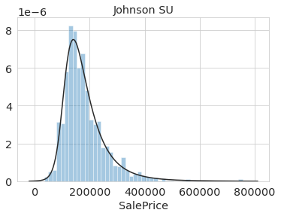

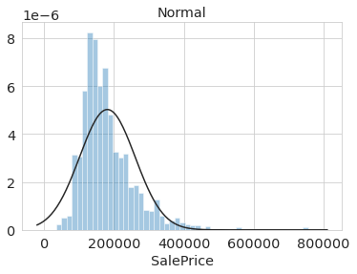
Sales (target) column transformation
The three figures on the right show that the target column which is the SalesPrice does not follow a normal distribution, so before performing regression it has to be transformed. While log transformation does pretty good job, best fit is unbounded Johnson distribution.

Slide 7
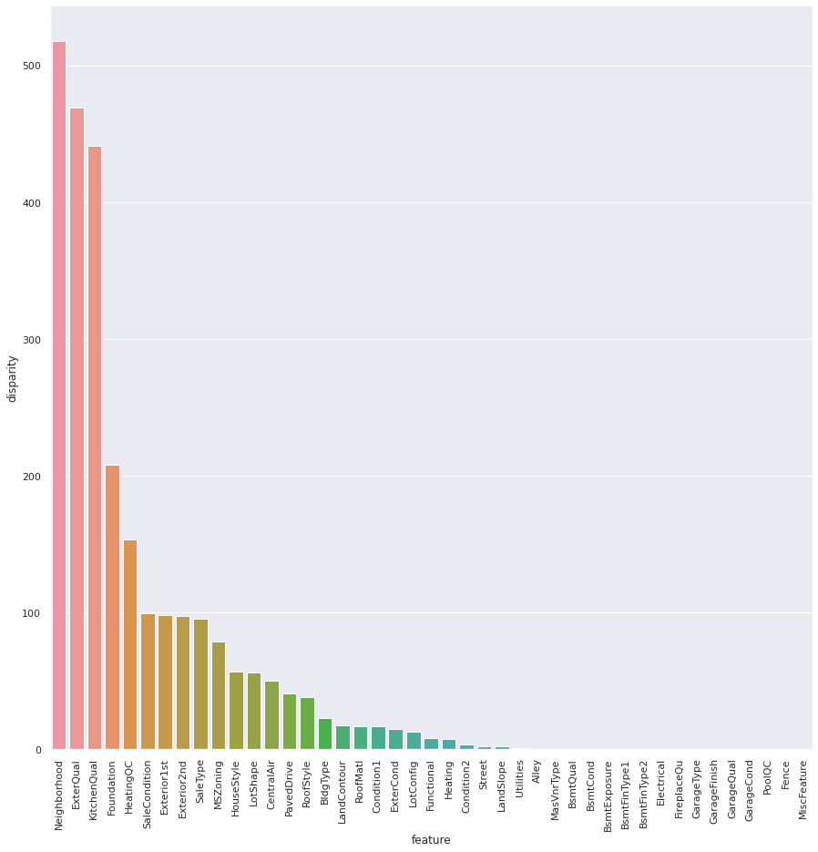
Anova Test P value Significance
On the right is the graph of Anova Test P values which gives a quick estimate of influence of categorical variables on SalePrice.
For each variable SalePrices are partitioned to distinct sets based on category values. Then check with ANOVA test if sets have similar distributions. If variable has minor impact then set means should be equal. Decreasing pval is sign of increasing diversity in partitions.

Slide 8
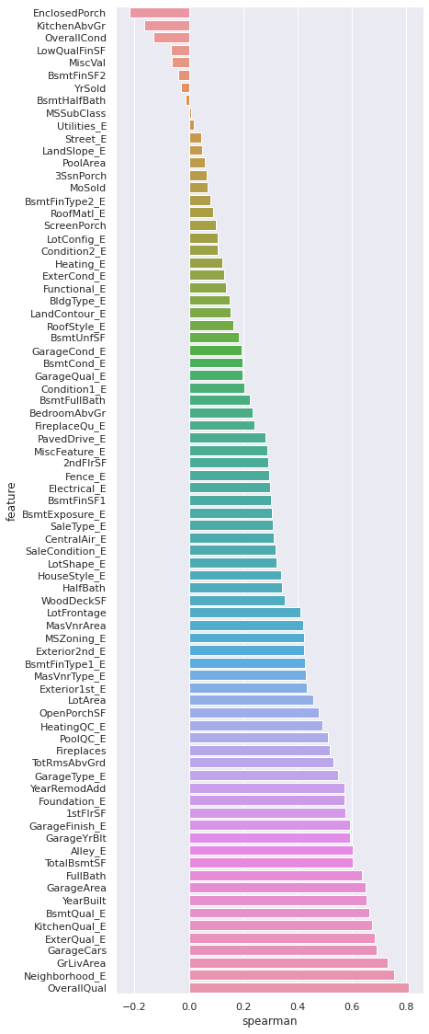
Spearman Correlation Test
Spearman correlation is better to work with in this case because it picks up relationships between variables even when they are nonlinear. OverallQual is main criterion in establishing house price. Neighborhood has big influence, partially it has some intrisinc value in itself, but also houses in certain regions tend to share same characteristics (confunding) what causes similar valuations.

Slide 9
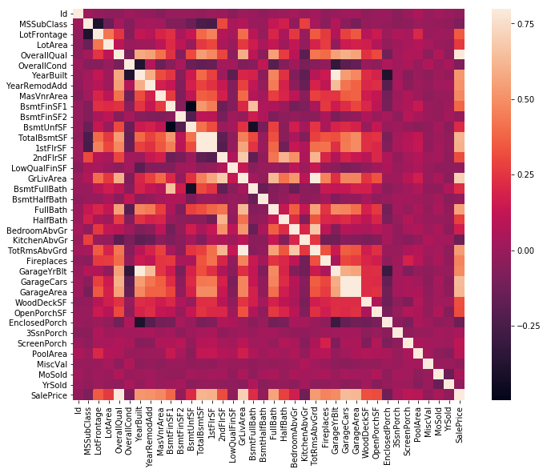
Correlation Heatplot
At first sight, there are two red-colored squares that get my attention. The first one refers to the 'TotalBsmtSF' and '1stFlrSF' variables, and the second one refers to the 'GarageX' variables. Both cases show how significant the correlation is between these variables. Actually, this correlation is so strong that it can indicate a situation of multicollinearity. If we think about these variables, we can conclude that they give almost the same information so multicollinearity really occurs. Heatmaps are great to detect this kind of situations and in problems dominated by feature selection, like ours, they are an essential tool.

Slide 10
Insights into the correlation plot
'OverallQual', 'GrLivArea' and 'TotalBsmtSF' are strongly correlated with 'SalePrice'.
'GarageCars' and 'GarageArea' are also some of the most strongly correlated variables. However, as we discussed in the last sub-point, the number of cars that fit into the garage is a consequence of the garage area. 'GarageCars' and 'GarageArea' are like twin brothers. You'll never be able to distinguish them. Therefore, we just need one of these variables in our analysis (we can keep 'GarageCars' since its correlation with 'SalePrice' is higher).

Slide 11
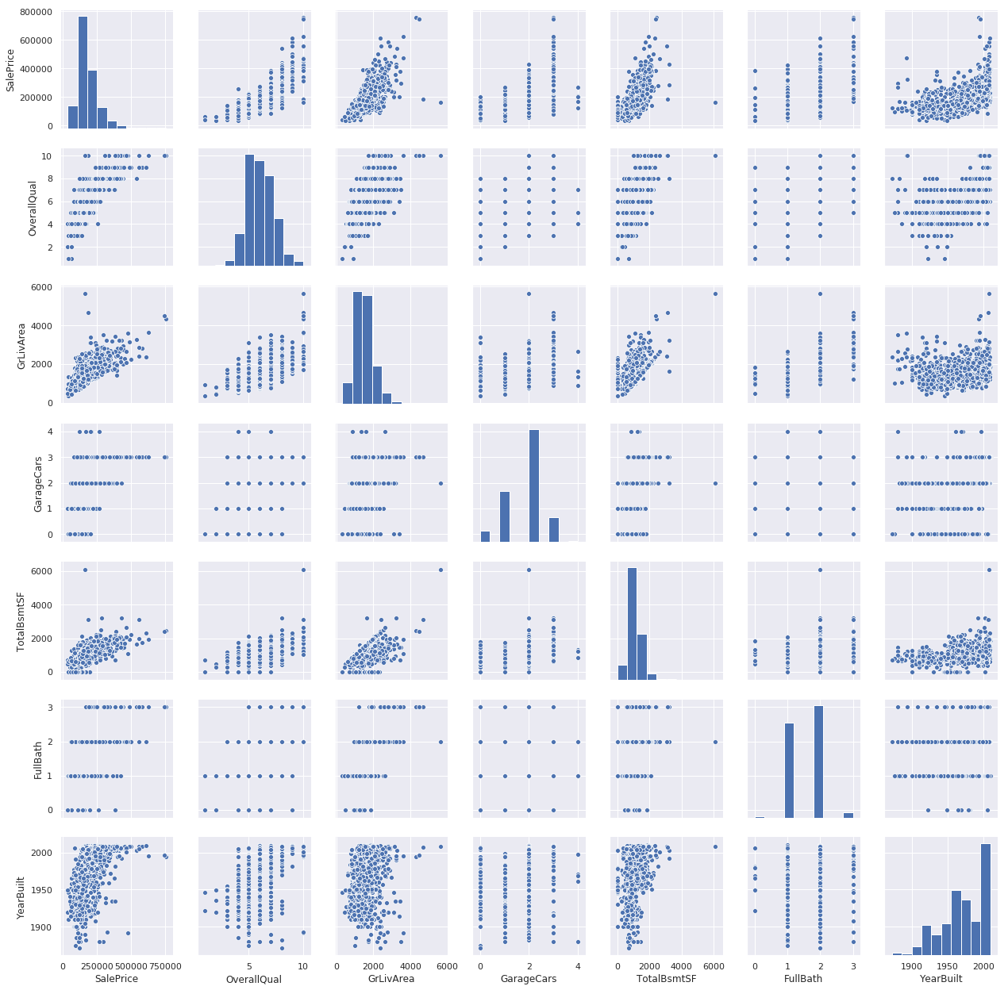
Scatter Plot
This mega scatter plot gives us a reasonable idea about variables relationships.
One of the figures we may find interesting is the one between 'TotalBsmtSF' and 'GrLiveArea'. In this figure, we can see the dots drawing a linear line, which almost acts like a border. It totally makes sense that the majority of the dots stay below that line. Basement areas can be equal to the above-ground living area, but it is not expected a basement area bigger than the above-ground living area.
The plot concerning 'SalePrice' and 'YearBuilt' can also make us think. At the bottom of the 'dots cloud', we see what almost appears to be a shy exponential function (be creative). We can also see this same tendency in the upper limit of the 'dots cloud'. Also, notice how the set of dots regarding the last years tend to stay above this limit

Slide 12
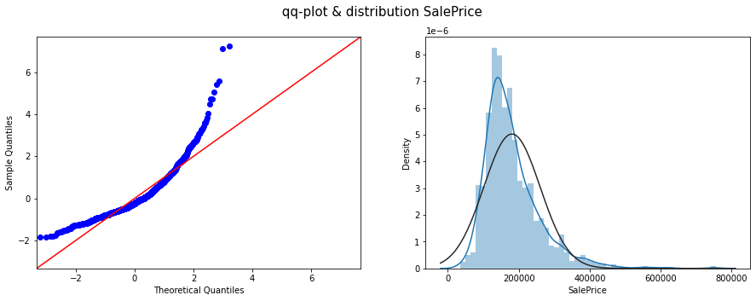
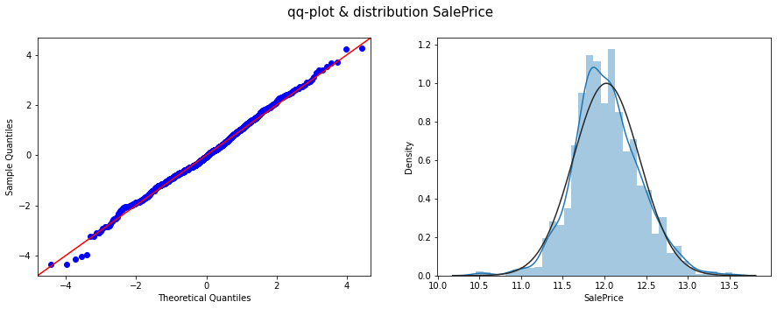
Target Column transformation Significance
The following figures show how the log transformation affects the distribution of SalesPrice values.
For those features that are highly skewed, they are normalized using Log transformation.

Slide 13
Data Preprocessing
Since we cannot directly fit our models to the data because it contains a lot of missing values, we needed to drop some features as well as do some data imputation techniques.
I have dropped the PoolQC, MiscFeature, Alley and Fence features because they have more than 80% of missing values.
For some of the categorical features such as BsmtQual, BsmtCond, BsmtExposure, BsmtFinType1, BsmtFinType2, GarageType, GarageFinish, GarageQual, FireplaceQu, and GarageCond, I have filled them with "None" value.
For the rest of the categorical features, I have filled them with the most frequent value (using its own most frequent value)
For the Numerical features, I have filled the features GarageYrBlt and LotFrontage with their respective median value and for the rest of the features I have filled 0 values.
We then divided the dataset in the ratio 66.67/33.33 into train/validation sets respectively. The model is trained on train dataset and further evaluated on the validation dataset. The evaluation metric used is Root Mean Square Error.

Slide 14
Baseline Models
This step helps us to decide and finalize which models to continue with and which ones to leave and not continue with
By the help of Pycaret Library, I implemented a number of different regression models on the dataset and found out that the models with gradient boosting such as XGBoost,CatBoost and LightGBM works quite well as compared to other Machine Learning models such as Linear Regression, Support Vector Machine,etc.

Slide 15
Feature Engineering
Apart from the initial features, I have created four more features that can helpn increase the performance of the model, they are as follows along with their formulas to calculate:
SqFtPerRoom = train_test["GrLivArea"] / (train_test["TotRmsAbvGrd"] +
train_test["FullBath"] +
train_test["HalfBath"] +
train_test["KitchenAbvGr"])
Total_Home_Quality = train_test['OverallQual'] + train_test['OverallCond']
Total_Bathrooms = (train_test['FullBath'] + (0.5 * train_test['HalfBath']) +
train_test['BsmtFullBath'] + (0.5 * train_test['BsmtHalfBath']))
HighQualSF = train_test["1stFlrSF"] + train_test["2ndFlrSF"]

Slide 16
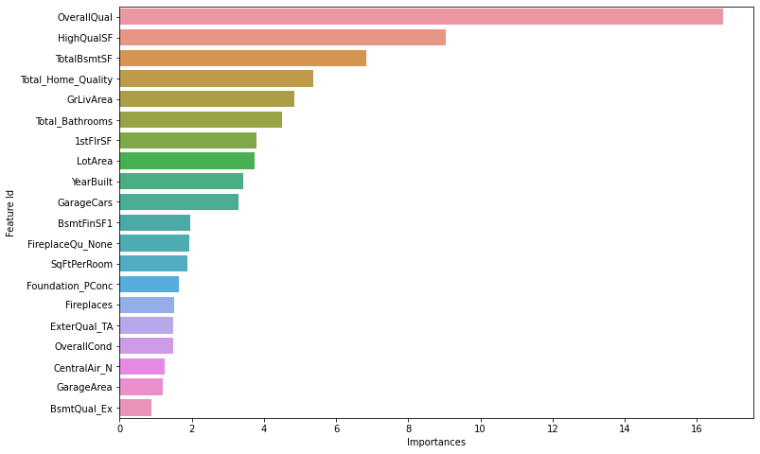
Feature Selection
This is one of the most important step of this project, when I did baseline models’ performances assessment, I used all the features without any preprocessing, without any feature selection. Sometimes there are some features that have very low importance and removing them won’t affect the model performance, it would just decrease the model’s computational burden.
Now, in order to do feature selection, we need feature importance first to do see how the algorithm of the model is performing and which features are more important than the others.
I implemented a CatBoost Regressor and fitted it on the train dataset. Following this I could easily get the feature importance of each feature for the model. The barplot on the right shows a quantitative estimate of feature importance of top twenty features.

Slide 17
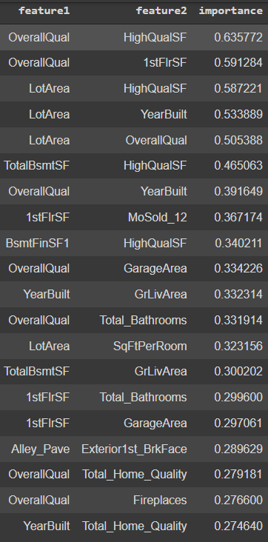
Feature Selection
Catboost comes with a great method: get_feature_importance. This method can be used to find important interactions among features. This is a huge advantage because it can give us insights about possible new features to create that can improve the performance.
The table on the right shows the interaction level between two features that can be used to generate new features or to remove certain features if they are almost equivalent to each other.

Slide 18
Hyper Parameter Tuning
In order to achieve the best performance of the model, we need to perform HyperParameter tuning of various different hyperparameter options that are given to us by Cat Boost Regressor.
In order to do this, we do a Random Grid Search in order to get the best combination of parameters, the parameters that we tune are “iterations”, which are used to specify the number of epochs the model will iterate over the training set, “learning_rate”, “depth” which implies the depth of decision tree that will be formed and “l2_leaf_reg” which is the L2 regularization term of the cost function.
The following are the best set of parameters obtained from the Grid Search
Iterations - 6000
Learning rate - 0.005
Depth - 4
L2_leaf_reg - 1
Evaluation_metric - RMSE (Root Mean Square Error)
Verbose - 200
Early Stopping Rounds - 200

Slide 19
Final Results and Conclusion
After implementing these Hyperparameters with CatBoost Regressor along with the features generated through feature Engineering, we were successfully able to achieve an RMSE score of 0.1098 on the train set and 0.0553 on the test set. Thus, we are successfully able to build a model that accurately predicts the prices of houses provided we know its feature values.
On submitting my predictions to the leaderboard of the competition on Kaggle, my predictions stand amongst the top 3% of the leaderboard.

Slide 20
Libraries
To conduct this project the following tools have been used :
● Python 3.8
● Pandas (Library) : http://pandas.pydata.org/
● Numpy (Library) : http://www.numpy.org/
● Scikit­learn (Library) : http://scikit­learn.org/
● Matplotlib (Library) : https://matplotlib.org/
● Seaborn (Library) : https://seaborn.pydata.org/
● XGBoost (Library) : https://xgboost.readthedocs.io/en/latest/
● CatBoost (Library) : https://catboost.ai/

Slide 21
Thank You

