Slide 1

Signature ID
Empowering Self-Sovereign Identity

Slide 2
Team Name : DID
Project Title : Signature ID
Project Domain : Self-Sovereign Identity
Team Members :
Monishwar M C
Sivanandh C C

Slide 3
Introduction
Welcome to Signature ID, a Dapp that empowers individuals with self-sovereign identity.
In today's digital world, identity theft, data breaches, and loss of privacy are creating serious threats to the people.
Traditional identity systems are centralized, leaving users vulnerable to exploitation and manipulation.
Signature ID aims to address these challenges by using blockchain technology to provide users with full control over their identity data, ensuring privacy and security.

Slide 4
Problem Statement
Identity theft, data breaches, and privacy violations has significant risks to individuals in the digital age.
Traditional identity systems are centralized, meaning users must trust third parties to safeguard their sensitive information.
Lack of control over personal data leads to exploitation, surveillance, and the erosion of privacy rights.
Registration systems like KYC is a great burden for the individual as it takes days for verification of the personal data.

Slide 5
Solution
Signature ID offers a decentralized platform where users can securely manage their digital identities and personal data.
By harnessing the power of blockchain technology, Signature ID eliminates the need for centralized authorities and intermediaries to manage data.
Users retain full ownership of their identity data, granting them autonomy and control over how their information is accessed and utilized.
With Signature ID, individuals can verify their identity, access services, and interact with others in a secure, private, and transparent manner.

Slide 6
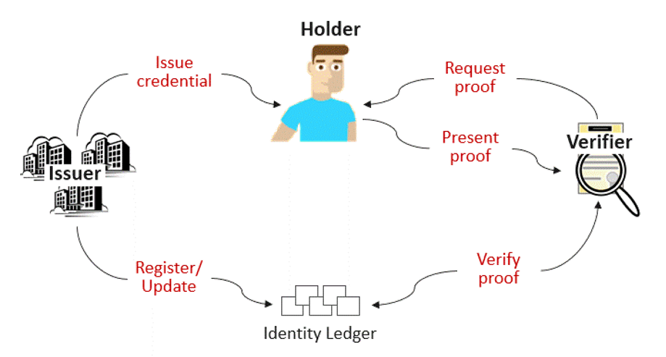


Model
Go-Plugin oracle
XDC network

Slide 7

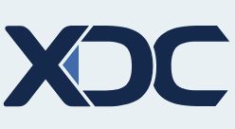


TECH-STACK
Frontend
BLOCKCHAIN
Next 14
Tailwind-css
XDC network
Ethers 6

Slide 8
Key Features
Decentralization: Signature ID operates on a decentralized xdc network, ensuring resilience, transparency, and censorship resistance.
Self-Sovereignty: Users have full control over their identity data, deciding who can access it and for what purpose.
Privacy Protection: Signature ID prevents unauthorized access and surveillance.
Interoperability: Compatible with existing identity standards and protocols, Signature ID enables seamless integration with various applications and services.

Slide 9
Target Audience
Signature ID targets a diverse range of users, including individuals, businesses, and organizations seeking to enhance their digital identity infrastructure.
Individuals concerned about privacy, security, and data sovereignty will find Signature ID valuable.
Businesses can use Signature ID to identity verification processes, reduce fraud, and enhance user trust and confidence.

Slide 10
Business Model
Licensing and Partnerships:
License the technology to enterprise clients, governments, and other organizations for integration into their existing systems.
Establish partnerships with identity verification providers, financial institutions, and government agencies to expand the reach of the platform.
Data Monetization (if applicable):
Enable users to monetize their own data by providing consent for its use in research, marketing, or other purposes.
Implement data anonymization and privacy-preserving techniques to ensure compliance with data protection regulations.
Transaction Fees:
Charge transaction fees for identity verification services and data exchanges on the platform.
Implement a pay-per-use model where users pay a fee for each transaction processed through the platform.

Slide 11
THANK
YOU

