Slide 1
Ajax
Hi people, I’m here to rescue the full page load

Slide 2
What can Ajax do ?
Get data from server after page loaded
Send data to server to perform something (etc insert/update/ validate)
After that do some changes into the page DOM.
In conclusion, any impact to server without posting a form, loading a page.

Slide 3
Ajax’s friend (xmlHttpRequest)
XmlHttpRequest is an object of javascript, handling AJAX
Main features:
New XmlHttpRequest() - new Instance.
Open(method, url, async) – open a request.
Send(params) – send to server
Onreadystatechange – handle ajax state changed.
setRequestHeaders – set the request headers.

Slide 4
Ajax’s methods
Get: to get any data.
Post: to insert any data.
Put: to modify any data.
Delete: to delete any data.
Follow restful api, these are the structure of how to route an api.
Ex: localhost/api/student will serve different functions for each method.

Slide 5
Send a get request ?
Get request represents getting data from server.
Usually get request will include the required parameters in the uri.
How to send a get request ?
xhttp.open("GET", "demo_get.asp?t=" + Math.random(), true); xhttp.send();

Slide 6
Send a post request ?
As restful describes post is to make inserting.
Required params will be included in the post body instead of uri.
How to send a post request ?
xhttp.open("POST", "demo_post2.asp", true); xhttp.setRequestHeader("Content-type", "application/x-www-form-urlencoded");
xhttp.send("fname =Henry&lname=Ford");

Slide 7
Ajax inheritance in javascript
Let’s make a ajax class handling requests to server.
GetReq will inherit that one with difference function of send compare to PostReq.

Slide 8
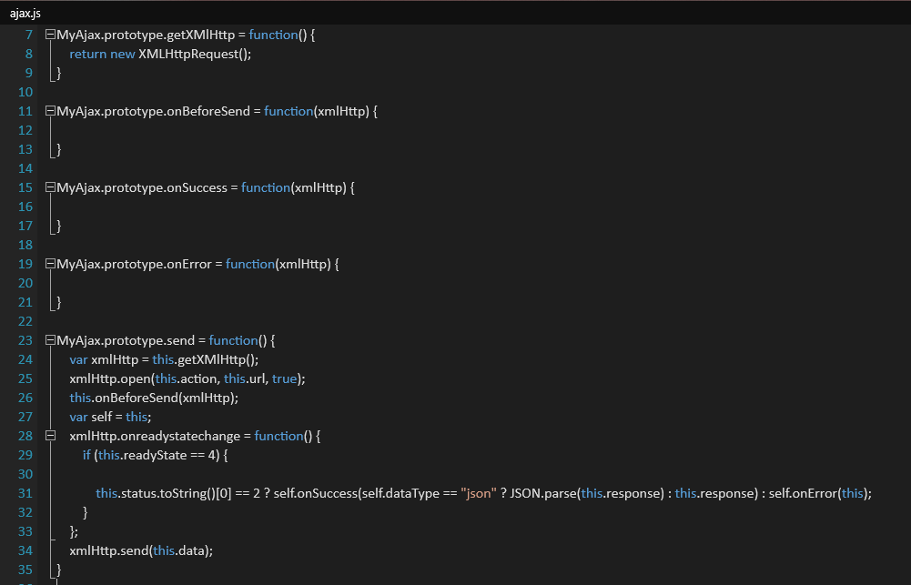
Base ajax class

