Slide 1
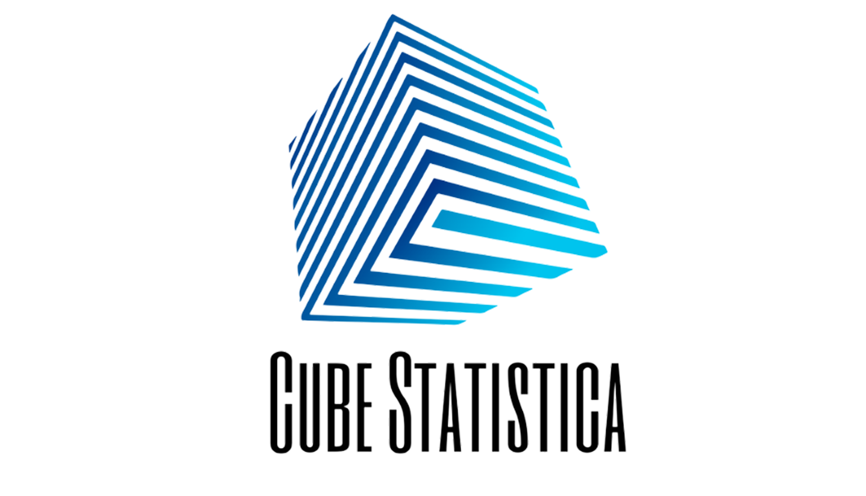




Online Professional Training
for Machine Learning & Data Science
Instructor
Faizan Khalid Mohsin
faizan.mohsin@cubestatistica.com
linkedin.com/in/faizan-khalid-mohsin/
github.com/FaizanKhalidMohsin

Slide 2
Exploratory Data Analysis
1
A data analytics process to understand the data in depth and learn the different data characteristics.
This allows you to get a better understanding of your data and find useful patterns in it.
You need to know the patterns in your data and determine which variables are important and which do not play a significant role in the output.
It helps you gather insights and make better sense of the data.
Allows a machine learning model to predict our dataset better.
It also helps us to choose a better machine learning model.
faizan.mohsin@cubestatistica.com
linkedin.com/in/faizan-khalid-mohsin/
github.com/FaizanKhalidMohsin

Slide 3
Steps Involved in EDA
2
Data Collection.
Data Cleaning.
Univariate Analysis.
Bivariate Analysis.
Correlation Matrix.
faizan.mohsin@cubestatistica.com
linkedin.com/in/faizan-khalid-mohsin/
github.com/FaizanKhalidMohsin

Slide 4
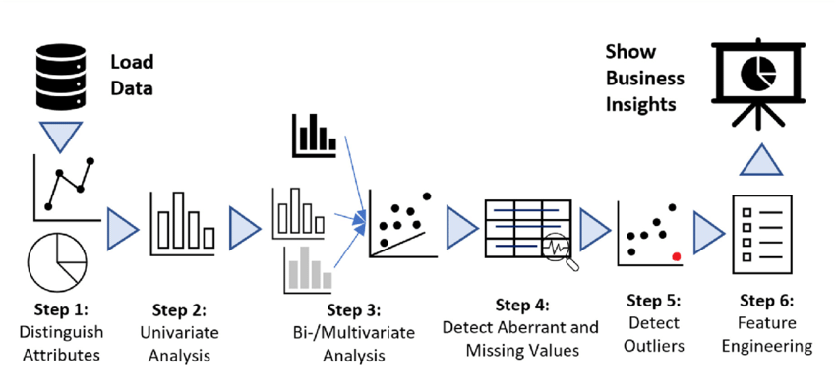
3
faizan.mohsin@cubestatistica.com
linkedin.com/in/faizan-khalid-mohsin/
github.com/FaizanKhalidMohsin

Slide 5
2 . Data Cleaning
4
It refers to the process of removing unwanted variables and values from your dataset and getting rid of any irregularities in it.
Removing missing values, outliers, and unnecessary rows/ columns.
Re-indexing and reformatting our data.
Also drop the columns which are missing
more than 15% of the data.
faizan.mohsin@cubestatistica.com
linkedin.com/in/faizan-khalid-mohsin/
github.com/FaizanKhalidMohsin

Slide 6
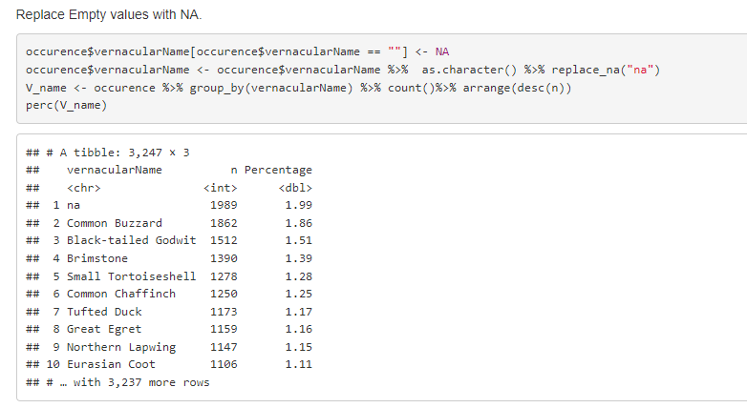
5
faizan.mohsin@cubestatistica.com
linkedin.com/in/faizan-khalid-mohsin/
github.com/FaizanKhalidMohsin

Slide 7
3 . Univariate Analysis
6
In Univariate Analysis, you analyze data of just one variable.
You can do this either with graphical or non-graphical.
Finding specific mathematical values in the data.
Some visual methods.
faizan.mohsin@cubestatistica.com
linkedin.com/in/faizan-khalid-mohsin/
github.com/FaizanKhalidMohsin

Slide 8
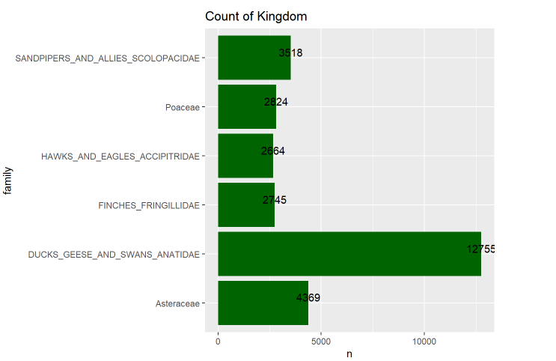
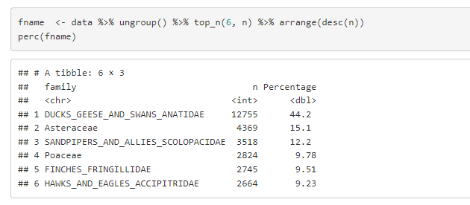
7
faizan.mohsin@cubestatistica.com
linkedin.com/in/faizan-khalid-mohsin/
github.com/FaizanKhalidMohsin

Slide 9
4 . Bivariate Analysis
8
Here, you use two variables and compare them.
you can find how one feature affects the other.
It is one of the simplest forms of statistical analysis.
faizan.mohsin@cubestatistica.com
linkedin.com/in/faizan-khalid-mohsin/
github.com/FaizanKhalidMohsin

Slide 10
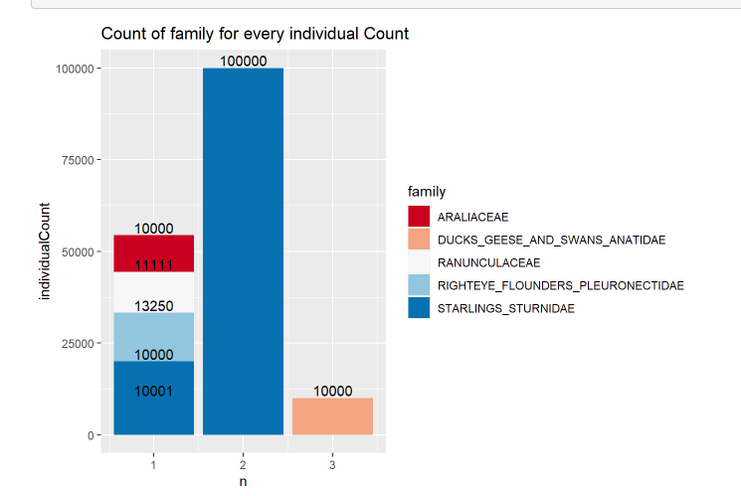
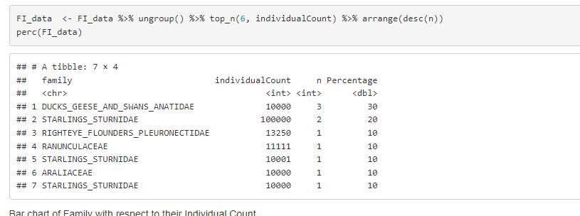
9
faizan.mohsin@cubestatistica.com
linkedin.com/in/faizan-khalid-mohsin/
github.com/FaizanKhalidMohsin

