Slide 1

CoFE

Slide 2
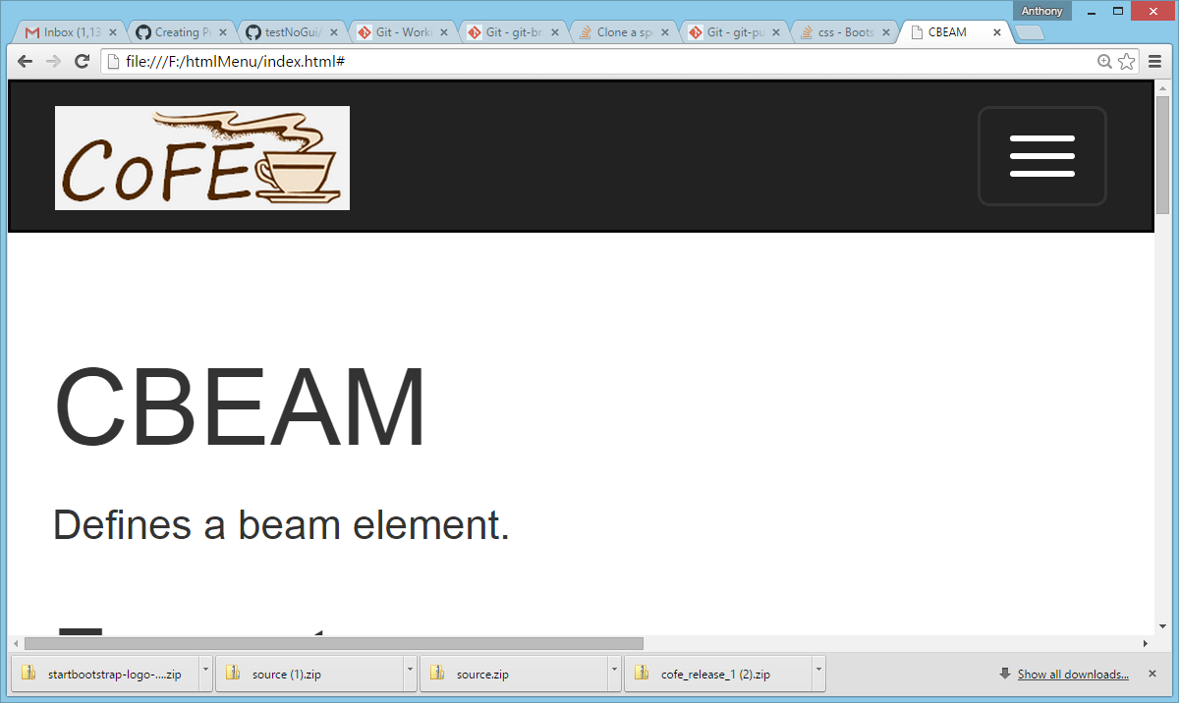
CoFE

