Slide 1
MedMCQA
Large-scale Multi-Subject Multi-Choice Dataset for Medical domain Question Answering
Logesh Kumar Umapathi
Research Engineer, Saama AI Research Lab
logesh.umapathi@saama.com
Malaikannan Sankarasubbu
VP of AI, Saama AI Research Lab
Malaikannan.Sankarasubbu@saama.com
Ankit Pal (Aaditya Ura)
Research Engineer, Saama AI Research Lab
ankit.pal@saama.com
Notes:
Hello, My name is Ankit Pal ( Aaditya Ura), and I will present our research work.
Our paper title is
"Pay Attention to the cough:
Early Diagnosis of COVID-19 using Interpretable Symptoms Embeddings with Cough Sound Signal Processing,”
and this is the work with my collabo-rator Malaikannan Sankarsubbu at Saama AI research lab. I hope you enjoy it.

Slide 2
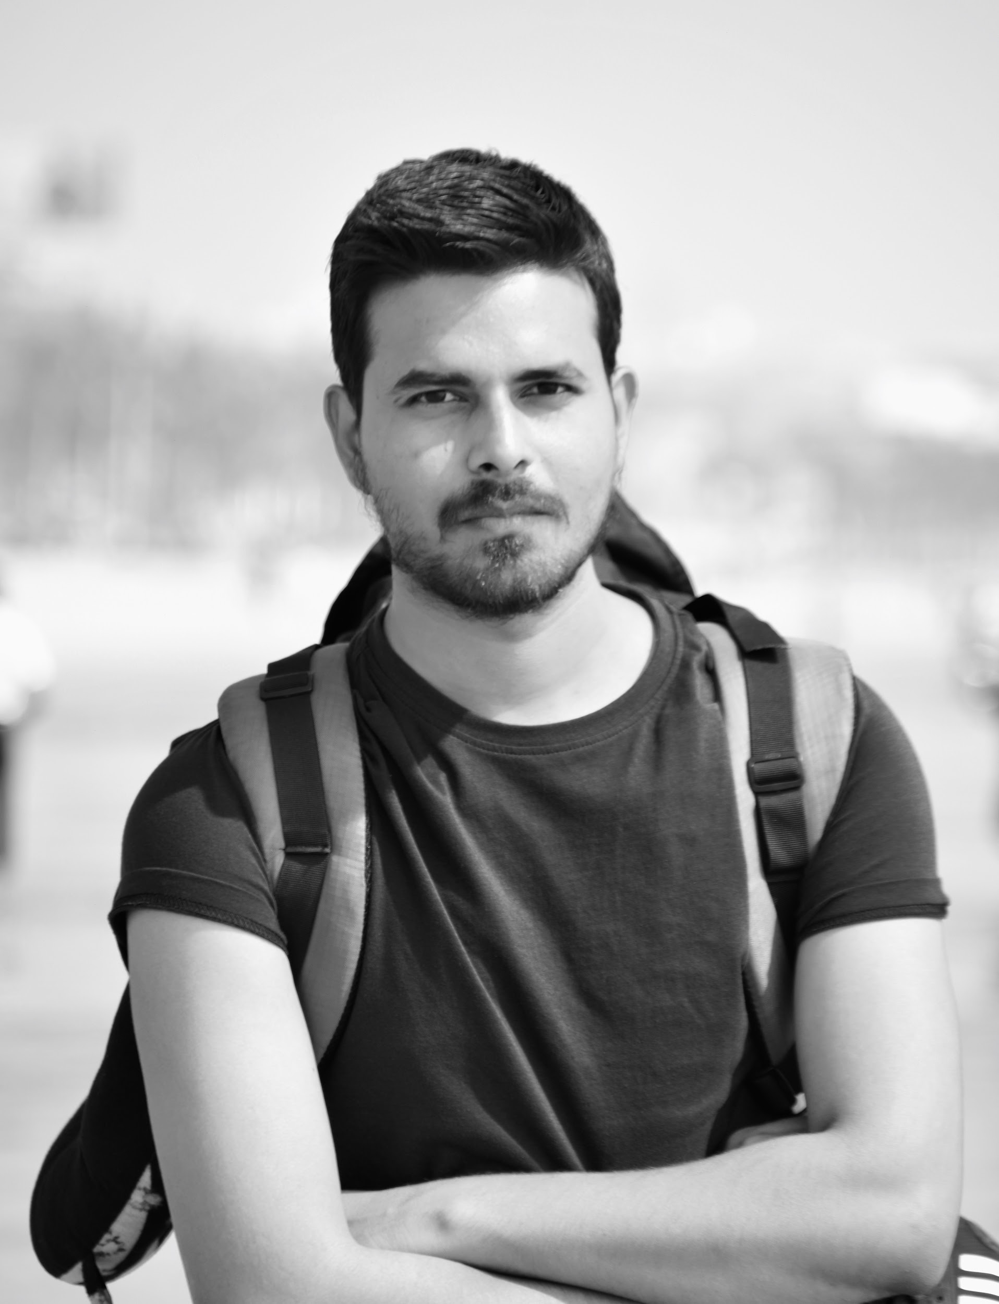

About Authors
Research Engineer @ Saama AI Research Lab
Research interests involve Representation Learning on Graphs and Manifolds
Interpretable Natural Language Processing, and their applications in Healthcare data
Respiratory, Neurophysiological (EEG, ECG, EMG etc.) based Signal Processing
Email : ankit.pal@saama.com
Website : aadityaura.github.io
twitter : @aadityaura
Research Engineer @ Saama AI Research Lab
Research interests involve information retrieval and their applications in Healthcare , clinical trials.
Email : logesh.umapathi@saama.com
Website : http://logeshumapathi.com
twitter : @logesh_umapathi
Ankit Pal (Aaditya Ura)
Logesh Umapathi
Notes:
A Little bit about myself, I am a Research Engineer @ Saama AI Research Lab
My Research interests involve Representation Learning on Graphs and Manifolds
Interpretable Natural Language Processing, and their applications in Healthcare data Respi-ratory, Neuro-physio-logical (EEG, ECG, EMG etc.) based Signal Processing

Slide 3
Outline
Introduction
MedMCQA Dataset
Sample data, Data Collection, Preprocessing & split criteria
Data statistics
Total questions, vocab etc
Data Analysis
Difficulty and Diversity of Questions
Answer types
Subject & Topic Analysis
Reasoning Types
Experiments
Retriever
Reader finetuning
Results
Notes:
This is the outline of the talk, first I am going to discuss the introduction, problem statement and motivation part,
later I’ll cover covid-19 collection, preprocessing and feature extraction part,
after that model architecture and experiments and finally the interpretability, in depth analysis, score & future work.

Slide 4
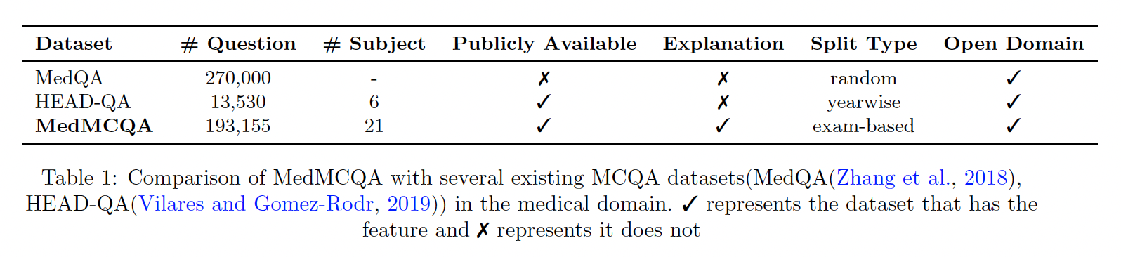
Introduction

Slide 5
MedMCQA Dataset
The dataset is designed to address real-world medical entrance exam questions
Question from AIIMS PG and NEET PG entrance exam
194k high-quality medical domain MCQs
2.4k healthcare topics
21 medical subjects
Tests 10+ reasoning abilities
Dataset :
X = {Q,O} , Q - questions , O - candidate options
O = {O1,O2, ...,On}.
Label : y ∈ R^{n} where y^{i} = {0,1} , n is number of options
Objective : f : X → y

Slide 6
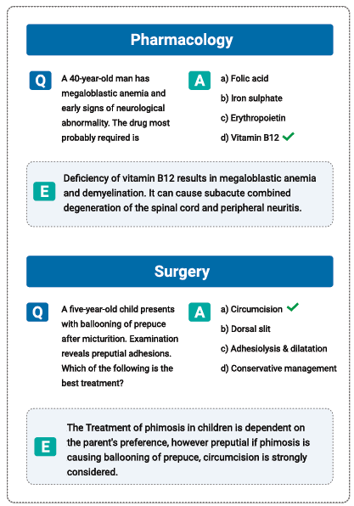
Sample Data

Slide 7
Exams
Sources of the dataset are from
All India Institute of Medical Sciences Post Graduate Exam (AIIMS PG)
National Eligibility cum Entrance Test ( NEET PG)
Eligibility
a Bachelor of Medicine and Bachelor of Surgery (MBBS) from a recognized institute
Completed a 12 months of mandatory rotating Internship
Merit candidates of these exams score an average of 90% marks

Slide 8
Data Collection & Preprocessing
Source:
Historical Exam questions from official websites - AIIMS & NEET PG (1991- present)
The raw data is collected from open websites and books
Quality Checks:
Questions with an inconsistent format were excluded
Questions with no best answer and missing or null candidates were also omitted.
Questions containing images or tables
Keywords: “equation”, “India”, “graph”, “map”
Preprocessing:
Heuristics rules to clean - HTML tags, Special symbols , URLs , Missing options
‘Grammarly’ was used to fix the grammar, punctuation, and spelling mistakes.
Duplicates were removed

Slide 9
Split Criteria
Rationale for exam based split:
To ensure the evaluation is closer to the real world examinations, model generalizability, and reusability
Similar questions from train , test and dev set were removed based on similarity
Exam based split :
Training set : Mock & online test series - 183K examples
Test set : Real AIIMS exam MCQs (years 1991- present) - 6K examples
Dev set : NEET exam MCQs (years 2001- present) - 4K examples

Slide 10
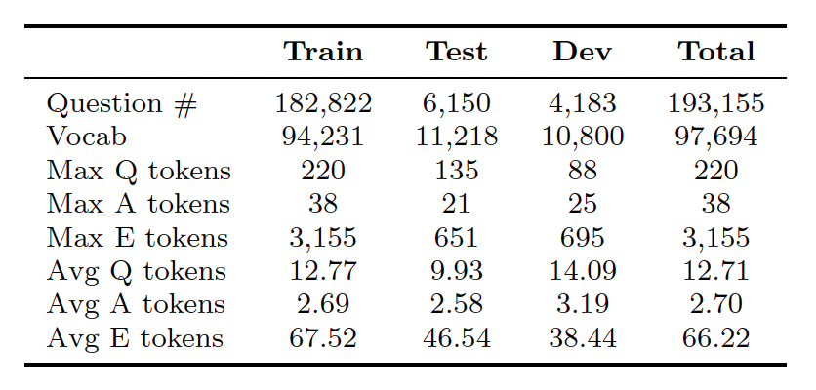
Data Statistics
Difficulty and Diversity of Questions :
majority of the dataset questions are non-factoid and open-ended in nature
mean length of 12.77 words

Slide 11
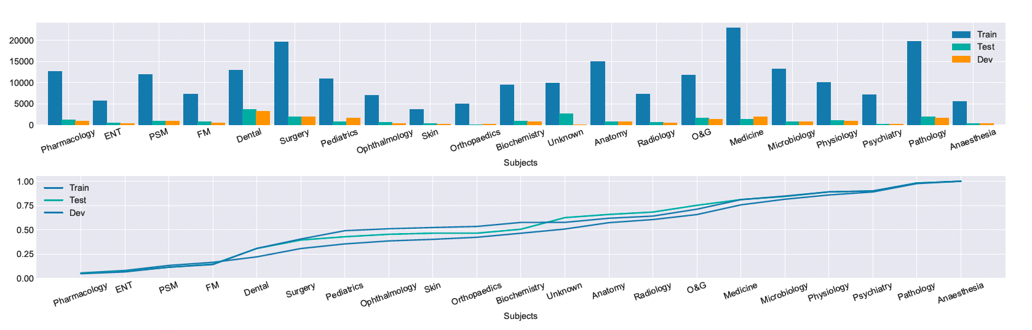
Data Statistics
Distribution of unique tokens & Cumulative Frequency Graph

Slide 12
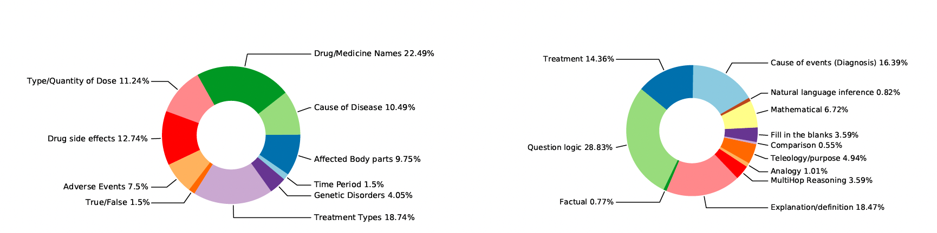
Data Statistics
Answering and Reason types

Slide 13
Baseline
Experiment Design:
Motivation :
Adequacy of the current models in answering multiple-choice questions meant for human domain experts
understand the level of domain specificity required in the models
To evaluate the need for external domain specific knowledge source:
No KB
Wikipedia
Pubmed
To evaluate the effectiveness of pretraining source:
out of domain pretrained models (BERT (Devlin et al., 2019) )
Mixed domain pretrained models (SciBERT (Beltagy et al., 2019) & BioBERT (Lee et al.,2020)
In-domain pretrained models (PubmedBERT (Gu et al., 2022))
Notes:
The primary motivation of the baseline experiments
is to understand the adequacy of the current models
in answering multiple-choice questions meant for
human domain experts (post-graduate medical students)
and to understand the level of domain specificity
required in the models. Therefore, models and
knowledge sources with varying levels of specificity
are selected.

Slide 14
Baseline
Retriever Models :
Wikipedia : Dense passage retrieval ( Karpukhin et al., 2020 )
Pubmed : PubmedBERT ( Gu et al., 2022)
Reader Models:
BERT (Devlin et al., 2019) - Out of domain pretraining
SciBERT (Beltagy et al., 2019) & BioBERT (Lee et al.,2020) - Mixed domain pretraining
PubmedBERT ( Gu et al., 2022) - In domain pretraining
Notes:
The primary motivation of the baseline experiments
is to understand the adequacy of the current models
in answering multiple-choice questions meant for
human domain experts (post-graduate medical students)
and to understand the level of domain specificity
required in the models. Therefore, models and
knowledge sources with varying levels of specificity
are selected.

Slide 15
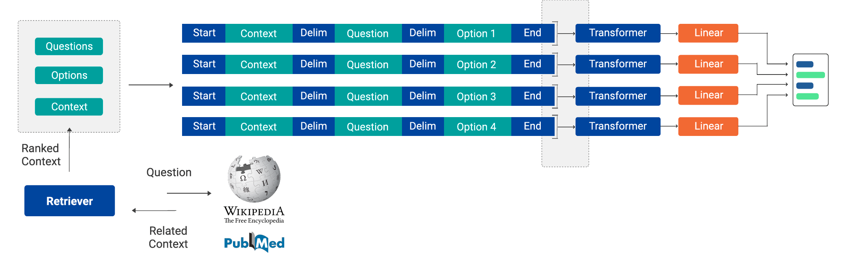
Baseline
Notes:
The primary motivation of the baseline experiments
is to understand the adequacy of the current models
in answering multiple-choice questions meant for
human domain experts (post-graduate medical students)
and to understand the level of domain specificity
required in the models. Therefore, models and
knowledge sources with varying levels of specificity
are selected.

Slide 16
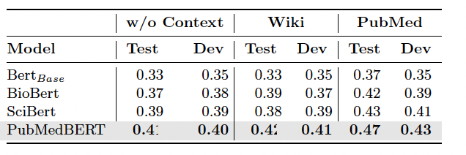
Baseline Results
Notes:
The primary motivation of the baseline experiments
is to understand the adequacy of the current models
in answering multiple-choice questions meant for
human domain experts (post-graduate medical students)
and to understand the level of domain specificity
required in the models. Therefore, models and
knowledge sources with varying levels of specificity
are selected.

Slide 17
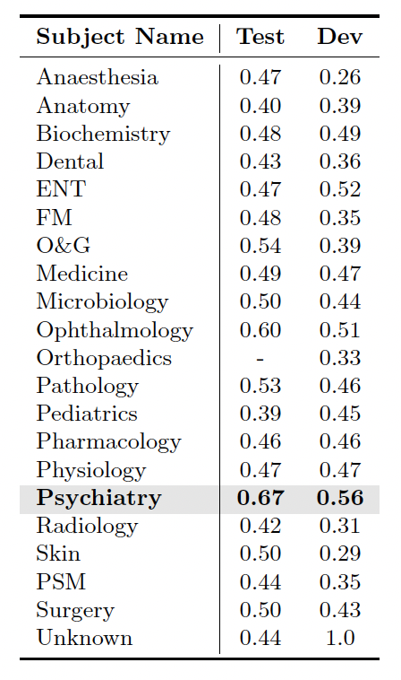
Baseline Results - evaluation per medical subject
Notes:
The primary motivation of the baseline experiments
is to understand the adequacy of the current models
in answering multiple-choice questions meant for
human domain experts (post-graduate medical students)
and to understand the level of domain specificity
required in the models. Therefore, models and
knowledge sources with varying levels of specificity
are selected.

Slide 18
Questions?
Thanks !
ankit.pal@saama.com, Logesh.umapathi@saama.com
twitter : @aadityaura, @logesh_umapathi
Notes:
Thanks for joining. With that, I hope you read our paper, and please feel free to reach out for any question, collaboration, or research idea about this work.
All right, Thank you!

