Slide 1

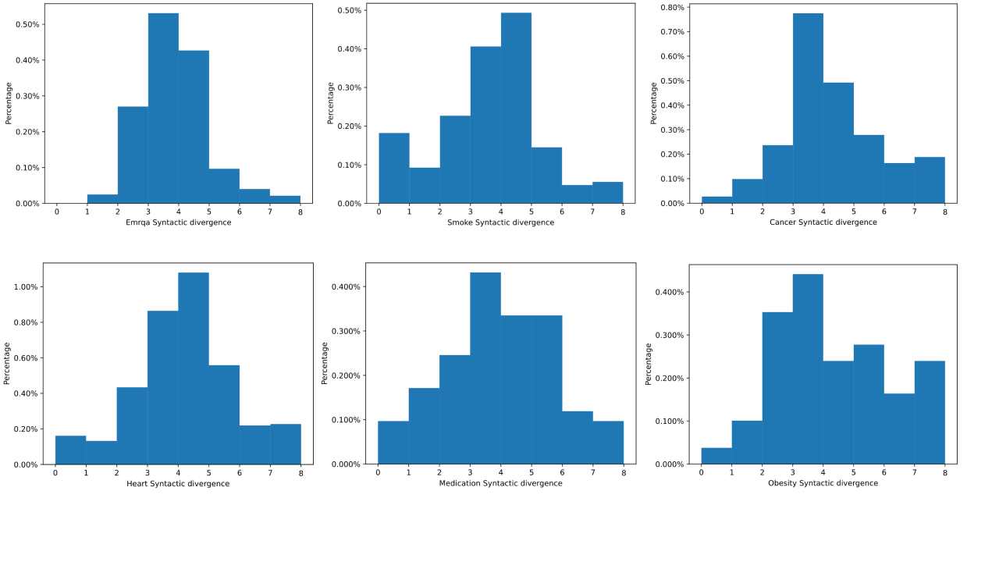
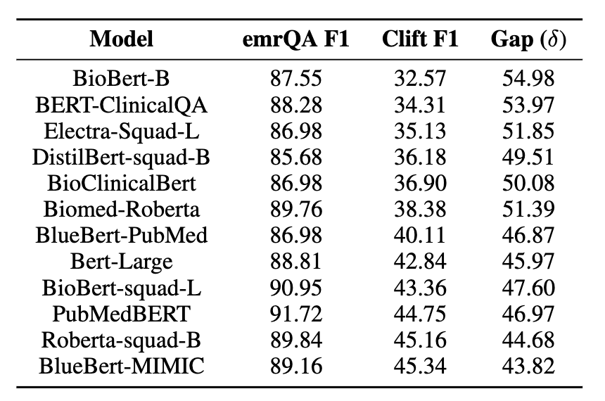
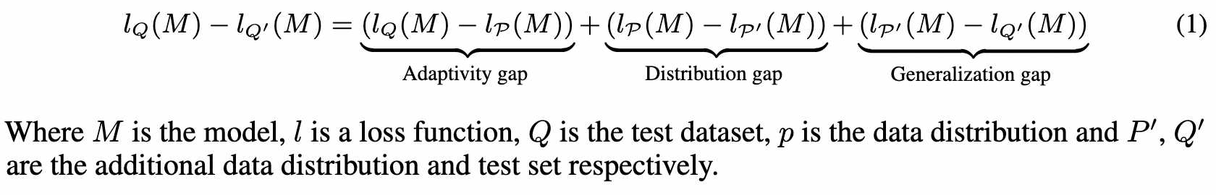
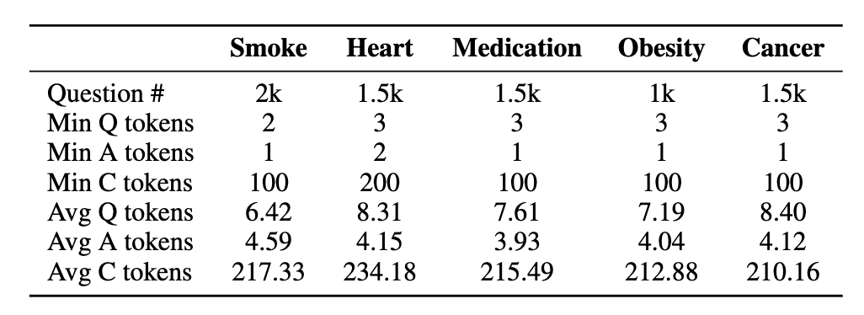
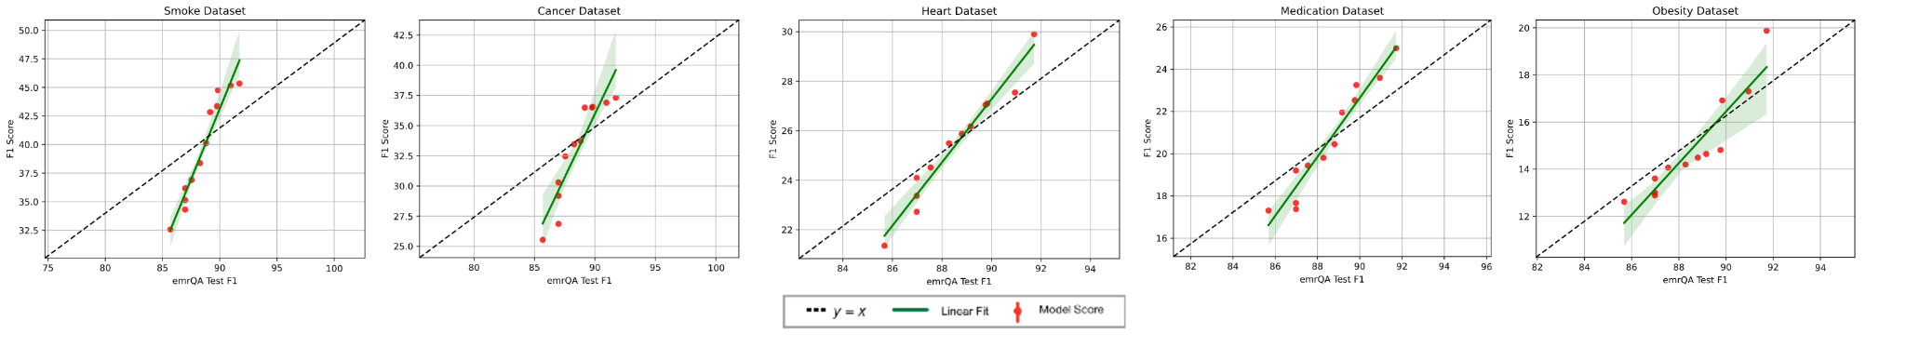

CLIFT : Analysing Natural Distribution Shift on Question Answering Models in Clinical Domain
Ankit Pal
Research Engineer at Saama AI Research Lab
https://aadityaura.github.io
Problem Statement
Dataset Statistics & Analysis
Experiment Results
In statistical learning theory, it is often assumed that test data comes from the same distributional underpinnings as training data for a machine learning model. However, in reality, data may be sampled from various distributions with considerable domain changes, i.e. Federated learning [1]. When data distribution unexpectedly changes, models that seem to be doing well in test set accuracy, fail when deployed in real time. Since healthcare data is very sensitive, Real-world deployments of health machine learning systems may encounter these failure situations. Robust machine learning aims to create techniques that consistently work in different environments.
\
Figure 1: Top row shows the histograms of the emrQA, Smoke and Cancer testset. The bottom row shows the Heart, Medication and Obesity histograms.
Table 2 : Performance of different models on the emrQA Testset and Smoke Testset
Proposed Testbed
We compared the F1 scores for all the models trained on the emrQA to the F1 scores on each of our additional test sets. Figure 2 shows that, when applied to proposed test datasets, All the models indicate a performance loss ranging from 43.82% to 73.07%. Table 2 shows the performance of different models on the Smoke test set. As we can see that BioBert-B drops around 54% F1 points while BlueBert-MIMIC drops around 43%
These results imply the potential for further study handling distribution shifts in clinical datasets. In addition, future research should look at specific model training parameters and the datasets' size, quality, and quantity that contribute to these variations. Our extensive testbed will indicate progress towards trustworthy machine learning in the healthcare area.
In this paper, we propose a testbed called CLIFT (Clinical Shift) to evaluate the clinical deep learning model's performance under the distributional shift of the different test sets. It will help to make the clinical ML models more robust. In brief, the contributions of this study are as follows.
Table 1 : statistics of the dataset
Table 1 summarizes the general statistics of preprocessed data. We plan to expand the corpus by adding more samples and model results. The full paper and the updated benchmark are available at https://openlifescience-ai.github.io/clift
We are proposing five new QA test datasets, including Cancer, Heart, Smoke, Obesity & Medication
Covering different clinical domain diseases and multiple sub-topics
These samples are from MIMIC-III clinical database
Detailed statistics and evaluation of natural distribution shift on emrQA
Open-source code and model checkpoints to reproduce the results
References
[1] Arthur Jochems (2016). “Distributed learning: Developing a predictive model based on data from multiple hospitals without data leaving the hospital - A real life proof of concept.” In: Radiotherapy and oncology : journal of the European Society for Therapeutic Radiology and Oncology
[2] Anusri Pampari (2018). “emrQA: A Large Corpus for Question Answering on Electronic Medical Records”. In: Proceedings of the 2018 Conference on Empirical Methods in Natural Language Processing
Optional caption or images, charts, and graphs
Figure 2 : Comparison of models’ F1 scores on emrQA and our proposed test datasets.

