Slide 1
MAGNET:
Multi-Label Text Classification using Attention-based Graph Neural Network
Ankit Pal
Research Engineer, Saama Tech.
ankit.pal@saama.com
Notes:
Giving the introduction of paper name and speaker’s info

Slide 2
Saama Technologies
Accelerated Drug Development
Critical Data Insights
Advanced Analytics
Notes:
Talking about company’s features and what they do

Slide 3
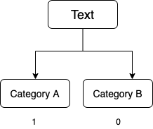
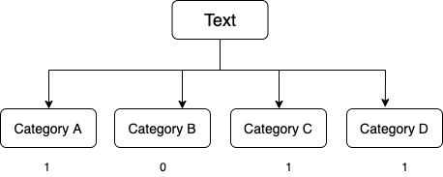
Multi-Label Text Classification ( MLTC )
Binary Text Classification
Multi-label Text Classification
Notes:
Explaining simple Binary text classification where the output will be either 1 or 0 at a time and multi label classification where output will be many labels at a time.

Slide 4
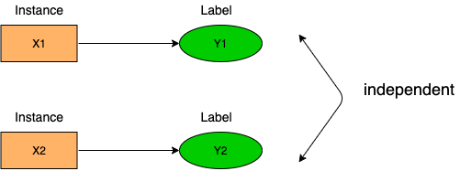
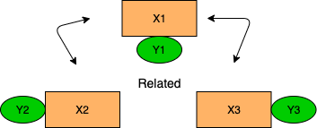
Multi-label Text Classification ( MLTC)
Conventional classification approaches assume that instances are independent identically distributed
In relational data and information networks, instances are correlated with
each other.
Notes:
Normal multi-label classification methods don’t consider the correlation between the labels
The key idea of this paper is to utilize the correlation of labels in dataset and add as a new feature to model
How to utilize the correlation of labels ? → By using Graph neural networks

Slide 5
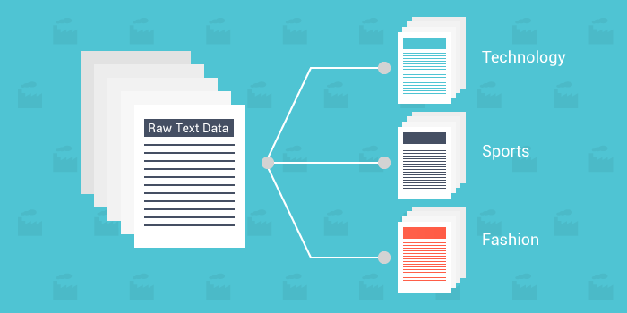
Reuters dataset
In reuters dataset, there is correlation between the labels.
Existing methods tend to ignore the relationship among labels.
Notes:
For example in Reuters dataset, There is clearly a correlation between labels but most of existing models ignore the correlation and classify the documents based on only text features.

Slide 6
What is Graph Neural Network?
Neural Network for Graph datasets :
Understanding the connection and capturing better correlation
Assume we have a graph G:
V is the vertex set.
A is adjacency matrix ( assume binary )
X is the matrix of node features
Notes:
Understanding what is graph and what is Graph neural networks
Graph neural networks are neural networks like CNN but they take graph as input and process node by node instead of pixel by pixel in image.

Slide 7
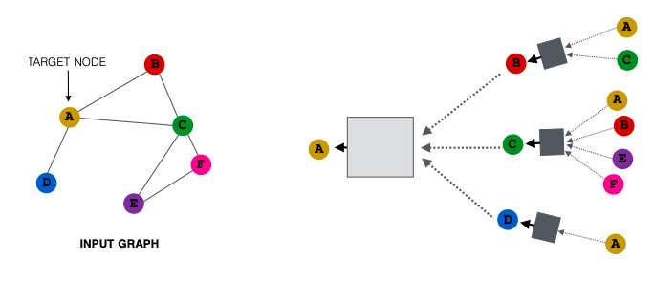
What is Graph Neural Network?
Key Idea : Neighborhood Aggregation
Generate node embeddings based on local neighborhoods.
Notes:
One node calculate all the weight of neighbours node
For quick and best understanding of Graph neural network and how this key idea is working, go here http://tkipf.github.io/misc/SlidesCambridge.pdf
https://towardsdatascience.com/how-to-do-deep-learning-on-graphs-with-graph-convolutional-networks-7d2250723780

Slide 8
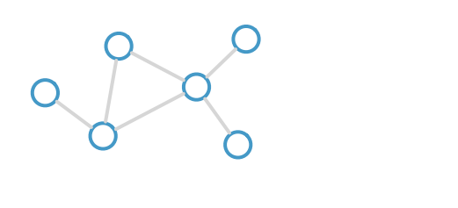
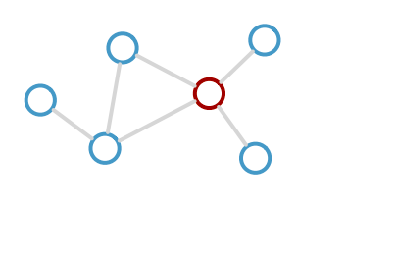
What is Graph Neural Network?
Consider this graph
Calculate Update for red node
Notes:
https://towardsdatascience.com/how-to-do-deep-learning-on-graphs-with-graph-convolutional-networks-7d2250723780
more info

Slide 9
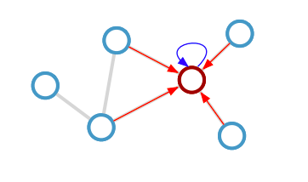
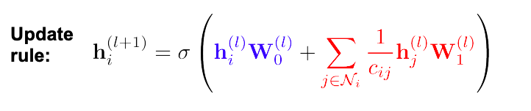
What is Graph Neural Network?
Calculate Update for red node
Notes:
https://towardsdatascience.com/how-to-do-deep-learning-on-graphs-with-graph-convolutional-networks-7d2250723780
more info

Slide 10
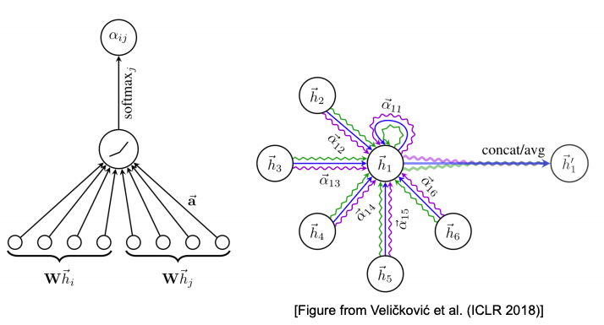
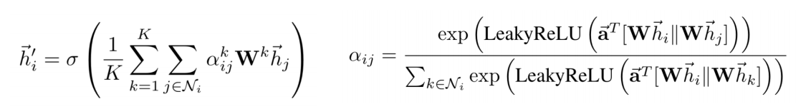
Graph Attention Networks
Rather than node embedding with equal or pre-defined weights of nodes, Graph attention networks utilize neighbours representations according to their relevance.
Notes:
Graph attention network, the main difference between Graph convolutional network and Graph attention network is
Graph convolution gives equal importance to each node while Graph attention network gives importance based on their relevance.

Slide 11
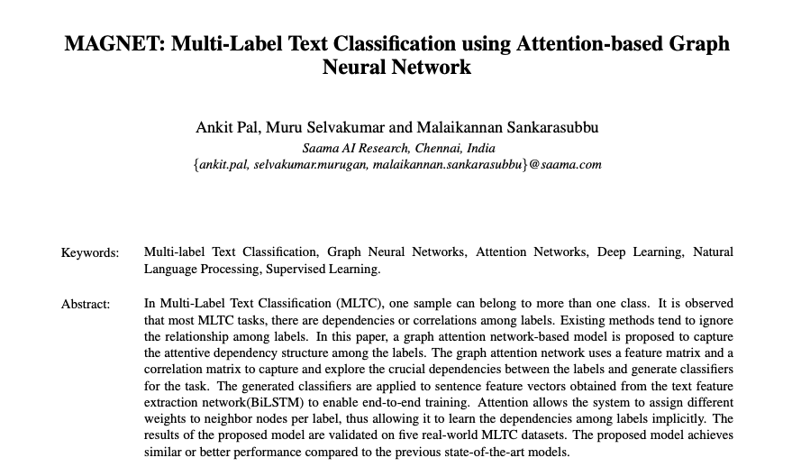
Graph Attention Networks For Multi-label Classification
Notes:
Paper

Slide 12
Graph Attention Networks For Multi-label Classification
MAGNET network
We present graph attention network-based model to capture the attentive dependency structure among the labels. The graph attention network uses a feature matrix and a correlation matrix to capture and explore the crucial dependencies between the labels and generate classifiers for the task. The generated classifiers are applied to sentence feature vectors obtained from the text feature extraction network(BiLSTM) to enable end-to-end training.
Notes:
Paper

Slide 13
Graph Attention Networks For Multi-label Classification
MAGNET network’s components :
Feature Extraction
Correlation between labels
Notes:
Main component of model

Slide 14
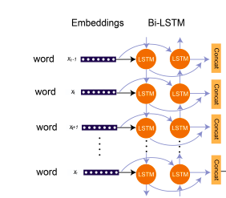
Graph Attention Networks For Multi-label Classification
Feature Extraction
Extracting Text features using LSTM network
Features
Notes:
The first part takes sentences as input and feed it to LSTM network from LSTM we get the features vector as output

Slide 15
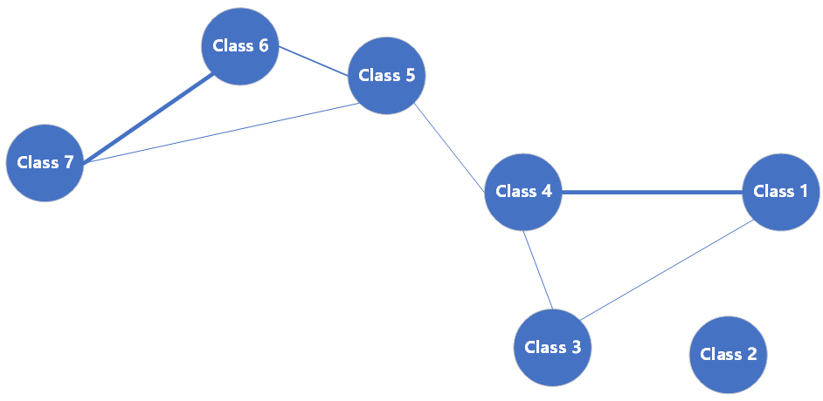
Reuters dataset
Graph is constructed by counting the pairwise co-occurrence of labels in dataset.

Slide 16
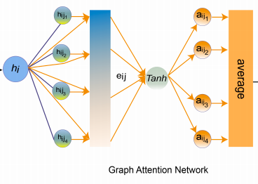
Graph Attention Networks For Multi-label Classification
Correlation between labels
Using Graph attention network to find correlation between labels

Slide 17
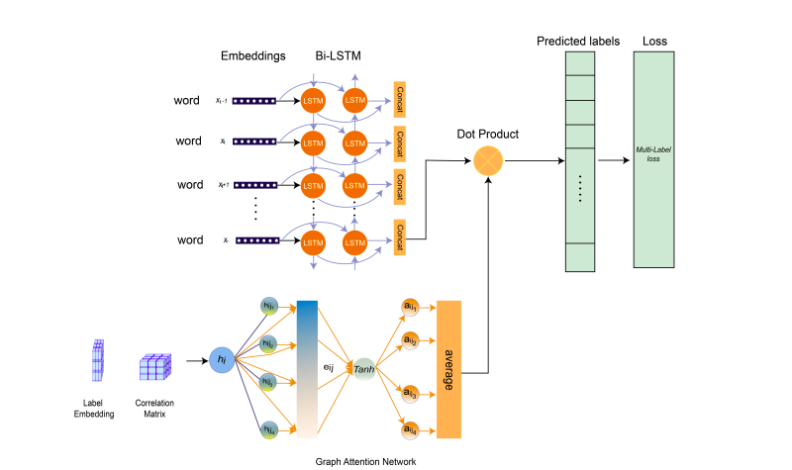
Graph Attention Networks For Multi-label Classification
Using both features to classify the documents

Slide 18
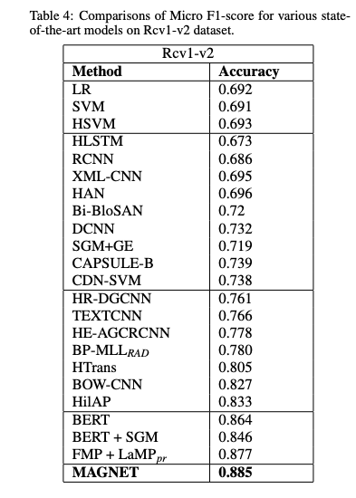
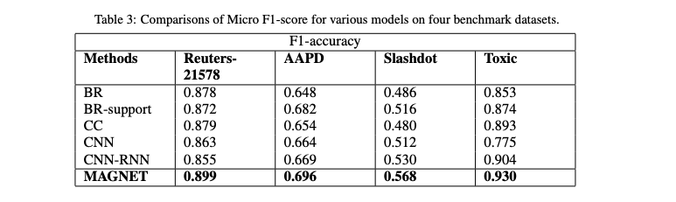
Graph Attention Networks For Multi-label Classification
Result
State-of-the-art accuracy compared to 27
different deep learning models including bert
across five benchmark datasets

Slide 19
Take-Home messages
Graph neural networks :
Graph neural networks captured better correlation compared to other deep learning models
Learning the correlation matrix from scratch performed better than providing the pre-order correlation to Graph neural network
The results of the proposed model are validated on five real-world MLTC datasets. The proposed model achieves similar or better performance compared to the previous state-of-the-art models.

Slide 20
Notes
Thanks !
aadityaura@gmail.com
twitter : @aadityaura

