Slide 1
Pay Attention to the cough
Early Diagnosis of COVID-19 using Interpretable Symptoms Embeddings
with Cough Sound Signal Processing
Malaikannan Sankarasubbu
VP, Saama AI Research Lab
malaikannan.sankarasubbu@saama.com
Ankit Pal (Aaditya Ura)
Research Engineer, Saama AI Research Lab
ankit.pal@saama.com
Notes:
Hello, My name is Ankit Pal ( Aaditya Ura), and I will present our research work.
Our paper title is
"Pay Attention to the cough:
Early Diagnosis of COVID-19 using Interpretable Symptoms Embeddings with Cough Sound Signal Processing,”
and this is the work with my collabo-rator Malaikannan Sankarsubbu at Saama AI research lab. I hope you enjoy it.

Slide 2

About Me
Research Engineer @ Saama AI Research Lab
Research interests involve Representation Learning on Graphs and Manifolds
Interpretable Natural Language Processing, and their applications in Healthcare data
Respiratory, Neurophysiological (EEG, ECG, EMG etc.) based Signal Processing
Email : ankit.pal@saama.com
Website : aadityaura.github.io
twitter : @aadityaura
Notes:
A Little bit about myself, I am a Research Engineer @ Saama AI Research Lab
My Research interests involve Representation Learning on Graphs and Manifolds
Interpretable Natural Language Processing, and their applications in Healthcare data Respi-ratory, Neuro-physio-logical (EEG, ECG, EMG etc.) based Signal Processing

Slide 3
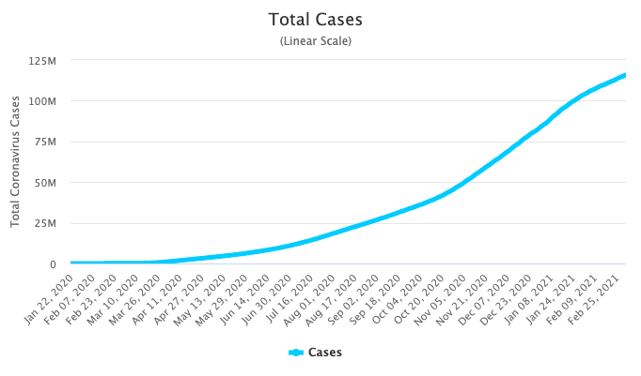
COVID-19
The novel coronavirus (COVID-19) disease has affected over 113 million lives, claiming more than 2.5 million fatalities globally, representing an epoch-making global crisis in health care.
Notes:
As we all know, The novel coronavirus (COVID-19) disease has affected over around 100 million lives, claiming more than 2.5 million fata-lities globally, representing an epoch-making global crisis in health care.
At the time of this writing this paper, no specific antivirus drugs or vaccines were recommended to control infection transmission and spread.

Slide 4
Outline
Introduction
Problem Statement
Motivation
COVID-19 Data
Data Collection, Statistics & Preprocessing
Feature Extraction
Cough Features
Model Architecture
Symptoms & Cough Embeddings, Final Model & loss
Experiments
Results
Interpretability
In depth Analysis
Scope & Future work
Notes:
This is the outline of the talk, first I am going to discuss the introduction, problem statement and motivation part,
later I’ll cover covid-19 collection, preprocessing and feature extraction part,
after that model architecture and experiments and finally the interpretability, in depth analysis, score & future work.

Slide 5
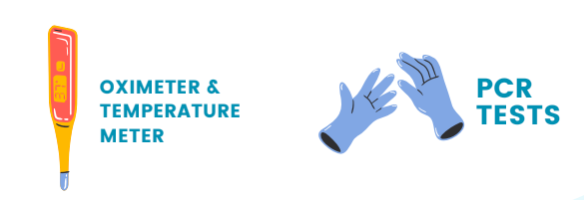
The Problem statement
The current diagnosis of COVID-19 is done by
Thermometer
It does not give an accurate estimation of deep body temperature
Reverse-Transcription Polymer Chain Reaction (RT-PCR)
Time-consuming, expensive, and not easily available in straitened regions
Notes:
The current diagnosis of COVID-19 is done by two methods:
Thermometer and Reverse-Trans-cription Polymer Chain Reaction (RT-PCR)
The problem with these methods are,
Measuring skin temperature does not give an accurate estimation of deep body temperature and it’s impractical and not a good indicator of disease.
The other method, RT-PCR testing is time-consuming, expensive, and not easily available in remote areas due to a lack of enough supplies, healthcare faci-lities, and medical professionals.

Slide 6
Motivation
Lack of a fast and reliable testing method challenge
A low-cost, rapid, easily accessible testing solution is required to increase diagnostic capability and devise a treatment plan
It is an essential tool in the fight to slow and reduce the virus's spread and impact
Notes:
So, why are we doing this?
One of the signi-ficant challenge medics face in the current pandemic is the lack of a fast and re-liable testing method for COVID-19.
A low-cost, rapid, and easily accessible testing solution is needed to increase the diag-nostic capability and devise a treatment plan.

Slide 7

Motivation
At the beginning of March 2020, we thought about a simple idea:
“Is it possible to do mass testing with current technology?”
Notes:
At the beginning of March 2020, we thought about a simple idea: “Is it possible to do mass testing with current technology?”

Slide 8
COVID-19 Symptoms
The main symptoms of COVID-19 given by WHO and CDC official report are
Fever
Shortness of breathing
COVID-19 Dry cough
Notes:
We closely look at the symptoms of COVID-19 given by WHO and CDC official report, the three primary symptoms of the COVID are fever, difficulty in breathing and dry cough.
Cough classification is usually carried out manually during a physical examination, and the clinician listens to several episodes of volun-tary or natural coughs to classify them.
It is challenging to go about door-to-door testing, but a major part of the population has access to mobile phones and the internet.
Our idea is to collect the information about cough using a microphone, fever & other vital information online via a smartphone. We then combine all the information and build an AI model to perform signal processing on cough sounds and find a pattern in COVID-19 symptoms.

Slide 9
Data collection
Data in this study were obtained from Dr. Ram Manohar Lohia Hospital, New Delhi, India
Out of 100 were confirmed positive from COVID-19 RT-PCR results
Bronchitis and Asthma cough samples were also collected from different online & offline sources
Additional data
Breathing sounds
counting 1 to 10 (natural voice samples)
sustained phonation of ’a,’ ’e,’ ’o’ vowel
Notes:
Ok, so All the COVID-19 data used in this research were obtained from 200 subjects in Dr RamManohar Lohia Hospital, New Delhi, India.
Out of 100 were confirmed positive from COVID-19 RT-PCR results. The Clinical Trials Registry, India (CTRI) approved the study protocols and the patient recruit-ment procedure.
Aside from COVID-19 and healthy data, We also collected Bronchitis and Asthma cough from different online and offline sources. The data collection person followed all the clinical safety measures and inclusion-exclusion criteria.
While collecting the COVID-19 data and the cough sounds, we also collected breathing sounds, counting 1 to 10 ( natural voice samples ), ’a,’ ’e,’ ’o’ vowel sounds, demographic, symptoms data such as fever, headache, sore Thorat, or any other medical conditions.

Slide 10
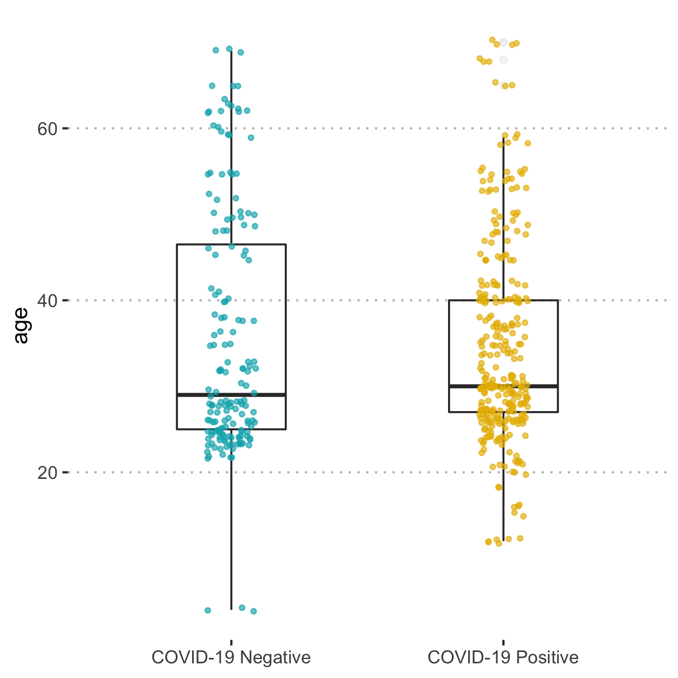
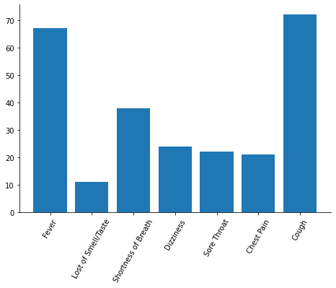
Data Statistics
Symptoms count
Age distribution
Notes:
To understand the data and get better insights, We perform Explo-ratory data analysis (EDA),
We found out that around 67% of patients have fever,
11% to 38% have lost smell or taste & shortness of breathing,
22 to 24% have sore throat & dizzi-ness,
21% have chest pain, and around 72% have a cough in the collected dataset.
The majority of Positive samples are between 20 to 40 age.

Slide 11
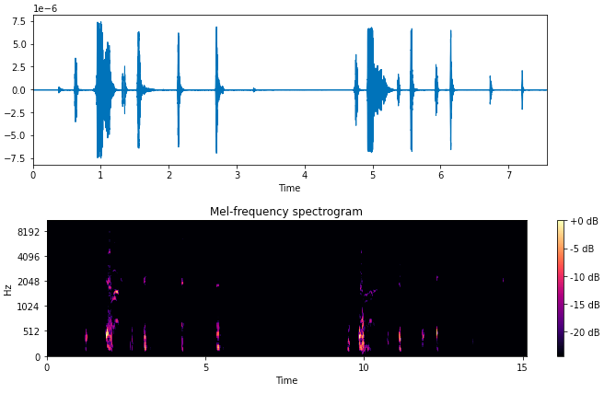
Healthy Cough
Random Sample of a Healthy Cough from collected dataset
Notes:
This is a Random Sample of a Healthy Cough from the collected dataset.
The upper image shows the waveform, which represents the changes in amplitude over a certain amount of time, and the below image shows the Mel-frequency spectrogram of the same cough sound, which represents the signal strength, or “loud-ness,” of a signal over time at various frequencies.

Slide 12
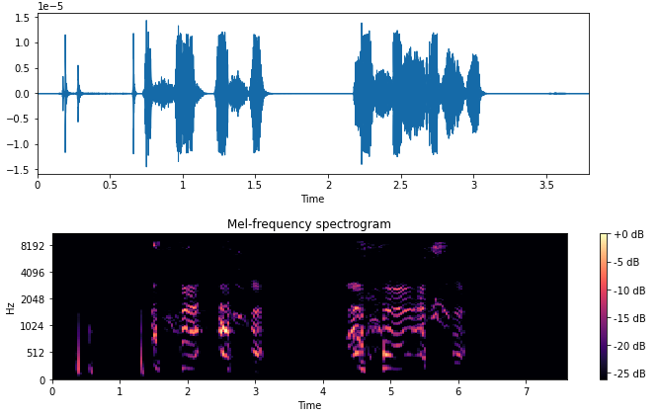
COVID-19 Cough
Random Sample of a COVID-19 Cough from collected dataset
Notes:
This is the second image of the cough visualisation part, and here we visualise one random Covid-19 patient cough from the collected dataset. As we can see, the changes in the covid-19 spectrogram are visible while comparing to the healthy cough spectrogram. With this data, we can easily locate strong signals and determine how frequencies change over time.

Slide 13
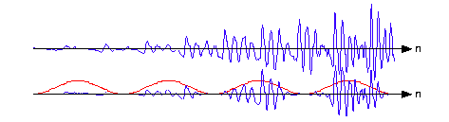
Data Preprocessing
Each cough recording was downsampled to 16 kHz
Normalization was applied to the cough signal level with a target amplitude of -28.0 dBFS
Normalized features were split based on the silence threshold
A High Pass Filter(HPF) was applied to reduce the noise
Divided into sub-segments of non-overlapping Hamming-windowed frames
An example of Non-Overlapping windows [1]
Notes:
Ok, so after collecting the data, we perform the data preprocessing steps on the raw audio files & symptoms data to transform it and bring it to such a state that now the machine can easily parse it.
Cough sound preprocessing involves a total of five steps,
At first, each cough recording was downsampled to 16 kilohertz; after
Normalisation was applied to the cough signal level with a target amplitude of -28.0 dbfs Next,
Normalised features were split into cough segments based on the silence threshold. Later
A High Pass Filter(HPF) was applied to reduce the noise, and finally, Cough segments were divided into sub-segments of non-overlapping Hamming-windowed frames.
And All the Symptoms & Demographic data was converted into one hot format.

Slide 14
Feature Extraction
After Preprocessing, Two types of features were extracted :
The cough Features
Symptoms & Demographic features
Notes:
So, After the preprocessing of cough and symptoms features, we worked on the feature extraction part. Two types of features were extra-cted for model training.
The cough Features
Symptoms & Demographic features
We will talk about each feature in the next slides,

Slide 15
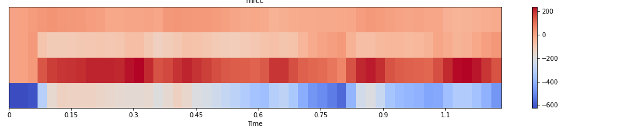
Cough Features
For each Hamming-windowed frames, the following features were extracted
Mel Frequency Cepstral coefficients (MFCCs)
The hearing mechanism of human beings inspires MFCC
Skewness
Measures the symmetry in a probability distribution
Notes:
For each Hamming-windowed frames, we extracted the following features,
Mel Frequency Cep-stral coefficients represent the short-term power spectrum of a signal on the Mel-scale of the frequency. The hearing mechanism of human beings inspires MFCC.
Skew-ness
Next, we calculated Skew-ness; Skew-ness is the third order moment of a signal, Which measures the symme-try in a probability distribution.

Slide 16
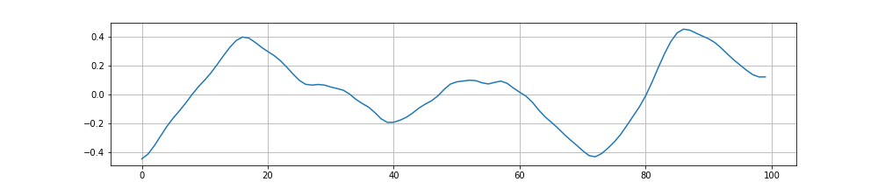
Cough Features
For each Hamming-windowed frames, the following features were extracted
Zero crossing rate(ZCR)
ZCR is used to calculate the number of times a signal crosses the zero axis
Entropy
Capture the difference between signal energy distributions
Notes:
Zero crossing rate(ZCR)
After that, we calculated the Zero crossing rate; ZCR is used to calculate the number of times a signal crosses the zero axes. To detect the cough signal’s periodic nature.
Entropy
Later, We computed the Entropy for each sub-segment of the cough signal to capture the difference between signal energy distributions.

Slide 17
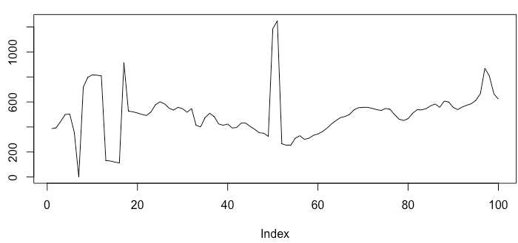
Cough Features
For each Hamming-windowed frames, the following features were extracted
Formant frequencies
Formant frequencies capture the vocal tract resonance characteristics
Kurtosis
Measures the peakiness or heaviness associated with the cough sub-segment probability distribution
Notes:
For-mant frequencies
In the analysis of speech signals, For-mant frequencies capture a human vocal tract resonance’s charac-teri-stics. The first four For-mant frequencies(F1-F4) are enough to discri-minate various acou-stic features of airways.
Kurt-osis
After that, we calculated Kurto-sis; Kurto-sis can be defined as the fourth-order moment of a signal, which measures the peaki-ness or heavi-ness associated with the cough sub-segment probability distribution.

Slide 18
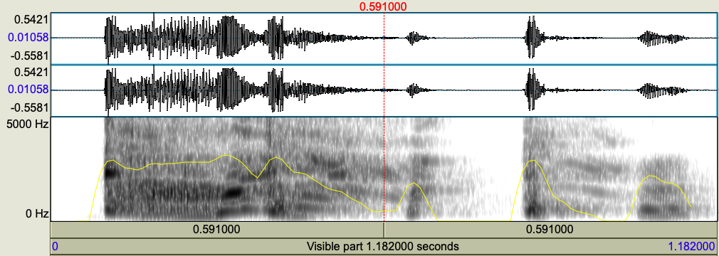
Cough Features
For each Hamming-windowed frames, the following features were extracted
Fundamental frequency(F0)
F0 is the frequency at which vocal cords vibrate in voiced sounds
Notes:
Fundamental frequency(F0)
At last, we computed Fundamental frequency(f0) or pitch; we used the centre-clipped auto-correlation method to estimate the f0 of cough sub-segments.

Slide 19
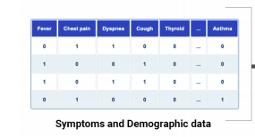
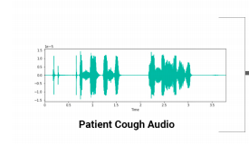
Model Architecture
The model architecture consists of two subnetworks components
Symptoms Embeddings
Cough Embeddings
Notes:
Ok, so after preprocessing and features extraction part, the next step is model building and training.
Our proposed model architecture consists of two subnetworks components, including the Symptoms Embedddings component and the Cough Embeddings component, that process the data from different moda-lities.

Slide 20
Symptoms Embeddings
Symptoms Embeddings capture the hidden features of patient characteristics, diagnosis, symptoms
We utilized the transformer-based tabular model called “TabNet,” which uses a sequential attention mechanism to generate the Symptoms embeddings
It consists of four main components :
Gated Linear Unit
Feature Transformer
Attentive Transformer
Decision Step
Notes:
Symptoms Embeddings capture the hidden features of patient features, dia-gnosis, symptoms. We utilise the transformer-based tabular model called “TabNet” to generate the Symptoms embeddings.
TabNet exploits sequential attention mechanisms to learn and select which symptoms feature to reason from at each step in the model based on information in their dataset. This mechanism makes it possible to explain how the model arrives at its covid-19 predictions, It consists of four main components :
Gated Linear Unit ○
Feature Transformer ○
Attentive Transformer ○
Decision Step
We are talking about each component in the next slides,

Slide 21
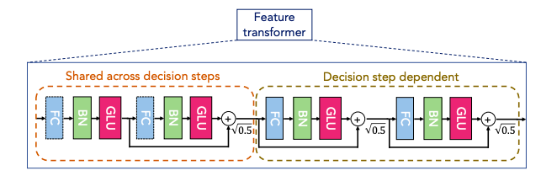
Symptoms Embeddings
Gated Linear Unit (GLU)
GLU functions like a filter; it regulates which parts of the signal should be allowed into the unit
Feature Transformer (FT)
Feature Transformer process the filtered features by looking at all the symptoms features assessed and deciding which ones indicate which class
Notes:
Ok, so the first component of Tabnet is the GLU layer; it consists of a Fully connected layer (FC), Ghost batch normalisation (GBN), and Gated Linear Unit.
The next component is the Feature Transformer.
Feature Transformer process the filtered features by looking at all the symptoms features and deciding which ones indicate which class.

Slide 22
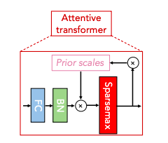
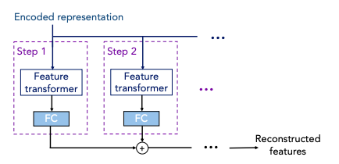
Symptoms Embeddings
Attentive Transformer (AT)
Utilizes sparse intense wise features selection based on learned symptoms dataset and focusing on specific symptoms features only
Decision Step (DS)
Decision steps are composed of a Feature Transformer(FT), Attentive Transformer(AT), and feature masking
Notes:
The third main component of Tabnet is
Attention Transformer
It uses Sparsemax for intense wise feature selection based on the learned symptoms dataset. It is a powerful way of channel the model on which features to look at for each decision step.
Decision Steps
At last, TabNet stacks Decision Steps one after the other. Decision steps are composed of a Feature Transformer(FT), Attentive Transformer(AT), and feature masking. Mask outputs are aggregated from all the decision steps to provide model interpretability results.
The final output is a linear combination of all the summed decision steps, similar to the decision tree result.

Slide 23
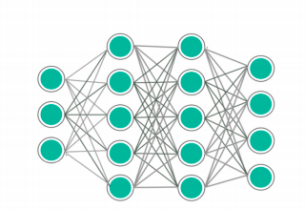
Cough Embeddings
Cough Embeddings learn and capture more in-depth features in temporal acoustic characteristics of cough sounds
We used Deep Neural Network (DNN) to learn the embeddings from cough features extracted in the previous feature engineering part
Notes:
Cough Embeddigs learn and capture more in-depth features in temporal aco-ustic features of cough sounds. We used DNN to learn the embeddings from cough features extracted in the previous feature Engineering part.

Slide 24
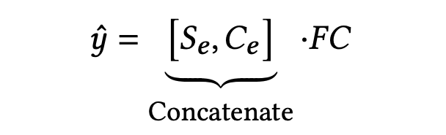
Final Model
Concatenating Symptoms Embeddings with Cough Embeddings followed by a Fully-Connected(FC) layer
Notes:
We get the prediction score by concatenating the Symptoms Embeddings with Cough Embeddings followed by an FC layer. Where S e & C e represents the Symptoms Embedding and Cough Embedding, respectively

Slide 25
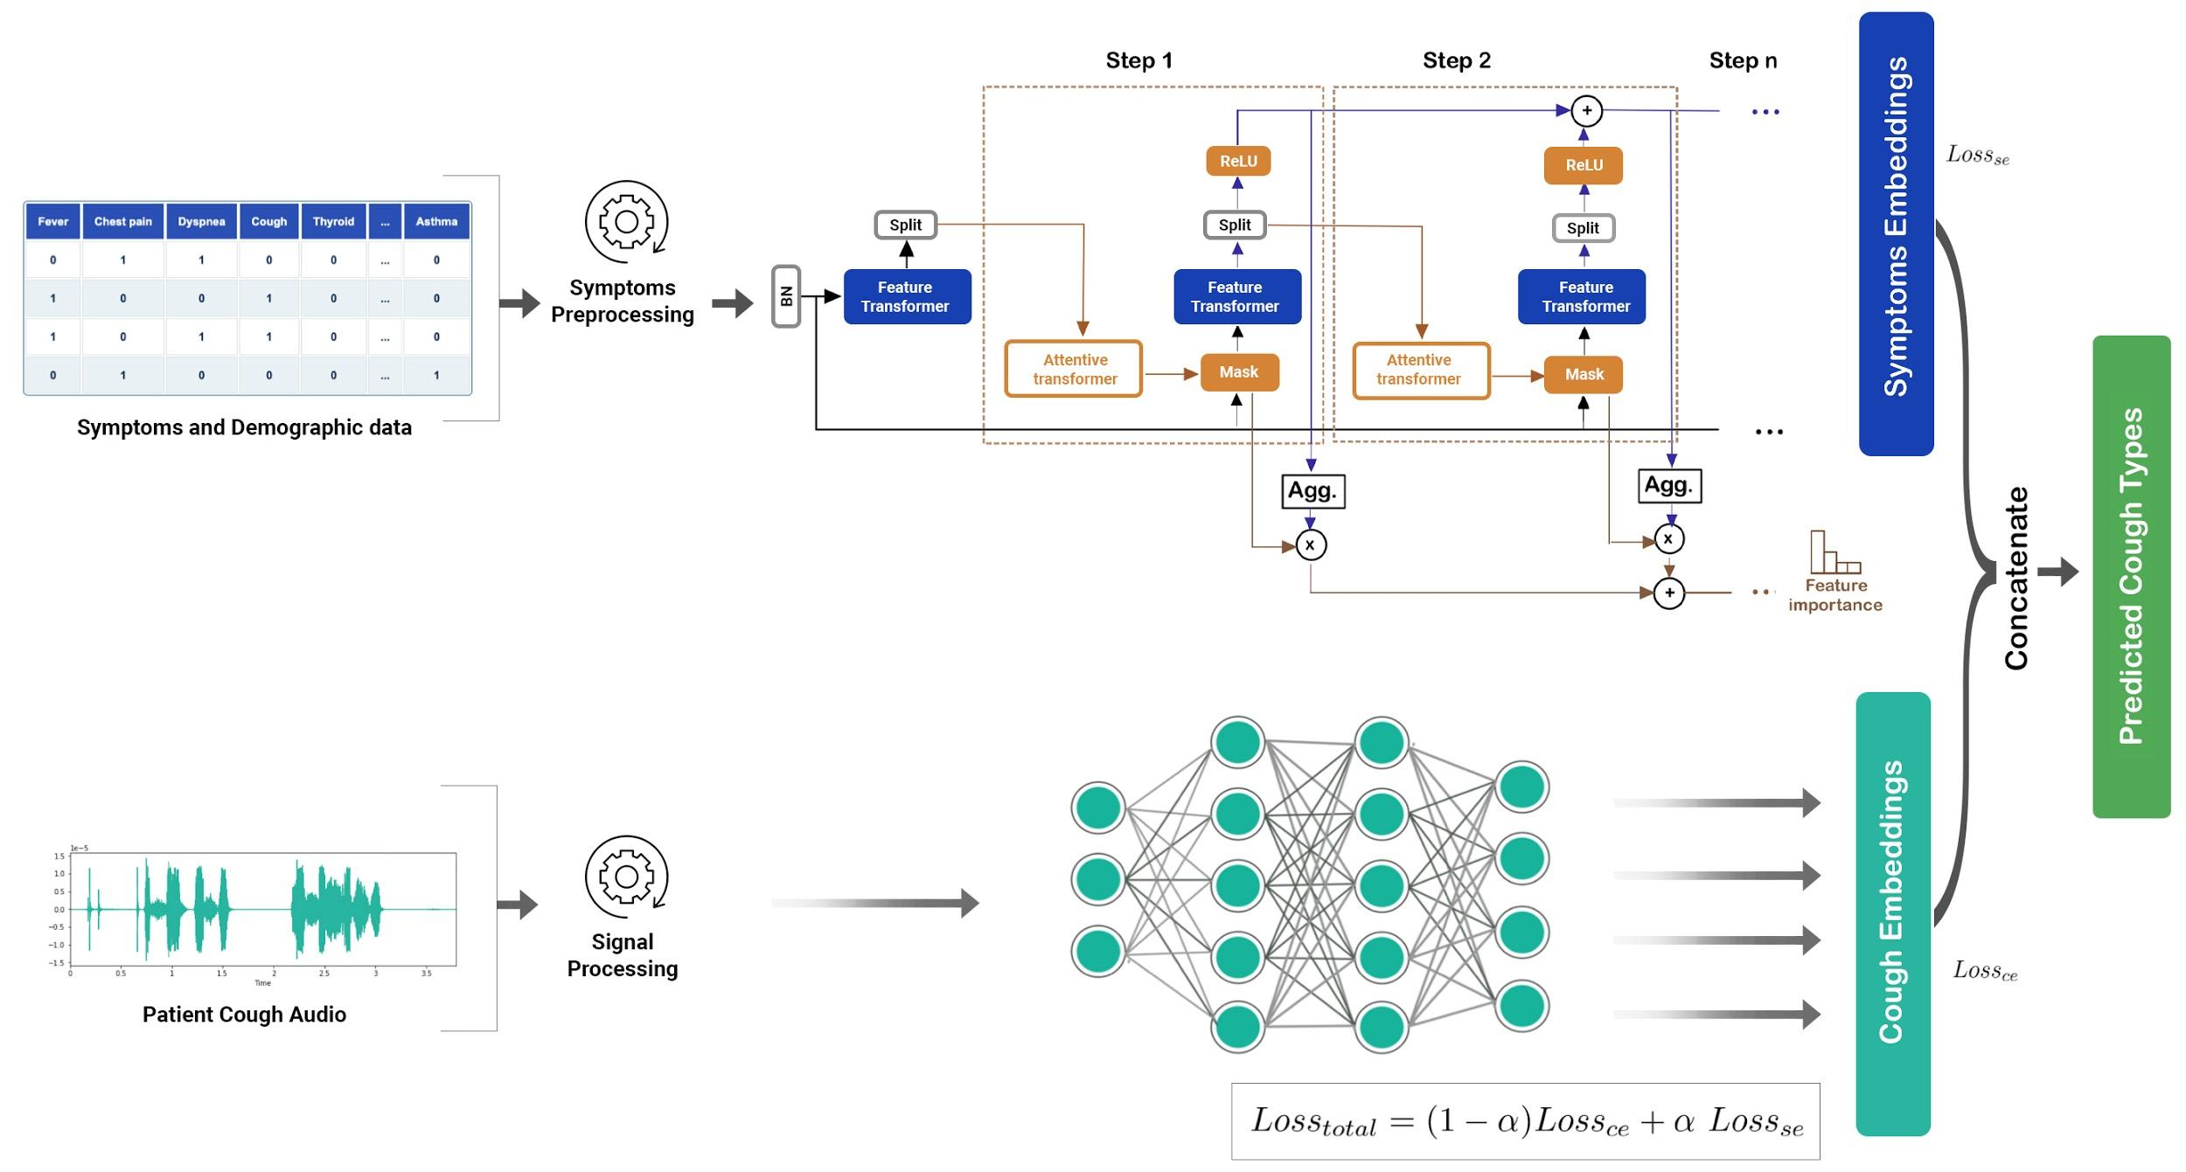
Final Model
Notes:
This is the Proposed Model's overall structure; the model consists of two subnetworks that process the data from different parts. The TabNet network at the top process features symptoms & Demographic data, while the network at the bottom processes the audio signal from cough. Attention Masks from each decision step are aggregated to provide model interpretability results.

Slide 26
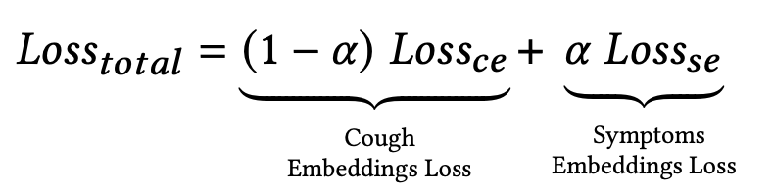

Total Loss
After this, the Total loss was calculated as follows
Notes:
The Final loss value that the model will minimise is weighted sum of all individual losses shown in the equation.
Where ce & se represent the cough & symptoms embeddings loss respectively, and a is small constant value to maintain the contribution of different loss.

Slide 27
Experiments
Based on the collected dataset, the model was trained on the following combination of features
Task 1, Using cough data only
Task 2, Using Demographic & Symptoms Data Only
Task 3, Using Both
Task 4, Using Both with different Cough Types
Notes:
We trained the model on different combinations of features to do in-depth analysis and provide better insights.

Slide 28
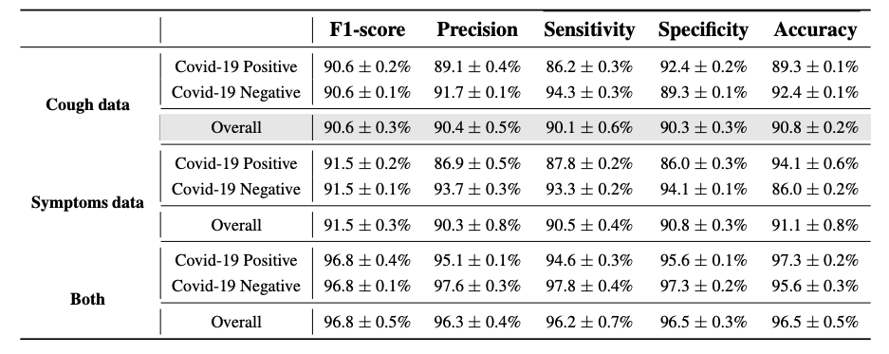
Results (Binary Classification : Task 1)
Model performance metrics across different models on Task 1 Using cough data only
Notes:
We trained the model on binary classification settings in the first task, where we utilized only cough data. The model performed well, and we got quite a decent accuracy & F1 score of 90.8& and 90.6%, respec-tively. It demonstrates that Cough data provides better features of the respi-ratory system and the pathogens involved.

Slide 29
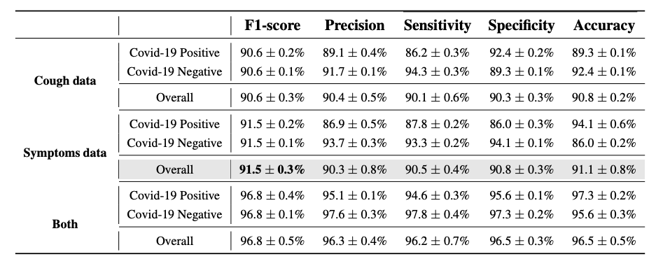
Results (Binary Classification : Task 2)
Model performance metrics across different models on Task 2 Using Demographic & Symptoms Data Only
Notes:
In the next Task, we trained the model on binary classification problems while using only Demographic & Symptoms Data. the model’s performance represents a slight increase in Accuracy Compared to Task 1. This increase is attributed to the rich categorical information present in Demographic and Symptoms data.

Slide 30
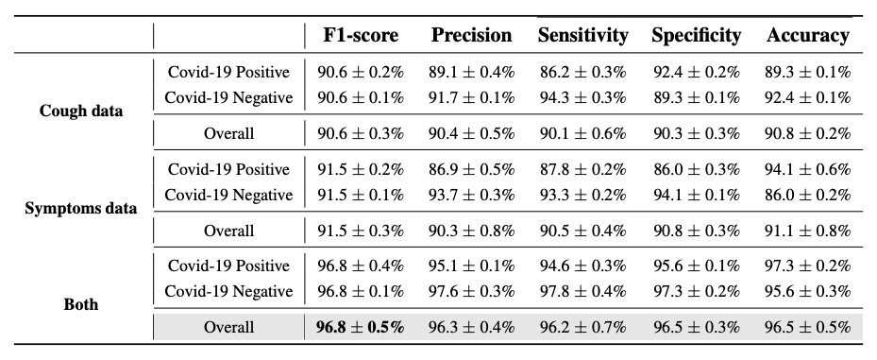
Results (Binary Classification : Task 3)
Model performance metrics across different models on Task 3 Using Using Both
Notes:
In Task 3, the Model makes better use of available data by combining both types of representation, which complement each other and significantly improve the classification’s performance.

Slide 31
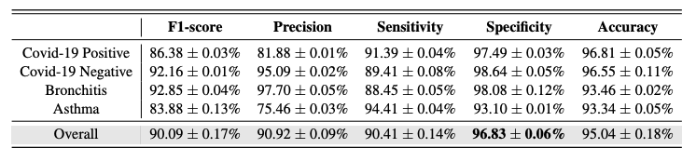
Results (Multi-Class Classification : Task 4)
Model performance metrics across four different diseases
Notes:
To further demonstrate the proposed Model’s flexi-bility, the Model was trained with a multi-class classification setting to distinguish between four types of cough classes, including Bronchitis, Asthma, COVID-19 Positive, and COVID-19 Negative. Results show that the Model can classify between four types of cough classes with an Accuracy of 95.4%. Both types of data enable the Model to learn deeper relationships between temporal aco-ustic features of cough sounds and Symptoms’ features, hence perform better.

Slide 32
Interpretability
The Clinical selection of an algorithm depends on two main factors,
its clinical usefulness, and
trustworthiness.
When the prediction does not directly explain a particular clinical question, its use is limited
Notes:
In AI research, the model should not be limited to accuracy and sensitivity reports; instead, it is expected to describe the predictions’ underlying reasons and enhance medical understanding and knowledge. The clinical selection of an algorithm depends on two main factors, its clinical usefulness and trustworthiness.

Slide 33
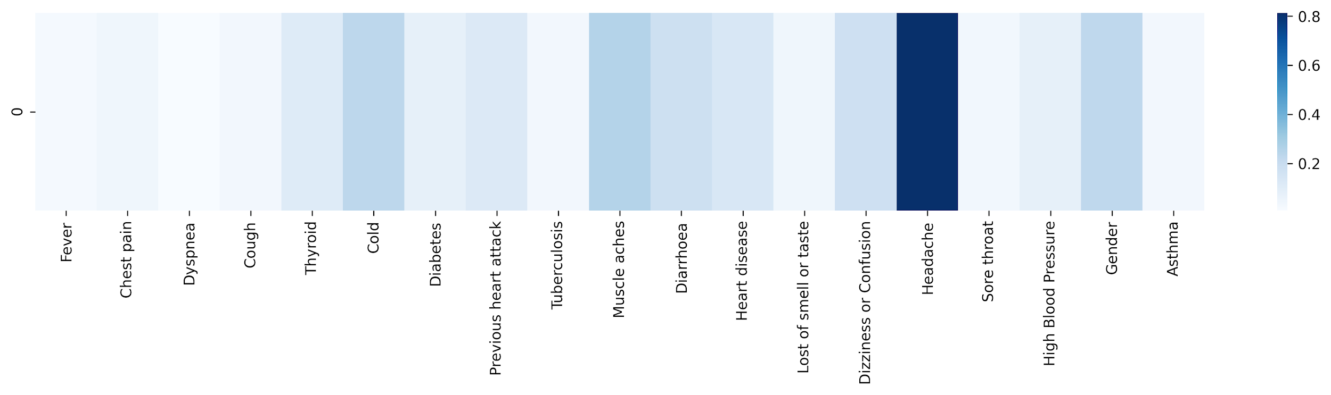
Interpretability
Attention distribution over the Symptoms of a random Healthy(COVID-19 Negative) person. The color depth expresses the seriousness of a symptom.
Notes:
Here is the Attention distribution over the Symptoms of a random Healthy(COVID-19 Negative) person. The colour depth expresses the seriousness of a symptom.

Slide 34
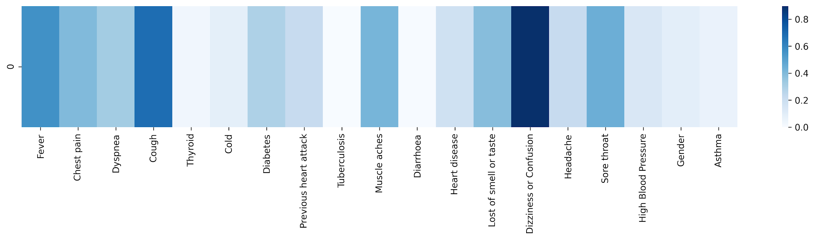
Interpretability
Attention distribution over the Symptoms of a random COVID-19 infected person, The color depth expresses the seriousness of a symptom.
Notes:
This is the second interpretable result, visualising the Attention distribution over the Symptoms of a random COVID-19 infected person. As we can see, it is visible from the attention score that Fever, Cough, Dizzi-ness, or Confusion, Chest pain is with high colour depth, showing that the model has learned the symptoms embedding based on demographic & cough features.

Slide 35
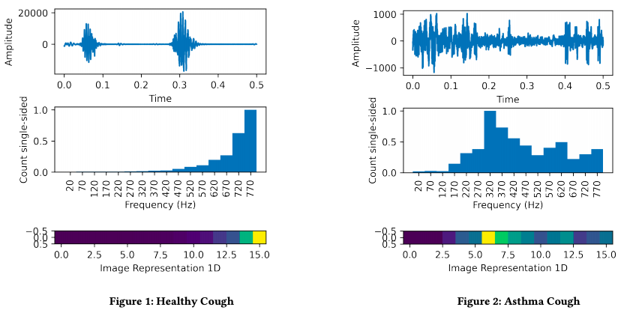
In-Depth Analysis (Different Types of cough)
Healthy & Asthma Cough with their original sound, FFT output, and 1D image representation
Notes:
Ok, So The coughing sound usually consists of three phases- Phase 1- Initial burst, Phase 2- Noisy airflow, and Phase 3- Glot-tal closure. To understand more details about COVID-19 and other cough types, we visualised the four types of cough sounds their original sound, FFT output, and 1D image representation. These two show the Healthy and asthma cough visualisation, and We observed that in the cough sample of healthy individuals, phase 3 finished with vocal folds activity.

Slide 36
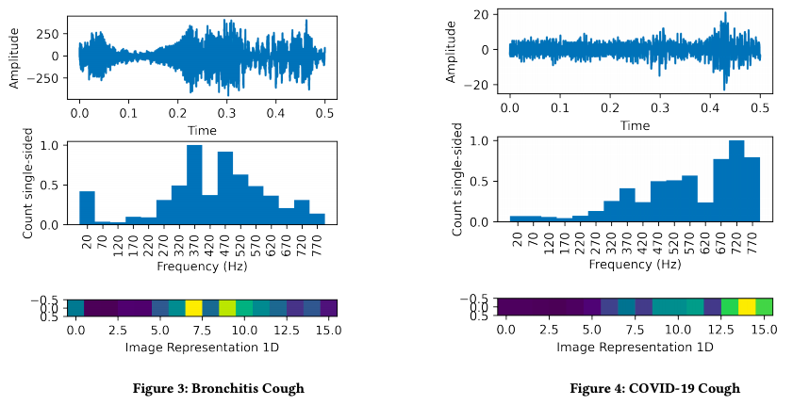
In-Depth Analysis (Different Types of cough)
Bronchitis & COVID-19 Cough with their original sound, FFT output, and 1D image representation
Notes:
These two figures show the Bronchitis and COVID-19 cough visualisation. Asthma & Bronchitis come under the wet cough category. In particular, vocal fold activity looks random, and the energy is expanded over a broader frequency band. It is observed that COVID-19 cough is continuous; energy distribution is spread across frequencies pre-ceded by a short catch.

Slide 37
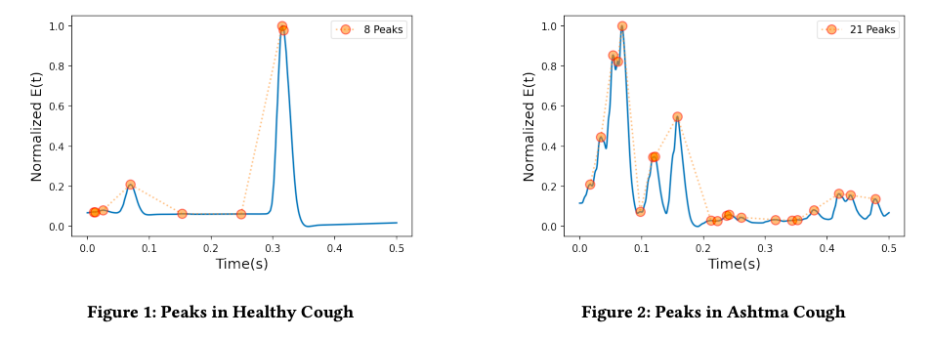
In-Depth Analysis (Peak Analysis)
Peaks analysis in Healthy & Asthma cough. Where y-axis represents Normalized Energy envelope E(t), obtained from applying band-pass filter followed by second-order Butterworth low pass filter, and the x-axis represents the time in seconds.
Notes:
We also analyse the peaks in the energy envelope of all four types of cough. Figure 1 shows that the healthy cough sample had the minimum number of peaks compared to the other three cough types. It starts with a peak followed by a float region with two small peaks and falls following a large peak. cough samples of Asthma shows fewer peaks than bronchitis’ but more peaks than healthy and COVID-19 ones.

Slide 38
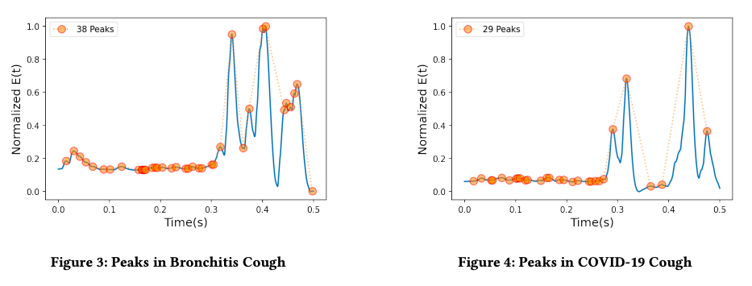
In-Depth Analysis (Peak Analysis)
Peaks analysis in Bronchitis & COVID-19 cough. Where y-axis represents Normalized Energy envelope E(t), obtained from applying band-pass filter followed by second-order Butterworth low pass filter, and the x-axis represents the time in seconds.
Notes:
Cough samples of Bronchitis exhi-bit the maximum number of peaks. Compared to asthma and bronchitis, COVID-19 consists of fewer peaks, starting with multiple small peaks and ending with large peaks in phase 3, which shows a significant difference between COVID-19 and other cough types.

Slide 39
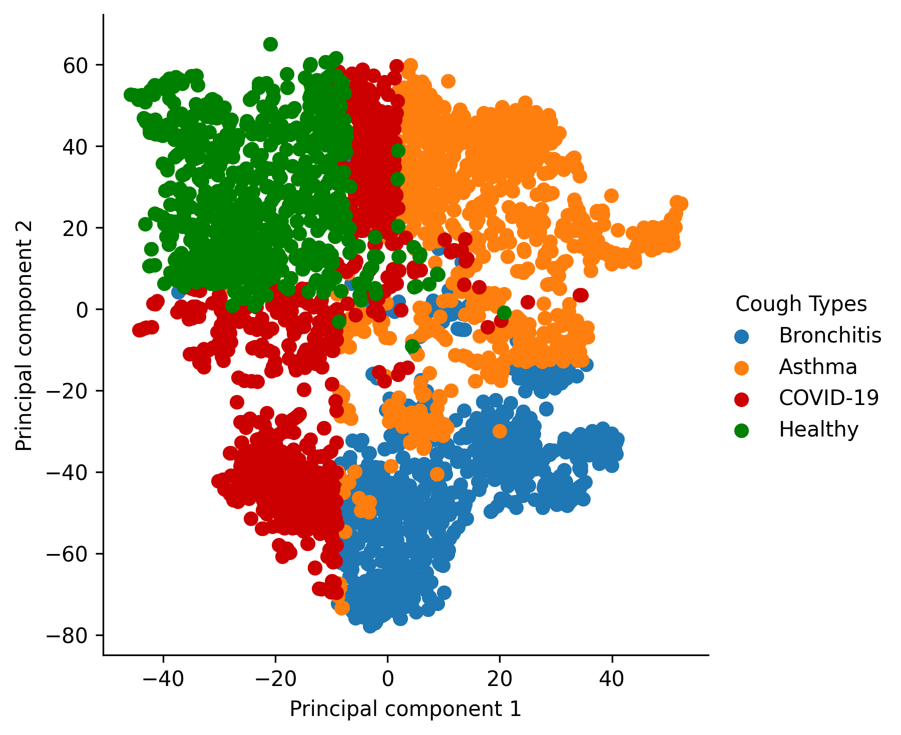
In-Depth Analysis (t-SNE visualization)
t-SNE visualization of four types of Cough features
Notes:
We also visualised the cough features.
To in-tuiti-vely show the representation’s quality, we also visualized the high dimensional cough features using an unsupervised algorithm called t-Distributed Stochastic Neighbour Embedding (t-SNE).

Slide 40
Scope & Future work
Low cost, rapid and interpretable AI-based diagnostic tool
Large-scale COVID-19 disease screening and areas where healthcare facilities are not easily accessible
Experiments will be carried out in the future by incorporating additional voice data features such as breathing sound, counting sound (natural voice samples), and sustained vowel phonation
Notes:
Ok, so here we are talking about our research scope and future work,
This study brings forth a Low cost, accurate and inter-pre-table AI-based dia-gnostic tool for COVID-19 screening by incorporating the demographic, symptoms, and cough features.
This significant achievement supports large-scale COVID-19 disease screening and areas where healthcare faci-lities are not easily accessible.
Experiments will be carried out in the future by incorporating different voice data features such as breathing sound, counting sound (natural voice samples), and sustained vowel pho-nation.

Slide 41
Take-Home Messages
It isn’t a replacement or a medically approved diagnostic tool; instead, it is a first-level diagnosis method for anyone, anywhere, anytime
Cough detection and classification is fast, affordable, and accurate using AI-based methods
We utilized different types of patient information; The results prove to be transparent, interpretable, and multi-model learning in cough classification research
Additional clinical data such as case trajectory, patient characteristics, diagnosis, symptoms, comorbidities, and outcomes & EHR data could be utilized to capture better symptoms & cough features to build a rapid, accurate, and easy-to-access mobile diagnosis tool for different diseases
Notes:
At last, Take-home messages,
It is not a replacement or a medically approved dia-gnostic tool; instead, It can be used as a first-level dia-gnosis method for anyone, anywhere, anytime.
Our research work shows Cough detection and classification is fast, affordable, and accurate using AI-based methods.
This paper utilised two different patient information types; The results prove to be transparent, interpretable, and multi-model learning in cough classification research.
Although this research work is not limited to only COVID-19 or specific cough classification task, Additional clinical data such as case reports, diagnosis, symptoms, co-mor-bidi-ties, outcomes & EHR data could be utilised to capture better signs & cough features.
To build a rapid, accurate, and easy-to-access mobile diagnosis tool for different diseases.

Slide 42
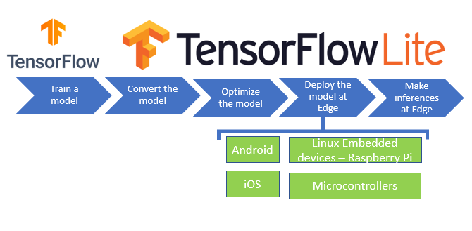
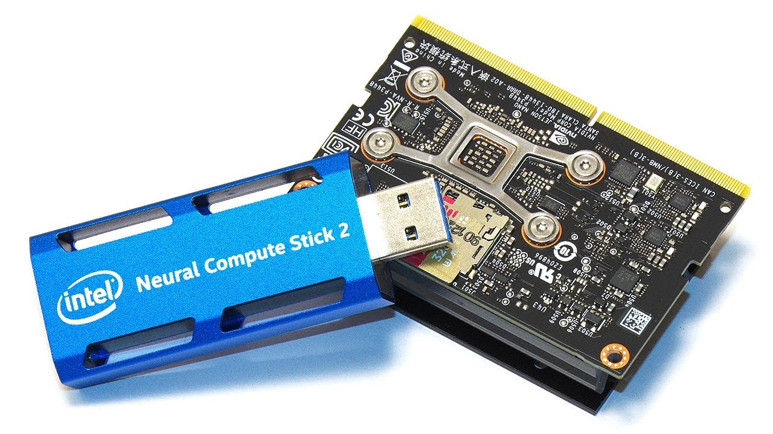
Edge deployment of models (on device and close-to-endpoint server)
Using Tiny ML, Intel’s Neural Compute Stick
TinyML is a type of machine learning that shrinks deep learning networks to fit on tiny hardware.
Machine Learning
Embedded system
TinyML
Trained edge level machine learning models using Intel’s Neural Compute Stick
Utilized the TinyML to train models on raspberry pi and deployed internally

Slide 43
Questions?
Thanks !
ankit.pal@saama.com
aadityaura.github.io
twitter : @aadityaura
Notes:
Thanks for joining. With that, I hope you read our paper, and please feel free to reach out for any question, collaboration, or research idea about this work.
All right, Thank you!

