Slide 1
<Michael Nana Kofi Ofori>
Web Tech Fall 2021 Final Exams

Slide 2
<Michael Ofori> is developing a data powered website to help <car dealers/customer/user/business> solve <the problem of poor access to vehicles available for sale in Ghana>.

Slide 3
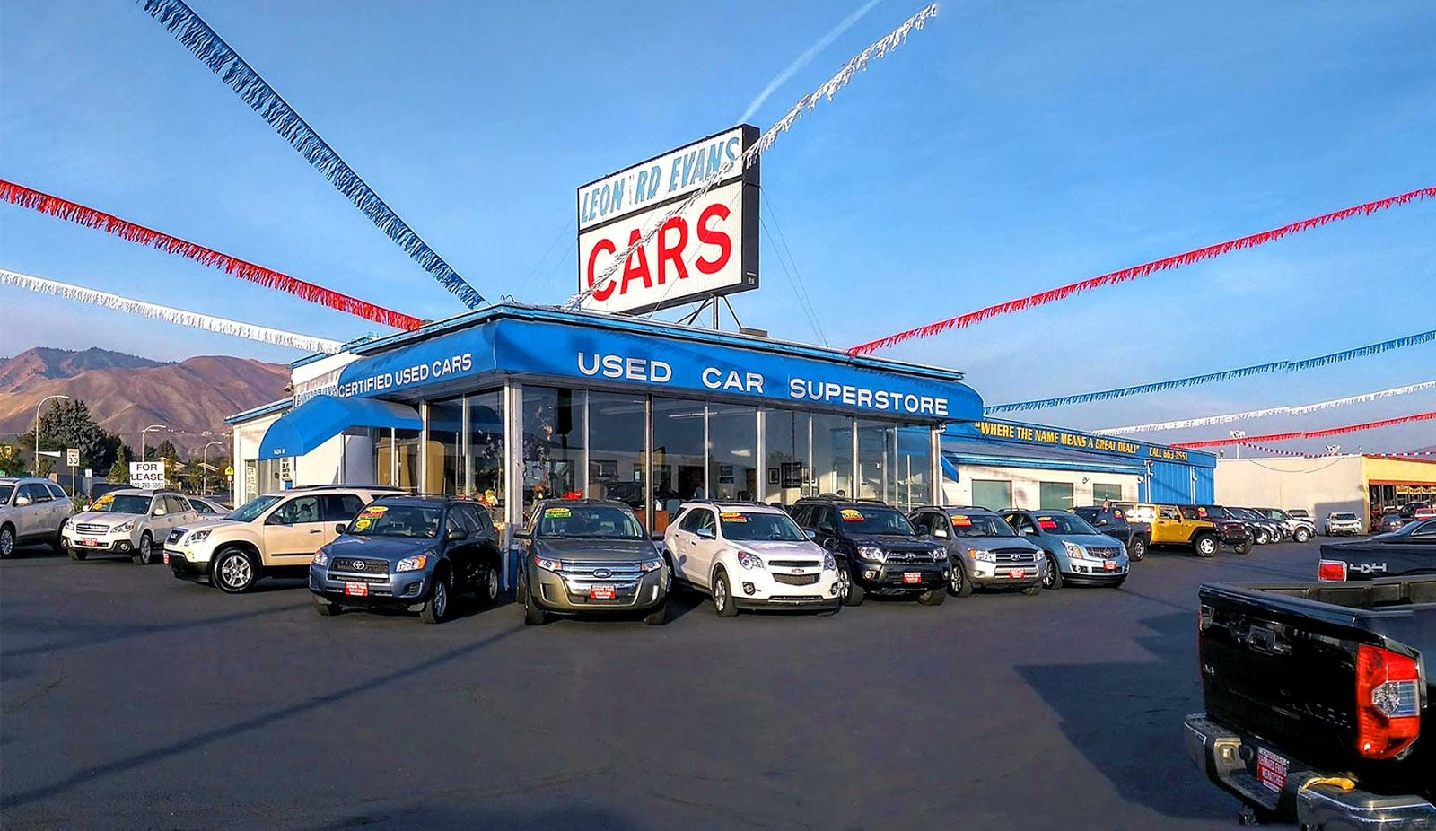
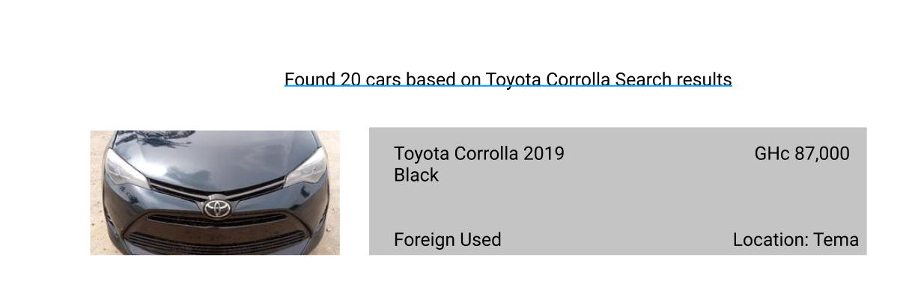


Project Title
ddd
PROBLEM: The website would help people in Ghana to get access to cars that are been sold at affordable prices.
PAYOFF: The user is able to view cars able for sale either used or new cars from various garages.
Kwame is an entrepreneur who is actively looking for a used car to buy for his personal use and a new car for his business.
FINISH: Users are better off with the website because it reduces the time they have to search for a car to buy thereby saving time and money.

Slide 4
User / Customer
The business is in car retail.
The business would be in the transport industry.
The people who are likely to use this website are between the ages of 17 to 60 years. Young people who are buying their first cars and people who would like to sell their cars.
The products would be either used or new cars.
Users would be able to buy and sell cars via the website.

Slide 5
Main Functions of the Website
Customers can view cars available for sale.
The garage or individual can post cars available.
The garage or individual can receive messages from interested clients.
The garage or individual can see customers who have booked to test a car.
Customers can post review after they have successfully purchased a car

Slide 6
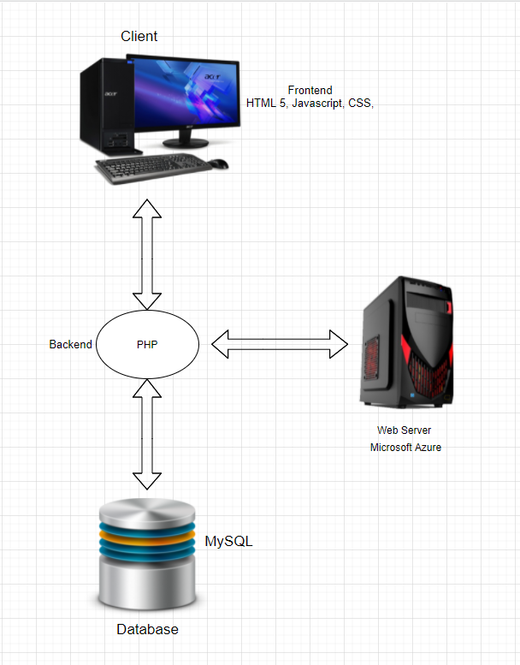
Architecture
HTML 5,CSS,JS were used for presentation layer.
PHP was sued for the backend.
MySql was used for database layer.

