Slide 1

FedPAQ: A Communication-Efficient Federated Learning Method with Periodic Averaging and Quantization
Amirhossein Reisizadeh
UC Santa Barbara
Aryan Mokhtari
UT Austin
Ramtin Pedarsani
UTC Santa Barbara
Ali Jadbabaie
MIT
Hamed Hassani
UPenn
Jitaru Ovidiu
MLDL
A.A. 2020/21
S280230

Slide 2
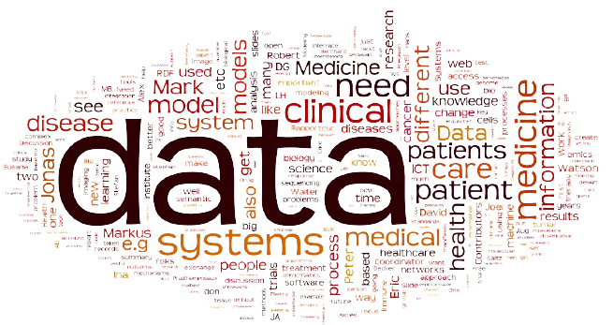
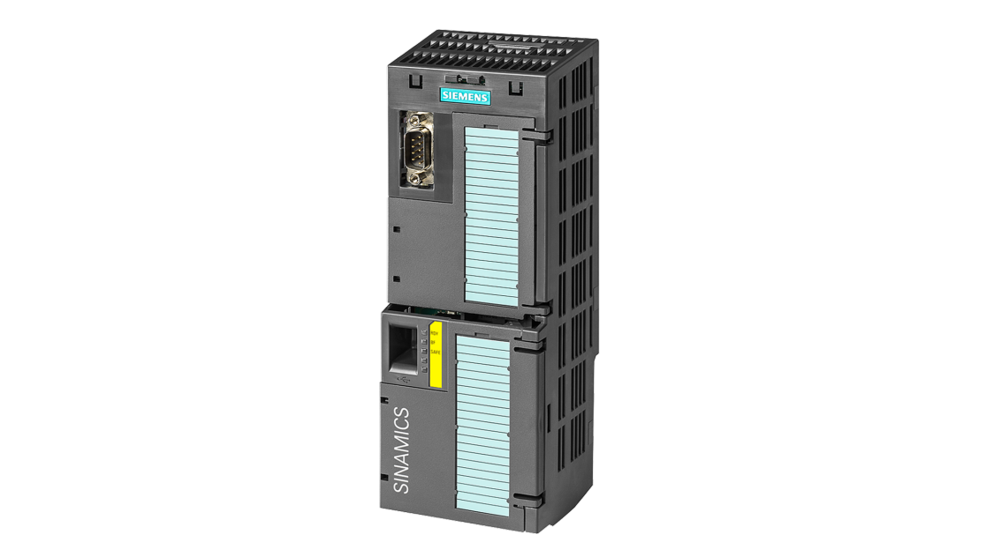
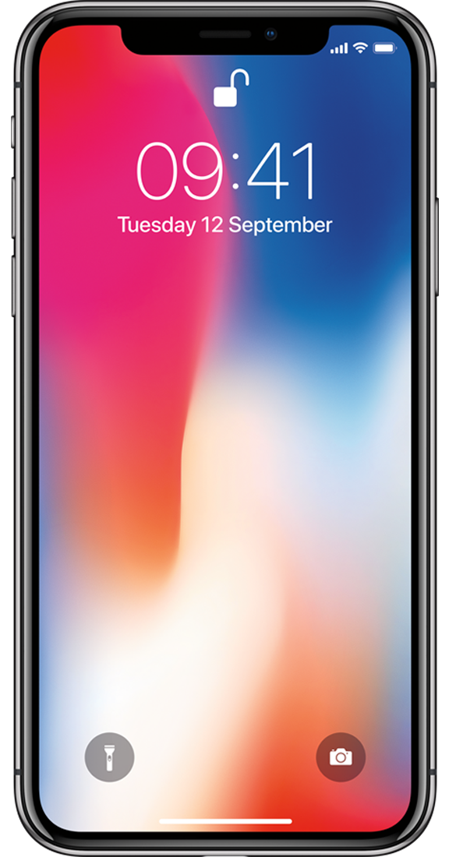





Classical Machine Learning aproach
Federated Learning
$$θ_{0}→ θ_{T}$$
$θ_{0}→ θ_{t+1}=$ Agg$\left\{θ_{t+1}^{1:m}\right\}$
SGD
$$θ_{0}→θ_{t+1}^{0}$$
SGD
$$θ_{0}→θ_{t+1}^{m}$$
$$θ_{0}→θ_{t+1}^{i}$$
SGD
drawbacks
SGD
Centralized Data
Privacy
Comunication loads
Slow Training
Improvements
Lower latency
No data deployment
More privacy
Low power consumption

Slide 3

















FEDPAQ
$$X_{k+1}=X_{k}+\frac{1}{r}\sum{Q(X_{k,τ}^{\left(i\right)}−X_{k}) }$$
$$Q(X_{k}^{\left(1\right)}−X_{k})$$
$$Q(X_{k}^{\left(2\right)}−X_{k})$$
$$Q(X_{k}^{\left(i\right)}−X_{k})$$
$$Q(X_{k}^{\left(n\right)}−X_{k})$$
$$X_{k}$$
$$X_{k}$$
$$X_{k}$$
$$X_{k}$$
SGD
$$τ$$
SGD
$$τ$$
SGD
$$τ$$
SGD
$$τ$$
$$X_{k}^{(1)}$$
$$X_{k}^{(2)}$$
$$X_{k}^{(i)}$$
$$X_{k}^{(n)}$$

Slide 4



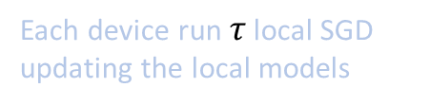
FedPAQ Modules min 10
Periodic Averaging
Model Quantization
Partial device participation
Each device run $τ$ local SGD updating the local models
Every node uploads quantized updates
Among the totla of n devices, only r nodes (r ≤ n) are available at each round of the training
Less comunication rounds
Less privacy leakage
Reduction of network comunication
Scalable
Heterogeneity aware

Slide 5
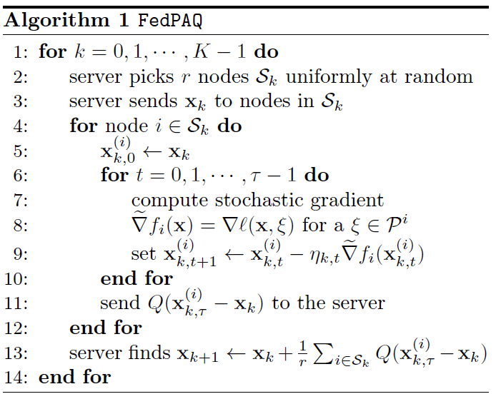

Algorithm Update
The parameter server broadcasts its current model xk to all the nodes in Sk and each node i $∈$ Sk performs $τ$ local SGD updates using its local dataset.

Slide 6
Convergence

