Slide 1
Data Networking Diagram
Raw torque plotter
Raw recorder
Test mode
Record mode
Raw port
Record flag port
CSV data file
Signal Processor
Filtered port
Filtered torque plotter
Callback
Test mode
Interface
NI_STREAMER
Interface/ game
Run mode

Slide 2
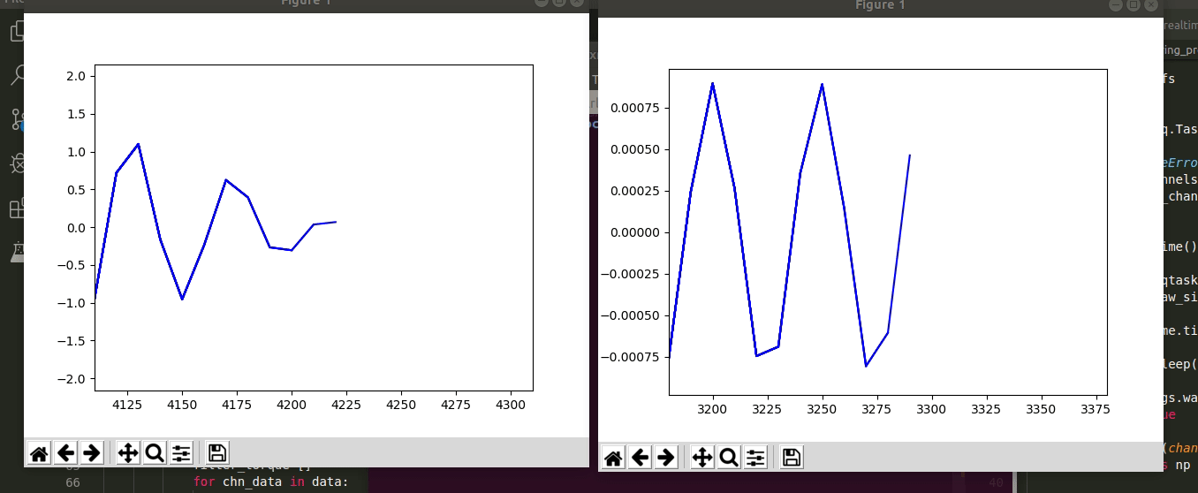
Test mode – raw vs. filtered

