Slide 1
Weekly Meeting 05/10
Hardware & Software Design Discussion
- Jingyan Ling

Slide 2
Hardware Design
Equipment Goal:
  1. Make sure torso is straight
  2. Make two shoulders at same level
  3. Lock wrist joint
  4. Adjust configuration of arms
    Allow 2 dof on shoulder
    Allow 1 dof on elbow (with surface constrain)

Slide 3
Configuration Variables
Corresponding Joint on Body | Configuration Description | Notation | Desired Value Range | Comment
Shoulder | Chest – Upper Arm | alpha | 85
Shoulder | Torso – Upper Arm | beta | 40
Elbow | Upper Arm - Forearm | gamma | 90

Slide 4
Hardware Design
Equipment Goal:
  5. Quick set up
  6. Quick Measurement

Slide 5
Hardware Design
Equipment Goal:
  1. Make sure torso is straight
  2. Make two shoulders at same level
  3. Lock wrist joint
  4. Adjust configuration of arms
    Allow 2 dof on shoulder
    Allow 1 dof on elbow (with surface constrain)
Interest Point * Attraction for kids

Slide 6
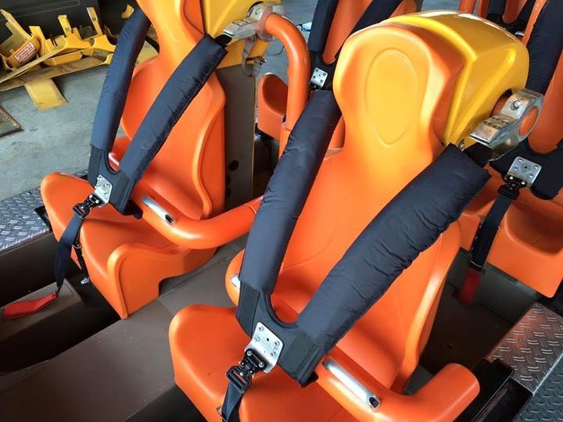
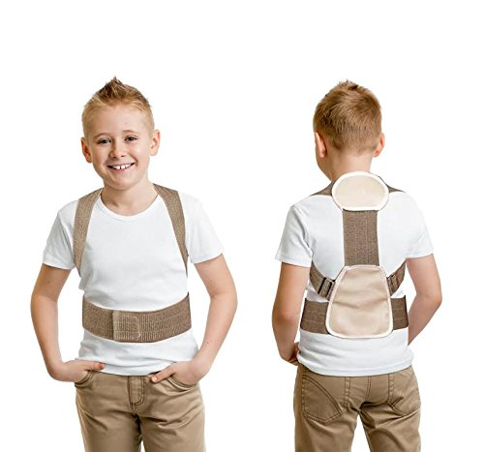
1.Make Torso Straight
  Shoulder can be considered as sphere joint (3 dof).
  Adding one constraint to lower dof
  Approach:
    Seat belt
    Posture Brace

Slide 7
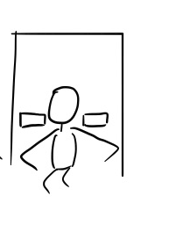
2. Fix shoulder level
Small blocks that can slide on chair back
Gently touch shoulder and provide constrain (Do not need to press hard)
* Make it looks like little wings

Slide 8
4. Adjustable configuration variables
Desk
  Adjustable in height
  Adjustable in the direction towards or away from subject
  On desk:
    Adjustable horizontal position for force sensors (elbow position)
    Revolution Joints underneath force sensors
    * Cartoon Painting on desk

Slide 9
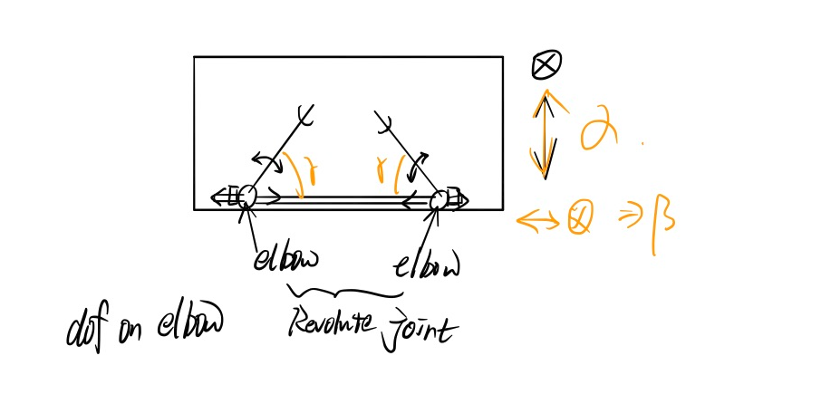
Desk Design

Slide 10
6. Quick Measurement
Approach:
  1. Manual Measurement
  2. Camera + AR tags
    Two cameras on shoulder block
    Two AR tags for each arm
      One besides force sensor
      One at tip of arm (finger position)
    Read transformation matrix seen from camera to AR tags.

Slide 11
Software Design
Pipeline
DAQ
Python
Pygame
DAQ
MATLAB
Simulink
ROS on Windows

Slide 12

Game Design
Ski-like game
Character rushes towards hill
Speed depends on torque
Change hill size for
different torque to
go through the hill

