Slide 1


Advanced Software Reverse Engineering
PhD Qualifying Examination
Zhibo Liu
Supervisor:
Dr. Shuai Wang
Committee Members:
Dr. Charles Zhang (Chair), Dr. Dimitris Papadopoulos and Dr. Lionel Parreaux
Notes:
The topic of my survey is advanced software reverse engineering. In this presentation, I will discuss challenges and existing reverse engineering techniques. In the end, I will briefly introduce several of our previous works and potential future research directions.

Slide 2





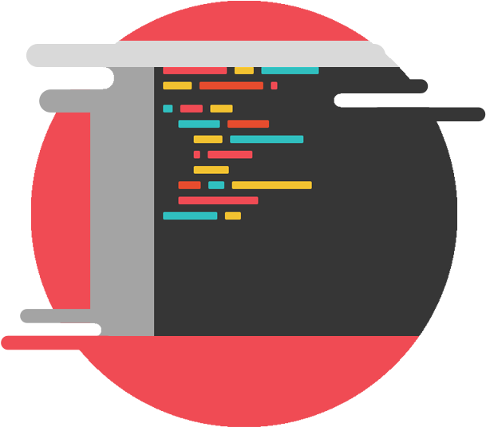

Binary cannot be used for understanding and analyzing directly.
Automatic Analyses
incomprehensible
Understanding
Binary without source code available
Reverse Engineering
Higher-level Representation
Fixing & Patching
Analyzing binaries without source code (e.g., malwares) heavily depends on reverse engineering.
…
Notes:
First, before we get into details of the software reverse engineering, let me briefly talk about the motivation for choosing reverse engineering as my PQE topic.
Essentially, reverse engineering is a process to extract high-level information from low-level binary code generated by compilers. The binary generated by compilers cannot be used for understanding and analyzing directly. Thus if the source code is not available, we have to preprocess the binary into high-level comprehensible representation before further analyses, understanding, fixing, and patching. Overall, analyzing binaries without source code heavily depends on reverse engineering.

Slide 3



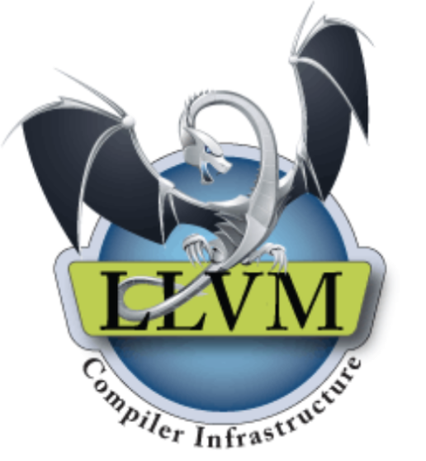
Why we use Software Reverse Engineering?
Software Reverse Engineering is proved to be an effective way to preprocess and analyze binaries.
Successful commercial tools: IDA-Pro, JEB3,…
Open-source tools: McSema, Ghidra, RetDec,…
Indispensable to analyze binaries without available source code.
E.g., malware analysis
Academia and industry have devoted many resources into reverse engineering research.
Over 50 research paper published in top conferences and journals
Tools developed by technology companies
Notes:
Software reverse engineering techniques have been researched for decades. It has been proved that reverse engineering is an effective way to preprocess and analyze binaries. Some successful commercial tools and open-source tools developed by technology companies are commonly used in academia and industry. Until now, academia and industry have devoted many resources and will devote more resources to reverse engineering research, as reverse engineering is indispensable to analyze binaries without source code available.

Slide 4
Outline
Preliminary Background
Problems and Challenges
Existing Solutions
Our Works
Future Direction
Notes:
This presentation is divided into five parts. I will first introduce the preliminary background, and then summarize the problems and existing challenges. After that, I will present existing solution. Finally, I will talk about our works and potential future research directions.

Slide 5
Outline
Preliminary Background
Problems and Challenges
Existing Solutions
Our Works
Future Direction
Notes:
So first of all, Let me introduce the background of software reverse engineering.

Slide 6
Modern Software Reverse Engineering Pipeline
Main Components
(Reassembleable) Assembly Code
(LLVM) IR
Analyses/Optimizations
Output
Symbolization
IR-level
Optimization
Control-Flow
Optimization
Input
Executable
Disassembly
Asm
IR Lifting
IR
Decompilation
High-level Source Code
Function Recovery
Control-Flow Structure Recovery
Variable/Type Recovery
CFG Recovery
Modern Software Reverse Engineering
Notes:
With years of research, nowadays, modern software reverse engineering has formed a three-component pipeline that consists of disassembly, lifting, and decompilation.
A complete software reverse engineering process starts with a binary executable.
First, the disassembler will parse and disassemble the binary file into assembly code.
Next, the disassembled code will be lifted to (customized) IR by lifters, this process usually involve some binary level analyses like CFG recovery and variable recovery.
Lastly, the control flow structure will be recovered and optimized in order to translate IR into the high-level programming language.
With some advanced techniques, the output of the disassembler even could be symbolized to be able to reassemble into a functional binary executable. In this case, the assembly or IR can also be used to support downstream applications without further processing.

Slide 7
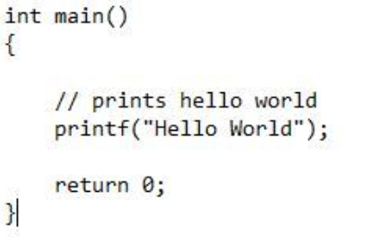
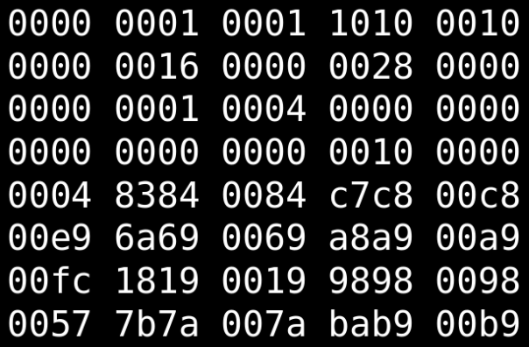
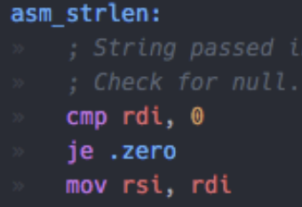
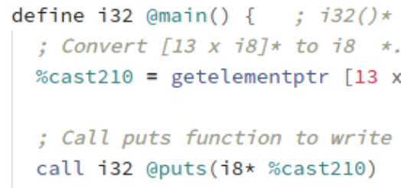
Main Components:
Disassembler, IR Lifter, and Decompiler.
Binary
Disassembly
Asm
IR Lifting
IR
Decompilation
Source Code
Unknown Binary
Assembly Code
Intermediate Representation (IR)
Source Code
Notes:
Here is a more straightforward example, the binary file is first translated into assembly code, then lifted to LLVM IR and finally to C source code. So next, I will introduce these three components in detail.

Slide 8
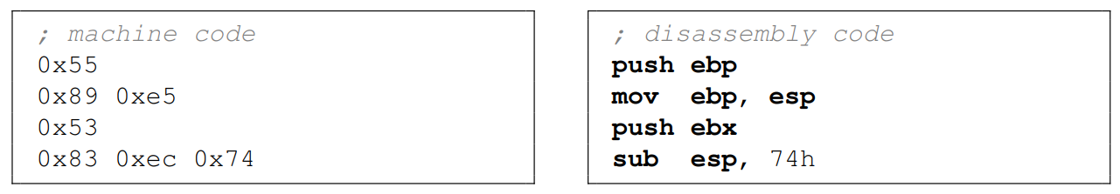
Taxonomy: Disassembly
Machine code → assembly code.
It is the reverse process of assembly.
Mostly solved, while some challenges remain.
Assembly code is still obscure, usually not directly used for analysis.
Notes:
Conceptually, disassembly is the process of translating machine code into assembly language. It is the reverse process of assembly. The translation part is relatively easy and mostly solved. Converting a hex value sequence into assembly code is shown in the example. However, there are still some challenges that remain, which we will talk about later. While assembly code is human-readable, it is still obscure, so it is usually not directly used for analysis.

Slide 9
Taxonomy: Reassembleable Disassembly
Traditional disassembly aims to readability and expressiveness only;
Uroboros ^{[1]}: Reassembleable Disassembly aims to produce output that can be reassembled back to a functional program.
The challenge is symbolization.
; not reassembleable
.text
mov 0xc0, %eax
.data
.long 0xa08
; reassembleable
.text
mov Glob, %eax
.data
Glob:
.long 0xa08
Notes:
Traditional disassembly aims to readability and expressiveness only, and the disassembled code cannot be reassembled into a functional program because symbols are not recovered. Uroboros is the first disassembler that presents the concept of reassembleable disassembly, reassembleable disassembly aims to produce output that can be reassembled back to a functional program.
However, there is a challenge known as symbolization problem, we will talk about it later.

Slide 10
Taxonomy: Intermediate Representation
Platform-independent
(Automated) Analysis-friendly
High-level information
Cross-platform without additional effort
x86
Further Process
arm
Intermediate Representation (IR)
Unified Output
mips
Notes:
The next stage is IR lifting, so I will talk about IR first. IR stands for Intermediate Representation. An IR is usually platform-independent and analysis-friendly, it also usually contains more high-level information than assembly code.
As an intermediate layer between assembly and high-level languages, IR enables reverse engineering to be cross-platform without additional effort.

Slide 11
Taxonomy: LLVM IR
IR used in the LLVM Compiler Infrastructure Project.
Static Single Assignment (SSA) format
Each var will be assigned only once, and assigned before used
Strong-typed (contains variables and types)
; LLVM IR
entry:
%a = alloca i32 ; explicit variable allocation
%hello = alloca [14 x i8] ; array allocation
store i32 0, i32* %a ; stack memory operation
%0 = bitcast [14 x i8]* %hello to i8* ; explicit type conversion
…
%1 = load i32, i32* %a
%call = call i32 @foo(i32 %1, i8* %arraydecay) ; explicit call with arguments
store i32 %call, i32* %a
ret i32 %call ; explicit return value
Notes:
Among all the IRs used by different reverse engineering platforms, LLVM IR is the most prominent one. LLVM IR is defined by the LLVM compiler project. LLVM IR is defined in the static single assignment format. Also, LLVM IR is a strong-typed language, which means it contains variables and types.
As shown in this example, variables, arguments and their types are explicitly defined in LLVM IR. These characteristics make LLVM IR suitable for analyses and optimizations.

Slide 12
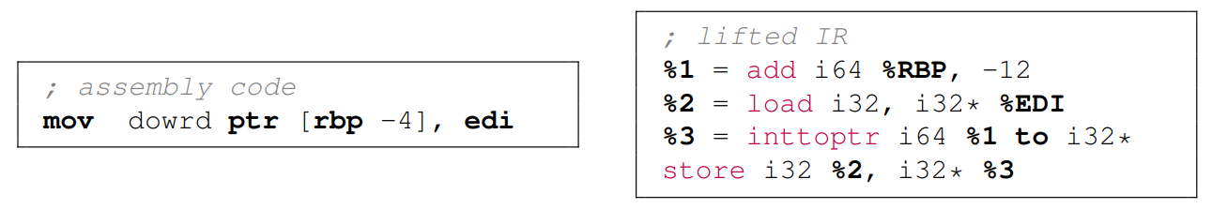
Taxonomy: IR Lifting
Assembly instruction → semantic-equivalent IR statements.
Line by line translation.
Many analysis tools developed by the LLVM can be reused.
The problem is, how to recover variables and types.
Notes:
IR lifting is the process of translating assembly code to semantic-equivalent IR statements. After IR lifting, many optimization and transformation passes provided by LLVM can be directly reused.
However, as we mentioned in the previous page, LLVM IR is a strong-typed language. The problem is, variables and types information is lost during compilation, so to lift assembly code, we first need to recover variables and their types from assembly code.

Slide 13
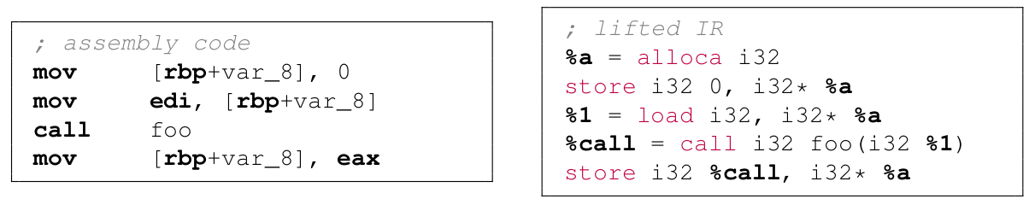
Taxonomy: Succinct-style Lifting
Try to recover variables and types
But do not guarantee correctness
E.g., [rbp + var_8] is lifted into an int32 variable.
Is it a real int32?
Notes:
Generally, there are two kinds of lifters, one is the succinct-style lifter, this kind of lifter tries to recover variables and types with the best effort, and generate IR that similar to compiler generated IR. But the lifting correctness is not guaranteed.
For example, the memory access in the assembly code is lifted into an int32 variable, however, it is not necessarily to be an int32, it could also be a pointer on the 32-bit platform.

Slide 14
Taxonomy: Emulation-style Lifting
Emulate the assembly instruction at hardware level
Ensure correctness → Complete, recompilable, and functional IR
Cons:
bloated code size
decreased speed
Notes:
Another kind of lifter is emulation-style lifters, this kind of lifter tries to emulate the assembly instruction at the hardware level. For example, the registers like RBP and EDI are represented as global variables in the lifted IR, and a simple mov instruction is translated into four IR statements which include add, load, int to pointer and store. In this way, the correctness could be guaranteed, thus it could generate complete, recompilable and functional IR. The downside is, the lifted IR will be more lengthy and thus the speed of the lifted program is decreased.

Slide 15
Taxonomy: Decompilation
“... machine-specific detail is discarded, leading to the essence of the program (source code), from which it is possible to divine a deeper truth (understanding of the program).” ^{[3]}
Notes:
Finally, at the end of reverse engineering, the lifted IR is usually fed to a decompiler as input, to produce high-level source code.
From a higher point of view, during decompilation, the machine-specific detail is discarded, leading to the essence of the program, so that the analysts can better understand the program.

Slide 16
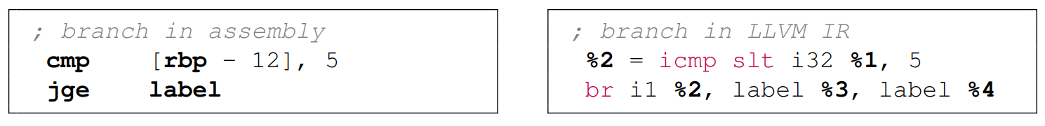
Why we need decompilation?
IR contains only basic operations (arithmetic, load, store, etc.)
The control flow in IR still remains a simple assembly-like structure.
1) + 2) makes it difficult for analysts to summarize and understand the higher-level intent of the program.
Notes:
So why is decompilation necessary? While IR is already more comprehensible than assembly code, IR contains only basic operations. Also, the control flow in IR still remains a simple assembly-like structure, as shown in the example. IR has only conditional jumps without high-level control flow structure. Overall, these characteristics make it difficult for analysts to summarize and understand the high-level intent of the program.

Slide 17
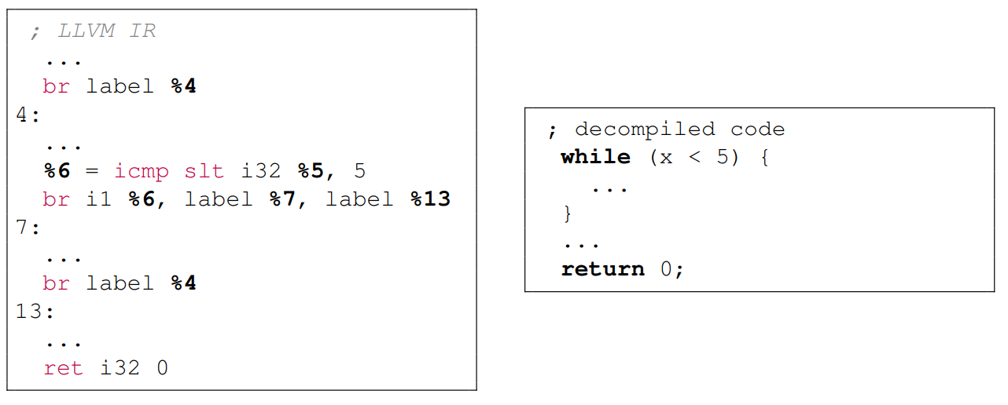
Taxonomy: Decompilation
Machine-specific detail → essence of the program
From IR (or Assembly instructions) to (pseudo) source code
Notes:
Here is an example of how to decompile LLVM IR into high-level source code. The three branch statements in IR are decompiled into a while loop. The programming language-like form makes the decompiled code easier to be understood by human analysts.

Slide 18
Outline
Preliminary Background
Problems and Challenges
Existing Solutions
Our Works
Future Direction
Notes:
After the background, now I will discuss the problems and challenges that exist in the reverse engineering pipeline.

Slide 19
Problem:
All problems in reverse engineering can be concluded into one question:
How to recover information lost during compilation?
The answers can be divided into four parts:
Differentiating Code from Data (Disassembly Stage)
Symbolization (Disassembly Stage)
Variables/Types Recovery (IR Lifting Stage)
Control-Flow Structure Recovery (Decompilation Stage)
Notes:
In the software reverse engineering pipeline, several challenges inhibit the further improvement of the accuracy and reliability.
Briefly speaking, the challenges can be summarized into one question: how to recover information lost during compilation from the stripped binary?
To answer this question, software reverse engineering researches can be divided into four different aspects. They are differentiating code from data, symbolization, variables/types recovery, and control-flow structure recovery. I'll cover each of these in more detail.

Slide 20
Challenges: Differentiating Code from Data
Code and data can be interleaved.
Code is not aligned, it can start from any offset.
Makes accurate and precise disassembly challenging ^{[33,34]}.
Code
jmp l2
Data
l1:
False Negatives
False Positives
l2:
Code and Data Layout
Linear Disassembly
Recursive Disassembly
Notes:
The first challenge is differentiating code from data. The problem is that code and data can be interleaved in x86 platform. And the code is not aligned, which means it can start from any offset.
This brings a challenge to precise and accurate disassembly. Generally, there are two kinds of classical solutions named linear disassembly and recursive disassembly, as illustrated in this example, linear disassembly will disassemble the whole section from the start to the end, causes lots of false positives. On the other hand, recursive disassembly will follow the control flow to disassemble, but may cause many false negatives.

Slide 21
Challenges: Symbolization
Symbol information is discarded during compilation.
Lacking symbol makes the disassembly code unrelocatable ^{[1]}.
.text
mov eax, 0xc0
.data
.long 0xa08
mov eax, 0xc0
unrelocatable
assemble
0xa08
mov eax, 0xc0
0xc0:
unknown
.text
mov eax, Glob
.data
Glob:
.long 0xa08
0xc0:
0xa08
mov eax, Glob
assemble
Binary
relocatable
Glob:
0xa08
Notes:
Another challenge is symbolization, as we briefly discussed in the background, Reassembleable Disassembly requires all symbols to be recovered. The symbol information is discarded during compilation. This figure illustrates the unrelocatable code, the symbol Glob is not recovered, thus the eax will point to an unknown value after assembly, and thus breaking the function of the reassembled program.
To reassemble the disassembly code, we have to solve symbolization problem first.

Slide 22
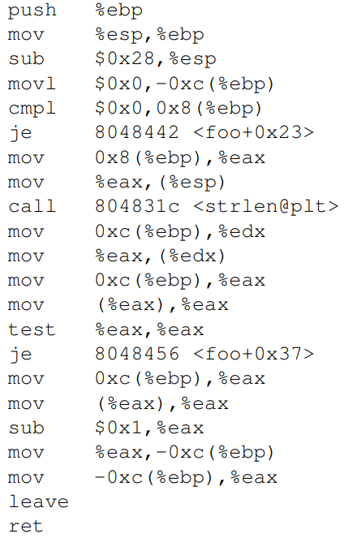
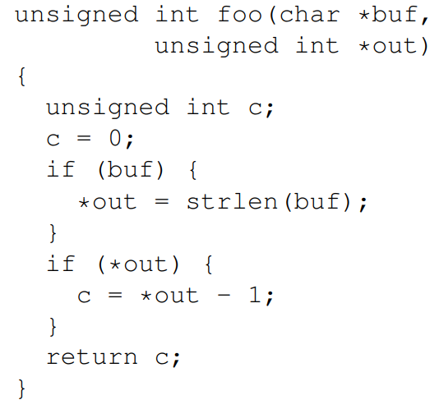
Challenges: Variables Recovery ^{[19]}
Recognize variables from memory access in assembly instructions.
Because compiler optimization, heuristics methods are not fully reliable.
(a) Source Code
(b) Disassembled Code
Notes:
A variable in source code could be mapped to a low-level register or a memory offset after compilation. Classifying a register or memory offset as a variable is known as the variable recovery problem.
In this example, we have to dynamically or statically analyze the disassembled code to recognize variables from memory access, one typical access pattern is accessing a memory block with the EBP register. However, because of the compiler optimization, heuristics methods are error-prone and not fully reliable.

Slide 23
Challenges: Types Recovery
Type information is discarded at compile time.
Variable of different types may correspond to similar assembly.
Indistinguishable.
Typical methods seek to infer types from context.
int a;
a = 0;
pushq %rbp
movq %rsp, %rbp
subq $32, %rsp
movl $0, -4(%rbp)
char * c_ptr;
c_ptr = NULL;
Notes:
Similarly, recovering types from stripped binary is challenging. Variables of different types may correspond to similar assembly instructions, in this example, the integer variable and pointer variable both have the same length and they will be compiled into the similar assembly instruction that mov zero to a memory block, it is generally not distinguishable, so typical methods seek to infer types from context.

Slide 24
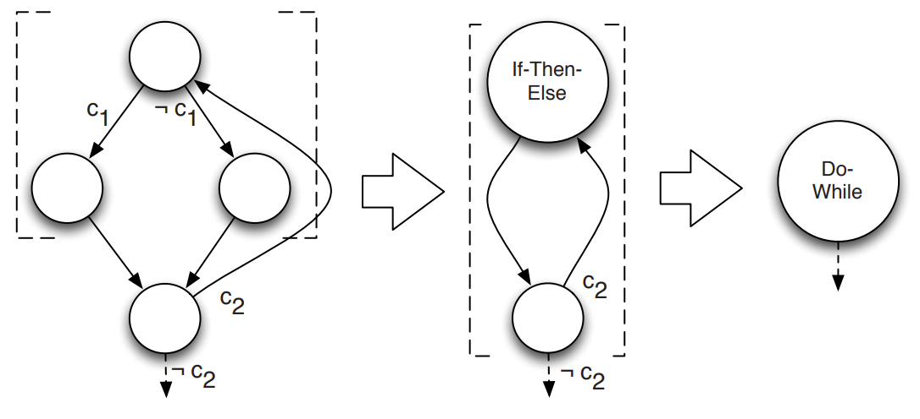
Challenges: Control-Flow Structure Recovery
Recover high-level structure from low-level Control Flow Graph (CFG) ^{[4]}.
Control flow information is generally available from binaries.
Notes:
The last problem is control-flow structure recovery.
In the decompilation stage, high-level control flow structures such as loops, if-then-else, and switch will be recovered from the Control Flow Graph (CFG) form. This problem is relatively easy to solve because all control flow information is generally available from binaries. Actually, there is already semantic-preserving structural analysis that can recover high-level structure without semantic loss.

Slide 25
Outline
Preliminary Background
Problems and Challenges
Existing Solutions
Our Works
Future Direction
Notes:
Then after discussing the challenges, in this section I will present existing solutions that try to solve these problems.

Slide 26
Solutions: Disassembly and Rewriting
Differentiating Code from Data:
Superset disassembly, Probabilistic disassembly (Multiverse, NDSS’18)
Datalog disassembly (Ddisassm, USENIX Sec’20)
Machine Learning based disassembly (XDA, NDSS’21)
Symbolization (Binary Rewriting):
Heuristics based (Uroboros, USENIX Sec’15)
(Ramblr, NDSS’17)
Position-Independent Code (PIC) information based (RetroWrite, S&P’20)
(Egalito, ASPLOS’20)
Extra Segment (Multiverse, NDSS’18)
Instruction-level instrumentation (E9Patch, PLDI’20)
Dynamic verification (StochFuzz, S&P’21)
Notes:
I will follow the reverse engineering pipeline to discuss the existing solutions. First, I will present the advanced disassembly techniques. Then I will discuss research related to the symbolization problem, since symbolization is usually used to reassemable disassembled code back to a functional program, this kind of research can also be categorized as binary rewriting research.

Slide 27
Solutions: IR Lifting
Lifters:
Static lifter (SecondWrite, EuroSys’13)
Dynamic lifter (BinRec, EuroSys’20)
Industrial Lifters (McSema, RetDec)
Variables and Types Recovery:
Dynamic approaches (Rewards, NDSS’10)
(Howard, NDSS’11)
Static approaches (TIE, NDSS’11)
(Retyped, PLDI’16)
ML-based approaches (Debin, CCS’18)
State-of-the-art (Osprey, S&P’21)
Lifters Verification:
Semantic based verification [Dasgupta et al., PLDI 2020]
Notes:
Then I will present research related to IR lifting. I will give a brief introduction about existing lifters. Then discuss different dynamic, static and machine learning-based approaches that are used to recover variables and types. After that I will shortly talk about the lifter verification research which is able to check the semantic correctness of IR statements lifted by lifter.

Slide 28
Solutions: Decompilation
Control Flow Structuring:
Semantic-preserving structural analysis (Phoenix, USENIX Sec’13)
Semantic-preserving goto-free transformation (Dream, NDSS’15)
Advanced CFG Recovery:
Customized Points-to Analysis (BPA, NDSS’21)
Meaningful Variable Names:
ML-based approach (DIRE, ASE’19)
Notes:
As for the decompilation part, I will first discuss the most important research related to structural analysis, which almost solved the control-flow structuring problem. Then I will talk about advanced CFG recovery and a ML-based work that try to recover meaningful variable names in decompiled code for better readability.

Slide 29
Solutions: Disassembly and Rewriting
Differentiating Code from Data:
Superset disassembly, Probabilistic disassembly (Multiverse, NDSS’18)
Datalog disassembly (Ddisassm, USENIX Sec’20)
Machine Learning based disassembly (XDA, NDSS’21)
Symbolization (Binary Rewriting):
Heuristics based (Uroboros, USENIX Sec’15)
(Ramblr, NDSS’17)
Position-Independent Code (PIC) information based (RetroWrite, S&P’20)
(Egalito, ASPLOS’20)
Extra Segment (Multiverse, NDSS’18)
Instruction-level instrumentation (E9Patch, PLDI’20)
Dynamic verification (StochFuzz, S&P’21)
Notes:
OK, so first let's start with the disassembly problem.

Slide 30
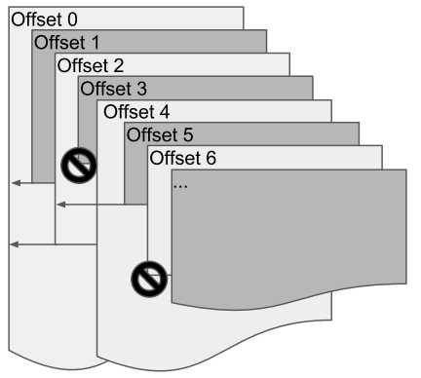
Solutions: Superset Disassembly ^{[5]}
Linear/Recursive disassembly: False Positives/Negatives
Superset: takes every offset in the text segment as one possible start of an instruction. (superset instructions)
No false negative.
Decreased performance.
Notes:
The linear and recursive disassembly introduced in the background both may cause some false positives or false negatives. To tackle this problem, Superset disassembly is proposed to guarantee zero false negative. To do so, superset disassembly takes every offset in the text segment as one possible start of an instruction. These instructions are called superset instructions. However, this approach will generate lots of false positives, and thus significantly decrease the performance of disassembled program.

Slide 31
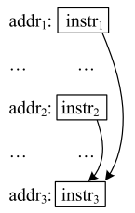
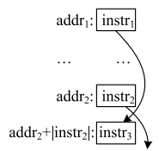
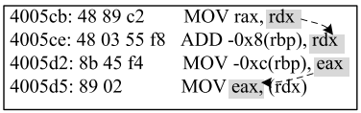
Solutions: Probabilistic Disassembly ^{[6]}
Superset Disassembly + hints-based probabilistic inference.
No false negative, less false positives.
(a) Hint I: Control Flow Convergence.
(b) Hint II: Control Flow Crossing.
(c) Hint III: Register Define-use Relation.
Notes:
To reduce the number of false positives, a subsequent work named probabilistic disassembly is proposed. This work is based on the superset disassembly and hints-based probabilistic inference.
The basic idea is to compute the probabilities of each address being the true positive.
They define three hints that imply true positive instructions and assign prior probabilities to these hints, then perform probabilistic inference to summarize the confidence of true positives from these hints.
As shown in the figure, if control-flow convergence or crossing and register define-use relation is observed, it implies that these instructions involved are very likely to be true positives.

Slide 32
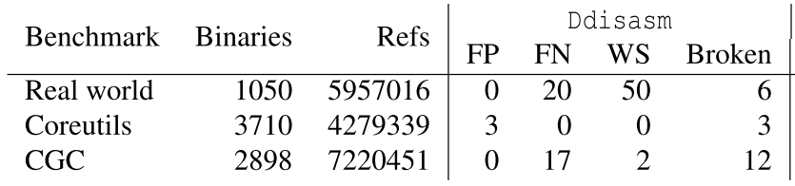
Solutions: Datalog Disassembly ^{[7]}
Ddisasm: Based on the Datalog language.
Combines heuristics and static analyses.
With accuracy higher than 99%.
Has false positives/negatives.
Refs: total number of references.
FP: False Positives.
FN: False Negatives.
WS: the number of references pointing to the wrong section.
Broken: number of broken binaries.
Question
Notes:
Besides the slow but false negative free superset disassembly approaches, some research aims to disassembly faster while keeping a low false positives/ negatives rate. Datalog Disassembly is a framework based on Datalog language, it combines static analysis and heuristics, achieving low false positives and false negatives rates while still fast enough.
The beauty of Datalog is that it allows all analyses and heuristics to be separately specified as logic rules; the Datalog engine then performs a fixed point calculation to compute the final outcome in an iterative fashion, without programmer involvement. This framework takes advantage of Datalog, enabling faster empirical evaluation of new heuristics and analyses.
(Performance penalty?)

Slide 33
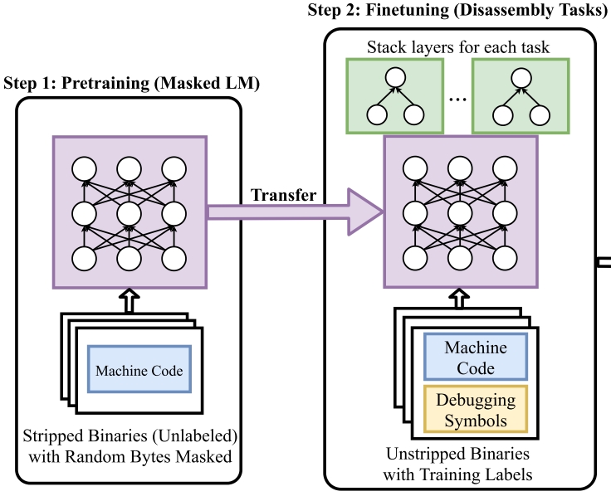
Solutions: ML-based Disassembly ^{[8]}
XDA: Transfer Learning
Use dependencies learned from machine code.
Faster than existing tools only with expensive GPUs.
False positives/negatives cannot be fixed.
(no need to manually label data).
Notes:
In addition to the disassembly based on binary analysis, machine learning is also used in disassembly. XDA leverages transfer learning to use the dependencies learned from machine code for accurate disassembly. Although this framework surpasses SOTA disassemblers on both speed and accuracy, errors in results cannot be easily fixed without retraining the model. Also, it requires expensive GPUs to outperform existing tools on speed.

Slide 34
Solutions: Disassembly and Rewriting
Differentiating Code from Data:
Superset disassembly, Probabilistic disassembly (Multiverse, NDSS’18)
Datalog disassembly (Ddisassm, USENIX Sec’20)
Machine Learning based disassembly (XDA, NDSS’21)
Symbolization (Binary Rewriting):
Heuristics based (Uroboros, USENIX Sec’15)
(Ramblr, NDSS’17)
Position-Independent Code (PIC) information based (RetroWrite, S&P’20)
(Egalito, ASPLOS’20)
Extra Segment (Multiverse, NDSS’18)
Instruction-level instrumentation (E9Patch, PLDI’20)
Dynamic verification (StochFuzz, S&P’21)
Notes:
Then let's talk about the research related to symbolization.

Slide 35
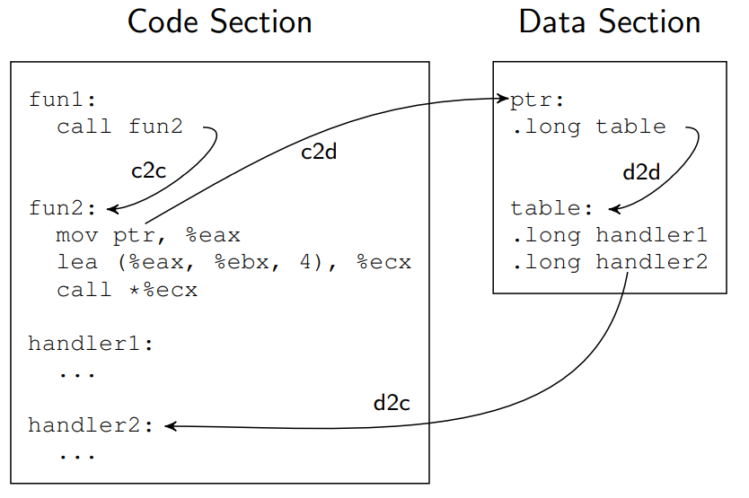
Solutions: Reassembleable Disassembly ^{[9,10]}
Uroboros defines four types of symbol references.
c2c (code-to-code)
c2d (code-to-data)
d2c (data-to-code)
d2d (data-to-data)
Zero code size explosion.
No speed slowdown.
Ramblr proposes more heuristics.
Notes:
Uroboros was the first disassembler tries to recover symbol information from striped binaries automatically. This figure illustrates c2c, c2d, d2d, and d2c in total four types of symbol references defined in Uroboros. To solve the symbolization problem, Uroboros summarizes several heuristics to distinguish these four types and thus can successfully rewrite real-world programs, with almost zero code size explosion and speed slowdown.
Ramblr further extended this method with more heuristics, however, it did not
go beyond the inherent limitations of heuristics and was still error-prone on different versions of compilers generated binaries.

Slide 36
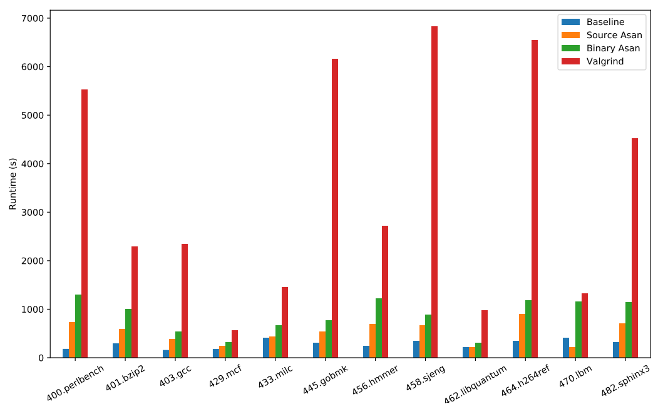
Solutions: PIC Binary Rewriting ^{[11,12]}
RetroWrite and Egalito leverages relocation information exist in PIC binaries.
Without heuristics.
Sound and scalable.
Able to support
Binary + Asan with low
overhead.
Notes:
Since efficient and error-free static rewriting on general binaries is difficult.
Some subsequent research turns to narrow down their research scopes to 64-bit PIC binaries only to avoid solving the challenging symbolization problem. RetroWrite and Egalito leverage relocation information existing in PIC binaries to identify symbolizable constants without heuristics.
In this way, RetroWrite presents a sound and scalable symbolization approach, which makes it robust enough to support multiple security-critical downstream applications, such as AddressSanitizer and coverage-guided grey-box fuzzing with relatively low overhead.

Slide 37
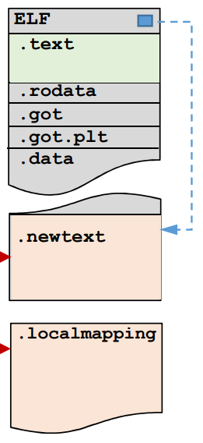
Solutions: Extra Segment^{[5]}
Multiverse bypasses the symbolization problem by adding an extra .newtext segment.
No need to recover symbols.
Bloated code size and performance slowdown.
Jump to .newtext when start.
Mapping from old addresses in .text to new addresses in .newtext
Notes:
Except for recovering symbol information precisely, another line of research tries to sacrifice code size and performance for stable binary rewriting. For example, MULTIVERSE appends the disassembled code and a mapping after the original binary as the .newtext segment and .localmapping segment, as illustrated in the figure, the new binary is set to start from the new text segment, and the binary rewriting is achieved without recovering symbols.

Slide 38
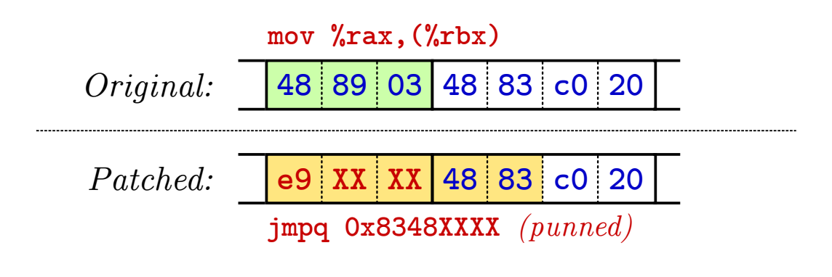
Solutions: Instruction-level Instrumentation^{[13]}
E9Patch inserts jumps to trampolines, while not changing layout.
No need to recover control flow or symbols.
Flexible static x86 rewriting. (scalable to large binaries)
However, not all instructions can be patched.
Notes:
On the other hand, E9PATCH introduced a new idea to achieve binary rewriting without
control flow recovery. For the purpose of more flexible static x86-64 binary rewriting,
E9PATCH insert jumps to trampolines while not changing the layout of the program. Since this
approach does not need a control-flow graph or any binary analysis, it can be easily applied to large-scale binaries. However, it is still limited as not all x86 instructions could be patched.

Slide 39
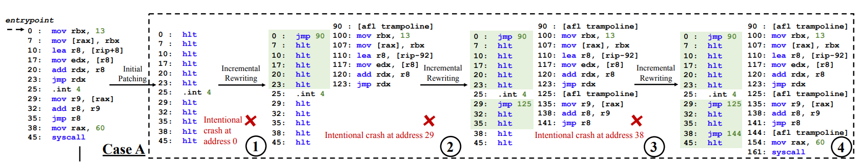
Solutions: Dynamic Approach ^{[14]}
StochFuzz generates many versions of binaries based on different assumptions (a symbol is code or data).
Dynamically fuzz each binary to see if there is unexpected runtime behavior.
① ② ③ ④ are different versions of binaries.
Notes:
In addition to all the static methods discussed above, one recent research proposed a dynamic method named stochfuzz, to solve the symbolization problem. This method accomplishes symbolization based on observation of runtime behavior, it dynamically verifies whether an address corresponds to data or code. Specifically, it generates many versions of binaries based on different assumptions, then dynamically fuzz each binary to see if there is unexpected runtime behavior.

Slide 40
Solutions: IR Lifting
Lifters:
Static lifter (SecondWrite, EuroSys’13)
Dynamic lifter (BinRec, EuroSys’20)
Industrial Lifters (McSema, RetDec)
Variables and Types Recovery:
Dynamic approaches (Rewards, NDSS’10)
(Howard, NDSS’11)
Static approaches (TIE, NDSS’11)
(Retyped, PLDI’16)
ML-based approaches (Debin, CCS’18)
State-of-the-art (Osprey, S&P’21)
Lifters Verification:
Semantic based verification [Dasgupta et al., PLDI 2020]
Notes:
That's all of the disassembly part, now I am going to discuss some works related to IR lifting.

Slide 41
Solutions: Lifters ^{[15,16]}
ScondWrite: first static succinct-style lifter. (not available)
Value Set Analysis (VSA)
Not scalable
BinRec: first dynamic emulation-style lifter.
100% functional on covered traces.
Huge overhead
McSema: static, emulation-style lifter developed by industry.
Lengthy, but reliable
RetDec: static, succinct-style lifter developed by industry.
Succinct, but error-prone
Notes:
In this slide, I list four lifters developed by academia and industry. The SecondWrite is the first static succinct-style lifter, it leverages VSA for variable recovery, which is believed as not scalable and precise enough on large binaries.
BinRec is a recent dynamic emulation-style lifter, it can generate IR that 100% percent functional on covered traces. However, it has a huge overhead, also the coverage is a problem.
McSema and RetDec are two lifters developed by industry, mcsema generates more lengthy IR but with higher reliability, RetDec, on the other hand, generates succinct IR but with lower reliability.

Slide 42
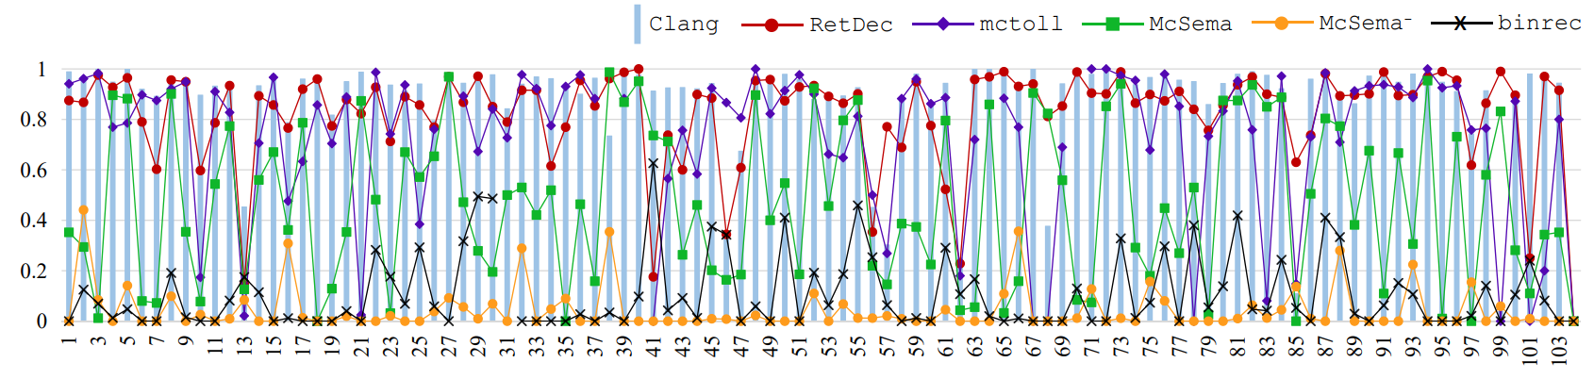
Solutions: Lifters
Although succinct-style lifters can hardly generate functional IR.
These lifters show encouraging support for classification task.
Classification analysis results. We report accuracy of each tool across all 104 classes of the POJ-104 dataset with Neural Code Comprehension (NCC) ^{[32]}.
Notes:
According to our evaluation, although succinct-style lifters can hardly generate functional IR, these lifters show encouraging support for some security downstream applications like discriminability analysis. We leverage the Neural Code Comprehension model to use different IR generated by different lifters for classification analysis.
As shown in this figure, red dots that represents RetDec IR is closer to the grey bar that represents compiled IR, which means lifters such as RetDec can generate IR code manifesting comparable quality with compiled IR.

Slide 43
Solutions: IR Lifting
Lifters:
Static lifter (SecondWrite, EuroSys’13)
Dynamic lifter (BinRec, EuroSys’20)
Industrial Lifters (McSema, RetDec)
Variables and Types Recovery:
Dynamic approaches (Rewards, NDSS’10)
(Howard, NDSS’11)
Static approaches (TIE, NDSS’11)
(Retyped, PLDI’16)
ML-based approaches (Debin, CCS’18)
State-of-the-art (Osprey, S&P’21)
Lifters Verification:
Semantic based verification [Dasgupta et al., PLDI 2020]
Notes:
Now we discuss the solutions that try to solve the challenging variables and type recovery problem.

Slide 44
Solutions: Dynamic Approaches ^{[17,18]}
Rewards use a dynamic type sink technique.
Type sink: a point where the type of one variable can be resolved
E.g., (1) system call, (2) standard library call, and (3) type-revealing instructions
Howard aims to recover data structures from memory access patterns in execution traces.
KLEE and test suites are used for traces generation.
Limited by coverage issue.
Notes:
As one dynamic method, REWARDS uses a "type sink" technique to reveal program data structures from binaries automatically. To be more specific, if a "type sink" that can resolve a variable's type is executed, the type information will be back propagated to all its references. Similarly, another dynamic solution, Howard, aims to recover data structures from memory access patterns in execution traces.
These dynamic approaches, while effective, are limited by the coverage issue.

Slide 45
Solutions: Static Approaches ^{[19,20]}
TIE defines a set of type inference rules to generate constraints.
First use heavy-weight data flow analysis to recover variables.
Then type inference rules are used to generate constraints for variables.
Constraints are solved to get the types.
Retypd use similar type inference system that support more advanced types, including recursive types and subtyping.
Inference rules example: If variable e is used in a unary negative operator, the type of e τ_{e} is at least intn_t and the result type τ is as most intn_t.
Notes:
TIE proposes an end-to-end type inference system.
It first use heavy-weight data flow analysis to recover variables. Then type inference rules are used to generate constraints for variables. Finally, constraints are solved to get the types.
TIE can produce accurate and conservative results, however, the heavy-weight data flow analysis used for variable recovery makes it less practical on large binaries. Similarly, Retypd also uses type inference rules for type recovery, except it supports more advanced types, including recursive types and subtyping.

Slide 46
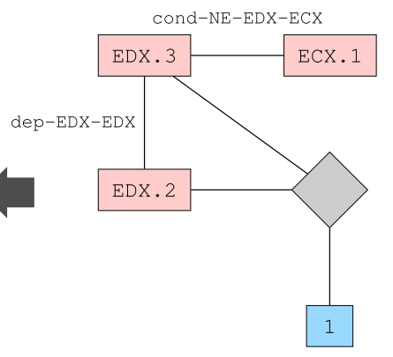
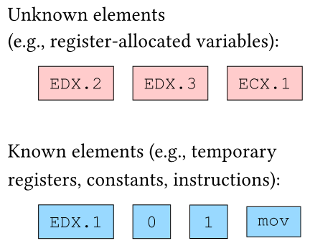
Solutions: ML-based Approaches ^{[21]}
Debin presents the first ML-based approach to predict debugging information. (68.8% precision and 68.3% recall on x64 platform)
Extract known/unknown elements from code.
Build Dependency Graph and predict debugging info on it with Extremely randomized Tree (ET) model.
Notes:
Machine learning has also been applied to recover variables and types.
DEBIN presents the first machine-learning-based approach to predict debugging information from stripped binaries.
It first extracts known/unkonwn elements from code, then builds a dependency graph and predicts debugging information on it with Extremely randomized Tree model. This approach effectively predicts symbol names and types with around 68% precision and recall on the x64 platform.

Slide 47
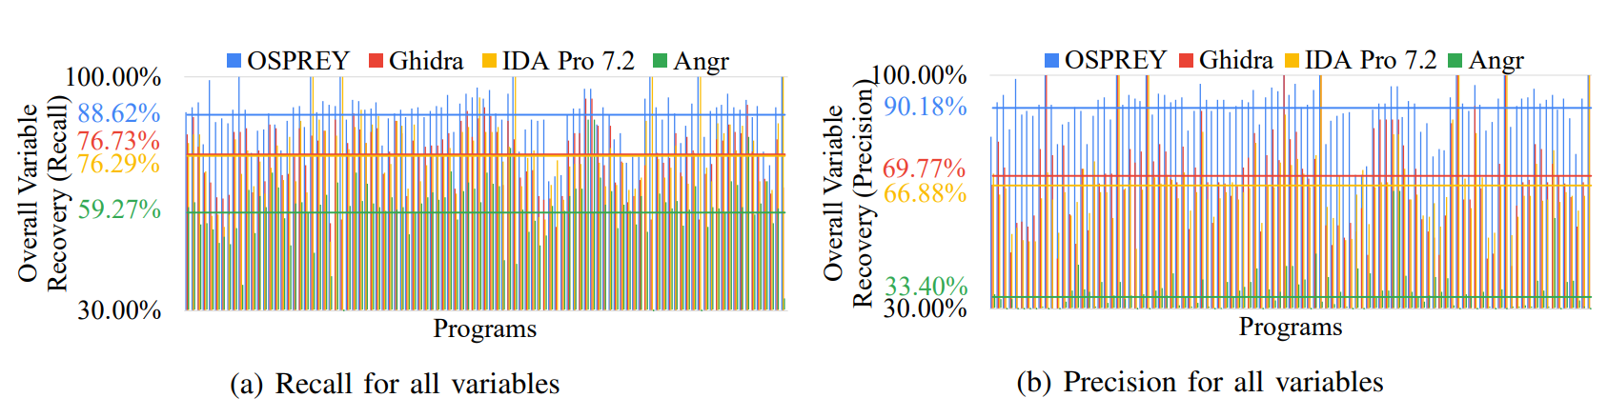
Solutions: State-of-the-art ^{[23, 24]}
Osprey leverages the advanced points-to analysis instead of VSA for variables recovery.
Path Sampling Driven Per-path Abstract Interpretation (BDA)
Introduce random variables in type inference system to model the probability that a memory location is of specific type.
Notes:
As for the state-of-the-art method, osprey leverages the path sampling driven per-path abstract interpretation instead VSA for variable recovery. It then introduces random variables in type inference system for type recovery, this tool achieves around 90 percent precision, largely outperforms expensive commercial tools.

Slide 48
Solutions: IR Lifting
Lifters:
Static lifter (SecondWrite, EuroSys’13)
Dynamic lifter (BinRec, EuroSys’20)
Industrial Lifters (McSema, RetDec)
Variables and Types Recovery:
Dynamic approaches (Rewards, NDSS’10)
(Howard, NDSS’11)
Static approaches (TIE, NDSS’11)
(Retyped, PLDI’16)
ML-based approaches (Debin, CCS’18)
State-of-the-art (Osprey, S&P’21)
Lifters Verification:
Semantic based verification [Dasgupta et al., PLDI 2020]
Notes:
Next, let's take a look at the lifter verification framework.

Slide 49
Solutions: Lifter Verification ^{[25]}
x86 instruction
Dasgupta et al. proposed semantic-based lifter verification framework.
Based on a complete formal semantics of x86-64 instructions.
Symbolic Execution
Z3 solver to solve symbolic constraints
Asm
Asm
Lifter (McSema)
Symbolic Execution
IR
Symbolic Execution
Symbolic Summary_{x86-64}
Symbolic Summary_{ir}
Verification Condition Generator
Z3 solver
z3.solve(summary_{x86-64} != summary_{ir})
Notes:
This framework is based on a complete formal semantics of x86 instructions. The assembly instructions and lifted IR are processed with symbolic execution to get constraints, then Z3 solver is used to check if two constraints from assembly and IR could be not equivalent. In this way the semantic correctness of lifter can be verified.

Slide 50
Solutions: Decompilation
Control Flow Structuring:
Semantic-preserving structural analysis (Phoenix, USENIX Sec’13)
Semantic-preserving goto-free transformation (Dream, NDSS’15)
Advanced CFG Recovery:
Customized Points-to Analysis (BPA, NDSS’21)
Meaningful Variable Names:
ML-based approach (DIRE, ASE’19)
Notes:
Finally, let's look at the works related to decompilation.

Slide 51
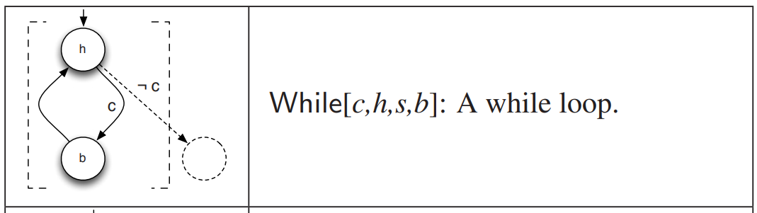
Solutions: Structural Analysis ^{[26]}
Recovering high-level control flow structure is relatively easy.
Control-flow information is not discarded during compilation.
Phoenix first propose a set of sematic-preserving structural patterns that transfer a sub-CFG into high-level structure. E.g.,
Notes:
Based on the lifted high-level IR, the critical step to translate IR to programming language is control flow structuring. The CFG is first reconstructed, then the structural analysis is employed to refine and summarize CFG nodes into high-level control flow structure such as if-then-else constructs and loops. Phoenix first proposes a set of semantic-preserving structural patterns that transfer a sub-CFG into a high-level structure. As shown in this example, the sub-CFG is summarized as a While loop.

Slide 52
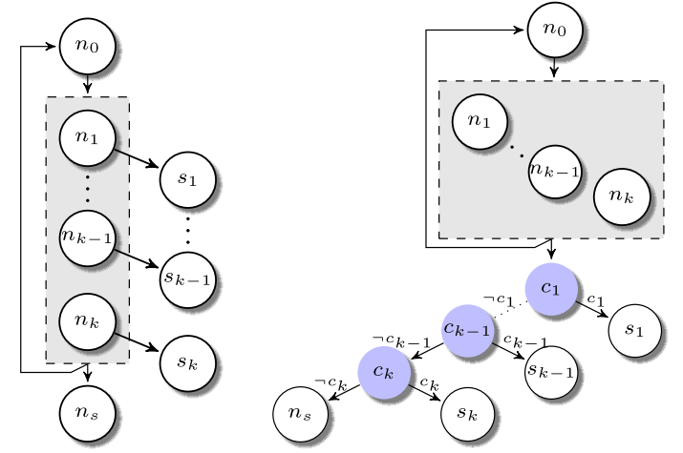
Solutions: Goto-Free Structural Analysis ^{[27]}
Dream further extended this method.
The semantic-preserving transformation:
Cyclic (multiple-entries or multiple-successors) subgraphs → acyclic (single-entry and single-successor) subgraphs.
Pattern-independent structuring.
Results without goto statement.
Notes:
On top of this idea, DREAM extends the structuring technique with sematic-preserving transformations that transform cyclic subgraphs with multiple entries or multiple successors into semantically equivalent single-entry single-successor (acyclic) subgraph. DREAM also presents a pattern-independent structuring algorithm that is able to recover all high-level control constructs in acyclic regions. With these two techniques, Dream can produce goto-free decompiled code.

Slide 53
Solutions: CFG Recovery ^{[31]}
Indirect jumps make the CFG recovery more challenging.
A precise and scalable binary-level points-to analysis is necessary.
VSA is highly conservative and not scalable.
Kim et al. proposed BPA (Binary-level Points-to Analysis) for high-precision CFGs construction.
Notes:
Another work is CFG recovery. Indirect jumps pose a threat to CFG recovery. A precise and scalable binary-level points-to analysis is necessary to statically recover CFG when indirect jumps exist. While state-of-the-art Value Set Analysis (VSA) is highly conservative and not scalable, BPA is proposed to replace VSA for high-precision CFGs construction. BPA achieves higher accuracy and scalability, which points out the possibility of reverse engineering on complex binaries with indirect jumps.

Slide 54
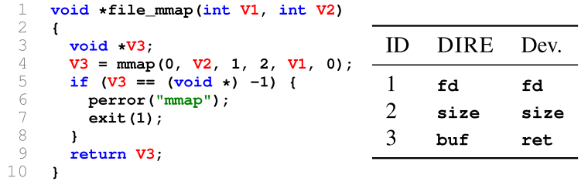
Solutions: Variable Names Recovery ^{[28]}
DIRE use an encoder-decoder network to recover meaningful names.
Based on the lexical and structural information of decompiled code.
Around 70% accuracy on 164k programs collected from Github.
Does not change the semantics, it can highly increase code readability.
Notes:
Besides the structuring techniques and CFG recovery, another work named DIRE uses an encoder-decoder network to reconstruct semantically meaningful variable names based on the lexical and structural information produced by the decompiler. While this method does not change the semantics of decompiled code, it can highly increase code readability.

Slide 55
Outline
Preliminary Background
Problems and Challenges
Existing Solutions
Our Works
Future Direction
Notes:
That's all the literature survey part of the presentation, before talking about future directions, I also would like to introduce some of our works on reverse engineering tasks.

Slide 56
Our Works:
Decompiler Testing (ISSTA 2020):
we test decompilation correctness of four best commercial and open-source C decompilers ^{[35]}.
Type inference still impedes C decompilers from generating correct outputs.
Lifter Benchmarking (S&P 2022):
Previous works only verify the correctness of binary lifters.
We demystify the expressiveness of binary lifters ^{[36]}.
With three downstream applications (pointer analysis, discriminability analysis, and decompilation).
Notes:
Our first work is about decompiler testing, we test decompilation correctness of the four best commercial and open-source C decompilers, and find that type inference still impedes C decompilers from generating correct outputs.
Another work is about lifter benchmarking, unlike previous work that only verify the correctness of binary lifters, we demystify the "expressiveness" of binary lifters with three downstream applications, including pointer analysis, discriminability analysis, and decompilation.
Our evaluation shows that modern lifters are suitable for discriminability analysis, but unsuited to rigorous static analysis.

Slide 57


Our Works:
DNN Decompiler (USENIX Sec 2022, under review):
DL compilers are proposed to compile DL models into standalone executables to leverage hardware primitives.
We developed a decompiler that relies on dynamic traces based symbolic execution.
The recover model specifications can be used to boost attacks, such as Adversarial Example generation and knowledge stealing.
Notes:
Our third work is a DNN executable decompiler. Recently, Deep learning compilers have been designed to compile DL models into standalone executables to leverage low-level hardware primitives. We developed a decompiler that relies on dynamic traces-based symbolic execution to recover model specifications from DNN executables.

Slide 58
Outline
Preliminary Background
Problems and Challenges
Existing Solutions
Our Works
Future Direction
Notes:
Finally, I will discuss one potential future research direction.

Slide 59



Possible Future Direction:
Lifted IR optimization:
 | Functionality | Expressiveness
Compiler IR | 100% | 100%
Emulation-style IR | High | Low
Succinct-style IR | Low | High
Optimized Emulation-style IR | Still High | Improved
LLVM optimization passes
Downstream Applications
Similarity analysis, function summary…
Notes:
One of the possible research directions is lifted IR optimization, as I presented, emulation-style IR is functional and recompilable but not comprehensible, while the output of succinct-style lifters is relatively analysis-friendly but without correctness guarantee. To combine the best of both, we envision that transformation passes provided by the LLVM framework could be applied to optimize emulation-style IR to support downstream applications better.

Slide 60
Conclusion:
We conclude and summarize the main challenges.
We present the existing solutions in three main stages of the reverse engineering pipeline.
We introduce our previous works and potential research direction.
Notes:
In conclusion, in this survey we conclude and summarize the main challenges that exist in reverse engineering tasks. We also present the existing solutions in three main stages of the reverse engineering pipeline. Finally, we introduce three of our previous works, and one potential future research direction.

Slide 61

Notes:
That's the end of my presentation. I would be glad to take some questions now.

Slide 63


Slide 64


Industry Adoption & Commercialization
1
2
3
4
IDA-Pro:
1879 USD/year
JEB Pro:
1800 USD/year
RetDec
Ghidra
Popular market.
Ghidra is developed by NSA.
Tencent’s malware analysis platform requires IDA-Pro or Ghidra as the frontend.

Slide 65
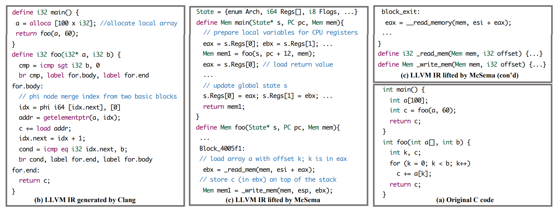
Emulation-style IR lifted by McSema ^{[2]}

Slide 66
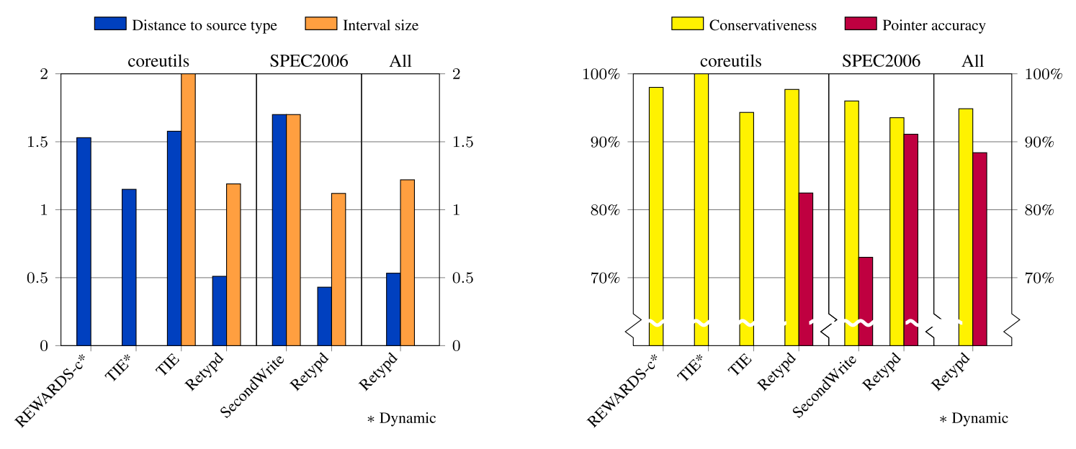
Solutions: Static Approaches ^{[19,20]}
TIE defines a set of type inference rules to generate constraints.
Retypd use similar type inference rules that support more advanced types, including recursive types and subtyping.
Lower distance, smaller interval size.
Higher conservativeness and pointer accuracy.

Slide 67
Solutions: Neural Decompiler ^{[29]}
Coda tries to get decompiled code from assembly code directly.
However, challenges mentioned previously are not solved.
And the metric used, Token Accuracy, cannot be considered as semantic or functional correctness metric.
We believe that neural networks are not ready for the end-to-end decompilation task.

Slide 68
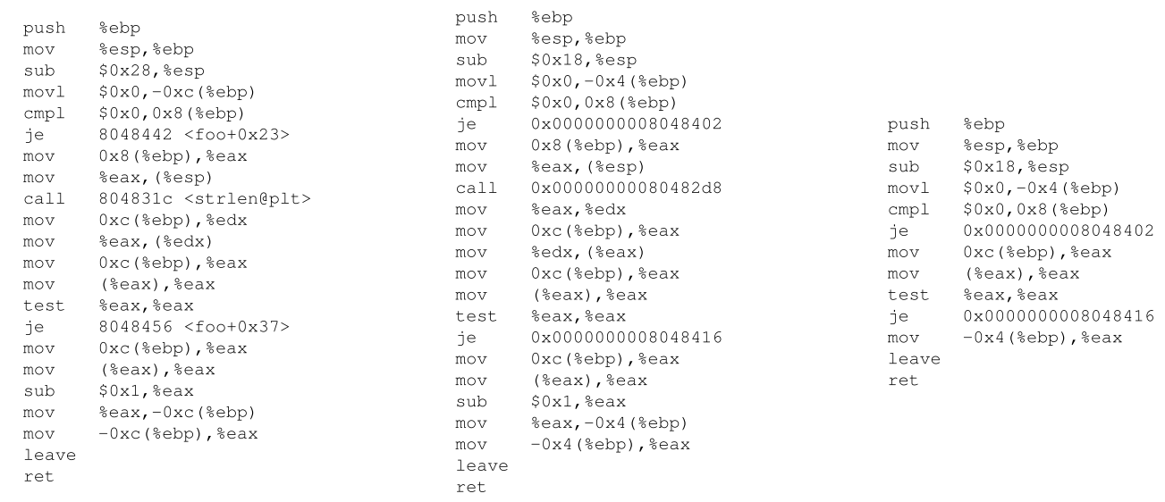
Solutions: Dynamic Approaches
Dynamic approaches are limited by coverage issues.
(a) Program.
(b) Trace 1.
(c) Trace 2.
Notes:
To be remove

Slide 69
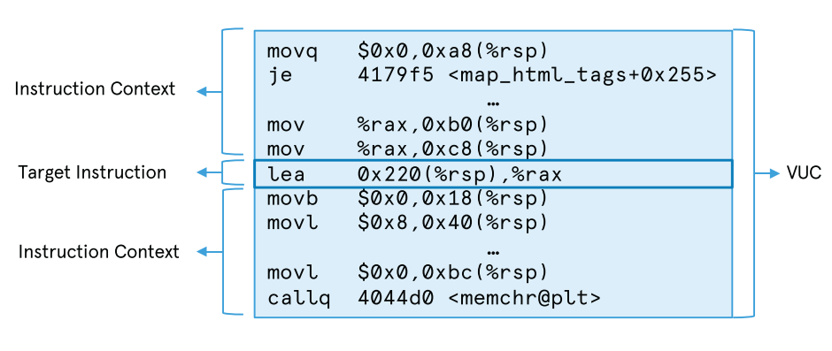
Solutions: ML-based Approaches ^{[22]}
CATI defines a new feature called Variable Usage Context (VUC).
Observations:
Neighboring instructions are likely to operate the same type of variables.
About 35% of variables have less than 3 related instructions.
71.2% accuracy.
Notes:
To be removed

Slide 70
Outline
Preliminary Background
Problems and Challenges
Existing Solutions
Advanced Topics
Our Works
Future Directions
Notes:
After discussing all the existing solutions for traditional reverse engineering on x86 binaries, I will also talk about some advanced topics a little.

Slide 71
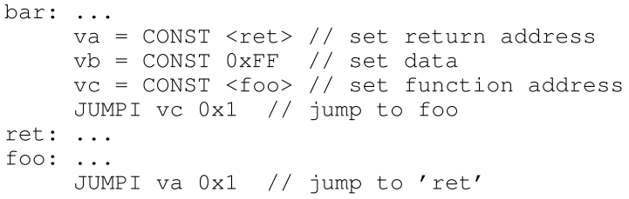
Advanced: Smart Contract Decompiler ^{[30]}
Gigahorse presents the state-ot-the-art Ethereum Virtual Machine (EVM) reverse engineering tool.
Similar pipeline as software reverse engineering on C programs
Bytecode → 3-address IR → source-level function
Generally, smart contracts’ purpose, functionality, and language features are simpler than C programs, thus we consider that it is relatively easier to decompile smart contract.
3-address IR example:
Notes:
One of the topic is Smart Contract Decompiler. Smart contracts run on blockchains, they are compiled to byte code, finally being executed by Ethereum Virtual Machine. Gigahorse presents the state-of-the-art EVM reverse engineering toolchain that can decompile smart contracts from bytecode into a high-level 3- address representation. This approach follows a similar pipeline as software reverse engineering on C programs. Generally, smart contracts' purpose, functionality, and language features are simpler, thus we consider that it is relatively easier to decompile smart contracts compared with decompiling C programs.

Slide 72
Outline
Preliminary Background
Problems and Challenges
Existing Solutions
Our Works
Future Directions
Notes:
Finally, I will discuss two potential future research directions.

Slide 73
Possible Future Directions:
Lifted IR optimization:
Fine tuning
Emulation-style
IR
LLVM optimization passes
Expressive IR
Functional and recompilable, but not comprehensible
Comprehensible, suitable for similarity analysis, while still functional
Notes:
The first one is lifted IR optimization, as I presented, emulation-style IR is functional and recompilable but not comprehensible, while the output of succinct-style lifters is relatively analysis-friendly but without correctness guarantee. To combine the best of both, we envision that transformation passes provided by the LLVM framework could be applied to optimize emulation-style IR.

Slide 74
Possible Future Directions:
Automatic Translation Rules Learning:
LLVM IR
w/ Debug Info
Semantic-based Symbolic Execution
Source Code
Compiler
Rule Candidates
Verified Rules
Lifters
Assembly
w/ Debug Info
Rules are used to develop more complete and reliable lifters.
Notes:
Another possible direction is translation rules learning, which may vastly improve existing lifters' performance. For example, we can get many pairs of IR and assembly instructions translation rule candidates with the help of the debug information generated by compiler, then it is possible to verify the semantic correctness of the translation rules with symbolic execution. These automatically learned translation rules can be used to improve and develop more complete and reliable lifters.

