Slide 1
BCSE410L • CYBER SECURITY • FINAL REVIEW
PulseGuard
A Behaviour-Aware Multi-Factor Authentication Fatigue Attack Detector
Detecting MFA fatigue attacks (MITRE ATT&CK T1621) by analysing abnormal authentication request frequency and how the user responds, then forcing a step-up before the capitulating approval lands.
PRESENTED BY
FACULTY
SCHOOL
REVIEW
Yash Sehrawat
Dr. Arun Prasath G
SCOPE, VIT
Final Review
Notes:
Good morning. I am Yash Sehrawat, and this is the final review of PulseGuard, a detector for MFA fatigue attacks. In Review I we proposed the idea; today I will show the built system, how we evaluated it, and what the numbers actually support, including where they do not.

Slide 2
What is an MFA fatigue attack?
02 • INTRODUCTION
An attacker who already holds a valid password floods the victim with push prompts until one is approved. No cryptography is broken: the target is human habituation.
1
2
3
Credential acquisition
Prompt flooding
Capitulation
Phishing, infostealer logs or a dark-web purchase. The password is already valid.
Login after login, each firing an “Approve sign-in?” push at the real user’s phone.
The user taps Approve to stop the barrage, or because a fake “IT support” caller says so. One tap opens a session.
MITRE ATT&CK T1621, Multi-Factor Authentication Request Generation. The signature: deny, deny, deny … approve.
!
Notes:
The attacker already has the password. All they lack is the second factor, which for push MFA is a single tap on the victim’s phone. So they keep triggering logins. Each one fires a prompt. The victim denies a few times, gets tired or confused, and eventually approves. Nothing cryptographic is defeated; the weak point is the human decision under load. MITRE tracks this as T1621.

Slide 3
Real incidents, and why push MFA is still everywhere
02 • INTRODUCTION
In the wild
Why the push path stays live
>99%
of account compromise attempts are blocked by MFA (Meyer et al., Microsoft, 2023). Attackers target the human step.
Uber, September 2022
Repeated Duo pushes, then a WhatsApp message posing as Uber IT. One approval gave VPN access.
Fast
Push is among the fastest and best-liked 2FA methods (Reese et al., SOUPS 2019).
Cisco, 2022
Voice phishing plus push spamming after harvesting browser-saved credentials.
Slow
Passkey and FIDO2 rollouts face real obstacles, so push fallbacks stay live for years (Lassak et al., 2024).
Scattered Spider, 2023 onward
MGM and Caesars: help-desk social engineering with push bombing (CISA AA23-320A).
Notes:
These are not lab attacks. Uber, Cisco and the Scattered Spider campaigns against MGM and Caesars all relied on push fatigue combined with social engineering. The right side explains why the problem persists: MFA is very effective overall, so attackers aim at the human approval; push is popular because it is fast and easy; and the migration to phishing-resistant passkeys is slow, so the push path remains as a fallback in most large organisations. PulseGuard defends that path during the migration.

Slide 4
Problem statement
03 • PROBLEM STATEMENT
“Design a monitoring system that detects MFA fatigue attacks by analysing abnormal authentication request frequency and user response behaviour.”
Who needs it
What “solved” means
Enterprise identity and SOC teams running Entra ID, Okta, Duo or Ping
Universities and hospitals with large push-MFA populations
MFA and identity vendors needing detection above prompt hardening
Detect the attack while it is in progress, not in a weekly report
Act before the capitulating approval opens a session
Keep false alarms rare and never lock out the real user
Notes:
This is the problem statement we were given. We read it as three requirements. First, detection has to be in-band: the alert is useless if it arrives after the attacker is logged in. Second, it has to act before the approval, which is why PulseGuard is wired to force a step-up challenge. Third, false positives and lockouts matter as much as recall, because a detector that annoys or locks out real users gets switched off.

Slide 5
Why today’s defences fall short
03 • PROBLEM STATEMENT
1
Prompt hardening is not detection
2
Fixed SIEM thresholds are brittle
Number matching raises the cost of approving but raises no alarm. In a 65-person study users still approved about half of simulated attacks under compare-and-confirm.
“More than 9 prompts in 10 minutes” is applied to every user alike: noisy on busy users, blind to an attacker who simply slows down.
3
FIDO2 migration is incomplete
4
No labelled dataset exists
Passkeys are the right end state, but legacy and fallback push paths stay live in large tenants, and attackers downgrade users onto them.
No public data has push floods with approve/deny decisions, so no prior work reports precision, recall or false-positive rate for this attack.
Notes:
Four challenges shape the design. Hardening the prompt helps but does not tell anyone an attack is happening, and users still make mistakes under it. Fixed SIEM rules treat every user the same, which fails in both directions. FIDO2 does not remove the push path during migration. And without a labelled dataset nobody can say how accurate any detector is, which is why building a benchmark became part of the project.

Slide 6
43 papers across six areas
04 • LITERATURE REVIEW
Only a handful study push-MFA attacks directly, and none detects fatigue from how the user reacts. That is the opening PulseGuard fills.
9
6
7
Push-MFA attacks and usability
Phishing-resistant MFA and deployment
Risk-based auth and account takeover
Jubur 2021, 2025 · Prakash 2021 · Mahdad 2023 · DuoLungo 2026
FIDO2 usability · passkey obstacles · downgrade attacks
Freeman 2016 · Wiefling 2019–2023 · Doerfler 2019
6
7
8
Habituation and decision science
Detection systems and datasets
ML method, adversaries, SOC
Anderson 2016 · Vance 2018 · Akhawe & Felt 2013 · Ratcliff 2008
DeepLog 2017 · Ho et al. · Euler 2022 · LANL auth logs
Arp 2022 · TESSERACT · mimicry attacks · SHAP · SOC false positives
Notes:
Review I covered six papers. For the final review we widened the survey to 43 papers in six areas. Blue cards are the security literature closest to the attack; green cards are the supporting evidence from human factors, detection systems and ML methodology. The next three slides take the most important papers from each group.

Slide 7
Push-MFA attacks: the threat is real, the fixes are redesigns
04 • LITERATURE REVIEW
Paper | Key finding | Gap for PulseGuard
Jubur et al., ACM ASIA CCS 2021 [3] | Users approve attacker pushes that look like their own (HIENA attack) | Attack paper: no defence, no detector
Prakash et al., IEEE EuroS&P 2021 [4] | Redesigned “just tap” prompts counter concurrent logins | Prevention by redesign; nothing is detected
Mahdad, Jubur, Saxena, MobiCom 2023 [5] | 82.2% of cross-service attack prompts approved (20 users) | A single-prompt attack no flood detector can see
Jubur, Saxena, Reegu, IEEE TMC 2025 [6] | Compare-and-confirm, 65 users: about half of attacks still approved | Number matching alone is not enough
Prapty, Tsudik, NDSS USEC 2026 [7] | Real Duo logs, 2,559 users: 7.82 s mean push overhead | Usability only; gives real numbers to calibrate latency
Every paper here either attacks push MFA or redesigns the prompt. None monitors the user’s decisions across a session.
Notes:
The push-MFA papers establish the threat model. Jubur 2021 shows users cannot tell attacker pushes from their own. Mahdad 2023 shows a related single-prompt attack, which we list honestly as out of reach for a flood detector. The 2025 TMC paper is the strongest argument for our work: even with code matching, about half of attacks still got approved, so changing the prompt is not enough. DuoLungo gives real push response times from 2,559 users, which we use as a calibration and robustness reference.

Slide 8
Risk-based auth and detection: they score logins, not sessions
04 • LITERATURE REVIEW
Paper | Approach | Gap for PulseGuard
Freeman et al., NDSS 2016 [13] | LinkedIn’s statistical per-login risk model | Each login scored alone; no approve/deny sequence
Wiefling et al., IFIP SEC 2019 [14] | How large services deploy RBA in practice | Context features only: IP, device, time
Wiefling et al., ACM TOPS 2023 [15], [16] | RBA on a large real service; public dataset of 3.3M users, 31.3M logins | No push prompts, no decisions: our benign base
Picard, Pierre, IEEE Access 2023 [17] | RLAuth: reinforcement learning adapts the challenge level | Models context, not the user’s reaction
Doerfler et al., WWW 2019 [18] | Measured login challenges against real account takeover | Supports step-up as the response, not detection
Du et al., ACM CCS 2017 [23] | DeepLog: LSTM over system-log event sequences | Closest precedent for our Stage C sequence model
The tools exist: per-user risk scoring, step-up challenges, sequence models. Nobody has pointed them at the approve/deny sequence and its timing.
Notes:
Risk-based authentication is the closest learned approach. Freeman’s LinkedIn model and Wiefling’s studies score each login independently from context: IP, device, time. RLAuth adapts the challenge level with reinforcement learning, but it still reads context, not behaviour. Wiefling’s 2023 paper also gives us the only large public login dataset, which we use as the benign base. Doerfler shows step-up challenges work against real attackers, which supports our response design, and DeepLog is the precedent for running a sequence model over events.

Slide 9
The human side, and how to evaluate honestly
04 • LITERATURE REVIEW
Habituation is measured
Evaluation pitfalls to avoid
Anderson et al., JMIS 2016 [19]
Arp et al., USENIX Security 2022 [25]
fMRI: repeated security prompts stop being processed by the brain.
Ten ML-security pitfalls, incl. sampling bias and lab-only results.
Vance et al., MIS Quarterly 2018 [20]
Pendlebury et al., TESSERACT 2019 [26]
Habituation sets in within days and carries across warnings.
Splits must not leak information across train and test.
Akhawe, Felt, USENIX Security 2013 [21]
Wagner, Soto, ACM CCS 2002 [27]
Click-through rates and response times from millions of real warnings.
Mimicry attacks: the basis of our adaptive attacker.
Ratcliff, McKoon, 2008 [22]
Alahmadi et al., USENIX Security 2022 [29]
Diffusion model: the standard account of yes/no reaction times.
SOC analysts drown in false alarms: FPR must be a primary metric.
Notes:
Two bodies of work outside authentication shaped the project. On the left, habituation research shows repeated security prompts genuinely stop being processed, which is the cognitive basis for MFA fatigue and for our latency hypothesis. It has been measured for browser warnings, but never for push prompts. On the right, the ML-security methodology papers told us how not to fool ourselves: split by user, compare with real baselines, test against an adaptive attacker, and treat false positives as a first-class metric.

Slide 10
Existing solutions fall into two camps
04 • LITERATURE REVIEW
CAMP A · CHANGE THE PROMPT
CAMP B · COUNT THE PROMPTS
Entra number matching
Splunk rule
Default for Authenticator push since 8 May 2023. An attacker on the real login page can relay the number.
More than 9 prompts in 10 minutes.
Duo Verified Push
Elastic rule
Numeric code; step-up after repeated denials, triggered by a fixed count.
2 denials followed by a success within 10 minutes.
Compare-and-confirm, FIDO2
Generic RBA and UEBA
Prevention by redesign; uneven adoption leaves push live.
Per-login or volume baselines; no model of the response trajectory.
Camp A changes the prompt. Camp B counts the prompts. Neither reads the user’s reaction.
Notes:
Summing up the existing solutions. Vendors change the prompt: number matching, verified push, compare-and-confirm, and ultimately FIDO2. SIEM vendors count prompts with fixed rules, which we reproduce as our baselines: Splunk’s more than nine in ten minutes and Elastic’s two denials then a success. Both camps miss the third signal, which is how the user is responding.

Slide 11
Research gap
05 • RESEARCH GAP AND NOVELTY
No peer-reviewed work detects MFA fatigue by jointly modelling request frequency and user response behaviour, with reported precision, recall and false-positive rate.
01
Response behaviour is unused
02
Deployed detection is fixed thresholds
Nobody models deny runs, the capitulation sequence or decision timing across a session.
One count for every user in the tenant; no learning, no per-user baseline.
03
No labelled dataset, no fatigue curve
04
No adaptive-attacker evaluation
Habituation is measured for browser warnings, never for push floods.
Rules are evaded by pacing; nobody tests detectors against an attacker who controls timing.
Notes:
The survey supports four gaps. One: the response signal is unused by everyone. Two: what is deployed is fixed thresholds. Three: there is no labelled dataset, and nobody has measured how push response time changes under a flood. Four: nobody evaluates fatigue detection against an attacker who adapts their pacing. PulseGuard addresses all four, and I will be clear later about which ones our evidence fully closes and which still need real human data.

Slide 12
Novelty: four pillars
05 • RESEARCH GAP AND NOVELTY
1
2
3
4
Response behaviour as a learned signal
Per-user baselines and a sequence model
Closed-loop in-band mitigation
Open, seeded fatigue benchmark
Deny runs, the capitulation signature, approval latency against the user’s own history, latency drift.
EWMA latency per user replaces the global threshold; a GRU reads the event sequence.
The score forces a number-matching step-up before the approval can grant a session, and never locks the user out.
Real benign logins plus labelled attacks, with adjustable fatigue strength and a release bundle.
THE CORE IDEA
FEWER FALSE ALARMS
DETECTION → PREVENTION
REPRODUCIBLE
Notes:
The novelty stands on four pillars. The first is the core idea: treat the user’s response behaviour as a learned signal. The second replaces one tenant-wide threshold with per-user baselines and adds a sequence model. The third closes the loop: the detection score directly forces a step-up before the approval lands. The fourth is the benchmark itself, which is seeded, reproducible and released, so others can measure against it.

Slide 13
The core hypothesis: decision latency collapses under fatigue
05 • RESEARCH GAP AND NOVELTY
A fatigued approval and a genuine approval are cryptographically identical. The latency trajectory is the evidence that could tell them apart.
latency_drift_slope: a linear fit over the session’s decision latencies, strongly negative only under fatigue.
Honest status: this 5 s → 0.74 s curve is the benchmark’s assumption, not a measurement. The fatigue sweep (slide 29) tests what happens without it.
Notes:
This is the hypothesis the project started from. As a victim is worn down, careful deliberation turns into a reflexive tap, so their decision time should shrink across the burst. A legitimate user’s time should stay stationary. We capture it with the drift slope feature. I want to be upfront: the curve on this chart is the generator’s model, a median falling from about five seconds to 0.74 seconds. It is a hypothesis, and we designed the fatigue-strength sweep specifically to test whether the detector depends on it.

Slide 14
Six objectives, each with a measurable target
06 • OBJECTIVES
# | Objective | How we measure it
O1 | Build a labelled, seeded MFA-fatigue benchmark on real benign logins | Same seed reproduces the corpus row for row
O2 | Engineer frequency and response-behaviour features with per-user baselines | Ablation: frequency-only vs both families
O3 | Build a three-stage detector (statistical, XGBoost, GRU), fused, calibrated and explained | Precision, recall, FPR vs Splunk and Elastic
O4 | Mitigate in-band: force a step-up before the approval, never lock the user out | Share detected before capitulation; anti-lockout invariant
O5 | Evaluate honestly: by-user split, baselines first, FPR as a primary metric | Frozen harness; independent reproduction
O6 | Stress-test against adaptive attackers and weaker fatigue signals | Recall vs attacker pacing; fatigue-strength sweep
Notes:
These are the six objectives, each tied to a concrete measurement so the panel can check them against results later. O1 is the benchmark; O2 the features; O3 the detector; O4 the in-band response; O5 the honest evaluation protocol; and O6 the stress tests. Slide 33 comes back to this table and marks each one.

Slide 15
Five layers, all running live
07 • PROPOSED SYSTEM ARCHITECTURE
L1
Telemetry
One adapter interface. Built: benchmark replay and an interactive victim simulator. Entra ID, Okta, Duo: future adapters.
L2
Ingestion
FastAPI validates each canonical event and produces it to Kafka, keyed by user so one user’s events stay ordered.
L3
Feature engine
Faust worker keeps each user’s open session in Redis and featurises the session-so-far on every decision. EWMA baselines; cohort fallback under 30 events.
L4
Detection engine
Stage A statistical · Stage B XGBoost · Stage C GRU, fused at the validation-tuned operating point; SHAP top-3 reasons. About 2 ms per decision.
L5
Response
Mitigation controller forces step-up via the identity provider (a mock IdP here); SOC dashboard; CEF export to a SIEM.
Canonical event: {user_id, ts, event_type, decision, decision_latency_ms, src_ip, geo, device_id, user_agent, session_id}
Notes:
The architecture has five layers, and all five run in the Docker stack today. Telemetry adapters feed canonical events into FastAPI, which publishes them to Kafka keyed by user. The feature engine keeps each user’s open session in Redis; a session is everything with no gap longer than 60 minutes. On every decision it featurises the session so far. The detection engine fuses three stages and writes scores and alerts to PostgreSQL with TimescaleDB. The response layer forces step-up. Real identity-provider adapters are designed for but not built, and I say so on the slide.

Slide 16
Detection engine: three stages, one calibrated score
07 • PROPOSED SYSTEM ARCHITECTURE
STAGE A · WEIGHT 0.10
STAGE B · WEIGHT 0.85
STAGE C · WEIGHT 0.05
Statistical deviation
XGBoost
GRU sequence model
How unusual is this session for this user? Latency z-score against their own baseline, drift slope, deny run, prompt count.
Gradient-boosted trees over both feature families, isotonic-calibrated. TreeSHAP gives exact per-feature reasons.
A recurrent network over the raw step-by-step decisions. Trained in PyTorch, run in NumPy at inference.
0.10·A + 0.85·B + 0.05·C ≥ 0.67
Alert and step-up. Weights and threshold chosen on validation users only, persisted, and loaded by the live scorer.
Every alert carries its top-3 reasons, taken from whichever stage drove the score, so an analyst can see why it fired.
Notes:
The detection engine combines three stages. Stage A is a simple per-user statistical deviation. Stage B, XGBoost over all features, carries most of the weight. Stage C, a GRU, reads the raw decision sequence. The weights and the 0.67 threshold were grid-searched on validation users only, never on test users, then saved and loaded by the live service, so the live system alerts on exactly the rule we evaluated. Each alert is explained with SHAP so an analyst sees the top three reasons.

Slide 17
Response: an escalation ladder that never locks the user out
07 • PROPOSED SYSTEM ARCHITECTURE
1
2
3
✓
Suppress blind approve
Force step-up
Alternate factor
Ceiling: never “locked”
Score crosses 0.67: push approvals for this user are suspended.
Webhook to the IdP: number matching the attacker cannot answer. 5-minute cooldown between step-ups.
3 failed step-ups in 30 minutes: the push channel is dropped and another factor is offered.
The controller has no lock state, so the attack cannot become a denial of service.
Plus a cross-session guard for slow attackers
7d
Per user, in Redis: alert when 3 denials with no approval within 10 minutes fall inside a 7-day window. OR-ed with the fused score.
Notes:
Detection is only half of it. When the score crosses the threshold, the controller suspends push approval and asks the identity provider for a number-matching step-up, which the attacker cannot complete because they cannot see the victim’s screen. If step-ups keep failing, the user is moved to an alternate factor. The key safety property is that there is no lock state at all, so an attacker cannot use PulseGuard to lock a victim out. We added a cross-session guard for attackers who pace prompts hours apart; it counts unresolved denials over seven days.

Slide 18
What happens on every approve or deny
08 • METHODOLOGY / WORKFLOW
1
Prompt fires and the user responds
The adapter emits a canonical event with the decision and its latency in milliseconds.
2
Ingest and order
FastAPI validates it; Kafka keeps each user’s events in order; late or duplicate events are handled.
3
Featurise the session so far
Session = no gap over 60 min. 19 features from both families, scored against the user’s EWMA baseline.
4
Score and explain
Stages A, B and C fuse into one score in about 2 ms; SHAP picks the top-3 reasons.
5
Act before the next approval
Above 0.67: alert, step-up through the IdP, timeline on the SOC dashboard, CEF to the SIEM.
Notes:
This is the per-decision workflow. The important design choice is session-level scoring: at every single decision, we featurise everything the user has done in the session so far and score it. That is what lets us intervene at the second or third prompt rather than after the burst ends. The whole path from event to decision takes a couple of milliseconds in the detector, which is the budget an in-band defence needs.

Slide 19
Building the benchmark: real logins, seeded attacks
08 • METHODOLOGY / WORKFLOW
+
=
BASE · REAL
OVERLAY · SYNTHETIC
RELEASED
31.3M logins
3 profiles
50,000 users
Wiefling RBA dataset
Seeded attack generator
Labelled corpus
3.3M users from a large online service: real times, IPs, countries and devices. CC BY 4.0, Zenodo 10.5281/zenodo.6782156.
Push floods with approve/deny decisions and lognormal response latencies; hard-negative benign users; adjustable fatigue strength s.
By-user split, datasheet, SHA-256 hashes; the same seed rebuilds it row for row.
Limitation, stated plainly: the RBA data has no push prompts and no decisions, so every reaction time, benign or attack, is synthetic. Real human response data is the main future work.
Notes:
Because no labelled dataset exists, we built one. The benign side comes from the Wiefling RBA dataset: 31.3 million real logins from 3.3 million users. On top of that, a seeded generator overlays push floods with approve and deny decisions and response latencies. The default experiment samples 50,000 users. Everything is deterministic from a seed, and the release bundle has a datasheet and hashes. The limitation is important: the real data has no push decisions, so all reaction times are generated. That is why the next steps centre on a user study.

Slide 20
Three attack profiles and the hard negatives
08 • METHODOLOGY / WORKFLOW
ATTACK
ATTACK
ATTACK
High-volume burst
Low-and-slow
Social-engineering assisted
Many prompts in quick succession until the victim gives in. The classic push bombing.
Prompts paced 20–40 minutes apart to stay under every fixed-threshold SIEM rule.
A fake “IT support” call mid-burst talks the victim into a fast approval.
BENIGN · HARD NEGATIVE
BENIGN · HARD NEGATIVE
WHY THEY MATTER
Power user
Occasional denial
They make FPR meaningful
Dozens of legitimate logins a day, with the occasional honest denial. Must not alert.
One mis-tap or unrecognised prompt, then ordinary approvals. Must not alert.
A busy legitimate user is exactly what trips a count-based rule.
Notes:
The generator produces three attack styles. The high-volume burst is classic push bombing. Low-and-slow deliberately paces prompts under fixed SIEM thresholds. The social-engineering profile adds a fake IT call that shortens the victim’s response. On the benign side we added hard negatives, users who log in dozens of times a day or occasionally deny a prompt, because those are the users that make false-positive rate a meaningful number.

Slide 21
Feature family 1: how often prompts arrive
08 • METHODOLOGY / WORKFLOW
Feature | What it captures
prompts_per_window | Prompt count in the current window
inter_prompt_mean | Average gap between prompts
inter_prompt_std | How regular the gaps are
burst_duration | First to latest prompt in the session
off_hours_flag | Outside the user’s usual login hours
geo_novelty | A country this user has not used before
device_novelty | A device this user has not used before
Standard UEBA building blocks
Chosen because they are proven. They are not the contribution.
Implemented, not used
impossible_travel exists in code, but the RBA data has no coordinates, so it stays out of the model.
Notes:
The first family is frequency and context: how many prompts, how close together, how long the burst, and whether the time, country or device is unusual for this user. These are standard UEBA features and we use them deliberately because they are proven. They form the frequency-only model that we ablate against. Impossible travel is implemented but disabled, because the dataset has no coordinates to compute it from.

Slide 22
Feature family 2: how the user responds
08 • METHODOLOGY / WORKFLOW
Feature | Definition
deny_run_length | Consecutive denials before any approval
capitulation_flag | The deny → deny → … → approve signature
approval_latency_z | Approval latency scored against this user’s own history
latency_drift_slope | Linear-regression slope of decision latencies across the session
post_burst_approval_gap | Time between the final denial and the eventual approval
denial_latency_variance | Spread of denial response times within the burst
Edge cases handled explicitly: single-event bursts, missing latencies, clock skew and out-of-order arrival.
Pure functions: every feature is unit-tested in isolation from the stream; the same code runs offline and live.
Notes:
The second family is the contribution: features of the response itself. How many denials in a row, whether the deny-then-approve signature appears, whether an approval is unusually fast for this particular user, whether latency is trending down across the session, how long after the last denial the approval came, and how variable the denials were. The drift slope has explicit handling for one-event bursts, missing values, clock skew and out-of-order arrival. Because the feature code is pure, the exact same functions run in the offline evaluation and in the live stream, so there is no train-serve skew.

Slide 23
Technology stack: Python end to end
09 • TOOLS AND TECHNOLOGIES
SERVICES & API
STREAMING
ONLINE STATISTICS
Python 3.12 + FastAPI
Kafka (KRaft) + Faust
River
Async collectors and service APIs
Python stream processing, no JVM code
Incremental EWMA baselines
STATE & STORAGE
ML · TABULAR
ML · SEQUENCE
Redis + PostgreSQL
XGBoost + scikit-learn
PyTorch GRU
Per-user state; TimescaleDB for events
Stage B, isotonic calibration
Trained in PyTorch, served in NumPy
EXPLAINABILITY
FRONTEND
DEPLOY & TEST
SHAP (TreeSHAP)
React + Recharts
Docker Compose · pytest
Top-3 reasons per alert
SOC dashboard and Attack Lab
Testcontainers for real services
Notes:
This is the stack as built. FastAPI services, Kafka in KRaft mode with Faust for stream processing, River for online baselines, Redis for per-user state, PostgreSQL with TimescaleDB for events, scores and alerts. XGBoost and a PyTorch-trained GRU for detection, SHAP for explanations, React and Recharts for the dashboard, and Docker Compose with pytest and Testcontainers to run and test it all. One change from Review I: the Keycloak demo was replaced by a mock identity provider that receives the step-up webhook.

Slide 24
Engineering decisions that keep it fast and reproducible
09 • TOOLS AND TECHNOLOGIES
2 ms
310
3
median scoring latency per decision in the live stack (p95: 5 ms), inside a 10 ms in-band budget
unit tests passing, plus a Docker integration suite that runs a slow attack end to end through Kafka
commands to run it anywhere: config-everything, run, stop
All-Python pipeline: no serialisation hop between feature code and the model, which loads in-process.
GRU served in NumPy: the live image needs no PyTorch, so it stays small and starts fast.
Models ship with the repo: a fresh clone runs the evaluated operating point without retraining.
Every decision logged: what, which alternative and why, in DECISIONS.md.
Notes:
A few engineering decisions matter for the result. Keeping everything in Python means the feature code and the model run in the same process, so scoring takes about two milliseconds at the median, five at the 95th percentile. The GRU is trained in PyTorch but served in NumPy. The trained models ship with the repository, so anyone can clone it and run the exact operating point we evaluated, with three commands. The test suite includes Docker integration tests that push a real slow attack through Kafka and check the step-up happens.

Slide 25
Corpus, split and evaluation protocol
10 • EXPERIMENTAL SETUP
50,000
3,859
Non-negotiable rules
users per corpus
test episodes
1. Split by user, never by event: no baseline state leaks into test
2. Reproduce industry baselines first and record them
3. Report false-positive rate as a primary metric
4. Ablate: frequency-only vs both families vs minus drift slope
5. Test adversaries: 1 prompt / 5 min, baseline mimicry
6. Check the anti-lockout invariant under sustained attack
5 seeds
By user
42, 1, 2, 3, 4 with 95% CIs
train / validation / test
Unit of evaluation: an episode, positive if any decision point crosses the threshold, the same rule the live system alerts on.
Notes:
The setup. Each corpus has 50,000 users, split by user into train, validation and test, so no test user is ever seen in training or tuning. The headline test split has 3,859 episodes. The research experiments repeat over five seeds and report 95 percent confidence intervals. On the right are the six evaluation rules we fixed before looking at any result. The first is the one reviewers check first: splitting by event would leak each user’s baseline into the test set and inflate every number.

Slide 26
Experiments run and the baselines we compare against
10 • EXPERIMENTAL SETUP
Experiment | Question it answers
Headline comparison | Do we beat the industry rules at a low FPR?
Feature ablation | What does the response family actually add?
Fatigue-strength sweep | Do we still work with no latency signal at all?
Before capitulation | Do we fire before the victim taps Approve?
Adaptive attacker | How does recall hold as the attacker slows down?
Cross-session guard | Can we catch attacks paced hours apart?
Hard negatives | What if benign users also deny in a row?
Robustness | What if the real fatigue curve has another shape?
Baselines
Splunk: >9 prompts / 10 min
Elastic: 2 denials + success / 10 min
2 denials in a row: a one-line rule
Isolation Forest: unsupervised, benign training users
Logistic regression: same features
Notes:
Eight experiments, each answering one question a reviewer would ask. We compare against five baselines. The two industry rules are the ones deployed today. We added three more to keep ourselves honest: a one-line rule that fires on two consecutive denials, an unsupervised Isolation Forest, and a logistic regression on the same features. If a simple baseline matches us, the panel should know, and as you will see, on some experiments it does.

Slide 27
Headline: far higher recall at a comparable false-positive rate
11 • RESULTS AND PERFORMANCE ANALYSIS
Detector (test split, seed 42) | Precision | Recall | FPR
Splunk (>9 / 10 min) | 1.000 | 0.337 | 0.000
Elastic (2 deny + success) | 0.997 | 0.610 | 0.003
Stage A alone (statistical) | 0.696 | 0.960 | 0.633
Stage B alone (XGBoost) | 1.000 | 0.999 | 0.001
Stage C (GRU) | 1.000 | 0.993 | 0.001
PulseGuard, full fusion | 0.999 | 1.000 | 0.001
3×
the recall of the Splunk rule
2 / 1,537
benign episodes falsely alerted
n = 3,859 test episodes · TP 2,321 · FP 2 · TN 1,535 · FN 1. Stage A alone is too noisy (FPR 0.633); fusion keeps its signal at a 0.10 weight.
Notes:
On the frozen by-user test split, the Splunk rule catches a third of attacks and Elastic about 61 percent. PulseGuard’s full fusion catches all but one of 2,322 attacks, with two false alarms out of 1,537 benign episodes. The statistical stage on its own is too noisy, with a 63 percent false-positive rate, which is why the fusion weights it at only 0.10. These numbers were reproduced independently from the seed: 49 of 50 headline values matched exactly. The next slides explain where this performance actually comes from.

Slide 28
Ablation: response behaviour cuts false positives about 100×
11 • RESULTS AND PERFORMANCE ANALYSIS
Recall: 0.991 → 0.999 → 1.000. Response-behaviour recall lift +0.8 pp, below the 2.0 pp noise floor.
No measurable lift from latency_drift_slope: removing it changes recall by −0.1 pp. A measured result, reported as such.
What Stage B relies on (SHAP): deny_run_length 84%, approval comparison 14%, new country 2%, drift slope ≈ 0%.
Notes:
The ablation is where the honest story starts. Adding the response-behaviour family barely moves recall, but it drops the false-positive rate from 6.9 percent to under 0.1 percent, roughly a hundredfold. That is the real value: it stops busy legitimate users from being flagged. But the feature we designed as the centrepiece, the drift slope, shows no measurable lift. When we asked the model what it relies on, 84 percent is the deny run length. We report this rather than hide it.

Slide 29
Fatigue sweep: no dependence on the latency curve
11 • RESULTS AND PERFORMANCE ANALYSIS
Detector · mean of 5 seeds | Recall s=0 | FPR s=0 | Recall s=1 | FPR s=1
Splunk rule | 0.314 | 0.000 | 0.316 | 0.000
Elastic rule | 0.618 | 0.002 | 0.618 | 0.002
Isolation Forest | 0.962 | 0.153 | 0.962 | 0.153
Frequency features only | 0.991 | 0.065 | 0.992 | 0.066
2 denials in a row (1 line) | 0.995 | 0.000 | 0.995 | 0.000
PulseGuard, full fusion | 0.995 | 0.001 | 0.999 | 0.001
The setup
s = 0: attack latencies drawn from exactly the benign distribution.
s = 1: full collapse to a 0.74 s median.
Corpus regenerated and every model retrained at each s.
Yes: with no latency signal, PulseGuard still reaches 0.995 recall vs Elastic 0.618 and Splunk 0.314.
But: a one-line “2 denials” rule matches it, because no generated benign user ever denies twice in a row.
Notes:
This experiment answers the obvious criticism: are we only detecting the latency curve we generated? We added a fatigue-strength parameter s, regenerated the corpus, and retrained everything at five strengths over five seeds. At s equals zero, attack latencies are identical to benign ones. PulseGuard still reaches 99.5 percent recall, so it does not depend on the curve. But the honest reading is that a one-line rule, alert on two denials in a row, does just as well on this benchmark, because the generator never makes a benign user deny twice in a row. The next experiments test what happens when that stops being true.

Slide 30
A new metric: detection before capitulation
11 • RESULTS AND PERFORMANCE ANALYSIS
Detector | Before | At / after | Missed
Splunk rule | 0.324 | 0.000 | 0.676
Elastic rule | 0.000 | 0.686 | 0.314
Frequency only | 0.953 | 0.039 | 0.009
2 denials in a row | 0.992 | 0.000 | 0.008
PulseGuard | 0.992 | 0.007 | 0.000
99.2%
of capitulating attacks flagged strictly before the victim’s approving tap
Median: fires at prompt 2, with 7 prompts still to spare
Elastic is always too late: its rule needs the success, so it can only fire on the approval itself.
Per profile (PulseGuard): high-volume 1.000 · low-and-slow 1.000 · social engineering 0.980.
Notes:
Recall alone hides the thing that matters for an in-band defence: did we fire before the victim approved? An alert on the approving tap is already too late. So we defined a new metric. Over 2,064 capitulating test attacks, PulseGuard fired strictly before the approval in 99.2 percent, typically at the second prompt with seven prompts still to come. The Elastic rule, by construction, can never fire before the approval because it needs to see the success. Social engineering is the hardest profile, at 98 percent, because the lure shortens the attack.

Slide 31
Adaptive attacker: the rules fail once pacing slows
11 • RESULTS AND PERFORMANCE ANALYSIS
Splunk is gone at a 2-minute gap; Elastic at 10 minutes.
PulseGuard holds to 1 hour, then the 60-minute session boundary splits the attack.
With the guard: ≥ 0.998 recall at every gap, at 0.002 FPR on never-attacked users.
Anti-lockout invariant: holds in all 72 settings.
Notes:
Here the attacker controls the gap between prompts, from one minute to four hours, across 400 test victims per setting. Splunk’s count rule is evaded by a two-minute gap, Elastic’s ten-minute window by a ten-minute gap. PulseGuard holds up to an hour, then fails, because a 60-minute gap splits the attack into separate sessions. That finding led us to build the cross-session guard, which counts unresolved denials over seven days; combined, recall stays at or above 99.8 percent at every pacing. The chart shows a victim with default fatigue, no usual-hours timing and no lure. And in all 72 attacker settings, the legitimate user was never locked out.

Slide 32
When benign users deny in a row, the learned model wins
11 • RESULTS AND PERFORMANCE ANALYSIS
Recall stays at about 0.99 for all three. This is the one setting where the latency signal measurably lowers false positives.
Robust to the fatigue model’s shape
What still gets through
Trained on a linear collapse, tested on exponential, step, per-victim variation and DuoLungo-calibrated benign data: recall ≥ 0.994, FPR 0.0013.
A lure that ends the attack after 1–2 denials, paced hours apart: 0.75 recall with the guard. Stated as a limitation.
Notes:
We then broke the easy separation on purpose. If 10 percent of busy benign logins come after a run of denials, which is realistic for a user who fumbles a few prompts, the one-line rule’s false-positive rate jumps to 42 percent. PulseGuard stays at 3.9 percent without a latency signal and 0.8 percent with the full collapse. This is the one setting where reading reaction time measurably helps, which is exactly why a real user study matters. The model is also robust to the shape of the fatigue curve. The remaining weakness is an attacker who uses a lure to end the attack early and paces it over hours.

Slide 33
Objectives achieved
12 • OBJECTIVES ACHIEVED AND CONTRIBUTIONS
# | Objective | Status | Evidence
O1 | Seeded benchmark | Met | Corpus rebuilt row for row from the seed; release bundle with datasheet
O2 | Two feature families | Met | Response family cuts FPR 0.069 → 0.0007; drift slope adds no lift
O3 | Fused, explained detector | Met | Recall 1.000 at FPR 0.001 vs Elastic 0.610; SHAP top-3 per alert
O4 | In-band, no lockout | Met | 99.2% flagged before the approval; no lockout in 72 settings
O5 | Honest evaluation | Met | By-user split; 49 of 50 headline numbers reproduced exactly
O6 | Adaptive stress tests | Partly met | Guard restores ≥ 0.998 recall at slow pacing; lure-ended attacks still slip through
Notes:
Back to the six objectives. Five are met with evidence from the results. O2 is met, but with an honest asterisk: the response family earns its place on false positives, while the drift slope does not show lift on this benchmark. O6 is partly met: the cross-session guard restores recall against slow pacing, but an attacker who combines slow pacing with a lure that ends the attack early can still get through about a quarter of the time.

Slide 34
Contributions, and their honest limits
12 • OBJECTIVES ACHIEVED AND CONTRIBUTIONS
C1 · Response-aware detector
C2 · Before-capitulation metric
Limitations
Session-level, five layers, live in Docker, about 2 ms per decision.
The first measure of whether a detector fires before the approving tap.
All reaction times are synthetic
Latency collapse is a hypothesis, not a finding
Single-prompt attacks are out of reach
Real Entra, Okta and Duo adapters not built
C3 · Adaptive-attacker study
C4 · Open benchmark
Pacing, timing and lure; plus a cross-session guard that closes slow pacing.
Seeded generator, adjustable fatigue strength, Zenodo-ready release bundle.
Reframed claim: reading the user’s responses cuts false positives on heavy legitimate users by about 100×; whether latency itself collapses needs real human data.
Notes:
Four contributions. A working response-aware detector; a new metric that measures whether detection happens before the victim approves; an adaptive-attacker evaluation with a fix for slow pacing; and an open, seeded benchmark. On the right are the limits. Every reaction time is synthetic, so the latency-collapse idea remains a hypothesis. So our claim is reframed to match the evidence: response behaviour cuts false positives about a hundredfold on busy legitimate users, and the latency question needs a user study.

Slide 35
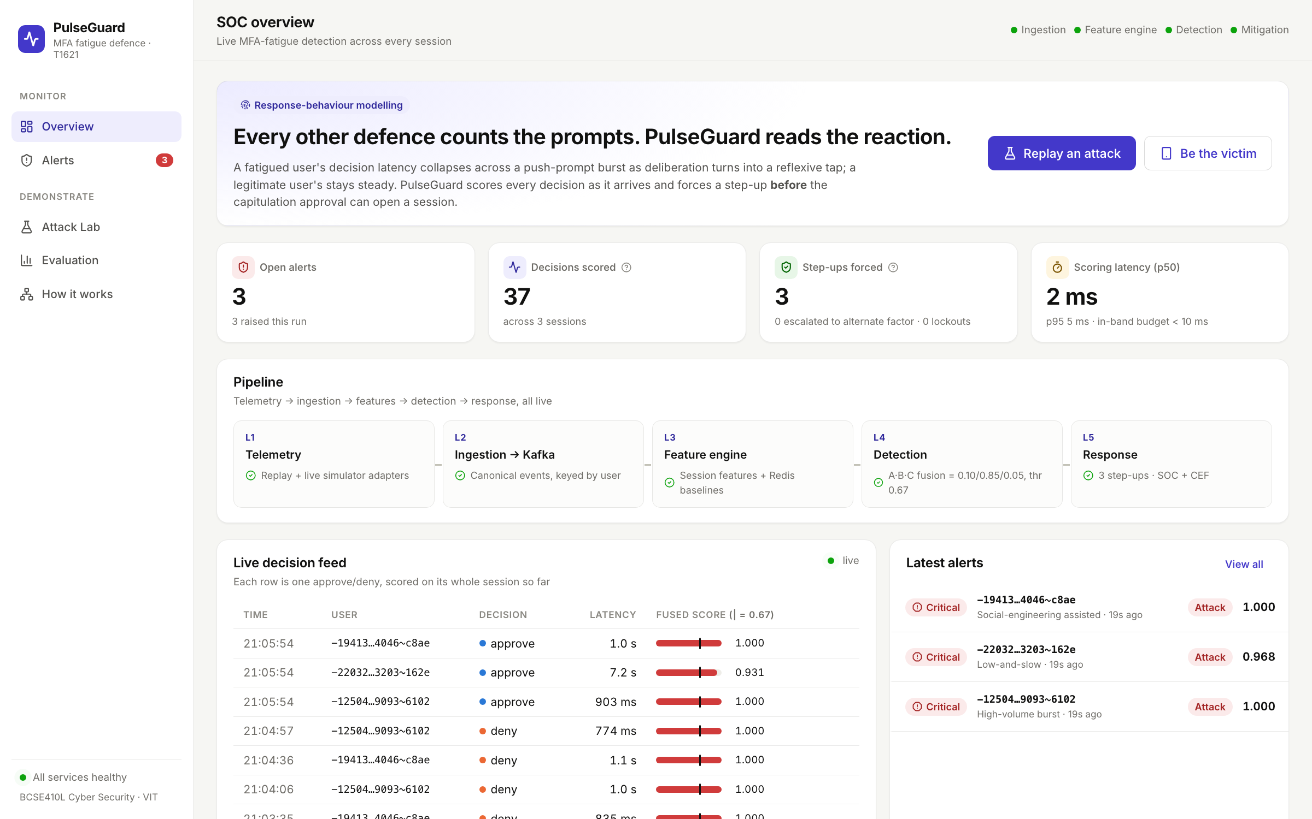
SOC overview: the live pipeline at a glance
13 • OUTPUT SCREENSHOTS
KPIs
Open alerts, decisions scored, step-ups forced (0 lockouts) and scoring latency: 2 ms median, 5 ms p95.
L1–L5 pipeline
Live health of every layer, with the fusion weights and threshold in use.
Live decision feed
Every approve or deny, its latency and its fused score against the 0.67 line.
Captured from the running stack after replaying three held-out test attacks.
Notes:
These screenshots come from the running system on my machine, after replaying three attack episodes from the held-out test split. The overview shows the KPIs, including three step-ups forced and zero lockouts, and a median scoring latency of two milliseconds. The pipeline strip shows every layer is healthy, and the live feed shows each decision being scored as it arrives.

Slide 36
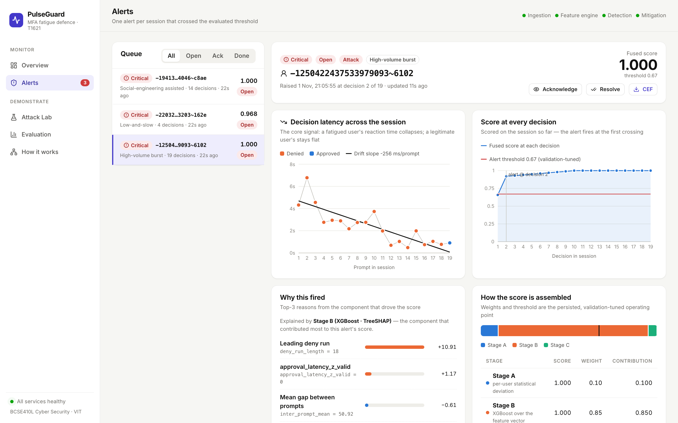
Alert evidence: a high-volume burst caught at decision 2
13 • OUTPUT SCREENSHOTS
Latency trajectory
19 decisions with the feature engine’s own drift line: −256 ms per prompt.
Score at every decision
Crosses 0.67 at decision 2, long before the final approval at 19.
Why it fired
TreeSHAP top reasons, led by a deny run of 18, and how stages A, B and C combine.
Acknowledge, resolve or export as CEF from the same page.
Notes:
This is the evidence an analyst sees for one alert. On the left chart, the victim’s decision latency falls across 19 prompts, with the drift line the feature engine computed. On the right, the fused score is already above the threshold at the second decision, which is when the step-up was forced. Below, SHAP explains the alert: the leading reason is a run of 18 denials. The analyst can acknowledge, resolve, or export the alert to a SIEM in CEF format.

Slide 37
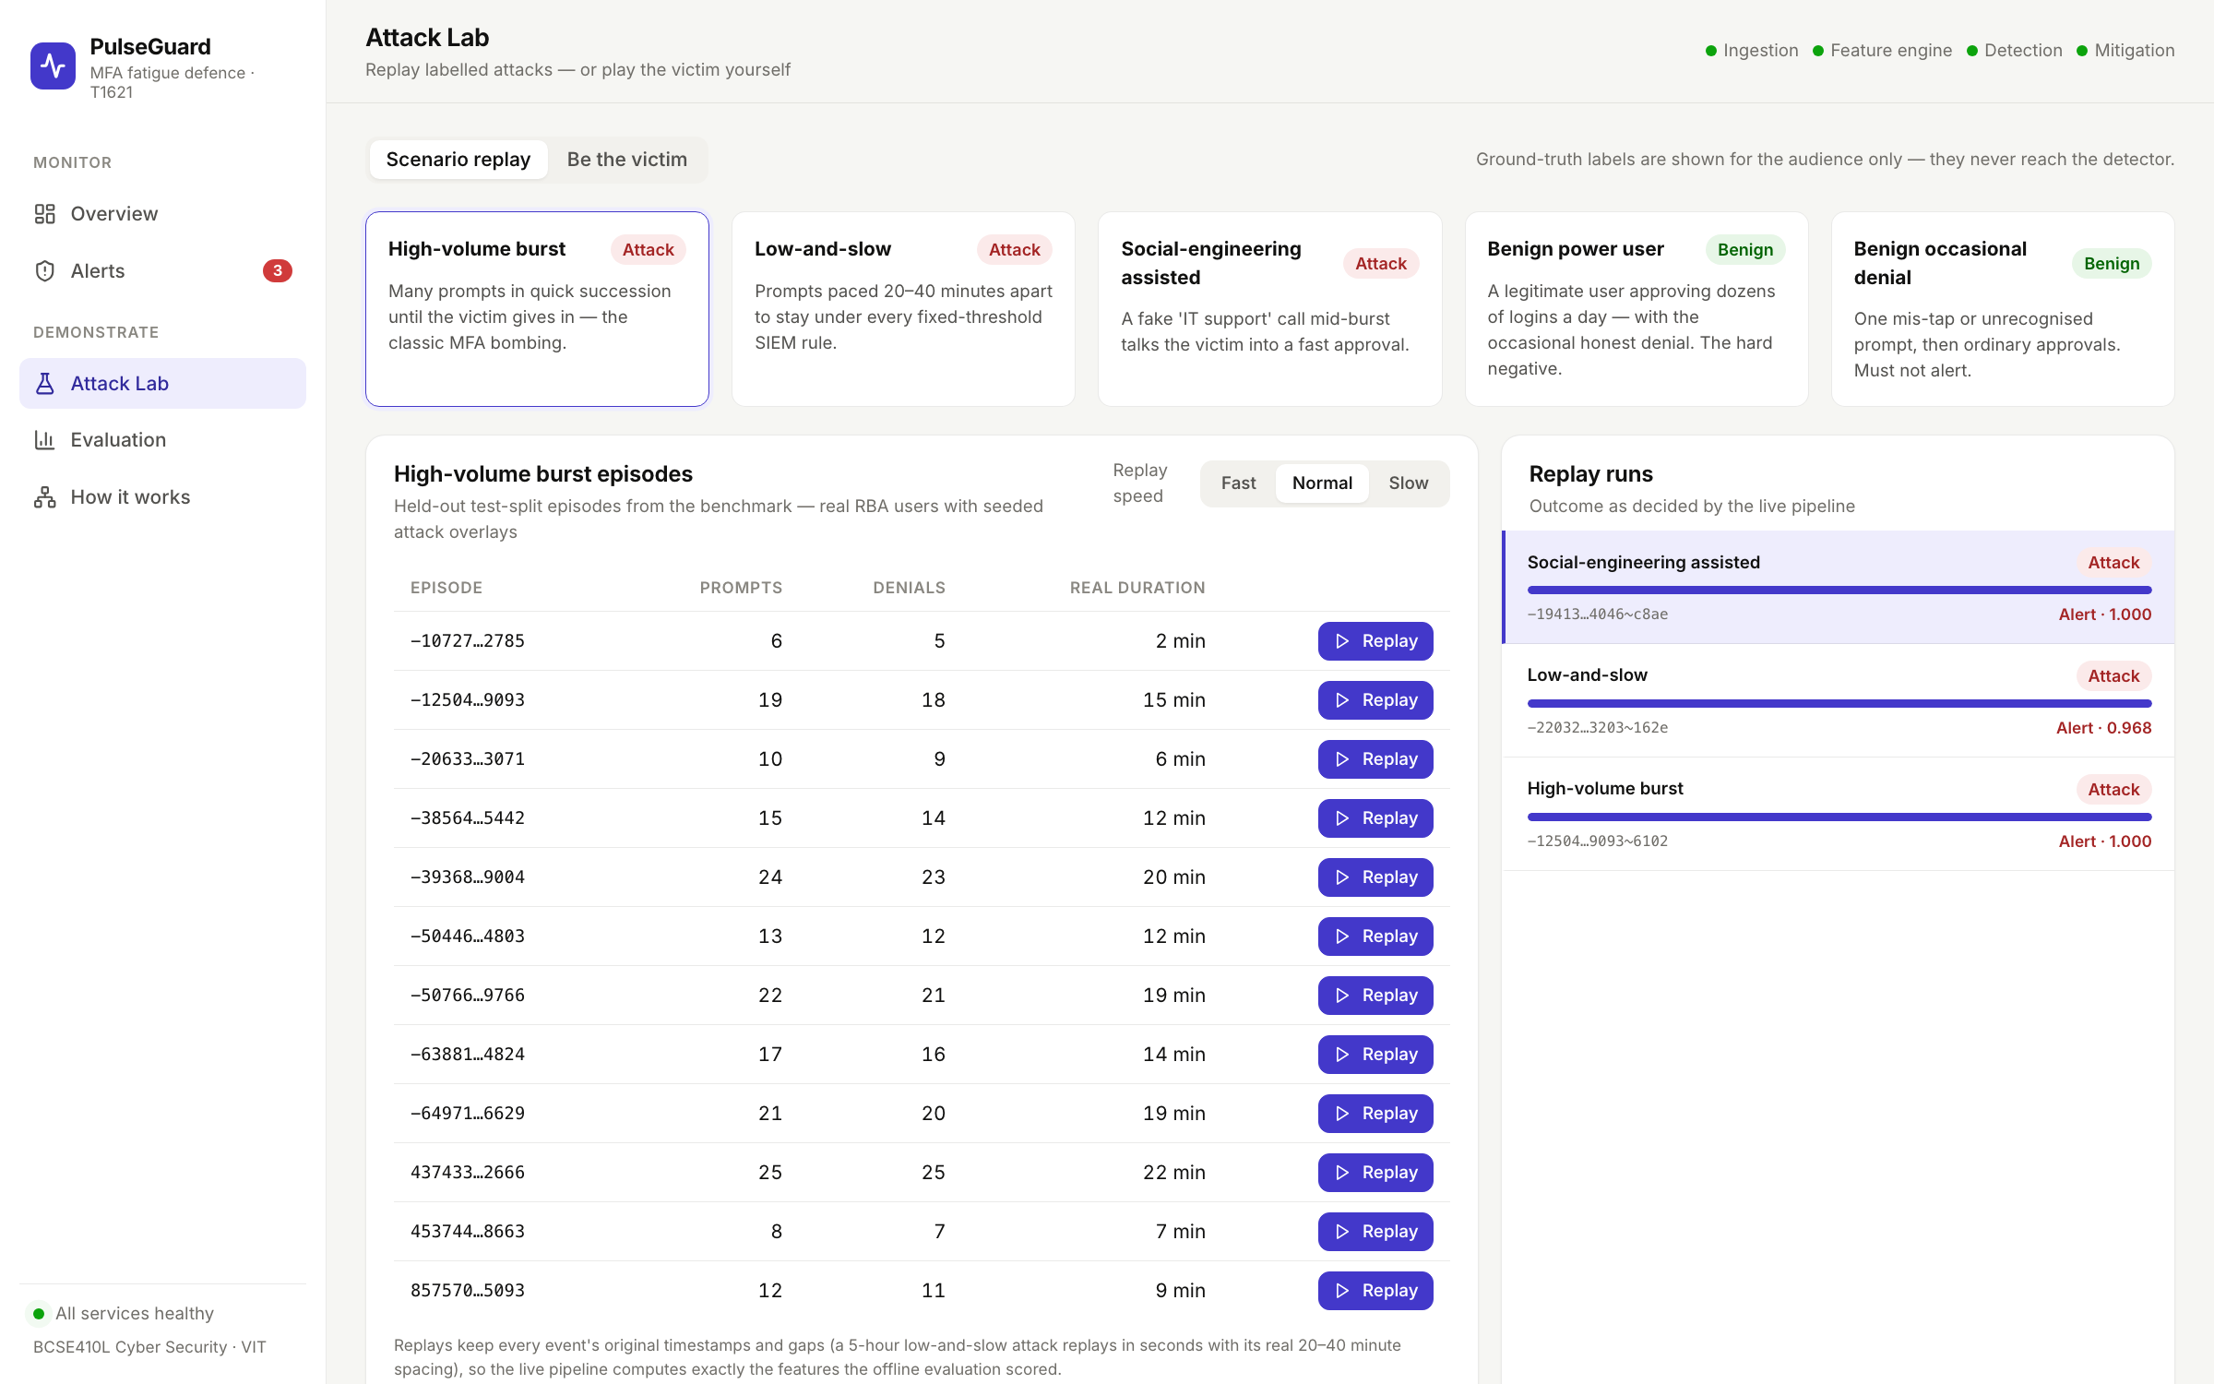
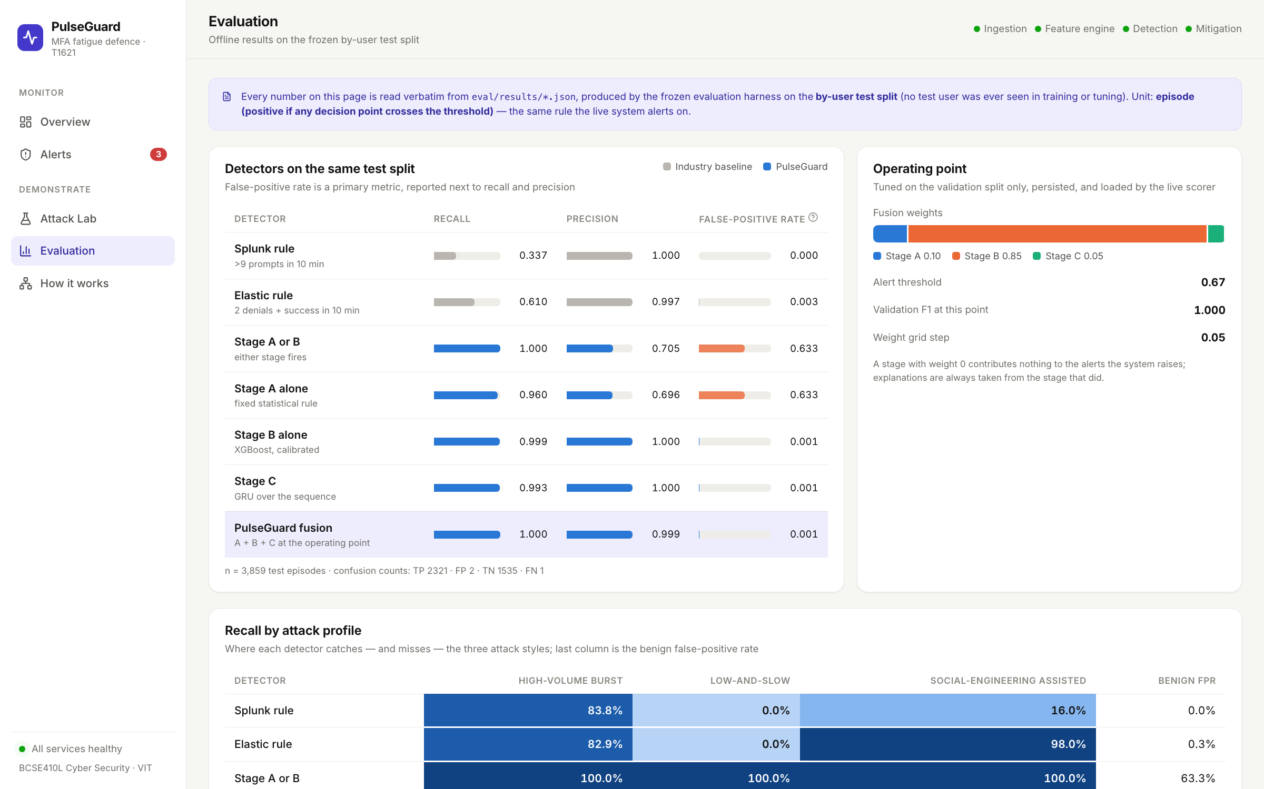
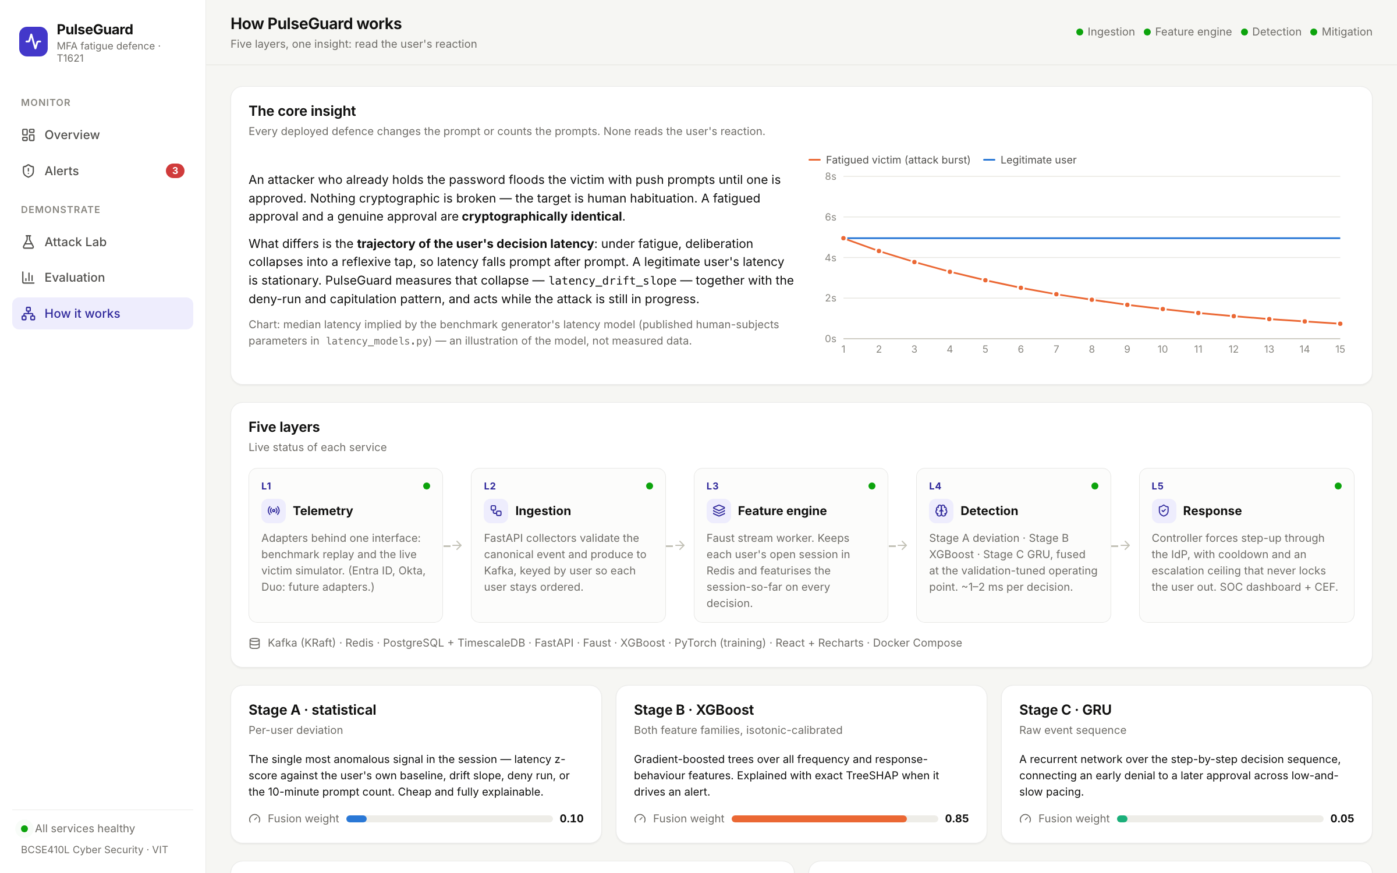
Attack Lab, Evaluation and How it works
13 • OUTPUT SCREENSHOTS
Attack Lab
Evaluation
How it works
Replay any held-out attack or hard negative, or play the victim on a simulated phone and get stepped up live.
Every number read straight from the committed result files, FPR beside recall.
The core insight, the five layers with live status, and the three stages with their weights.
Notes:
Three more pages. The Attack Lab replays real held-out episodes through the live pipeline, or lets you play the victim: deny a few prompts, start tapping faster, and PulseGuard suspends push and shows a number-matching challenge. The Evaluation page reads every number directly from the committed result files, so the demo and the report never disagree. How it works explains the system for a non-specialist audience. If time allows, I can demo the victim mode live.

Slide 38
References (1 of 2)
14 • REFERENCES
[1] MITRE ATT&CK, “T1621: Multi-Factor Authentication Request Generation,” MITRE Corp.
[2] CISA, “Scattered Spider,” Cybersecurity Advisory AA23-320A, 2023.
[3] Jubur et al., “Bypassing push-based second factor and passwordless authentication with human-indistinguishable notifications,” ACM ASIA CCS, 2021.
[4] Prakash et al., “Countering concurrent login attacks in ‘Just Tap’ push-based authentication,” IEEE EuroS&P, 2021.
[5] Mahdad, Jubur, Saxena, “Breaking mobile notification-based authentication with concurrent attacks outside of mobile devices,” ACM MobiCom, 2023.
[6] Jubur, Saxena, Reegu, “Usability and security analysis of the compare-and-confirm method in mobile push-based 2FA,” IEEE TMC, 24(6), 2025.
[7] Prapty, Tsudik, “DuoLungo: Usability study of Duo 2FA,” NDSS USEC, 2026.
[8] Meyer et al., “How effective is multifactor authentication at deterring cyberattacks?” arXiv, 2023.
[9] Reese et al., “A usability study of five two-factor authentication methods,” SOUPS, 2019.
[10] Lyastani et al., “Is FIDO2 the kingslayer of user authentication?” IEEE S&P, 2020.
[11] Lassak et al., “Why aren’t we using passkeys? Obstacles companies face deploying FIDO2 passwordless authentication,” USENIX Security, 2024.
[12] Ulqinaku et al., “Is real-time phishing eliminated with FIDO? Social engineering downgrade attacks,” USENIX Security, 2021.
[13] Freeman et al., “Who are you? A statistical approach to measuring user authenticity,” NDSS, 2016.
[14] Wiefling, Lo Iacono, Dürmuth, “Is this really you? An empirical study on risk-based authentication applied in the wild,” IFIP SEC, 2019.
[15] Wiefling et al., “Pump up password security! Evaluating and enhancing risk-based authentication on a real-world large-scale online service,” ACM TOPS, 26(1), 2023.
[16] Wiefling et al., “RBA dataset,” Zenodo, doi:10.5281/zenodo.6782156.

Slide 39
References (2 of 2)
14 • REFERENCES
[17] Picard, Pierre, “RLAuth: A risk-based authentication system using reinforcement learning,” IEEE Access, vol. 11, 2023.
[18] Doerfler et al., “Evaluating login challenges as a defense against account takeover,” WWW, 2019.
[19] Anderson et al., “From warning to wallpaper: Why the brain habituates to security warnings,” J. Mgmt. Inf. Systems, 2016.
[20] Vance et al., “Tuning out security warnings: A longitudinal examination of habituation,” MIS Quarterly, 2018.
[21] Akhawe, Felt, “Alice in Warningland: A large-scale field study of browser security warning effectiveness,” USENIX Security, 2013.
[22] Ratcliff, McKoon, “The diffusion decision model: Theory and data for two-choice decision tasks,” Neural Computation, 2008.
[23] Du et al., “DeepLog: Anomaly detection and diagnosis from system logs through deep learning,” ACM CCS, 2017.
[24] Killourhy, Maxion, “Comparing anomaly-detection algorithms for keystroke dynamics,” IEEE/IFIP DSN, 2009.
[25] Arp et al., “Dos and don’ts of machine learning in computer security,” USENIX Security, 2022.
[26] Pendlebury et al., “TESSERACT: Eliminating experimental bias in malware classification across space and time,” USENIX Security, 2019.
[27] Wagner, Soto, “Mimicry attacks on host-based intrusion detection systems,” ACM CCS, 2002.
[28] Lundberg, Lee, “A unified approach to interpreting model predictions,” NeurIPS, 2017.
[29] Alahmadi, Axon, Martinovic, “99% false positives: A qualitative study of SOC analysts’ perspectives on security alarms,” USENIX Security, 2022.
[30] Chen, Guestrin, “XGBoost: A scalable tree boosting system,” ACM KDD, 2016.
[31] Cho et al., “Learning phrase representations using RNN encoder–decoder for statistical machine translation,” EMNLP, 2014.
[32] Wiefling et al., “More than just good passwords? A study on usability and security perceptions of risk-based authentication,” ACSAC, 2020.

Slide 40
Others count the prompts. PulseGuard reads the reaction.
15 • CONCLUSION
What we showed
What comes next
A live, five-layer detector that scores every decision in about 2 ms
Recall 1.000 at FPR 0.001, vs 0.610 for Elastic and 0.337 for Splunk
99.2% of attacks flagged before the approving tap; no lockouts
Response behaviour cuts false positives about 100× on busy users
With the cross-session guard, slow pacing no longer evades detection
A user study with 30–60 participants in the victim simulator, to measure real fatigue latency
Train on synthetic data, test on real participant sessions
Entra ID, Okta and Duo adapters; a temporal split
Publish the benchmark on Zenodo and write the IEEE paper
Thank you. Questions?
Notes:
To conclude. We built a working, live detector that reads how users respond to push prompts, evaluated it honestly against the industry rules and stronger baselines, introduced a metric for detection before capitulation, and closed the slow-pacing evasion with a cross-session guard. The most important next step is a user study: the existing victim simulator can measure how real people’s response times change under a flood, which would turn our hypothesis into a finding. Thank you; I am happy to take questions or show a live demo.

