Slide 1
Convolution Acceleration Dynamic Hardware
Designed/Presented by David Cain
Special thanks to Omar Eddash and Adam Frost for mentorship

Slide 2
Overview
-Design Objective
-Intro to Vivado
-Learn Verilog
-Partial Reconfig Multipliers
-Crossbar Data Switch
-Partial Reconfig Adder
-Matric Accelerator
-Asynchronous FIFO
-Matrix Controller
-Convolution Accelerator Top Wrapper
-Enabling Partial Reconfig
-Dynamic Resources
-Floorplan
-Resource Utilization
-Power Report
-Conclusions

Slide 3
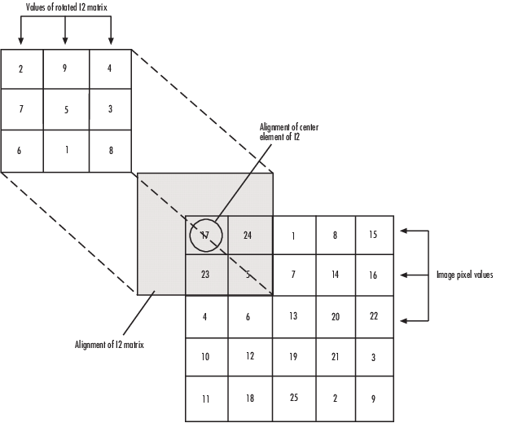
Design Objective
Develop an FPGA based reconfigurable design to accelerate matrix convolution
This is a computationally intensive step used in many image processing algorithms
The design must accept multiple data types
Integer data values
Floating point data values
Fixed point data values
Each of these data types can be dynamically reconfigured on device
Notes:
This is a computationally intensive step used in many image processing algorithms
can benefit from hardware acceleration

Slide 4
Learn Verilog
-Design Objective
-Learn Verilog
-Intro to Vivado
-Partial Reconfig Multipliers
-Crossbar Data Switch
-Partial Reconfig Adder
-Matrix Accelerator
-Asynchronous FIFO
-Matrix Controller
-Convolution Accelerator Top Wrapper
-Enabling Partial Reconfig
-Dynamic Resources
-Floorplan
-Resource Utilization
-Power Report
-Conclusions

Slide 5

Upon entering the project, I was referenced this book and several tutorials to get a feeling of Verilog
Free Range VHDL, Bryan Mealy, 2018
Xilinx also has tutorials with pre-built designs to be imported and demonstrate concepts of how to use the hardware available
YouTube tutorials were also helpful for workflow within Vivado

Slide 6
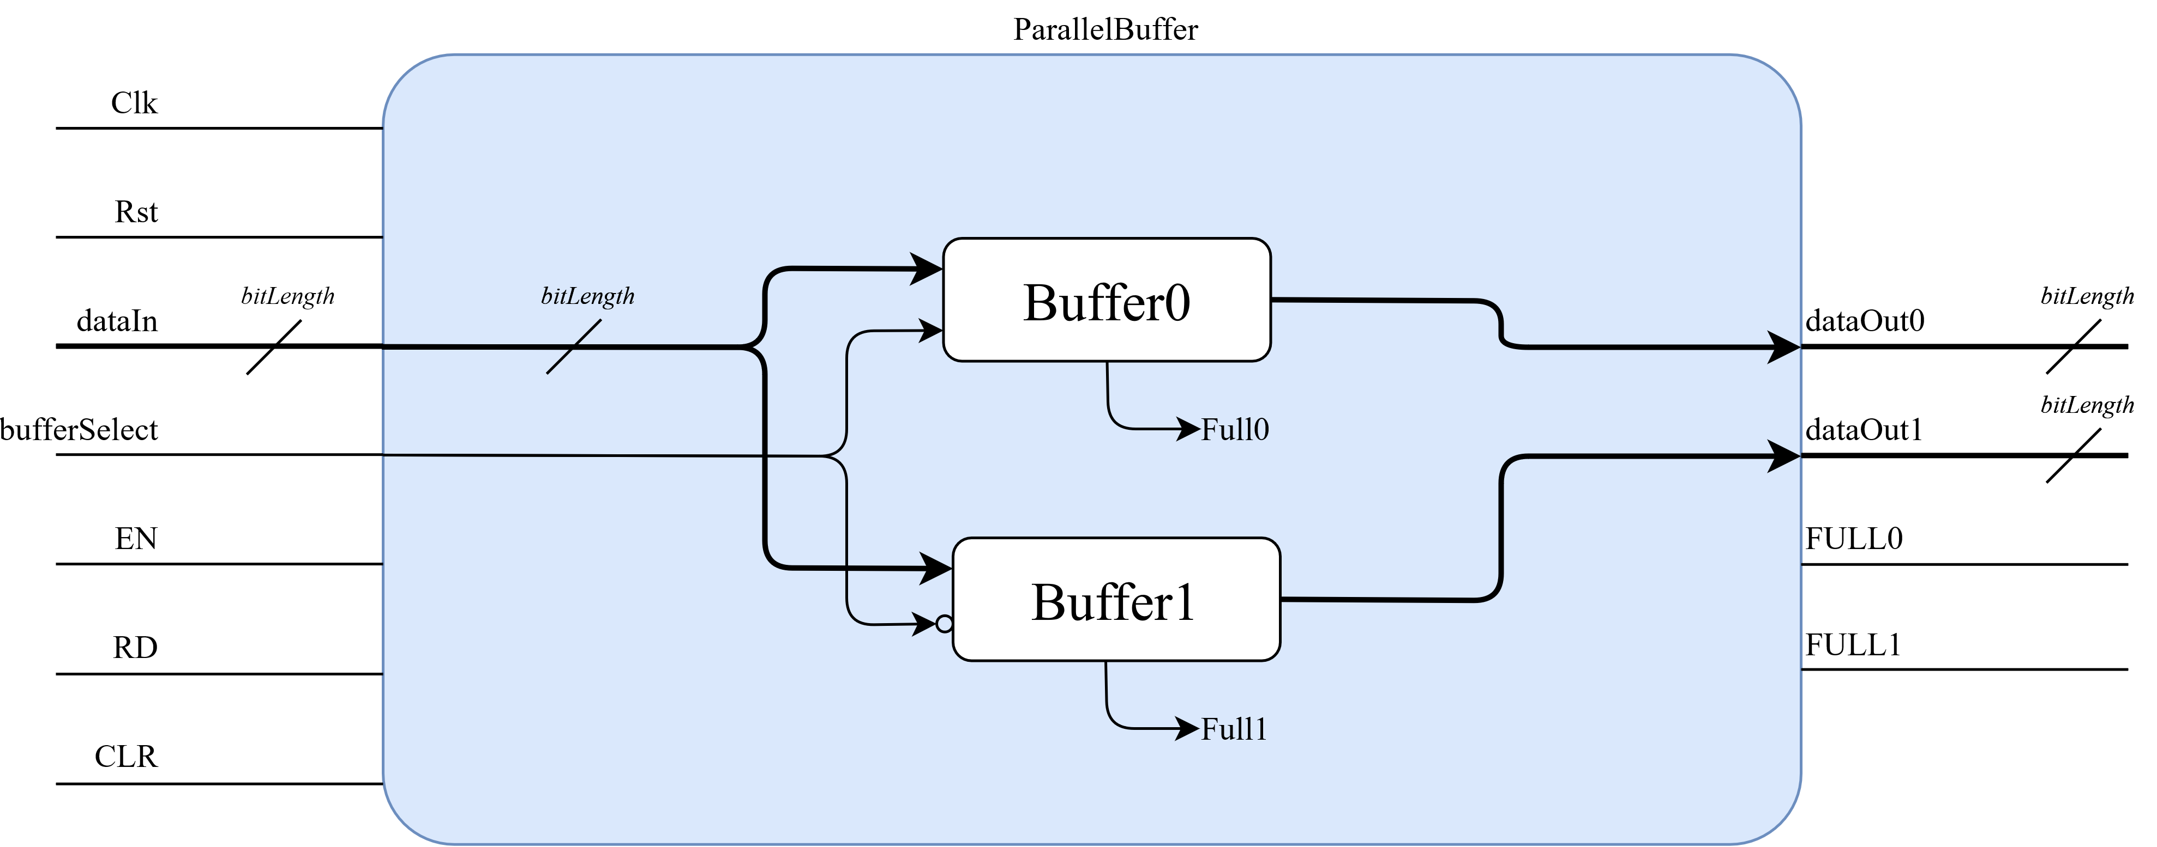
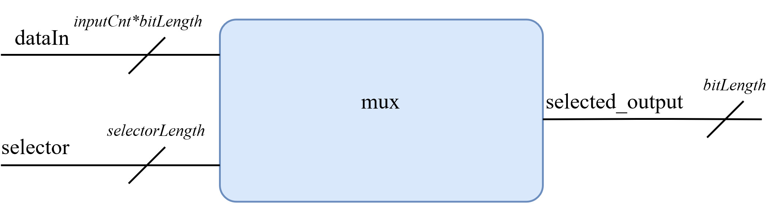
With a simple understanding of Verilog, basic designs were created and tested:
Multibit flipflop register (FlipFlop.v)
Parallel multibit flipflop (ParallelBuffer.v)
Multibit port MUX (mux.v)

Slide 7
Intro to Vivado
-Design Objective
-Learn Verilog
-Intro to Vivado
-Partial Reconfig Multipliers
-Crossbar Data Switch
-Partial Reconfig Adder
-Matrix Accelerator
-Asynchronous FIFO
-Matrix Controller
-Convolution Accelerator Top Wrapper
-Enabling Partial Reconfig
-Dynamic Resources
-Floorplan
-Resource Utilization
-Power Report
-Conclusions

Slide 8
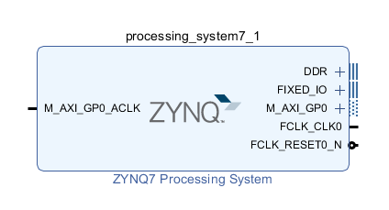
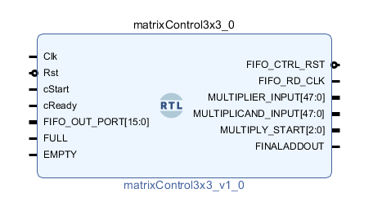
Vivado is the primary software suite used when working with Xilinx based FPGAs such as the Pynq-Z2
Vivado offers design development using HDL or the built in IP Integrator using block diagrams
Often both development forms are used when working on a design
Notes:
Vivado offers design development using HDL or the built in IP Integrator using block diagrams
These block diagrams can compose of either base IPs provided by Xilinx or user custom IPs that are imported/created within the project
The HDL defining these Xilinx based IPs are not viewable by end-user

Slide 9
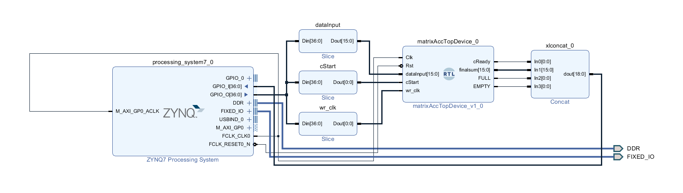
Example of block diagram interface
*For synthesis, block diagrams must be packaged with HDL wrappers generated by Vivado

Slide 10
Partial Reconfig Multipliers
-Design Objective
-Learn Verilog
-Intro to Vivado
-Partial Reconfig Multipliers
-Crossbar Data Switch
-Partial Reconfig Adder
-Matrix Accelerator
-Asynchronous FIFO
-Matrix Controller
-Convolution Accelerator Top Wrapper
-Enabling Partial Reconfig
-Dynamic Resources
-Floorplan
-Resource Utilization
-Power Report
-Conclusions

Slide 11
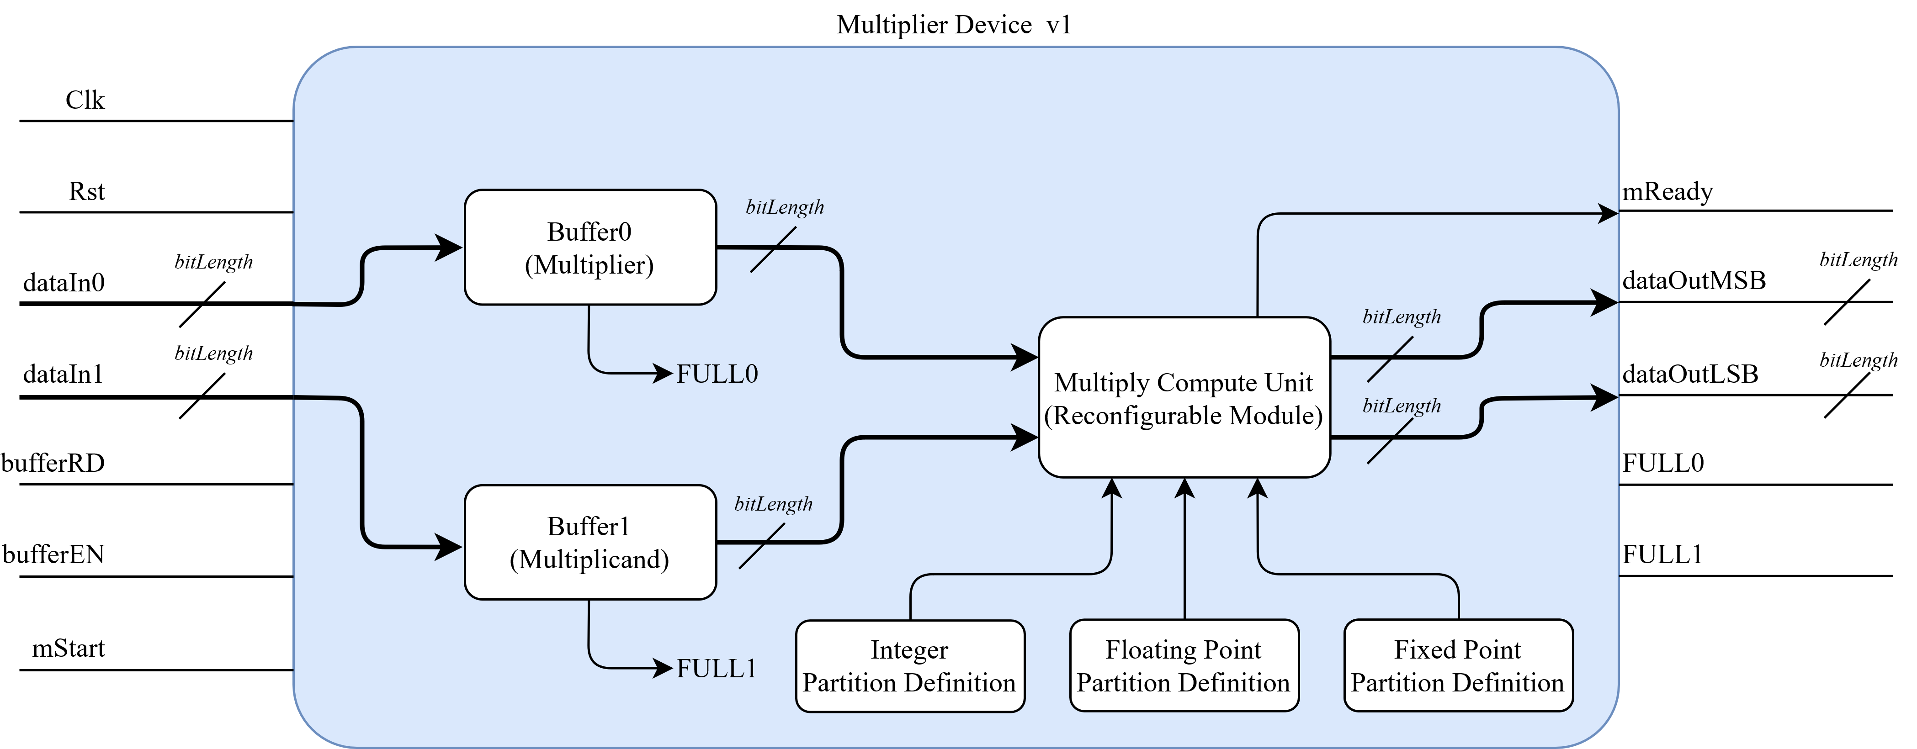
A first step was to implement devices that could intake 2 data values, multiply them, then return the product
Decided to change layout later in development.
Block diagram of multiplier v1
Reconfigurable Partition
Definitions
Notes:
A first step was to implement devices that could intake 2 data values, multiply them, then return the product
This needed to be designed for three separate data types, with separate algorithms to complete each computation type
Decided to change layout later in development.
This was initially designed to buffer input data internally, allowing for parallel computations. The buffered input was removed due to adding undesirable delay while pipelining data streams

Slide 12
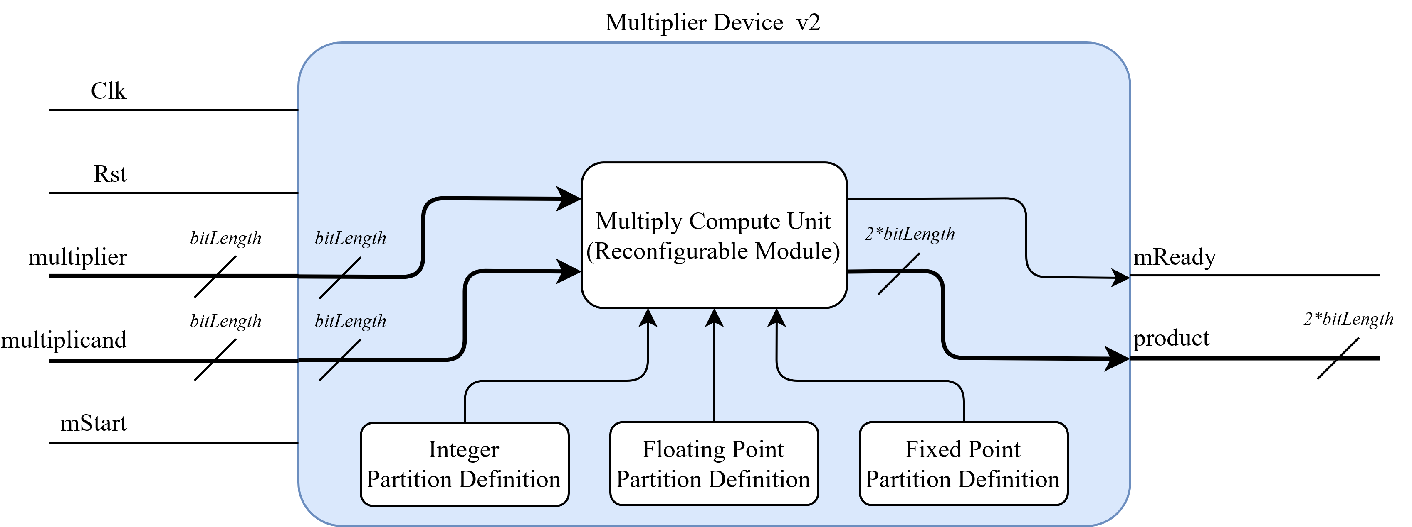
Block diagram of multiplier v2, updated design in use

Slide 13
Crossbar Data Switch
-Design Objective
-Learn Verilog
-Intro to Vivado
-Partial Reconfig Multipliers
-Crossbar Data Switch
-Partial Reconfig Adder
-Matrix Accelerator
-Asynchronous FIFO
-Matrix Controller
-Convolution Accelerator Top Wrapper
-Enabling Partial Reconfig
-Dynamic Resources
-Floorplan
-Resource Utilization
-Power Report
-Conclusions

Slide 14
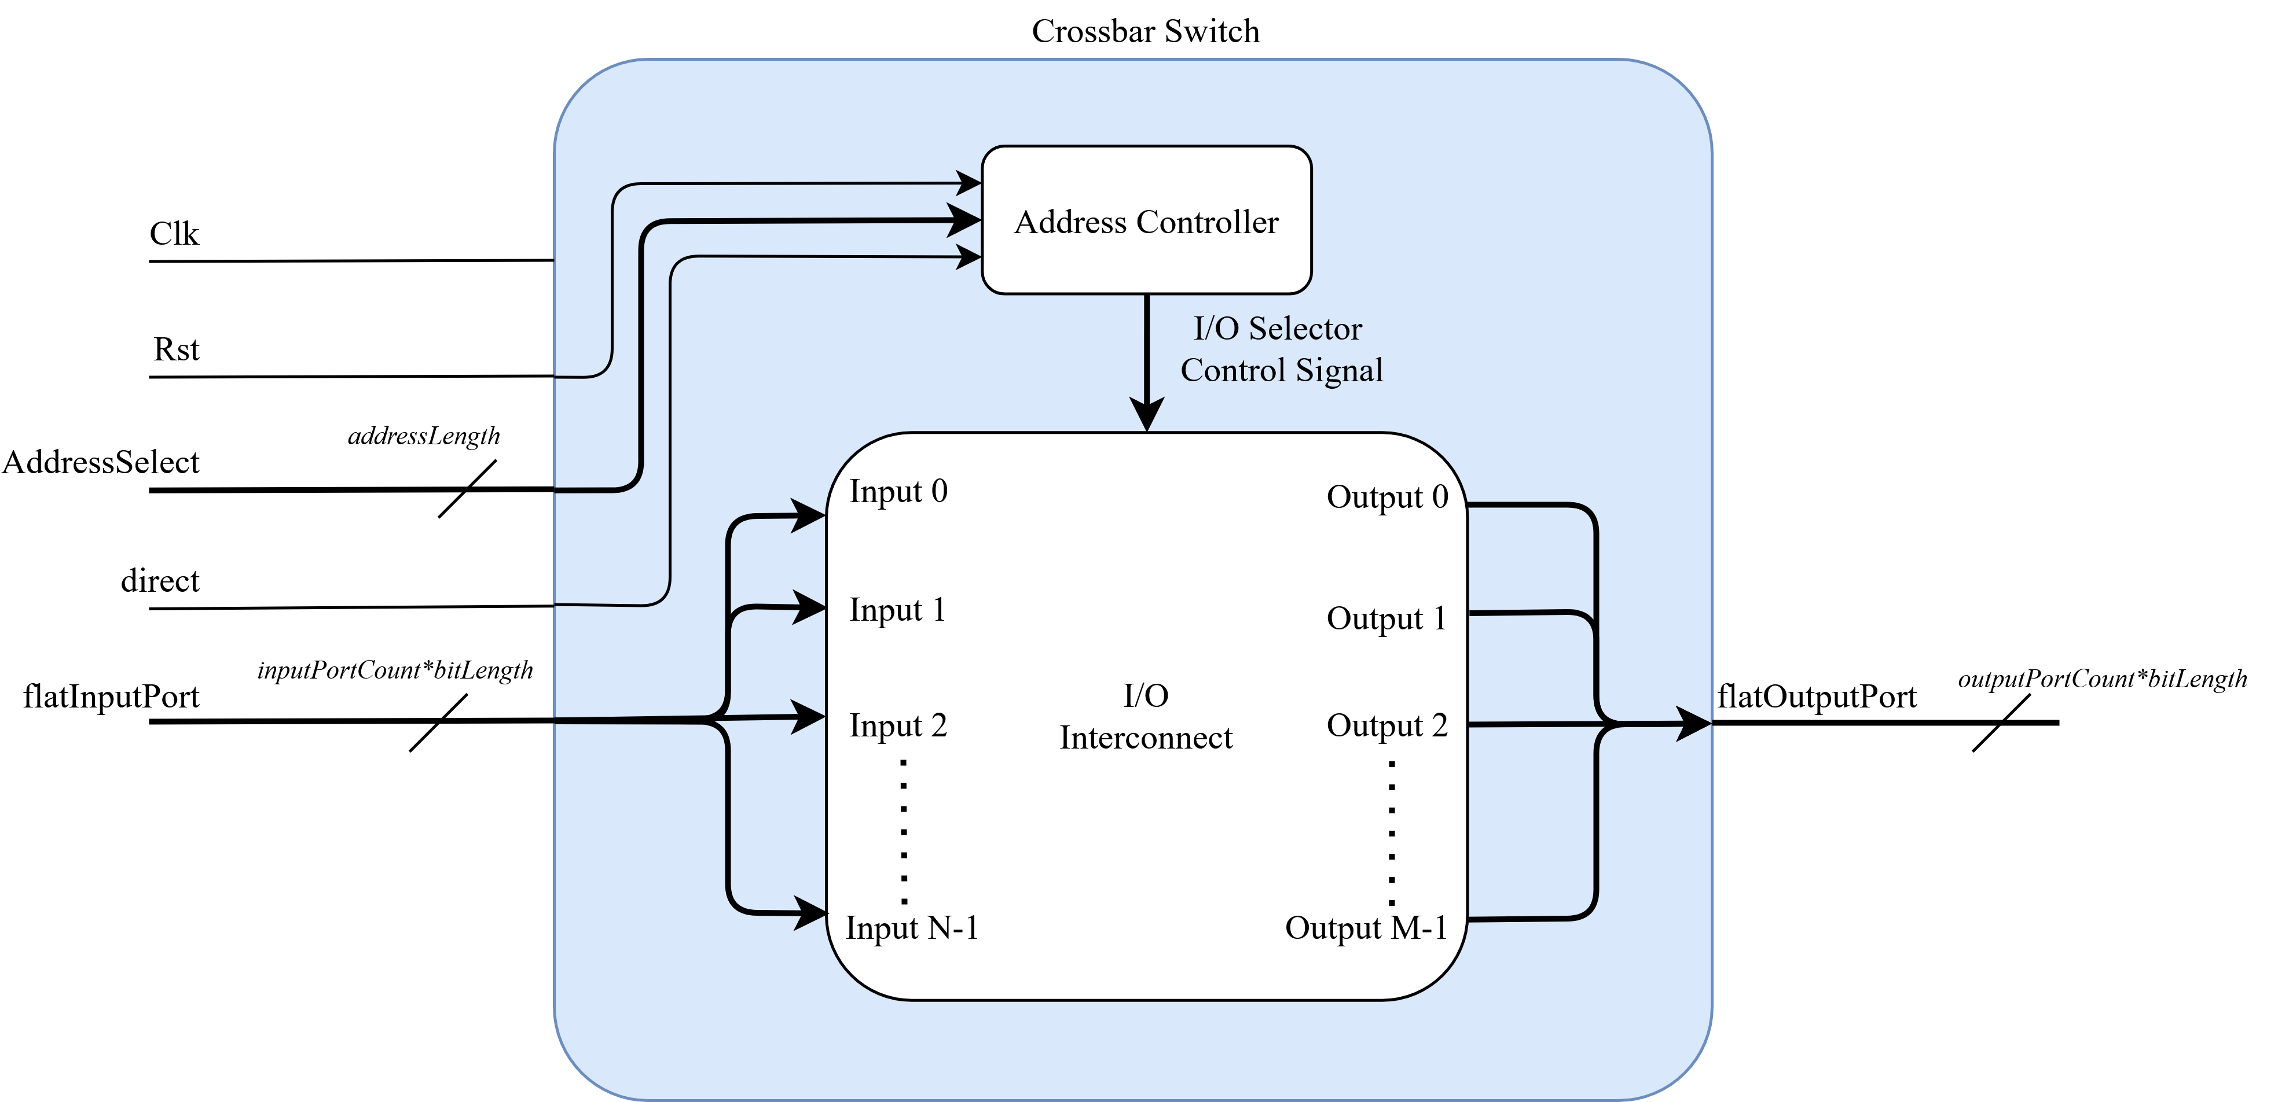
A crossbar switch was designed and implemented. This switch allows for any input port to be selected and connected to any output port.
Block diagram of crossbar
Notes:
A data link was needed to interface many parallel multiplier outputs to many parallel adder devices
A crossbar switch was designed and implemented. This switch allows for any input port to be selected and connected to any output port.
The crossbar was written from scratch to have variable input and output port counts
These ports are also variable bit length
-The data connection is asynchronous, mimicking wire connections

Slide 15
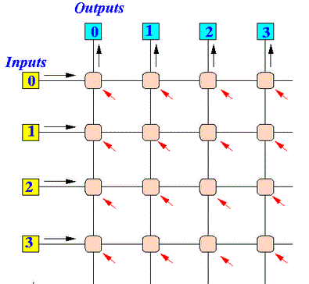
The crossbar operates on a grid connection method. With N inputs and M outputs, this generates NxM valid address selections
At positive edge clocks, the address on AddressSelect port is toggled
If direct is HIGH, equal I/O ports will be connected.
i.e. Output0 = Input0; Input1 = Output1;…
M = 4
N = 4
1
2
3
4
5
6
7
8
9
10
11
12
13
14
15
16 Addresses
Notes:
Indexing actually starts at zero. This was just making the total count obvious

Slide 16
Partial Reconfig Adder
-Design Objective
-Learn Verilog
-Intro to Vivado
-Partial Reconfig Multipliers
-Crossbar Data Switch
-Partial Reconfig Adder
-Matrix Accelerator
-Asynchronous FIFO
-Matrix Controller
-Convolution Accelerator Top Wrapper
-Enabling Partial Reconfig
-Dynamic Resources
-Floorplan
-Resource Utilization
-Power Report
-Conclusions

Slide 17
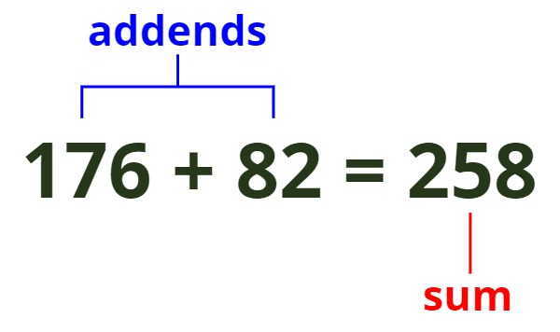
With a method to now compute many products in parallel and sort them, a device was needed to accumulate the sum of products
2 Partition definitions were created:
Integer/Fixed Point Adder
Floating Point Adder
Notes:
-Floating point needs much more logic due to needing to check the magnitude difference, then normalize the values

Slide 18
Matrix Accelerator
-Design Objective
-Learn Verilog
-Intro to Vivado
-Partial Reconfig Multipliers
-Crossbar Data Switch
-Partial Reconfig Adder
-Matrix Accelerator
-Asynchronous FIFO
-Matrix Controller
-Convolution Accelerator Top Wrapper
-Enabling Partial Reconfig
-Dynamic Resources
-Floorplan
-Resource Utilization
-Power Report
-Conclusions

Slide 19
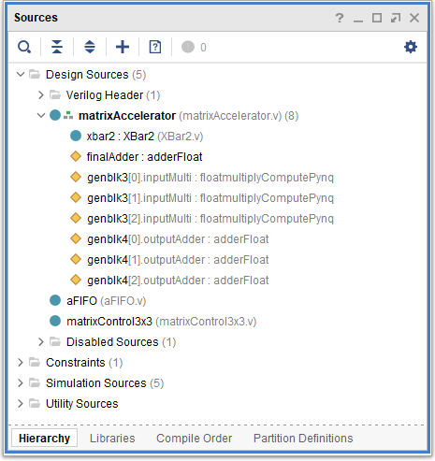
The devices were then packaged into a single IP, matrixAcclerator
This device has a lot of I/O and no control logic
It must be packaged with a controller IP
Hierarchy View
Dynamic Partitions

Slide 20
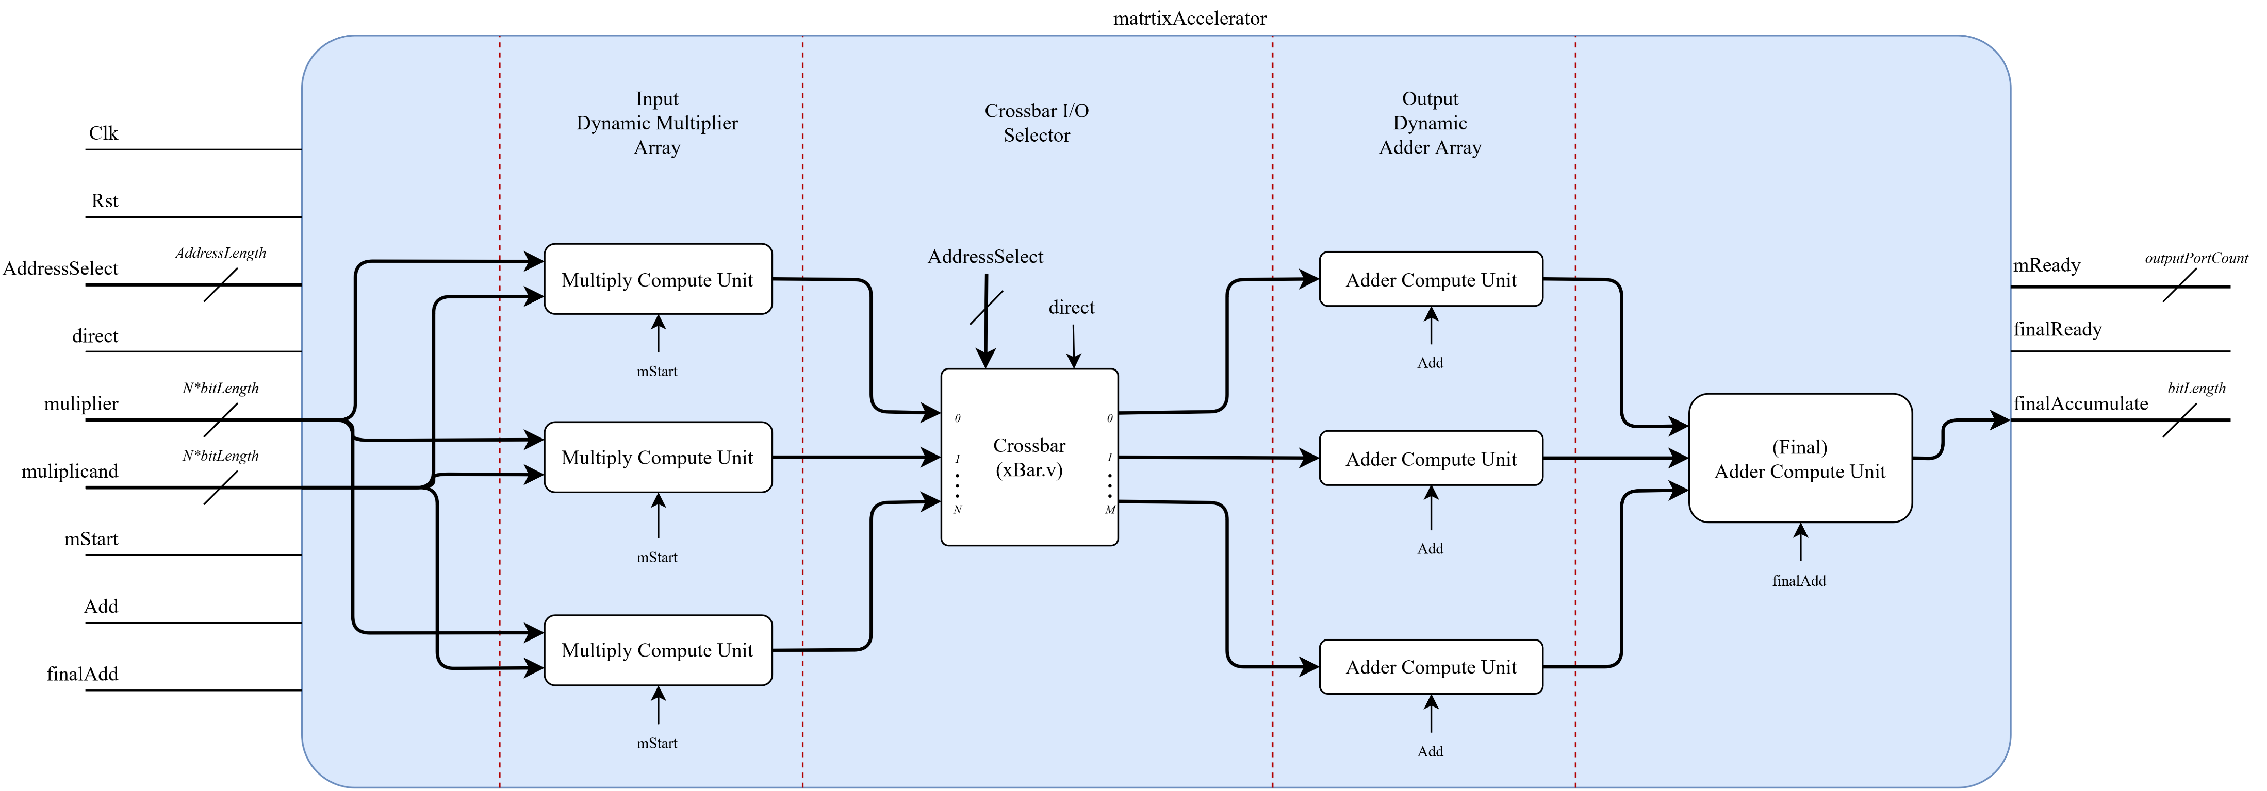

Block diagram of matrix accelerator

Slide 21
Asynchronous FIFO
-Design Objective
-Learn Verilog
-Intro to Vivado
-Partial Reconfig Multipliers
-Crossbar Data Switch
-Partial Reconfig Adder
-Matrix Accelerator
-Asynchronous FIFO
-Matrix Controller
-Convolution Accelerator Top Wrapper
-Enabling Partial Reconfig
-Dynamic Resources
-Floorplan
-Resource Utilization
-Power Report
-Conclusions

Slide 22
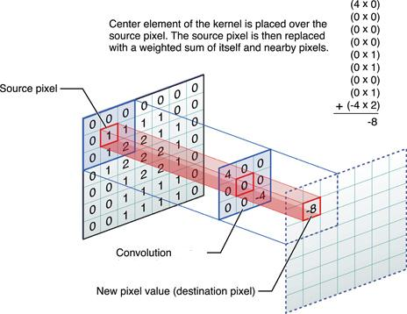
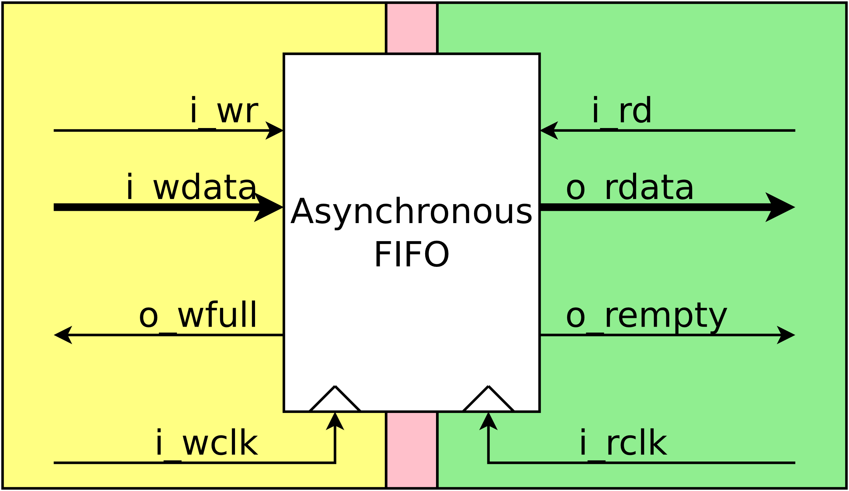
The convolution accelerator needs much data input
Data Set (Image Values)
Filter Set (Filter Values)
Since the program will not be able to load values and operate the FPGA properly, an asynchronous FIFO buffer was used to input a data set across the clock domains

Slide 23
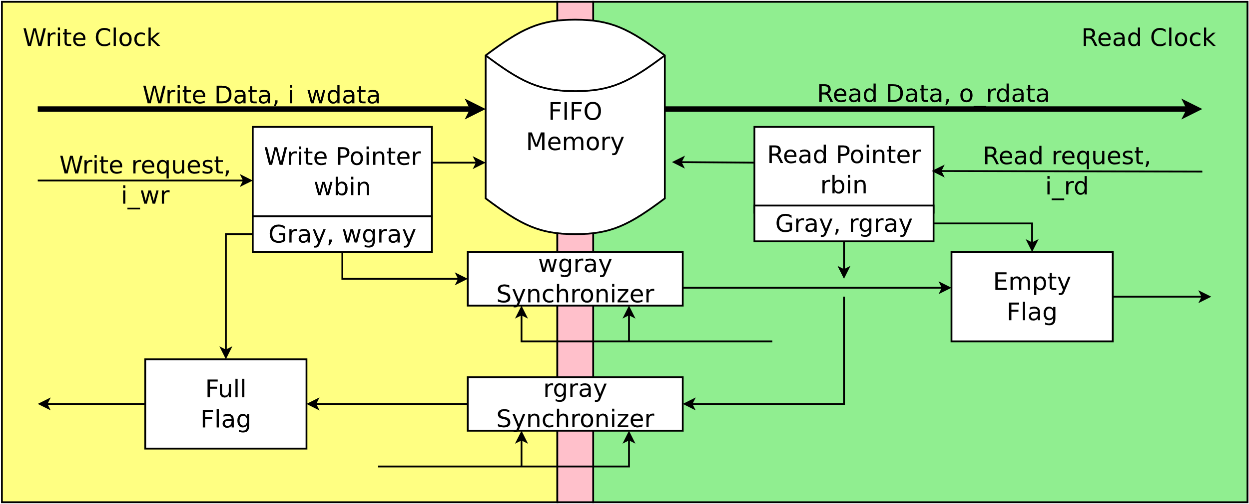
There was a helpful online project:
Crossing Clock Domains with an Asynchronous FIFO, Dan Gisselquist, 2018
https://zipcpu.com/blog/2018/07/06/afifo.html
I attempted to write this IP from scratch, but the problem was difficult
This write-up by Gisselquist was an extensive overview of the device problems, behavior, and similar work

Slide 24
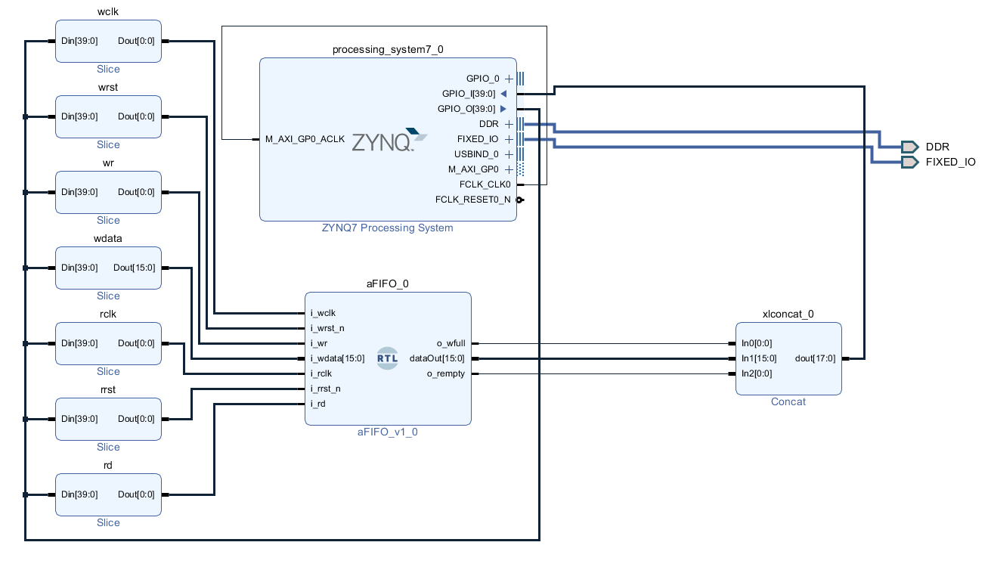
To verify this FIFO design was suitable, it was first tested in Vivado simulation
In the Python environment, the buffer would be filled with a random data set
Next, the buffer data would be extracted and compared with original input
The load/compare times were also tracked
Notes:
A bitstream and block diagram was generated to program the FPGA with the Python3 interface

Slide 25
Matrix Controller
-Design Objective
-Learn Verilog
-Intro to Vivado
-Partial Reconfig Multipliers
-Crossbar Data Switch
-Partial Reconfig Adder
-Matrix Accelerator
-Asynchronous FIFO
-Matrix Controller
-Convolution Accelerator Top Wrapper
-Enabling Partial Reconfig
-Dynamic Resources
-Floorplan
-Resource Utilization
-Power Report
-Conclusions

Slide 26
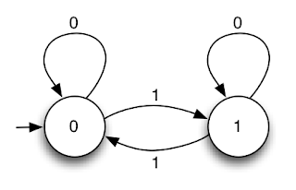
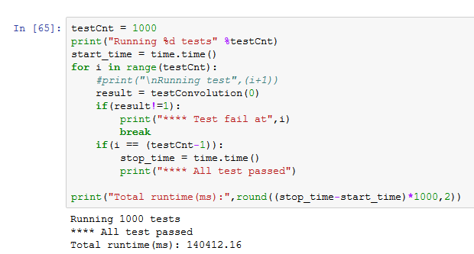
The controller needs to:
Read data in the input buffer
Pipeline data into the matrix accelerator
Use matrix accelerator control signals to generate convolution sum
The controller has three main states:
Reading data from the buffer
Multiplying the input values
Add the resulting products
Notes:
-Now with hardware to allow for external data input, a state machine controller is needed to complete computation
-Not complete with design because data throughput is very slow due to bad controller logic

Slide 27
Convolution Accelerator Top Wrapper
-Design Objective
-Learn Verilog
-Intro to Vivado
-Partial Reconfig Multipliers
-Crossbar Data Switch
-Partial Reconfig Adder
-Matrix Accelerator
-Asynchronous FIFO
-Matrix Controller
-Convolution Accelerator Top Wrapper
-Enabling Partial Reconfig
-Dynamic Resources
-Floorplan
-Resource Utilization
-Power Report
-Conclusions

Slide 28
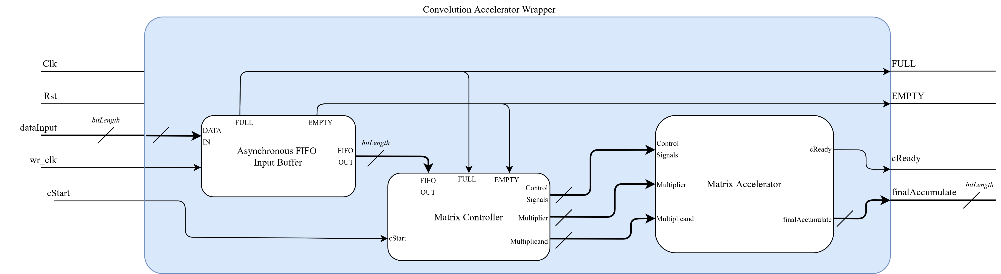
A top-level package was created to wrap the input buffer, matrix accelerator, and controller into one design
Convolution Accelerator block diagram
Notes:
This device has three dynamic configurations: Integer, Floating Point, Fixed Point

Slide 29
Enabling Partial Reconfig
-Design Objective
-Learn Verilog
-Intro to Vivado
-Partial Reconfig Multipliers
-Crossbar Data Switch
-Partial Reconfig Adder
-Matrix Accelerator
-Asynchronous FIFO
-Matrix Controller
-Convolution Accelerator Top Wrapper
-Enabling Partial Reconfig
-Dynamic Resources
-Floorplan
-Resource Utilization
-Power Report
-Conclusions

Slide 30
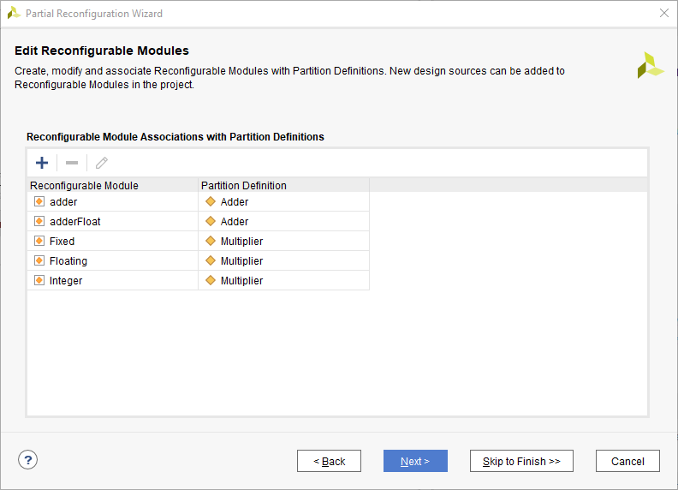
Using Vivado’s partial reconfiguration wizard, designs can become dynamically reconfigurable
This allows for partitions of the FPGA to be reprogrammed during runtime
When converting a project to partially reconfigurable, simulation is no longer available
Notes:
When converting a project to partially reconfigurable, simulation is no longer available
It is recommended to flesh out much of a PR design while static, then create a new project for a dynamic version

Slide 31
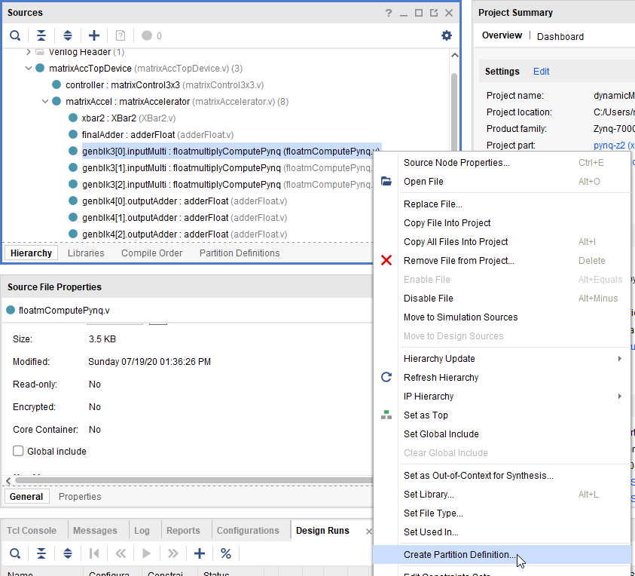
Backup project
Enable Partial Reconfiguration
Tools->Enable Partial Reconfiguration…
Select a device in top to create a partition definition
Notes:
Mention how Vivado makes the whole project PR
When a project is PR, can’t to simulation
A static and dynamic version of the project was created

Slide 32
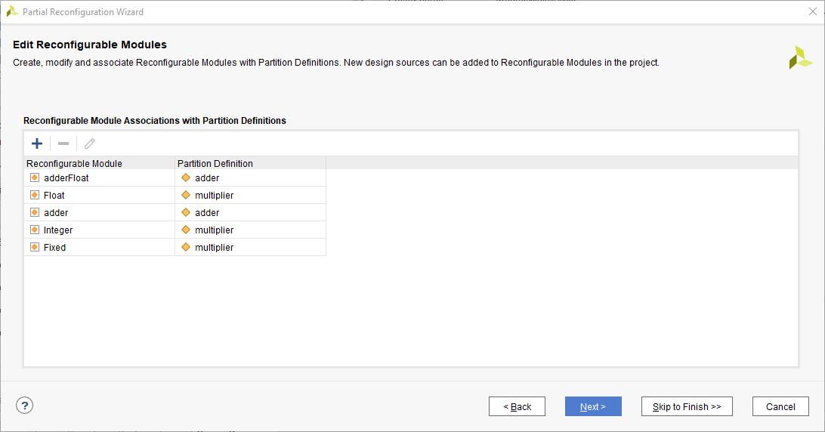
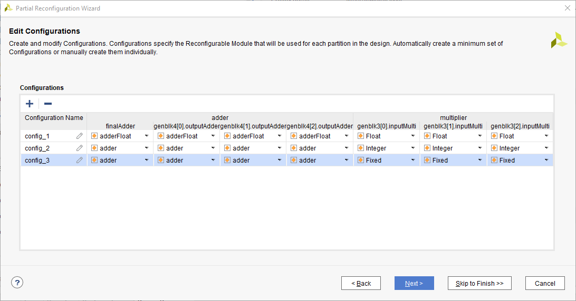
Add any needed partitions and modules
Create a configuration with modules set as needed
Notes:
Mention how Vivado makes the whole project PR
When a project is PR, can’t to simulation
A static and dynamic version of the project was created

Slide 33
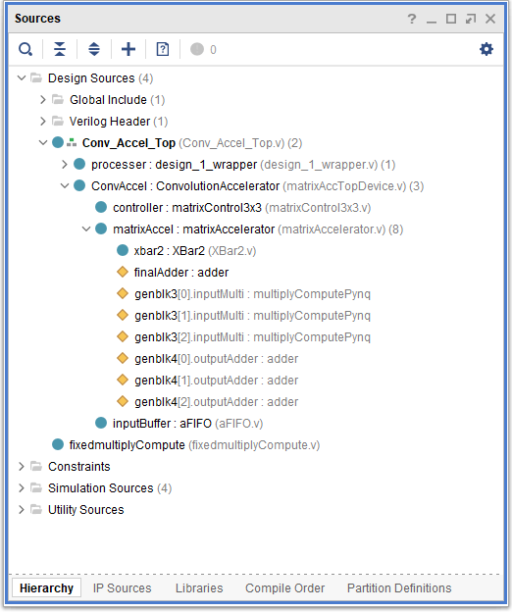
Hierarchy view of design wrapped together with partial reconfiguration enabled
Design Top
IP
Partial Reconfigurable
Partitions
Notes:
Mention how Vivado makes the whole project PR
When a project is PR, can’t to simulation
A static and dynamic version of the project was created

Slide 34
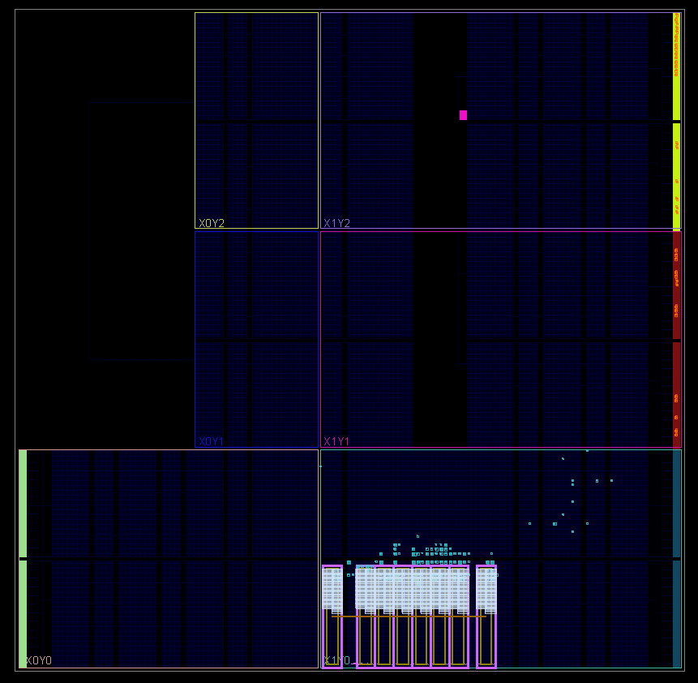
Each reconfigurable partition requires a dedicated pBlock to dictate the hardware available for reconfiguration
This is a screenshot of the floorplan for a design with 8 pBlocks to enable 8 separate reconfigurable multiply compute partitions.
Static Hardware
pBlock Definitions
Notes:
This is not a screenshot of the convolution accelerator. This was just a design that had less going on visually and was easier to demonstrate the components
Each reconfigurable partition requires a dedicated pBlock to dictate the hardware available for reconfiguration
This pBlock should contain only the dynamic module. Static modules will be placed and routed automatically

Slide 35
Dynamic Resources Floorplan
-Design Objective
-Learn Verilog
-Intro to Vivado
-Partial Reconfig Multipliers
-Crossbar Data Switch
-Partial Reconfig Adder
-Matrix Accelerator
-Asynchronous FIFO
-Matrix Controller
-Convolution Accelerator Top Wrapper
-Enabling Partial Reconfig
-Dynamic Resources
-Floorplan
-Resource Utilization
-Power Report
-Conclusions

Slide 36
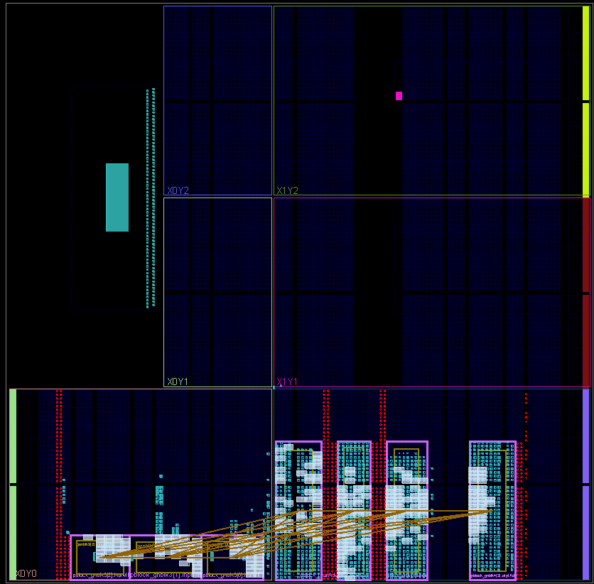
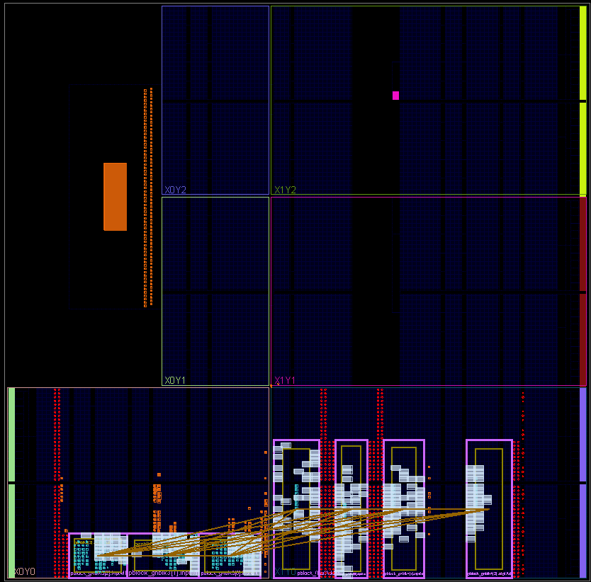
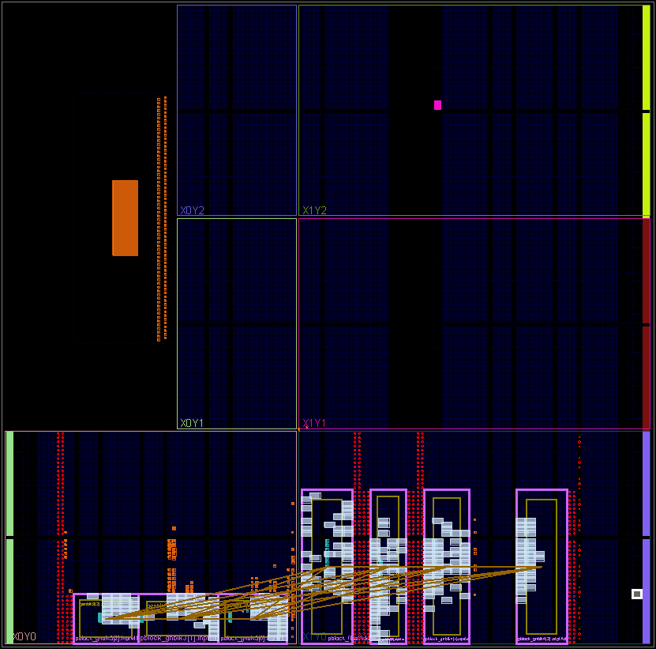
Floating Point
Configuration Floorplan
Fixed Point
Configuration Floorplan
Integer
Configuration Floorplan
Notes:
Technically not the most recent but should be mostly accurate

Slide 37
Dynamic Resources Resource Utilization
-Design Objective
-Learn Verilog
-Intro to Vivado
-Partial Reconfig Multipliers
-Crossbar Data Switch
-Partial Reconfig Adder
-Matrix Accelerator
-Asynchronous FIFO
-Matrix Controller
-Convolution Accelerator Top Wrapper
-Enabling Partial Reconfig
-Dynamic Resources
-Floorplan
-Resource Utilization
-Power Report
-Conclusions

Slide 38
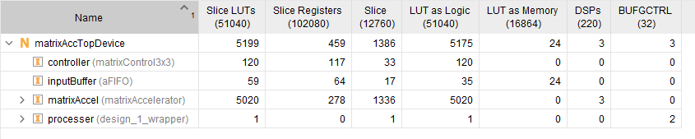
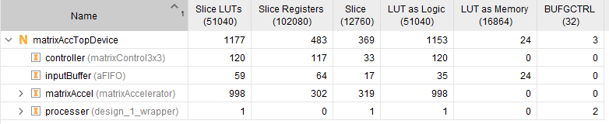
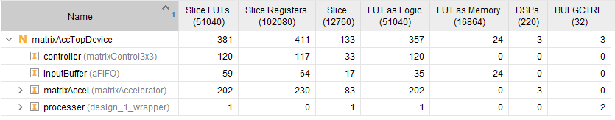
!!!!
Floating Point
Configuration Resource Utilization
Fixed Point
Configuration Resource Utilization
Integer
Configuration Resource Utilization
Notes:
Floating point uses much much more device resources
Even with high utilization of resources from floating point, design uses about 10% of available LUTs on Pynq-Z2
Technically not the most recent but should be mostly accurate

Slide 39
Dynamic Resources Power Report
-Design Objective
-Learn Verilog
-Intro to Vivado
-Partial Reconfig Multipliers
-Crossbar Data Switch
-Partial Reconfig Adder
-Matrix Accelerator
-Asynchronous FIFO
-Matrix Controller
-Convolution Accelerator Top Wrapper
-Enabling Partial Reconfig
-Dynamic Resources
-Floorplan
-Resource Utilization
-Power Report
-Conclusions

Slide 40
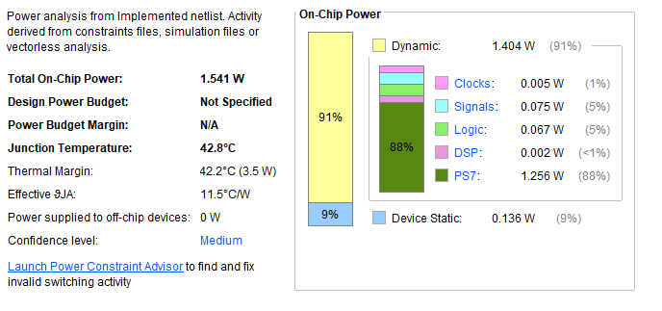
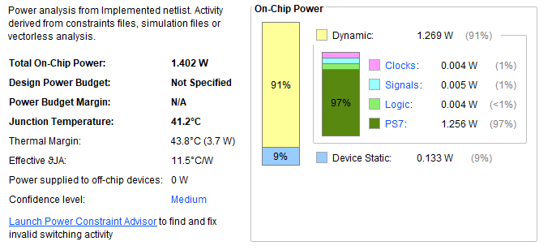
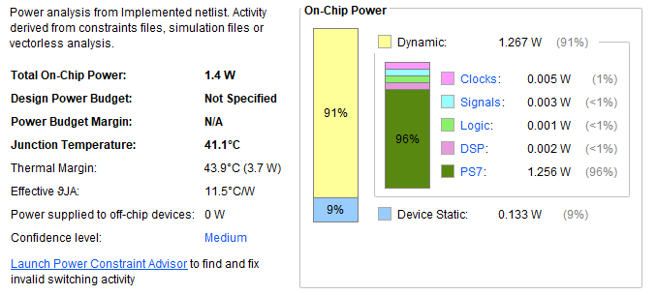
Floating Point
Configuration Power Report
Fixed Point
Configuration Power Report
Integer
Configuration Power Report
Notes:
Technically not the most recent but should be mostly accurate

Slide 41
Conclusions and Goals
-Design Objective
-Learn Verilog
-Intro to Vivado
-Partial Reconfig Multipliers
-Crossbar Data Switch
-Partial Reconfig Adder
-Matrix Accelerator
-Asynchronous FIFO
-Matrix Controller
-Convolution Accelerator Top Wrapper
-Enabling Partial Reconfig
-Dynamic Resources
-Floorplan
-Resource Utilization
-Power Report
-Conclusions

Slide 42
While much of the development process for RTL has streamlined by Xilinx, many times development and debugging could be quite tedious
The Convolution Accelerator controller needs new logic or pipeline to speed up
Floating point calculation needs work
Produce an actual feature map!
Notes:
While much of the development process for RTL has streamlined by Xilinx, many times development and debugging could be quite tedious
Much of the development process is very well documented for users of Tcl but nothing else
This often led to scrolling through forum posting for information rather than being able to rely on the official documentation
The Convolution Accelerator controller needs new logic or pipeline to speed up
When testing the design as is, I’ve found that much of the time for completing convolution is due to loading. I need to restructure my pipeline to allow for loading more than one data set at a time
Adding a buffer to hold the filter set is also in progress
Floating point calculation needs work
Due to timing failure, this part of the design is not functioning properly.
A likely next step would be to break up my math computation across more clocks
Produce an actual feature map ASAP
Since integer/fixed point is currently working, I would like to begin producing feature maps

Slide 43
Thank You

