Slide 1
Convolution Acceleration using Dynamic Hardware
Designed/Presented by David Cain
Special thanks to Omar Eddash and Adam Frost for mentorship

Slide 2
Overview
Design Objective
Project Introduction
Learn Verilog & Intro to Vivado
Enabling Partial Reconfig
Design Components
Partially Reconfigurable Multipliers
Crossbar Data Switch
Partially Reconfigurable Adder
Matric Accelerator
Matrix Controller
Asynchronous FIFO
Design High Level Wrapper
Design Resources
Floorplan
Resource Utilization
Power Report
Conclusions & Future Work

Slide 3
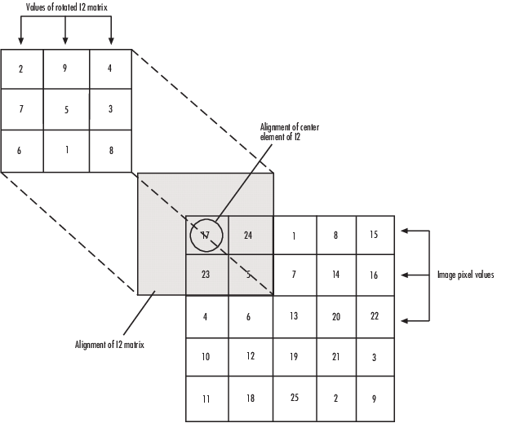
Design Objective
Develop an FPGA based reconfigurable design to accelerate matrix convolution within a greater processing pipeline
This is a computationally intensive step used in many image processing algorithms
The design must accept multiple data types
Each of these data types can be dynamically reconfigured on device
Notes:
This is a computationally intensive step used in many image processing algorithms
can benefit from hardware acceleration

Slide 4
Learn Verilog & Intro to Vivado
Design Objective
Project Introduction
Learn Verilog & Intro to Vivado
Enabling Partial Reconfiguration
Design Components
Partially Reconfigurable Multipliers
Crossbar Data Switch
Partially Reconfigurable Adder
Matric Accelerator
Matrix Controller
Asynchronous FIFO
Design High Level Wrapper
Design Resources
Floorplan
Resource Utilization
Power Report
Conclusions & Future Work
Project Introduction:

Slide 5

Upon entering the project, I was referenced this book and several tutorials to get a feeling of Verilog
Free Range VHDL, Bryan Mealy, 2018
Xilinx also has tutorials with pre-built designs to be imported and demonstrate concepts of how to use the hardware available
YouTube tutorials were also helpful for workflow within Vivado

Slide 6
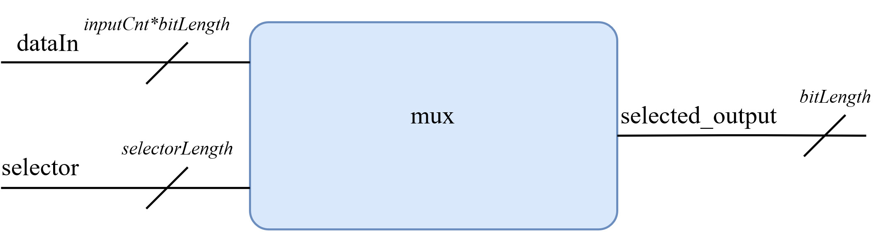
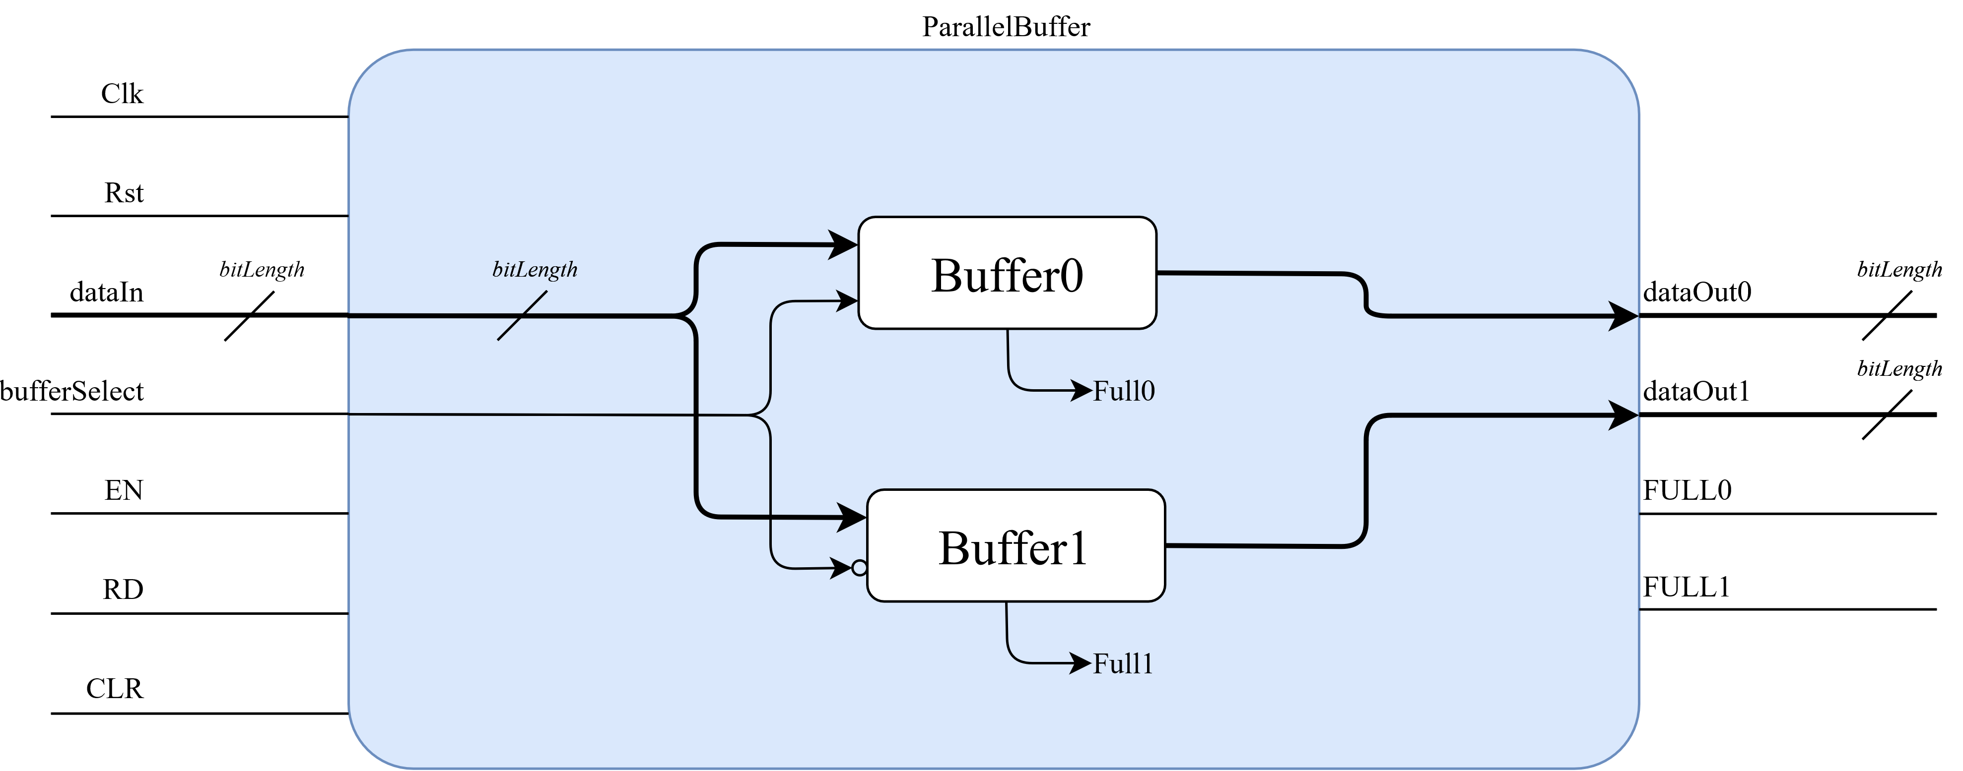
With a simple understanding of Verilog, basic designs were created and tested:
-Multibit port MUX
-Multibit flipflop register
-Parallel multibit flipflop
-Etc…

Slide 7
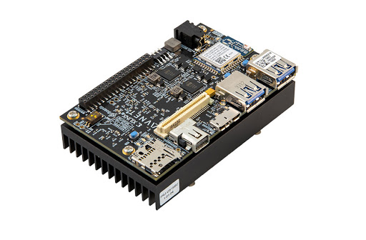
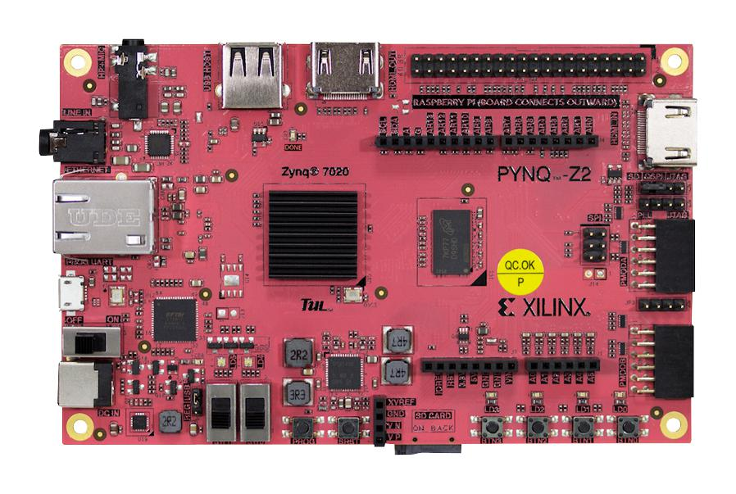
Vivado is the primary software suite used for RTL design when implementing on Xilinx based FPGAs such as the Pynq-Z2 & Ultra96 V2
Vivado offers multiple development forms:
HDL support for Verilog or VHDL
Built in IP Integrator using block diagrams
Notes:
Vivado offers design development using HDL or the built in IP Integrator using block diagrams
These block diagrams can compose of either base IPs provided by Xilinx or user custom IPs that are imported/created within the project
The HDL defining these Xilinx based IPs are not viewable by end-user

Slide 8
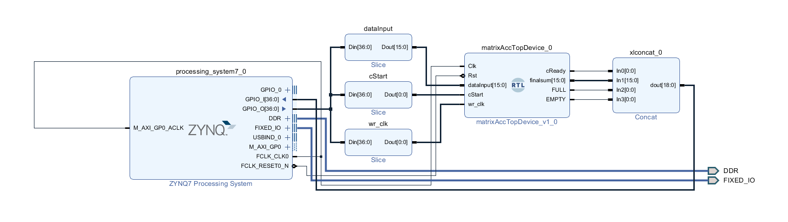
Example of block diagram interface
*For synthesis, block diagrams must be packaged with HDL wrappers generated by Vivado

Slide 9
Enabling Partial Reconfiguration
Design Objective
Project Introduction
Learn Verilog & Intro to Vivado
Enabling Partial Reconfiguration
Design Components
Partially Reconfigurable Multipliers
Crossbar Data Switch
Partially Reconfigurable Adder
Matric Accelerator
Matrix Controller
Asynchronous FIFO
Design High Level Wrapper
Design Resources
Floorplan
Resource Utilization
Power Report
Conclusions & Future Work
Project Introduction:

Slide 10
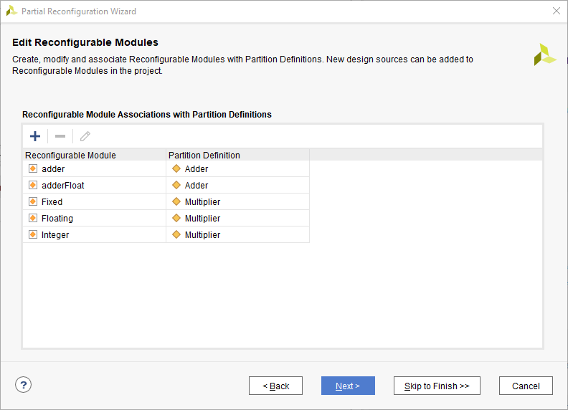
Using Vivado’s partial reconfiguration wizard, designs can become dynamically reconfigurable
This allows for partitions of the FPGA to be reprogrammed during runtime
When converting a project to partially reconfigurable, simulation is no longer available
Notes:
When converting a project to partially reconfigurable, simulation is no longer available
It is recommended to flesh out much of a PR design while static, then create a new project for a dynamic version

Slide 11
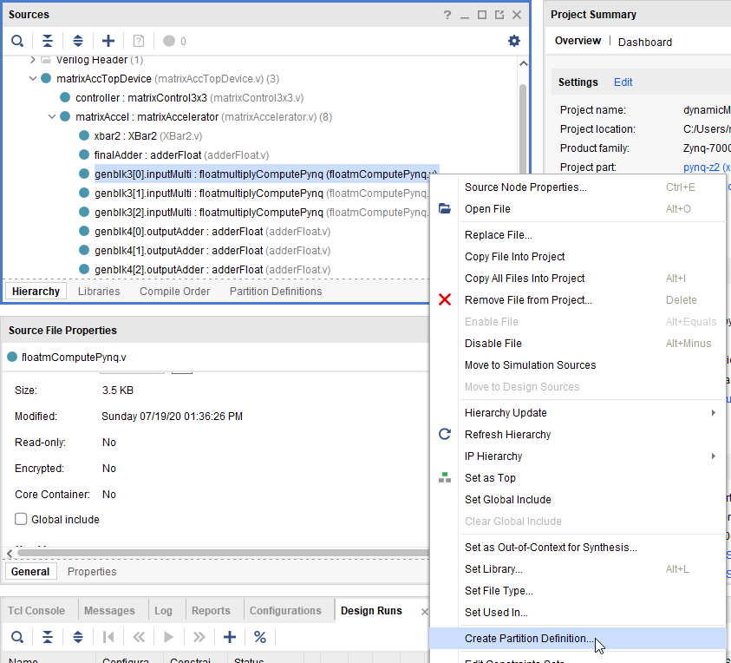
Backup project
Enable Partial Reconfiguration
Tools->Enable Partial Reconfiguration…
Select a device in top to create a partition definition
Notes:
Mention how Vivado makes the whole project PR
When a project is PR, can’t to simulation
A static and dynamic version of the project was created

Slide 12
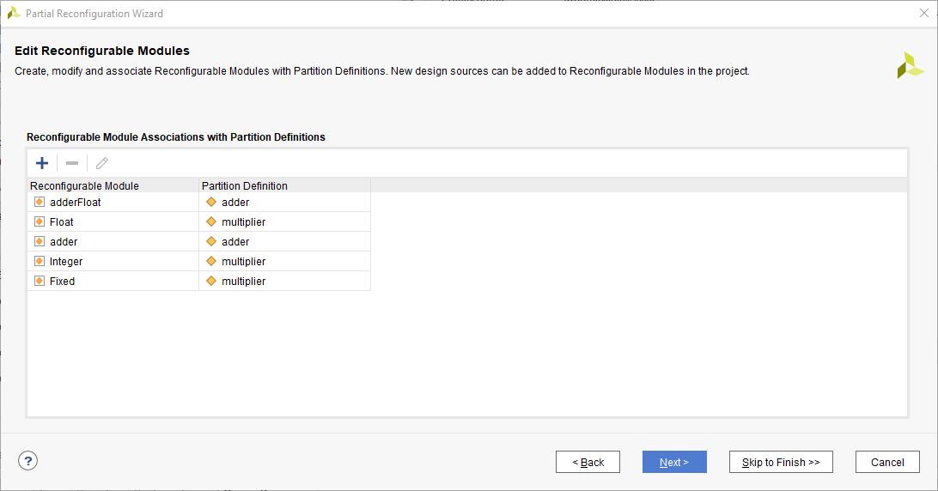
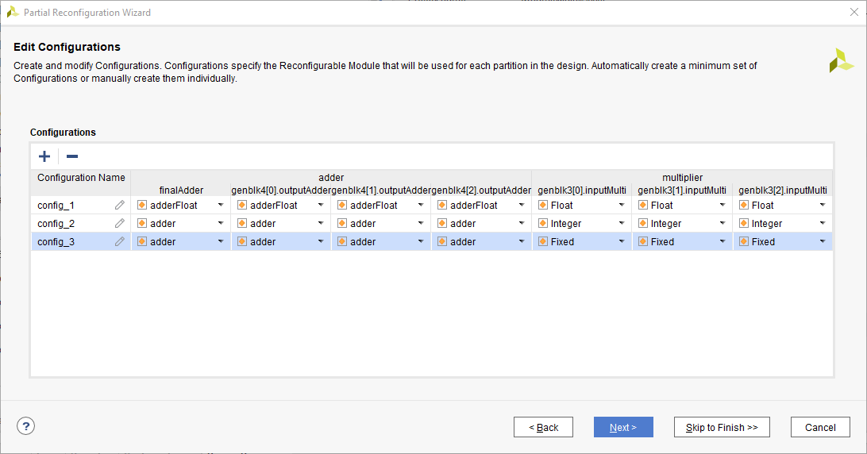
Add any needed partitions and modules
Create a configuration with modules set as needed
Notes:
Mention how Vivado makes the whole project PR
When a project is PR, can’t to simulation
A static and dynamic version of the project was created

Slide 13
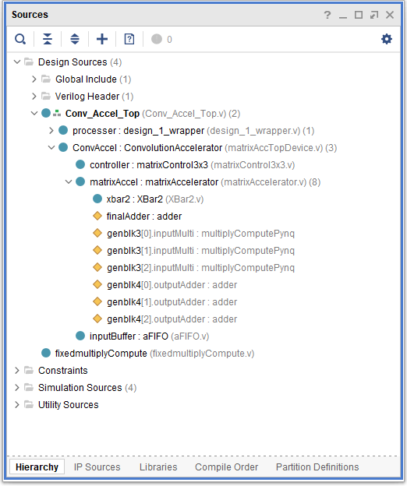
Hierarchy view of design wrapped together with partial reconfiguration enabled
Design Top
IP
Partial Reconfigurable
Partitions
Notes:
Mention how Vivado makes the whole project PR
When a project is PR, can’t to simulation
A static and dynamic version of the project was created

Slide 14
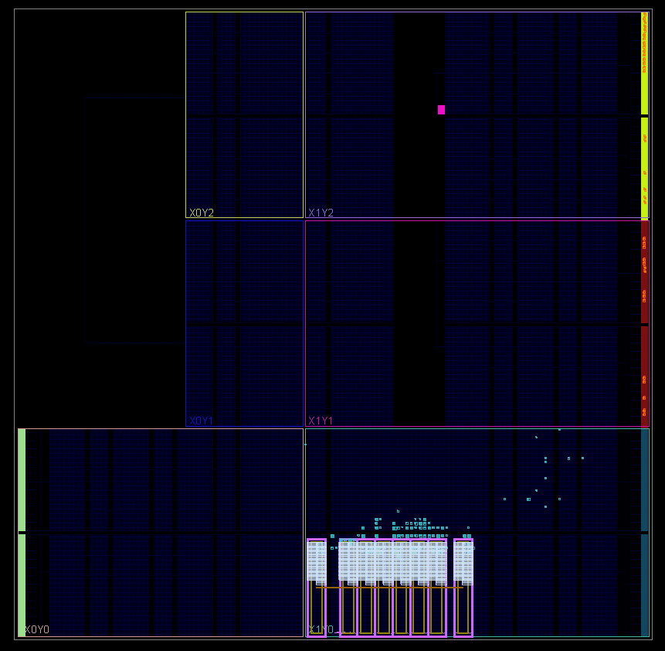
Each reconfigurable partition requires a dedicated pBlock to dictate the hardware available for reconfiguration
This is a screenshot of the floorplan for a design with 8 pBlocks to enable 8 separate reconfigurable multiply compute partitions.
Static Hardware
pBlock Definitions
Notes:
This is not a screenshot of the convolution accelerator. This was just a design that had less going on visually and was easier to demonstrate the components
Each reconfigurable partition requires a dedicated pBlock to dictate the hardware available for reconfiguration
This pBlock should contain only the dynamic module. Static modules will be placed and routed automatically

Slide 15
Partially Reconfigurable Multipliers
Design Objective
Project Introduction
Learn Verilog & Intro to Vivado
Enabling Partial Reconfiguration
Design Components
Partially Reconfigurable Multipliers
Crossbar Data Switch
Partially Reconfigurable Adder
Matric Accelerator
Matrix Controller
Asynchronous FIFO
Design High Level Wrapper
Design Resources
Floorplan
Resource Utilization
Power Report
Conclusions & Future Work
Design Components

Slide 16
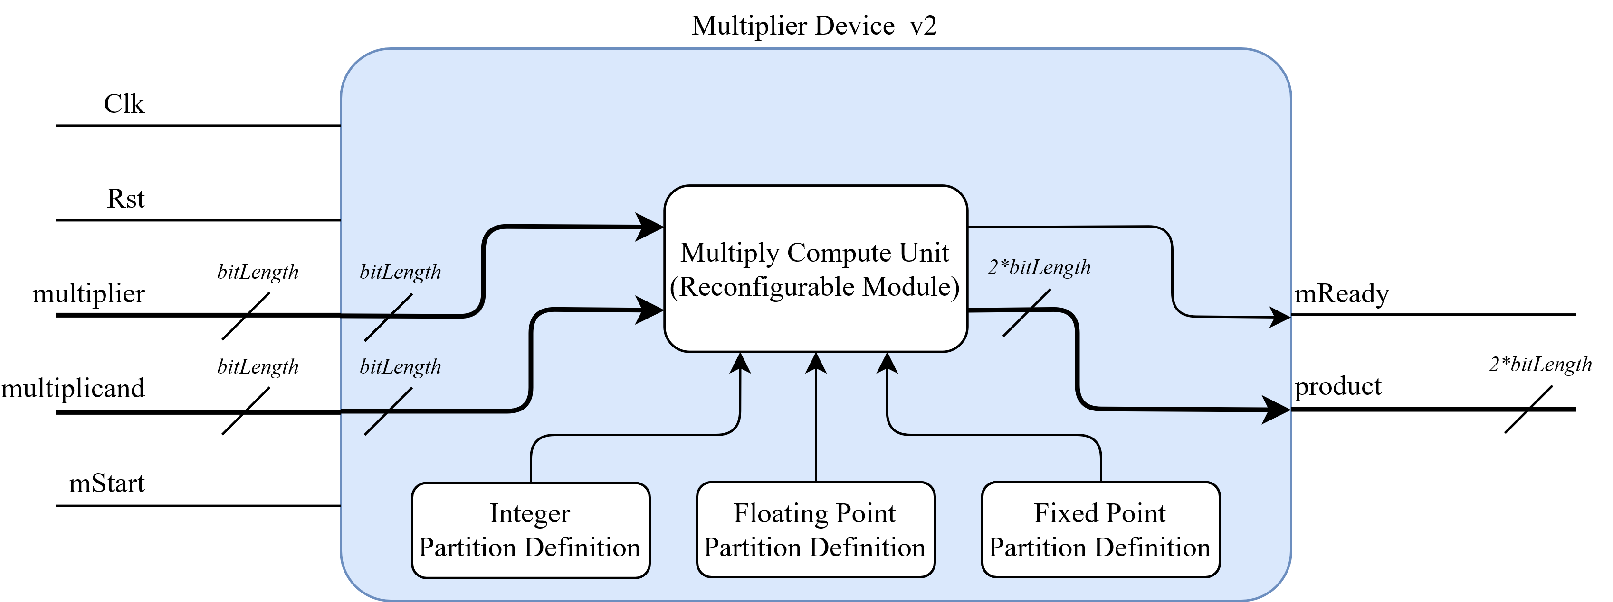
A first step was to implement devices that could intake 2 data values, multiply them, then return the product
The data type can be dynamically reconfigured as needed within the pipeline
The multiplication block is reliant on having DSPs available for allocation
Reconfigurable Partition
Definitions

Slide 17
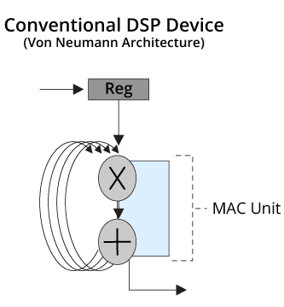
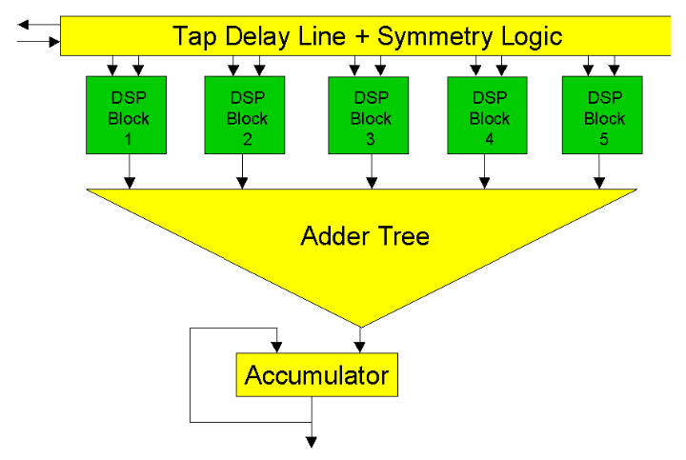
To elaborate on DSP use
While multiplication could be implemented strictly through logic, this would be resource wasteful and slow
Multipliers are often implemented on DSPs, particularly when time performance is important

Slide 18
Crossbar Data Switch
Design Objective
Project Introduction
Learn Verilog & Intro to Vivado
Enabling Partial Reconfiguration
Design Components
Partially Reconfigurable Multipliers
Crossbar Data Switch
Partially Reconfigurable Adder
Matric Accelerator
Matrix Controller
Asynchronous FIFO
Design High Level Wrapper
Design Resources
Floorplan
Resource Utilization
Power Report
Conclusions & Future Work
Design Components

Slide 19
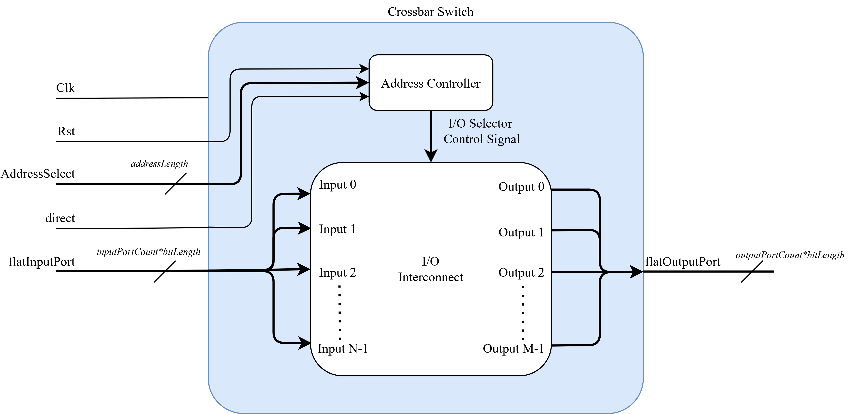
A crossbar switch was designed and implemented to handle product outputs
Basis for a crossbar switch is to allow any input port to be connected to any output port
Block diagram of crossbar
Notes:
A data link was needed to interface many parallel multiplier outputs to many parallel adder devices
A crossbar switch was designed and implemented. This switch allows for any input port to be selected and connected to any output port.
The crossbar was written from scratch to have variable input and output port counts
These ports are also variable bit length
-The data connection is asynchronous, mimicking wire connections

Slide 20
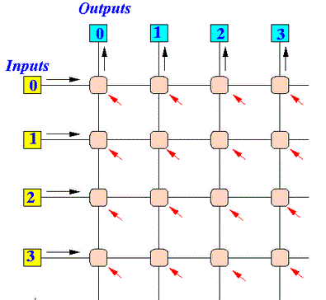
The crossbar operates on a grid connection concept. With N inputs and M outputs, this generates NxM valid address selections
At positive edge clocks, the address on AddressSelect port is toggled
If direct is HIGH, equal I/O ports will be connected.
i.e. Output0 = Input0; Input1 = Output1;…
M = 4
N = 4
1
2
3
4
5
6
7
8
9
10
11
12
13
14
15
16 Addresses
Notes:
Indexing actually starts at zero. This was just making the total count obvious

Slide 21
Partially Reconfigurable Adder
Design Objective
Project Introduction
Learn Verilog & Intro to Vivado
Enabling Partial Reconfiguration
Design Components
Partially Reconfigurable Multipliers
Crossbar Data Switch
Partially Reconfigurable Adder
Matric Accelerator
Matrix Controller
Asynchronous FIFO
Design High Level Wrapper
Design Resources
Floorplan
Resource Utilization
Power Report
Conclusions & Future Work
Design Components

Slide 22
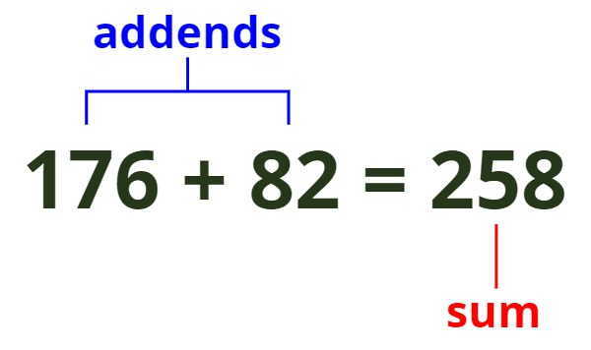
With a method to now compute many products in parallel and sort them, a device was needed to accumulate the sum of products
2 Partition definitions were created:
Integer/Fixed Point Adder
Floating Point Adder
Notes:
-Floating point needs much more logic due to needing to check the magnitude difference, then normalize the values

Slide 23
Matrix Accelerator
Design Objective
Project Introduction
Learn Verilog & Intro to Vivado
Enabling Partial Reconfiguration
Design Components
Partially Reconfigurable Multipliers
Crossbar Data Switch
Partially Reconfigurable Adder
Matric Accelerator
Matrix Controller
Asynchronous FIFO
Design High Level Wrapper
Design Resources
Floorplan
Resource Utilization
Power Report
Conclusions & Future Work
Design Components

Slide 24
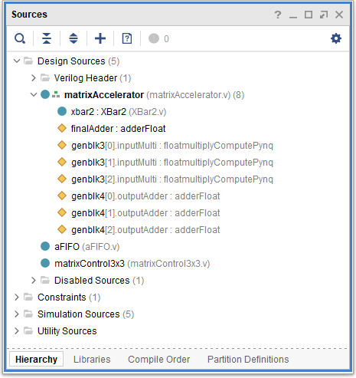
Hierarchy View
These components were then packaged into a single IP
This device has a lot of I/O and no built-in control logic
This means it must be packaged with a controller IP for operation
Dynamic Partitions

Slide 25
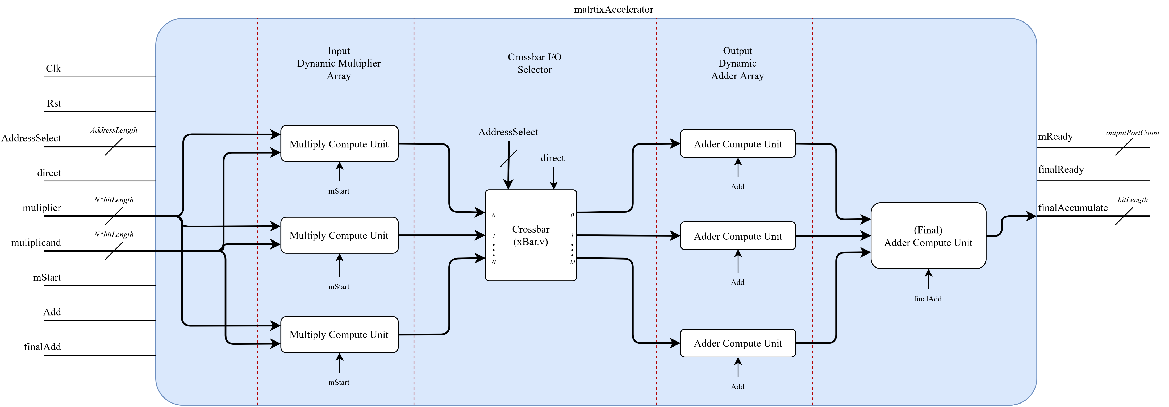

Block diagram of matrix accelerator

Slide 26
Matrix Controller
Design Objective
Project Introduction
Learn Verilog & Intro to Vivado
Enabling Partial Reconfiguration
Design Components
Partially Reconfigurable Multipliers
Crossbar Data Switch
Partially Reconfigurable Adder
Matric Accelerator
Matrix Controller
Asynchronous FIFO
Design High Level Wrapper
Design Resources
Floorplan
Resource Utilization
Power Report
Conclusions & Future Work
Design Components

Slide 27
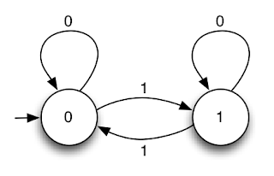
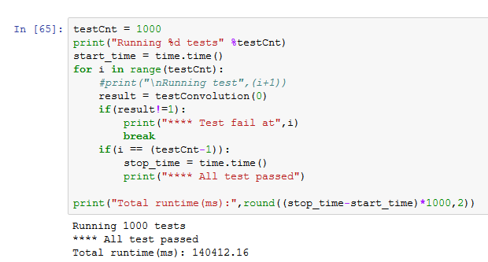
The controller needs to:
Read data in the input buffer
Pipeline data into the matrix accelerator
Use matrix accelerator control signals to generate convolution sum
The controller has three main states:
Reading data from the buffer
Multiplying the input values
Add the resulting products
Notes:
-Now with hardware to allow for external data input, a state machine controller is needed to complete computation
-Not complete with design because data throughput is very slow due to bad controller logic

Slide 28
Buffers are used to temporarily hold input values
Data Input Buffer
Filter Kernel Buffer
Notes:
-Now with hardware to allow for external data input, a state machine controller is needed to complete computation
-Not complete with design because data throughput is very slow due to bad controller logic

Slide 29
Buffers are used to temporarily hold input values
The first full input set is stored as the filter
Data Input Buffer
Filter Kernel Buffer
1
4
7
2
5
8
3
6
9
Notes:
-Now with hardware to allow for external data input, a state machine controller is needed to complete computation
-Not complete with design because data throughput is very slow due to bad controller logic

Slide 30
Buffers are used to temporarily hold input values
The first full input set is stored as the filter
The next full input set is temporarily stored as the data to be operated on
Data Input Buffer
1
4
7
2
5
8
3
6
9
Filter Kernel Buffer
1
4
7
2
5
8
3
6
9
Notes:
-Now with hardware to allow for external data input, a state machine controller is needed to complete computation
-Not complete with design because data throughput is very slow due to bad controller logic

Slide 31
Buffers are used to temporarily hold input values
The first full input set is stored as the filter
The next full input set is temporarily stored as the data to be operated on
After the convolution is completed, the data set is shifted to the left
Data Input Buffer
4
7
5
8
6
9
Filter Kernel Buffer
1
4
7
2
5
8
3
6
9
Notes:
-Now with hardware to allow for external data input, a state machine controller is needed to complete computation
-Not complete with design because data throughput is very slow due to bad controller logic

Slide 32
Buffers are used to temporarily hold input values
The first full input set is stored as the filter
The next full input set is temporarily stored as the data to be operated on
After the convolution is completed, the data set is shifted to the left
The next column of data fills the empty buffers, acting as a slide on the original feature set
The next convolution can now be computed
Data Input Buffer
4
7
10
5
8
11
6
9
12
Filter Kernel Buffer
1
4
7
2
5
8
3
6
9
Notes:
-Now with hardware to allow for external data input, a state machine controller is needed to complete computation
-Not complete with design because data throughput is very slow due to bad controller logic

Slide 33
Asynchronous FIFO
Design Objective
Project Introduction
Learn Verilog & Intro to Vivado
Enabling Partial Reconfiguration
Design Components
Partially Reconfigurable Multipliers
Crossbar Data Switch
Partially Reconfigurable Adder
Matric Accelerator
Matrix Controller
Asynchronous FIFO
Design High Level Wrapper
Design Resources
Floorplan
Resource Utilization
Power Report
Conclusions & Future Work
Design Components

Slide 34
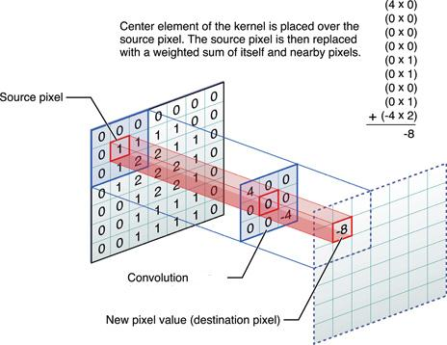
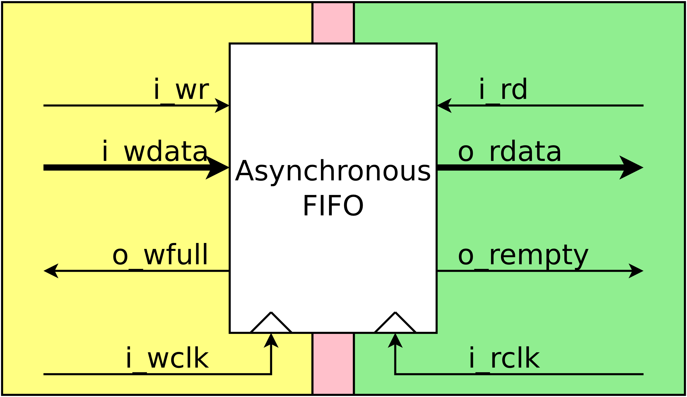
The convolution accelerator needs much data input
Data Set (Image Values)
Filter Set (Filter Values)
Since the program will not be able to load values and operate the FPGA properly, an asynchronous FIFO buffer was used to input a data set across the clock domains

Slide 35
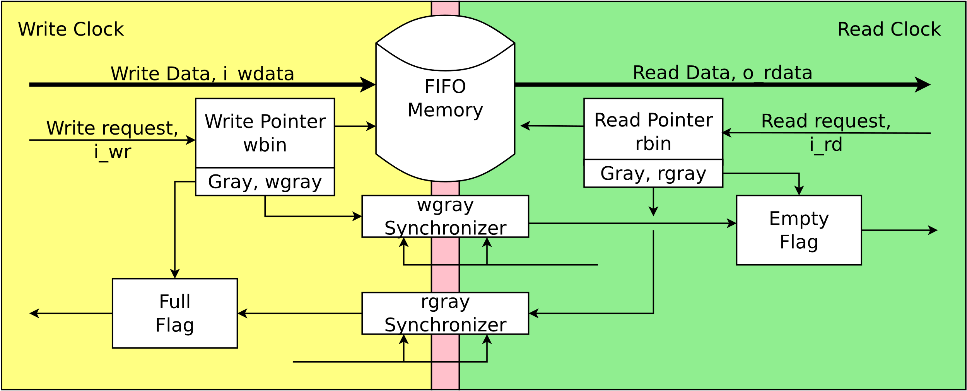
There was a helpful online project:
Crossing Clock Domains with an Asynchronous FIFO, Dan Gisselquist, 2018
https://zipcpu.com/blog/2018/07/06/afifo.html
I attempted to write this IP from scratch, but the problem was difficult
This write-up by Gisselquist was an extensive overview of the device problems, behavior, and similar work

Slide 36
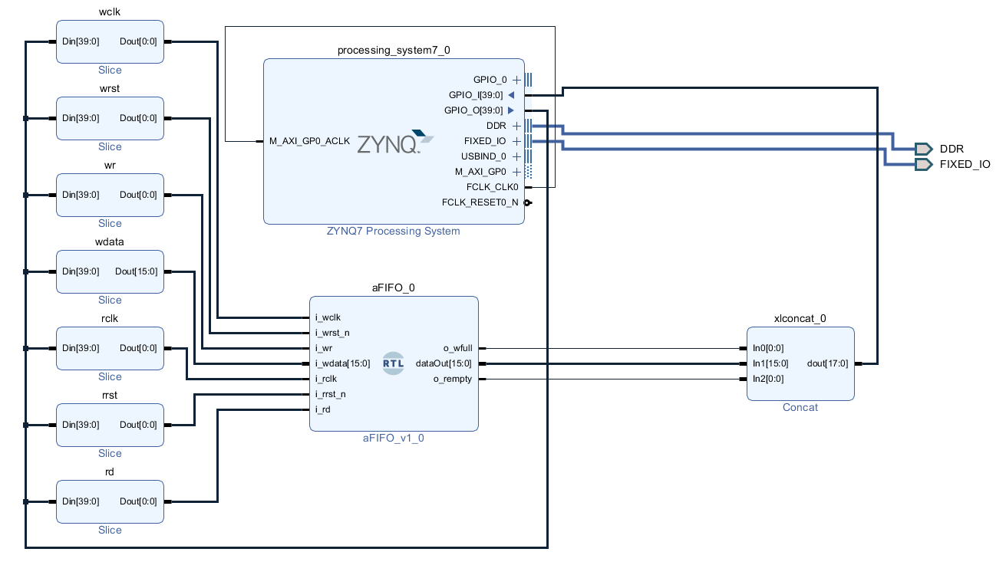
To verify this FIFO design was suitable, it was first tested in Vivado simulation
In the Python environment, the buffer would be filled with a random data set
Next, the buffer data would be extracted and compared with original input
The load/compare times were also tracked
Notes:
A bitstream and block diagram was generated to program the FPGA with the Python3 interface

Slide 37
Design High Level Wrapper
Design Objective
Project Introduction
Learn Verilog & Intro to Vivado
Enabling Partial Reconfiguration
Design Components
Partially Reconfigurable Multipliers
Crossbar Data Switch
Partially Reconfigurable Adder
Matric Accelerator
Matrix Controller
Asynchronous FIFO
Design High Level Wrapper
Design Resources
Floorplan
Resource Utilization
Power Report
Conclusions & Future Work
Design Components

Slide 38
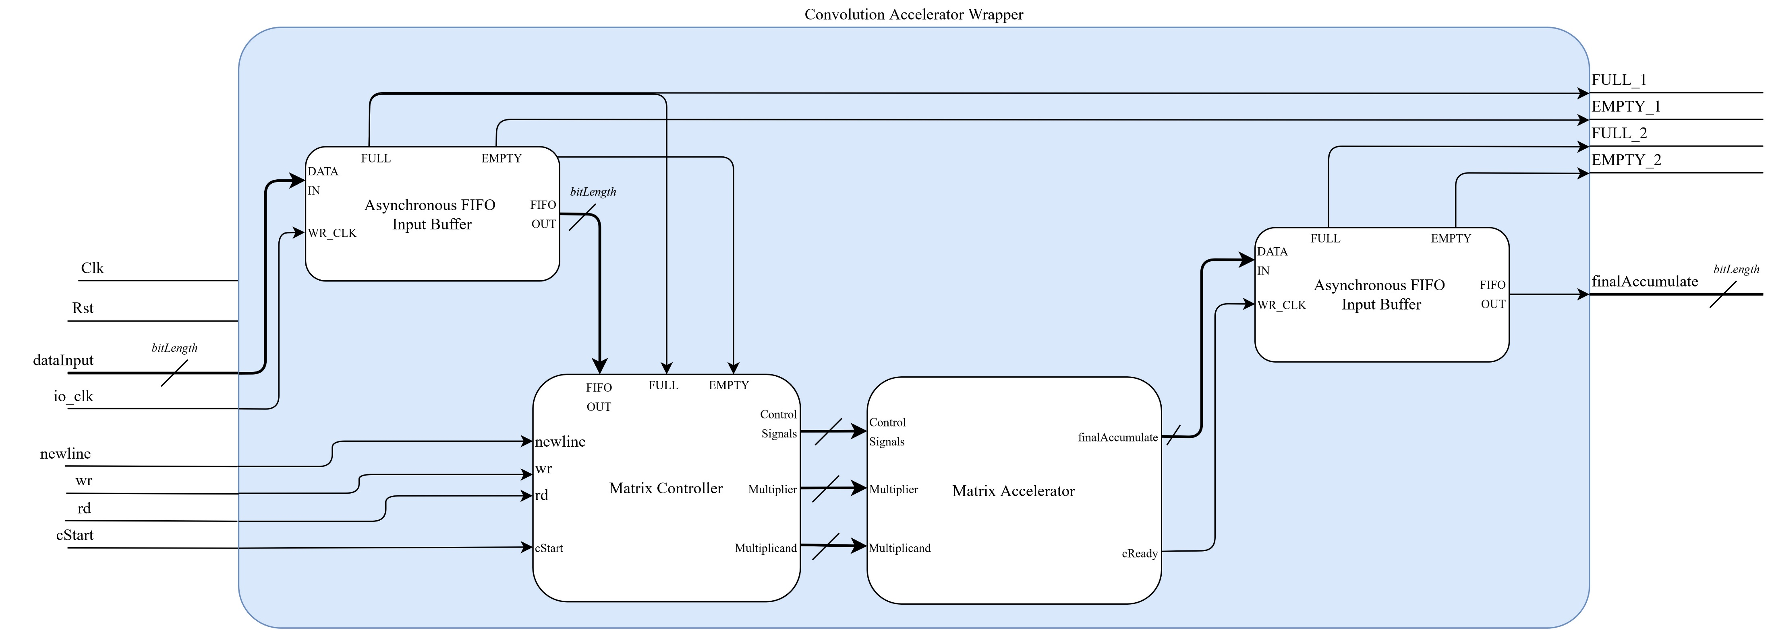
A top-level package was created to wrap the input buffer, matrix accelerator, and controller into one design
Convolution Accelerator block diagram
Notes:
This device has three dynamic configurations: Integer, Floating Point, Fixed Point

Slide 39
Floorplan
Design Objective
Project Introduction
Learn Verilog & Intro to Vivado
Enabling Partial Reconfiguration
Design Components
Partially Reconfigurable Multipliers
Crossbar Data Switch
Partially Reconfigurable Adder
Matric Accelerator
Matrix Controller
Asynchronous FIFO
Design High Level Wrapper
Design Resources
Floorplan
Resource Utilization
Power Report
Conclusions & Future Work
Design Resources

Slide 40
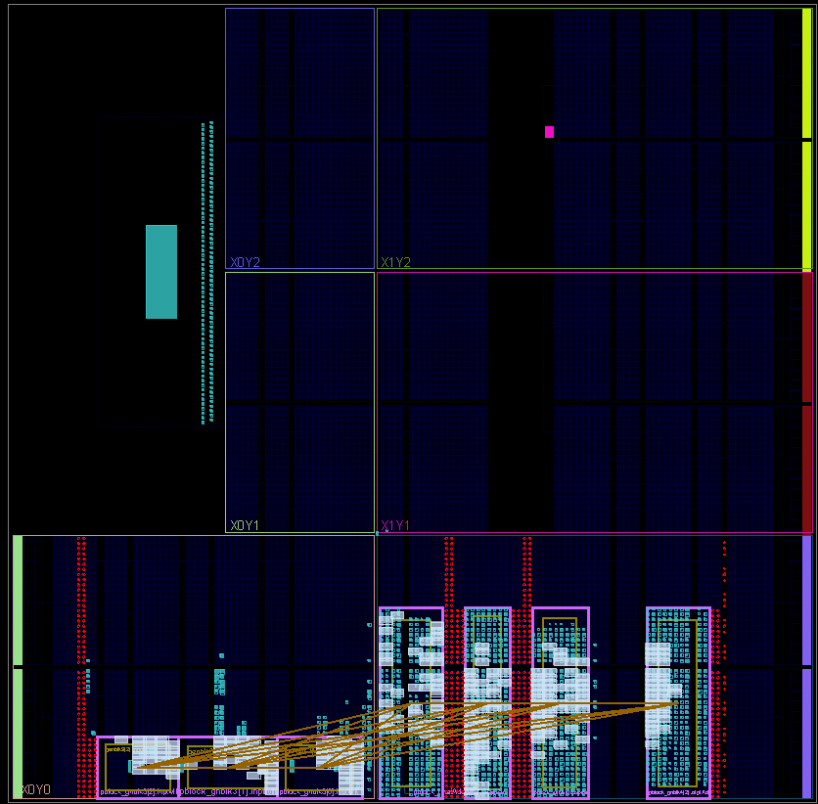
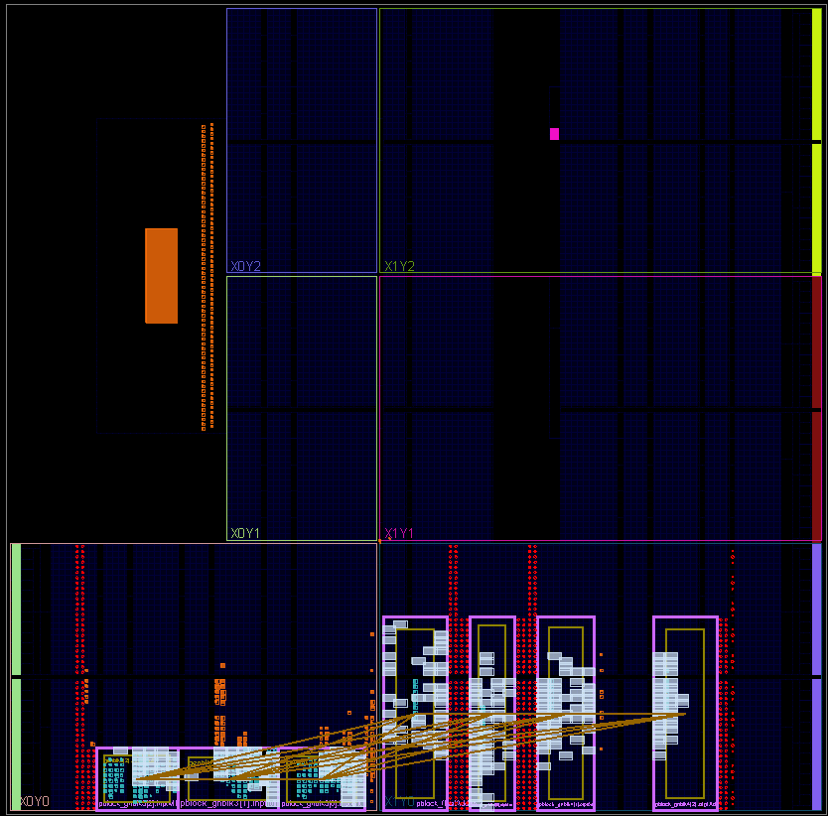
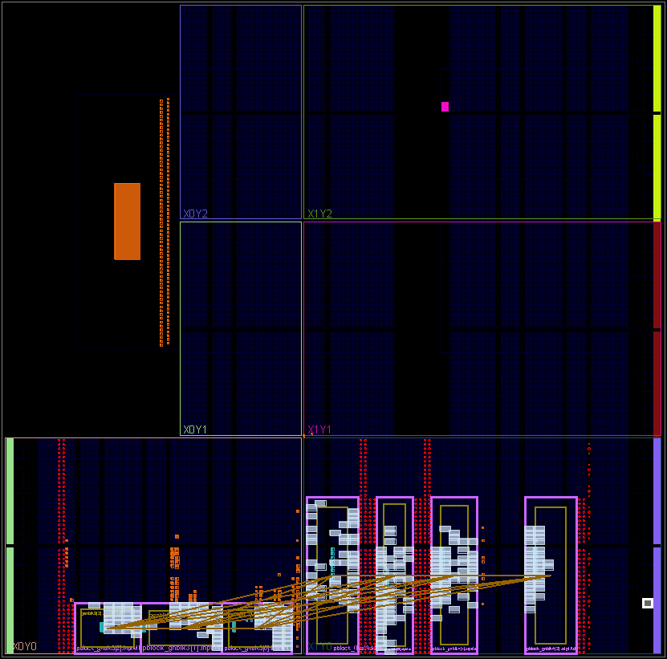
3x3 Kernel at 16-bit width
Floating Point
Configuration Floorplan
Fixed Point
Configuration Floorplan
Integer
Configuration Floorplan
Notes:
Technically not the most recent but should be mostly accurate

Slide 41
Resource Utilization
Design Objective
Project Introduction
Learn Verilog & Intro to Vivado
Enabling Partial Reconfiguration
Design Components
Partially Reconfigurable Multipliers
Crossbar Data Switch
Partially Reconfigurable Adder
Matric Accelerator
Matrix Controller
Asynchronous FIFO
Design High Level Wrapper
Design Resources
Floorplan
Resource Utilization
Power Report
Conclusions & Future Work
Design Resources

Slide 42
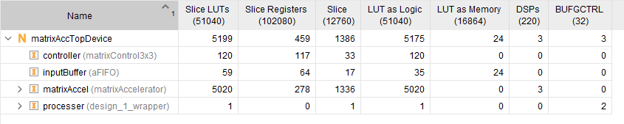
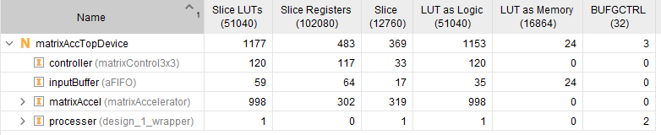
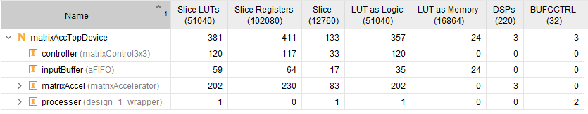
!!!!
Floating Point
Configuration Resource Utilization
Fixed Point
Configuration Resource Utilization
3x3 Kernel at 16-bit width
Integer
Configuration Resource Utilization
Notes:
Floating point uses much much more device resources
Even with high utilization of resources from floating point, design uses about 10% of available LUTs on Pynq-Z2
Technically not the most recent but should be mostly accurate

Slide 43
Power Report
Design Objective
Project Introduction
Learn Verilog & Intro to Vivado
Enabling Partial Reconfiguration
Design Components
Partially Reconfigurable Multipliers
Crossbar Data Switch
Partially Reconfigurable Adder
Matric Accelerator
Matrix Controller
Asynchronous FIFO
Design High Level Wrapper
Design Resources
Floorplan
Resource Utilization
Power Report
Conclusions & Future Work
Design Resources

Slide 44
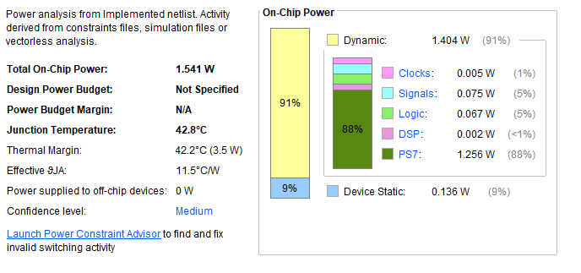
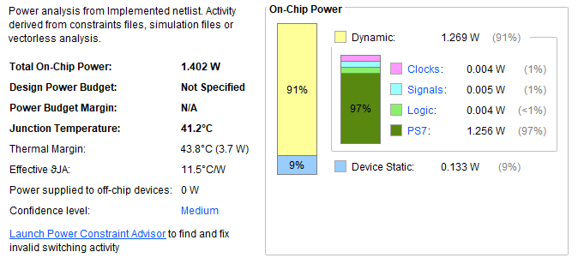
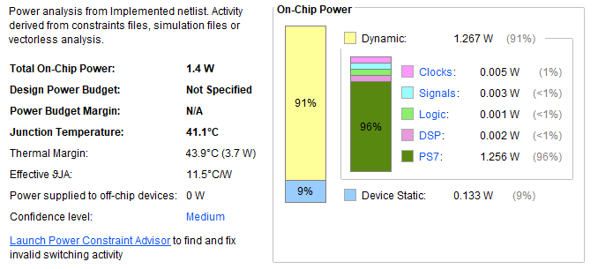
3x3 Kernel at 16-bit width
Floating Point
Configuration Power Report
Fixed Point
Configuration Power Report
Integer
Configuration Power Report
Notes:
Technically not the most recent but should be mostly accurate

Slide 45
Conclusions & Future Work
Design Objective
Project Introduction
Learn Verilog & Intro to Vivado
Enabling Partial Reconfiguration
Design Components
Partially Reconfigurable Multipliers
Crossbar Data Switch
Partially Reconfigurable Adder
Matric Accelerator
Matrix Controller
Asynchronous FIFO
Design High Level Wrapper
Design Resources
Floorplan
Resource Utilization
Power Report
Conclusions & Future Work

Slide 46
Conclusions
While much of the development process for RTL has streamlined by Xilinx, many times development and debugging could be quite tedious
Currently software to control the FPGA is python based and seems to result in long runtimes for simple computation
Floating point utilizes much more resources compared to integer or fixed point
Notes:
While much of the development process for RTL has streamlined by Xilinx, many times development and debugging could be quite tedious
Much of the development process is very well documented for users of Tcl but nothing else
This often led to scrolling through forum posting for information rather than being able to rely on the official documentation
The Convolution Accelerator controller needs new logic or pipeline to speed up
When testing the design as is, I’ve found that much of the time for completing convolution is due to loading. I need to restructure my pipeline to allow for loading more than one data set at a time
Adding a buffer to hold the filter set is also in progress
Floating point calculation needs work
Due to timing failure, this part of the design is not functioning properly.
A likely next step would be to break up my math computation across more clocks
Produce an actual feature map ASAP
Since integer/fixed point is currently working, I would like to begin producing feature maps

Slide 47
Future Work
New software for loading data sets will likely be written in Xilinx’s SDK suite
Floating point needs to be overlooked due to failing synthesis with timing issues
Gather data comparing runtime and efficiency compared to software-based methods
Begin generating feature maps
Notes:
While much of the development process for RTL has streamlined by Xilinx, many times development and debugging could be quite tedious
Much of the development process is very well documented for users of Tcl but nothing else
This often led to scrolling through forum posting for information rather than being able to rely on the official documentation
The Convolution Accelerator controller needs new logic or pipeline to speed up
When testing the design as is, I’ve found that much of the time for completing convolution is due to loading. I need to restructure my pipeline to allow for loading more than one data set at a time
Adding a buffer to hold the filter set is also in progress
Floating point calculation needs work
Due to timing failure, this part of the design is not functioning properly.
A likely next step would be to break up my math computation across more clocks
Produce an actual feature map ASAP
Since integer/fixed point is currently working, I would like to begin producing feature maps

Slide 48
Thank You

