Slide 1
Dynamic Hardware Matrix Acceleration Design Reflection
Designed/Presented by David Cain
Special thanks to Omar Eddash and Adam Frost for mentorship

Slide 2
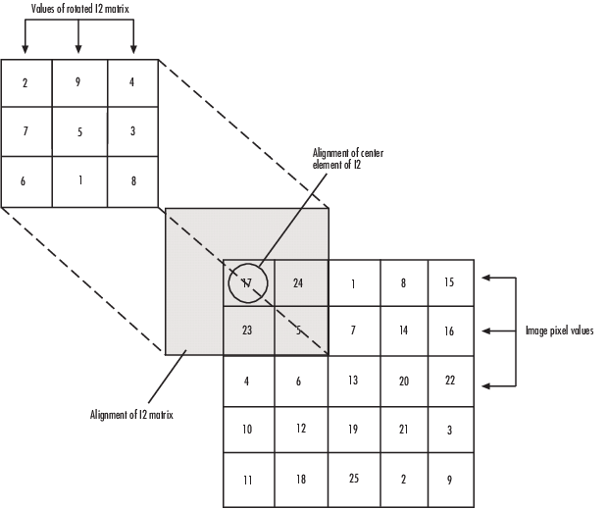
Design Objective
Develop an FPGA based reconfigurable design to accelerate matrix convolution
This is a computationally intensive process used in many image processing algorithms that can benefit from hardware acceleration
The design must accept multiple data types
Integer data values
Floating point data values
Fixed point data values
Each of these data types can be dynamically reconfigured on device

Slide 3
Intro to Vivado
Vivado is the primary software suite used when working with Xilinx based FPGAs such as the Pynq-Z2
Vivado offers design development using HDL or the built in IP Integrator using block diagrams
These block diagrams can compose of either default IPs provided by Xilinx or user custom IPs that are imported/created within the project
The HDL defining these Xilinx based IPs are not viewable by end-user
Often both development forms are used when working on a design

Slide 4
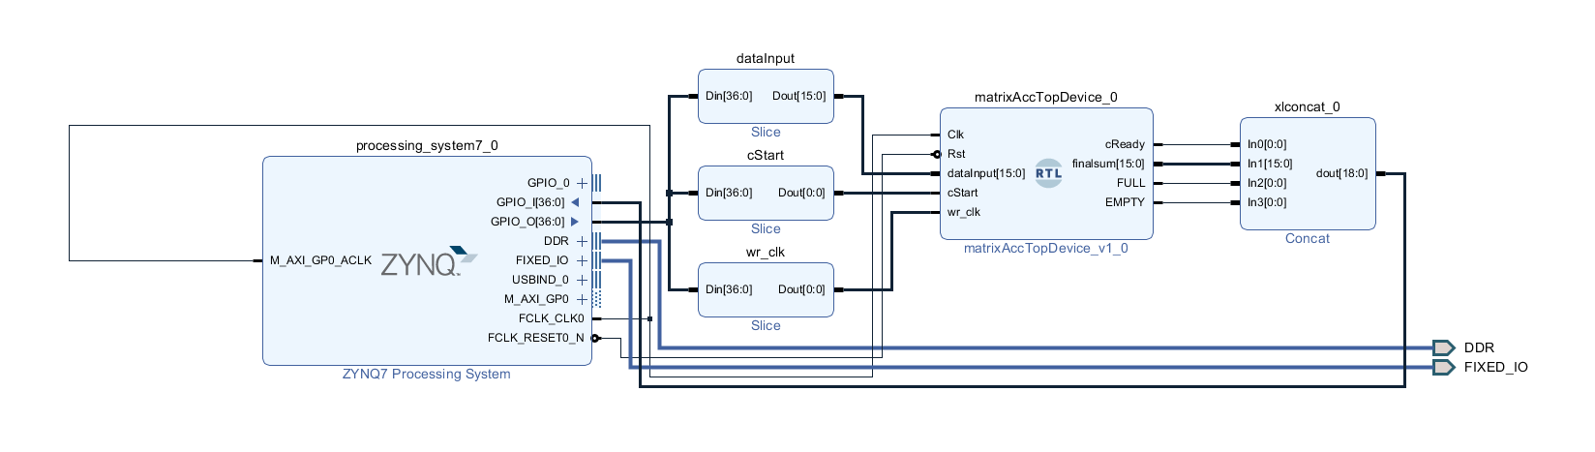
Intro to Vivado (cont.)
Example of block diagram interface
*For synthesis, block diagrams must be packaged with HDL wrappers generated by Vivado

Slide 5

Design Step 1: Learn Verilog
Upon entering the project, I was referenced this book and several tutorials to get a feeling of Verilog
Free Range VHDL, Bryan Mealy, 2018
Xilinx also has tutorials with pre-built designs to be imported and demonstrate concepts of how to use the hardware available
YouTube tutorials were also helpful for workflow within Vivado

Slide 6
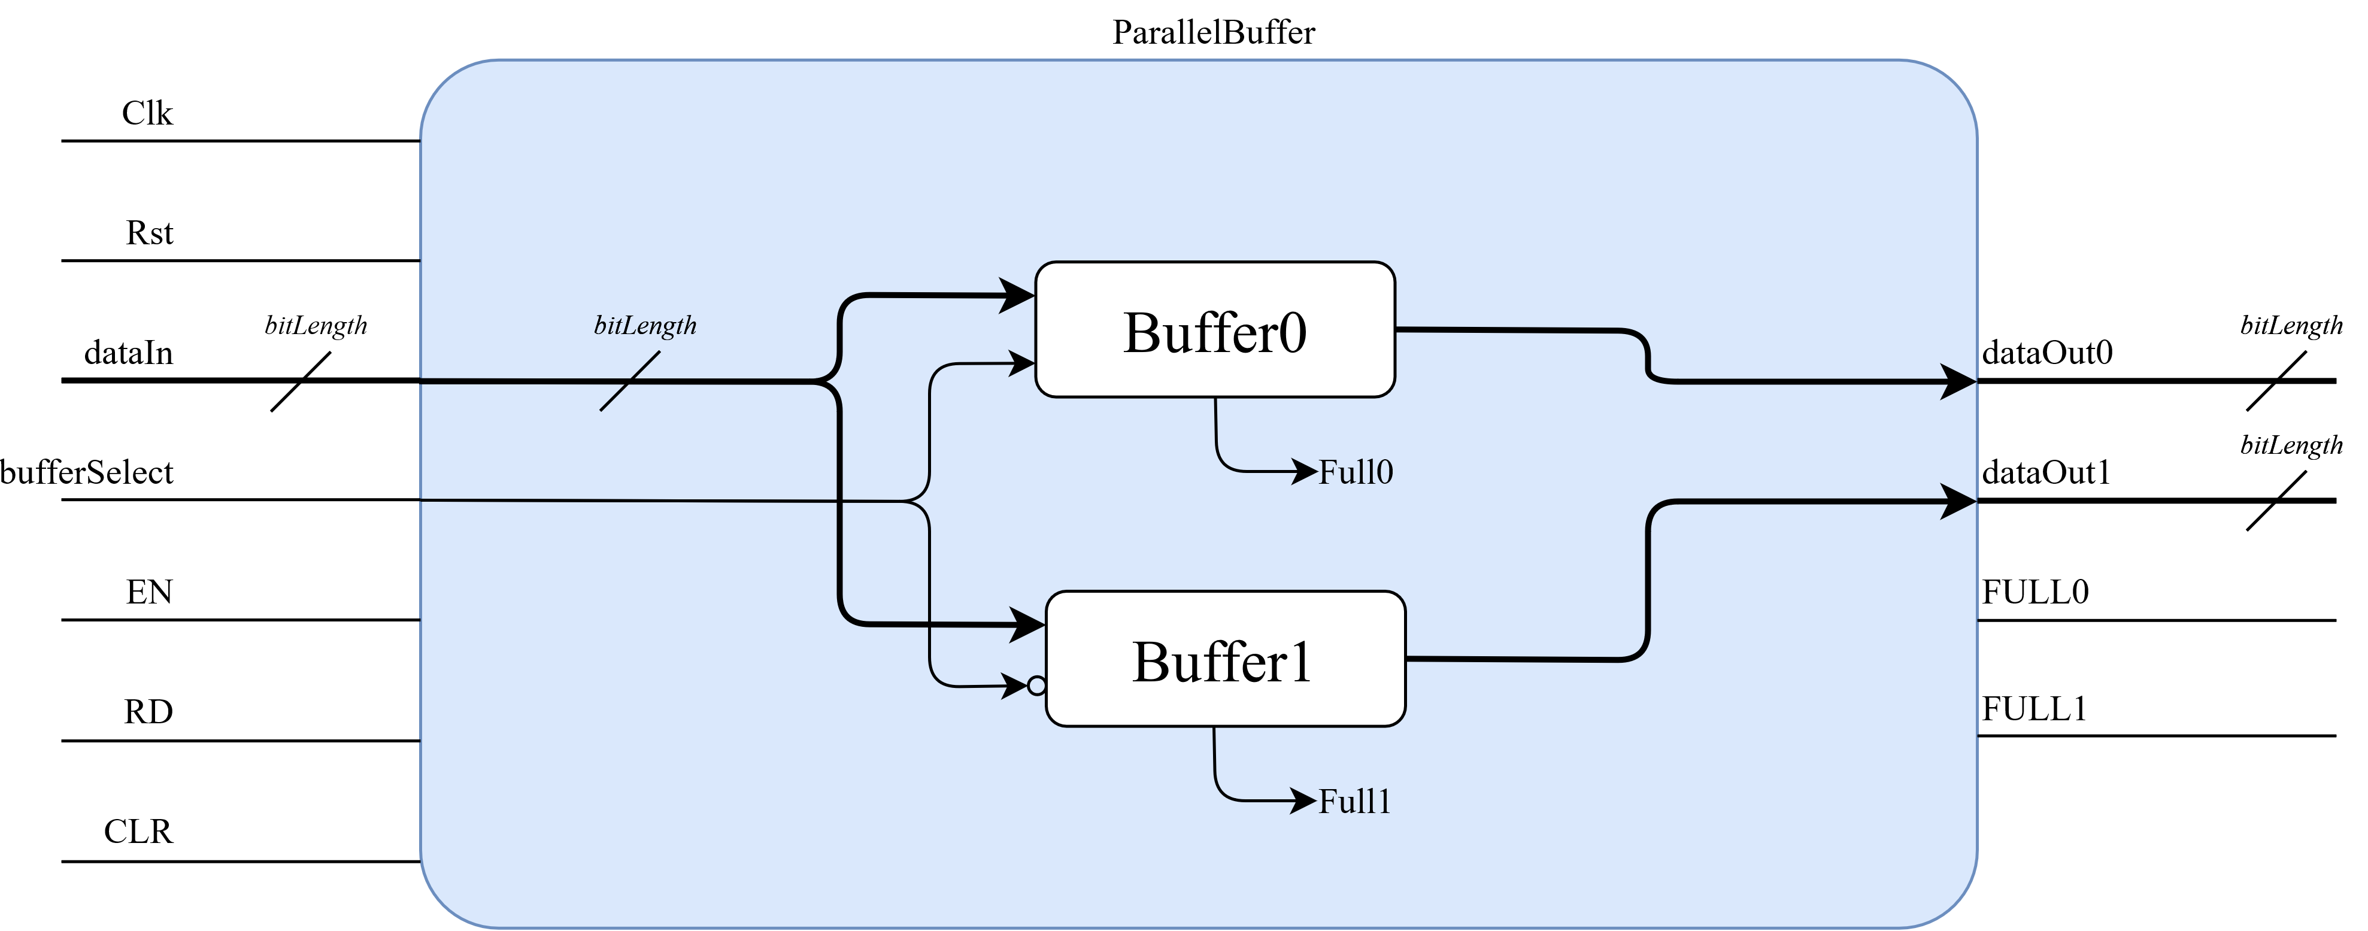
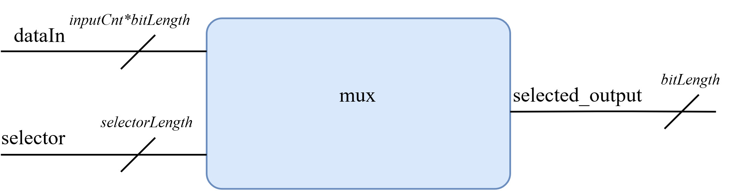
Design Step 1: Learn Verilog (cont.)
With a simple understanding of Verilog, basic designs were created and tested to verify understanding:
Multibit flipflop register (FlipFlop.v)
Parallel multibit flipflop (ParallelBuffer.v)
Multibit port MUX (mux.v)
Variable data slicer (dataSplit.v)

Slide 7
Design Step 2: Partial Reconfig Multipliers
A first step was to implement devices that could intake 2 data values, multiply them, then return the product
This needed to be designed for three separate data types, with separate algorithms to complete each computation type
This was initially designed to buffer input data internally, allowing for parallel computations. The buffered input was removed due to adding unnecessary delay while pipelining data streams

Slide 8
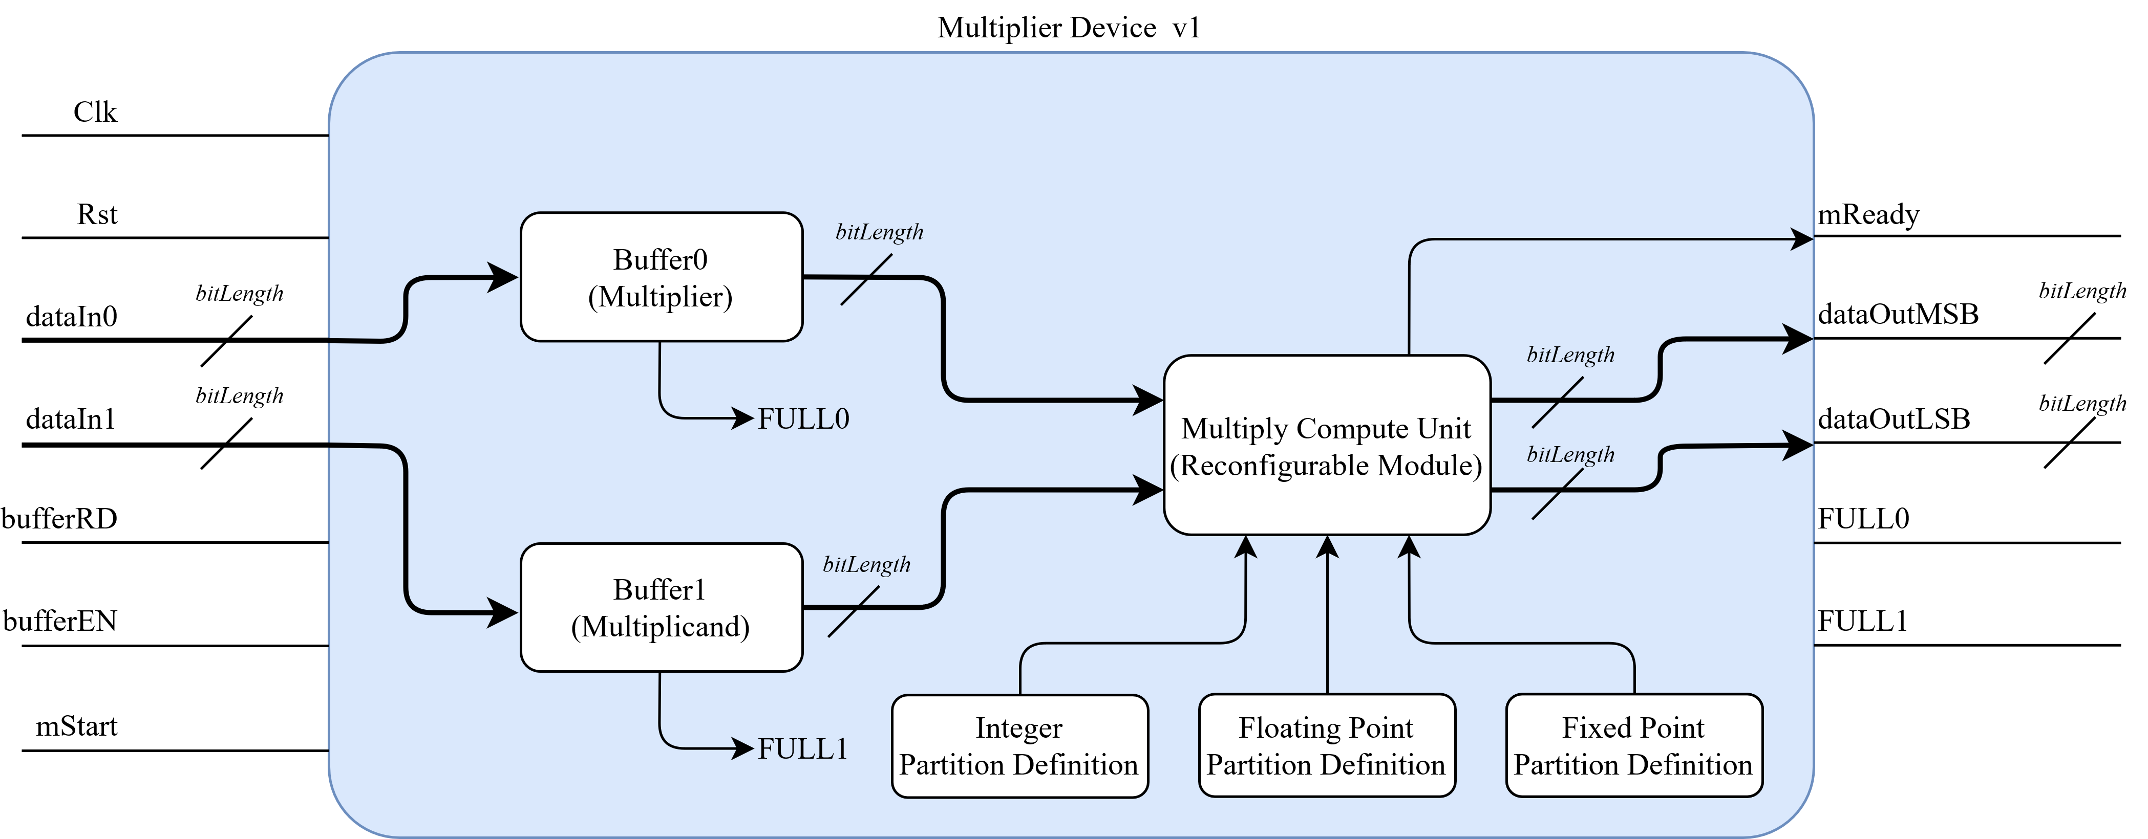
Design Step 2: Partial Reconfig Multipliers (cont.)
Block diagram of multiplier v1

Slide 9
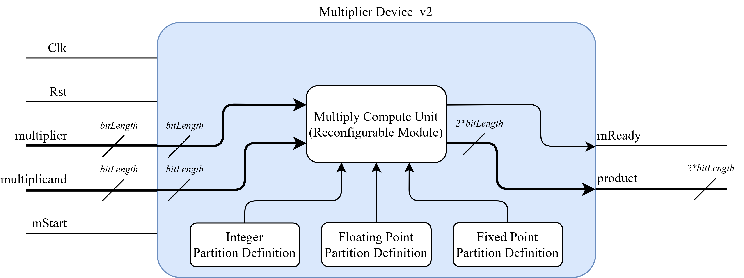
Design Step 2: Partial Reconfig Multipliers (cont.)
Block diagram of multiplier v2

Slide 10
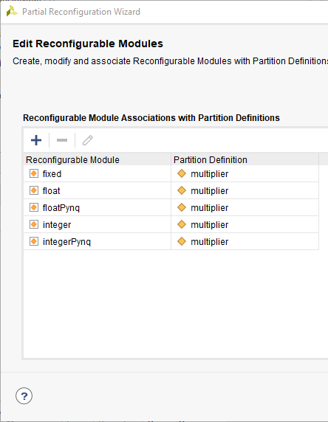
Design Step 3: Enabling Partial Reconfig
Using Vivado’s partial reconfiguration wizard, designs can become dynamically reconfigurable
This allows for partitions of the FPGA to be reprogrammed. Reprogrammable partitions a can be loaded with many module types for different functionality
When converting a project to partially reconfigurable, simulation is no longer available
It is recommended to flesh out much of a PR design while static, then create a new project for a dynamic version
Notes:
Mention how Vivado makes the whole project PR
When a project is PR, can’t to simulation
A static and dynamic version of the project was created

Slide 11
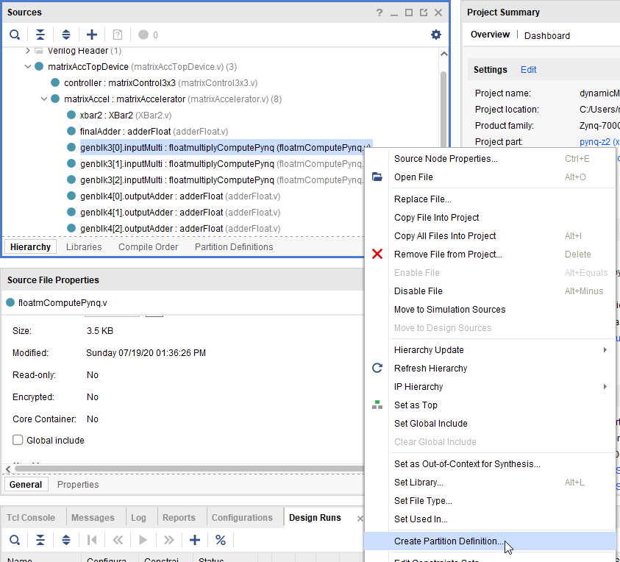
Design Step 3: Enabling Partial Reconfig (cont.)
Backup project
Enable Partial Reconfiguration
Tools->Enable Partial Reconfiguration…
Select a device in top to create a partition definition
Notes:
Mention how Vivado makes the whole project PR
When a project is PR, can’t to simulation
A static and dynamic version of the project was created

Slide 12
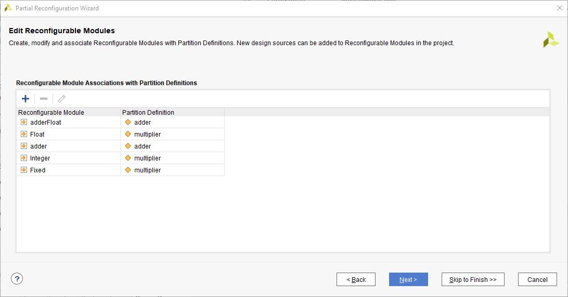
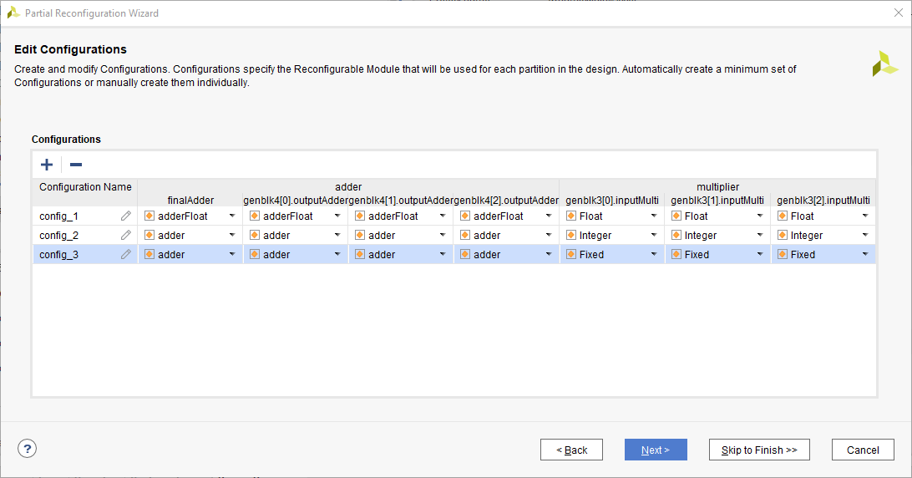
Design Step 3: Enabling Partial Reconfig (cont.)
Add any needed partitions and modules
Create a configuration with modules set as needed
Notes:
Mention how Vivado makes the whole project PR
When a project is PR, can’t to simulation
A static and dynamic version of the project was created

Slide 13
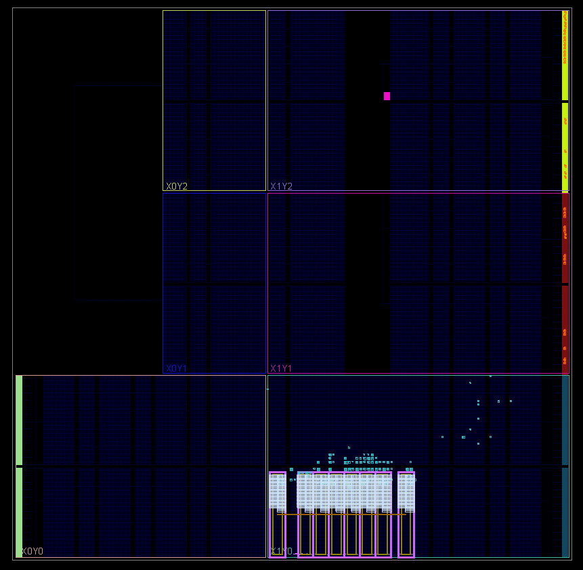
Design Step 3: Enabling Partial Reconfig (cont.)
Each reconfigurable partition requires a dedicated pBlock to dictate the hardware available for reconfiguration
This pBlock should contain only the dynamic module. Static modules will be placed and routed automatically
This is a screenshot of the floorplan for a design with 8 pBlocks to enable 8 seperate reconfigurable multiply compute partitions.
Static Hardware
pBlock Definitions

Slide 14
Design Step 4: Crossbar Data Switch
A data link was needed to interface many parallel multiplier outputs to many parallel adder devices
A crossbar switch was designed and implemented. This switch allows for any input port to be selected and connected to any output port.
The crossbar was written from scratch to have variable input and output port counts
These ports are also variable bit length
The data connection is asynchronous, mimicking wire connections

Slide 15
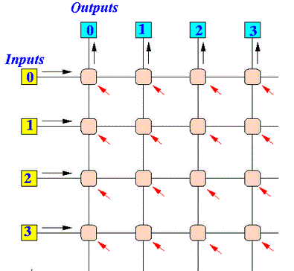
Design Step 4: Crossbar Data Switch (cont.)
The crossbar operates on a grid connection method. With N inputs and M outputs, this generates NxM valid address selections
At positive edge clocks, the address on AddressSelect port is toggled
If direct is HIGH, equal I/O ports will be connected.
i.e. Output0 = Input0; Input1 = Output1;…
M = 4
N = 4
1
2
3
4
5
6
7
8
9
10
11
12
13
14
15
16 Addresses

Slide 16
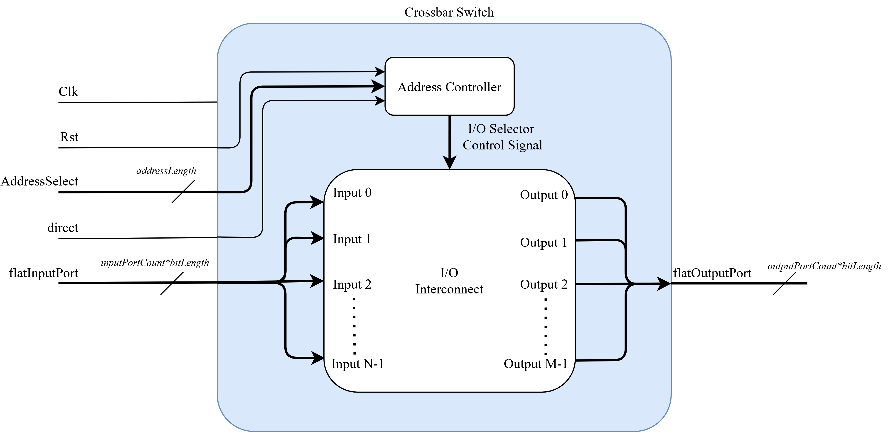
Design Step 4: Crossbar Data Switch (cont.)
Block diagram of crossbar

Slide 17
Design Step 5: Partial Reconfig Adder
With a method to now compute many products in parallel and sort them, a device was needed to accumulate the sum of products
2 Partition definitions were created:
Integer/Fixed Point Adder
Floating Point Adder
Floating point needs much more logic due to needing to check the magnitude difference, then normalize the values

Slide 18
Design Step 6: Matrix Accelerator
The devices were then packaged into a single IP, matrixAcclerator

