Slide 1

Project Go Live
Item Alarm

Slide 2
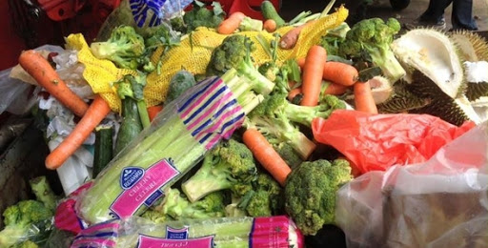
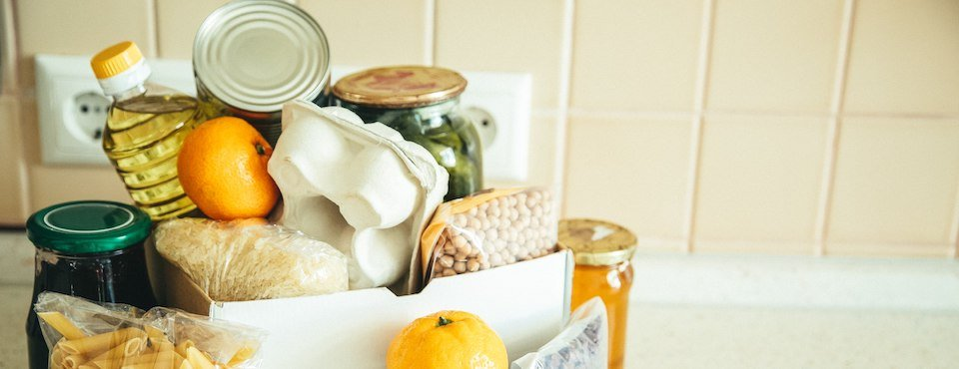
Why are we here?
Motivation to reduce the constant waste cause by expired products
2019 study shows food wasted due to expiry amounts to S$342million each year (https://www.todayonline.com/singapore/every-singaporean-household-throws-away-average-s258-worth-food-year-study)
Food waste contribute to about 10% of the total waste generated in Singapore (http://www.greenfuture.sg/2020/04/15/has-singapore-flatten-the-curve-on-waste-generation/)

Slide 3
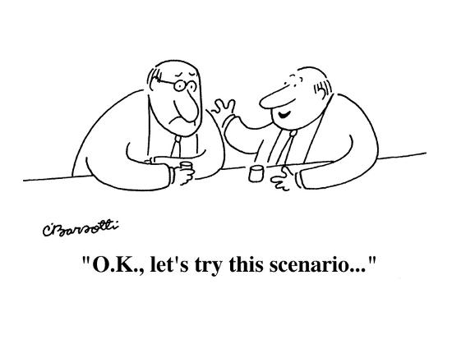
Scenario
A friend gives you a box of muffins.
You chuck it in the fridge and accidentally forgets about it due to your busy schedule.
A week plus later and suddenly you have a midnight craving, only to reach into your fridge to find a box of expired muffins.
You can either risk having stomachache or throw it away sadly.

Slide 4

Solution
Web application to:
Track expiry dates & usage
Notify the user according to individual settings
Thus, actively reminds the user to utilize the products before expiry & also give use to items that are idle

Slide 5
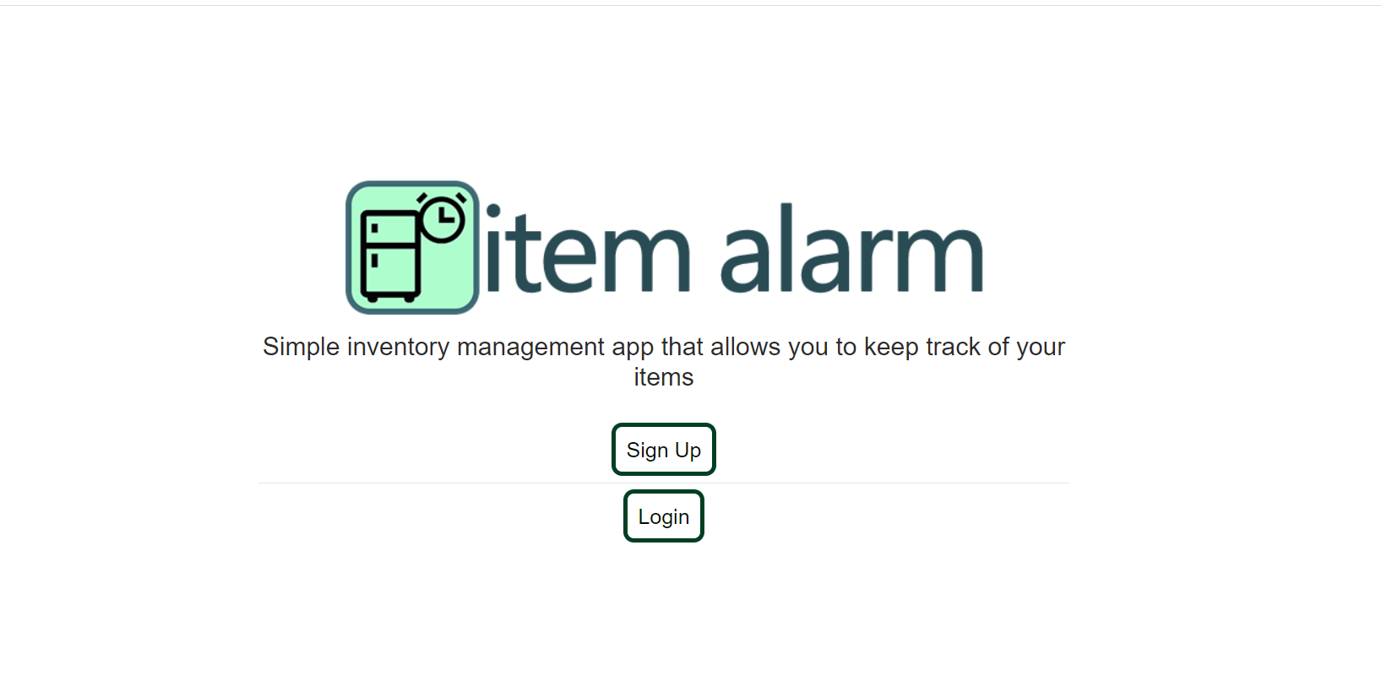
What is it?
For [Anyone]
Who is [Conscious about wasting items such as food]
the [Item Alarm]
is a [Inventory Management App]
that [Actively reduces waste by expired & idling products].
Unlike [Other Inventory Management] / Tracks idling items as well (can be use for item other than food)

Slide 6
Features of Solution
Feature 1:
Create entries with ease
Feature 2:
Actively track expiring & idling products
Feature 3:
Simple Interface
Feature 4:
Notifies you according to your setting on your expiring goods

Slide 7
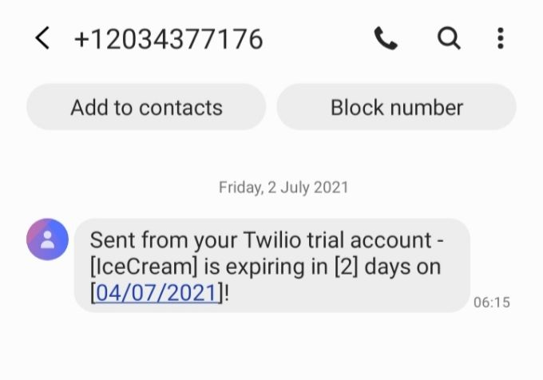
Technical Solution
Twilio API
Sends data to user’s registered phone
Friendly reminder to eat that iceCream
Json
GET, POST, DELETE, PUT Requests
GET, POST Requests
Json, JWT Auth
SQL Statements
Docker-
MYSQL Container: port 56990
Persistent Storage
Users
GET & POST requests
Client: port 8081
Store information in BST to allow quicker access instead of constantly querying API
Sends notification to Users based on settings (Will check expiry at Set timing & send relevant information)
Actively tracks users data
Uses 3rd Party Twilio API to send notification to user
Using Cron to schedule checking tasks hourly
APIServer: port 8080
Provides JSON responses for CRUD functions
Communicates with MYSQL database for persistent storage (GORM auto-creates tables)

Slide 8

Technical Stacks
Technologies used:
Go, HTML, CSS, Javascript, Docker, MySQL, GitHub
3rd Party Package: Gorm, Golang-JWT, bcrypt, Gorilla-Mux, Godotenv, Satori UUID, Cron
3rd Party TWILIO API
Skills and Techniques used:
Go programming
Client/Server
REST API
Error Handling
Software Security
Micro-Services (Docker containerization)
RegExp Input Sanitization
Session Management
Logging
Go routines
Data structures
Git

Slide 9

Project Timeline
Complete!
Debug/ Test
Refactor/ Improvisation
Delivery
Ideas/ App Design
Development
Week 1
Week 2
Week 3

Slide 10
Limitations of the project & how to overcome/contingency plan
Limitations #1 Not enough users to test application (Create lots of test data)
Limitations #2 Bounded by time (Do what I can)
Limitations #3 Technical knowledge (Learn on the go)
Future Plans
Plan #1 – Refactor the code, use data structures like AVL to manage data on the client side rather than constantly calling API
Plan #2 – Add more features like separating inventories
Plan #3 - Add a friend feature, allows for inventory and notifications to be shared and items given away if idling

Slide 11



