Slide 1
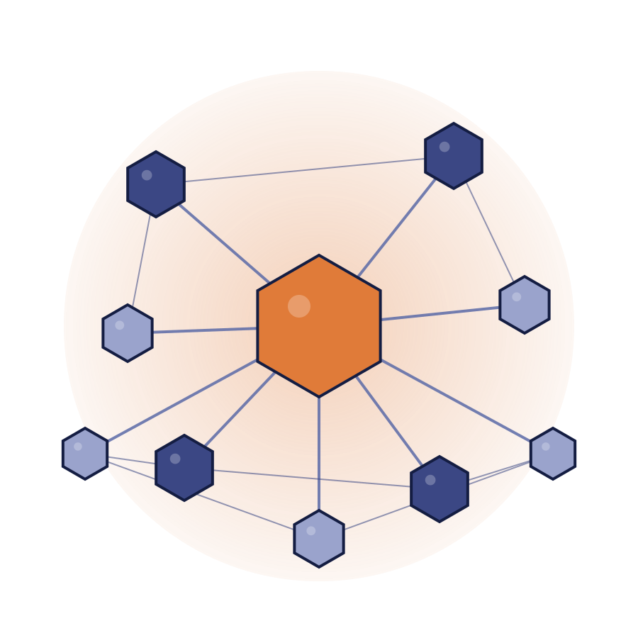
CognitiveOS
The Operating System for the Physical World
MONKEYPATCHED
Prashun Javeri — Founder, Monkeypatched

Slide 2
THE PROBLEM
Most agents are built on
Prompt → LLM → Tool Call → Result.
That works fine when the world holds still. It breaks the moment an agent sees milk in stock, plans the purchase, and by the time it executes, the milk is gone — and so is your dad who left to get milk.
The model didn't reason badly. Reality just moved.

Slide 3
THE REFRAME
Most agent systems build agents that can call tools. Monkeypatched builds the operating system that lets autonomous actors exist inside a changing world.
CognitiveOS enables autonomous entities to interact with the world in a state-aware way — continuously grounding decisions in changing world state, updating local and global state through action, and learning from the results.

Slide 4



We're taking this from validated architecture into design-partner deployments now.
If you're running the systems that already run your business — and don't want to throw them away for AI — I'd like to talk.
+91 8779857307
prashun@monkeypatched.com

