Slide 1
MTA Traffic Analysis for _x0001_New York Food Truck Association
Presented by: Kenan Turkmeneli
EDA Project for
Metis Online(Flex) Bootcamp

Slide 2
Introduction
New York Food Truck Assoc. (NYFTA) is an association of the best mobile food vendors in NYC.
NYFTA wants an analysis of New York’s current foot traffic to best optimize location selection for its members.
Aim: Apply data analytics on the MTA subway data on traffic flow to observe pattern changes in the city from pre covid 2019 to post covid 2021 timeline in order to find out new optimal spots.

Slide 3
Methodology
Used python to webscape weekly MTA turnstile data to analyze traffic.
Downloaded Data has been processed though SQL to give data bases their inital format
Used multiple python libraries to analyse the data such as: Pandas, Numpy etc.
Used certain python libraries for visual graphs to help understand the story we have from data. ( Matplotlib and Seaborn)
See appendix for a sample data and the column identification and data cleaning processes

Slide 4
Data Preparation
Sorted and looked out for error data such as:
duplicates, null values and outliers, backward counting turnstiles, random resetting turnstiles etc.
Dropped those rows from data set with certain columns to clean the data.
Further processed data using SQLAlchemy and Pandas to create new data frames and saved those files.
Used 48 weeks of data from 2019 and same amount of data from 2021 to compare pre and post covid patterns

Slide 5
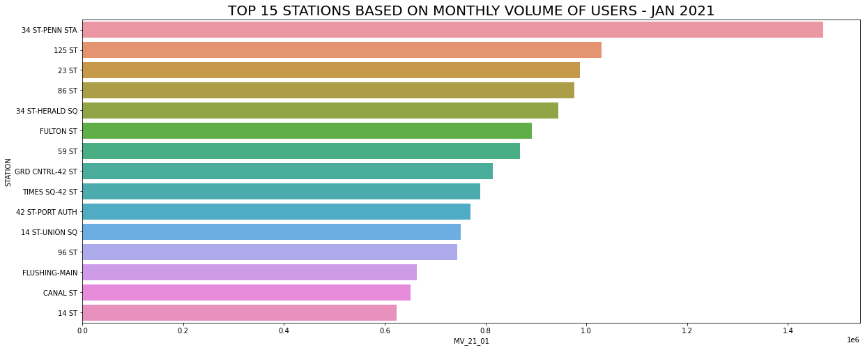
Results
Sample data from Jan 2021. Top 15 stations are either in dense residential areas or close to city centre with a lot of daily.
I wanted to see if a similar pattern is observed in a yearly data.

Slide 6
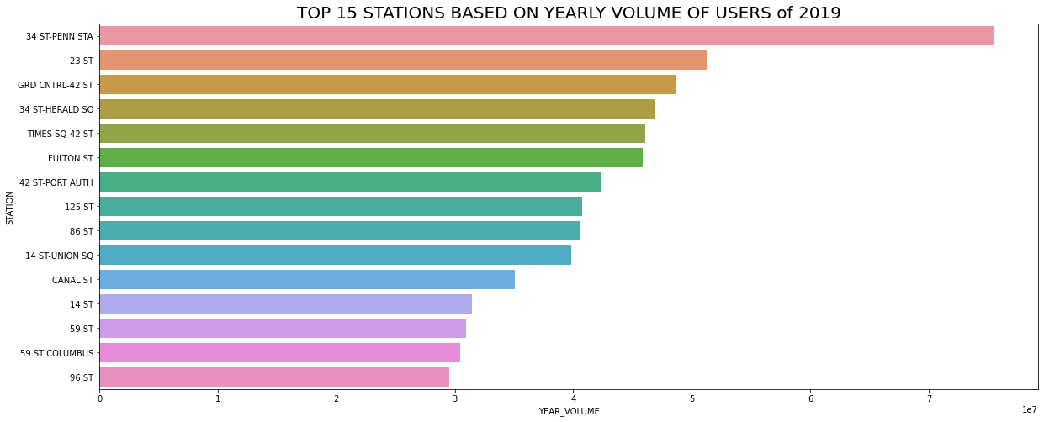
Results
34 St - Penn Station has noticeably more traffic than the rest.
Notice that the x-axis is multiple of 10million yearly users
I wanted to see whether there is a shift in pattern in 2021

Slide 7
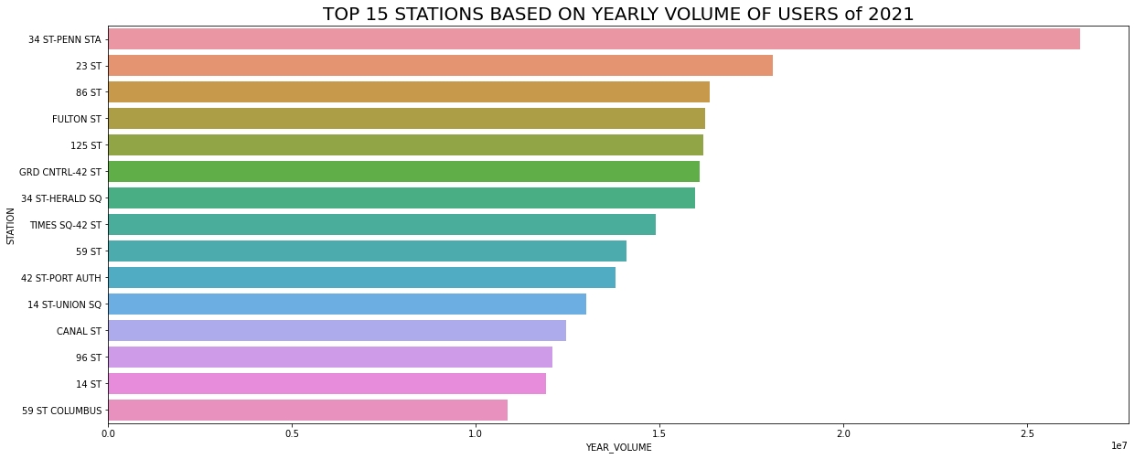
Results
GRD Cntrl-42 St , 34 St - Herald SQ, Times SQ-43 Sthas gone down significantly in the list but the rest look pretty much the same.

Slide 8
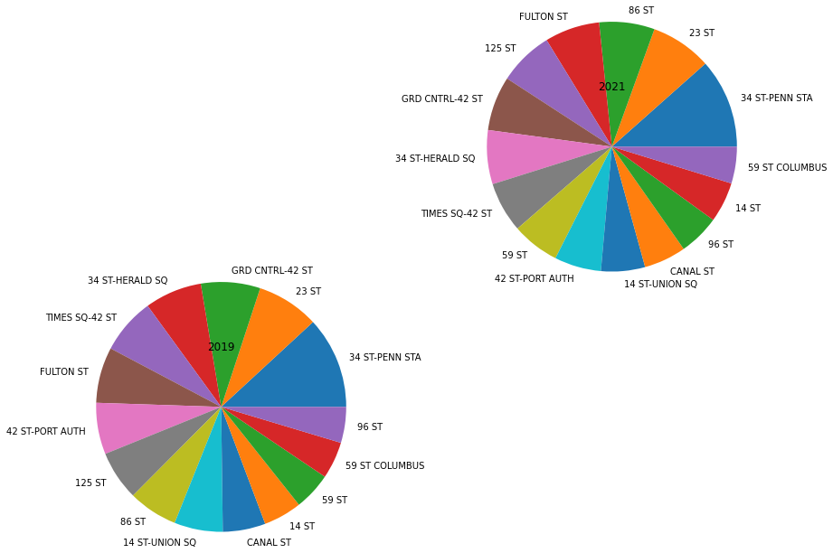
Results

Slide 9
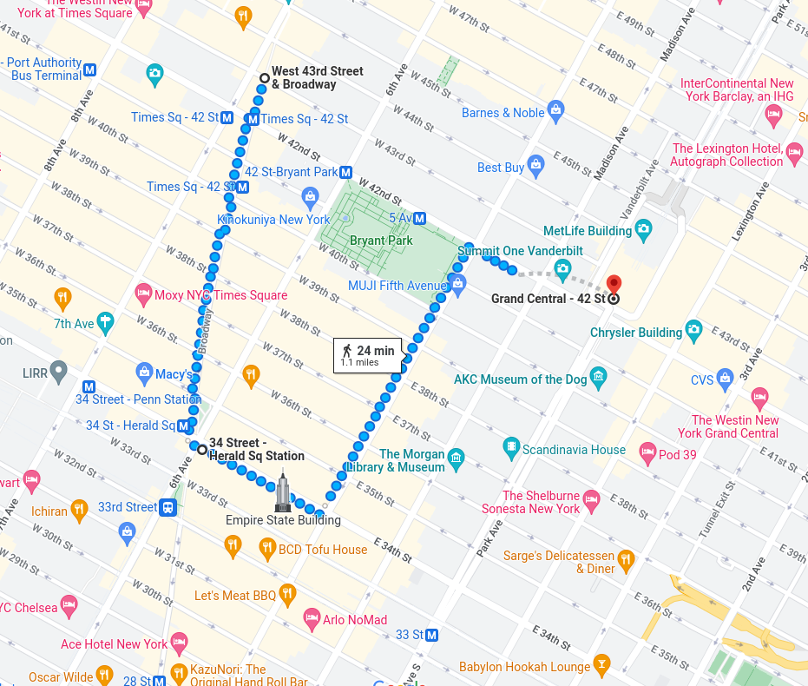
Results
GRD Cntrl-42 St , 34 St - Herald SQ, Times SQ-43 St
These 3 stations are litrerally in the hearth of the city. Looks like people are not going out much as they used to do.

Slide 10

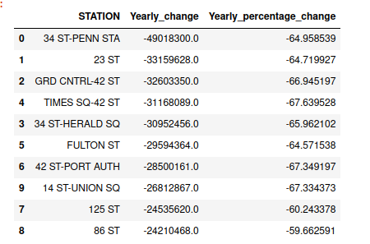
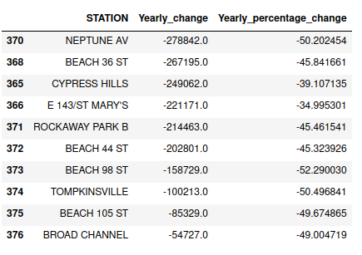
Results
Top 10 and bottom 10 of all stations sorted by change in volume from 2019 to 2021.

Slide 11
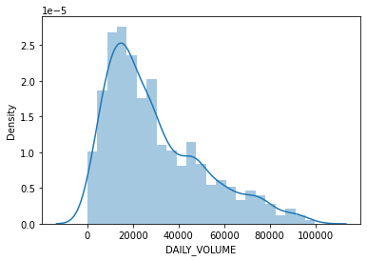
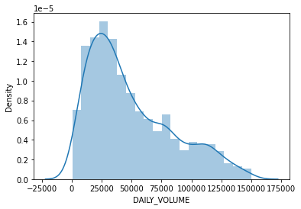
Results
Daily volume distribution of all stations in December!
2021 on the left, 2019 on the right. Shape is same size is smaller.

Slide 12
Conclusion
In terms of daily/weekly/monthly patterns nothing much changed other than the shrinked size in every station’s volume of foot traffic.
If your Food truck is still operational keep staying there. Otherwise there is no better place in tornw to move to at this point until covid madness is 100% behind us.

Slide 13
Future Work
Wait for 2022 first 6 month data to hit and compare that season to 2021 and 2019 first 6 months and observe any healing in overall volume of traffic.
Map the stations with zip codes and get a measure of non mobile restaurant density in the area to figure out need for more mobile food trucks in the area.

Slide 14
Thanks for your time !

Slide 15
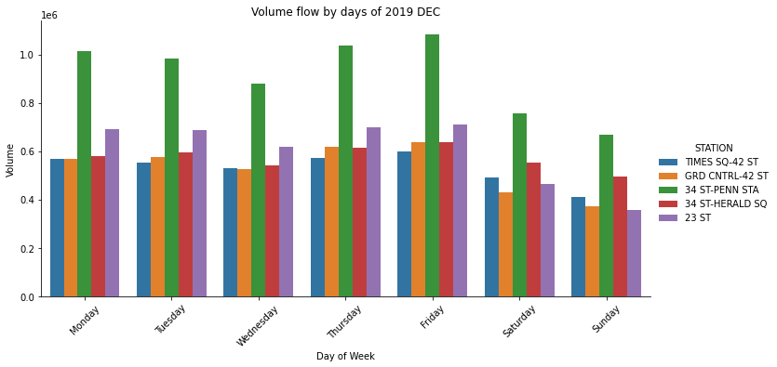
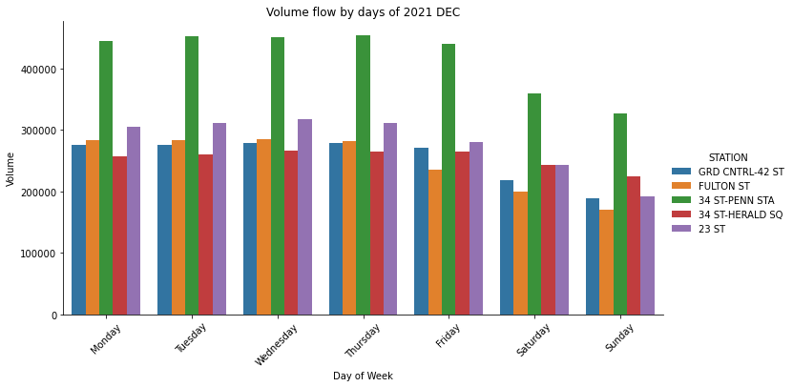
Results
Daily volume distribution of top 5 stations. 2019 on the left, 2019 on the right. Similar patternbs with lower volume

Slide 16
Appendix:
Top 5 rows of a a random data set. First 4 columns identifies each turnstile in each station. Data&Time represents the time intervals of data collection. Fianlly numerical columns: Entries and Exits, helps us identify daily traffic across that turnstile.
 | C/A | UNIT | SCP | STATION | LINENAME | DIVISION | DATE | TIME | DESC | ENTRIES | EXITS
0 | A002 | R051 | 02-00-00 | 59 ST | NQR456W | BMT | 2021-08-22 | 00:00:00 | REGULAR | 7347810 | 2832191
1 | A002 | R051 | 02-00-00 | 59 ST | NQR456W | BMT | 2021-08-22 | 04:00:00 | REGULAR | 7347812 | 2832197
2 | A002 | R051 | 02-00-00 | 59 ST | NQR456W | BMT | 2021-08-22 | 08:00:00 | REGULAR | 7347824 | 2832208
3 | A002 | R051 | 02-00-00 | 59 ST | NQR456W | BMT | 2021-08-22 | 12:00:00 | REGULAR | 7347852 | 2832248
4 | A002 | R051 | 02-00-00 | 59 ST | NQR456W | BMT | 2021-08-22 | 16:00:00 | REGULAR | 7347937 | 2832276
200k + rows per 7 day data

