Slide 1
CPSC 230: Intro to CS Week 2
Data types
Variables
Collections
Operators
Precedence

Slide 2
Object Oriented Programming (OOP)
Python = Object oriented
Almost everything in Python is an object
Numbers, lists, functions, etc.
Objects have:
An id
Some attributes and methods
0 or more names
A type
Notes:
Let them know that there will be more on each of these topics later, this is just an introduction

Slide 3

Running a Program/Module
In terminal (if python installed and added to PATH):
python3 <name of file>
E.g. if a file is named first_project.py, then to run it, you would type:
python3 first_project.py
The interpreter takes care of execution
In VSCode, you can simply press the play button in the top right corner

Slide 4

Data Types
Integer: whole numbers, negative or positive
0, 25, -6
Float: decimal numbers
1.0, 5.5, -73.2
Boolean: True (1), False (0)
True, False
String: Collection of symbols; usually a word
Surrounded by ‘ ‘, “ “, ‘’’ ‘’’, or “”” “””
‘a’, “hello”, “123_abc”
We will work with all data types in this class. Booleans are used more than you might think (pssst … conditionals and loops)
Notes:
For strings, mention that it is good practice to use single quotes for single character strings and double quotes for any words that are larger. Triple quotes are used for multiline strings

Slide 5
Data Types: Methods
type(<variable>) returns the type of the given variable
a = 6
a_type = type(a)
isinstance(<variable>, <type>) returns Boolean (T/F) if the given variable is of type <type>
pair_is_string = isinstance(“pair”, str))

Slide 6
Variables
Variable: a way to store information in a known location in memory
Can be almost any name
Variable naming rules
Must start with a letter or underscore
Cannot start with a number
Can only contain alpha-numeric characters and underscores (A-Z, 0-9, _)
Case sensitive (e.g. cat and CAT are different)
Cannot be a python keyword (e.g. for, if, finally, with)
Full list

Slide 7

Variables: Assignment
Not this kind of assignment…
To assign a value to a variable, variable goes on LHS, value on RHS
Separated by =
e.g. my_var = 3
Variables can be re-assigned
my_var = 3
print(my_var)
my_var = 10.5
print(my_var

Slide 8

Variable Naming Conventions
Name variables something meaningful
Instead of a = ”D-”, maybe use grade = “D-”
Helps you and others reading your code to understand what is going on
Typically, programmers use camel case or snake case
Camel case: first letter of each word capitalized except for the first word
E.g. bestPlayerEver
Snake case: underscore between each word
E.g. best_player_ever
This Photo by Unknown Author is licensed under CC BY-ND

Slide 9
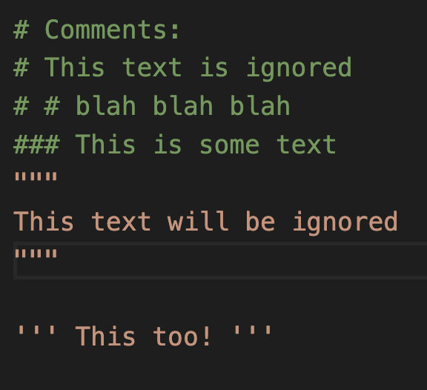
Comments
Ignored by the interpreter
Communicates meaningful information to anyone reading the code
Important for documentation
Describes
Intended behavior of the program
What various functions do and what they return
What variables hold
Indicated by: #, ’’’…’’’, ”””…”””

Slide 10

Print()
Way to output to the terminal
Typical use:
print("This appears in the terminal")
my_str = "Hello World Number:"
world_num = 246
print(my_str, world_num)
Optional arguments:
print(value, … , sep = ' ', end = '\n', file = sys.stdout, flush = False)
sep: string inserted between values
end: string appended after the last value
file: the file-like object to which you would like to write
flush: determines where to forcibly flush the stream

Slide 11
Input()
To interact with the outside world (outside of the program, that is)
Takes input from the command line
Can be stored into a variable within your program
Example:

Slide 12
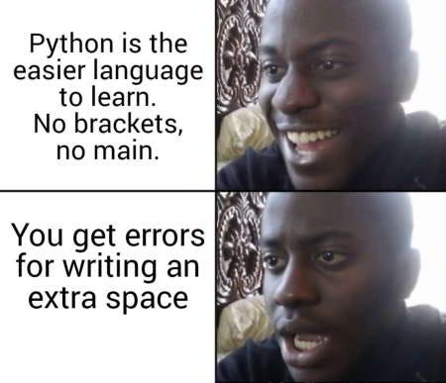
White Space

Slide 13
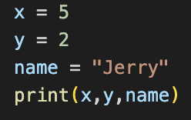

White Space
Proper
Don't do this ^^^
Whitespace matters
Any blank space or new line
Pay attention to little details when you first start programming
This includes whitespace
Proper indentation is required in Python
Conditionals, loops, and functions especially require you to follow whitespace protocol
Improper

Slide 14
Collections: Principle
Why?
Storage of multiple items in one structure
Allows for ease of access to related information
Iterable in loops
Types
Lists
Sets
Dictionaries
Tuples
Each collection type has its own uses

Slide 15
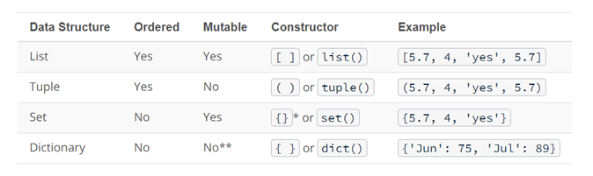
Quick Reference

Slide 16
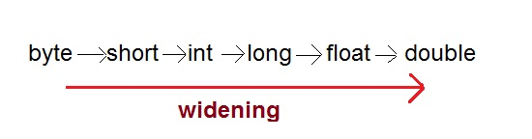
Type Casting
AKA Constructors in Python
Changing the data type of a variable into another
Uses <type>(<variable_name>)
e.g.
i = 5.0
i = int(i)
Now i is of type int instead of float and has value of 5

Slide 17
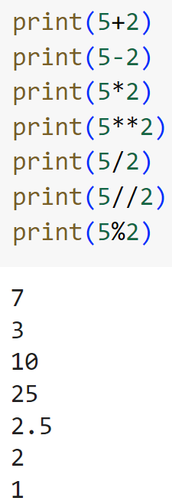
Arithmetic Operations
Addition (+)
Subtraction (-)
Multiplication (*)
Exponentiation (**)
Floating point division (/)
Floor division (//)
Modulo AKA Remainder (%)

Slide 18
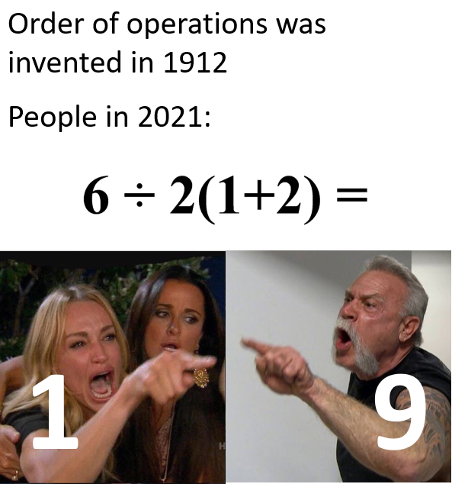
Precedence
AKA Order of Operations

Slide 19
Precedence
()
**
+ - (pos, neg)
/ % //
+ - (add, sub)
Left -> right
Solve: 20 % 3 ** 2 - (6 + 3 // 2) + 9

Slide 20
Full Precedence List

