Slide 1

HC Box
(Secure Document Sharing)
Anton Hoffman - Will Casey
20 April 2026
Briefly describe the contents of the presentation or
the purpose of the meeting. Tell your audience
what to expect.

Slide 2
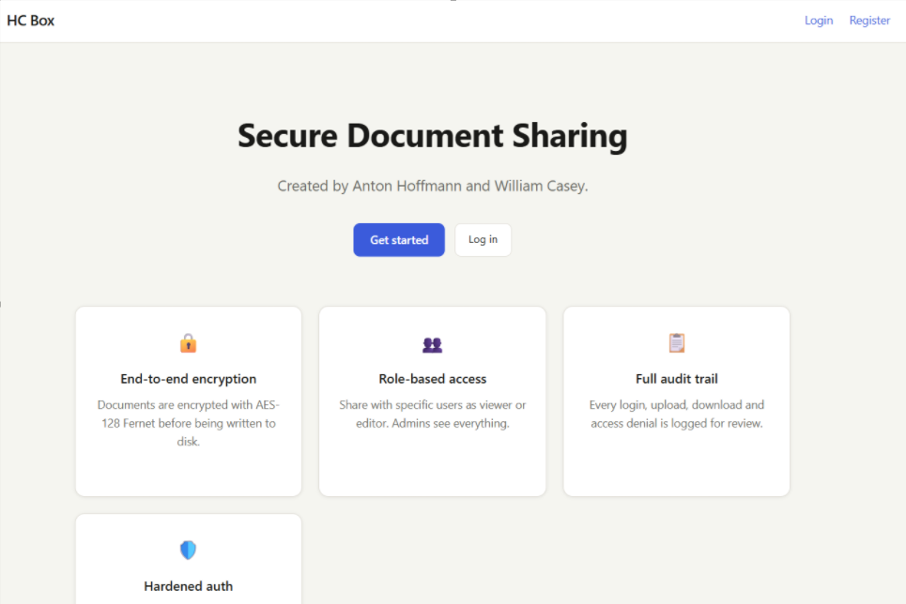
Project Overview
What We Built:
HC Box is a secure, browser-based document sharing platform built with Python and Flask. Users can register accounts, upload confidential files, and share them with others, all with encryption at rest and strict access controls enforced on every request. The system stores no passwords in plaintext and requires no external database, using structured JSON files for persistence and Fernet symmetric encryption for stored documents.

Slide 3
Security Architecture
HC Box is built around a layered security model where every layer independently enforces controls, so a failure in one layer does not compromise the entire system.
Transport: HTTPS enforced. Secure, HttpOnly, SameSite=Strict cookies. HSTS header with 1-year max-age and includeSubDomains.
Authentication: bcrypt with cost factor 12. Rate limiting at 10 attempts per IP per minute. Account lockout after 5 failures. Session tokens via secrets.token_urlsafe(32) with 30-minute timeout.

Slide 4

Security Architecture cont...
Authorization: RBAC with three roles. Every route decorated with @require_auth and @require_permission. Admins can view all; Users manage their own; Guests view shared only.
Encryption: Fernet symmetric encryption on all stored files. Key stored in data/secret.key (git-ignored). Files overwritten with random bytes before deletion.
Headers & CSP: Content-Security-Policy blocks inline scripts. X-Frame-Options: DENY. X-Content-Type-Options: nosniff. Permissions-Policy disables camera, microphone, and geolocation.

Slide 5
Key Security Implementations
Password Hashing: All passwords are hashed with bcrypt at cost factor 12 before storage. Plaintext passwords are never written anywhere - not to logs, not to files, not to sessions. Verification uses a constant-time comparison to prevent timing attacks.
Input Validation & XSS Prevention: All user inputs are sanitized with html.escape() on entry and Jinja2 auto-escaping on output. Filenames are passed through secure_filename() and validated against an allowlist of extensions. Path traversal is blocked by checking that resolved paths stay within the upload directory.
Session Management: Session tokens are 32-byte cryptographically random strings. Each token is stored server-side in sessions.json with the user ID, creation time, and last activity timestamp. Sessions expire after 30 minutes of inactivity and are immediately destroyed on logout.
Audit Logging: Security-relevant events - login attempts, lockouts, file uploads, downloads, shares, deletes, access denials, and admin actions, are written as a structured JSON entry to logs/security.log. Admins can review the last 200 events in real time through the audit log dashboard.

Slide 6
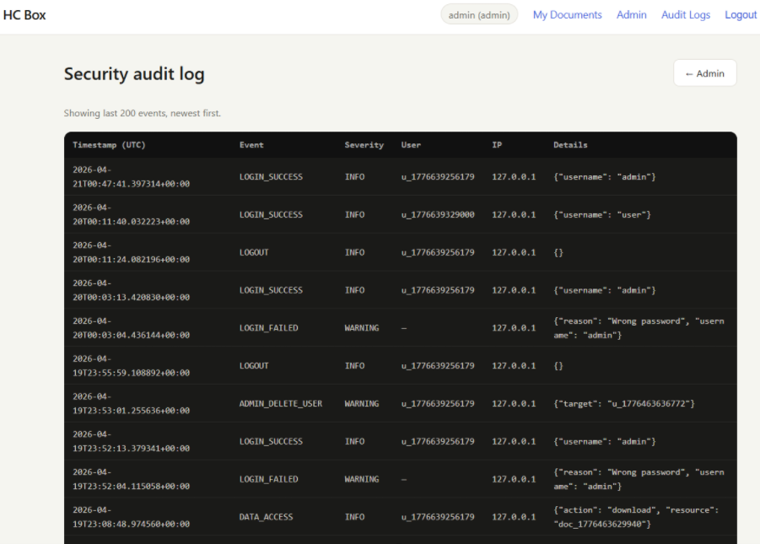
Challenges and Lessons Learned
Content Security Policy vs. Inline JavaScript: Our original dashboard used onclick= and onsubmit= attributes which worked in the browser but were silently blocked by our own CSP header. The fix required moving all event handling into external JS using data-* attributes and addEventListener
Test Isolation with Shared State: Our test suite ran all tests from the same IP address, causing the rate limiter to block later tests after earlier ones exhausted the login attempt budget. We learned to reset shared mutable state, the rate limiter bucket and users.json
Stale Object Bugs in Lockout Logic: After recording a failed login attempt, our lockout check used the original user object from before the write, so it never saw the updated locked_until value. The fix — re-fetching the user from disk after writing

