Slide 1
In the pinhole camera model, the image coordinates (x, y) of a 3D point (X, Y, Z) are calculated as:
x = f * (X / Z) y = f * (Y / Z)
where f is the focal length.
If we increase the focal length (f), the values of x and y increase for a given 3D point (X, Y, Z). This means that the projected point on the image plane appears further from the center of the image, making the object appear larger in the image, similar to zooming in.
Conversely, if we decrease the focal length, the values of x and y decrease for a given 3D point, meaning the projected point appears closer to the center of the image. This makes the object appear smaller in the image, similar to zooming out.
So, the focal length directly affects the scale of the projected image in the pinhole camera model.

Slide 2
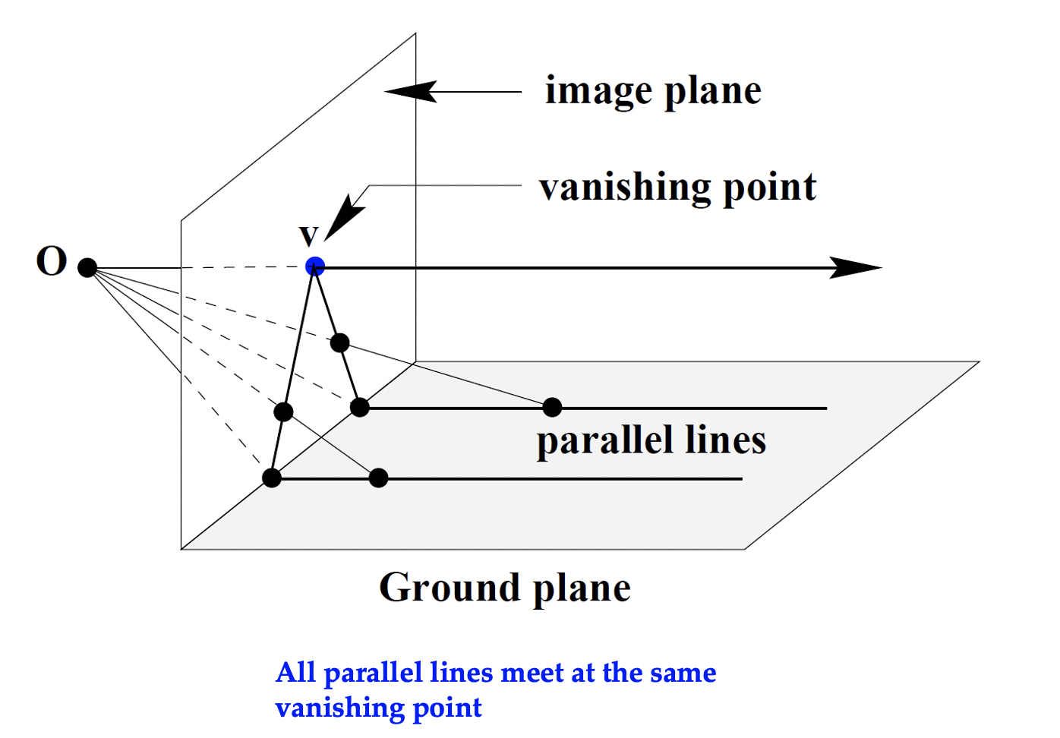

Answer:
A line of 3D points is given by :
$$\left(x_{1},y_{1},z_{1}\right)+λ\left(a,b,c\right)=A+λD, \left\{\begin{aligned}a=x_{2}−x_{1} \\ b=y_{2}−y_{1} \\ c=z_{2}−z_{1}\end{aligned}\right.$$
We have:
$$x^{′}=f\frac{x}{z}=\frac{f(x_{1}+λa)}{z_{1}+λc}$$
Let $λ→∞$,
$$x^{′}=\frac{f(x_{1}+λa)}{z_{1}+λc}≈f\frac{a}{c}$$

