Slide 1

Characterizing edges
An edge is a place of rapid change in the image intensity function
intensity function (along horizontal scanline)
image
first derivative
edges correspond to extrema of derivative
Source: L. Lazebnik

Slide 2
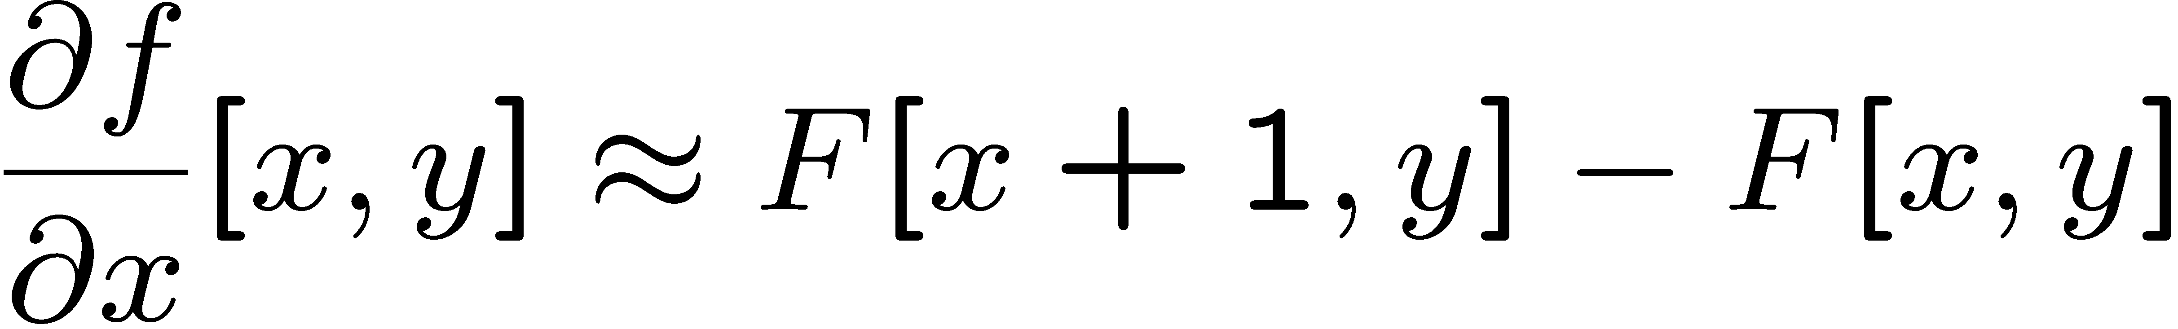




Image derivatives
How can we differentiate a digital image F[x,y]?
Option 1: reconstruct a continuous image, f, then compute the derivative
Option 2: take discrete derivative (finite difference)
How would you implement this as a linear filter?
1 | -1
 | -1
 | 1
:
:
Source: S. Seitz

Slide 3
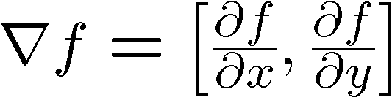
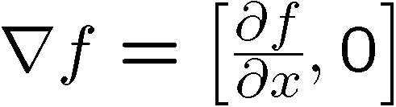
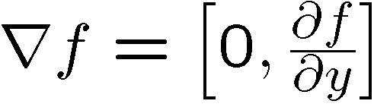
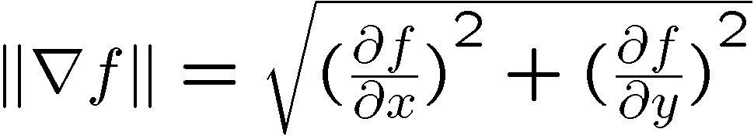
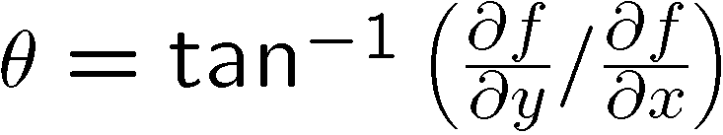
Image gradient
The gradient of an image:
The gradient points in the direction of most rapid increase in intensity
The edge strength is given by the gradient magnitude:
The gradient direction is given by:
Source: Steve Seitz

Slide 4


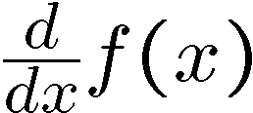
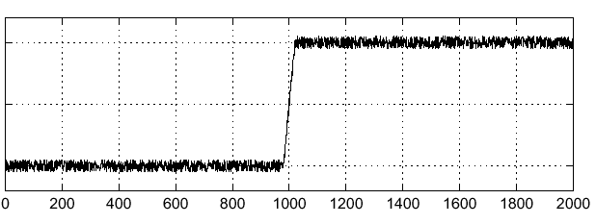
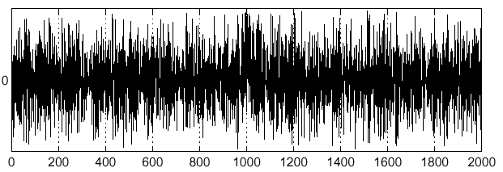
Effects of noise
Noisy input image
Where is the edge?
Source: S. Seitz
Notes:
How to fix?

Slide 5
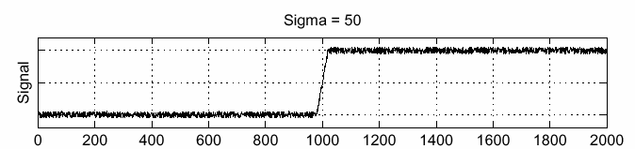
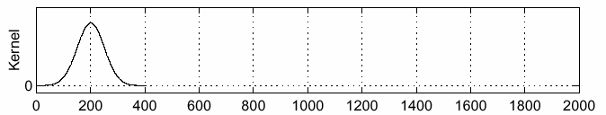
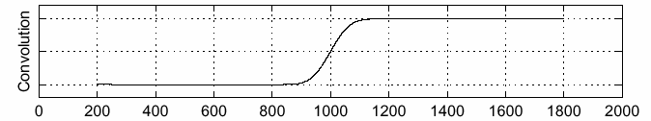
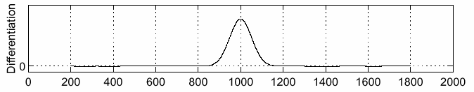
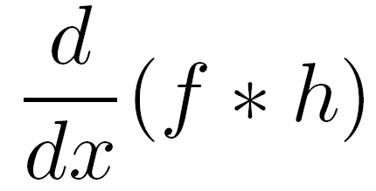
Solution: smooth first
f
h
f * h
To find edges, look for peaks in
Source: S. Seitz

Slide 6
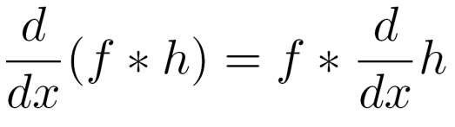
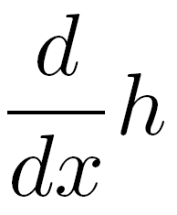
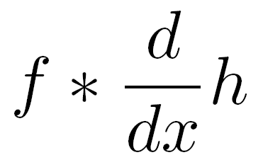
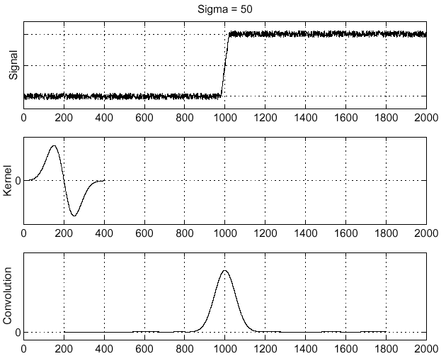
Associative property of convolution
Differentiation is convolution, and convolution is associative:
This saves us one operation:
f
Source: S. Seitz

Slide 7
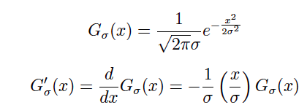
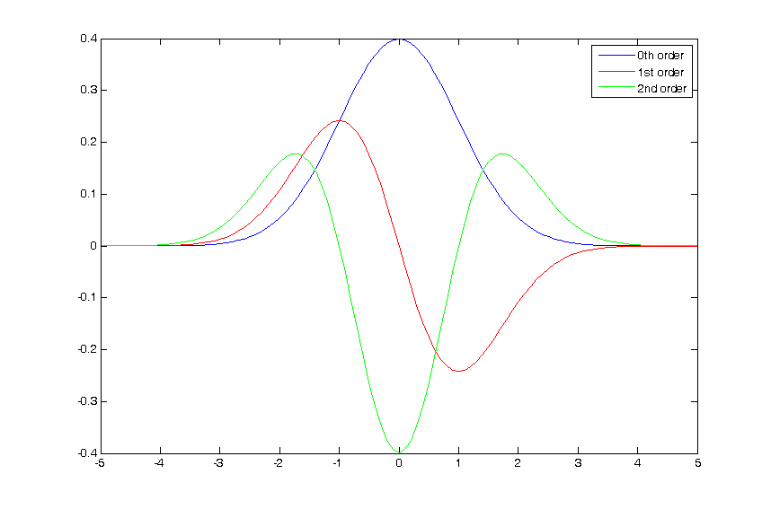
The 1D Gaussian and its derivatives

Slide 8
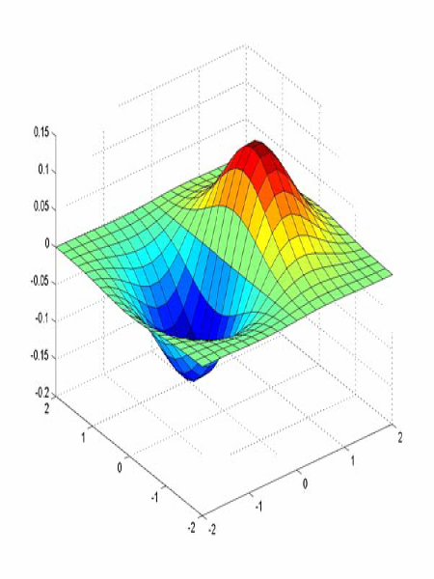
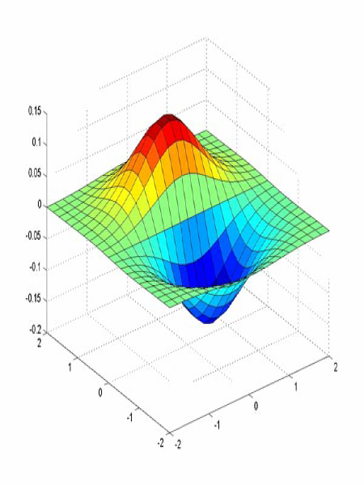
Derivative of Gaussian filter
x-direction
y-direction

Slide 9



The Sobel operator
Common approximation of derivative of Gaussian
-1 | 0 | 1
-2 | 0 | 2
-1 | 0 | 1
1 | 2 | 1
0 | 0 | 0
-1 | -2 | -1
The standard defn. of the Sobel operator omits the 1/8 term
doesn’t make a difference for edge detection
the 1/8 term is needed to get the right gradient magnitude
Notes:
9

Slide 10
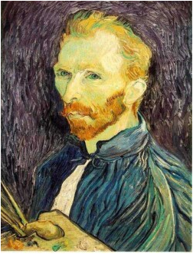
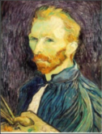



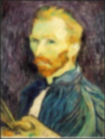


Gaussian pre-filtering
Solution: filter the image, then subsample
F₀
F₁
F₂
…
blur
subsample
blur
subsample
F₀ H
F₁ H
*
*

Slide 11
{
Gaussian pyramid
F₀
F₁
F₂
…
blur
subsample
blur
subsample
F₀ H
F₁ H
*
*

Slide 12
Histograms
A histogram of a gray-tone image is an array H[*] of bins, one for each gray tone.
H[i] gives the count of how many pixels of an image have gray tone i.
P[i] (the normalized histogram) gives the percentage of pixels that have gray tone i.

Slide 13
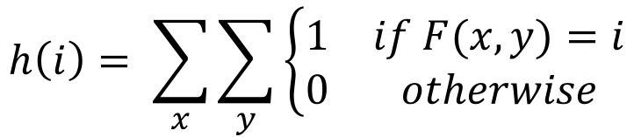
Gray image histogram
$$h\left(i\right)= \sum_{x}{\sum_{y}{\left\{\begin{matrix}1 & if F(x,y)=i \\ 0 & otherwise\end{matrix}\right.}}$$

