Slide 1

Q2
$K$ is a 2D symmetric filter of size $k×k$, and $k$ is an odd number. By convoluting $K$ on an image $I$ (denoted as $K∗I$), we obtain a filtered image $I_{K}$.
(a) Given an image pixel at location $(x,y)$, find its value in the filter image $I_{K}$(x,y). Express your answer in terms of $I$, $K$, $k$, $x$ and y.

Slide 2
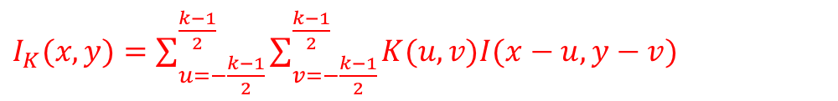

Q2
$K$ is a 2D symmetric filter of size $k×k$, and $k$ is an odd number. By convoluting $K$ on an image $I$ (denoted as $K∗I$), we obtain a filtered image $I_{K}$.
(a) Given an image pixel at location $(x,y)$, find its value in the filter image $I_{K}$(x,y). Express your answer in terms of $I$, $K$, $k$, $x$ and y.
Solution:
$I_{K}(x,y)=\sum_{u=−\frac{k−1}{2}}^{\frac{k−1}{2}}{\sum_{v=−\frac{k−1}{2}}^{\frac{k−1}{2}}{K(u,v)I(x−u, y−v)}}$

Slide 3

Q2
$K$ is a 2D symmetric filter of size $k×k$, and $k$ is an odd number. By convoluting $K$ on an image $I$ (denoted as $K∗I$), we obtain a filtered image $I_{K}$.
(b) Calculate the number of operations in (a)? An operation is defined as an addition or multiplication of two numbers. Assuming the size of an image is 𝑁×𝑁. Express your answer in terms of 𝑁 and 𝑘.

Slide 4


Q2
$K$ is a 2D symmetric filter of size $k×k$, and $k$ is an odd number. By convoluting $K$ on an image $I$ (denoted as $K∗I$), we obtain a filtered image $I_{K}$.
(b) Calculate the number of operations in (a)? An operation is defined as an addition or multiplication of two numbers. Assuming the size of an image is 𝑁×𝑁. Express your answer in terms of 𝑁 and 𝑘.
Solution:
Multiplication: $O_{m1}=k^{2}{\left(N−k+1\right)}^{2}$;
Addition: ${O_{a1}=(k}^{2}−1){\left(N−k+1\right)}^{2}$;

Slide 5
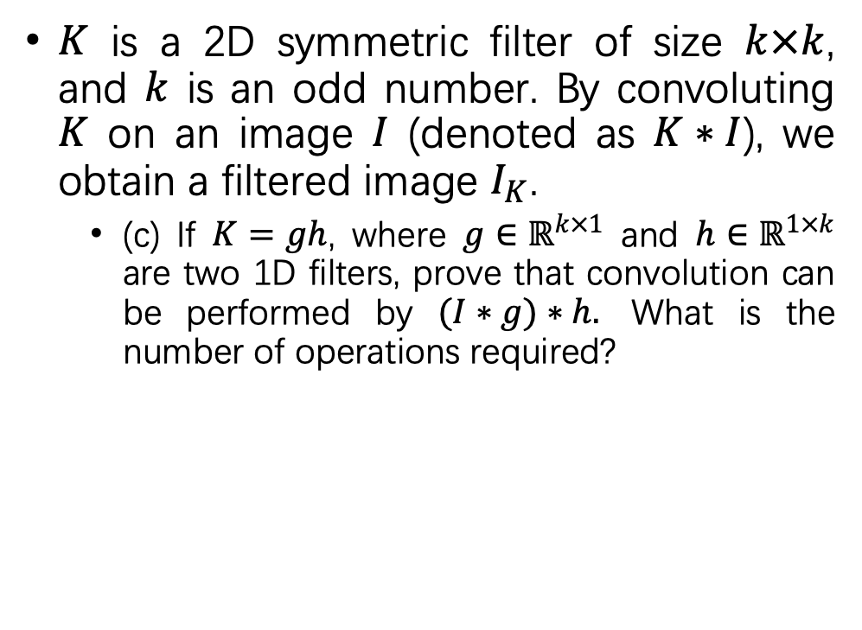
Q2
$K$ is a 2D symmetric filter of size $k×k$, and $k$ is an odd number. By convoluting $K$ on an image $I$ (denoted as $K∗I$), we obtain a filtered image $I_{K}$.
(c) If $K=gh$, where $g∈ℝ^{k×1}$ and $h∈ℝ^{1×k}$ are two 1D filters, prove that convolution can be performed by $(I∗g)∗h.$ What is the number of operations required?

Slide 6
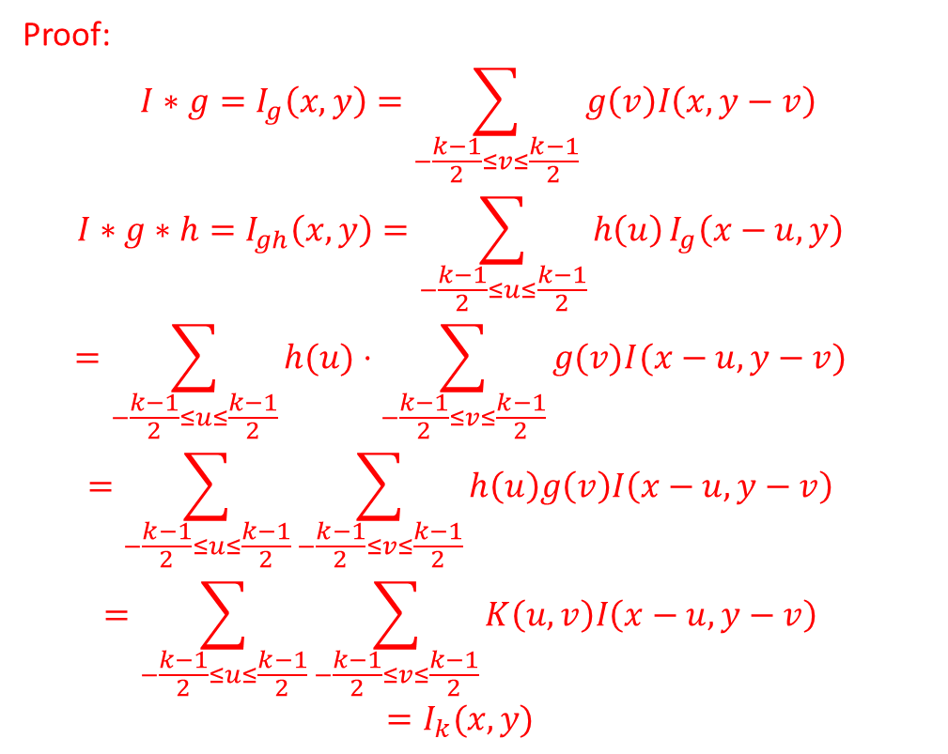

Q2
Solution:
Proof:
$$I∗g=I_{g}\left(x, y\right)=\sum_{−\frac{k−1}{2}≤v≤\frac{k−1}{2}}{g\left(v\right)I\left(x, y−v\right)}$$
$$I∗g∗h=I_{gh}\left(x,y\right)=\sum_{−\frac{k−1}{2}≤u≤\frac{k−1}{2}}{h\left(u\right)}I_{g}\left(x−u, y\right)$$
$$=\sum_{−\frac{k−1}{2}≤u≤\frac{k−1}{2}}{h(u)}⋅\sum_{−\frac{k−1}{2}≤v≤\frac{k−1}{2}}{g(v)I(x−u,y−v)}$$
$$=\sum_{−\frac{k−1}{2}≤u≤\frac{k−1}{2}}{\sum_{−\frac{k−1}{2}≤v≤\frac{k−1}{2}}{h\left(u\right)g\left(v\right)I\left(x−u, y−v\right)}}$$
$$=\sum_{−\frac{k−1}{2}≤u≤\frac{k−1}{2}}{\sum_{−\frac{k−1}{2}≤v≤\frac{k−1}{2}}{K\left(u,v\right)I\left(x−u, y−v\right)}}$$
$$=I_{k}(x,y)$$
$K$ is a 2D symmetric filter of size $k×k$, and $k$ is an odd number. By convoluting $K$ on an image $I$ (denoted as $K∗I$), we obtain a filtered image $I_{K}$.
(c) If $K=gh$, where $g∈ℝ^{k×1}$ and $h∈ℝ^{1×k}$ are two 1D filters, prove that convolution can be performed by $(I∗g)∗h.$ What is the number of operations required?
Multiplication: $O_{m2}=k\left(N−k+1\right)(2N−k+1);$
Addition: $O_{a2}=(k−1)(N−k+1)(2N−k+1)$

Slide 7

Q2
$K$ is a 2D symmetric filter of size $k×k$, and $k$ is an odd number. By convoluting $K$ on an image $I$ (denoted as $K∗I$), we obtain a filtered image $I_{K}$.
(d) Is (c) more computationally efficient than (b)? How many operations are saved?

Slide 8
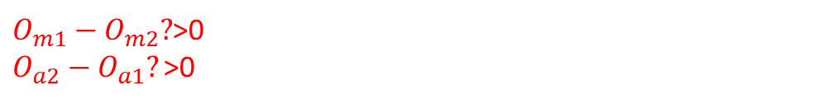
Q2
$K$ is a 2D symmetric filter of size $k×k$, and $k$ is an odd number. By convoluting $K$ on an image $I$ (denoted as $K∗I$), we obtain a filtered image $I_{K}$.
(d) Is (c) more computationally efficient than (b)? How many operations are saved?
$O_{m1}−O_{m2}?$>0
$O_{a2}−O_{a1}?\text{>}$0

