Slide 1
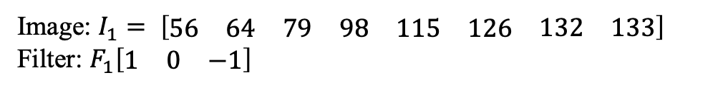

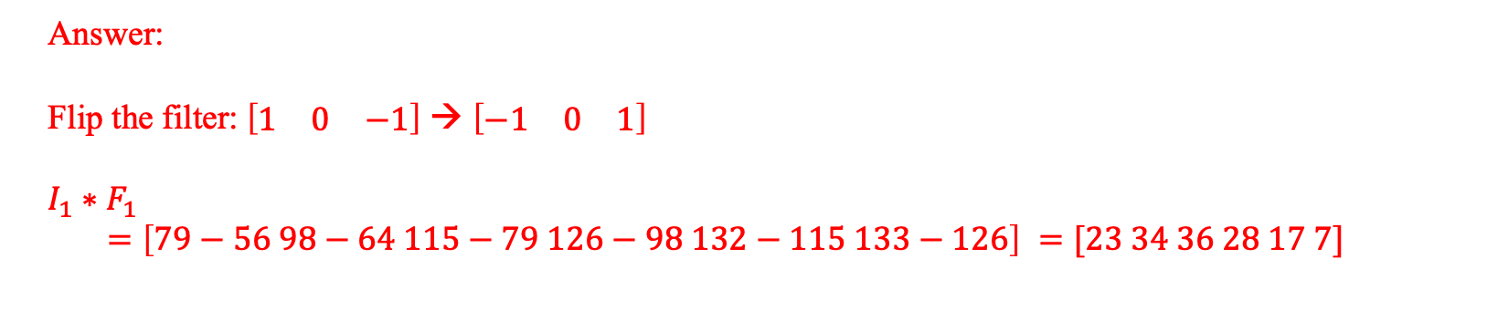
(a) Given the image and a filter, calculate the convoluting result.
i). Given an image of $1×8$ resolution and a filter of $1×3$ size as following, show the result of convoluting the image with filter
Image: $I_{1}= \left[\begin{matrix}\begin{matrix}56 & 64 & 79\end{matrix} & \begin{matrix}98 & 115 & 126\end{matrix} & \begin{matrix}132 & 133\end{matrix}\end{matrix}\right]$
Filter: $F_{1}\left[\begin{matrix}1 & 0 & −1\end{matrix}\right]$
Answer:
Flip the filter:$\left[\begin{matrix}1 & 0 & −1\end{matrix}\right]$ → $\left[\begin{matrix}−1 & 0 & 1\end{matrix}\right]$
$$I_{1}∗F_{1}$$
$$=\left[79−56 98−64 115−79 126−98 132−115 133−126\right] =[23 34 36 28 17 7]$$

Slide 2

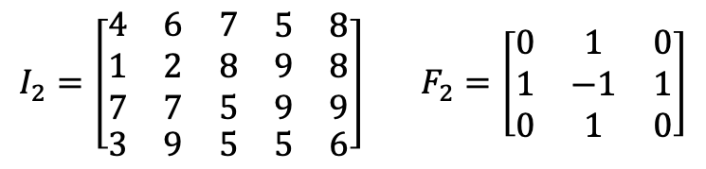
(a) Given the image and a filter, calculate the convoluting result.
ii). Given an image of 4x5 resolution and a filter of 3x3 size as following, show the result of convoluting the image with filter
$I_{2}=\left[\begin{matrix}\begin{matrix}4 & 6 & 7 \\ 1 & 2 & 8 \\ 7 & 7 & 5\end{matrix} & \begin{matrix}\begin{matrix}5 & 8\end{matrix} \\ \begin{matrix}9 & 8\end{matrix} \\ \begin{matrix}9 & 9\end{matrix}\end{matrix} \\ \begin{matrix}3 & 9 & 5\end{matrix} & \begin{matrix}5 & 6\end{matrix}\end{matrix}\right]$ $F_{2}=\left[\begin{matrix}0 & 1 & 0 \\ 1 & −1 & 1 \\ 0 & 1 & 0\end{matrix}\right]$
Answer:$I_{2}∗F_{2}=\left[\begin{matrix}20 & \begin{matrix}15 & 21\end{matrix} \\ 16 & \begin{matrix}24 & 19\end{matrix}\end{matrix}\right]$

Slide 3
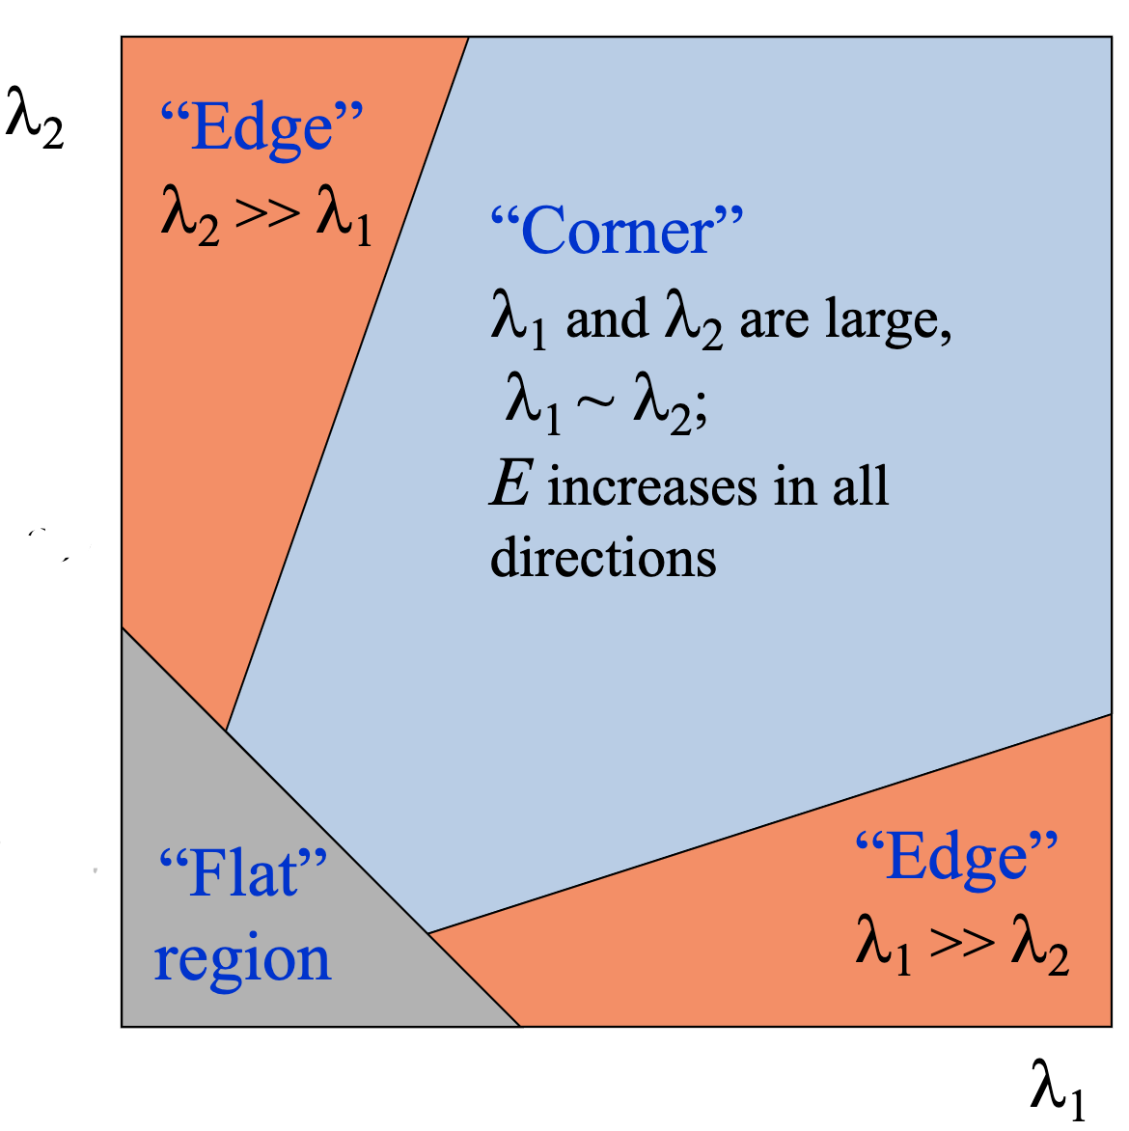
(b) Can Harris corner detector be used to detect edges? Explain your answer by describing how Harris matrix will respond to edges.
Answer: Yes, when one eigenvalue has large value and the other has small value.

Slide 4
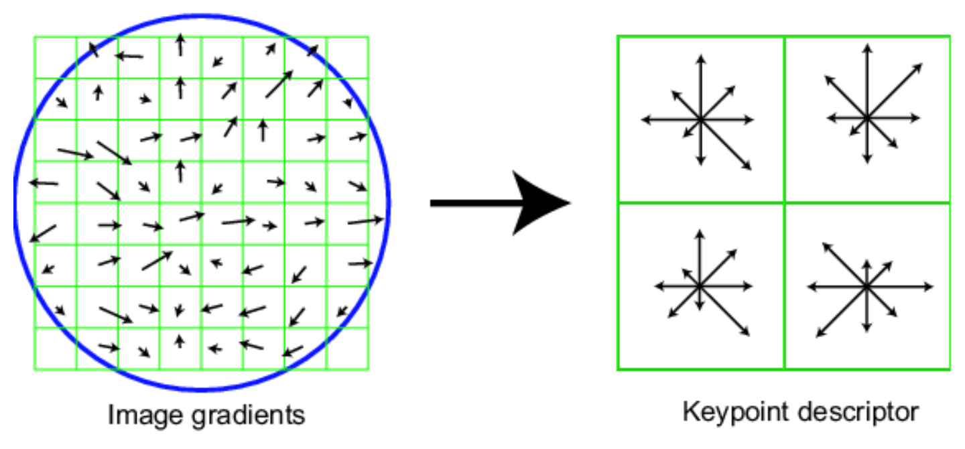
(c). Explain how SIFT can achieve invariances in (i) illumination, (ii) scale, (iii) rotation.
(i). illumination : the SIFT descriptor is based on gradient magnitude, instead of pixel value.
(ii). Scale: SIFT detects the interest points across different scale levels.
(iii). Rotation: the image is firstly rotated to the dominant orientation, thus SIFT is invariant to rotation.

Slide 5
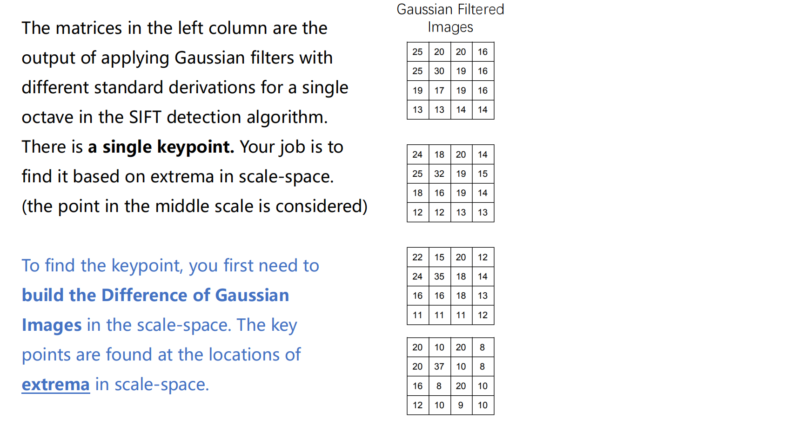
(d).

Slide 6
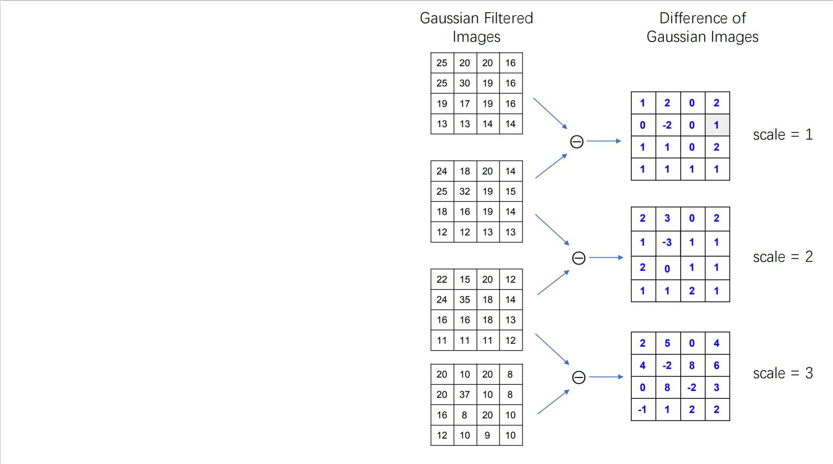

Slide 7
