Slide 1
CS5351 Software Engineering 2024-2025 Semester B
Prof. Zhi-An Huang
Department of Computer Science
Office: AC4-503
Email: huang.za@cityu-dg.edu.cn

Slide 2
Teaching Assistant
Zongxian Yang
Email: zongxian.yang@cityu-dg.edu.cn
Office: AC4-537

Slide 3
CS5351
The standard is two-hour lectures + 1 hour tutorial.
One integral session lasting for 3 hours
We will have lecture presentations and hands-on activities interleaved each class.
Classes will start at 2:00pm every Tuesday afternoon in Sem B.

Slide 4
Repeat
One continual session (lecture + tutorial) from 2:00pm to 4:50pm
But likely we will overrun each week
Lecture : stay in AC5-415
Tutorial : stay in AC5-415

Slide 5
Face-To-Face Teaching and Learning and Assessment
All activities, including lectures, tutorials, quiz and other in-class activities and assessments are conducted in the face-to-face mode.

Slide 6
CILOs in Brief
Describe fundamental software engineering process models and comprehend the current trends
Explain and analyze advanced software engineering principles and techniques
Create and maintain the design and codebase of software engineering projects
Perform team-based software engineering tasks
⇒ You need to record/apply/implement advanced software engineering processes, principles, and techniques in your team-based projects as your coursework

Slide 7
Pre-requisite
CS2312 Problem Solving and Programming or equivalent
What does it mean?
In the CityU CS Undergraduate Programme, CS2312 is the third CS course in programming taken in Year 2
The first two courses are CS2310 and CS1302 taken in Year 1.
CS1302: Introductory JavaScript Programming
CS2310: C++ Programming
CS2312: Object-Oriented Programming (Java) + Python
CS5351 assumes students have good programming ability in developing code projects and know the basis of program development.
CS5351 is not a course to assess students to write code. We do not teach programming in this course.

Slide 8
Course Assessment
Course Assessment
Course Work 50%
Attendance. 10%
Exam* 40%
Weighting of Coursework Assessment
Quiz 15% (Week 7)
Survey of Research Papers 10% (Week 11)
Team-Based Code Project 25% (Week 13)
* For a student to pass the course, at least 30% of the maximum mark for the examination must be obtained.

Slide 9
Tentative Course Schedule
Week | Topic
1 (1.7) | Introduction (Course Project)
2 (1.14) | Software Process
3 (1.21) | Modern Code Review
4 (2.18) | Software Requirements
5 (2.25) | Software Architecture
6 (3.4) | Technical Debt in Software Design
7 (3.11) | Quiz
8 (3.18) | Code with Quality
9 (3.25) | Software Testing (Part 1) Research Paper Due
10 (4.1) | Software Testing (Part 2)
11 (4.8) | Software Maintenance
12 (4.15) | Revision
13 (4.22) | Project Presentation Course Project Due

Slide 10
Assessment: Quiz
Weight: 15%
Week 7
Cover Topics in Weeks 1-6

Slide 11
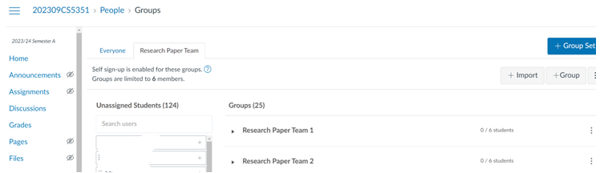
Assessment: Research Paper (1)
Weight: 10%.
6-8 students to form one team to conduct a survey on the recent advances in a chosen software engineering research topic.
Expect to spend 15 hours per student.
Write a review to accurately describe, compare and categorize N papers on your selected topic if the team has N student members
Self-enroll to your team in Canvas

Slide 12
Assessment: Research Papers (2)
Review N papers selected from the following list for a team of N students
https://conf.researchr.org/track/icse-2024/icse-2024-research-track?#event-overview
https://conf.researchr.org/track/icse-2023/icse-2023-technical-track?#event-overview
https://conf.researchr.org/track/icse-2022/icse-2022-papers?#event-overview
Report
For each of the N students in the team:
Write a review summary of your selected paper in 300 words
Motivation
Key problem solved
Key technique or methodology that solves the problem
Key results
Key experiments done
Your assessments on the merits and limitations of the work. Give convincing technical reasons or concrete counter-examples to illustrate the limitations.
Write in 200 words about your own ideas to improve the reviewed work and justify your proposal
For the whole team
Write a 500-word summary to elaborate the team-based idea into a new solution for one of the problems solved by a reviewed paper. Describe the process in the form of requirement engineering
Self-reflection of each student: No word limit

Slide 13
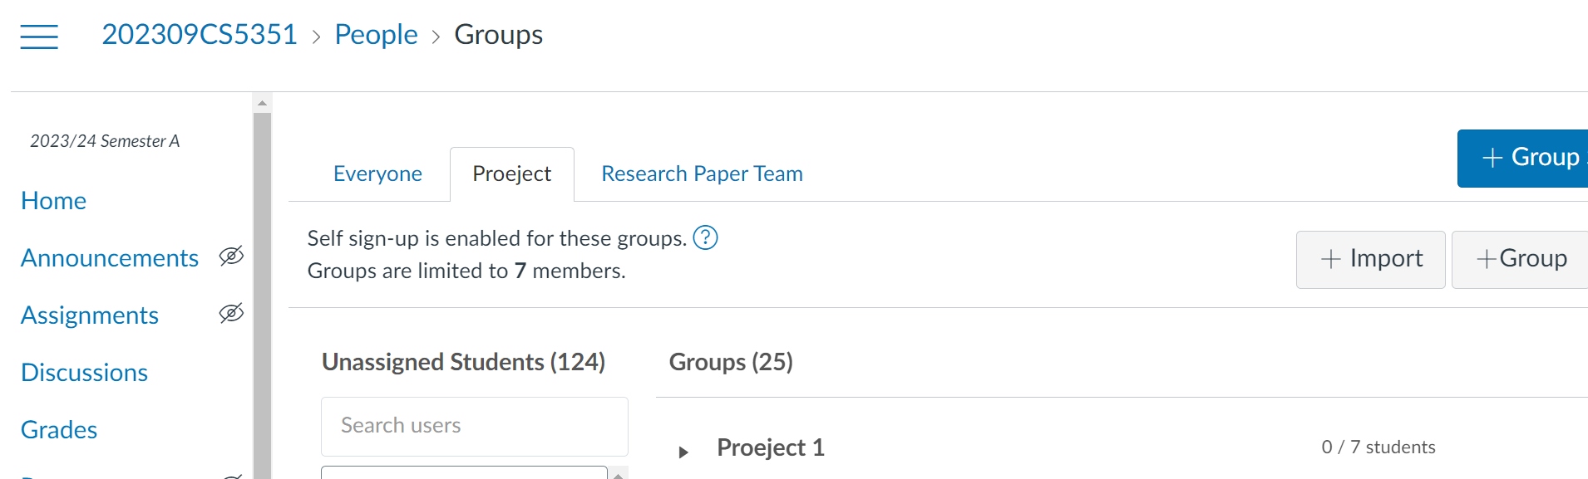
Assessment: Project
5-8 students per team
Self-enrol in a team
Produce a code-based project
A project is heavy. Do not form a small team, in which you may not have sufficient manpower to complete a good enough project by week 13.
Read the latter slides in this document for details

Slide 14
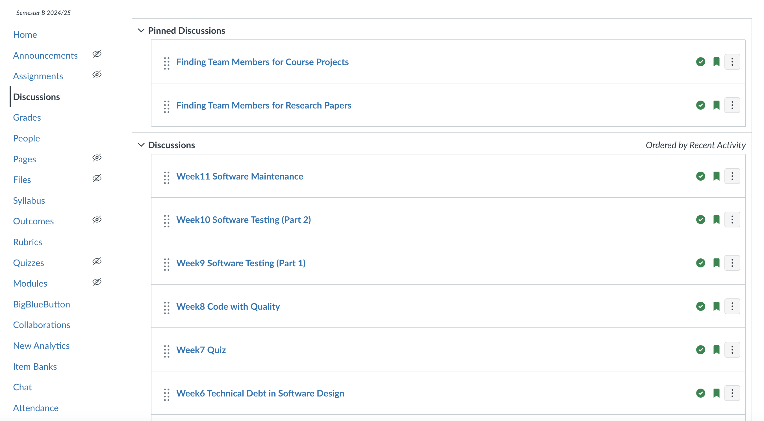
Discussions Threads in Canvas
Share your thoughts and comments, inquires and facilitate peer learning

