Slide 1
Scrum Simulation
Tutorial on Agile Process
CS5351 Software Engineering City University of Hong Kong (Dongguan)
2024-2025 Semester B
The materials of the game were adopted from the scrum game materials publicly available in Github https://github.com/OMerkel/Scrum-Card-Game (now https://scrumcardgame.com).
We would like to thank its authors and contributors: Lucho Salazar, Nils Bernert, Oliver Merkel, and Timofey (Tim) Yevgrashyn

Slide 2
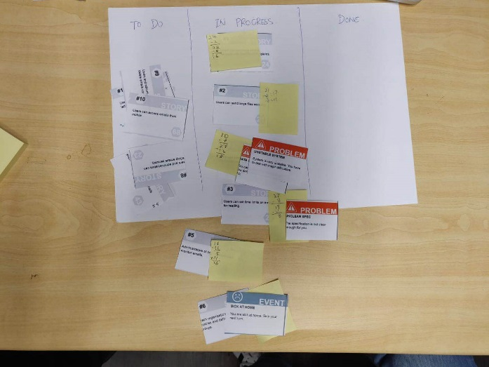
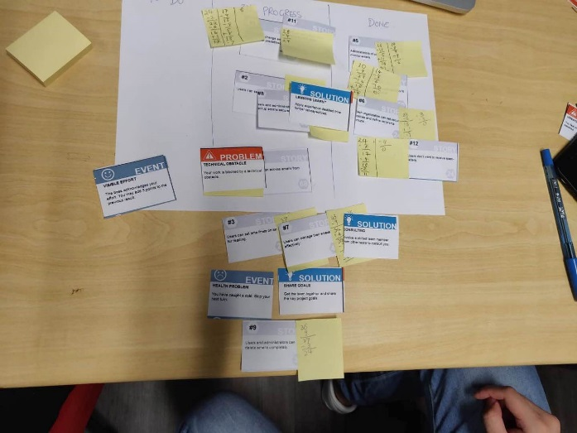
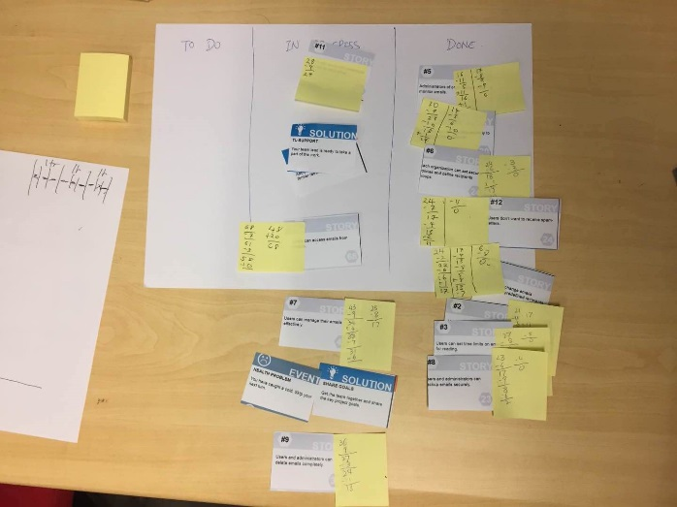
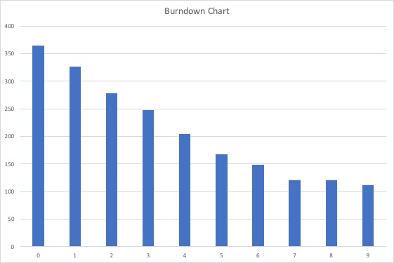
Scrum Card Game by TAs
Sprint 1
Sprint 2
Sprint 3
Burndown Chart
Story points
Sprint

Slide 3
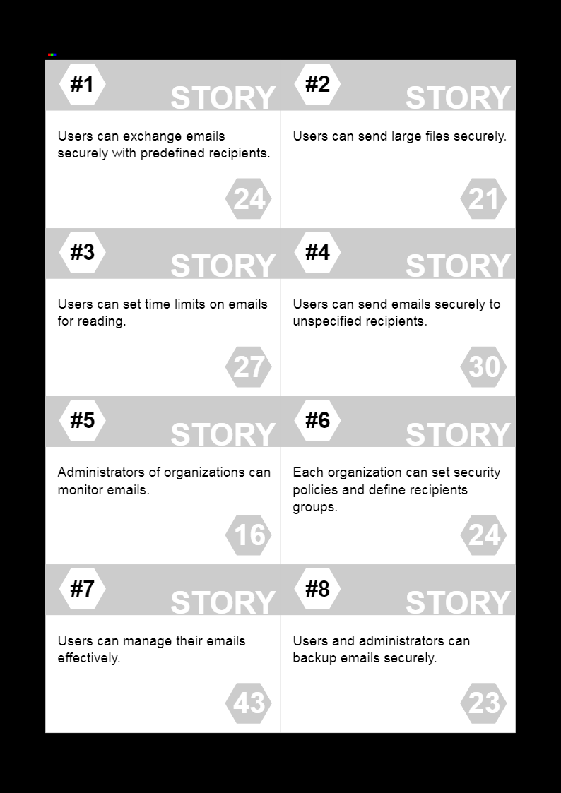
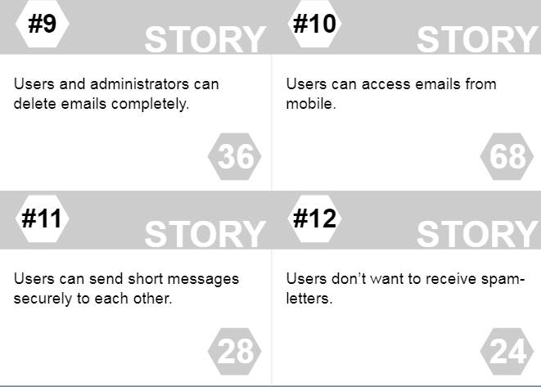
We have a Project!
For a software engineering project, we target to create a software application. The application to build is an email system.
After discussing with users and product owners, a set of 12 user stories (as numbered at the top-left corner) is created.

Slide 4
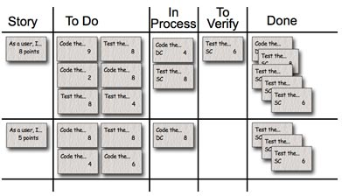
Self-Organize into Teams
Form a team of 4-6 students.
This team is independent of the course project or other coursework. Just form a team so that we can learn the Scrum idea through a simulation game
Each team
clusters around a region of the classroom.
collects the following from the teacher’s desk
one whiteboard to serve as the task board of your Scrum project.
two dice
a deck of Chance cards (shuffle the deck and up-side-down)

Slide 5
Estimate efforts for delivering the stories
Story ID
Let’s complete one round of the game using this estimated effort
Later, your team can use your own estimates and play another round of the game
story ID | hours
1 | 24
2 | 21
3 | 27
4 | 30
5 | 16
6 | 24
7 | 43
8 | 23
9 | 36
10 | 68
11 | 28
12 | 24
total | 364
Number of estimated efforts required (in hours) to deliver the user story
Total estimated efforts (let’s use hours instead of story points in this tutorial)

Slide 6
Prioritize product backlog
Our target is to deliver higher-priority user stories to users first
Now, each team should prioritize the set of 12 user stories.
Reorder the list into your favorable list
(the item with highest priority = the first element in your list)

Slide 7
Step 1: Planning for a Sprint
We work faster sometimes and slower at the other time.
Consider you only have 8 hours to work each day.
Let’s use THREE DAYS as the duration for a sprint.
How many hours does your sprint occupy?
E.g., 6 (students) x 3 (days) x 8 (hours per day) = 144 (= M hours)
[Initial planning] Before Sprint 1, we need 364 “outstanding” manhours for the remaining user stories
So, we need 364 / 144 = 3 sprints
Place stories that occupy at most M hours of effort into the “To-Do” column of the task board.
The set of placed stories is the Sprint backlog
Conduct a standing meeting [each member picks a story to work on].

Slide 8
Step 2: Player’s work each Day with the Sprint
For each of the three days, do
1.1 For each team member, do
1.1.1 Select a story to work on
1.1.2 Roll two dice to determine the number of productive hours of this team member on this day
1.2.3 draw a card from the “Chance” deck of cards (there are 3 types of cards)
Event: is a one-time action that cannot be prevented or postponed on the user story or the team member or the whole team
Problem: this issue blocks a Story the team member is working on. Attach the problem to the user story. It prevents the story from being DONE. But you can keep working on it (by wasting time!)
Solution: is the whole team’s asset. It can be used anytime to solve one problem of one story being blocked and unlock a story. Once it is used, the problem-solution pair is discarded.
Discuss each problem case and decide, if, in real life, you would apply such a Solution to this kind of problem. If everyone in the team agrees, a problem is solved.
1.1.4 A user story is moved to the “Done” column if it has 0 hours remaining and no unresolved problem is attached to the story.

Slide 9
Step 3: Review of Sprint
After each player has passed 3 turns – the Sprint is over
Calculate the number of stories DONE by the Sprint
Add the data point to the burndown chart
Compare the Actual result with the initial Plan
Review undone work and discuss
Retrospect on how to achieve more in the next Sprint

Slide 10
Step 4: Sprint 2
Repeat
Step 1: Planning
Step 2: Work each Day within the Sprint
Step 3: Sprint Review + Retrospective
If your team plays the game fast, try Sprint 3
If your team has completed this round of the game, you can use your own set of features as user stories and start another round of the game

Slide 11
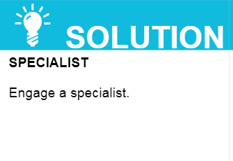
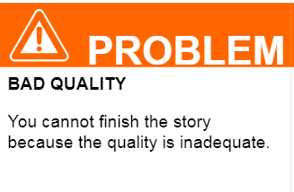
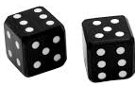
Game In Action
Solve?
Get consensus from the team on whether the solution solves the attached problem and only if your team has this solution on hand. Once the attached problem is solved, both cards are discarded (and return to the chance deck of cards).
backlog
To-do
In-Progress
Done
To-do
In-Progress
Done
attached
13
(= 24 – 11)
backlog
To-do
In-Progress
Done
If no problem attached to a story and 0 hours remained, move the story to “Done”
To-do
In-Progress
Done
13 5 0
roll dices
draw a chance card
At the end of the sprint, update the burndown chart
Drop by 24

Slide 12
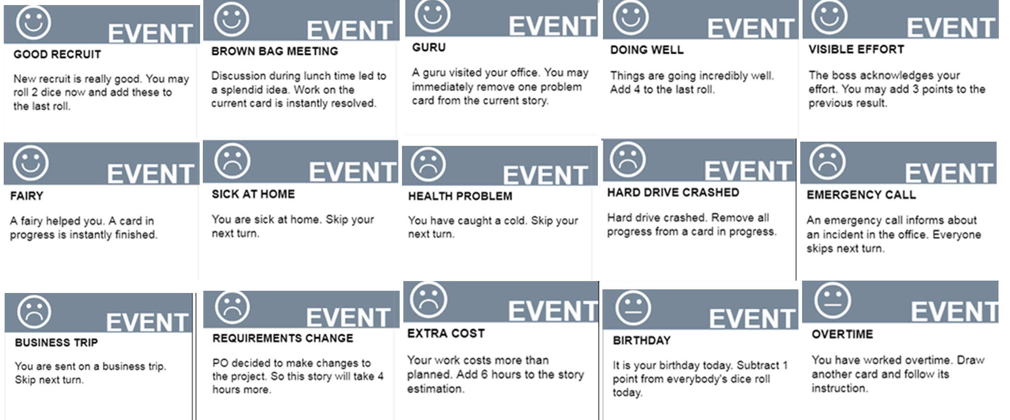
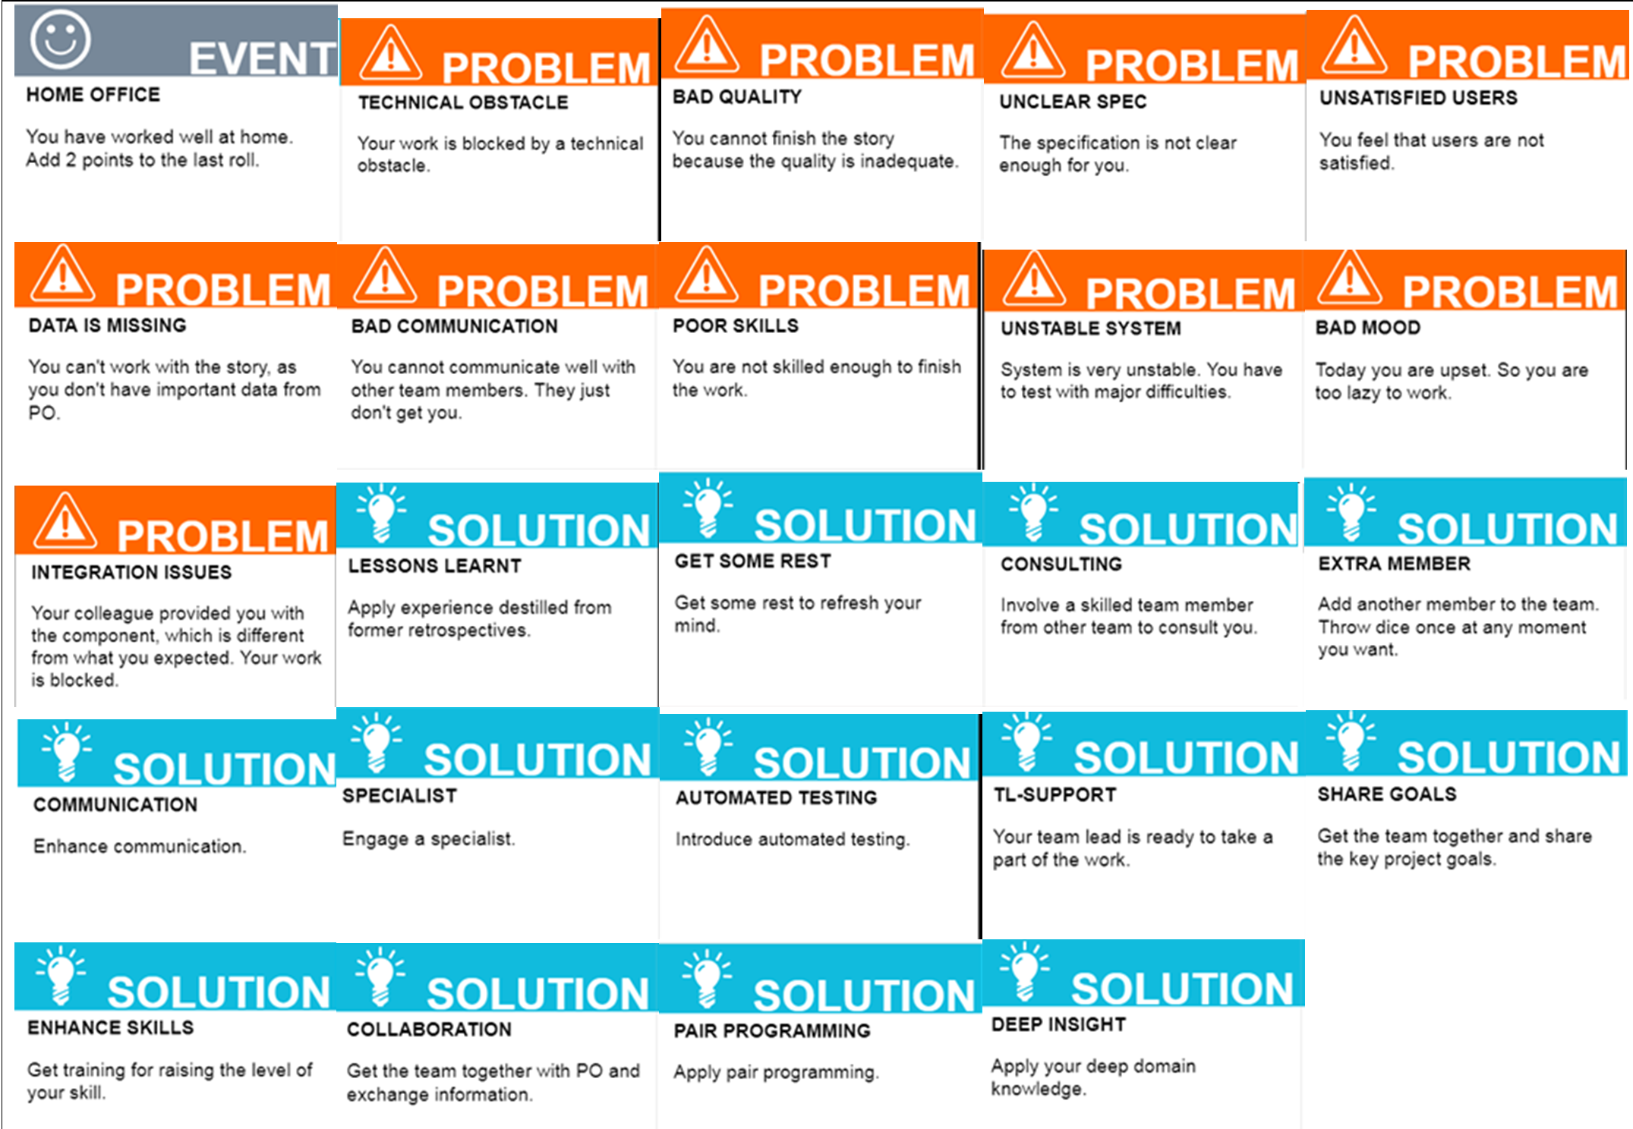
Chance Cards (Events, Problems, and Solutions)
https://www.youtube.com/watch?v=BVbfNiRbgjU

