Slide 1
CS5351 Software engineering 2024/25 Semester B Requirements Engineering Exercise
Prof. Zhi-An Huang
Email: huang.za@cityu-dg.edu.cn

Slide 2
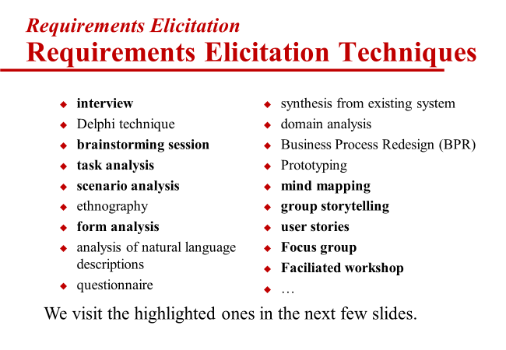
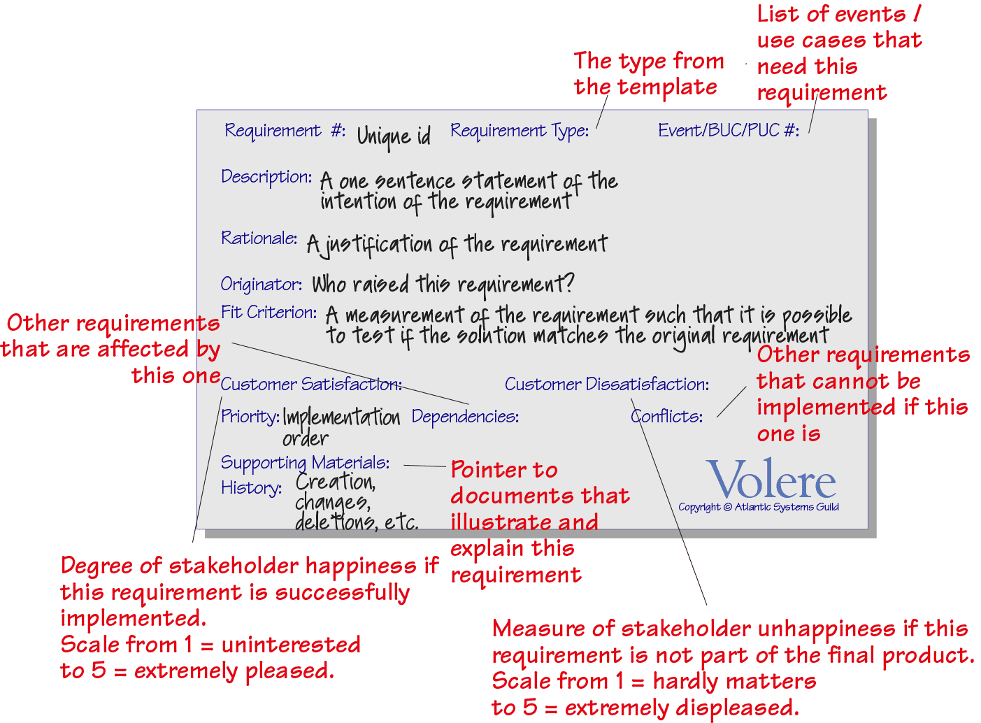
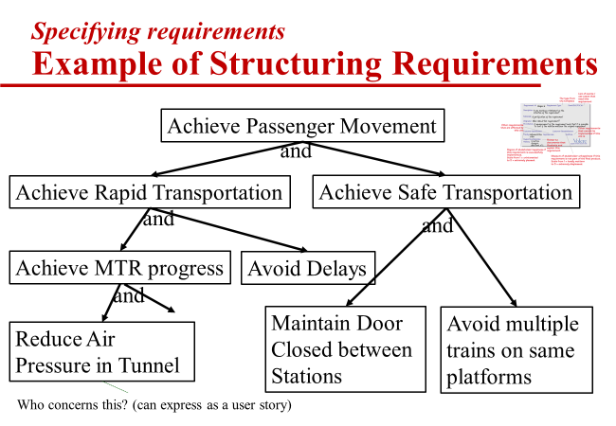
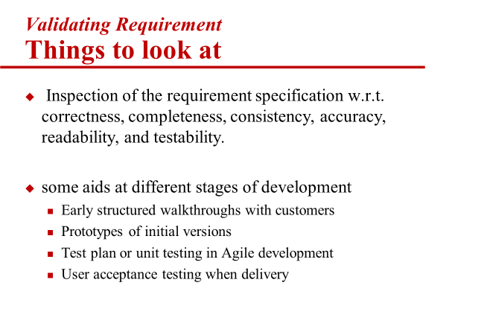
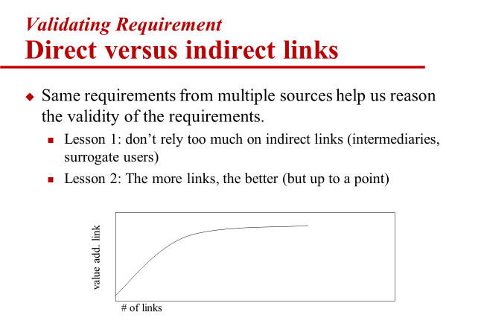
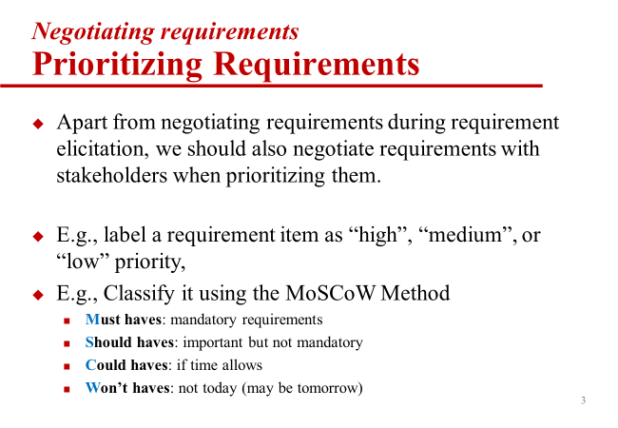
Requirements Engineering
Understand the application domain
Identify the sources of requirements
Analyse the stakeholders
Select the techniques, approaches, and tools to use
Elicit the requirements
understand the problem: elicitation
describe the problem (as a domain model): specification
Including analysis and structuring
agree upon the nature of the problem: validation
agree upon the boundaries of the problem: negotiation
Including RE analyst position
preparation steps

Slide 3
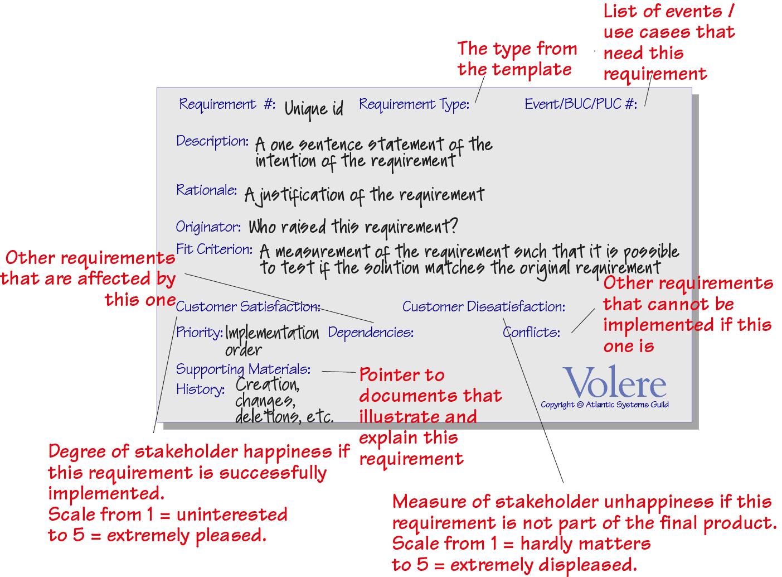
Volere Specification Template
Requirement # |  | Requirement Type | <ignore this field> | Use Case/Story #:
Description:
Rationale:
Originator:
Fit Criterion
Customer Satisfaction: |  |  | Customer Dissatisfaction:
Priority |  | Dependencies: |  | Conflicts:
Supporting Materials
Version History | Creation on Date 0 Revised on Date 1 Delete on Date 2

Slide 4
Volere Specification Template

Slide 5
Example: Two Meetings
Meeting M1: Mary, a game designer, expresses that one use case of the game is to clear a stage. She says, “Stage 1 of the game should be easy to conquer and level up for everyone. Otherwise, we cannot attract new users to play the game.” As an analyst, you follow up by asking what happens if Stage 1 is more difficult and varies from player to player. Mary, however, does not like this what-if scenario. She considers the storyboard of the game for Stage 1 will be too complicated. She wants Stage 1 to focus on the core value and the game's central theme to lock in users to play with a common value with a core theme shared between the game and the players. You ask, “Can Stage 1 be more difficult and standardized across players?”. Still, Mary hesitates about this scenario. You then ask, “Can we simply have one stage (a flat world) rather than a series of stages in the game?” Mary is not satisfied with this alternate idea of the game. You say, “You seem quite happy if the game has this feature implemented.” Mary nods.
Requirement # | R1 | Requirement Type | <ignore> | Event/BUC/PUC #: | UC1: Clear stage
Description: | Stage 1 of the game should be easy to conquer and level up for everyone
Rationale: | Lock in users to play with a common value shared between the game and the players Otherwise, it cannot attract new users to play the game.
Originator: | Mary (the game designer)
Fit Criterion | The game should not be flat and deliver a core theme of common value to players.
Customer Satisfaction: |  | 5? | Customer Dissatisfaction: |  | 5?
Priority | High | Dependencies: | NIL | Conflicts: | R2
Supporting Materials | Notes of Meeting M1
Version History | Creation Date: 17 Sep; Revised: 18 Sep

Slide 6
Example: Two Meetings
Meeting M2: John, a game KOL, is very excited about the concept of “clear a stage”. He says, “Wonderful idea! The stage should be exciting and contain different difficulties with encouragement gifts (e.g., bonus food items for collection)”, and “Players can collect gifts and conquer all difficulties to reach the target destination to level up.” You say, “Would it be too difficult if the player is in Stage 1?” John says “No, the game should be exciting all the time!”, and “The player experience in overcoming the difficulties demonstrates the core values and the central theme of the game.” You ask, “how to judge what kind of difficulties and at which difficulty level suitable for a stage?” John could not give an immediate answer and ponders around. He says, “We can play a prototype of the game first and then finetune them. Oh, let me think about it and tell you later”. You ask, “Are you happy if a stage is easy to pass through?” John says he is right about that and has few preferences. You ask, “Are you very happy if the game features what you say?” John agrees with you very well.
Requirement # | R2 | Requirement Type | <ignore> | Event/BUC/PUC #: | UC1: Clear stage
Description: | A stage (including Stage 1) should be exciting and contain different difficulties with encouragement gifts
Rationale: | the game should be exciting all the time! The player's experience in overcoming the difficulties demonstrates the game's core values and central theme.
Originator: | John (game KOL)
Fit Criterion | John says, “We can play a prototype of the game for a while first and then finetune them.”?
Customer Satisfaction: |  | 5? | Customer Dissatisfaction: |  | 1?
Priority | High | Dependencies: | NIL | Conflicts: | R1
Supporting Materials | Notes of Meeting M2
Version History | Creation Date: 18 Sep

Slide 7
High Level Logistics
Photo the resulting cards, their organization, and who performed the activity in each step.
[Background] Team A wants to elicit the requirements from Team B, and Team B wants to elicit the requirements from Team A.
All steps below refer to Team A to collect the requirements from Team B.
[5 mins] Everyone prepares a requirement. Sketch some screens.
Team A splits into A1 and A2 and Team B splits into B1 and B2.
A1 is supposed to interview B1.
[10 mins, preparation] A1 prepares for eliciting B’s requirements from B1. In parallel, B1 studies all requirements, chooses roles, and decides conflicts.
[15 mins, meeting] A1 elicits the requirement set AB from B1.
[10 mins, analysis] A1+A2 analyze and prioritize AB, and determine the follow-ups with B.
[10 mins, meeting] A2+B2 finalize the requirement priority. (A2 interviews B2)
[5 mins] A presents findings of B’s requirements, and B presents the actual requirement of B’s requirements.
Findings = requirements card, prioritization list, structuring of requirements cards

Slide 8
Illustration
Team A
Team B
Steps 2&3
Preparation
&Elicitation
(10+15 mins)
A1
interview
B1
RE Analyst
Customer
A2
interview
B2
Customer
RE Analyst
Step 4
Specification
&Validation
(10 mins)
A1
Elicited B’s requirements (AB)
Elicited A’s requirements
(BA)
analyze
B1
analyze
A2
B2
A1
interview
B1
Step 5
Negotiation
(10 mins)
Customer
RE Analyst
A2
interview
B2
RE Analyst
Customer
Step 6
Presentation
(5 mins)
A presents AB and other findings. B presents the original requirements
B presents BA and other findings.
A presents the original requirements

Slide 9
Step 1: Elicitation Preparation (5 mins)
Team A: Your course project team
Team B: Your course project team
Use your course project as the application to be built.
Set up a WhatsApp/WeChat group for your team (for photo sharing)
Each student writes a requirement about the project as a Volere card.
Sketch some screens/docs to represent the existing system feature or the expected system feature.
Decide who is in subteam 1 and who is in subteam 2.
Subteam A1 elicits B’s requirements from B1.
Subteam B2 elicits A’s requirements from A2.

Slide 10
Step 2: Elicitation Preparation (10 mins)
Team A1
A1 fills out the background form, to collect information about the application domain, the type of application in the mind of B1, and the roles of B1 members.
Team B1
B1 studies B2’s Volere cards, takes roles (PM, lead, operation, developers, users) to deliver the card requirement in Step 3, and decides whether there is any slight difference in opinions on requirements among these roles.

Slide 11
Step 3: Elicitation Meeting 1 (15 mins)
B1 is passive
A1 meets with B1 to elicit the requirement.
A1 generates a set of Volere requirements cards for B’s application (denoted as AB).
A1 should participate actively in shaping the requirements
choose the position of RE analyst to take,
lead B1 to resolve conflicts,
structure cards,
find out the importance of each collected requirement, and
validate requirements with multiple sources such as doc sketches and multiple B1 members.

Slide 12
Step 4: Analysis (10 mins)
A1 and A2 group again.
The whole team A analyzes AB and the background form.
Find ambiguity, conflict, or missing requirements of B’s application as an internal validation.
Preliminarily prioritize AB.
In parallel, A should check the cards for A's applications generated in Step 1.

Slide 13
Step 5: Elicitation Meeting 2 (10 mins)
A2 takes the role of RE analyst
B2 takes the role of customers
A2 meets with B2 to
follow up on the analysis results,
ask additional questions,
fix misunderstandings/issues,
correct and structure cards, and
finalize the card priority.

Slide 14
Step 6: Presentation (5 mins)
One team presents the collected requirements of another team.
The latter team presents the actual ones.

