Slide 1
CS5351 Software engineering 2024/25 Semester B Requirements Engineering
Prof. Zhi-An Huang
Email: huang.za@cityu-dg.edu.hk

Slide 2
Example
“As a customer, I want to buy PS5 from the website.”
This is a functional and verifiable requirement.
Development Team’s Expectation: Delivering the requirement will make the customer happy.
Sufficient? Many other concerns …
[Efficiency Issue] How about the customer needs to wait 30 minutes after each click or the input to each textbox on the website to complete a purchase of an item?
[Scalability Issue] How about the website only allows exactly one customer to buy exactly one item at any time?
…
We must know the non-functional part of the requirements

Slide 3
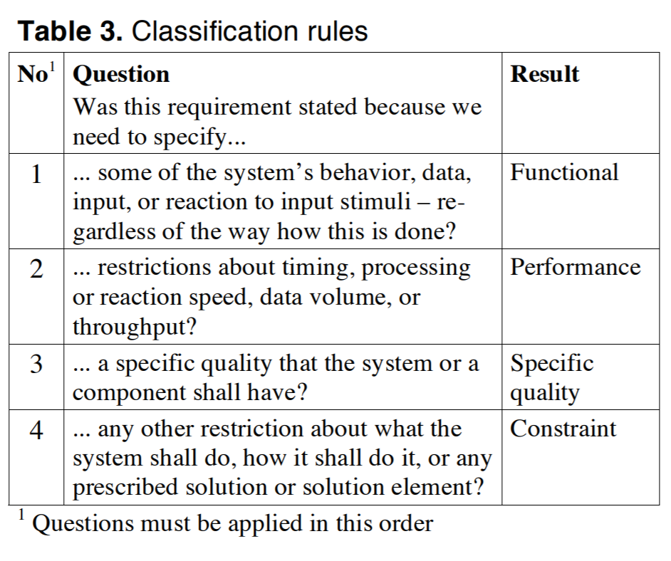
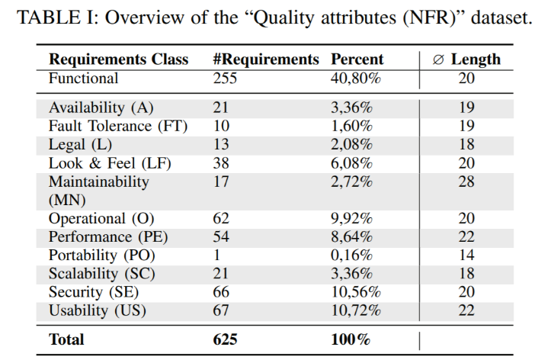
Requirements Engineering (RE)
RE is a process to find out and structure the functional and non-functional requirements of the software to be built.
[6]
Example dataset
[7]
In many cases, a high proportion of all requirements are non-functional requirements

Slide 4
Many faces of non-functional requirements
Be careful!
Different people in different domains may use different terminologies
Example “words” from users to mean non-functional requirements :
System properties/characteristics / constraints
Quality attributes, non-behavioral requirements, concerns, goals, extra-functional requirements, quality requirements, system attributes

Slide 5
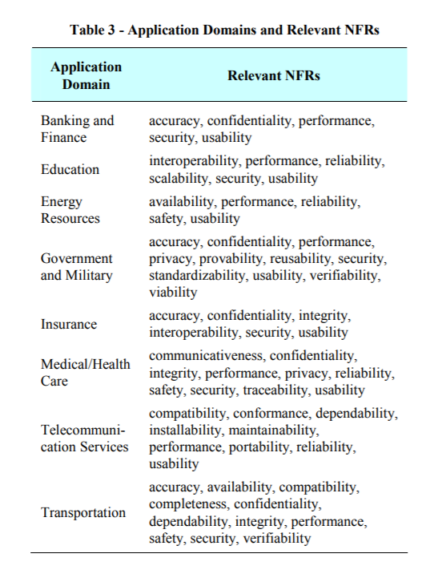
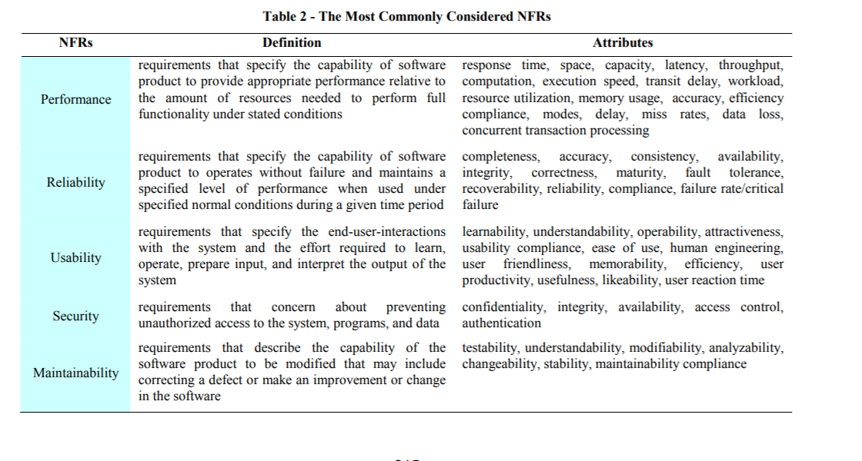
Many faces of non-functional requirements
Different application domains have different sets of major quality attributes.

Slide 6
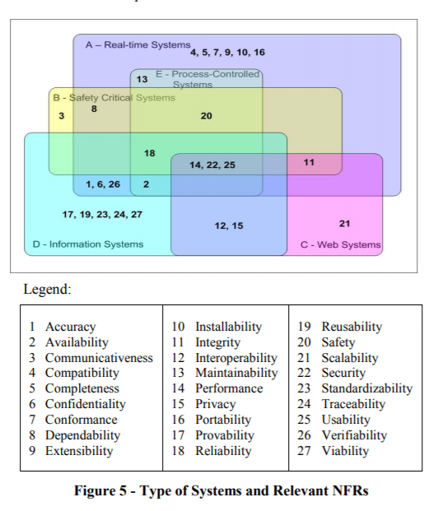
Many faces of non-functional requirements
Even in the same application domain, different types of applications have different sets of non-functional requirements

Slide 7
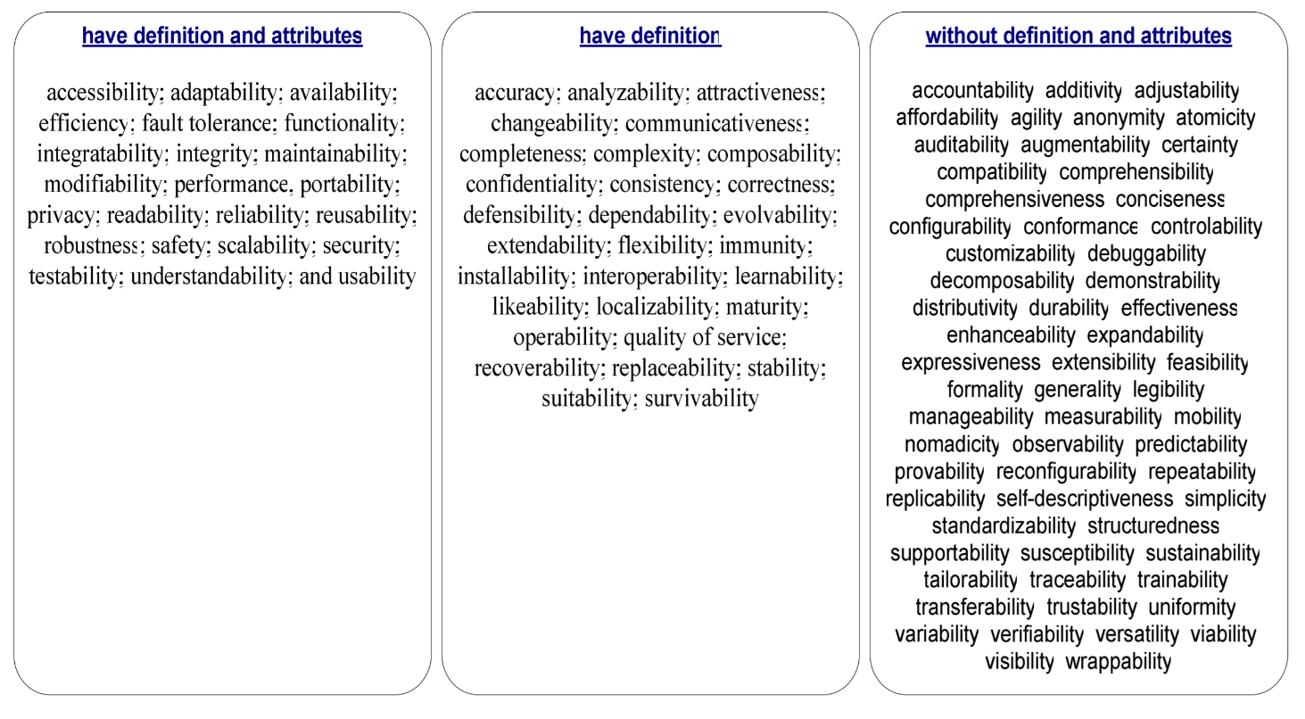
Many faces of non-functional requirements
Some quality attributes are undefined or vaguely known.
If a quality attribute cannot be measured or cannot be verified, we cannot know whether we cannot predict how well our software meets them
For such quality attributes, we can only rely on user evaluations on the software

Slide 8
We need to Handle Multi-Level Concerns
specific to the application domain
=> meet the general requirement of the industry sector
specific to the type of software application
=> meet the general requirement for the type of software
the specific to the application
=> meet the unique requirements of the current application
In all levels, consider non-functional requirements
If not, our application will not be used easily in the application environment

Slide 9
Requirements Engineering

Slide 10
Requirements Engineering (RE)
is the first step in finding a solution for a data processing problem
the results of requirements engineering is a requirements specification
requirements specification is a
contract for the customer
starting point for design

Slide 11
Avoid Common Mistakes in RE [https://ieeexplore.ieee.org/document/1695257]
noise: does not add relevant information
silence: feature in the problem not mentioned in the specification
over-specification: talk about the solution rather than the problem
contradictions: inconsistent description
ambiguity: unclear
forward references: especially cumbersome in long documents
wishful thinking: features that cannot realistically be realized

Slide 12
Natural language specs are dangerous
e.g., “All users have the same control field”
The same value in the control field?
The same format of the control field?
There is one (1) control field for all users?
We should validate the documented requirements to avoid misunderstanding. It leads to the RE process (see the next slide).

Slide 13
Requirements engineering, main steps
Four major steps in an RE process
understanding the problem: elicitation
describing the problem: specification
agreeing upon the nature of the problem: validation
agreeing upon the boundaries of the problem: negotiation
This is an iterative process
specification
elicitation
validation
doc & mgt
negotiation

Slide 14
Conceptual modeling
We explicitly model the scope of the requirements as a domain model
Making a model explicit requires solving two problems:
Analysis: to find and clear ambiguity: Because of the unspoken assumptions, different languages /terminologies being spoken, incomplete codification of the problem domain
Negotiation: to resolve ambiguity due to stakeholders with different goals (e.g., workers against management).
As an analyst, we must participate in shaping the domain model
Having an explicit model reduces later surprises.

Slide 15
How we study the world around us
people have a set of assumptions about a topic they study
this set of assumptions concerns/affects:
how knowledge is gathered
how the world (they know) is organized
this results in two dimensions:
subjective-objective (w.r.t. knowledge)
conflict-order (w.r.t. the world)
which results in 4 basic positions to requirements engineering that an analyst can take

Slide 16
The Positions of Analyst in RE
functional (objective+order): the analyst is the expert who empirically seeks the truth
social-relativism (subjective+order): the analyst is a `change agent’. RE is a learning process guided by the analyst
radical-structuralism (objective+conflict): there is a struggle between classes; the analyst chooses for either party
neohumanism (subjective+conflict): the analyst is kind of a social therapist, bringing parties together

Slide 17
Four positions to RE Functional
Functional: functional (objective+order): the analyst is the expert who empirically seeks the truth
Conflicts are solved by management.
Management tells how things go.
Requirements are well-articulated, shared, objective.
Development is formal, rational.
Politics is irrelevant.
Reality is measurable, and the same to everyone.
Design is a technical problem.

Slide 18
Four positions to RE Social-Relativism
Social-relativism: (subjective+order): the analyst is a `change agent’
There is not one truth, there may be different perceptions.
An information system is part of a continually changing social environment.
System goals result from an organization shaping its own reality.
There is no objective criterion of good or bad.
The goal is to arrive at a consensus.

Slide 19
Four positions to RE Radical-Structuralism and Neohumanism
Radical-structuralism: radical-structuralism (objective+conflict):
There is a struggle between classes; the analyst chooses for either party
There is a fundamental truth, but there also is a fundamental battle between classes.
You may choose for either management (machines replace people, machines guide people’s work, supervision, loss of jobs, less interesting work) or for the workers (enhance labor skills, make work more interesting and challenging).
Neohumanism (subjective+conflict): rather hypothetical; emancipation, remove barriers

Slide 20
Requirements Elicitation
After knowing the position we play in the RE process of a project, the next thing we do is to collect the requirements.
The activities in the requirements elicitation process can be classified into five types.
Understanding the application domain
Identifying the sources of requirements
Analysing the stakeholders
Selecting the techniques, approaches, and tools to use
Eliciting the requirements from stakeholders and other sources
Since Elicitation is an iterative process, we cannot finish one type before starting another.

Slide 21
Requirements Elicitation 1. Understanding the application domain
Start from understanding the application domain
The current environment of the system needs to be thoroughly explored including the political, organizational, and social aspects related to the system, in addition to any constraints they may enforce upon the system and its development.

Slide 22
Requirements Elicitation 2. Identifying the sources of requirements
Requirements spread across many sources and exist in different formats.
People
Stakeholders: the main source of requirements for the system.
Users and subject matter experts: supply details and needs
Things
E.g., Existing systems and operation processes
E.g., Existing documentation (e.g., manuals, forms, and reports):
provide useful information about the organization, environment, and rationales

Slide 23
Requirements Elicitation 3. Analyzing the stakeholders
Stakeholders are people who have an interest in the system
Groups and individuals internal and external to the organization.
Customers and direct users of the system
Analyze and involve all the relevant stakeholders.
The process of analyzing the stakeholders also often includes identifying key user representatives and product champions (who support the software).
Consult them during requirements elicitation.

Slide 24
Requirements Elicitation 4. Selecting the techniques, approaches, and tools to use
Requirements elicitation is best performed using a variety of techniques (e.g., interviewing and form analysis).
In many projects, several elicitation techniques are employed during and at different software development life cycle stages.

Slide 25
Requirements Elicitation 5. Eliciting the requirements from stakeholders and other sources
After the above four preparation steps, this step is the actual step to collect requirements.
Targets
Establish the scope of the system
Investigate in detail the needs and wants of the stakeholders, especially the users
Determine the future processes the system will perform with respect to the business operations,
Examine how the system may support to satisfy the major objectives (and address the key problems) of the business

Slide 26
Requirements Elicitation Requirements Elicitation Techniques
interview
Delphi technique
brainstorming session
task analysis
scenario analysis
ethnography
form analysis
analysis of natural language descriptions
questionnaire
synthesis from existing system
domain analysis
Business Process Redesign (BPR)
Prototyping
mind mapping
group storytelling
user stories
Focus group
Faciliated workshop
…
We visit the highlighted ones in the next few slides.

Slide 27
Requirements Elicitation Interview
Commonly used in requirements elicitation.
Ask stakeholders questions about the current application’s usage and the usage of the application to be built.
Good at getting an overall understanding of stakeholders' needs and the current application's problem from their views.
Inherently informal, and their effectiveness depends greatly on the quality of interaction between the participants.
Interviews provide an efficient way to collect large amounts of data quickly

Slide 28
Requirements Elicitation Interview
Three types of interviews: unstructured, structured, and semi-structured (hybrid of the former two)
Unstructured
Limited control over the direction of discussions.
Best applied for exploration when there is a limited understanding of the domain
Risky: Too much detail in some areas, and not enough in others

Slide 29
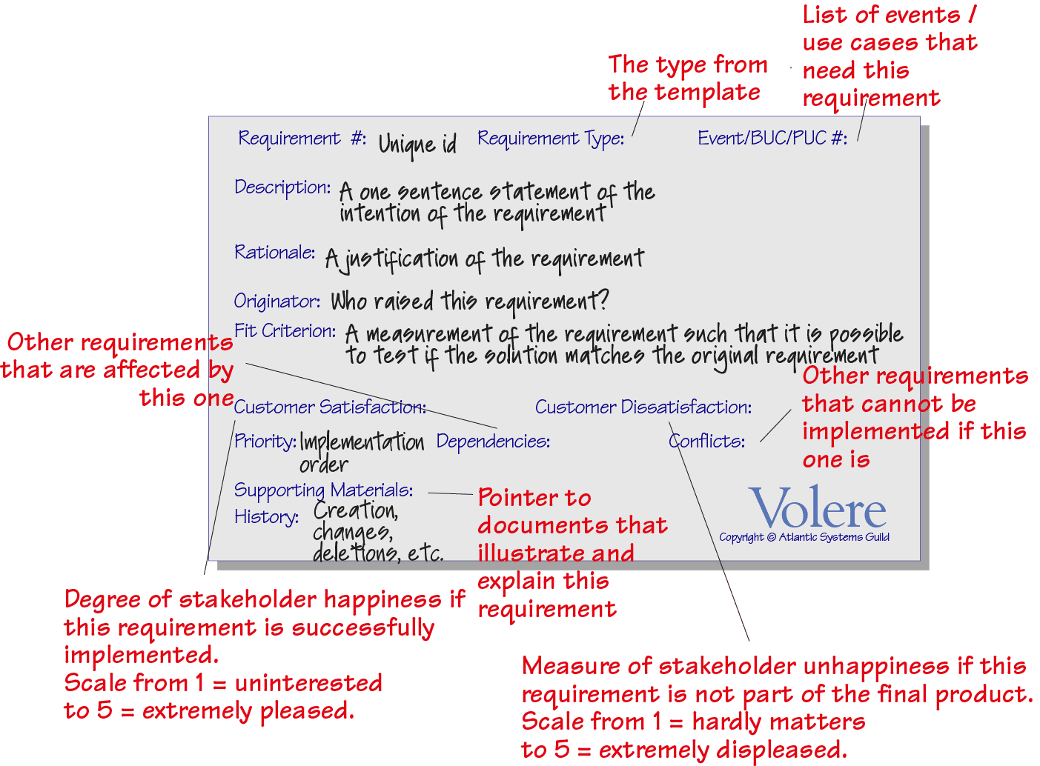
Requirements Elicitation Interview
Structured
using a predetermined set of questions to gather specific information
The success of structured interviews depends on knowing what are the right questions to ask, when should they be asked, and who should answer them. Templates that provide guidance on structured interviews for requirements elicitation such as Volere can be used.
Questions can be open-ended first then close-ended (more specific).

Slide 30
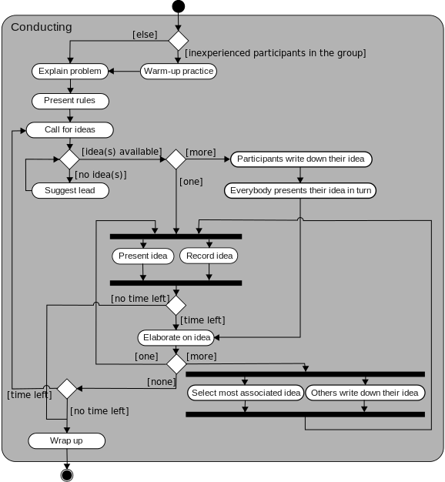
Requirements Elicitation Brainstorming session
Osborn's method
Brainstorming is a group-based activity by gathering a list of ideas iteratively toward a particular topic

Slide 31
Requirements Elicitation Task Analysis
Task analysis analyzes how people perform their jobs:
the things they do, the things they act on, and the things they need to know.
It employs a top-down approach where high-level tasks are decomposed into subtasks and eventually detailed sequences until all actions and events are described.
It determines the knowledge used or required to carry tasks out.
E.g., how an SGS staff completes the student enrolment task, in which many typical and atypical situations need to be handled.

Slide 32
Requirements Elicitation Scenario-Based Analysis
Provides a more user-oriented perspective on designing and developing an interactive system.
E.g., observe how the SGS staff handles the enrolments of a non-local student A and a local student B. Then, ask questions on cases not yet covered.

Slide 33
Requirements Elicitation Scenario-Based Analysis (example)
first shot by observation on book return in Library.
check due back date
if overdue, collect fine
record book as being available again
put book back
followed by a discussion with the librarian
what if the person returning the book is not registered as a client?
what if the book is damaged?
how to handle in case the client has other books that are overdue, and/or an outstanding reservation?

Slide 34
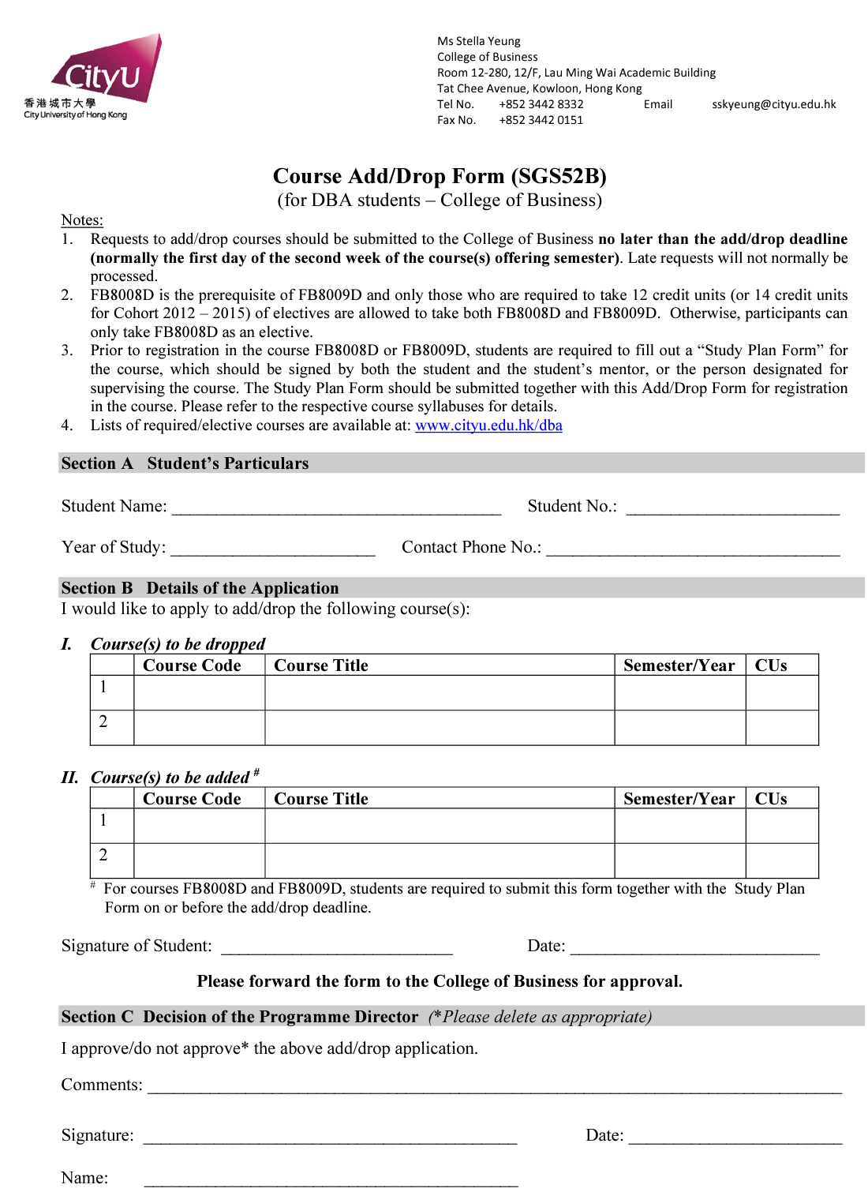
Requirements Elicitation Form analysis
Figure out items that are certain or have variety, and the time (past, while filling the form, or future) that the information for the item is available.

Slide 35
Requirements Elicitation Focus Group and Facilitated Workshop
A focus group is a small, but demographically diverse, group of people whose reactions are studied in guided or open discussions.
people are asked about their perceptions, opinions, beliefs, and attitudes towards
RE Analyst records the vital points he or she is getting from the group.
A facilitated workshop involves cross-functional team members to study the topic from all perspectives and make a decision as the outcome of the workshop.

Slide 36
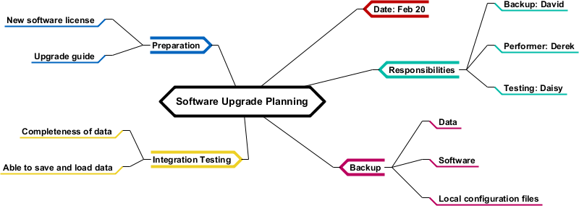

Requirements Elicitation Mind mapping, group storytelling, user stories
Mind map
Group storytelling
Co-construct a story, share a story, complete an unfinished story provided by a facilitator, zoom-in/out or summarize a story, roleplay a story, analyze a story
User story
E.g., As a manager, I want to browse my existing quizzes so I can recall what I have in place and figure out if I can just reuse or update an existing quiz for the position I need now

Slide 37
Elicitation Technique Selection: How Do Experts Do It? [4]
Interviewing: particularly useful to gather initial background information when working on new projects in new domains.
Collaborative Sessions (focus group, workshop, brainstorming): Effective
Data Gathering from Existing Systems: must do, but not over-analyze
Agile (mind mapping, group storytelling, user stories): popular nowadays.
Questionnaires: Not effective

Slide 38
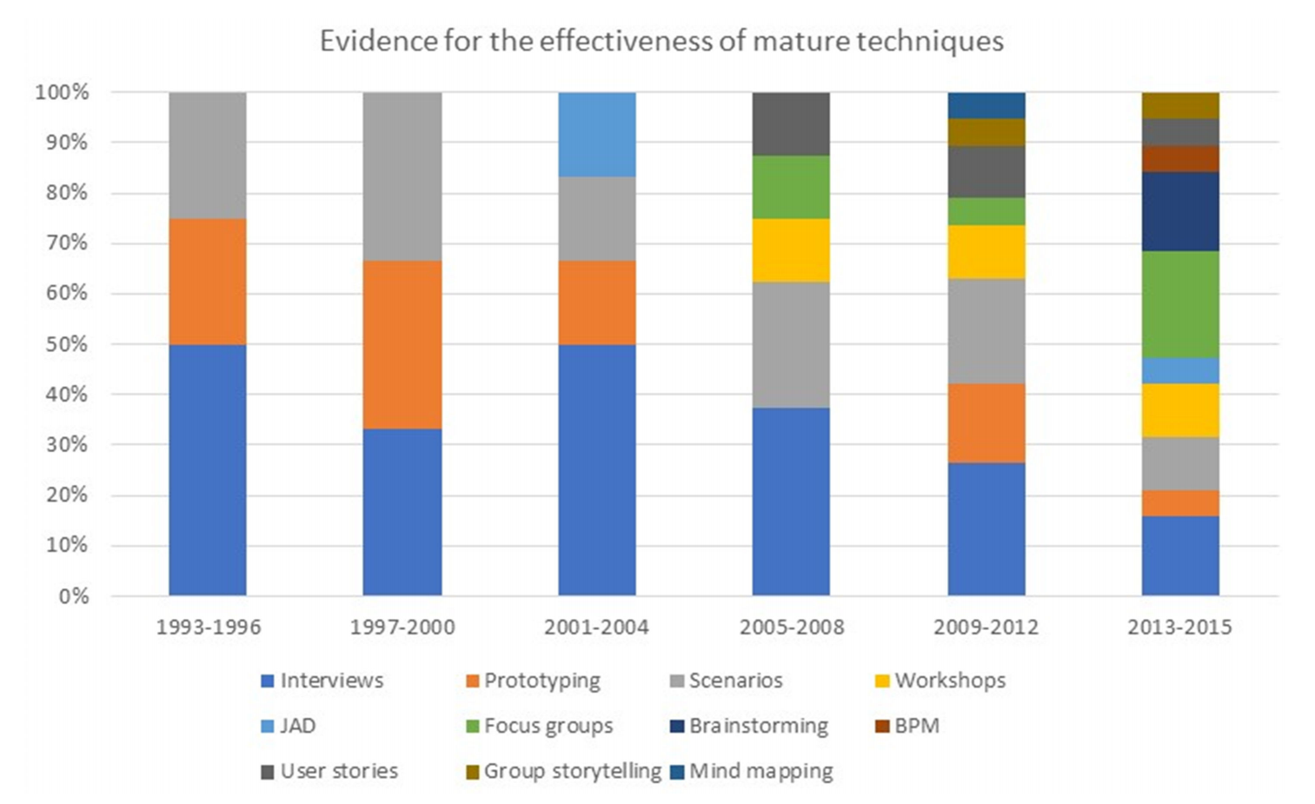
Requirements Elicitation Effectiveness of mature techniques [5]
Mind mapping. Out?
emerging
Brainstorming
✓
Focus group
✓
workshop
✓
Phasing out
Phasing out

Slide 39
Recall? Requirements engineering, main steps
Four major steps in an RE process
understanding the problem: elicitation
describing the problem: specification
agreeing upon the nature of the problem: validation
agreeing upon the boundaries of the problem: negotiation
This is an iterative process
specification
elicitation
validation
doc & mgt
negotiation

Slide 40
Specifying requirements Structuring a set of requirements
While we collect the requirements, we should structure them.
Hierarchical structure: Higher-level requirements are decomposed into lower-level requirements
Link requirements to specific stakeholders (e.g., management and end users each have their own set)
So, while we structure the requirements, we also analyze them and their relationships.

Slide 41
Specifying requirements Example of Structuring Requirements
Achieve Passenger Movement
and
Achieve Rapid Transportation
Achieve Safe Transportation
and
and
Achieve MTR progress
Avoid Delays
and
Maintain Door Closed between Stations
Avoid multiple trains on same platforms
Reduce Air Pressure in Tunnel
Who concerns this? (can express as a user story)
Notes:
In this particular graph, we have and-relations: the search book AND search news item requirements together make up the search requirement.
We can also have other kinds of links. E.g. conflicts with.

Slide 42
Validating Requirement Direct versus indirect links
Same requirements from multiple sources help us reason the validity of the requirements.
Lesson 1: don’t rely too much on indirect links (intermediaries, surrogate users)
Lesson 2: The more links, the better (but up to a point)
value add. link
# of links

Slide 43
Validating Requirement Things to look at
Inspection of the requirement specification w.r.t. correctness, completeness, consistency, accuracy, readability, and testability.
some aids at different stages of development
Early structured walkthroughs with customers
Prototypes of initial versions
Test plan or unit testing in Agile development
User acceptance testing when delivery

Slide 44
Negotiating requirements Prioritizing Requirements
Apart from negotiating requirements during requirement elicitation, we should also negotiate requirements with stakeholders when prioritizing them.
E.g., label a requirement item as “high”, “medium”, or “low” priority,
E.g., Classify it using the MoSCoW Method
Must haves: mandatory requirements
Should haves: important but not mandatory
Could haves: if time allows
Won’t haves: not today (may be tomorrow)

Slide 45
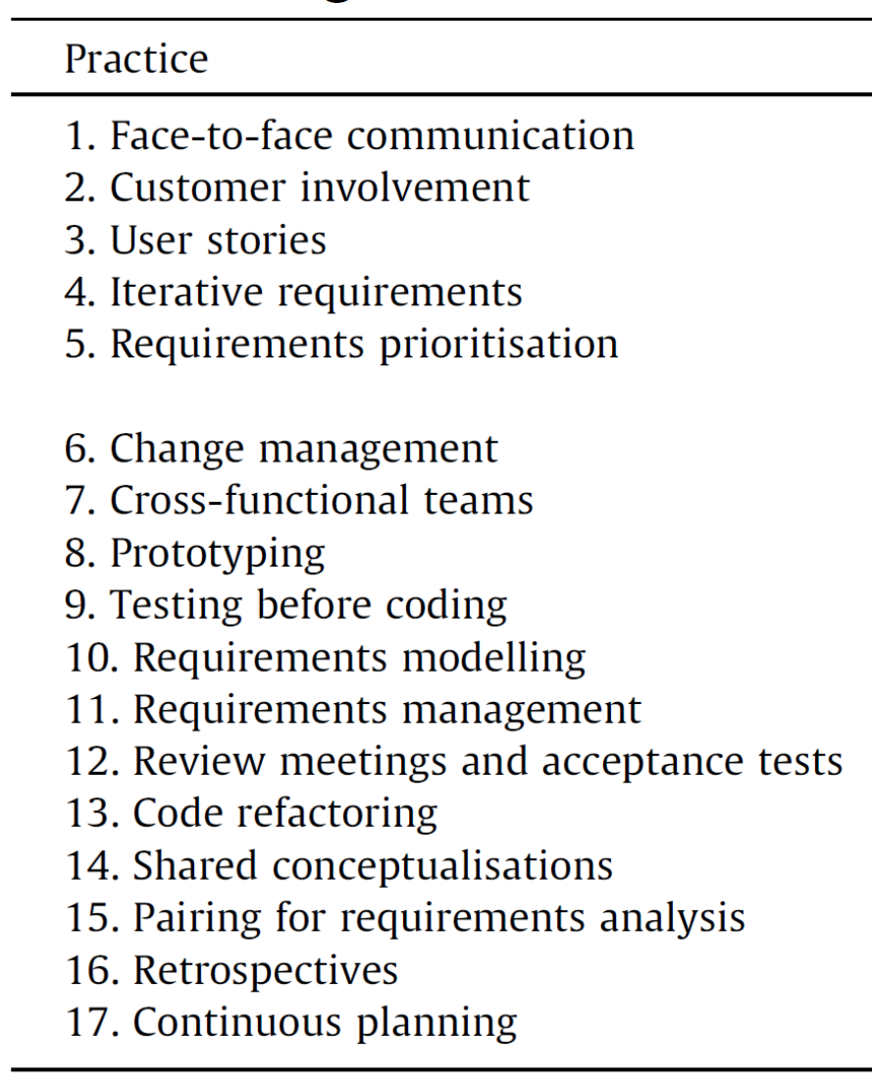
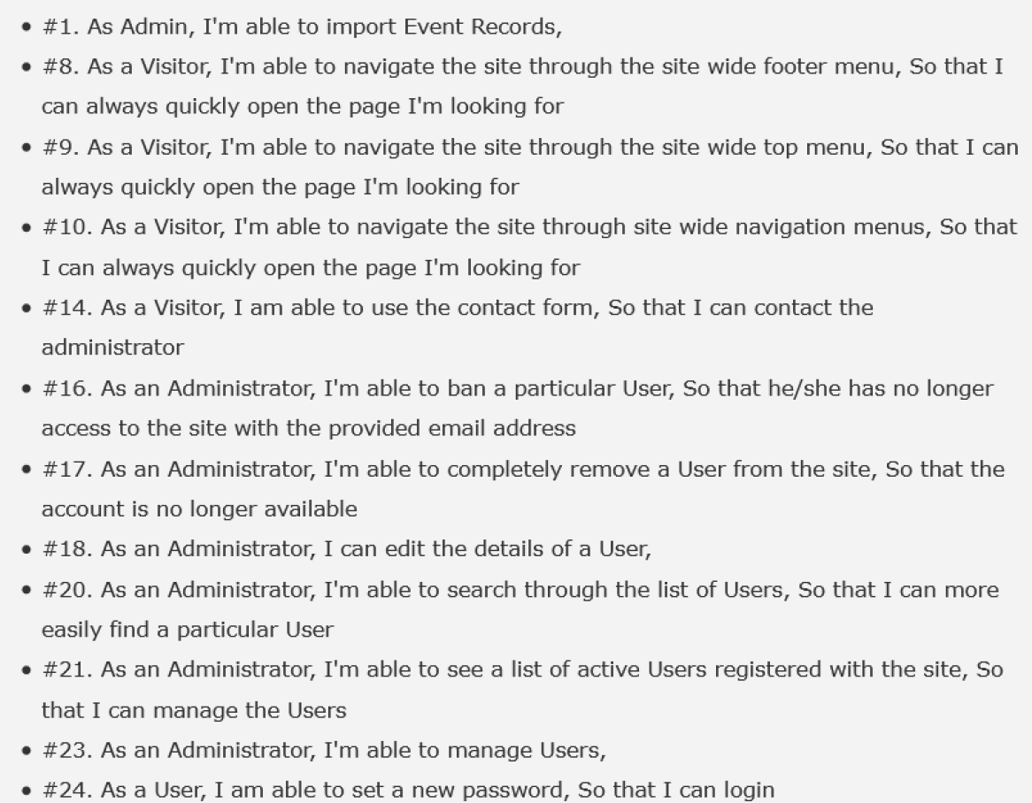
Example Practices in Agile Requirement Management
Example user stories in brief

Slide 46
Summary
RE involves elicitation, specification, validation, and negotiation
Elicitation has five iterative steps, four of which are preparation steps. We use multiple elicitation techniques.
We not only collect the requirements but also shape them
Analyzing requirements by structuring them
Negotiating with stakeholders in requirement elicitation and prioritization
Validating requirements from multiple sources

Slide 47
References and Resources
Sommerville, Software Engineering, 10th Edition. (Chapter 4)
Irum Inayat, Siti Salwah Salim, Sabrina Marczak, Maya Daneva, and Shahaboddin Shamshirband. 2015. A systematic literature review on agile requirements engineering practices and challenges. Comput. Hum. Behav. 51, PB (October 2015), 915-929. DOI: http://dx.doi.org/10.1016/j.chb.2014.10.046 or https://www.sciencedirect.com/science/article/pii/S074756321400569X
Catarina Gralha, Daniela Damian, Anthony I. (Tony) Wasserman, Miguel Goulão, and João Araújo. 2018. The evolution of requirements practices in software startups. In Proceedings of the 40th International Conference on Software Engineering (ICSE '18). ACM, New York, NY, USA, 823-833. DOI: https://doi.org/10.1145/3180155.3180158
Ann M. Hickey and Alan M. Davis. 2003. Elicitation Technique Selection: How Do Experts Do It?. In Proceedings of the 11th IEEE International Conference on Requirements Engineering (RE '03). IEEE Computer Society, Washington, DC, USA, 169- http://www.cse.msu.edu/~chengb/RE-491/Papers/elicitation-hickey-davis.pdf
Carla L. Pacheco, Ivan A. Garcia, Miryam Reyes: Requirements elicitation techniques: a systematic literature review based on the maturity of the techniques. IET Software 12(4): 365-378 (2018)
Martin Glinz: On Non-Functional Requirements. RE 2007: 21-26, 2007.
Zijad Kurtanovic, Walid Maalej: Automatically Classifying Functional and Non-functional Requirements Using Supervised Machine Learning. RE 2017: 490-495
Dewi Mairiza, Didar Zowghi, Nur Nurmuliani: An investigation into the notion of non-functional requirements. SAC 2010: 311-317, 2010.

