Slide 1
CS5351 Software Engineering 2024/25 Semester B Technical Debt
Prof. Zhi-An Huang
Email: huang.za@cityu-dg.edu.cn

Slide 2
Outline
What is Technical Debt
Identify Technical Debt
Manage Technical Debt
Card Game for Managing Technical Debts
Managing Technical Debts in Practice

Slide 3
Technical Debt
Technical debt (TD)
is a metaphor originally proposed in 1992 [1]. The metaphor is that doing things in a “quick and dirty” way creates a technical debt (TD).
is a design or construction approach that is expedient in the short term but that creates a technical context in which the same work will cost more to do later than it would cost to do now (including increased cost over time) [2].
Example of a decision leading to a TD consequence
“We don't have time to reconcile these two databases before our deadline, so we'll write some glue code that keeps them synchronized for now and reconcile them after we ship.”

Slide 4
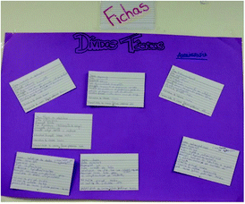
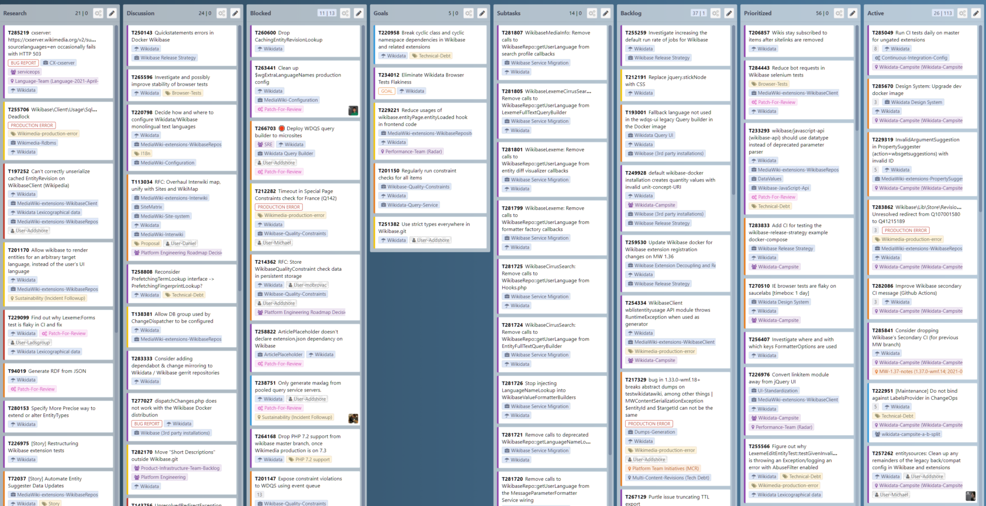
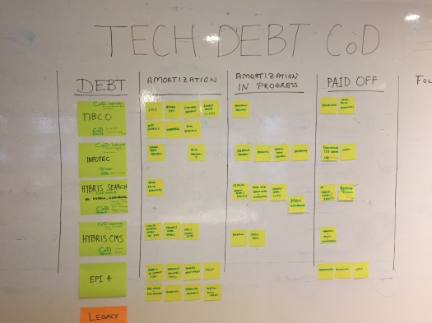
Examples
Technical debt in task board
https://addshore.com/2021/06/tackling-technical-debt-big-and-small-in-wikidata-and-wikibase/
https://theagilepmo.blog/2016/12/30/technical-debt-visualised-using-cost-of-delay/

Slide 5

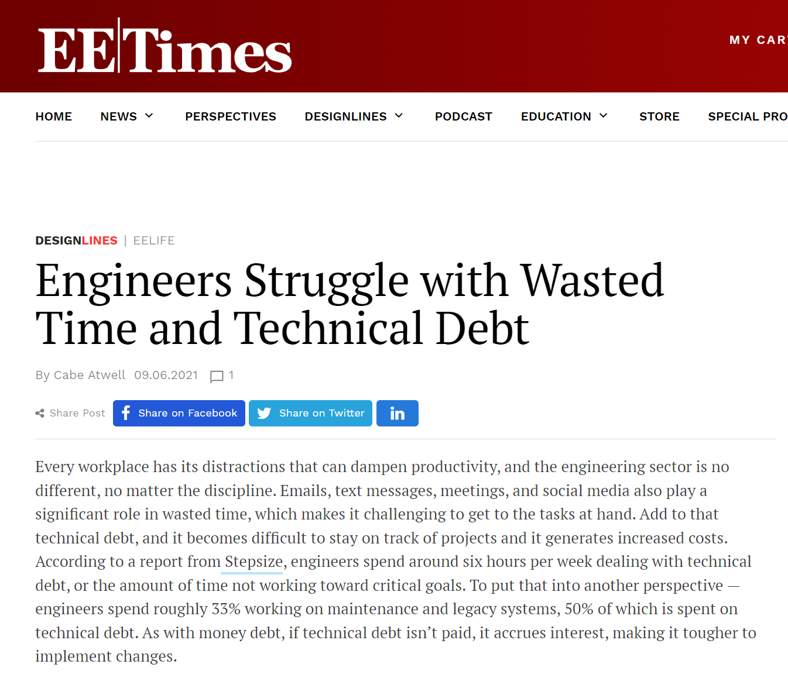
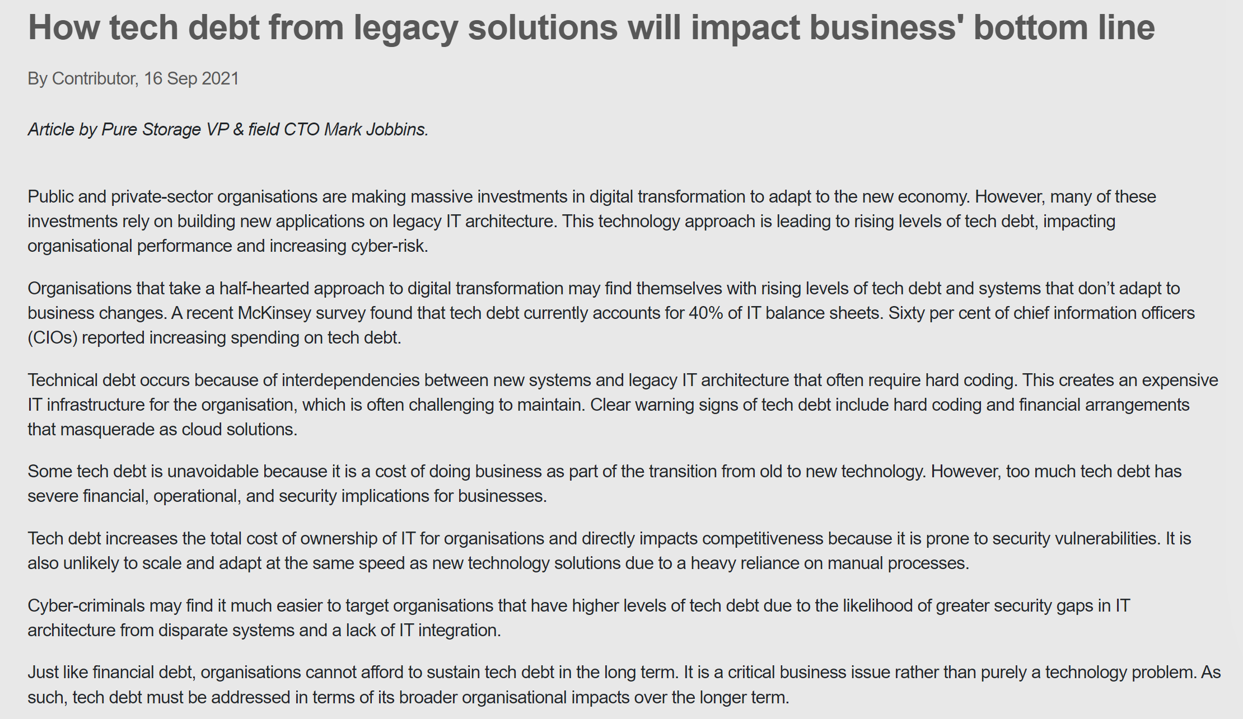
Effects of Technical Debt in Media

Slide 6
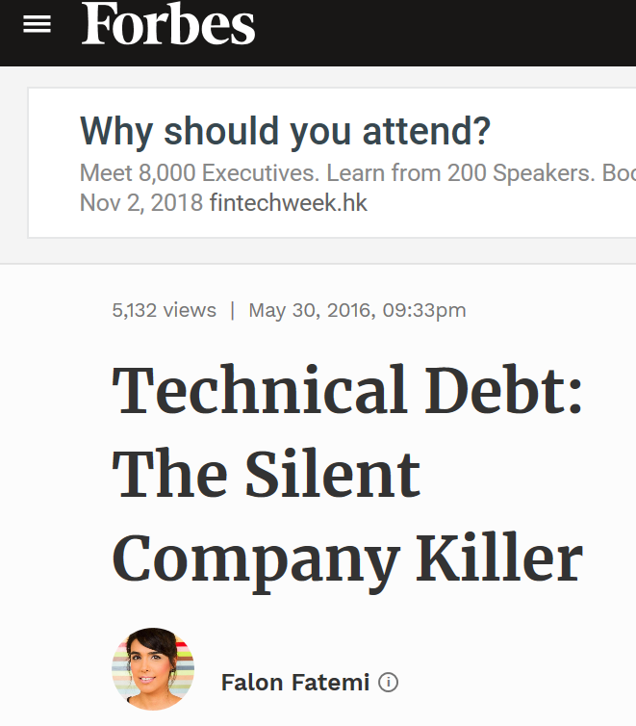
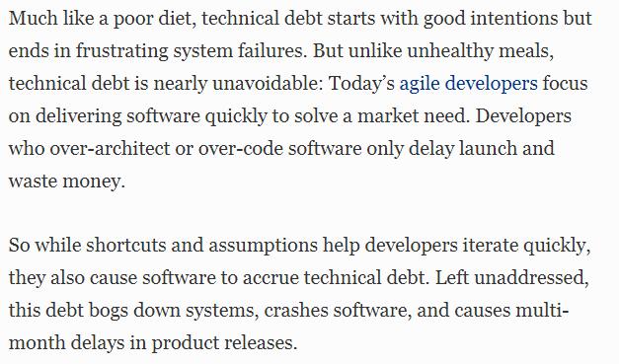
Consequence of Technical Debt in Media

Slide 7

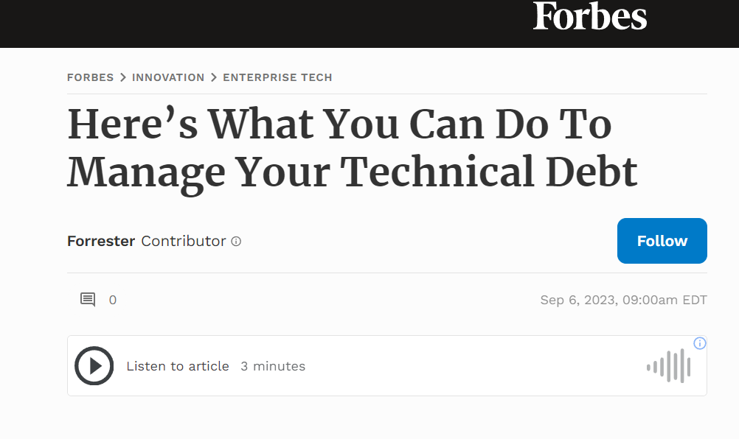
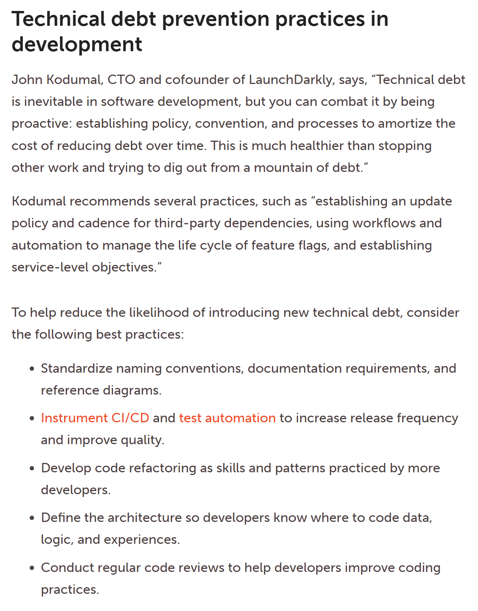
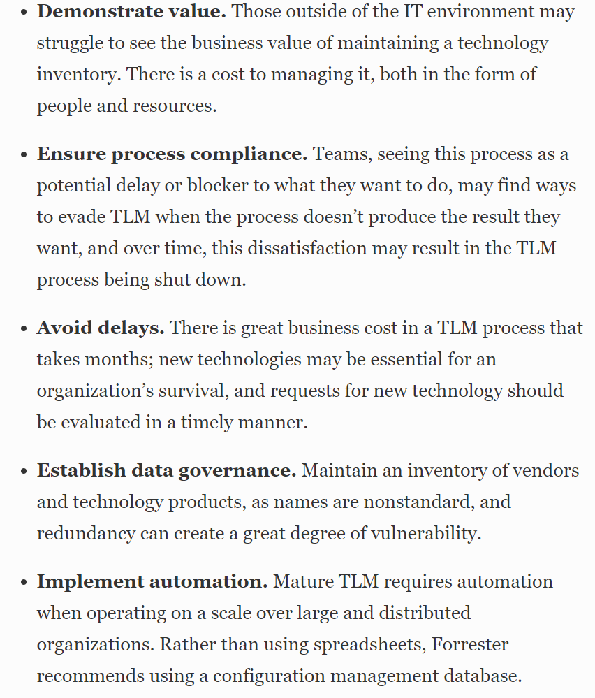

Solutions to Technical Debt in Media

Slide 8
Technical Debt incur, then pay interest, finally pay back
Typical scenario:
Sprint 1
Sprint 6
Sprint 10
“Expose module X as API for other modules to use? We aren’t going to need it! No need to design for it.”
“Uh oh, we ARE going to need it! Let’s work around it to make the current release possible first.”
“Time to refactor – we’ve gotta fix it (the workaround) !”
Note: the API development is a feature, rather than a TD.
Wrong - Incur the technical debt
Pay interest on the technical debt
Pay back the technical debt

Slide 9
Examples of “Interest Payments” on Technical Debt
e.g., Lack of unit tests on legacy code causes new development, testing, and debugging to take longer
e.g., Overly simple design does not readily support changes in the environment, and seemingly simple environment changes require massive code rework
e.g., High product support cost for a buggy system (non-software interest payment)
e.g., Brittle system means each bug-fix introduces unintended side effects (e.g., new bugs), so each bug-fix becomes a multibug-fix project
e.g., Bug reports are so frequent that time spent fixing bugs in the production system prevents any work on new functionality
e.g., Overly lengthy edit-compile-debug times due to poor development environment (non-code cause of technical debt)

Slide 10
Counterexamples of Technical Debts
Many kinds of delayed or incomplete work are not technical debt:
feature backlog, deferred features, cut features
In general, if “the same (development) work will not cost more to do later than it would cost to do now”, then it is not a technical debt.

Slide 11
Technical Debts in Practice [8]
Ernst et al. surveyed 1831 software engineers and architects found:
31% stated TD as an implicit part of their backlog
25% stated TD as an explicit part of their backlog
TD items commonly are not present in the official sprint backlog; they are often documented in quite ad-hoc managed shadow backlogs (i.e., “unofficial”, e.g., private notes of the team or a member, comments in source code commits).
A sprint backlog includes a mix of different items (e.g., new features, bugs/defects, and improvements). TD is often grouped as Improvements.
When TD is present in the software, the only significantly effective way of reducing TD is to refactor the software.

Slide 12
Impacts of Technical Debts
In some large organizations, development time dedicated to managing Technical Debt is substantial (an average of 25% of the overall development. Some said 40%-50%)

Slide 13
Company View
Many companies tend to trade
their longer-term ability to produce new releases frequently, with high quality, quick feedback and small effort
in exchange for
short-term features that might quickly fix them but slow them down in the long run.
This strategy makes these companies vulnerable to their competitors

Slide 14
Two Sides of the Same Story with a Company [2]
Business View
Shorten time to market
Preserve startup investment
Delay development expense
Business staff tend to be optimistic about the benefit and the costs. These attitudes are often unconscious.
Technical View
Technical staff tends to be pessimistic about the benefit and the costs. These attitudes are often unconscious.
Take on debt
Debt reduces productivity
Less time for new features
Behind schedule

Slide 15
Technical Debt and Its Basic Management
Technical debts have been classified by dimension:
Type (e.g., design, testing, or documentation debt),
Intentionality (intentionally or unintentionally),
Time horizon (short or long term), and
Degree of focus.
(Popular) Technical Debts management idea
Identify a technical debt and track it through product backlog of the software project. Discuss them.
E.g., put the following into the backlog: “We don't have time to reconcile these two databases before our deadline, so we'll write some glue code that keeps them synchronized for now and reconcile them after we ship.”
Use them to judge a technical debt

Slide 16
Dimensions of Technical Debts

Slide 17
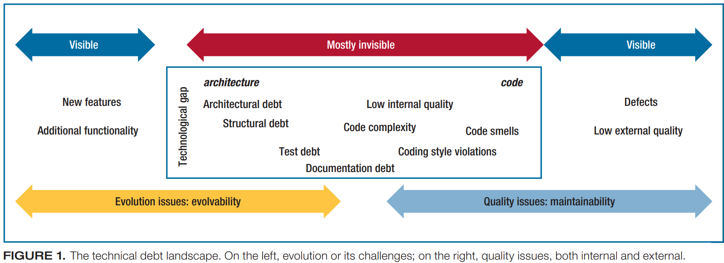
Dimension 1: Types of Technical Debt
Technical Debt is not just a coding problem.
Refactoring out the code smells cannot solve them all.
[3]
Notes:
The image is taken from Ref [3]: Philippe Kruchten, Robert L. Nord, and Ipek Ozkaya. 2012. Technical Debt: From Metaphor to Theory and Practice. IEEE Softw. 29, 6 (November 2012), 18-21. DOI: https://doi.org/10.1109/MS.2012.167 .

Slide 18
Dimension 2: Intentionality of Technical Debt
Intentional Technical Debt
Debt incurred by intention (we intend to commit to do it)
e.g., “If we don’t get this release done, there won’t be a second release. Let’s focus on coding with minimal testing effort. No documentation. Operate the system with users in the first few days after the release rather than training them upfront. ”
e.g., “We don’t have time to build general support for multiple platforms. We’ll support iOS now and build in support for Android, etc., later. Code only needs to function well in iOS apps.”
e.g., “We didn’t have time to write unit tests for all the code we wrote in the last 2 months of the project even though I know we are using a test-driven development approach. We’ll write those after we release the software.”

Slide 19
Dimension 2: Intentionality of Technical Debt
Unintentional Technical Debt
Debt incurred unintentionally due to low-quality work.
e.g., A junior programmer writes bad code
e.g., A newcomer/contractor writes code that doesn’t follow the coding standard
e.g., A major design strategy (e.g., decide to use the model-view-controller architecture to connect all major modules in the software) turns out poorly
e.g., A comprehensive refactoring task goes sideways
e.g., Honest Mistakes. “I wish we’d known Framework 2.1 would be so much better than Framework 2.0.”
e.g., Careless Mistakes. “Design? What design? Hardware design?

Slide 20
Dimension 3: Time Horizon
Short-Term Debt
Usually incurred reactively and actions are done in a short time
e.g., Skipping some integration tests to get a release out the door
e.g., "We don't have time to implement this the right way; just hack it in, and we'll fix it after we ship."
e.g., Violating the coding standards to deploy a critical patch urgently
Long-Term Debt
Usually incurred proactively, for strategic reasons
e.g., “We don’t think we’re going to need to support a second platform for at least 3 years, so our design supports only one platform.”
e.g., The core part is in COBOL for 40 years. This module should continue to use COBOL as the programming language.

Slide 21
Dimension 4: Degree of Focus
Focused Short-Term Debt
Individually identifiable shortcuts (e.g., partial implementation of a class)
Unfocused Short-Term Debt
Numerous tiny shortcuts (e.g., not following the coding standard frequently or loose documentation)
Focused Long-Term Debt
e.g., “We don’t think we’re going to need to support a second platform for at least 3 years, so our design supports only one platform.”
Unfocused Long-Term Debt
e.g., Let’s use the most productive languages and frameworks to implement individual features.

Slide 22
Identify Technical Debts

Slide 23
Patterns to Increase Technical Debts
There are some well-known patterns in software development to increase technical debts
Schedule Pressure
Duplication of Code
Get it “right” the first time

Slide 24
Patterns to Increase Technical Debts: 1. Schedule Pressure
When a team is held to a commitment that is unreasonable, they are bound to cut corners to meet management expectations.
E.g., creeping scope of new features, change in team composition, late integration
Solution
Use a more flexible planning approach

Slide 25
Patterns to Increase Technical Debts: 2. Duplication of Code
Many reasons for code duplications
Lack of experience on the part of the team members
Copy-and-paste programming practice
Conform to the poor design of existing software
Pressure to deliver; guess a schedule
Solution
Use static analysis tool for assistance (see Code for Quality slides)
Pair programming
To spread the knowledge and improve the competence of team members
Either (a) Repay debts now or (b) Track it if replay later,
(1) fix it now, (2) add a runtime exception to the location of technical debts and fix it a few minutes later, (3) add the debt (location, description, potential cost of not fixing it) to the project backlog

Slide 26
Patterns to Increase Technical Debts: 3. Get it “right” the first time
Opposite of duplication – create a lot of powerful design up-front.
We have over-engineered and over-generalized our intended product.
Costs associated with fixing keep growing

Slide 27
Manage Technical Debts

Slide 28
Mange Technical Debts [5]
If we can’t avoid technical debt, we must manage it.
This means recognizing it, tracking it, making reasoned decisions about it, and preventing its worst consequences.

Slide 29
Methods to Manage Technical Debts: Tracking Technical Debts [2]
Tracking technical debts (TD) is necessary to manage them.
All “good debt” can be tracked (at least by definition)
Log as defects
Include in product backlogs
Monitor project velocity
Monitor the amount of rework
Ways to Measure Debt
Total debt in the product backlog
Maintenance budget (or fraction of maintenance budget)
Measure debt in money, not features, e.g., “50% of the R&D budget is nonproductive maintenance work”

Slide 30
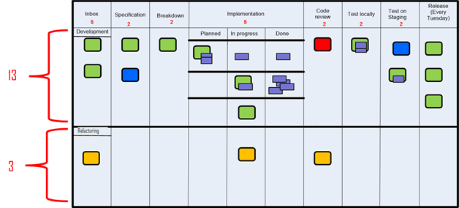
Methods to Manage Technical Debts: Tracking Technical Debts Visually [6]
Visualize the technical debts on task boards. The lower section includes three refactoring tasks (i.e., instances of technical debts) to be addressed in a project: one is under code review, another one is “in progress”, and the last one has not been handled at all.
Notes:
Jesper Boeg, Successfully balancing technical debt and new features – staying in the “flow-zone” or how to get back in there. http://agileupgrade.com/successfully-balancing-technical-depth-and-new-features-staying-in-the-flow-zone-or-how-to-get-back-in-there/

Slide 31
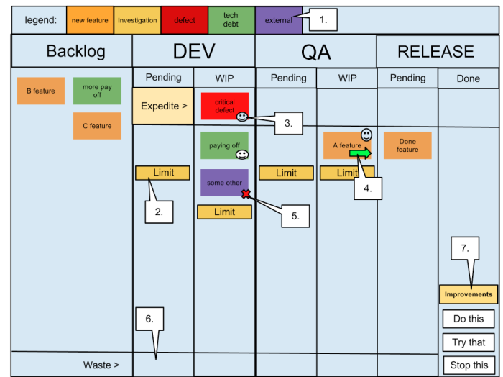
Methods to Manage Technical Debts: Tracking Technical Debts Visually [6]
Visualize the technical debts on Kanban board. (for the 1-7, see the next
slide)
Notes:
http://www.iainjmitchell.com/blog/kanban-board-tour
Legend – This shows the types of cards (by colour) that can be on the board, these include New features, Tech debt, Defects, Investigations (support) and External Issues (e.g. new servers). The purpose of this is to clearly visualise the type of work that is being processed
Limits – Each pending and work in progress column has a limit to control the amount of work that can be taken on. These limits are set based on resource levels and other bottlenecks, and are intended to encourage the PULLING of work when capacity exists rather than continuing to force more work onto a bottleneck.
Avatar – Each team member has ONE avatar to place on the item they are on, this tells other team members that this card is being worked upon and should be progressing. As we pair on most development, there will often be more than one avatar on each Dev task.
Arrows – Indicate movement of tasks since the last standup, again this is part of the visualisation of the process. These cards are often ignored at the standup, as we want to focus on the items that are not progressing, such as…
Blockers – We want to minimise blockers as they cause more bottlenecks in the system, so we clearly indicate these items with blocked avatar. An additional requirement to blocking a card is to add the details of WHO and WHY the item is unable to proceed.
Waste – Tasks can be abandoned at any stage in the process, we collect these and review at the weekly retrospective.
Continuous Improvements – Also, at the weekly retrospective we decide upon three improvement points that we want to tackle for the following week. These are summarised on the board and recalled at the beginning of the morning standup, if we fail to make any progress on an improvement then it may be rolled over to the next week.

Slide 32
The seven legends on the last slide
Legend – This shows the types of cards (by color) that can be on the board, these include New features, Tech debt, Defects, Investigations (support) and External Issues (e.g. new servers). The purpose of this is to clearly visualize the type of work that is being processed
Limits – Each pending and work in progress column has a limit to control the amount of work that can be taken on. These limits are set based on resource levels and other bottlenecks, and are intended to encourage the PULLING of work when capacity exists rather than continuing to force more work onto a bottleneck.
Avatar – Each team member has ONE avatar to place on the item they are on, this tells other team members that this card is being worked upon and should be progressing. As we pair on most development, there will often be more than one avatar on each Dev task.
Arrows – Indicate movement of tasks since the last standup, again this is part of the visualization of the process. These cards are often ignored at the standup, as we want to focus on the items that are not progressing, such as…
Blockers – We want to minimize blockers as they cause more bottlenecks in the system, so we clearly indicate these items with blocked avatar. An additional requirement to blocking a card is to add the details of WHO and WHY the item is unable to proceed.
Waste – Tasks can be abandoned at any stage in the process, we collect these and review at the weekly retrospective.
Continuous Improvements – Also, at the weekly retrospective we decide upon three improvement points that we want to tackle for the following week. These are summarized on the board and recalled at the beginning of the morning standup, if we fail to make any progress on an improvement then it may be rolled over to the next week.
Notes:
http://www.iainjmitchell.com/blog/kanban-board-tour

Slide 33
Methods to Manage Technical Debts: Repay Technical Debts
An effective tactic is to periodically reserve a timeslot to deal with technical debt.
Longer time for refactoring to trade for a smaller number of refactoring cycles, and vice versa.
Prioritize refactoring tasks to address the critical areas first.
Involve product owners and stakeholders to get their perspectives
time
Feature development
refactoring
Feature development
refactoring
Notes:
Jesper Boeg, Successfully balancing technical debt and new features – staying in the “flow-zone” or how to get back in there. http://agileupgrade.com/successfully-balancing-technical-depth-and-new-features-staying-in-the-flow-zone-or-how-to-get-back-in-there/

Slide 34
Methods to Manage Technical Debts: Discuss Technical Debts
Educate technical staff about business decision-making involved in the project
Fit developers into the business context
Educate business staff about technical decision-making
Also serve as an aspect of the inputs to their business or operational decisions
Raises awareness/transparency of important issues that are often covered up
As a risk aversion measure
Allows TDs to be managed more explicitly and visually
As a starting point for a project to resolve them individually.

Slide 35
Managing Technical Debt

Slide 36
Managing Technical Debts in Practice
Although developers may have a desire for better ways of doing all these things, and yet they do not do it.
Strategies in workplaces (from a survey [5] on 26 companies)
Do nothing—“if it ain’t broke, don’t fix it”—because the debt might never become visible to the customer.
Use a risk management approach to evaluating and prioritizing technical debt’s cost and value. E.g., allocate 5 to 10 percent of each release cycle to addressing technical debt.
Manage the expectations of customers and nontechnical stakeholders by making them equal partners and facilitating open dialogue about the debt’s implications.
Conduct audits with the development team to make technical debt visible and explicit; track it using a backlog/task board.

Slide 37
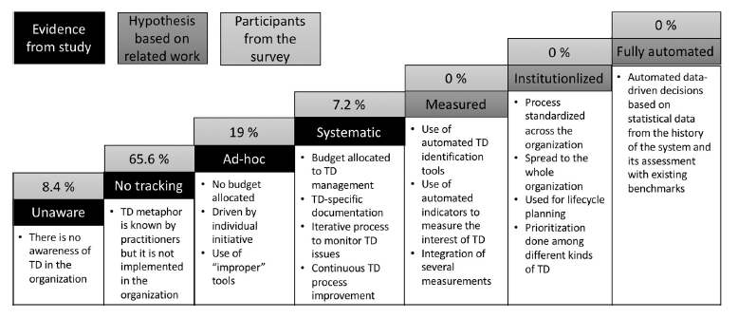
Managing Technical Debts in Practice [7]
We are here
Context of the survey [7] : 226 participants from 15 large organizations with different roles (developers, architects, managers)

Slide 38
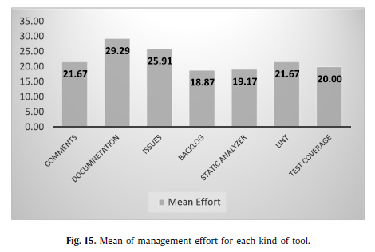
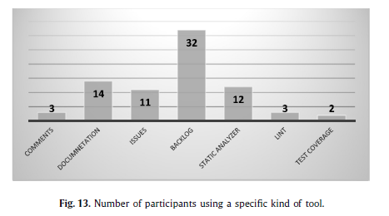
Managing Technical Debts in Practice [7]
highest
lowest
See the next two slides for the qualitative analysis on these tools

Slide 39
Managing Technical Debts in Practice [7]
[Effective] Backlogs, static analyzers and “lint” programs all increase the tracking level, but we cannot see a big difference (although static code analyzers seem to contribute better to the participants’ awareness). They are also the ones with the least overhead. They therefore seem to be considered the best practices at the moment to track TD.
[Effective] Backlogs are the most used tool among the participants. In particular, the most used backlog tools are Jira, Hansoft, and Excel.
[Ineffective] Comments in the code help awareness, but they are not considered tracking, and they are used by just 1% of the respondents. This is probably because they are not used in a document that can be monitored by the team outside the code.
[Ineffective] Documentation increases TD awareness, but it is not considered as a high level of tracking, and it has the highest overhead. The main tools used here were Microsoft Excel or Word. We can infer that this practice is not recommendable in comparison with the other ones.
[Ineffective] Using a bug system for tracking TD is not considered as contributing to a better level of awareness or tracking compared to the other techniques, and it has a slightly higher overhead. We would infer that this is also not the best way of tracking TD.
[Ineffective] Test coverage does not seem to contribute too much to the awareness and tracking level, although it does not involve much overhead. This might be because test coverage is related to only a small part of TD.

Slide 40
References and Resources
Ward Cunningham. 1992. The WyCash portfolio management system. In Addendum to the proceedings on Object-oriented programming systems, languages, and applications (Addendum) (OOPSLA '92), Jerry L. Archibald and Mark C. Wilkes (Eds.). ACM, New York, NY, USA, 29-30. DOI=http://dx.doi.org/10.1145/157709.157715
S. McConnell, "Managing technical debt (slides)," in Workshop on Managing Technical Debt (part of ICSE 2013): IEEE, 2013
http://2013.icse-conferences.org/documents/publicity/MTD-WS-McConnell-slides.pdf
Philippe Kruchten, Robert L. Nord, and Ipek Ozkaya. 2012. Technical Debt: From Metaphor to Theory and Practice. IEEE Softw. 29, 6 (November 2012), 18-21. DOI: https://doi.org/10.1109/MS.2012.167
Chris Sterling, 2010. Managing Software Debt: Building for Inevitable Change. Addison-Wesley Professional; 1 edition, ISBN-10: 0321948610. [a good resource to know technical debts]
Lim, N. Taksande, and C. Seaman, “A balancing act: What software practitioners have to say about technical debt,” IEEE Software. DOI: 10.1109/MS.2012.130
Jesper Boeg, Successfully balancing technical debt and new features – staying in the “flow-zone” or how to get back in there. http://agileupgrade.com/successfully-balancing-technical-depth-and-new-features-staying-in-the-flow-zone-or-how-to-get-back-in-there/
Antonio Martini, Tersese Besker, Jan Bosch: Technical Debt tracking: Current state of practice: A survey and multiple case study in 15 large organizations. Sci. Comput. Program. 163: 42-61 (2018)
Terese Besker, Antonio Martini, and Jan Bosch. 2019. Technical debt triage in backlog management. In Proceedings of the Second International Conference on Technical Debt (TechDebt '19). IEEE Press, Piscataway, NJ, USA, 13-22. DOI: https://doi.org/10.1109/TechDebt.2019.00010

