Slide 1
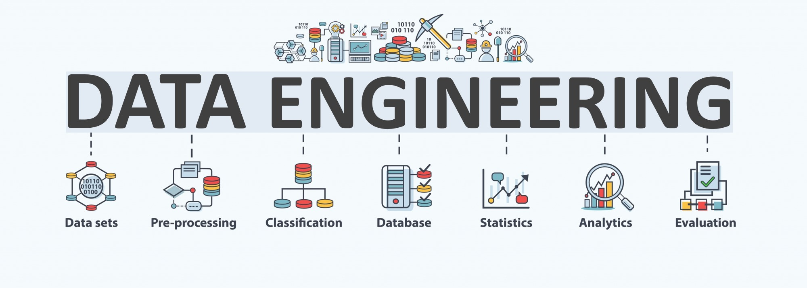

Lecture 3: Data Preprocessing
CS5481 Data Engineering
Instructor: Yifan Zhang

Slide 2
Outline
Why data preprocessing?
Data Cleaning
Data Integration
Data Transformation
Data Reduction
Data Discretization

Slide 3
Why data preprocessing - dirty data
Data in the real world is dirty: Lots of potentially incorrect data, e.g., instrument faulty, human or computer error, transmission error
Incomplete: lacking attribute values, lacking certain attributes of interest, or containing only aggregate data
e.g., Occupation=“ ” (missing data)
Noisy: containing noise, errors, or outliers
e.g., Salary=“−10” (an error)
Inconsistent: containing discrepancies in codes or names, e.g.,
Age=“42”, Birthday=“03/07/2010”
Was rating “1, 2, 3”, now rating “A, B, C”
discrepancy between duplicate records
Intentional (e.g., disguised missing data)
Jan. 1 as everyone’s birthday?

Slide 4
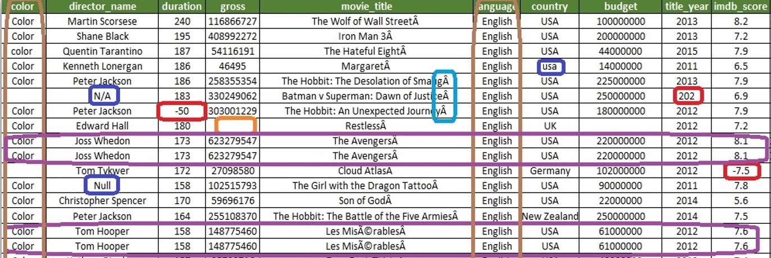
Dirty data example
All of these are commonly seen in the real-world (an example of IMBD movie rating data)
Zeros or nulls replace missing values
Spelling inconsistency (usa/USA), errors and noises (meaningless symbols)
Rows are duplicated
Others: inconsistent date formats (e.g. 10/9/15 vs. 9/10/15), units not specified (kg or pound)

Slide 5

Why data preprocessing - GIGO
No quality data, no quality mining results
Quality decisions must be based on quality data
Data warehouse needs consistent integration of quality data

Slide 6
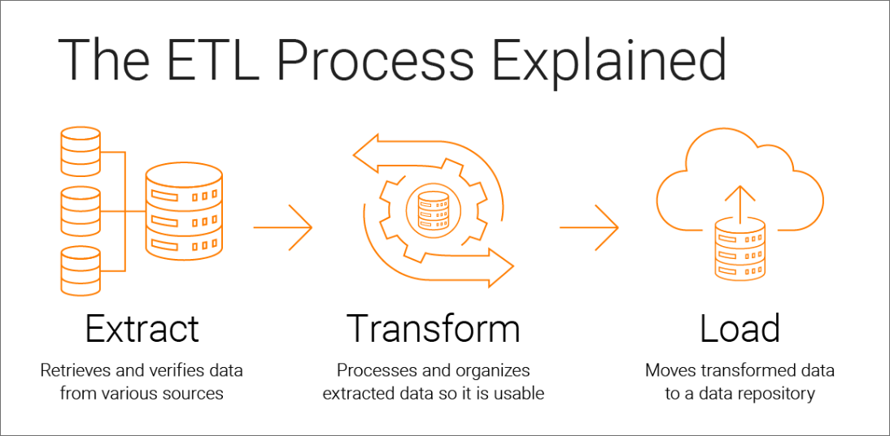
ETL process: Extract, Transform, and Load
It’s a three-step data integration process used by organizations to combine and synthesize raw data from multiple data sources into a data warehouse, data lake, data store, relational database or any other application.

Slide 7
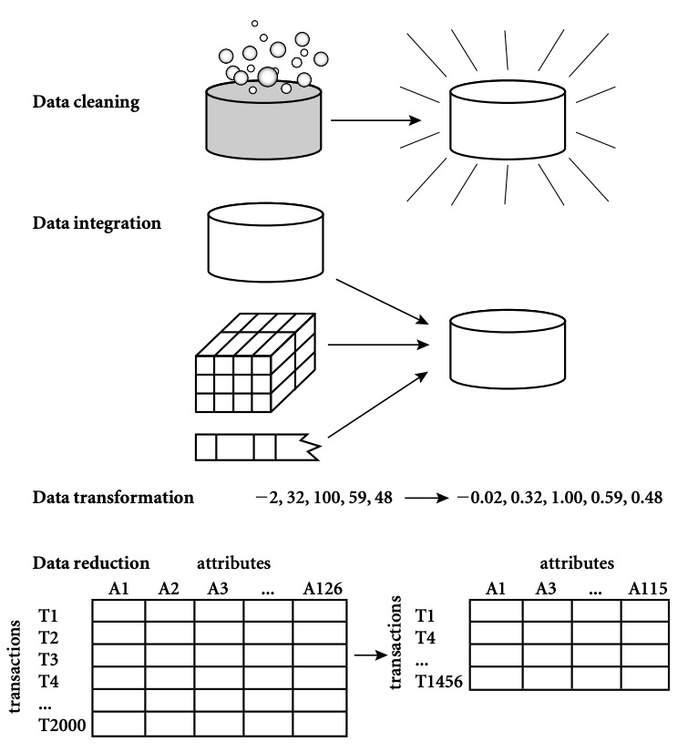
Major tasks in data preprocessing
Data cleaning: Fill in missing values, smooth noisy data, identify or remove outliers, and resolve inconsistencies.
Data integration: Integration of multiple databases, data cubes, files, or notes.
Data transformation: Normalization (scaling to a specific range), aggregation.
Data reduction: Obtains reduced representation in volume but produces the same or similar analytical results.

Slide 8
Data cleaning
What is data cleaning?
The process of transforming raw data to facilitate subsequent analysis.
Major tasks
Fill in missing values
Identify outliers and smooth out noisy data
Correct inconsistent data
Example: filling in missing values in blood test.

Slide 9
Data cleaning – missing data
Data is not always available
Many tuples have no recorded value for several attributes, such as customer income in sales data
Missing data may be due to
equipment malfunction
inconsistent with other recorded data and thus deleted
data not entered due to misunderstanding
certain data may not be considered important at the time of entry
not register history or changes of the data
Missing data may need to be inferred

Slide 10
Data cleaning – handling missing data
Ignore the tuple: usually done when class label is missing (assuming the task is classification—not effective in certain cases)
Fill in the missing value manually: tedious + infeasible
Automatically:
Use a global constant to fill in the missing value: e.g., “unknown”, a new class
Use the attribute mean to fill in the missing value
Use the attribute mean for all samples of the same class to fill in the missing value: smarter
Use the most probable value to fill in the missing value: inference-based such as regression, Bayesian formula, decision tree

Slide 11
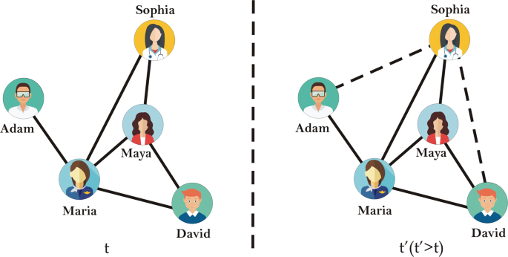
Data cleaning – example of handling missing data
Example: Link Prediction
Notes:
https://www.nature.com/articles/s41598-019-57304-y

Slide 12
Data cleaning – noisy data
Noise: random error in a measured variable.
Incorrect attribute values may be due to
faulty data collection instruments
data entry problems
data transmission problems
technology limitation
inconsistency in naming convention
Other data problems which requires data cleaning
Duplicate records, incomplete data, inconsistent data

Slide 13
Data cleaning – handling noisy data
Binning method
First sort data and partition into bins
Then one can smooth by bin means, median, and boundaries, etc.
Used also for discretization
Clustering
Detect and remove outliers
Semi-automated method
Combined computer and human inspection
Detect suspicious values and check manually
Regression
Smooth by fitting the data into regression functions

Slide 14
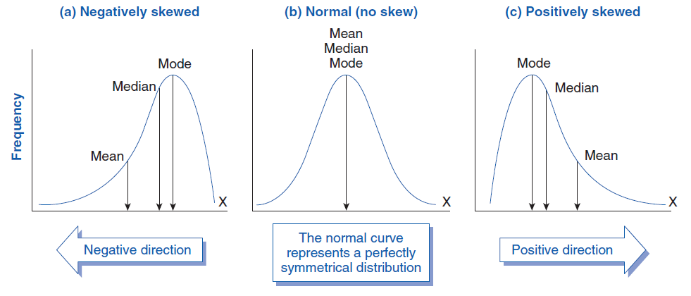
Data cleaning – equal-width data binning
Equal-width (distance) partitioning
It divides the range into N intervals of equal size: uniform grid
if A and B are the lowest and highest values of the attribute, the width of intervals will be: W = (B-A)/N.
The most straightforward
But outliers may dominate presentation
Skewed data may not be handled well
Skewness refers to a distortion or asymmetry that deviates from the symmetrical bell curve, or normal distribution, in a set of data. If the curve is shifted to the left or to the right, it is said to be skewed.

Slide 15
Data cleaning – equal-depth data binning
Equal-depth (frequency) partitioning
It divides the range into N intervals, each containing approximately same number of samples
Good data scaling
Managing categorical attributes can be tricky.

Slide 16
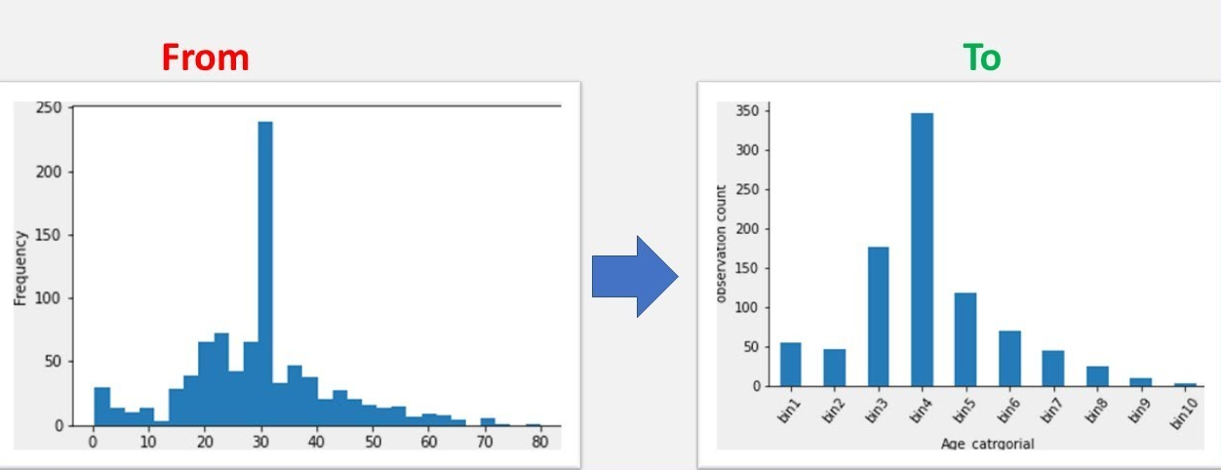
Data cleaning – examples of data binning
Examples of data binning: number of COVID-19 vaccine doses administered per 100 people
Notes:
https://www.youtube.com/watch?v=wJgto87zEEs
https://www.saedsayad.com/unsupervised_binning.htm

Slide 17
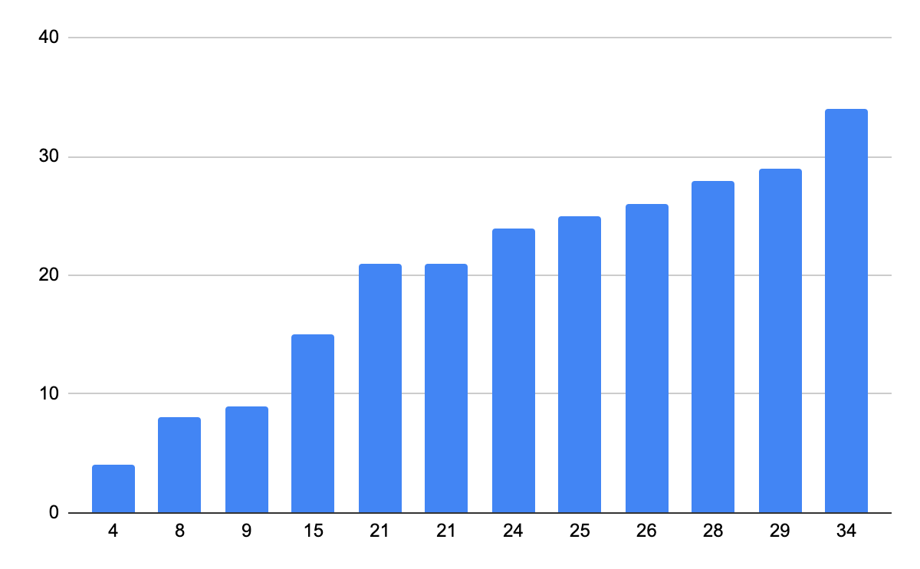
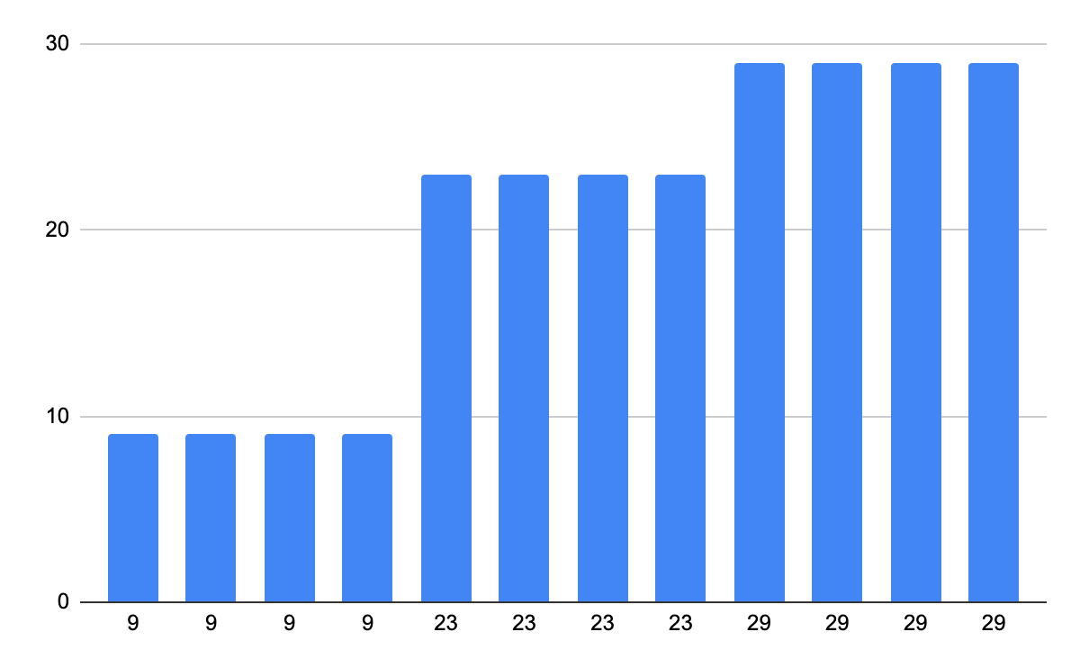
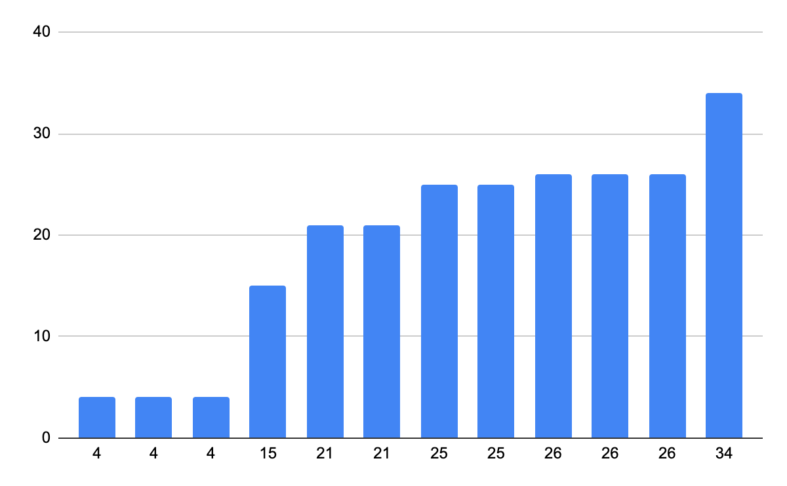
Data cleaning – binning methods for data smoothing
Sorted data for price (in dollars): 4, 8, 9, 15, 21, 21, 24, 25, 26, 28, 29, 34
Partition into (equi-depth) bins:
- Bin 1: 4, 8, 9, 15
- Bin 2: 21, 21, 24, 25
- Bin 3: 26, 28, 29, 34
Smoothing by bin means:
- Bin 1: 9, 9, 9, 9
- Bin 2: 23, 23, 23, 23
- Bin 3: 29, 29, 29, 29
Smoothing by bin boundaries:
- Bin 1: 4, 4, 4, 15
- Bin 2: 21, 21, 25, 25
- Bin 3: 26, 26, 26, 34
Notes:
https://www.youtube.com/watch?v=wJgto87zEEs
https://www.saedsayad.com/unsupervised_binning.htm

Slide 18
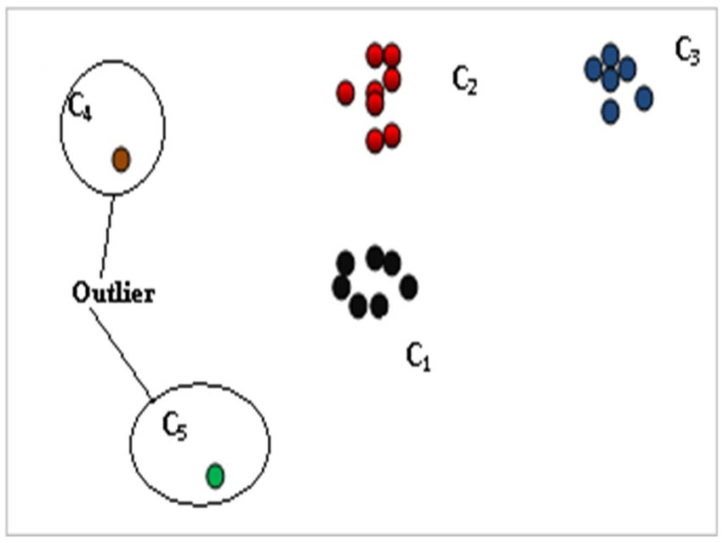
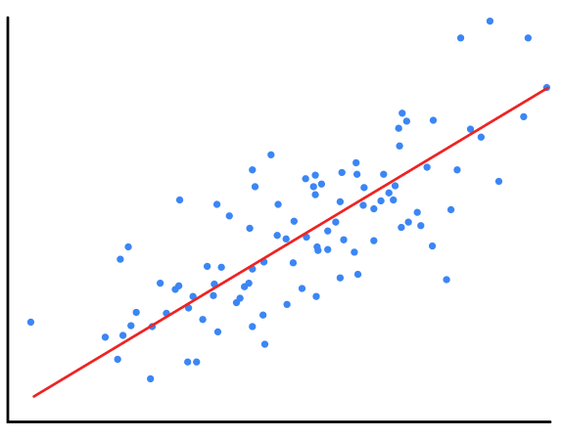
Data cleaning – clustering & regression
Linear regression (best line to fit two variables)
Multiple linear regression (more than two variables, fit to a multidimensional surface
Notes:
https://www.youtube.com/watch?v=wJgto87zEEs
https://www.saedsayad.com/unsupervised_binning.htm

Slide 19
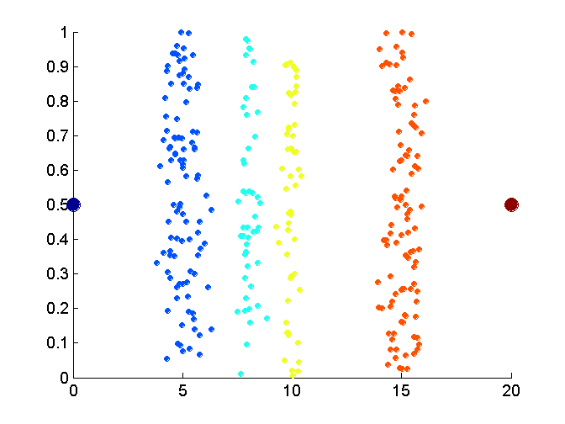
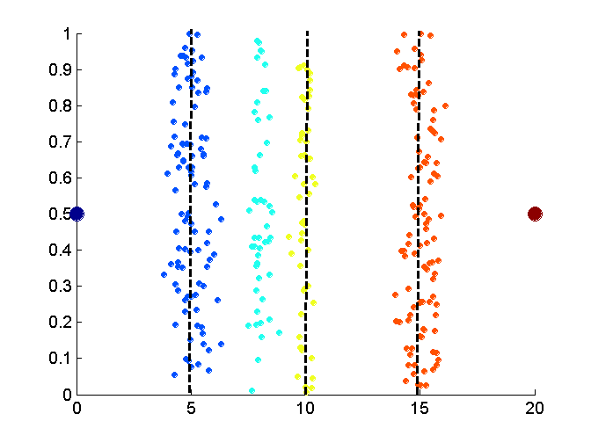
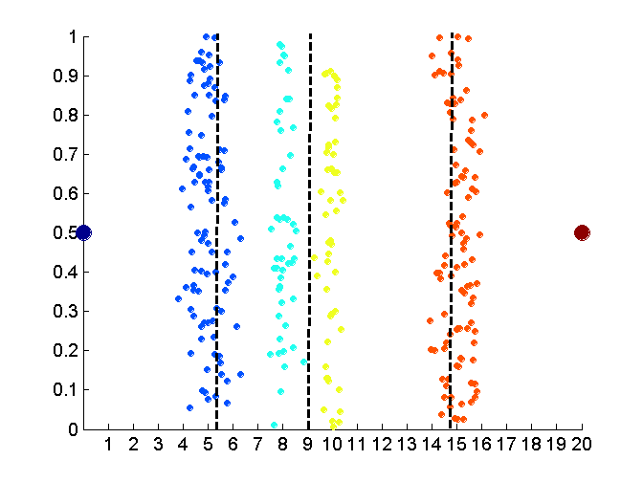
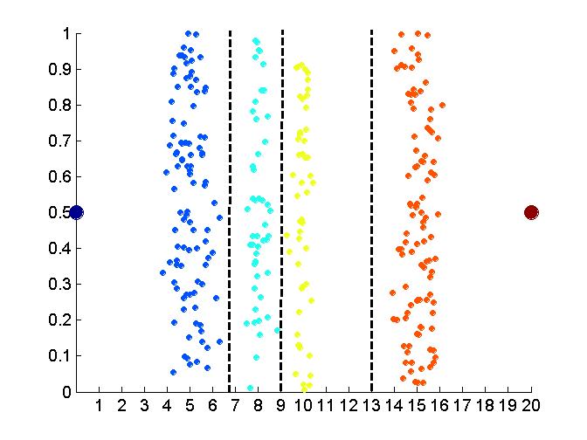
Binning vs. clustering
Original data
Equal-width binning
Data
Equal interval width (binning)
Equal depth (frequency) binning
K-means clustering leads to better results
19
Notes:
19

Slide 20
Data cleaning – handling inconsistent data
Manual correction using external references
Use metadata (metadata is the data about data: e.g., a digital image may include metadata that describes the size of the image, its color depth, resolution, when it was created, the shutter speed, and other data.), such as domain, range, dependency, distribution to check the data inconsistency
Check field overloading (e.g., using an unused bit of an attribute whose value range uses only, say, 31 out of 32 bits)
Check uniqueness rule, consecutive rule and null rule
Semi-automatic using various tools
To detect violation of known functional dependencies and data constraints
To correct redundant data
Use commercial tools
Data scrubbing: use simple domain knowledge (e.g., postal code, spell-check) to detect errors and make corrections
Data auditing: by analyzing data to discover rules and relationship to detect violators (e.g., correlation and clustering to find outliers)

Slide 21

Data integration
Data integration: combines data from multiple sources into a coherent store
Schema integration
Integrate metadata from different sources
Entity identification problem: identify real world entities from multiple data sources
Detecting and resolving data value conflicts
For the same real world entity, attribute values from different sources are different
Possible reasons: different representations, different scales, e.g., Metric vs. British units, different currency

Slide 22
Data integration – handling redundant data
Redundant data occur often when integrating multiple DBs
The same attribute may have different names in different databases
Dependency: One attribute may be a “derived” attribute in another table, e.g., annual revenue
Redundant data may be able to be detected by correlational analysis
Careful integration can help reduce/avoid redundancies and inconsistencies and improve mining speed and quality

Slide 23
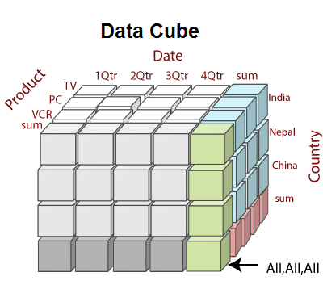
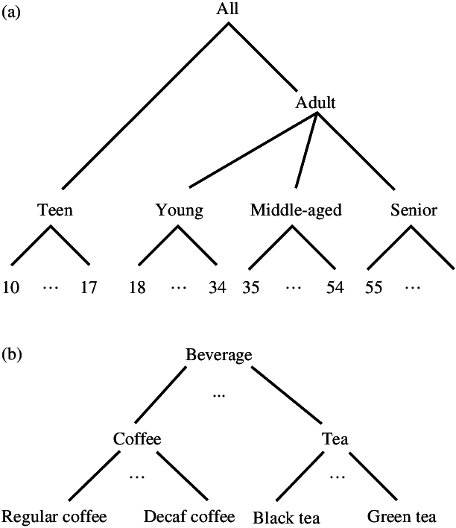
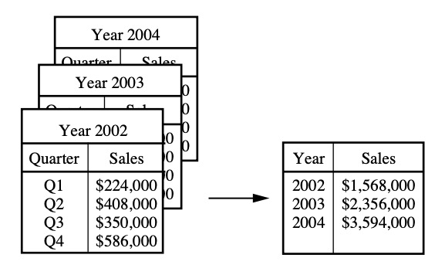
Data transformation (1)
Smoothing: remove noise from data (binning, clustering, regression)
Aggregation: summarization, data cube construction (the quarterly sales data may be aggregated so as to compute annual total amounts.)
Generalization: concept hierarchy generation
Aggregation
A data cube is a data structure optimized for fast and efficient analysis. It enables consolidating or aggregating relevant data into the cube and then drilling down, slicing and dicing, or pivoting data to view it from different angles.
Concept hierarchy

Slide 24
Data transformation (2)
Normalization: scaled to fall within a small, specified range
min-max normalization
z-score normalization
normalization by decimal scaling
Attribute/feature construction
New attributes constructed from the given ones

Slide 25
Data transformation – normalization
min-max normalization
z-score normalization
normalization by decimal scaling
Where j is the smallest integer such that Max(| |)<1

Slide 26
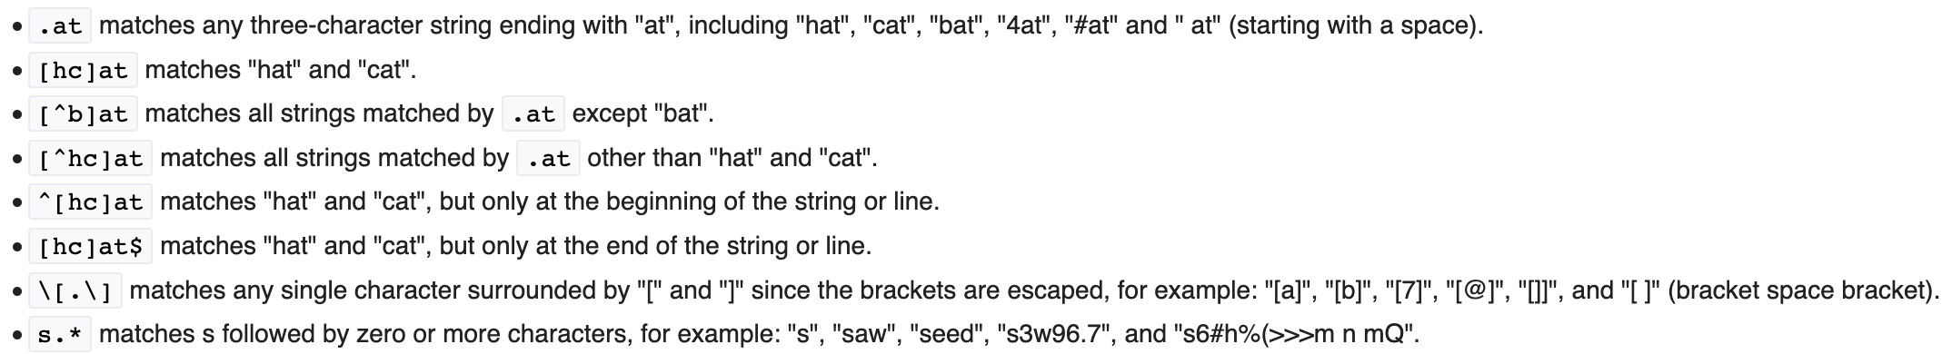
A useful tool: Regular expressions (Regex)
What is Regex
A regular expression is a sequence of characters that specifies a search pattern in text.
It can be used when
testing the pattern within the string
identify specific text in a document, delete the text completely, or replace it with other text
extract substrings from strings based on pattern matching
Regex examples
Refer to https://en.wikibooks.org/wiki/Regular_Expressions

Slide 27
Data reduction
Problem:
Data warehouse may store terabytes of data – complex data Analysis/mining may take a very long time to run on the complete data set.
Solution:
Data reduction – obtains a reduced representation of the data set that is much smaller in volume but yet produces the same (or almost the same) analytical results

Slide 28
Data reduction strategies
Data cube aggregation
Dimensionality reduction
Data compression
Numerosity reduction
Discretization and concept hierarchy generation

Slide 29
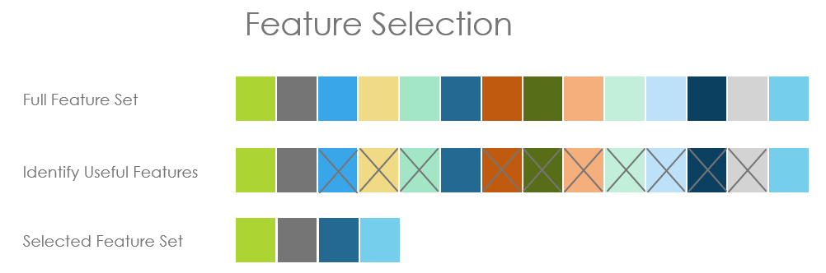
Data reduction – dimensionality reduction
Feature selection (i.e., attribute subset selection):
Select a minimum set of features such that the probability distribution of different classes given the values for those features is as close as possible to the original distribution given the values of all features.
Nice side-effect: reduces # of attributes in the discovered patterns, easier to understand.

Slide 30
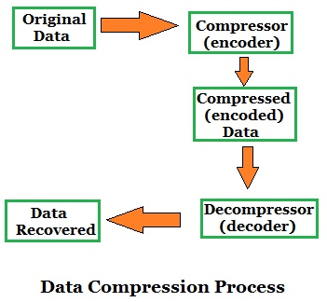
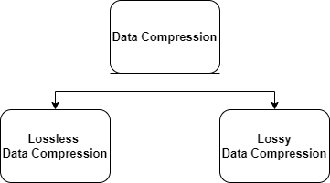
Data reduction – data compression
Notes:
https://electronics-club.com/data-compression-lossy-and-lossless-compression/

Slide 31
Data reduction – data compression
String compression
There are extensive theories and well-tuned algorithms (Shannon source coding theory)
Typically lossless
But only limited manipulation is possible without expansion
Audio/video, image compression
Typically lossy compression, with progressive refinement
Sometimes small fragments of signal can be reconstructed without reconstructing the whole
Time sequences (e.g., stock prices over time)
Typically short and vary slowly with time

Slide 32
Data reduction – numerosity reduction (1)
Parametric methods
Assume the data fits some model, estimate model parameters, store only the parameters, and discard the data (except possible outliers)
E.g.: Log-linear models: obtain value at a point in m-D space as the product on appropriate marginal subspaces
Non-parametric methods
Do not assume models
Major families: Histograms, Clustering, Sampling

Slide 33
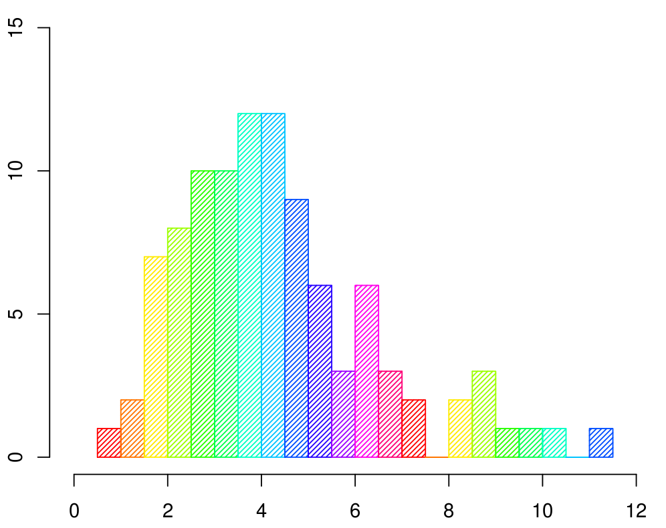
Data reduction – numerosity reduction (2)
Numerosity reduction – histogram
Approximate data distributions
Divide data into buckets and store average (sum) for each bucket
A bucket represents an attribute-value/frequency pair
Can be constructed optimally in one dimension using dynamic programming
Related to quantization problems.

Slide 34
Data reduction – numerosity reduction (3)
Numerosity reduction – clustering
Partition data set into clusters, and store cluster representation only
Quality of clusters measured by their diameter (max distance between any two objects in the cluster) or centroid distance (avg. distance of each cluster object from its centroid)
Can be very effective if data is clustered but not if data is “smeared”
Can have hierarchical clustering (possibly stored in multi-dimensional index tree structures (B+-tree, R-tree, quad-tree, etc))

Slide 35
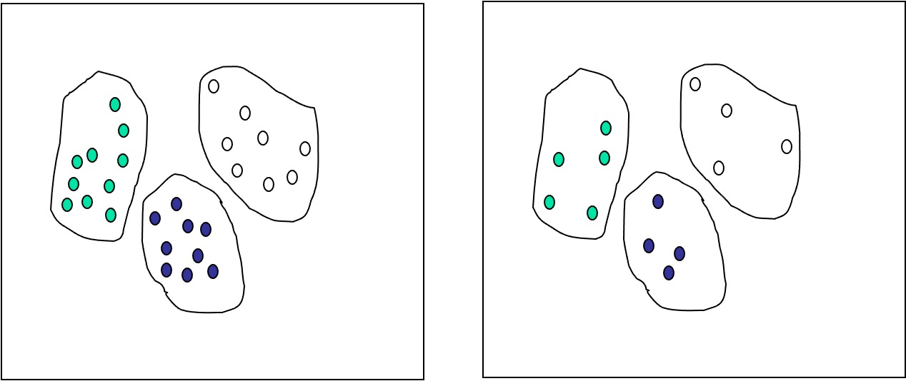
Data reduction – numerosity reduction (4)
Numerosity reduction – sampling
Choose a representative subset of the data
Develop adaptive sampling methods
Stratified sampling:
Approximate the percentage of each class (or subpopulation of interest) in the overall database
Used in conjunction with skewed data

Slide 36
Data discretization (1)
Three types of attributes:
Nominal — values from an unordered set
Ordinal — values from an ordered set
Continuous — real numbers
Discretization/Quantization:
Divide the range of a continuous attribute into intervals
Some classification algorithms only accept categorical attributes.
Reduce data size by discretization
Prepare for further analysis

Slide 37
Data discretization (2)
Discretization
Reduce the number of values for a given continuous attribute by dividing the range of the attribute into intervals. Interval labels can then be used to replace actual data values.
Concept Hierarchies
Reduce the data by collecting and replacing low level concepts (such as numeric values for the attribute age) by higher level concepts (such as young, middle-aged, or senior).

Slide 38
Data discretization (3)
Discretization and concept hierarchy generation for numeric data
Hierarchical and recursive decomposition using:
Binning (data smoothing)
Histogram analysis (numerosity reduction)
Clustering analysis (numerosity reduction)
Entropy-based discretization
Segmentation by natural partitioning

Slide 39
Data discretization (4)
Entropy-Based Discretization
Given a set of samples S, if S is partitioned into two intervals S1 and S2 using threshold T on the value of attribute A, the information gain resulting from the partitioning is:
where the entropy function E for a given set is calculated based on the class distribution of the samples in the set. Given m classes the entropy of S1 is:
where pi is the probability of class i in S1.
The threshold that maximizes the information gain over all possible thresholds is selected as a binary discretization.
The process is recursively applied to partitions obtained until some stopping criterion is met, e.g.,
Experiments show that it may reduce data size and improve classification accuracy

Slide 40
Data discretization
Segmentation by natural partitioning
3-4-5 rule can be used to segment numeric data into relatively uniform, “natural” intervals.
It partitions a given range into 3,4, or 5 equal-width intervals recursively level-by-level based on the value range of the most significant digit.
If an interval covers 3, 6, 7 or 9 distinct values at the most significant digit, partition the range into 3 equi-width intervals.
If it covers 2, 4, or 8 distinct values at the most significant digit, partition the range into 4 intervals.
If it covers 1, 5, or 10 distinct values at the most significant digit, partition the range into 5 intervals.

Slide 41
Data discretization
Discretization and concept hierarchy generation for Categorical Data
Categorical data: no ordering among values
Specification of a partial ordering of attributes explicitly at the schema level by users or experts
Specification of a portion of a hierarchy by explicit data grouping
Specification of a set of attributes, but not of their partial ordering
Specification of only a partial set of attributes

Slide 42
Summary
Data preparation is a big issue for both warehousing and mining
Data preparation includes
Data cleaning and data integration
Data reduction and feature selection
Discretization
A lot a methods have been developed but still an active area of research

Slide 43
Thanks for your attention!

Slide 44
Appendix 1. https://en.wikipedia.org/wiki/Data_cleansing 2.https://docs.google.com/presentation/d/1cLSOsGYrzOZo1awGJoaQFQRkYq4shzkGbjXIHBsLS0E/htmlpresent 3. http://hanj.cs.illinois.edu/cs412/bk3/03.pdf

