Slide 1


Lecture 5: Data Indexing
CS5481 Data Engineering
Instructor: Yifan Zhang

Slide 2
Outline
Data Storage
Records and Files
Hashed Files
Indexing Techniques
Tree Data Structure

Slide 3
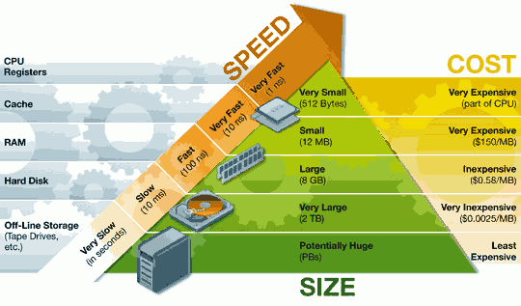
Data storage
Memory Hierarchy
Storage medium: In computers, a storage medium is a physical device that receives and retains electronic data for applications and users and makes the data available for retrieval.
Slower in access delay but
larger in memory size (less
expensive).

Slide 4
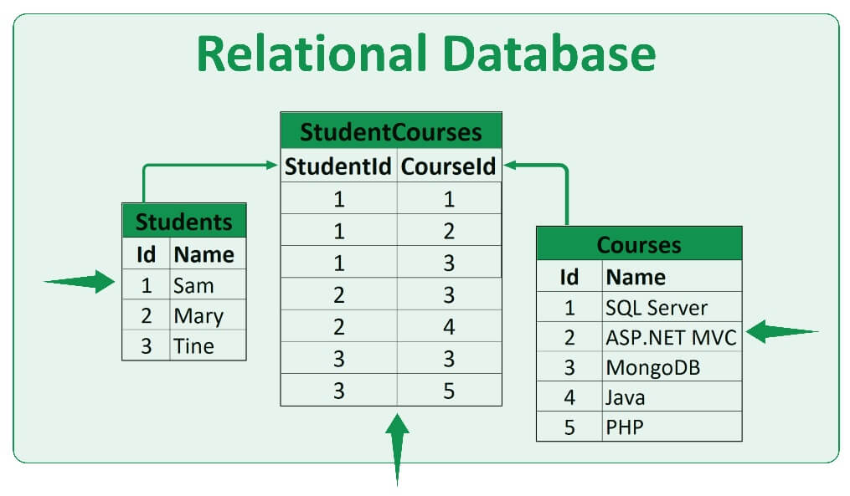
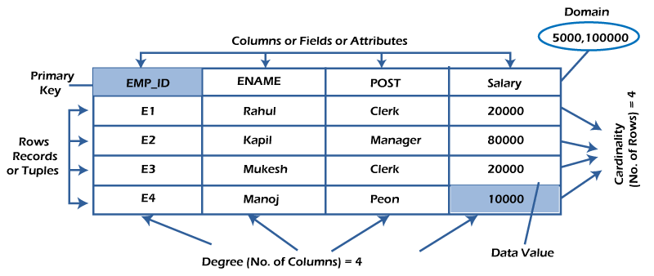
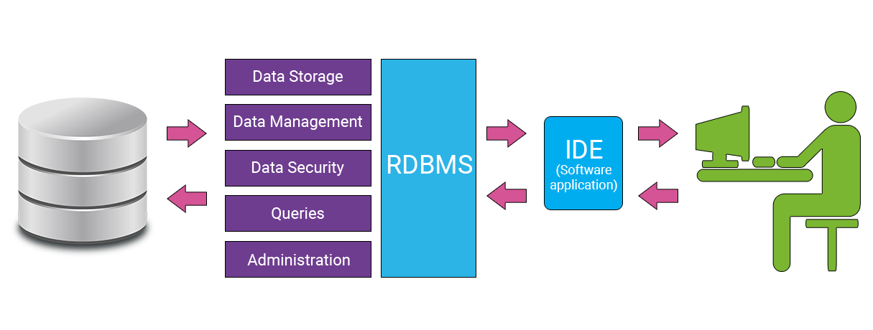
Relational databases
A relational database is based on the relational model of data.
A relational database management system (RDBMS) is a system to maintain relational databases.
Many relational database systems are equipped with the option of using the SQL (Structured Query Language) for querying and maintaining the database.

Slide 5
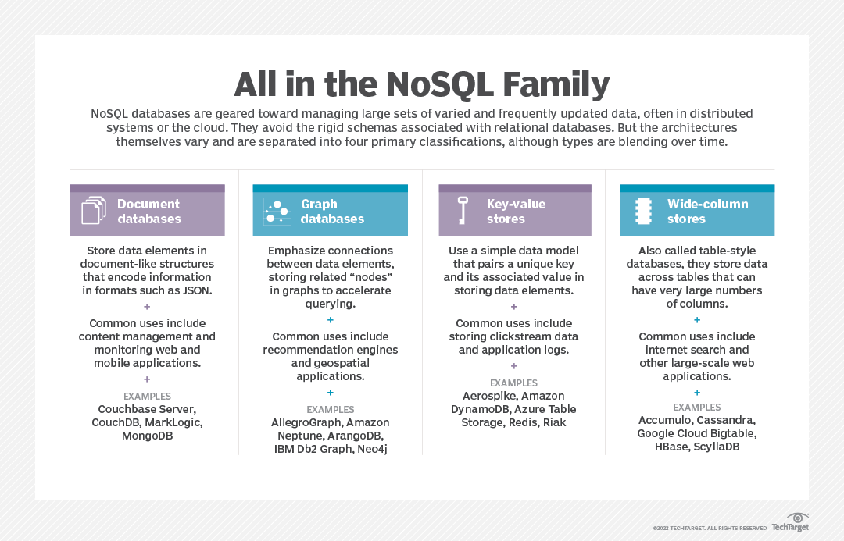
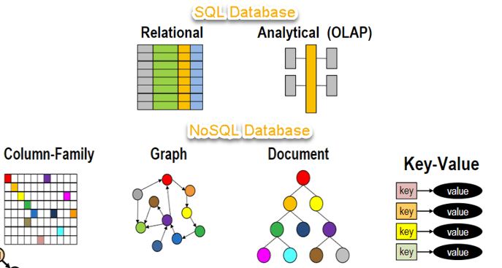
NoSQL databases
NoSQL stands for:
No Relational
No RDBMS
Not Only SQL
NoSQL is an umbrella term for all databases and data stores that don’t follow the RDBMS principles
A class of products
A collection of several (related) concepts about data storage and manipulation
Often related to large data sets

Slide 6
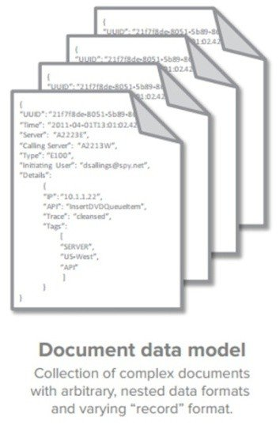
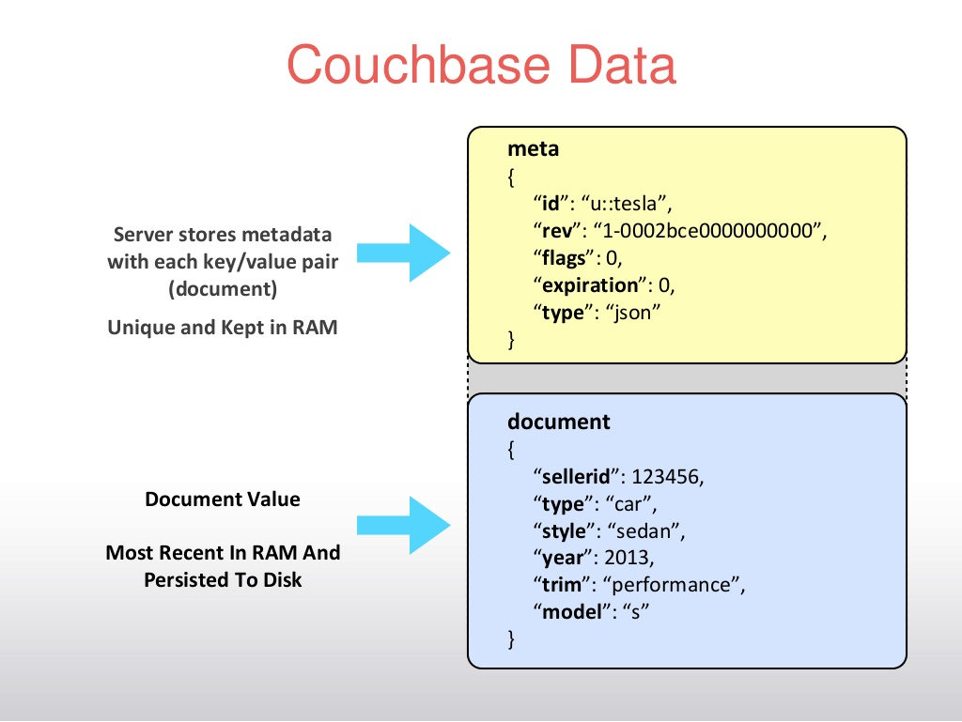
NoSQL database types (1)

Slide 7
NoSQL database types (2)
Data are represented as vertices and edges
Graph databases are powerful for graph-like queries (e.g., find the shortest path between two elements)
Id:100
Label: knows
Since: 2001/10/03
Id: 2
Name: Bob
Age: 22
Id:101
Label: knows
Since: 2001/10/03
Id: 1
Name: Alice
Age: 18
Id:105
Label: is_member
Since: 2011/02/14
Id:104
Label: Members
Id:103
Label: Members
Id: 3
Name: Chess
Type: Group
Id:102
Label: is_member
Since: 2005/07/01

Slide 8
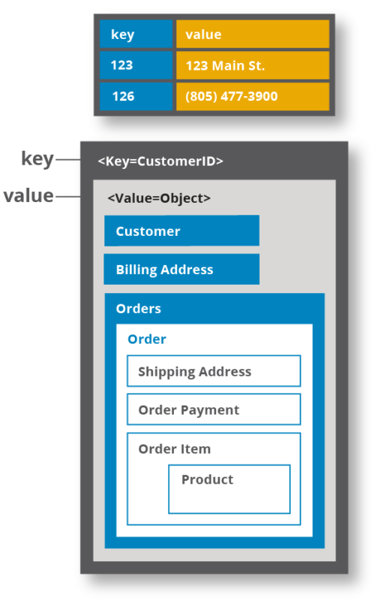
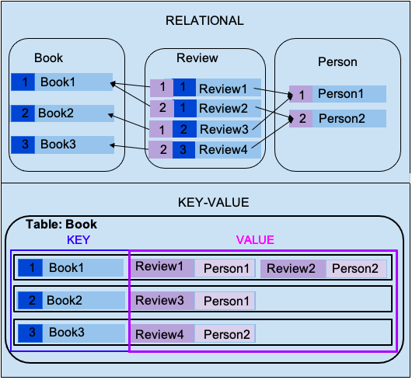
NoSQL database types (3)

Slide 9
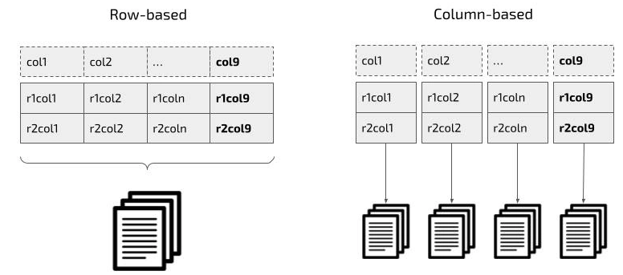
NoSQL database types (4)
Columnar Databases
Columnar databases are a hybrid of RDBMSs and Key-Value stores
Values are stored in groups of zero or more columns, but in Column-Order (as opposed to Row-Order)
Values are queried by matching keys
Fast access, e.g., average age
Record 1
Column A
Column A = Group A
Alice
3
25
Bob
Alice
Bob
Carol
Alice
Bob
Carol
4
19
Carol
0
3
4
0
25
3
25
4
19
45
19
45
0
45
Column Family {B, C}
Row-Order
Columnar (or Column-Order)
Columnar with Locality Groups

Slide 10
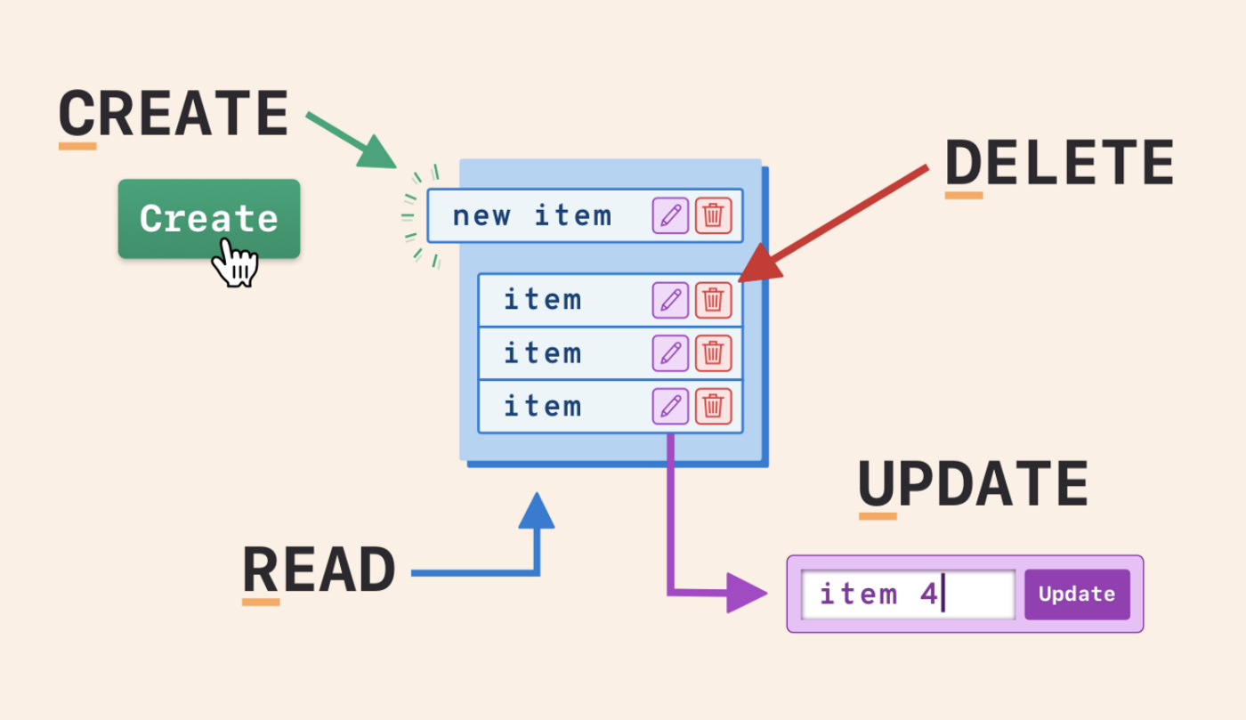
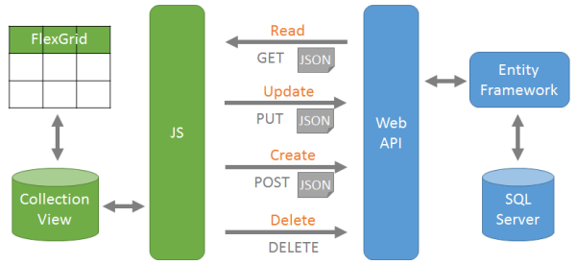
CRUD-basic database operations
Create, or add new entries
Read, retrieve, search, or view existing entries
Update, or edit existing entries
Delete, deactivate, or remove existing entries

Slide 11
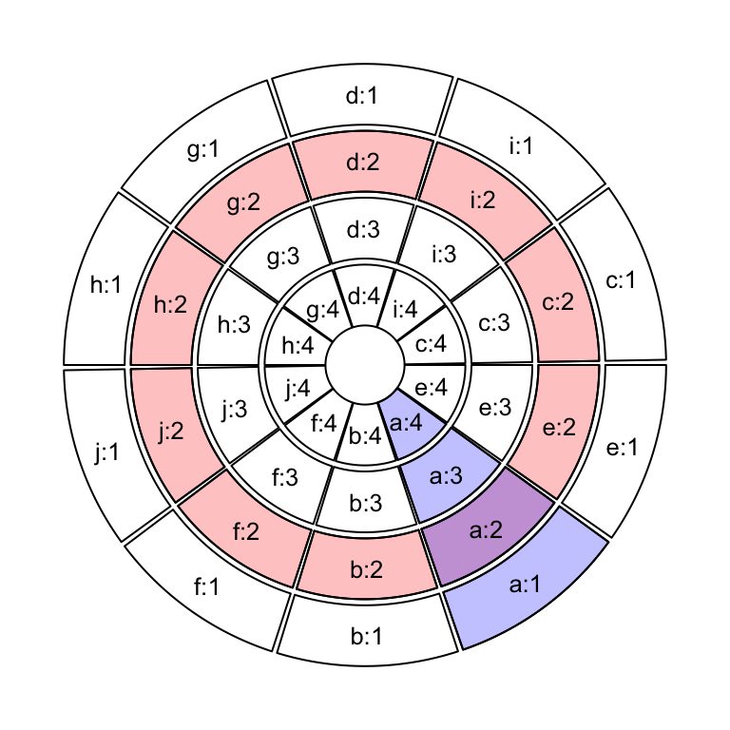
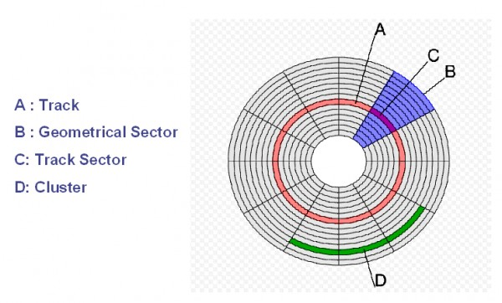
Records and files
Files of records are stored in a disc
A record is a collection of data values (fields).
A file (e.g., table) is a sequence of records (e.g., tuples).
A file can have fixed-length or variable length records.
Fixed length records: every record in the file has exactly the same size (in bytes).
Variable length records: different records in the file have different sizes.
Notes:
https://courses.cs.washington.edu/courses/csep544/14wi/video/archive/html5/video.html?id=csep544_14wi_3

Slide 12
Record blocking
A record block is usually a track sector
The records of a file must be allocated to disk blocks because a block is the unit of data transfer between disk and memory.
When block size > record size, each block will contain numerous records.
Blocking: storing a number of records into one block in the disk.

Slide 13
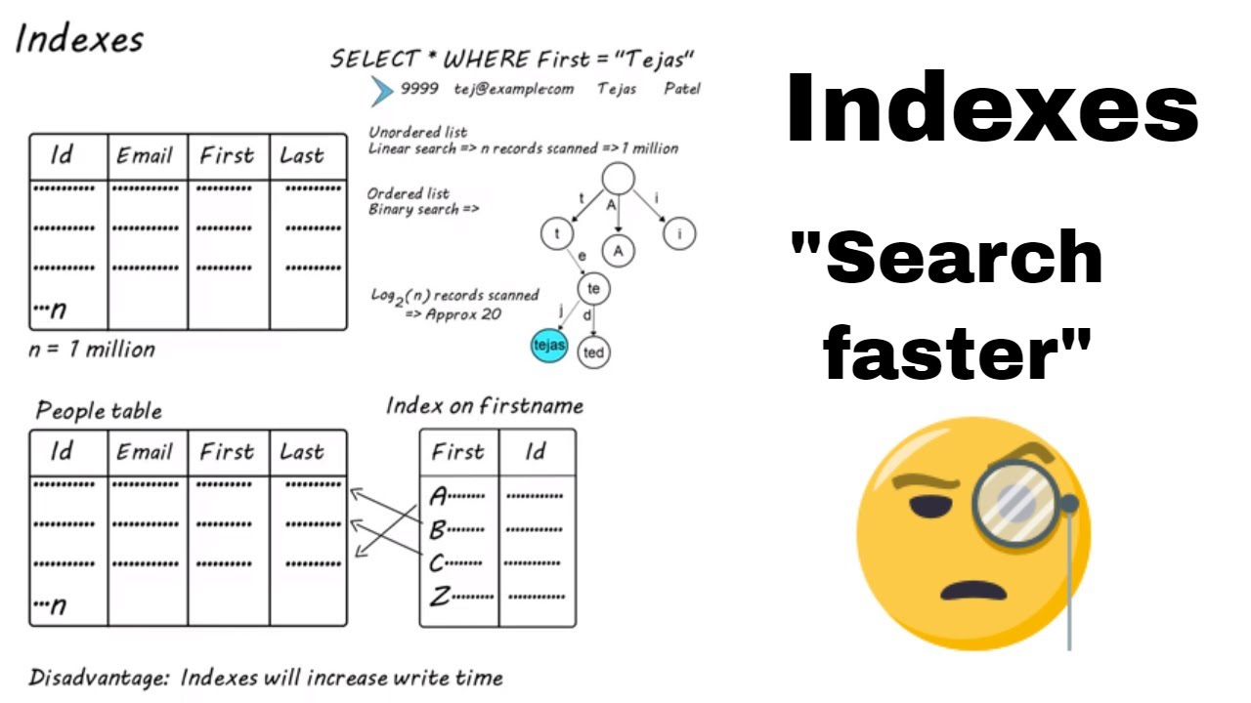
Data indexing
A database index is a data structure that improves the speed of data retrieval operations on a database table at the cost of additional writes and storage space to maintain the index data structure.

Slide 14
Methods for organizing records on disks
Unordered records (Heap files)
Ordered records (Sorted files)
Hashed records

Slide 15

Unordered files
Also called a heap file (records are unorded).
Insertion: New records are inserted at the end of the file
Arranged in their insertion sequence.
Record insertion is efficient (add to the end).
Searching: A linear search through the file records is necessary to search for a record.
This requires reading and searching half the file blocks on average, and is hence quite expensive (n/2)
Worst case, all records (n)

Slide 16

Ordered files
Also called a sequential file (records are ordered)
File records are kept sorted by the values of an ordering field
Insertion is expensive: records must be inserted in the correct order
It is common to keep a separate unordered overflow file for new records to improve insertion efficiency; this is periodically merged with the main ordered file
Reading the records in order of the ordering field is quite efficient

Slide 17
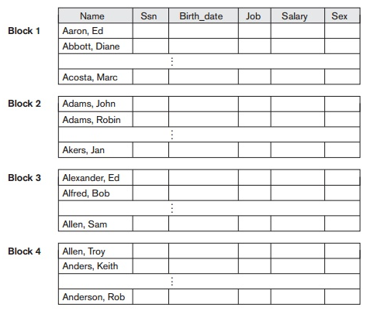
Ordered file example
Some blocks of an ordered file of EMPLOYEE records with Name as the ordering key field.
Notes:
https://www.brainkart.com/article/Files-of-Ordered-Records-%28Sorted-Files%29_11515/

Slide 18
Hashed files: a simple indexing idea (1)
Hashing for disk files is called External Hashing (files on disk)
The file blocks are divided into M equal-sized buckets, numbered bucket 0, bucket 1, ..., bucket M-1
One of the file fields is designated to be the hash key of the file
If a record has search key K, we store the record by linking it to the bucket list for the bucket numbered h(K)
h(K) is a hash function that transforms the hash field value into an integer between 0 and M-1.

Slide 19
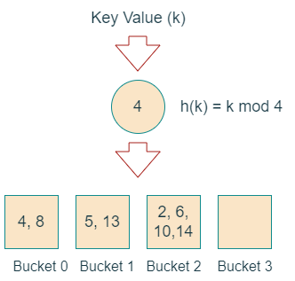
Hashed files (2)

Slide 20
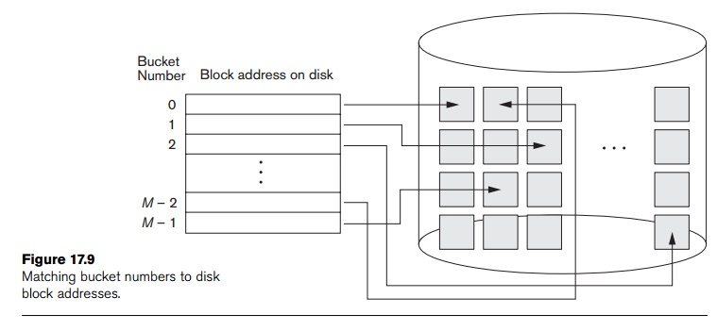
Hashed files (3)
External hashed files
Notes:
https://www.brainkart.com/article/External-Hashing-for-Disk-Files_11518/

Slide 21
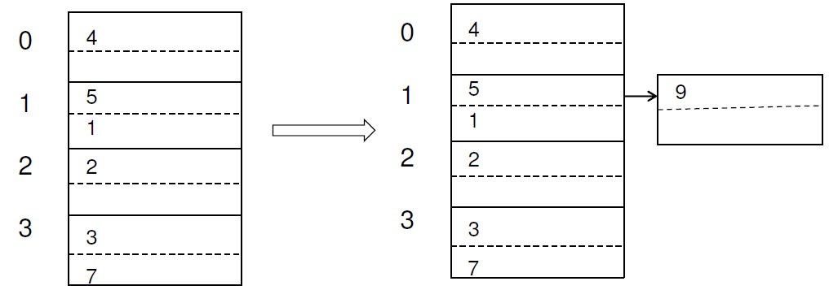
Hashed files (4)
Hashed tables example
We assume a block can hold two records and M = 4, i.e., the hash function h returns values from 0 to 3.
Example: We add to the hash table a record with key g and h(g) = 1. Then we add the new record to the bucket numbered 1.
Collisions occur when a new record hashes to a bucket that is already full -> Collision resolution is needed.

Slide 22
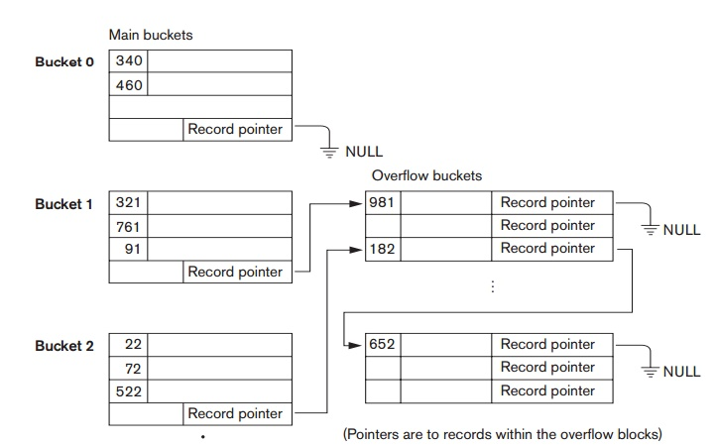
Hashed files (5)
Collision resolution by chaining
For this method, various overflow locations are kept, usually by extending the array with a number of overflow positions
In addition, a pointer field is added to each bucket
A collision is resolved by:
placing the new record in an unused overflow bucket and
setting the pointer of the occupied hash address bucket to the address of that overflow bucket
Notes:
https://www.brainkart.com/article/External-Hashing-for-Disk-Files_11518/

Slide 23
Hashed files (6)
To reduce the number of overflow, a hash file is typically kept 70-80% full.
The hash function h should distribute the records uniformly among the buckets.
Otherwise, search time will be increased because many overflow records will exist.
Searching overflow records are more expensive.
Main disadvantages of static external hashing:
Fixed number of buckets M -> Difficult to expand and shrink the file dynamically.
-> Need hashing techniques that allow dynamic file expansion.

Slide 24
Hashed files (7)
Extendible and dynamic hashing: Hashing techniques are extended to allow dynamic growth and shrinking of the number of file records .
Both dynamic and extendible hashing use the binary representation (e.g., 1100…) of the hash value h(K) in order to access a directory.
In Extendible Hashing, the directory is an array of size 2^d, where d is called the global depth.
In Dynamic Hashing, the directory is a binary tree.
The directories can be stored on disk, and they expand or shrink dynamically.
Directory entries point to the disk blocks that contain the stored records.
An insertion in a disk block that is full causes the block to split into two blocks and the records are redistributed among the two blocks.
The directory is updated appropriately.

Slide 25
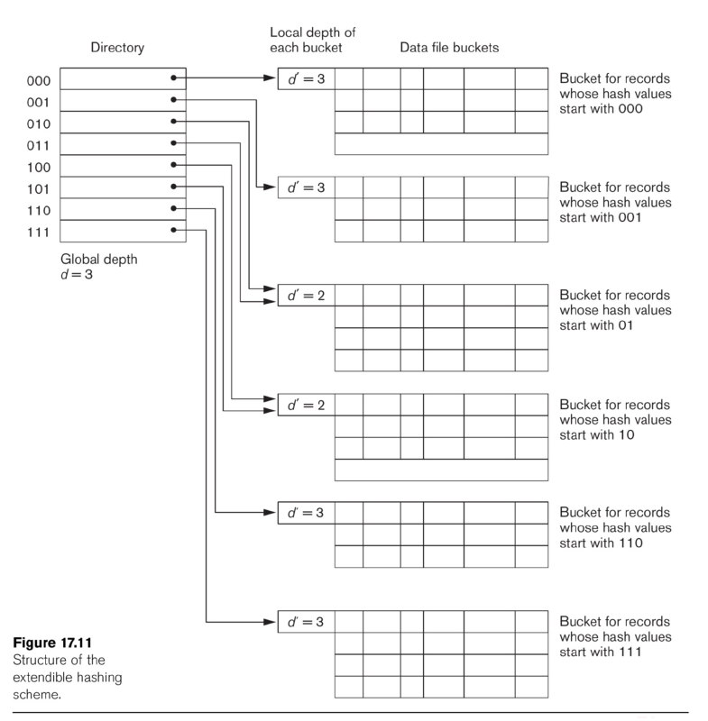
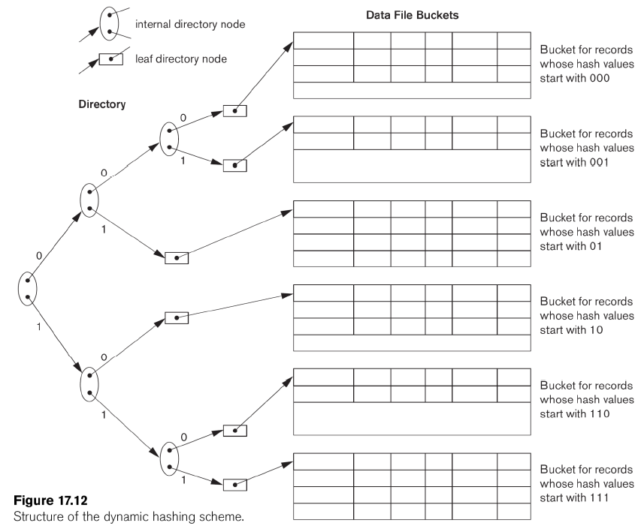
Hashed files (8)
Extendible Hashing
Dynamic Hashing

Slide 26
Indexing techniques (1)
Index are auxiliary files on disk that provide secondary access paths, which provide fast access to records without affecting the physical placement of records in the primary data file on disk.
An index is an ordered sequence of entries <indexing field value, pointer to record>:
It is ordered by the indexing field value
The pointer provides the address of the required record.
Instead of searching the data file sequentially, we search the index to get the address of the required records.
The index file usually occupies considerably less disk blocks than the data file because its entries are much smaller

Slide 27
Indexing techniques (2)
Dense index vs sparse index
A dense index has an index entry for every search key value (and hence every record) in the data file.
Thus larger index size
A sparse index, on the other hand, has index entries for only some of the search values.
Thus smaller index size

Slide 28
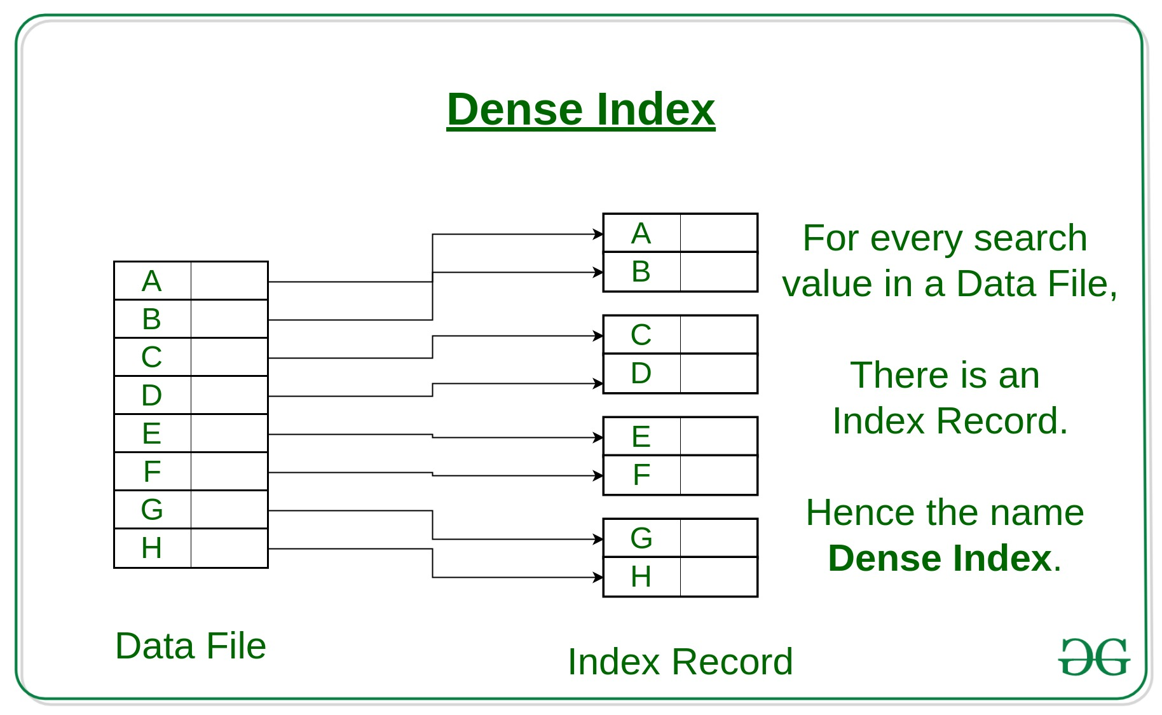
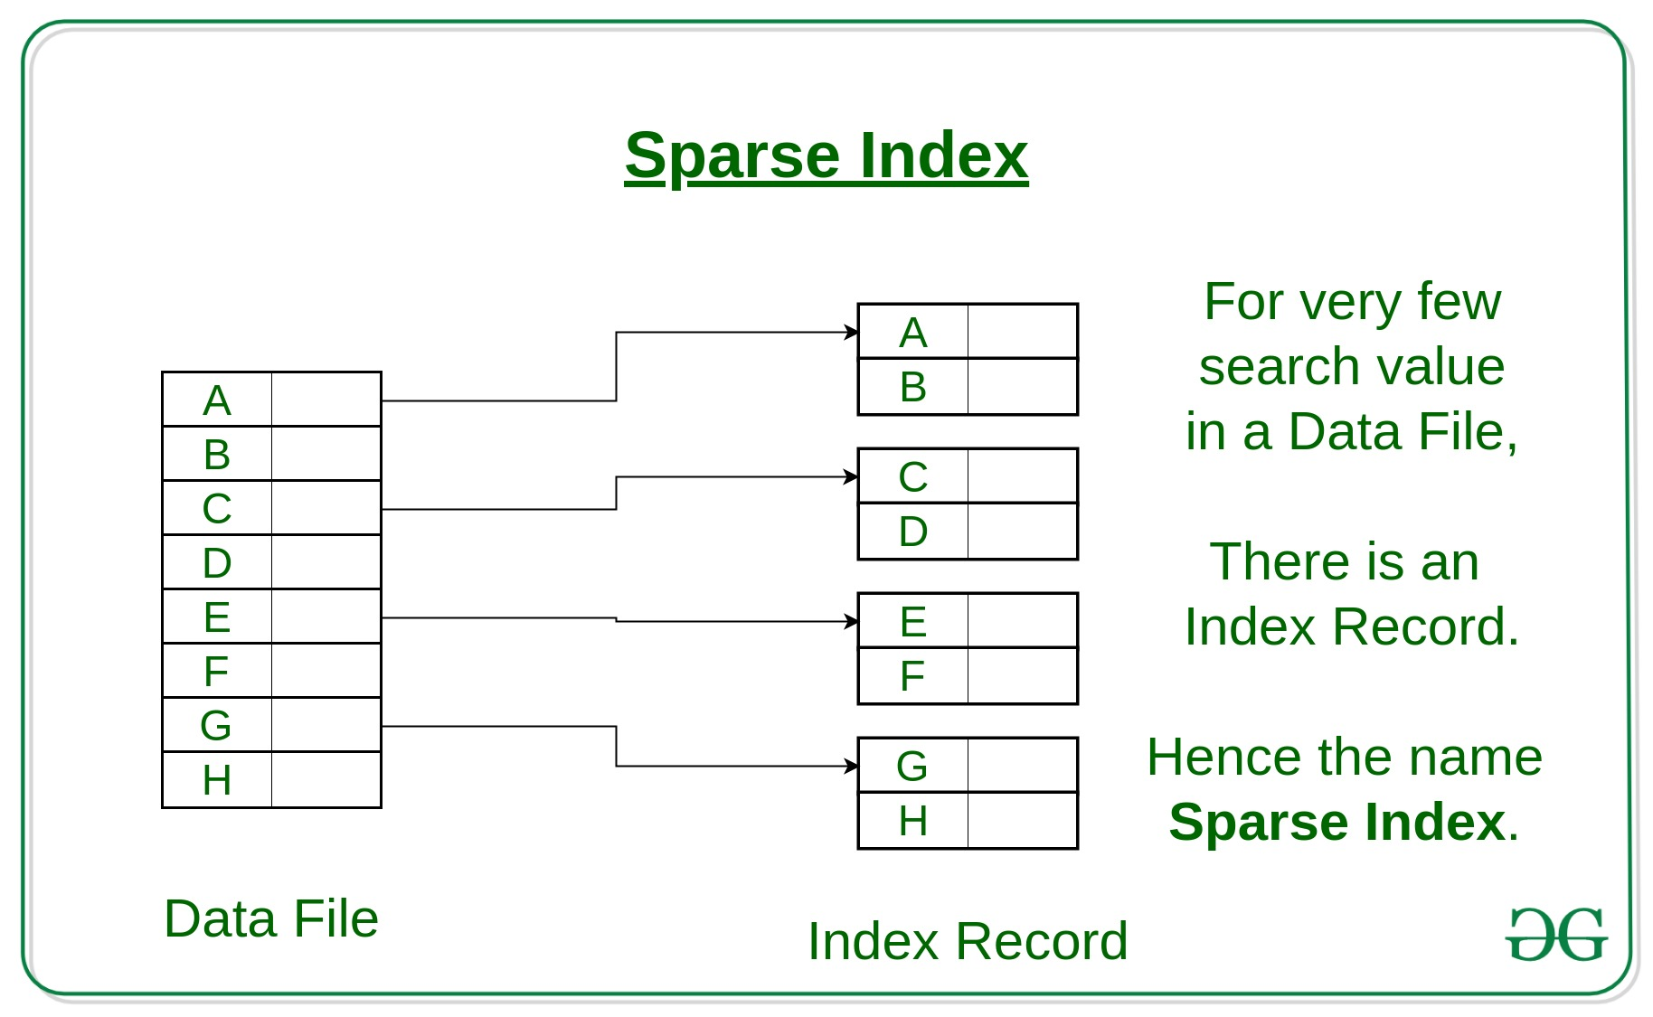
Indexing techniques (3)
Dense index vs. sparse index
Notes:
https://www.geeksforgeeks.org/indexing-in-databases-set-1/

Slide 29
Indexing techniques (4)
Multi-level indices
Because a single-level index is an ordered file, we can create another index to the index itself.
In this case, the original index file is called the first-level index and the index to the index is called the second-level index.
We can repeat the process, creating a third, fourth, ..., top level until all entries of the top level fit in one disk block.

Slide 30
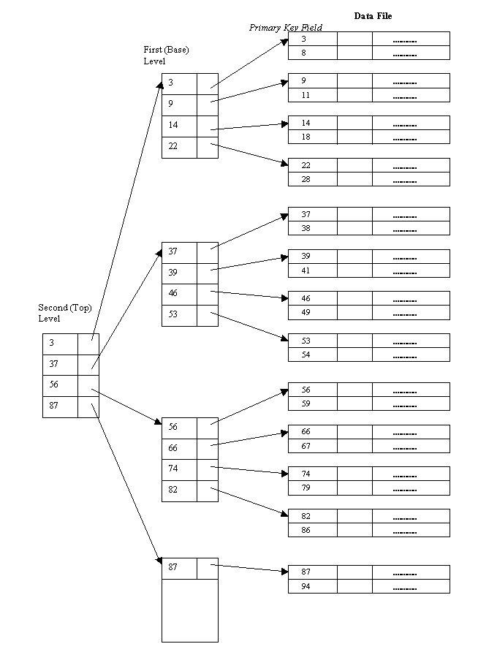
Indexing techniques (5)
A 2-level index
A multi-level index can be created for any type of first-level index as long as the first-level index consists of more than one disk block.
Notes:
https://www.cs.uct.ac.za/mit_notes/database/htmls/chp11.html

Slide 31
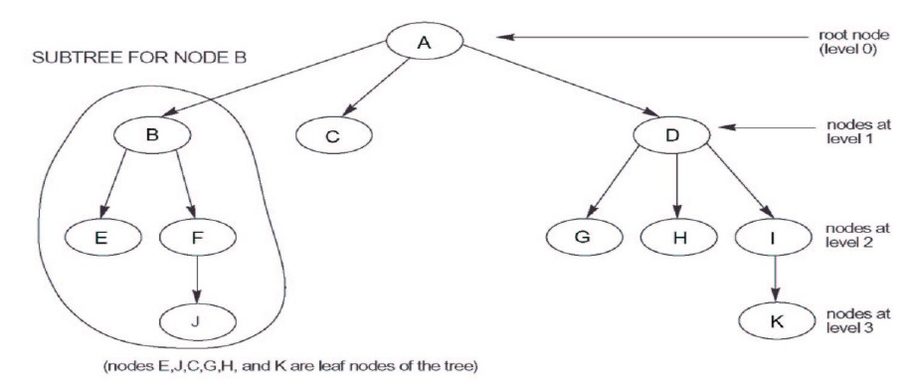
Tree data structure (1)
A tree is formed of multi-level nodes
Except the root node, each node in the tree has one parent node and zero or more child node.
A node that does not have any child nodes is called a leaf node.
A non-leaf node is called internal node.
A sub-tree of a node consists of the node and all its descendant.
If the leaf nodes are at different levels,
the tree is called unbalanced.

Slide 32
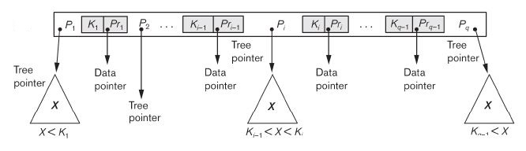
Tree data structure (2)
B-tree index
Each internal node in a B-tree is of the form
<P1, <K1, Pr1>, P2, <K2, Pr2>, …, <Kq-1, Prq-1>, Pq> where q ≤ p
Each Pi is a tree pointer to another node in the B-tree
Each Pri is a data pointer points to the record whose search key field value = Ki
Within each node, K1 < K2 < … < Kq-1
For all search key field values X in the
subtree pointed by Pi, we have Ki-1 < X < Ki for 1 < i < q; X < Ki
for i = 1; and Ki-1 < X for i = q
Notes:
https://vitalflux.com/dummies-notes-what-is-b-tree-and-why-use-them/

Slide 33
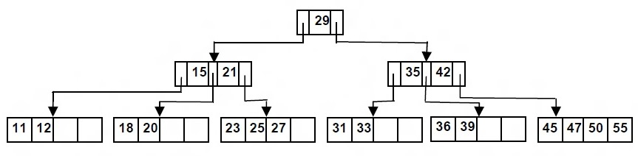
Tree data structure (3)
B-tree index
All leaf nodes are at the same level (balanced tree).
All leaf nodes have the same structure as internal nodes except that all of their tree pointers of Pi are NULL.
Each node has at most p tree pointers (order of the tree).
Each node except the root and leaf nodes, has at least ceil(p/2) tree pointers.
Notes:
https://vitalflux.com/dummies-notes-what-is-b-tree-and-why-use-them/

Slide 34
Tree data structure (4)
B+ tree index
Most implementations of a dynamic multilevel index use a variation of the B-tree data structure called a B+-tree.
In a B+-tree, data pointers are stored only at the leaf nodes of the tree.
The pointers in internal nodes are tree pointers to blocks that are tree nodes.
The pointers in leaf nodes are data pointers to the data file records.
Because entries in the internal nodes of a B+-tree does not include data pointers, more entries (tree pointers) can be packed into an internal node and thus fewer levels (higher capacity).
The leaf nodes of a B+-tree are usually linked to provide ordered access on the search field to the records.

Slide 35
Tree data structure (5)
B+ tree index (internal nodes)
The structure of internal nodes of a B+-tree of order p
Each internal node is of the form <P1, K1, P2, K2, …,Pq-1, Kq-1,Pq> where q ≤ p
Pi : tree pointer
Ki : search key field value
Within each node, K1 < K2 < … < Kq-1
For all search key field values X in the subtree pointed by Pi, we have Ki-1 < X ≤ Ki for 1 < i < q; X ≤ Ki for i = 1; and Ki-1 < X for i = q or Ki-1 ≤ X < Ki for 1 < i < q; X < Ki for i = 1; and Ki-1 ≤ X for i = q.
Each node has at most p tree pointers
Each node except the root and leaf nodes has at least ceil(p/2) tree pointers

Slide 36
Tree data structure (6)
B+ tree index (leaf nodes)
Each leaf node is of the form <<K1, Pr1> ,<K2, Pr2>, …,<Kq-1, Prq-1>, Pnext>
Pri is a data pointer pointing to the record whose search field is Ki.
Pnext points to the next leaf node of the tree.
Within each node, K1 < K2 < … < Kq-1.
Each leaf node has at least ceil(p/2) values.
All leaf nodes are at the same level.

Slide 37
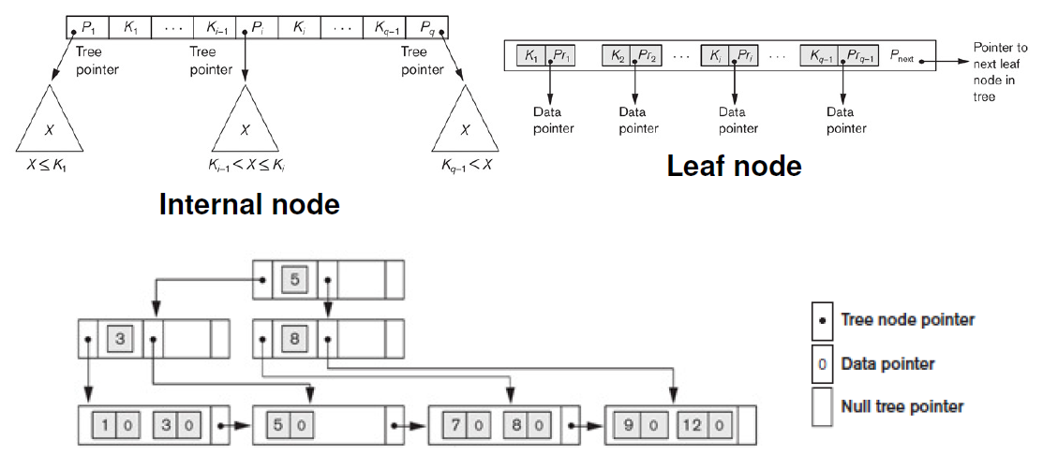
Tree data structure (7)
B+ tree index example

Slide 38
Tree data structure (8)
B+ tree index insertion
Step 1: Descend to the leaf node where the key fits
Step 2:
(Case 1): If the node has an empty space, insert the key into the node.
(Case 2) If the node is already full, split it into two nodes by the middle key value, distributing the keys evenly between the two nodes, so each node is half full.
(Case 2a) If the node is a leaf, take a copy of the middle key value, and repeat step 2 to insert it into the parent node.
(Case 2b) If the node is a non-leaf, exclude the middle key value during the split and repeat step 2 to insert this excluded value into the parent node.

Slide 39
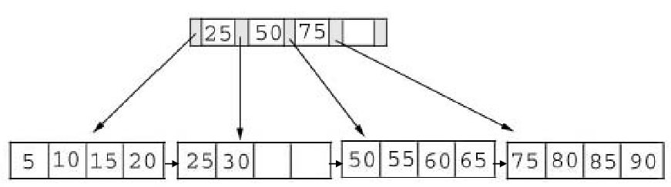

Tree data structure (9)
B+ tree index insertion – example 1: insert 28 into the tree below
The node has an empty space

Slide 40
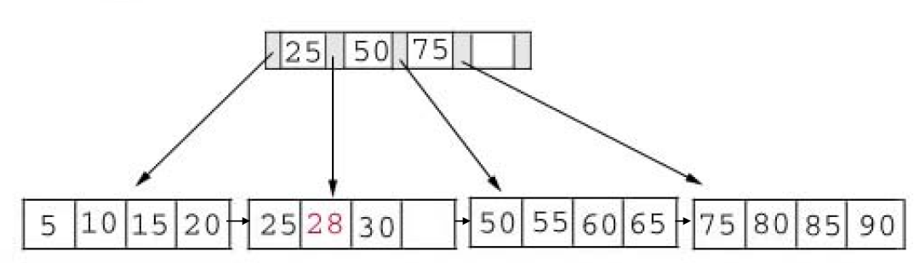
Tree data structure (10)
B+ tree index insertion – example 1: insert 28 into the tree below
Insert 28 into the appropriation leaf node.

Slide 41
Tree data structure (11)
B+ tree index insertion – example 2: insert 70 into the tree below

Slide 42
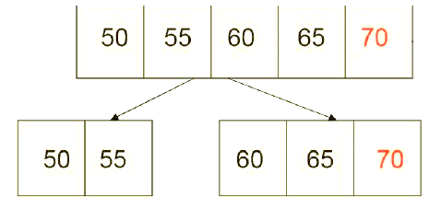
Tree data structure (13)
B+ tree index insertion – example 2: insert 70 into the tree below
The leaf node is full -> split

Slide 43
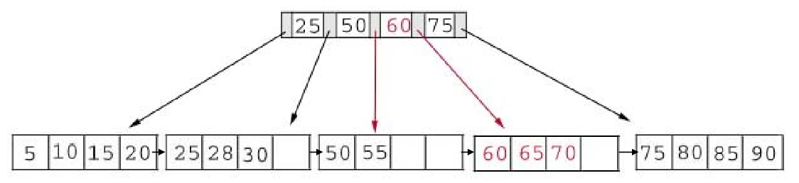
Tree data structure (14)
B+ tree index insertion – example 2: insert 70 into the tree below
Split leaf node from the middle, chose the middle key 60, and place it into the parent node.

Slide 44
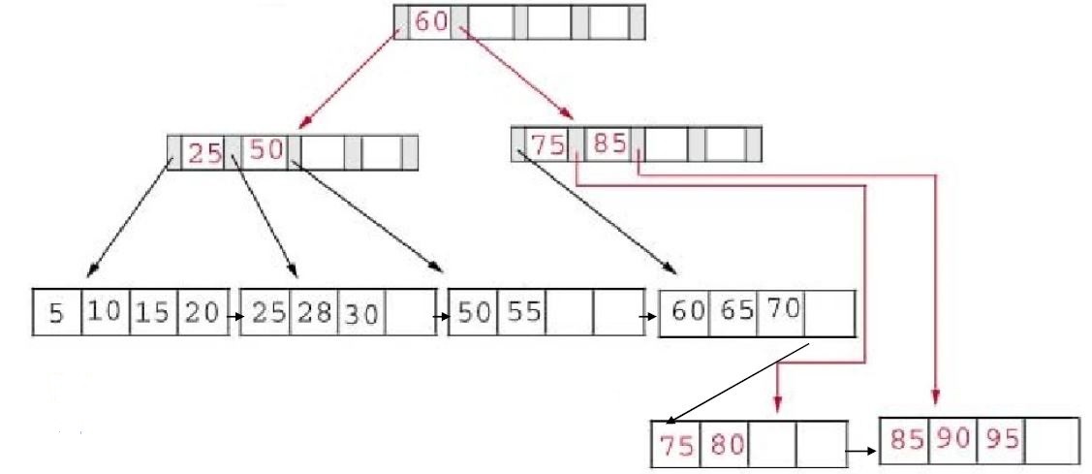
Tree data structure (15)
B+ tree index insertion – example 3: insert 95 into the tree below
Split leaf node from the middle, and split the parent node.

Slide 45
Tree data structure (16)
B+ tree index deletion
Step1: Descend to the leaf node where the key fits
Step 2: Remove the required key and associated reference from the node.
(Case 1): If the node still has half-full keys, repair the keys in parent node to reflect the change in child node if necessary and stop.
(Case 2): If the node is less than half-full, but left or right sibling node is more than half-full, redistribute the keys between this node and its sibling. Repair the keys in the level above to represent that these nodes now have a different “split point” between them.
(Case 3): If the node is less than half-full, and left and right sibling node are just half-full, merge the node with its sibling. Repeat step 2 to delete the unnecessary key in its parent.

Slide 46
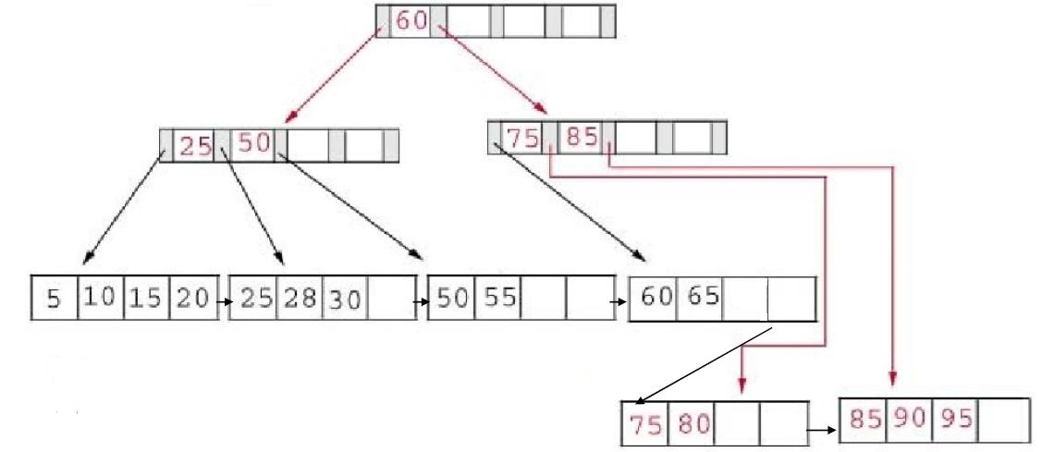
Tree data structure (17)
B+ tree index deletion – example 1: delete 70 from the tree below
Just delete 70 from the leaf node.

Slide 47
Tree data structure (18)
B+ tree index deletion – example 2: delete 25 from the tree below

Slide 48
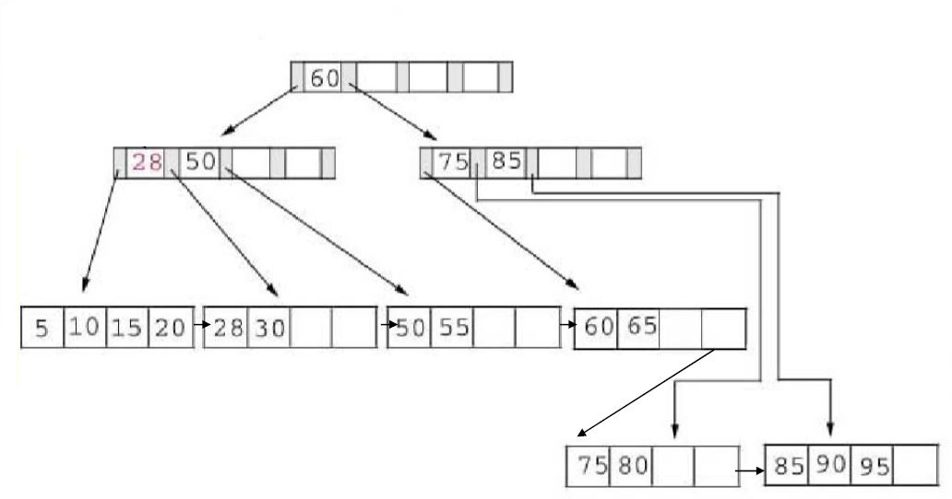
Tree data structure (19)
B+ tree index deletion – example 2: delete 25 from the tree below
Delete 25 from the leaf node and internal node, replace it with 28 in the internal node.

Slide 49
Tree data structure (20)
B+ tree index deletion – example 3: delete 60 from the tree below

Slide 50


Tree data structure (21)
B+ tree index deletion – example 3: delete 60 from the tree below
Less than half-full

Slide 51
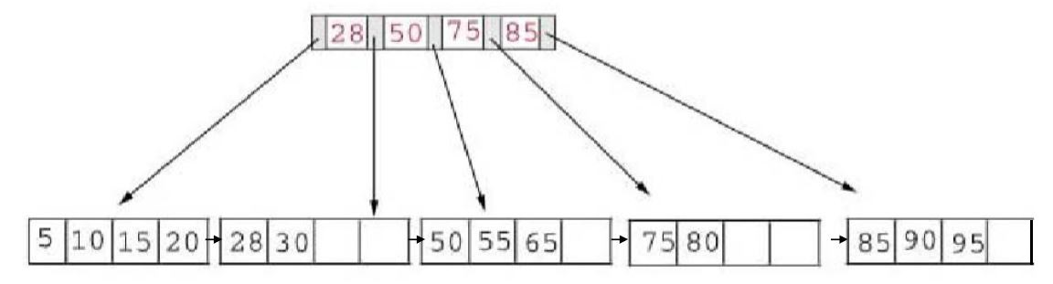
Tree data structure (22)
B+ tree index deletion – example 3: delete 60 from the tree below
Delete 60 from the leaf node, combine leaf nodes and then internal nodes.

Slide 52
Thanks for your attention!

Slide 53
Appendix 1. https://www.cs.usfca.edu/~galles/visualization/BPlusTree.html

