Slide 1


Asset location using low-cost beacons, smart roaming devices and cloud computing
Samuel Nixon | 15444418

Slide 2
Today’s Objectives
Chosen Solution
Progress so far
Remaining work

Slide 3
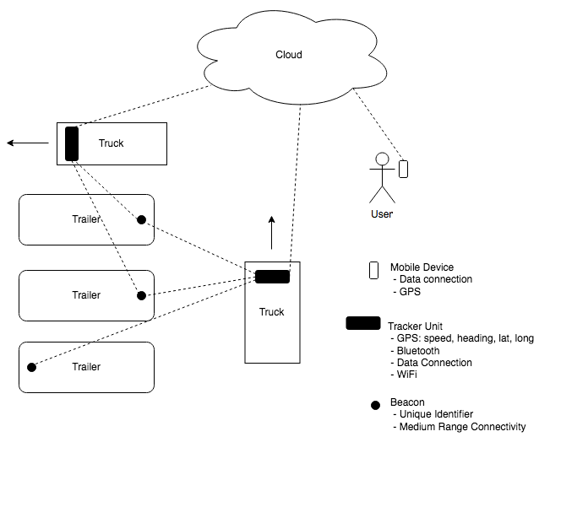
Overall Solution

Slide 4
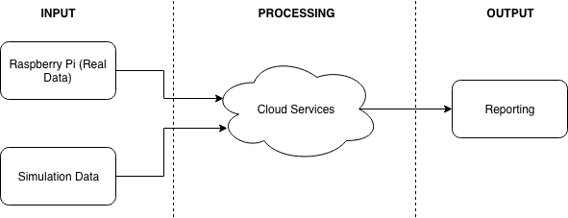
Overall Solution

Slide 5
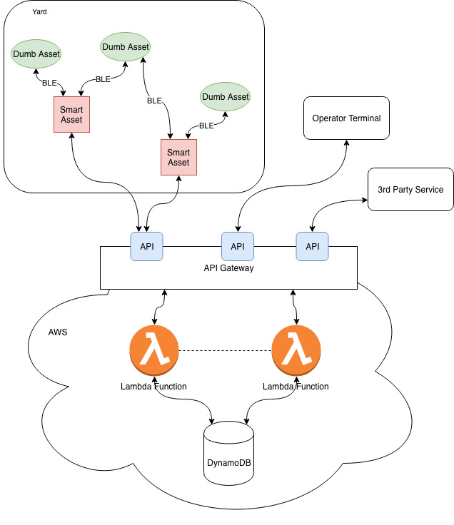
Planned Implementation
”Dumb Asset” refers to simple BLE Beacon
“Smart Asset” refers to a Raspberry Pi with BLE, WiFi and GPS.
‘Serverless’ cloud computing hosted on Amazon Web Services (AWS)
“Operator Terminal” provides end user with UI to view data collected from assets and view system’s predictions for asset location

Slide 6
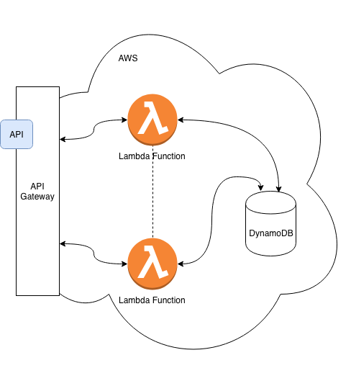
Cloud Architecture
Serverless components hosted by AWS
API Gateway
Provides a RESTful API for devices and reporting services to access e.g. PUT https://5o6pmquqyi.execute-api.us-east-2.amazonaws.com/api/readings
Triggers Lambda
Lambda
Runs code when triggered. Automatically scales as needed.
Processes API requests and writes/reads data from DynamoDB using Node.js
DynamoDB
Key-value and document store (NoSQL)
Provides system storage

Slide 7
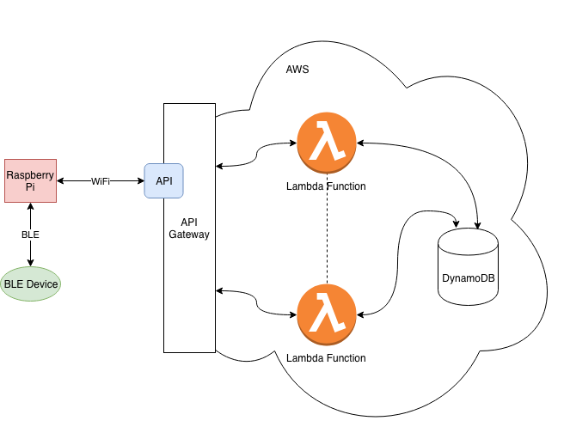
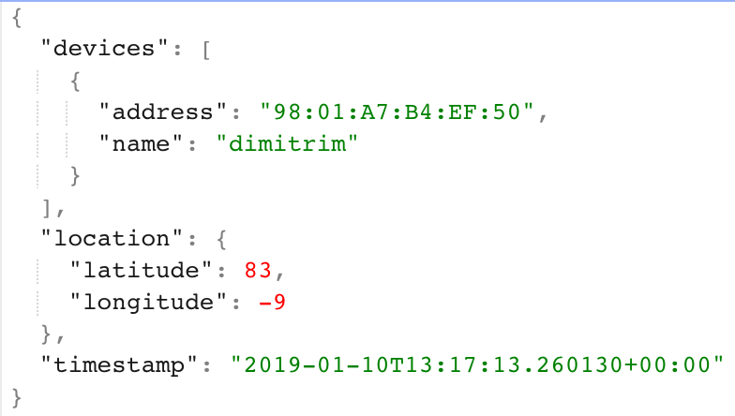
Current System
Raspberry Pi running a Python script to scan for Bluetooth devices and uploading found devices to cloud services.
Uploaded Data (JSON)

Slide 8
Remaining work
Collection of real-world GPS and BLE data
Simulation
Experimentation
Nice to have’s:
End User Interface
Multiple Pi functionality – ID
Authentication

Slide 9
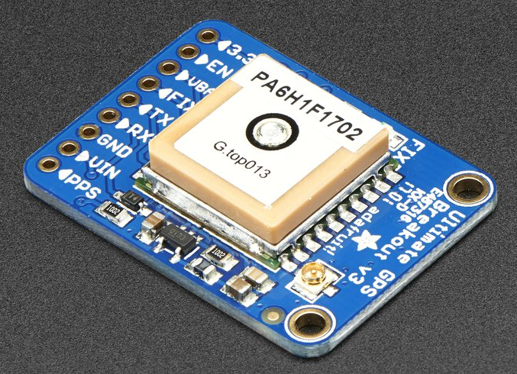
Collection of real-life GPS and Ble data
Adafruit Ultimate GPS
Accuracy
Update Frequency
BLE Beacon
Accuracy
Distance/Obstructions
Baseline for simulations

Slide 10
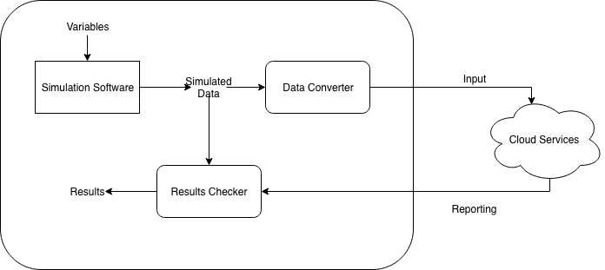
Simulation
Software to allow simulation of assets and their movements.
Variables:
Number of assets and ratio of smart:dumb
Rate of change of location of assets
Noisy data
Accuracy of GPS
Burstiness of asset uploads
Possible software:
GAMMA (https://gama-platform.github.io/)
AnyLogic (https://www.anylogic.com/transportation/)
Brinkhoff Generator

Slide 11
Experimentation
How will system cope with large volumes of traffic/bursty traffic?
Simulation
Trajectory analysis/prediction?
How useful would System be in real life?
Real-life testing?

Slide 12
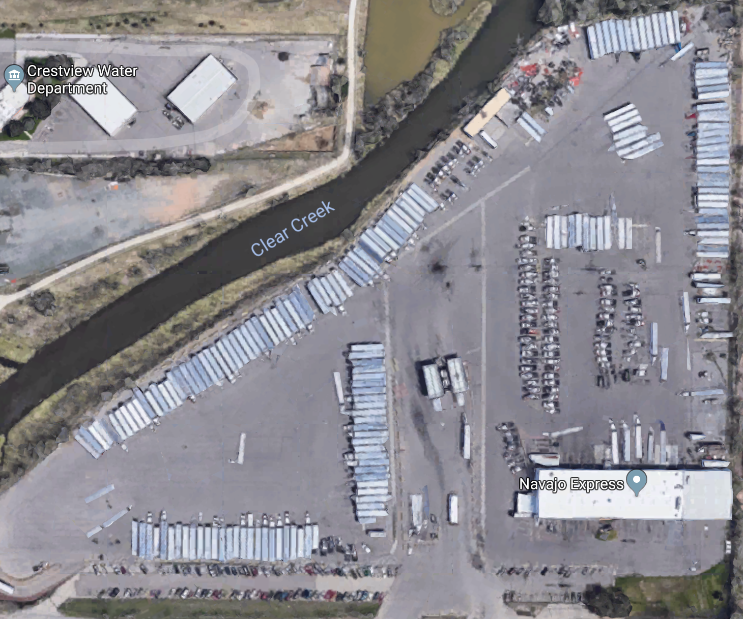
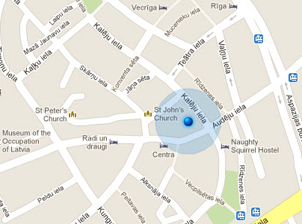
User Interface
Mobile Application or Website to allow user to see live System updates and estimations of asset location

