Slide 1

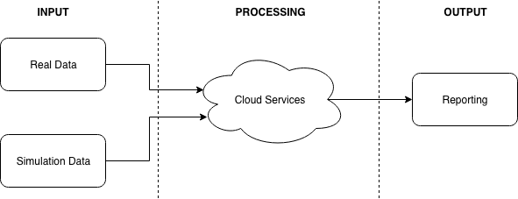
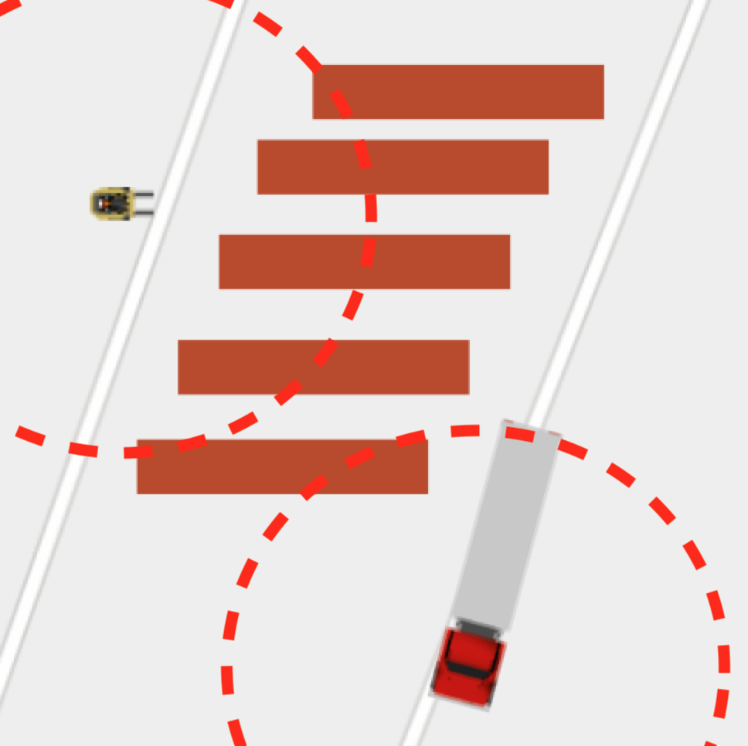
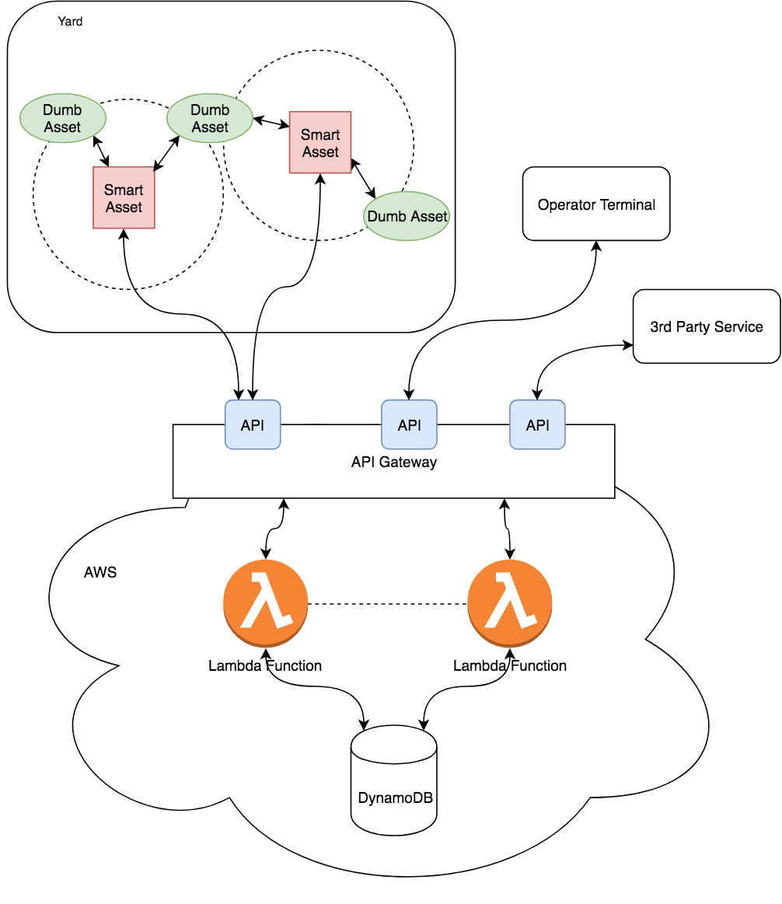
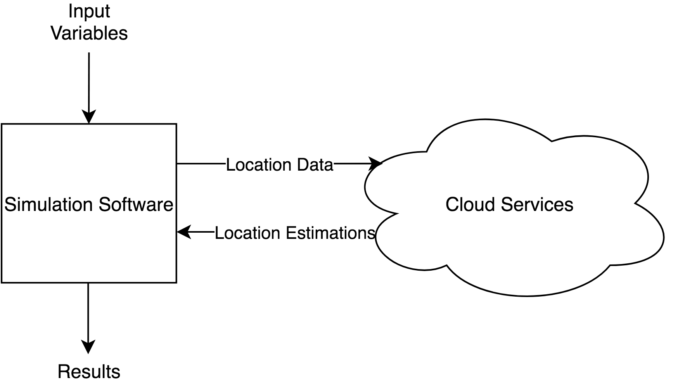

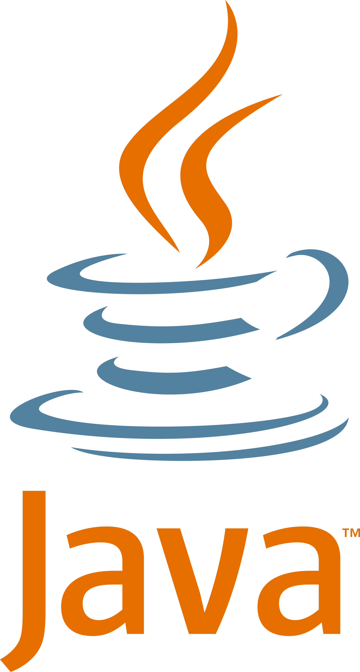
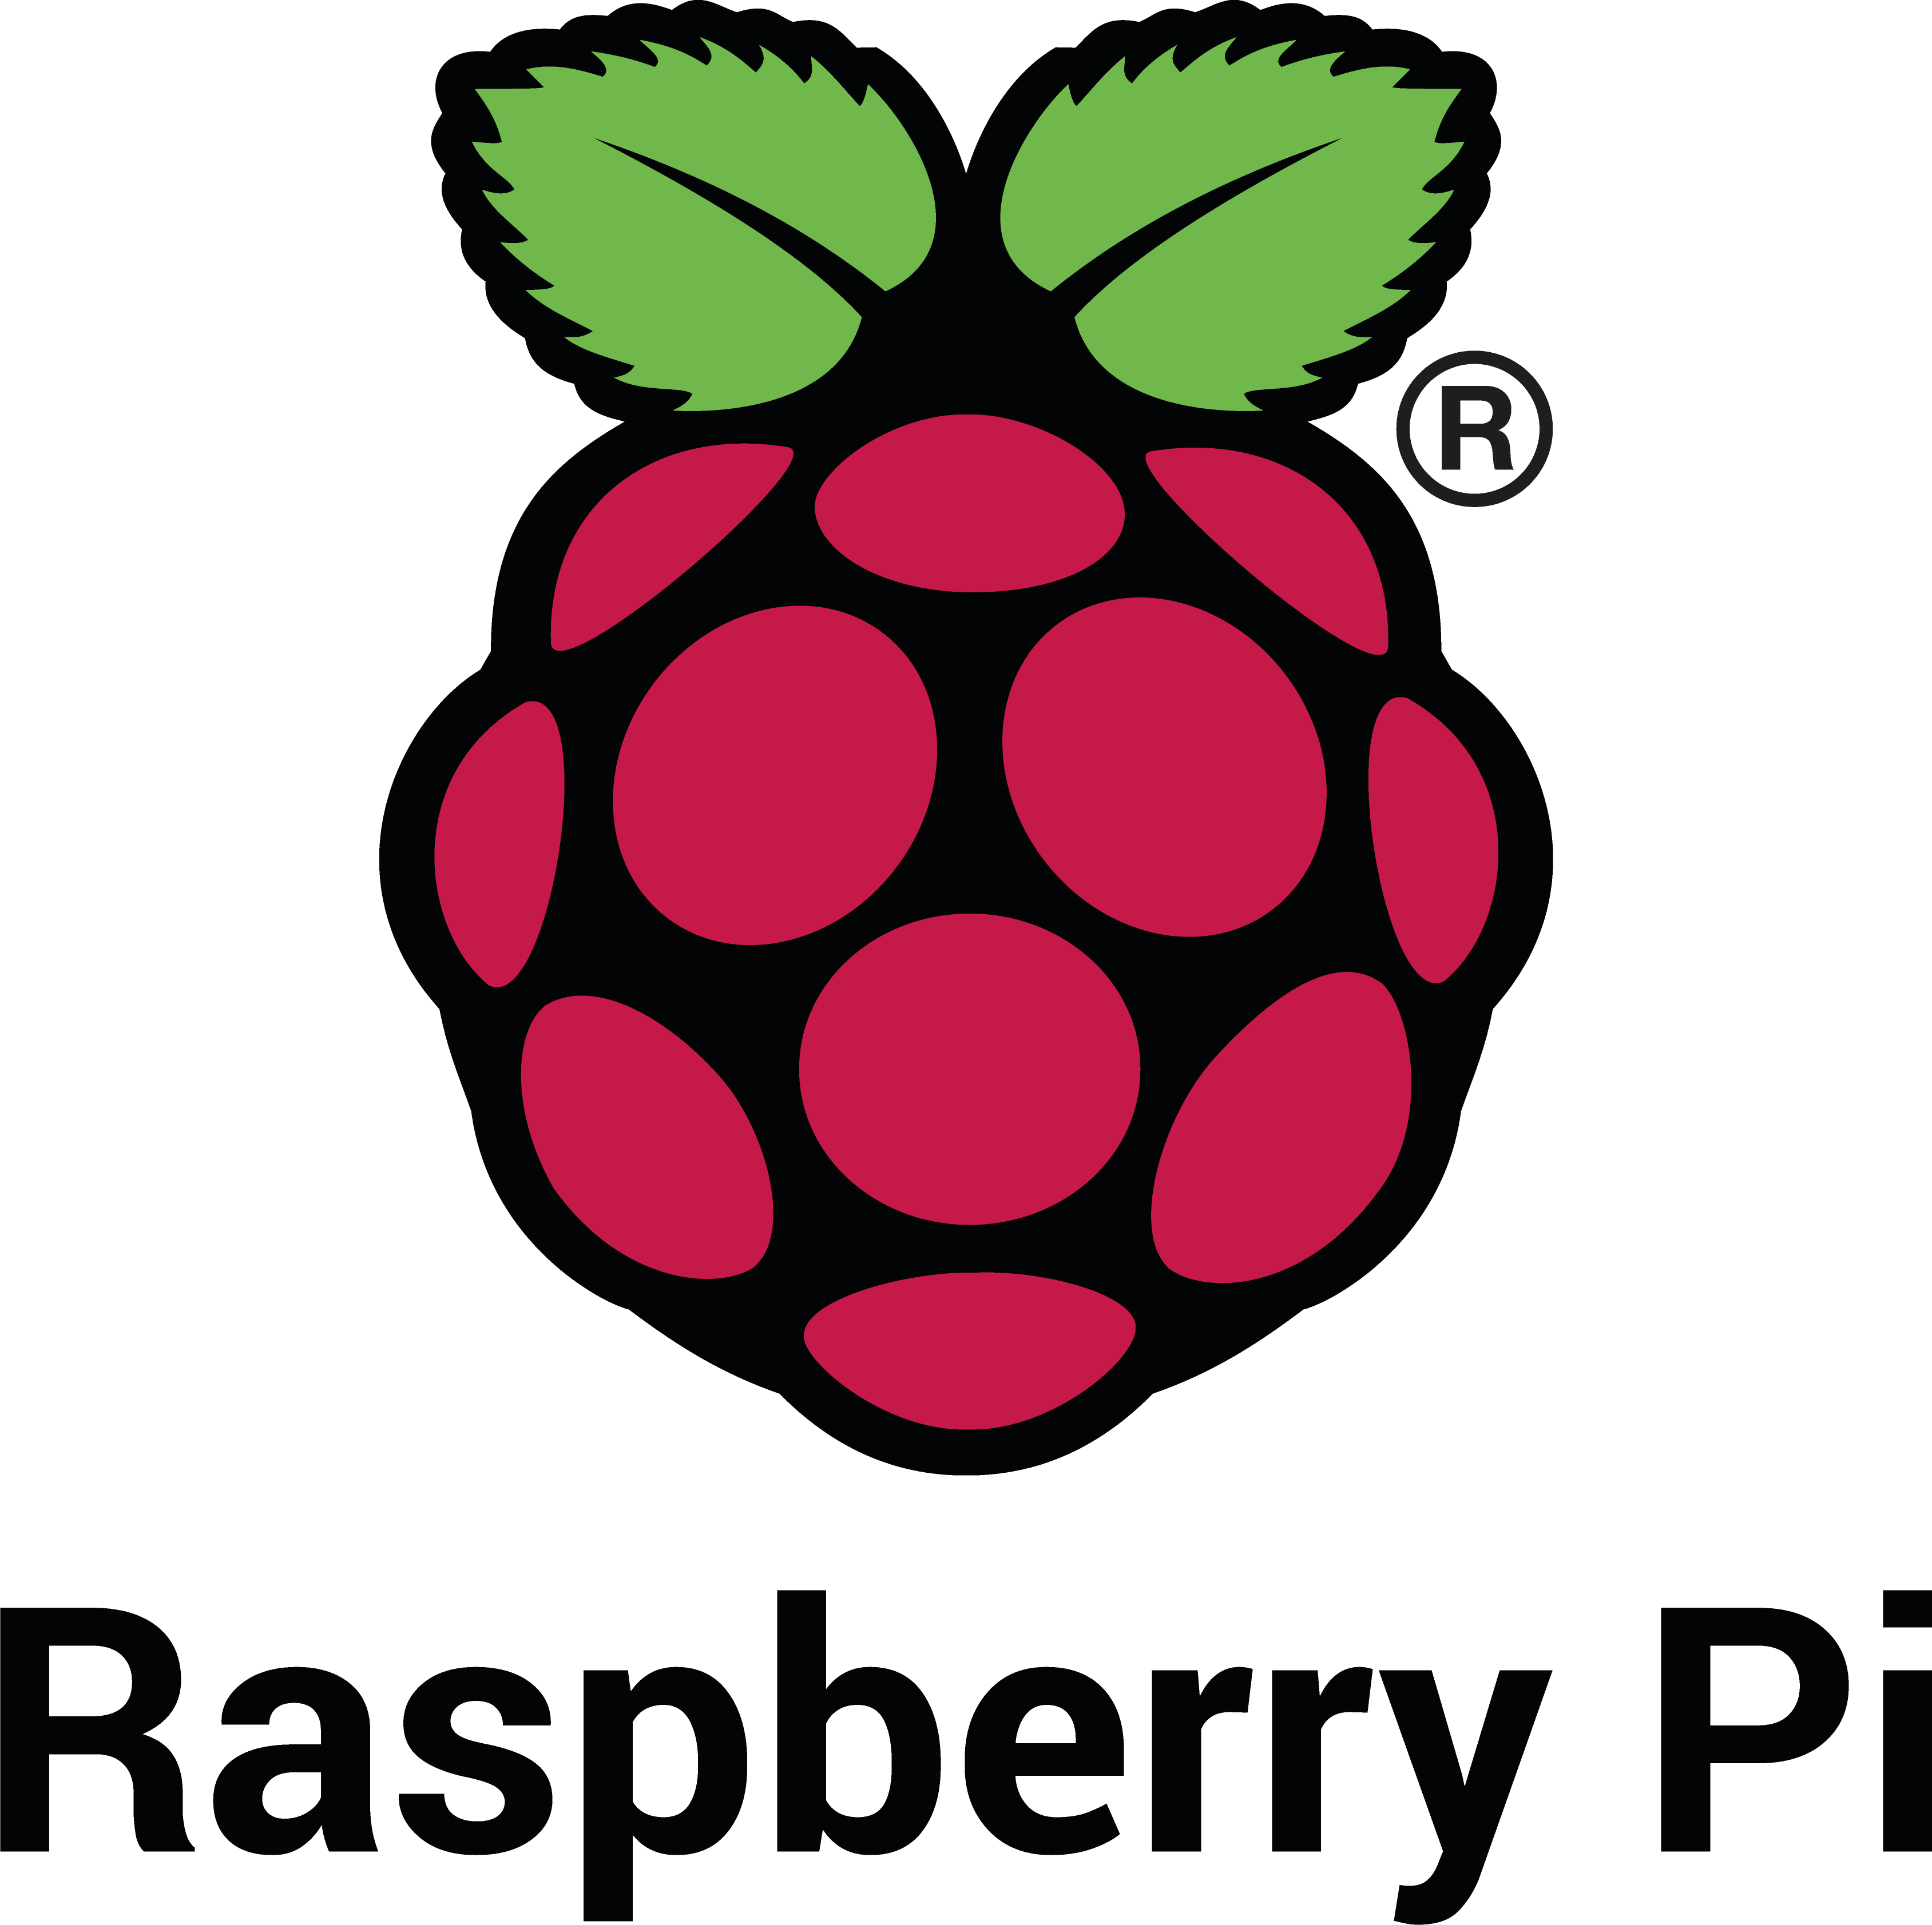

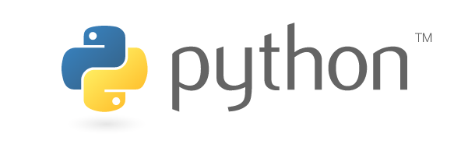
Asset Location using Cloud Computing, Smart Devices and Low-Cost Beacons
Student Samuel Nixon
Project Supervisor Dr. Edward Jones
1. Introduction
2. Objectives
Asset location in industry using devices with on-board GPS radios is a problem that already has a solution. However, a low cost solution that can leverage existing on-board technology (such as AOBRD/ELD) has yet to be developed. Simple Bluetooth beacons can be bought off-the-shelf from vendors easily, and this project seeks to utilize these simple beacons in combination with connected devices and cloud services to provide a solution that could, for example, provide telematics data on trailers, equipment and machinery in a busy yard.
Build cloud computing platform using Amazon Web Services (AWS)
Collect real-world data for use in simulation
Simulate traffic in a yard
Test performance of cloud computing against various simulations
3. Implementation
This project was separated into three main sections: Input, Processing and Output. Figure 1 shows how these sections interact to provide a plug-and-play architecture. Real data was provided by a Raspberry Pi with a GPS module running a Python script.
Simulation:
AnyLogic simulation software is used to generate agent-based simulations of device movement around a Geographic Information System (GIS) yard, in order to provide input to the cloud services and assess the accuracy of the cloud services output. This style of simulation is known as symbiotic simulation i.e. where a real system responds to input from a simulation. Figure 3 shows a simple simulation with 5 trailers, a forklift and a truck in a mock yard. These simulations can be tuned to adjust parameters such as:
The number of active devices
Frequency of device movement
Speed of device movement
Burstiness of data
Range of Bluetooth radio
Figure 4 shows the symbiotic relationship between AnyLogic and the Cloud Services. AnyLogic is Java based, allowing fine grained control of simulations.
Figure 1.
Figure 2 shows what a full production implementation would look like, with physical devices interacting with Cloud Services to provide a solution a user could query to glean information on the location of devices. Using AWS to provide the computational resources has allowed a flexible, scalable architecture to be developed that will automatically scale to production-ready numbers. Node.js is used in the Lambda Functions.
Figure 3.
Figure 4.
GPS Location Estimation Algorithm:
A Kalman filter is used to provide location estimations. This filter implemented in Node.js and run using a Lambda function triggered on input to the Database. Kalman filters work by estimating the value of variables based on previous state and uncertainty, sensor readings (GPS), control input (steering angle, throttle position)
Figure 2.
4. Remaining Work
5. Acknowledgements
Refinement of Kalman Filter
Build more complex simulation (more devices, greater simulation duration)
Testing of Cloud Services using simulation
I would like to thank Dr. Edward Jones, Mr. Martin Burke, Mr. Myles Meehan and Orbcomm for the help I have received throughout this project.

