Slide 1

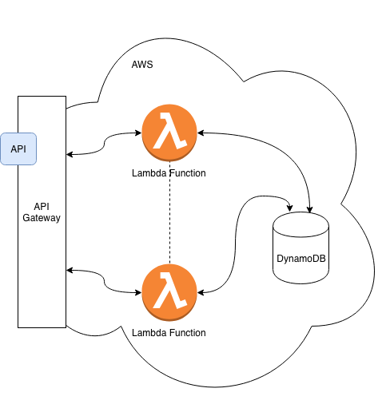
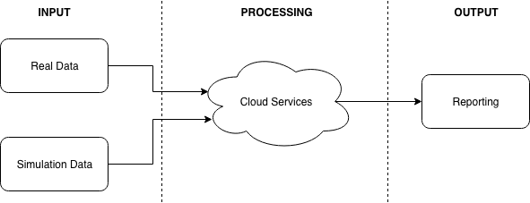
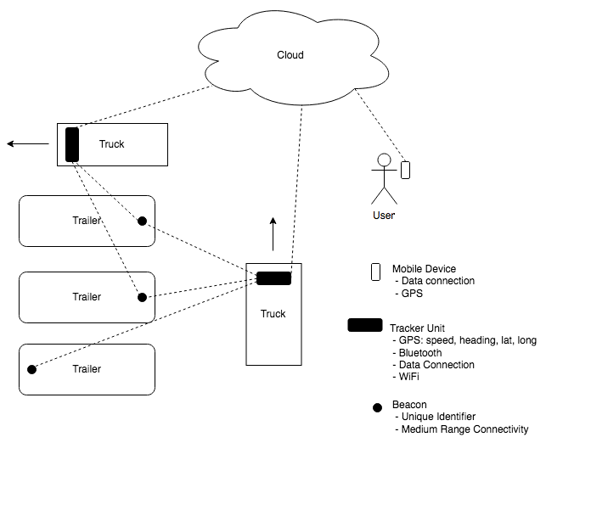






Asset Location using Cloud Computing, Smart Devices and Low-Cost Beacons
Student Samuel Nixon
Project Supervisor Eddie Jones
1. Introduction
2. Objectives
Asset location in industry using devices with on-board GPS radios is a problem that already has a solution. However, a low cost solution that can leverage existing on-board technology (such as AOBRD/ELD) has yet to be developed. Simple Bluetooth beacons can be bought off-the-shelf from vendors easily, and this project seeks to utilize these simple beacons in combination with connected devices and cloud services to provide a solution that will allow monitoring and reporting of device locations in a site or yard.
Build cloud computing platform using Amazon Web Services (AWS)
Collect real-world data for use in simulation
Simulate real-world traffic in a yard
Test performance of cloud computing against various simulations
3. Implementation
This project was separated into three main components: Cloud Services, Hardware and Simulation. Figure x shows how these three components interact to create a solution that a user could query to glean information on the location of devices.
Components:
Cloud Services (AWS)
Hardware (Raspberry Pi & Adafruit GPS)
Simulation (AnyLogic)
Simulation:
AnyLogic simulation software is used to generate simulations of device movement around a mock-yard, in order to provide input to the cloud services and assess the accuracy of the cloud services output. This style of simulation is known as symbiotic simulation i.e. where a real system responds to input from a simulation. The simulation technique used is known as agent-based simulation, where individual agent behavior is modelled. These simulations can be tuned to adjust parameters such as:
The number of active devices
Frequency of device movement
Speed of device movement
Burstiness of data
Range of Bluetooth radio
AnyLogic simulation software provides a GUI that allows graphical drag and drop building of simulations, with more complex relationships and modelling done by inputting Java.
Insert screenshot of anylogic
GPS Location Estimation Algorithm:
Details on the algo not built yet…
Remaining Work:
Build algo
Test algo
Test using simulations etc
Real world testing of beacon?
Acknowledgements:
I would like to thank the following people for their assistance in the development of this project:
Dr. Edward Jones
Mr. Martin Burke
Mr. Myles Meehan

