Slide 1

Retrieving and Processing Information on Company Reviews
PRI, group 69
Bruno Rosendo, up201906334
João Mesquita , up201906682
Rui Alves, up201905853
Professor:
Sara Fernandes

Slide 2
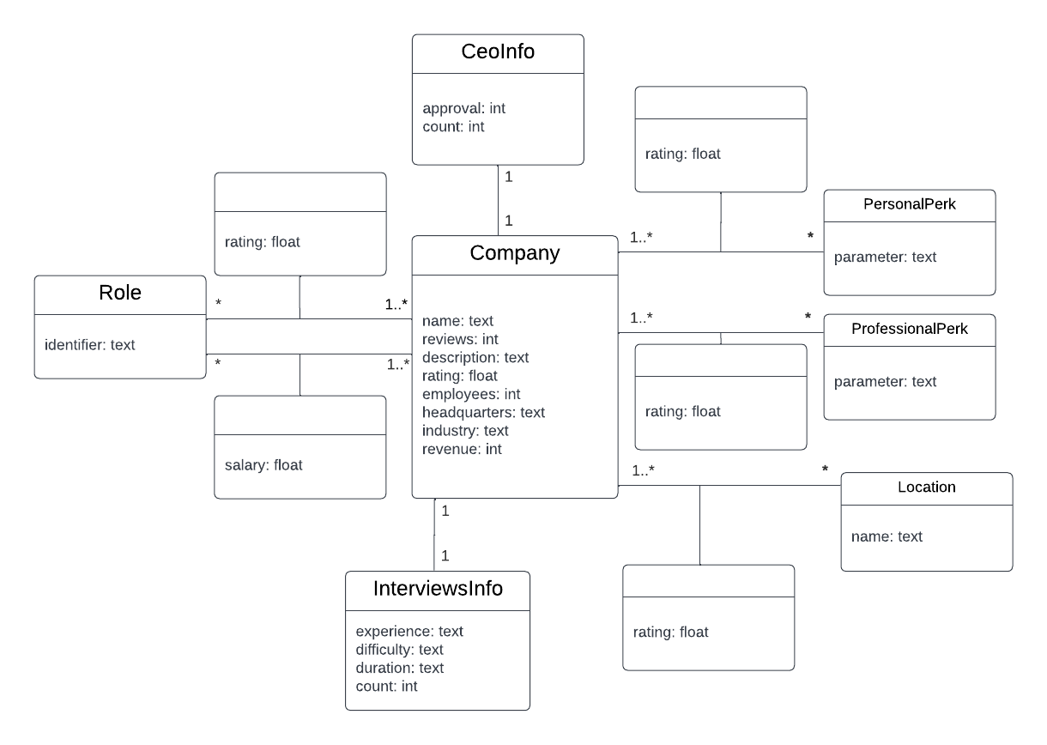
Conceptual Model of the Dataset

Slide 3



Document Based System
Reviews
Company reviews dataset in JSON format
Tool selected for information retrieval
Single collection of company reviews (core)

Slide 4
Indexing: Defined Types
regularText: written text, usually carrying a considerable amount of words.
StandardTokenizerFactory
ASCIIFoldingFilterFactory, LowerCaseFilterFactory, PorterStemFilterFactory, StopFilterFactory, SynonymGraphFilterFactory, RemoveDuplicatesTokenFilterFactory
categoricText: textual fields representing categories, such as names of entities or genres.
StandardTokenizerFactory
ASCIIFoldingFilterFactory, LowerCaseFilterFactory
ratingValue and percentage: double values used for the different ratings and percentages the dataset.
countable and enumerable: integer values used for whole numbers with real meaning (e.g. number of ratings) or fields holding categorical information in the form of numbers.

Slide 5
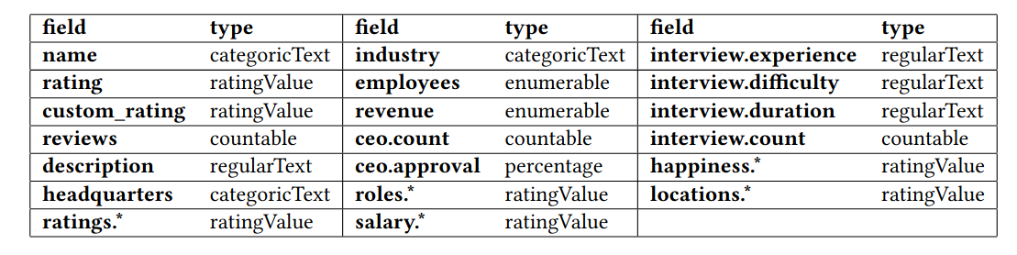
Indexing: Schema Fields
The reviews.count, ceo.count, and interview.count fields do not require indexing, since they do not represent information useful for the user to query by.
Since every field from the dataset has relevant information for the user, the stored attribute is enabled in all of them.

Slide 6
Live Demo, let's jump into Solr!

Slide 7
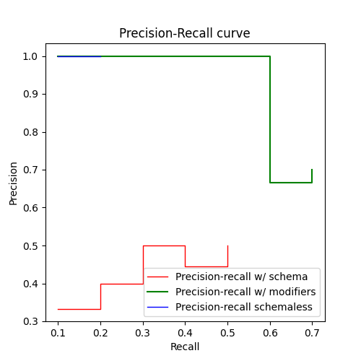
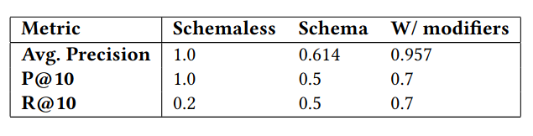
Evaluation of Search Results
A user wants to find companies working in the industry of telecommunications.
Query: Telecommunications

Slide 8
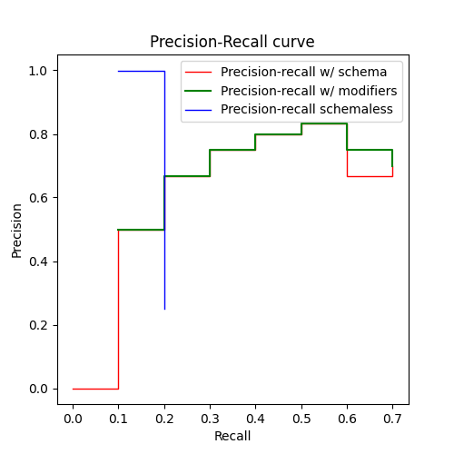
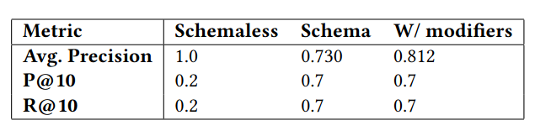
Evaluation of Search Results
A user wants to find companies working in the financial technology industry that have more than 5000 employees (categorical value of 8 or more).
Query: Financial Technology (employees: [8 TO *])

Slide 9
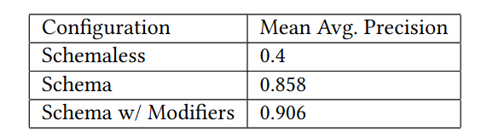
Evaluation of Search Results
Mean average precision for the three systems tested in the evaluation process:

Slide 10
Future Work
Review Iteration
Review if the work done on Iteration 2 is ready for the following stages
Improve Search System
Experiment with more boosts and modifiers. Create additional information needs.
Product enhancement for the end user
Develop a friendly user interface to interact with the system

