Slide 1

Retrieving and Processing Information on Company Reviews
PRI, group 69
Bruno Rosendo, up201906334
João Mesquita , up201906682
Rui Alves, up201905853
Professor:
Sara Fernandes

Slide 2
Dataset
Name | Rating | Description | Happiness | CEO Approval | Ratings | Roles | Salary | industry
VeriFone | 3.4 | Verifone is an American multinational corporation… | {} | 57% | {'Work Balance': '3.4', 'Compensation': '3.5', 'Management': '2.9’, …} | {'Software Engineer': '4.6', 'Sales Executive': '4.0’, …} | {'Software Engineer': '$117,979 per year', 'Project Manager': '$70,874 per year’, …} | Manufacturing
Sitel |  | Sitel Groups 75,000 people across the globe to connect many… | {'Happiness': '55', 'Learning': '62', 'Support': '60', 'Compensation': '60’, … } | 70% | {'Work Balance': ‘2.7', 'Compensation': ‘3.9', 'Management': ‘2.1’, …} | {'Tier 1 Agent': '4.6', Director of Finance': '4.0’, …} | {'Agent': '$11.72 per hour', 'Project Manager': $14.48 per hour’, …} | Telecommuni-cations
YMCA | 4 | YMCA of the USA is the national resource office… | {'Flexibility': '79', 'Purpose': '79', 'Appreciation': '77', 'Achievement': '77’, …} | 83% | {} | {} | {'Camp Counselor': ‘$2,063 per month', 'Lifeguard': '$10.02 per hour’, …} | Nonprofit & NGO

Slide 3
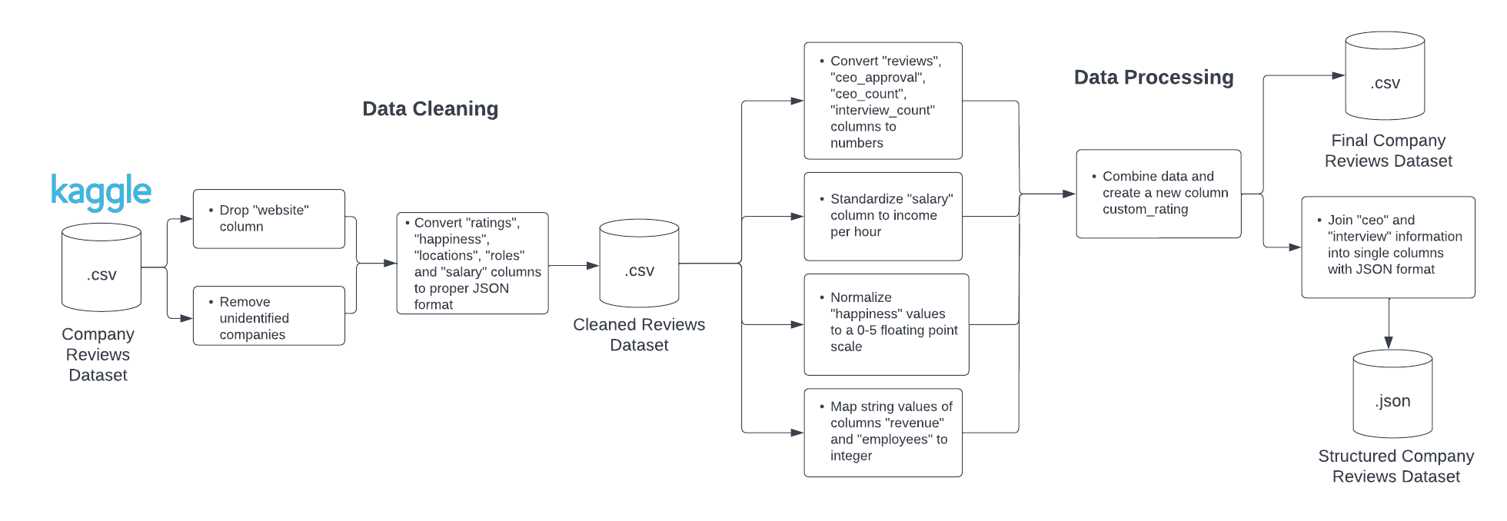
Pipeline

Slide 4
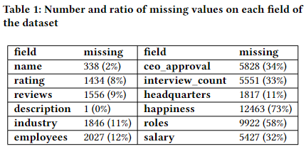
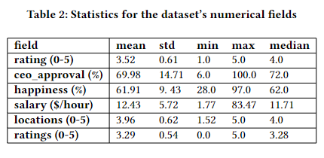
Data Characterization

Slide 5
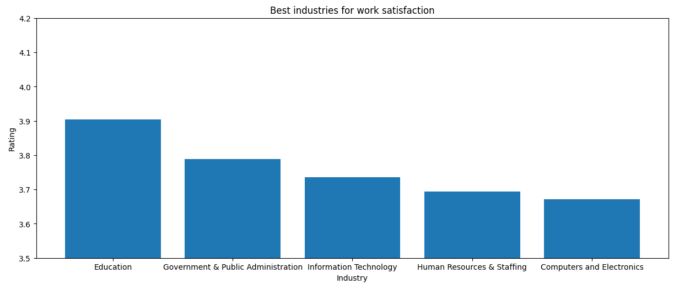
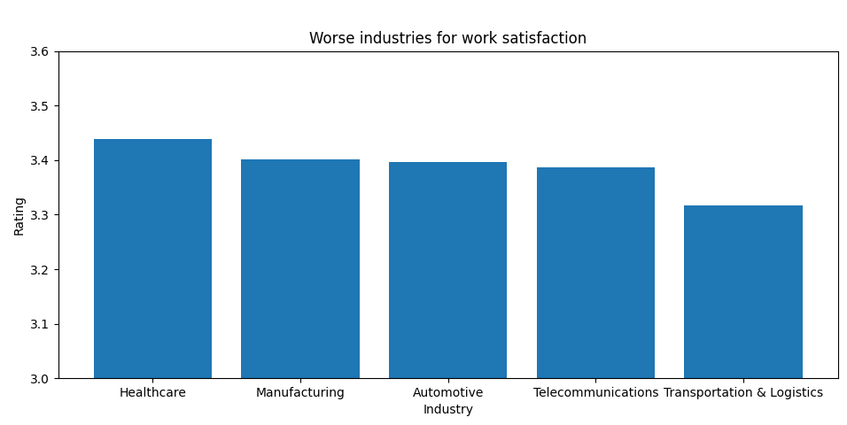
Data Characterization

Slide 6
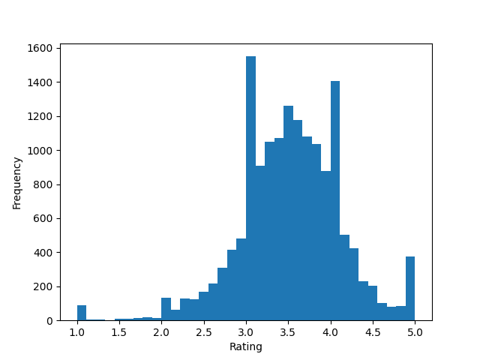
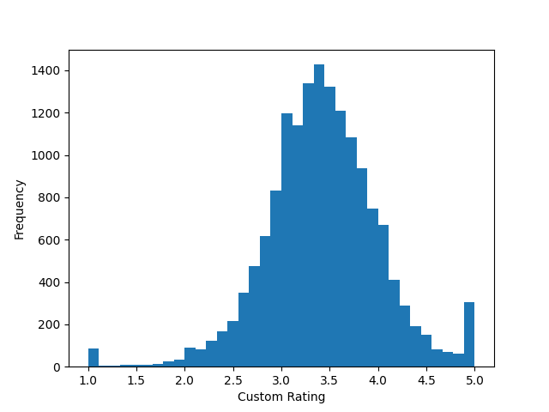
Data Characterization
Rating
Custom Rating
V.S

Slide 7
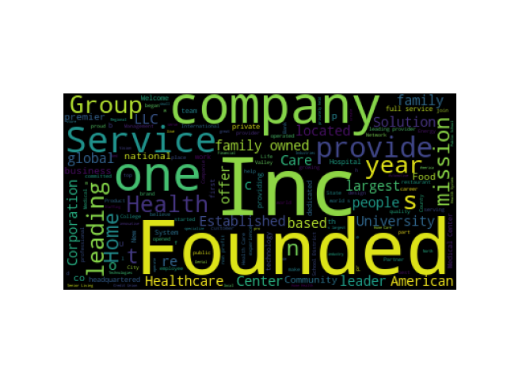
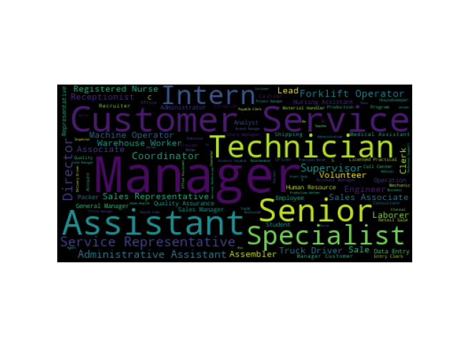
Data Characterization
Description
Roles

Slide 8
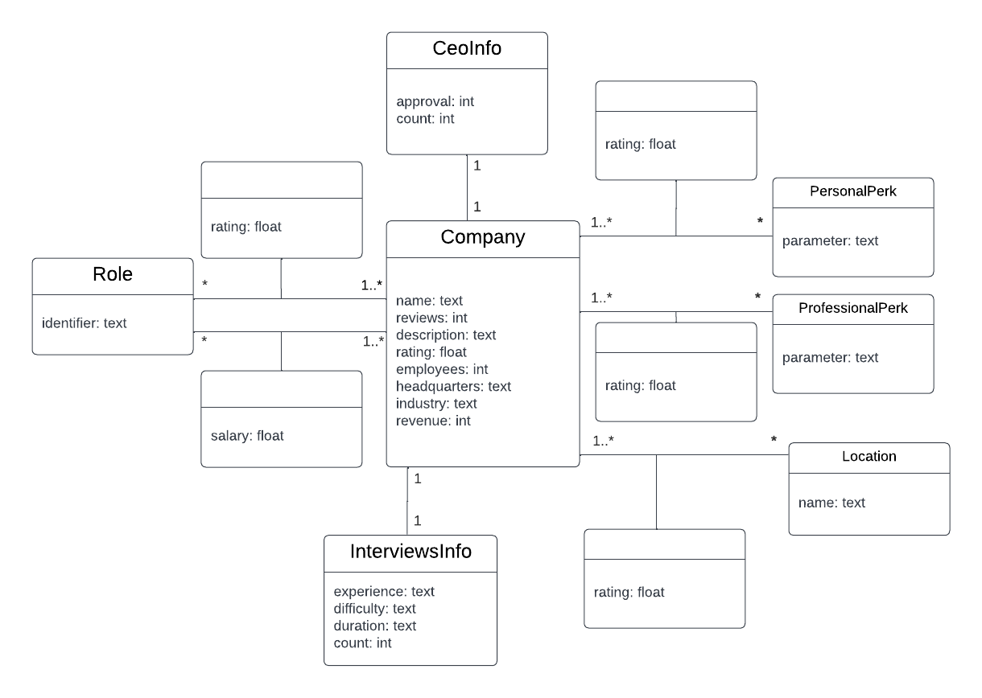
Conceptual Model of the Final Dataset

Slide 9
Future Work
Review Iteration
Review if the work done on Iteration 1 is ready for the following stages
Retrieve Information
Use of an information retrieval tool on the dataset and its exploration with free-text queries
Create Search System
Create a search system based on the dataset

