Slide 1

Retrieving and Processing Information on Company Reviews
PRI, group 69
Bruno Rosendo, up201906334
João Mesquita , up201906682
Rui Alves, up201905853
Professor:
Sara Fernandes

Slide 2
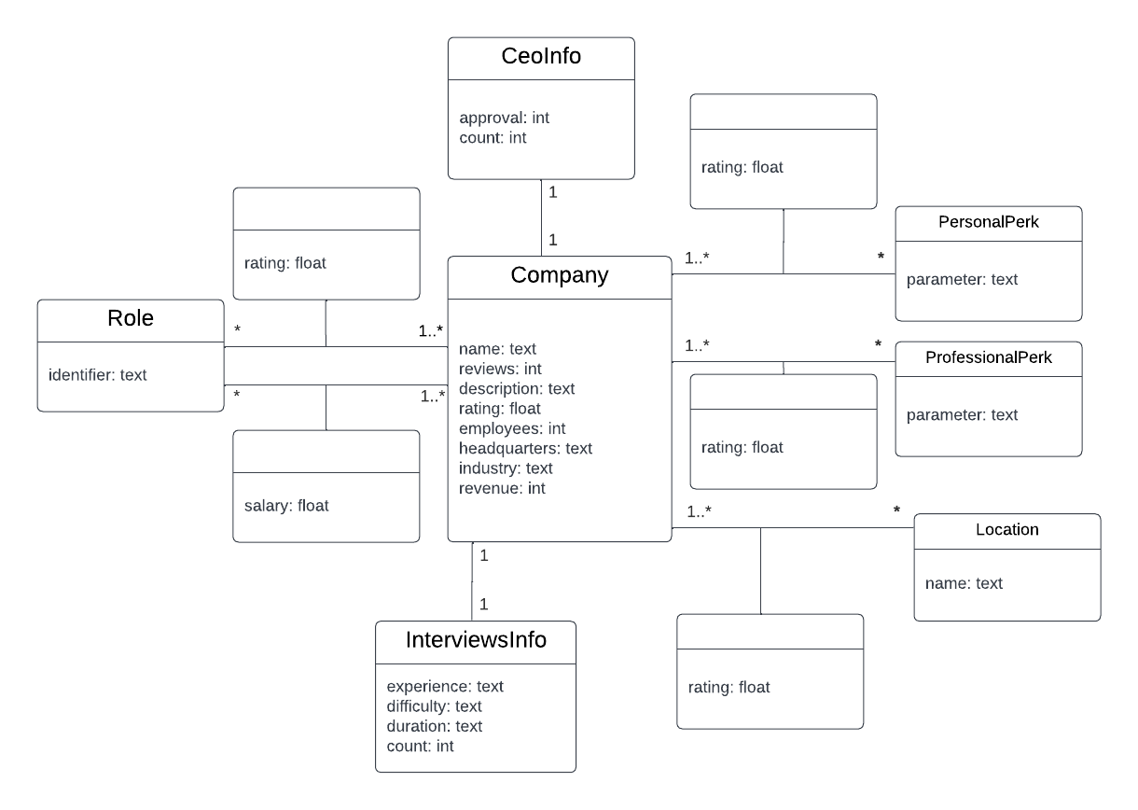
Conceptual Model of the Dataset

Slide 3
Search System Improvements
Improved list of synonyms.
Faceted search.
Spell-checking.
Suggestion of queries.
Appealing user interface (frontend) to improve the experience in the system.
Enhancements in previous iterations (data analysis, information retrieval and results evaluation).

Slide 4




Improved List of Synonyms
WordNet, a digital lexical database for English
Python script uses WordNet's API to generate a custom list of synonyms
New and improved list of synonyms
List is uploaded into Solr's configuration

Slide 5
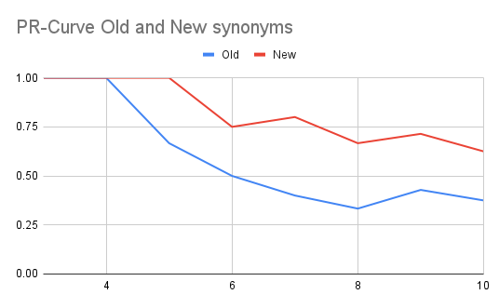
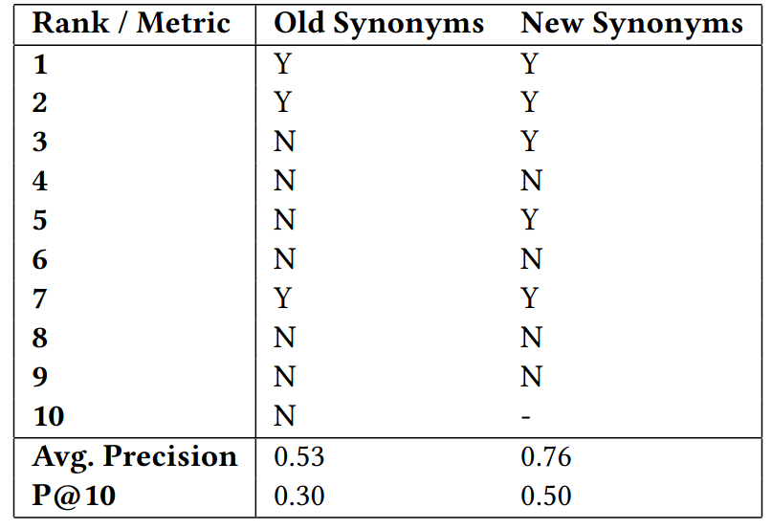
Improved List of Synonyms
Let's test the new system by searching for companies involved with panic support and management (query: "panic").

Slide 6
Spell-Checking
Spell-checking allows the users to be informed of possible typos they might write in their queries.
IndexBasedSpellChecker was used in the company's description, the field with the most text density.
Response:
"suggestions":[ "tecknology",{ "numFound":1, "startOffset":0, "endOffset":10, "suggestion":["technology"]
} ]
Request:
/solr/reviews/spellcheck?q=tecknology

Slide 7
Query Suggestions
Suggestions areuseful to display suggestions while the user is typing their query, identically to what happens in a Google search.
FreeTextLookupFactory was used as an auto-complete that recommends words (from the description field) when the user starts writing them.
Response:
"suggest":{"reviewsSuggester":{ "tech":{ "numFound":10, "suggestions":[{ "term":"technology", "weight":10745044845232370, "payload":""}, ... { "term":"techlogix", "weight":118948835925081, "payload":""}]} }}
Request:
/solr/reviews/suggest?q=tech

Slide 8
Faceted Search
Faceting is the arrangement of search results into categories based on indexed terms
In this system, many categorical values benefit from this functionality: industry, employees, revenue, interview experience and interview difficulty.
Response:
"facet_counts":{ "facet_fields":{ "industry":[
"healthcare",439, "services",281,
... "transportation",74]}, "facet_heatmaps":{}} }
Request:
/solr/reviews/select?q=*:*&facet=true& facet.field=industry&facet.limit=10

Slide 9


User Interface
The final focus was on enhancing the experience for the end user so that anybody can use the system without technical background.
The UI was developed using React and MaterialUI, with Solr as the backend.

Slide 10
Live Demo, let's jump into the Website!

Slide 11
Future Work
Enhance UI
Improve the User Interface by, for example, integrating faceted search and spell-checking.
Improve Information Retrieval
Improve the system even more by means of machine learning models that train with data from active users
Create User Accounts
Allow users to save their favorite reviews and have personalized search results.

