Slide 1
Fake Social - Decentralized Timeline
Large Scale Distributed Systems
Bruno Rosendo, up201906334
Henrique Nunes, up201906852
João Mesquita, up201906682
Rui Alves, up201905853

Slide 2




Technologies used
Frontend
Backend

Slide 3
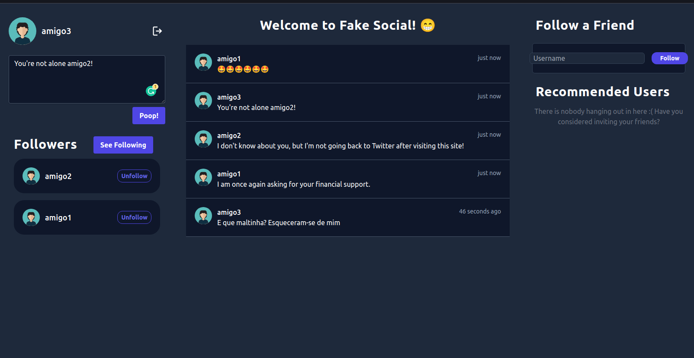
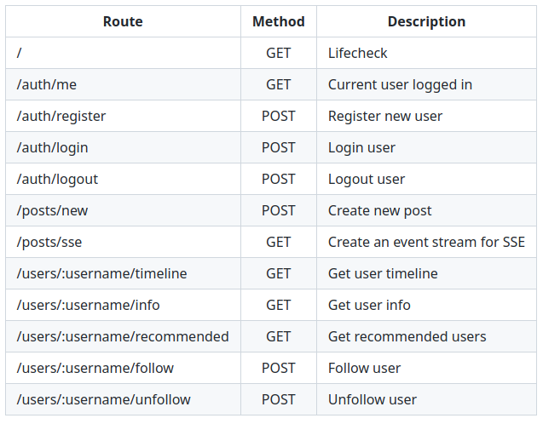
Application design
Backend
API to handle client requests and execute the respective protocols.
Frontend
Login/Register.
Side panel with followers and following.
Side panel with recommended users.
User timeline & User profile.

Slide 4
Libp2p
Transport (TCP, Noise, Mplex)
Encrypted: Connections must be end-to-end encrypted, so we use noise protocol of chainsafe/libp2p-noise.
Multiplexed: Multiplex multiple reliable streams over a single reliable transport connection.
Peer/Content Routing
Kademlia DHT: Distributed hash table used for content and peer routing.
Peer Discovery
Bootstrap: Nodes with known addresses that accept connections from the application nodes and allow them to join the network and find other existing and upcoming nodes.
MulticastDNS: Used to find nodes in our network and that are not connected to the bootstrap nodes.
Publish/Subscribe
Gossip PubSub: Peers gossip about messages they have recently seen through lightweight metadata messages. This allows other nodes to notice whether they missed a message on the full-message network.

Slide 5
Data and Storage
USER RECORD
{
"followers":["amigo2","amigo1"],
"following":[“amigo3”],
"posts":[{"username":"amigo3","text":"E que maltinha? Esqueceram-se de mim\n","timestamp":1670933663549}]
}
Local Storage:
Each node locally saves its own and followed users’ records.
DHT:
All registered accounts.
Trackers to indicate which peers provide a desired Record.

Slide 6
Garbage Collection
STORAGE LIMIT
TIME LIMIT
Each user only stores up to 100 posts for each followed user. When this limit is reached, the older post is removed.
Periodically, each node checks for posts older than 24 hours and removes them from local storage.

Slide 7
Pub/Sub Topics
FOLLOWED
Notify followers upon a follow action.
UNFOLLOWED
Notify followers upon an unfollow action.
WAS FOLLOWED
Notify followers when the user was followed.
WAS UNFOLLOWED
Notify followers when the user was unfollowed.
POST
Notify followers when the user has a new post.

Slide 8
Records merging algorithm
{
posts: [p1, p2, p3],
followers: [],
following: [u1]
}
{
posts: [p1, p2],
followers: [u1, u2],
following: [u1]
}
{
posts: [p1, p3],
followers: [u1, u2],
following: [u1]
}
When requested, a peer tries to fetch a user record (posts, followers and following) from a maximum number of providers.
Merge the fetched profiles by using a Majority Voting Algorithm for each field.
{
posts: [p1, p2, p3],
followers: [u1, u2],
following: [u1]
}

Slide 9
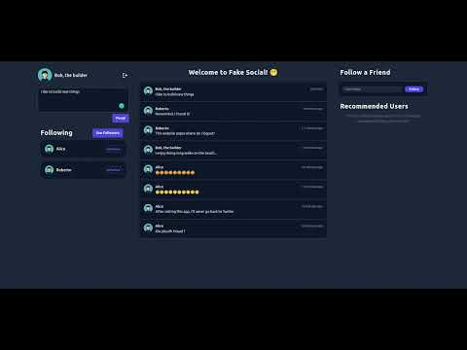
DEMO

Slide 10
Future Work
1
2
3
4
New topic for User Advertisement
UI/UX Upgrade
Server-Sent Events
Improve the Merging Algorithm
Alternative way of discovering other users to avoid manually inserting the username.
Improve the user experience, based on the observations made by the users.
Add automatic updates for other events, such as follow actions and suggested users.
Test our system under more extreme conditions to validate its stability.

