Slide 1
Mono: Developing and Deploying Microsoft .Net Applications for Linux
  Karl Bunnell
  Software Engineer Consultant, Novell Inc.
  kbunnell@novell.com

Slide 2
The one Net vision
:
:
:
Novell exteNd™
Novell Nsure™
Novell Nterprise™
Novell NgageSM
:
one Net: Information without boundaries…where the right people are connected with the right information
at the right time to make the right decisions.
Notes:
This represents our one Net vision. As a company, we are committed to providing solutions to your business problems based on the fulfillment of this strategic framework. Since we announced one Net in 1999, we have been working to identify and develop the technologies, products and solution suites that make the vision a reality for our customers. One Net brings you closer to a world where networks of all types work together seamlessly, so you can connect employees, customers, suppliers and partners across organizational boundaries – and give them faster, easier and more secure access to all the information and resources they need, when and where they need it. And our fulfillment of the one Net strategic framework translates directly into business solutions that offer more opportunity, higher ROI and closer, more productive relationships with you and everyone who matters to your business.
Let’s take a brief tour of one Net to help set the context for our discussion today.
Starting in the center, our Ngage teams employ proven methodologies and expertise, training, and support at all levels of your organization to facilitate the design, development and deployment of secure, scalable business solutions.
Novell exteNd, our integrated development environment for the creation of Web services-based solutions help transform rigid “silo” applications into personalized, standards-based, process-driven secure Web solutions.
Novell Nsure, our secure identity management solutions family, delivers your enterprise resources and business information based on who people are and what they need, wherever they need it.
Novell Nterprise, our cross platform network services suites, add invaluable capabilities to all kinds of mixed networks and diverse infrastructures. Nterprise solutions are the embodiment of this philosophy. We will deliver and support the services on the platforms our customers and the market demand. Today and in the foreseeable future, Linux running on Intel is the platform the market and our customers are demanding.

Slide 3
The one Net vision
:
:
:
Novell exteNd™
Novell Nsure™
Novell Nterprise™
Novell NgageSM
:
Novell Nterprise™
Novell Nterprise is an innovative family of products which gives you the power to enable and manage the constant interaction of people with your business systems — regardless of who they are or where they are.
Notes:
This represents our one Net vision. As a company, we are committed to providing solutions to your business problems based on the fulfillment of this strategic framework. Since we announced one Net in 1999, we have been working to identify and develop the technologies, products and solution suites that make the vision a reality for our customers. One Net brings you closer to a world where networks of all types work together seamlessly, so you can connect employees, customers, suppliers and partners across organizational boundaries – and give them faster, easier and more secure access to all the information and resources they need, when and where they need it. And our fulfillment of the one Net strategic framework translates directly into business solutions that offer more opportunity, higher ROI and closer, more productive relationships with you and everyone who matters to your business.
Let’s take a brief tour of one Net to help set the context for our discussion today.
Starting in the center, our Ngage teams employ proven methodologies and expertise, training, and support at all levels of your organization to facilitate the design, development and deployment of secure, scalable business solutions.
Novell exteNd, our integrated development environment for the creation of Web services-based solutions help transform rigid “silo” applications into personalized, standards-based, process-driven secure Web solutions.
Novell Nsure, our secure identity management solutions family, delivers your enterprise resources and business information based on who people are and what they need, wherever they need it.
Novell Nterprise, our cross platform network services suites, add invaluable capabilities to all kinds of mixed networks and diverse infrastructures. Nterprise solutions are the embodiment of this philosophy. We will deliver and support the services on the platforms our customers and the market demand. Today and in the foreseeable future, Linux running on Intel is the platform the market and our customers are demanding.

Slide 4
Mono Overview

Slide 5

What is Mono?
An Open Source .NET Framework Implementation.
  Effort lead by Ximian, launched in July 2001
  100 contributors, ~30 very active
Goals
  Bring the .NET Framework to Unix
  Virtual Execution System
  Class Libraries compatible with .NET Framework
  CLI compliant execution system.
  Just-in-time compiler on x86 systems.
  Multi-platform (Linux, Solaris, BSD, Windows)
Notes:
Background.
The GNOME project goal was to bring missing technologies to Unix and make it competitive in the current market place for desktop applications. We also realized early on that language independence was important, and that is why GNOME APIs were coded using a standard that allowed the APIs to be easily wrapped for other languages. Our APIs are available to most programming languages on Unix (Perl, Python, Scheme, C++, Objective-C, Ada).
The Common Language Infrastructure platform.
Microsoft has created a new development platform. The highlights of this new development platform are:
A runtime environment that provides garbage collection, threading and a virtual machine specification (The Virtual Execution System, VES)
A comprehensive class library.
A new language, C#. Very similar to Java, C# allows programmers to use all the features available on the .NET runtime.
A language specification that compilers can follow if they want to generate classes and code that can interoperate with other programming languages (The Common Language Specification: CLS)
The Common Language Infrastructure platform is similar to the goals we had in GNOME of giving language independence to programmers. It is more mature, documented, larger in scope, and has a consistent design.
Any API that is written using a CLS provider language can be used by any language that is a CLS consumer. Compilers generate code in a format called Common Intermediate Language (CIL) which is an intermediate representation of a compiled program and is easy to compile to native code or compiled using Just-in-Time (JIT) engines. The restrictions placed by the runtime on the CIL byte codes ensures that it is possible to do a good job at optimizing the code in a JIT compiler.
There is not really a lot of innovation in this platform: we have seen all of these concepts before, and we are all familiar with how these things work.
What makes the Common Language Infrastructure development platform interesting is that it is a good mix of technologies that have been nicely integrated.
The .NET development platform is essentially a new foundation for program development that gives Microsoft a room to grow for the coming years.
Why use GNOME components?
GNOME is an umbrella project that consists of infrastructural components (GUI toolkit, XML libraries, CORBA implementation, printing architecture, imaging system), a desktop environment, and productivity applications.
The GNOME infrastructural components can be used to quickly implement various pieces of the class libraries without reinventing the wheel, and since all those components are licensed under the terms of the GNU LGPL it is a perfect fit.
Libart will be used to implement the Drawing.2D API; Gtk+ and the GNOME libraries will be used to implement the WinForms API and of course Glib and libxml will be used in various places

Slide 6
Mono Platforms
Mono currently supports:
  Unix:
    X86: Linux, xxxBSD
    PPC: Linux
    StrongARM: Linux
    Sparc: Linux and Solaris
    S390: Linux.
  Windows NT:
    NT and XP (x86)
  Windows 9x core.
JIT: x86 at this point only.

Slide 7

What Exactly Does Mono Include?
Runtime (Embedded)
Classes
Gtk#
ASP.NET
ADO.NET
C# Compiler
VB Compiler
Notes:
What makes up Mono?
There are various pieces that make up Mono today:
A C# compiler.
The Virtual Execution System: that has the Just-in-Time compiler, garbage collector, loader, threading engine. A byte code interpreter is provided for quickly porting Mono to new systems and debugging the JIT purposes, but it is not intended to be the ideal execution environment.
An implemenation of the .NET class libraries: Remoting, Reflection, Reflection.Emit, Xml, Xpath, Xslt, Xml Serialization, Web Services support.
Cross platform class libraries for data access: Postgress, MySQL, DB2, TDS, Sybase, Oracle, ODBC and Gnome's GDA.
Unix class libraries: Mono.Posix
Gnome-specific class libraries: The Gtk# family.
A code pre-compiler to generate native code ahead of time.
Gtk# a toolkit to develop GNOME applications on Unix and Windows.
An implementation of the Remoting infrastructure in .NET
Other work-in-progress components:
A VB.NET compiler and JScript compilers are in the works.
Web services on the server side.
We are planning to include Remoting.CORBA as part of Mono standard distribution.
Why use GNOME components?
GNOME is an umbrella project that consists of infrastructural components (GUI toolkit, XML libraries, CORBA implementation, printing architecture, imaging system), a desktop environment, and productivity applications.
The GNOME infrastructural components can be used to quickly implement various pieces of the class libraries without reinventing the wheel, and since all those components are licensed under the terms of the GNU LGPL it is a perfect fit.
Libart will be used to implement the Drawing.2D API; Gtk+ and the GNOME libraries will be used to implement the WinForms API and of course Glib and libxml will be used in various places

Slide 8
The Mono Runtime
Runtime: compatible with the .Net runtime
  Mono
    Our Just-in-Time and Ahead-of-Time code generator for maximum performance.
  Mint
    The Mono interpreter. This is an easy-to-port runtime engine.
Just-in-Time Engine
  Written their own JIT compiler
    Ahead-of-time compilation
    Have a good platform for doing code optimizations
    Reduce the effort required to port the Mono code generator to new architectures
Notes:
The Mono runtime
The Mono runtime engine is considered feature complete.
It implements a Just-in-Time compiler engine for the CIL virtual machine, the class loader, the garbage collector, threading system and metadata
access libraries.
We currently have two runtimes:
mono: Our Just-in-Time and Ahead-of-Time code generator for maximum performance.
mint: The Mono interpreter. This is an easy-to-port runtime engine.
We are using the Boehm conservative garbage collector.
The Mono runtime can be used as a stand-alone process, or it can be embedded into applications (see the documentation in mono/samples/embed
for more details).
Embedding the Mono runtime allows applications to be extended in C# while reusing all of the existing C and C++ code.
Paolo Molaro did a presentation on the current JIT engine and the new JIT engine. You can find his slides here

Slide 9
The Mono Runtime
Garbage Collection
  Using the Boehm conservative GC
IO and threading
  IO model and a threading model that is very similar to the Win32 API.
Notes:
The Mono runtime
The Mono runtime engine is considered feature complete.
It implements a Just-in-Time compiler engine for the CIL virtual machine, the class loader, the garbage collector, threading system and metadata
access libraries.
We currently have two runtimes:
mono: Our Just-in-Time and Ahead-of-Time code generator for maximum performance.
mint: The Mono interpreter. This is an easy-to-port runtime engine.
We are using the Boehm conservative garbage collector.
The Mono runtime can be used as a stand-alone process, or it can be embedded into applications (see the documentation in mono/samples/embed
for more details).
Embedding the Mono runtime allows applications to be extended in C# while reusing all of the existing C and C++ code.
Paolo Molaro did a presentation on the current JIT engine and the new JIT engine. You can find his slides here

Slide 10

Class Libraries
Should be compatible with Microsoft's .NET implementation
Classes in Mono are organized by the assembly that they belong to
  corlib: The core library.
  System: Extra modules
  System.Xml.
  System.Data: Database access functionality
  System.Drawing.
  System.Web: ASP.NET classes
  System.Web.Services.
  Microsoft.VisualBasic: Support runtime for Visual Basic Windows.Forms:
  System.Runtime.Serialization.Formatters.Soap.
  System.Security: Xml Signature Security classes
Notes:
The Class Library
The Class Library should be compatible with Microsoft's .NET implementation.
Please see the Class Status page for a status of who is working on which classes. We will write as much code as possible in C#.
We may need to interface with code written in C to gain access to the functionality of libraries like libart, Gtk+, and libc.

Slide 11
Gtk#
Gtk# is a .Net language binding for the gtk+ toolkit and assorted GNOME libraries.
  Brings the power and ease of .Net development
  Provides a C source parser and C# code generator
    Produce .Net assemblies that bind to GObject based libraries.
  Currently wrapped libraries
gtk
gnomedb
gdk
gconf
atk
libgnomecanvas
pango
libgnomeui
gda
libglade
Notes:
Gtk#
Gtk# (Gtk sharp) is a set of C# language bindings for the Gtk+ toolkit and other libraries that are part of the GNOME platform .
GTK# On Linux
Where to get distributions of GTK# for Linux:
RPMs
Debs
Buidling on Linux:
Get GTK# source from Gtk# Project.
run ./autogen.sh --prefix=my_mono_installation_prefix
make
make install

Slide 12

ASP.NET
ASP
ASP.NET supports
  Web Forms (Web Applications infrastructure)
  Web Services (the SOAP-based rpc system)
ASP.NET works with
  XSP
    A light-weight C# web server that runs ASP.NET applications
  Mod_mono
    An apache module that can host the Mono runtime and the ASP.NET runtime
Limited to C# for the server-side-scripts
Notes:
ASP.NET
ASP.NET support is divided in two pieces:
Web Forms (Web Applications infrastructure).
Web Services (the SOAP-based rpc system).
Both are functional at this point, and applications like "IBuySpy" run with Mono.
ASP.NET works either embedded into our XSP server test server or the mod_mono Apache module.
We are now working on bug fixing and adding missing features after making the whole pipeline compatible with MS.
Tim started work on the Web Services. After that, Lluis is in charge and has been working hard on them as part of our SourceGear contract. Web services are now supported and there are some samples in the XSP set of tests.
Hosting
ASP.NET provides a hosting interface. Today we ship support for two different hosting mechanisms:
XSP: A light-weight C# web server.
mod_mono: An apache module that can host the Mono runtime and the ASP.NET runtime
XSP
XSP is a simple web server written in C# that can be used to run your ASP.NET applications. The code is available from our download page or from the Anonymous CVS repository (module name: xsp)/. This is where initial development of the .aspx/.ascx/.asax compiler to C# took place. That compiler is now integrated in System.Web classes mostly under System.Web.Compilation namespace. We added a new web server that works with mono and MS runtime and is being used to debug our classes. It resides in xsp/server.
A couple of classes of this new server can be reused/extended to make an apache module/cgi using mono (MonoWorkerRequest and MonoApplicationHost). This server also uses a couple of plugins distributed with Mono to support gzip HTTP transfers.
There is also a set of .aspx pages to test the server along with a few user controls under xsp/test.
You can check it out from CVS and run 'make install' to test it.
mod_mono
This Apache module is available from our download page. The cvs module name is mod_mono. It works with both 1.3 and 2.0 versions of the apache server.
It allows apache to serve ASP.NET pages.
Work is underway to improve it.

Slide 13
ASP.NET - Execution Model
VB
C#
C++
Source Code
Unmanaged Component
Compiler
Compiler
Compiler
Managed Code
Assembly
IL Code
Assembly
IL Code
Assembly
IL Code
Common Language Runtime
JIT Compiler
Native Code
Operating System Services

Slide 14
ADO.NET
ADO
ADO.NET Data Providers
Mono has many ADO.NET Data Providers to get you connected:
  IBM DB2 Universal Database
  MySQL
  ODBC
  Oracle
  OLE DB
  PostgreSQL
  Microsoft SQL Server
  SQL Lite
  Sybase
  TDS Generic
Notes:
ADO.NET
Data Access in Mono
Today, our goal is to be compatible with .NET 1.0 and .NET 1.1. We also would like to extend data access beyond what is included with .NET 1.0 and .NET 1.1, such as, including access to more databases, such as, PostgreSQL and MySQL, but also provide classes that help in creating data source-agnostic code, such as, Mono.Data.ProviderFactory.
In the future, we would like to be compatible with .NET 1.2. This would include features like:
ObjectSpaces
provide support for hosting Mono languages (C-Sharp, MonoBASIC, etc...) within a DBMS engine, such as, MySQL or PostgreSQL.
implement .net 1.2 classes, such as, those found in System.Data.ProviderBase
other stuff which can be brought up on the mono-list

Slide 15
C# Compiler
C# Compiler
C# Compiler (mcs)
  Written in C#
  Considered feature complete
  MCS is able to compile itself
Mono Debugger
  Written in C#
    Implements its own debugging framework.
    Debugging classes, multiple front-ends.
  Multi-language debugger
    Can debug .NET applications.
    Can debug native Unix applications.
  New GUI front-end for the debugger
Notes:
MCS: The Ximian C# compiler
The Mono C# compiler is considered feature complete at this point and relatively mature. MCS is able to compile itself and many more C# programs (there is a test suite included that you can use). It is routinely used to compile Mono, roughly half a million lines of C# code.

Slide 16
VB Compiler
VB Compiler
Mono's Basic.NET (mbas)
  CIL compiler of the Visual Basic language
  Extended version of VisualBasic.NET
  Based on the MCS compiler
  Still under development
Notes:
mbas: Mono's Basic.NET Compiler.
MBAS is a CIL compiler for the Visual Basic language, an extended version of VisualBasic.NET. It's based on the MCS compiler and still in heavy development, though many language features are already supported.

Slide 17
Summary
Mono Development Tools:
C# Compiler, Debugger, Profiling.
.NET Classes:
Core + XML
ADO.NET
ASP.NET
Mono Classes:
Gtk#: Gtk, Gnome, A11n, Media
PEToolkit
Mono Runtime
JIT, Loader, Verifier
Threads, I/O
GC
Native Platform (x86, SPARC, PPC, StrongARM, S390)

Slide 18

Mono Project Resources
Mono:
  http://www.go-mono.com
  http://www.go-mono.com/download.html
GNOME project:
  http://www.gnome.org

Slide 19
ASP.NET Primer

Slide 20


What is ASP?
ASP
ASP is a server side scripting technology that enables scripts (embedded in web pages) to be executed by an Internet server.
  ASP is a Microsoft Technology
  ASP stands for Active Server Pages
  Also known as Classic ASP
  ASP is a program that runs inside IIS
  IIS stands for Internet Information Services
  PWS is a smaller - but fully functional - version of IIS
  PWS can be found on your Windows 95/98 CD

Slide 21
What is an ASP File?
ASP
  An ASP file is just the same as an HTML file
  An ASP file can contain text, HTML, XML, and scripts
  Scripts in an ASP file are executed on the server
  An ASP file has a .asp extension

Slide 22
How Does it Work?
ASP
  When a browser requests an HTML file, the server returns the file
  When a browser requests an ASP file, IIS passes the request to ASP
  ASP engine reads the file, line by line, and executes the scripts in the file
  Finally, the ASP file is returned to the browser as plain HTML

Slide 23

What is ASP+?
ASP
  ASP+ is the same as ASP .NET.
  ASP+ is just an early name used by Microsoft when they developed ASP .NET.

Slide 24

What is ASP .NET?
  ASP 3.0 is the latest version of ASP, but there will never be an ASP 4.0 version
  ASP .NET is the next generation ASP, but it's not an upgraded version of ASP.
  ASP .NET is an entirely new paradigm for server-side ASP scripting.
  ASP .NET is a part of the new .NET (dotnet) Framework. Microsoft spent three years rewriting ASP .NET from the ground up, and ASP .NET is not fully backward compatible with ASP 3.0.
ASP .NET

Slide 25

.NET Framework
ASP .NET
  Is a common environment for building, deploying, and running Web applications and Web Services.
  Contains a common language runtime and common class libraries - like ADO .NET, ASP .NET and Windows Forms.
  Currently it supports C++, C#, Visual Basic, and JScript (The Microsoft version of JavaScript).
  Microsoft's Visual Studio.NET is a common development environment for the new .NET Framework.

Slide 26
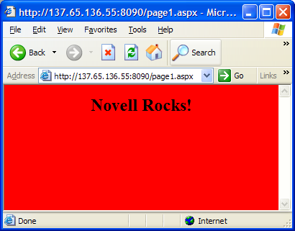
ASP .Net Pages
A simple ASP .NET page looks just like an ordinary HTML page
  <html>
  <body bgcolor=“red">
  <center>
  <h2>Novell Rocks!</h2>
  </center>
  </body>
  </html>

Slide 27
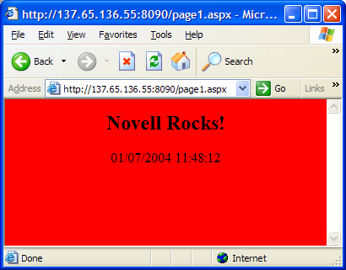
Dynamic Page in ASP .NET
The code inside the <% --%> tags is executed on the server.
  <html>
  <body bgcolor="red">
  <center>
  <h2>Novell Rocks!</h2>
  <p><%=DateTime.Now%></p>
  </center>
  </body>
  </html>

Slide 28
ASP .NET – Server Controls
With Classic ASP it is impossible to separate executable code from the HTML itself.
ASP .NET has solves this problem with server control tags that are understood by the server.
ASP .NET
  There are three kinds of server controls
    HTML Server Controls - Traditional HTML tags
    Web Server Controls - New ASP .NET tags
    Validation Server Controls - For input validation
1
2
3

Slide 29
ASP .NET – HTML Server Controls
1
Are HTML tags understood by the server.
Add a runat="server" attribute to the HTML element. This attribute indicates that the element should be treated as a server control. The id attribute is added to identify the server control. The id reference can be used to manipulate the server control at run time.
All HTML server controls must be within a <form> tag with the runat="server" attribute. The runat="server" attribute indicates that the form should be processed on the server. It also indicates that the enclosed controls can be accessed by server scripts.

Slide 30
ASP .NET
HTML Server Controls Example
<script runat="server">
void Page_Load (Object obj, EventArgs e) {
link1.HRef=“http://www.novell.com”;
}
</script>
<html>
<body>
<form runat="server">
<a id="link1" runat="server">Visit Novell!</a>
</form>
</body>
</html>

Slide 31
HTML Server Control Description
HTML
HtmlAnchor Controls an <a> HTML element
HtmlButton Controls a <button> HTML element
HtmlForm Controls a <form> HTML element
HtmlGeneric Controls other HTML element not specified by a specific HTML server control, like <body>, <div>, <span>, etc.
HtmlImage Controls an <image> HTML element
HtmlInputButton Controls <input type="button">, <input type="submit">, and <input type="reset"> HTML elements
HtmlInputCheckBox Controls an <input type="checkbox"> HTML element
HtmlInputFile Controls an <input type="file"> HTML element
HtmlInputHidden Controls an <input type="hidden"> HTML element
HtmlInputImage Controls an <input type="image"> HTML element
HtmlInputRadioButton Controls an <input type="radio"> HTML element
HtmlInputText Controls <input type="text"> and <input type="password"> HTML elements
HtmlSelect Controls a <select> HTML element
HtmlTable Controls a <table> HTML element
HtmlTableCell Controls <td>and <th> HTML elements
HtmlTableRow Controls a <tr> HTML element
HtmlTextArea Controls a <textarea> HTML element

Slide 32
ASP .NET – Web Server Controls
2
Web server controls are special ASP .NET tags understood by the server.
Like HTML server controls, Web server controls require a runat="server" attribute to work. However, Web server controls do not necessarily map to any existing HTML elements and they may represent more complex elements.
The syntax for creating a Web server control
<asp:control_name id="some_id" runat="server" />

Slide 33
ASP .NET
Web Server Controls Example
<script runat="server">
void submit(object o, EventArgs e) {
button1.Text="You clicked me!" ;
}
</script>
<html>
<body>
<form runat="server">
<asp:Button id="button1" Text="Click me!"
runat="server" OnClick="submit"/>
</form>
</body>
</html>

Slide 34
ASP .NET
Validation Server Controls
3
Are used to validate user-input. Displays an error message if not valid.
Each validation control performs a specific type of validation (like validating against a specific value or a range of values).
By default, page validation is performed when a Button, ImageButton, or LinkButton control is clicked. You can prevent validation when a button control is clicked by setting the CausesValidation property to false.
The syntax for creating a Validation server control is
<asp:control_name id="some_id" runat="server" />

Slide 35
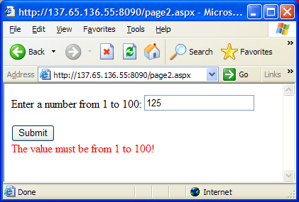
ASP .NET
Validation Server Controls Example
<html>
<body>
<form runat="server">
Enter a number from 1 to 100:
<asp:TextBox id="tbox1" runat="server" /> <br /><br />
<asp:Button Text="Submit" runat="server" /> <br /> <asp:RangeValidator ControlToValidate="tbox1" MinimumValue="1" MaximumValue="100" Type="Integer" EnableClientScript="false" Text="The value must be from 1 to 100!" runat="server" />
</form>
</body>
</html>

Slide 36

Validation Server Control Description
CompareValidator Compares the value of one input control to the value of another input control or to a fixed value
CustomValidator Allows you to write a method to handle the validation of the value entered
RangeValidator Checks that the user enters a value that falls between two values
RegularExpressionValidator Ensures that the value of an input control matches a specified pattern
RequiredFieldValidator Makes an input control a required field
ValidationSummary Displays a report of all validation errors occurred in a Web page

Slide 37
ASP .NET Web Forms
All server controls must appear within a <form> tag, and the <form> tag must contain the runat="server" attribute.
<form runat="server">
...HTML + server controls
</form>
If you specify an action attribute, it is ignored. If you omit the method attribute, it will be set to method="post". If you do not specify the name and id attributes, they are automatically assigned by ASP.NET.
<form name="_ctl0" method="post" action="page.aspx" id="_ctl0">
...some code
</form>

Slide 38
Submitting a Form
A form is most often submitted by clicking on a button.
<asp:Button id="id" text="label" OnClick="sub" runat="server" />
The id attribute defines a unique name for the button and the text attribute assigns a label to the button. The onClick event handler specifies a named subroutine to execute.

Slide 39
Maintaining the ViewState
When a form is submitted in ASP .NET, the form reappears in the browser window together with all form values. This is because ASP .NET maintains your ViewState. The ViewState indicates the status of the page when submitted to the server. The status is defined through a hidden field placed on each page with a <form runat="server"> control.
<form name="_ctl0" method="post" action="page.aspx" id="_ctl0">
<input type="hidden" name="__VIEWSTATE" value="dDwtNTI0ODU5MDE1Ozs+ZBCF2ryjMpeVgUrY2eTj79HNl4Q=" />
.....some code
</form>
If you do NOT want to maintain the ViewState, include the directive <%@ Page EnableViewState="false" %> at the top of an .aspx page or add the attribute EnableViewState="false" to any control.

Slide 40

Web Server Controls
AdRotator Displays a sequence of images
Button Displays a push button
Calendar Displays a calendar
CheckBox Displays a check box
CheckBoxList Creates a multi-selection check box group
DataGrid Displays fields of a data source in a grid
DataList Displays items from a data source by using templates
DropDownList Creates a drop-down list
HyperLink Creates a hyperlink
Image Displays an image
ImageButton Displays a click-able image
Label Displays static content which is programmable
LinkButton Creates a hyperlink button
ListBox Creates a single- or multi-selection drop-down list
Literal Displays static content which is programmable
Panel Provides a container for other controls
PlaceHolder Reserves space for controls added by code
RadioButton Creates a radio button
RadioButtonList Creates a group of radio buttons
Repeater Displays a repeated list of items bound to the control
Table Creates a table
TableCell Creates a table cell
TableRow Creates a table row
TextBox Creates a text box
Xml Displays an XML file or the results of an XSL transform

Slide 41
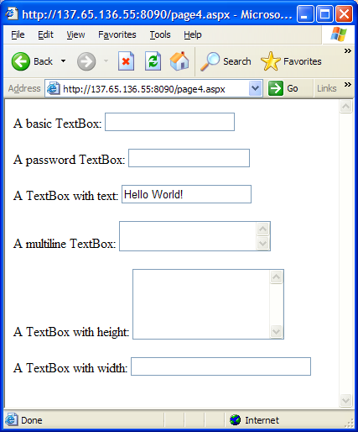
The TextBox Control Examples
<html>
<body>
<form runat="server">
A basic TextBox:
<asp:TextBox id="tb1" runat="server" />
<br /><br />
A password TextBox:
<asp:TextBox id="tb2" TextMode="password"
runat="server" />
<br /><br />
A TextBox with text:
<asp:TextBox id="tb4" Text="Hello World!"
runat="server" />
<br /><br />
A multiline TextBox:
<asp:TextBox id="tb3" TextMode="multiline"
runat="server" />
<br /><br />
A TextBox with height:
<asp:TextBox id="tb6" rows="5"
TextMode="multiline" runat="server" />
<br /><br />
A TextBox with width:
<asp:TextBox id="tb5" columns="30"
runat="server" />
</form>
</body>
</html>

Slide 42
TextBox Script Example
<script runat="server">
Void change(Object obj, EventArgs e) {
lb1.Text="Your name is " + txt1.Text;
}
void submit(Object obj, EventArgs e) {
lbl1.Text="Your name is " + txt1.Text;
}
</script>
<html>
<body>
<form runat="server">
Enter your name:
<asp:TextBox id="txt1" OnTextChanged="change" runat="server" />
<asp:Button OnClick="submit" Text="Submit" runat="server" />
<p><asp:Label id="lbl1" runat="server" /></p>
</form>
</body>
</html>

Slide 43
What is ADO .NET
ADO .NET
ADO .NET is a part of the .NET Framework
ADO .NET consists of a set of classes used to handle data access
ADO .NET is entirely based on XML
ADO .NET has, unlike ADO, no Recordset object

Slide 44
ADO.NET Data Providers
Mono has many ADO.NET Data Providers to get you connected:
  IBM DB2 Universal Database
  MySQL
  ODBC
  Oracle
  OLE DB
  PostgreSQL
  Microsoft SQL Server
  SQL Lite
  Sybase
  Older Microsoft SQL Server and Sybase databases

Slide 45
MySQL Data Provider
ByteFX.Data.MySQLClient
  Written in 100% C#
  Does not require a client library
  Works on Mono and Microsoft .NET
  Requires at least Mono 0.18 and MySQLNet 0.65 for it to work on Mono
  Works in the SQL# command-line and GTK# GUI version
Mono.Data.MySql (deprecated)
  Deprecated in favor of ByteFX.Data.MySQLClient
  Written in C# and uses the MySQL C Client Library
  Exists in namespace Mono.Data.MySql and assembly Mono.Data.MySql

Slide 46
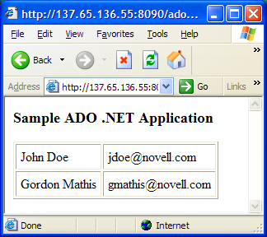
  <%@ import namespace="System.Data" %>
  <%@ import namespace="System.Reflection" %>
  <script runat=server>
  void Page_Load(Object obj, EventArgs e) {
  string providerAssemblyName = "ByteFX.Data";
  string connectionTypeName = "ByteFX.Data.MySqlClient.MySqlConnection";
  string cncString = "Server=localhost;User ID=monotest;Password=monotest;Database=monotest";
  Assembly dbAssembly = Assembly.Load (providerAssemblyName);
  IDbConnection cnc=(IDbConnection)Activator.CreateInstance(dbAssembly.GetType(connectionTypeName, true));
  cnc.ConnectionString = cncString;
  cnc.Open ();
  IDbCommand selectCommand = cnc.CreateCommand();
  selectCommand.CommandText = "SELECT * FROM test";
  IDataReader reader = selectCommand.ExecuteReader ();
  while (reader.Read ()) {
  TableRow row = new TableRow ();
  for (int i = 0; i < reader.FieldCount; i++) {
  TableCell cell = new TableCell ();
  cell.Controls.Add (new LiteralControl (reader.GetValue (i).ToString ()));
  row.Cells.Add (cell);
  }
  myTable.Rows.Add (row);
  }
  }
  </script>
  <html>
  <body>
  <h2>ADO .NET sample database application</h2>
  <asp:Table id="myTable" GridLines="both" CellPadding="5" runat="server"/>
  </body>
  </html>

Slide 47
Mono – ASP.NET Exercises

Slide 48
Install the Mono Environment
Execute the Red Carpet installer
  From the top menu bar select System and then Software Update
  Select the Available Software tab
  Select Mono for the Channel
  Select ALL the Mono components by clicking in the action field of each component
  Click the Run Now button on the tool bar
  Click the Continue button
  When the installation is complete click the OK button
  Close the Red Carpet Installer
Test the Installation
  From a Terminal window execute the following:
    export MONO_PATH=/opt/gnome2/lib
  Execute the Mono documentation just to make sure things are working
    monodoc
MONO

Slide 49

Start the Web Server
ASP.NET execution environment (consists of stand-alone web server and ASP.NET execution environment).
Execute the stand-alone web server XSP
  cd to /usr/bin
  mono xsp.exe --root /usr/share/doc/xsp/test --port 8090

Slide 50
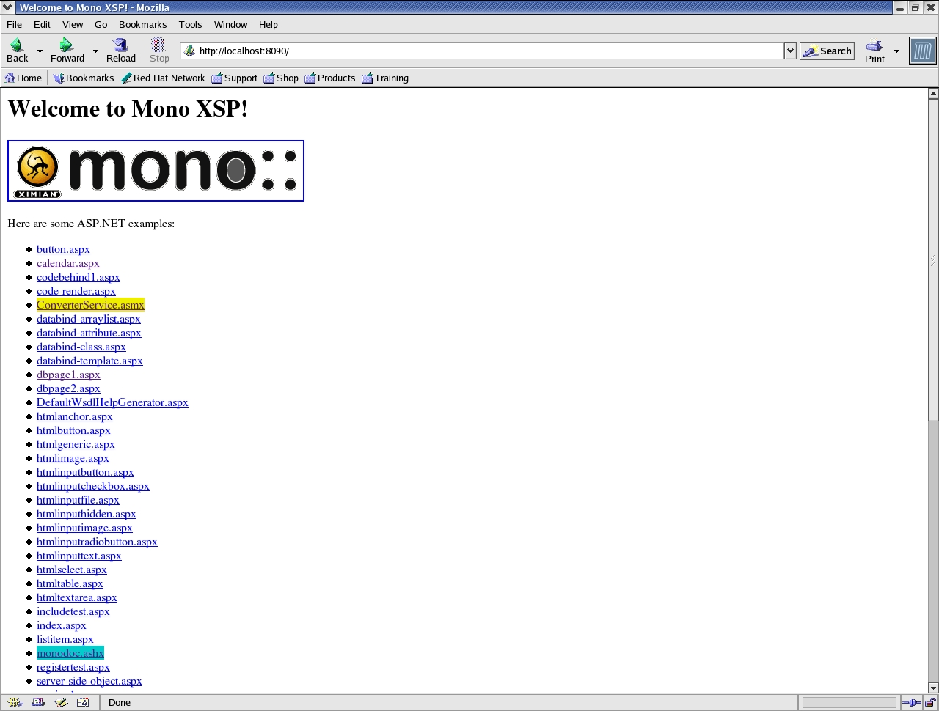

Become Familiar with ASP.NET
Point web browser to http://localhost:8090
(Note: A page of links to ASP.NET pages will appear)
  Click on some of the links that have the .aspx extension.

Slide 51
Modify Custom httphandler
Open the file /usr/share/doc/xsp/test/webhandler.ashx with your favourite editor. Change the text “Hi There!” within the “resp.Write” method to “Hello World”. Save the file then click on the link “webhandler.ashx” from your web browser.
Q. How is the code in “webhandler.ashx” different from the “hellocs.cs” code you built in the Mono GUI class?

Slide 52
Create a Simple ASP.NET Application
Open an editor and insert the following text:
  <%@ language="C#" %>
  <html>
  <head>
  <title>Welcome to Mono ASP.NET</title>
  </head>
  <body>
  <h1>Hello and welcome!</h1>
  <p>The date/time is: <%= DateTime.Now %></p>
  </html>
Save the file as “hello.aspx” in the root docs directory of the XSP server.

Slide 53
Test your ASP.NET Application
Refresh your browser and click on the “hello.aspx” link?
Q: Are you able to add additional c# functions to the “hello.aspx” code? (hint: See the “Class Library” section within monodoc.)
Q: How is this code different from the webhandler.ashx?

Slide 54


Install and Configure MySQL
Using Red Carpet Install MySQL 3.23
  mysql
  mysql-client
Using Administrator Settings select System, Runlevel Editor, and then Runlevel Properties. Select mysql from the list and check run levels 3 and 5 and then click the Start button.

Slide 55
Create a MySQL Database (monotest)
Using the mysql client to create a monotest database with two tables: test, and customers. Also create a monotest user and grant him all rights.
From a Linux Terminal Window enter the following:
  mysql –h localhost –u root
  create database monotest;
  use monotest;
  create table test (person varchar(80), email varchar(80));
  insert into test values (‘john doe’, ‘jdoe@novell.com’);
  create table customers( id int, name varchar(80), address varchar(120));
  use mysql;
  grant all on *.* to monotest@’localhost’ identified by ‘monotest’;

Slide 56
Install the ByteFX driver
Download/Extract the ByteFX.Data.74.zip from http://sourceforge.net/projects/mysqlnet/ to /opt/gnom2/lib
Modify the /usr/share/doc/xsp/test/web.config and change the following:
  DBProviderAssembly
    Mono.Data.ProgresClient to ByteFX.Data
  DBConnectionType
    Mono.Data.PostgreSqlClient.PgSqlConnection to ByteFX.Data.MySqlClient.MySqlConnection
  DBConnectionString
    Host Addr to Server and set it equal to localhost
    user to User ID
    password to Password
    dbname to Database.

Slide 57
Test ADO .NET
From you browser execute the dbpage1.aspx. Use mysql client to add few more people and then play with the SQL wild card ‘%’
INSERT INTO test VALUES (‘<Person Name>’, ‘<Email Address>’);
  Execute the dbpage2.aspx. Add and modify customers. Use mysql client to validate that the customers are being added to the customers table.
  SELECT * FROM Customers;

Slide 58
Install the mod_mono for Apache
Edit the /etc/apache2/httpd.conf add the following lines to the end of the file
  AddType application/x-asp-net .aspx .ashx .asmx .ascx .asax .config .ascx
  LoadModule mono_module /usr/lib/apache2/mod_mono.so
  MonoUnixSocket /tmp/mod_mono_server
  Alias /mono "/usr/share/doc/xsp/test"
1

Slide 59
Install the mod_mono for Apache
2
Start the Apache2 Web Server Running
  From a terminal window execute SuSEconfig
  Using Administrator Settings select System, Runlevel Editor, and then Runlevel Properties
  Select Apache2 from the list and check run levels 3 and 5 and then click the Start button. Or you can simply execute /etc/init.d/apache2 start from a terminal window

Slide 60
Install the mod_mono for Apache
3
Start mod-mono-server
Open a Linux Terminal Window
cd to /usr/bin
  mono mod-mono-server.exe --root /usr/share/doc/xsp/test --applications /mono:.
  Open another terminal window and execute chmod 666 /tmp/mod_mono_server

Slide 61
Test mod-mono
Point web browser to http://localhost/mono/index.aspx
(The same page of links to ASP.NET pages will appear)

Slide 62
Creating a Web Service with ASP.NET
Open and review the file:
  /usr/share/doc/xsp/test/TestService.asmx
Q: What transforms the c# class into a web service?
Click on the “TestService.asmx” link from your browser.
Invoke the “Echo” and “Add” methods.
  (Hint: Click the Test Form link to test the method)

Slide 63
Creating a Web Service with ASP.NET
Modify the TestService.asmx and add a Subract, Multiply, and Divide method.
(Hint: you can simply copy the Add() method and make the necessary changes)
Q. Do the new methods show up when you invoke the class again?
Click on the “C# proxy” link. What is this?
(Hint: The proxy code can be used to build a library that can, in turn be linked to c# or vb.net client applications that need to call the “TestService” methods.)

Slide 64
Creating a Web Service with ASP.NET
Build a c# library from the c# proxy code by cutting and pasting it into an editor. Save the file as “TestService.cs”.
Build the TestService as an library (dll) assembly by invoking the following command:
mcs TestService.cs /target:library -r System.Web.Services.dll
Now you can use the “TestService.dll” assembly with other c# or vb.net applications to call the TestService.asmx web service. (Try it!)

Slide 65
Web Service Client Solution
Create a file named TestClient.cs containing the following:
using System;
class TestClient {
static void Main() {
TestServiceSoap s = new TestServiceSoap();
Console.WriteLine(“Web Service says: “ + s.Echo(“Hola”));
Console.WriteLine(“Web Service said 10 + 2 = “ + s.Add(10, 2));
Console.WriteLine(“Web Service said 10 - 2 = “ + s.Subtract(10, 2));
Console.WriteLine(“Web Service said 10 * 2 = “ + s.Multiply(10, 2));
Console.WriteLine(“Web Service said 10 / 2 = “ + s.Divide(10, 2));
}
}
Build Command:
mcs TestClient.cs –r TestService.dll
Run:
mono TestClient.exe

Slide 67


General Disclaimer
This document is not to be construed as a promise by any participating company to develop, deliver, or market a product. Novell, Inc., makes no representations or warranties with respect to the contents of this document, and specifically disclaims any express or implied warranties of merchantability or fitness for any particular purpose. Further, Novell, Inc., reserves the right to revise this document and to make changes to its content, at any time, without obligation to notify any person or entity of such revisions or changes. All Novell marks referenced in this presentation are trademarks or registered trademarks of Novell, Inc. in the United States and other countries. All third-party trademarks are the property of their respective owners.
No part of this work may be practiced, performed, copied, distributed, revised, modified, translated, abridged, condensed, expanded, collected, or adapted without the prior written consent of Novell, Inc. Any use or exploitation of this work without authorization could subject the perpetrator to criminal and civil liability.
Notes:
This means that no work is lost with either the Novell Nsure UDDI corporate or testing solution.
Enterprises that build their UDDI solutions with Novell Nsure UDDI Server, are not only leveraging the deep experience Novell Identity Management foundation brings to the standard, they are securing their own future by building on an open standard implementation that will grow and scale with their corporate needs.

