Slide 1
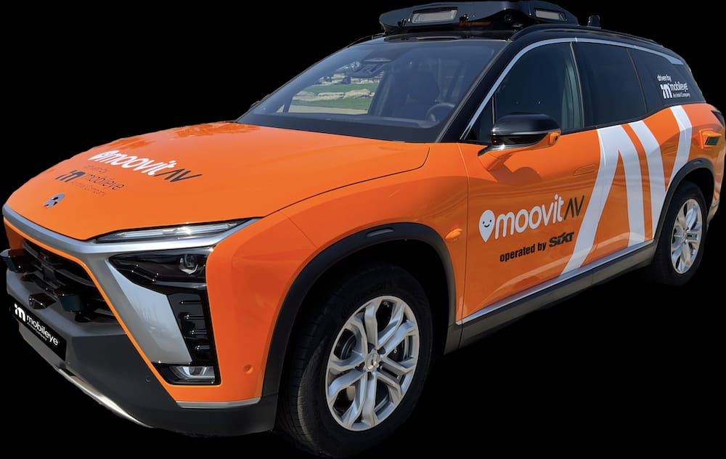
Sixt RoboTaxi App
A new way of traveling living

Slide 2
Team
Khadim Fall: Informatics Student, Main Front-End
Tristan Kaupa , Back-End
Aiden Saulick , Back-End
Dennis Gölitz: EI – Student, Front-End, Organisation

Slide 3
Features

Slide 4
Demo Time !

Slide 5



