Slide 1
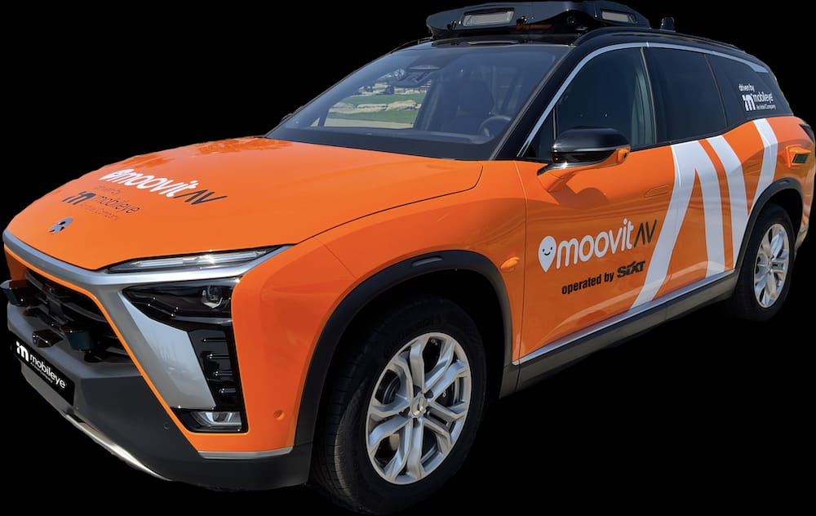
Sixt RoboTaxi App
A new way of traveling living

Slide 2
Team
Khadim Fall: Informatics Student, Main Front-End
Tristan Kaupa Computer Scienc, Main Back-End
Dennis Gölitz: EI – Student, Front-End, Organisation

Slide 3
Features
Book a ride -> let the car pick you up
User-Friendly interface with address auto-completion
Performance-Optimised Algorithm to quickly present you the nearest available vehicles
Sightseeing Mode: Let the car show you the coolest places in the city
Deliver Mode: Let the car pick up any stuff (like food) for you

Slide 4
Demo Time !

Slide 5



