Slide 1
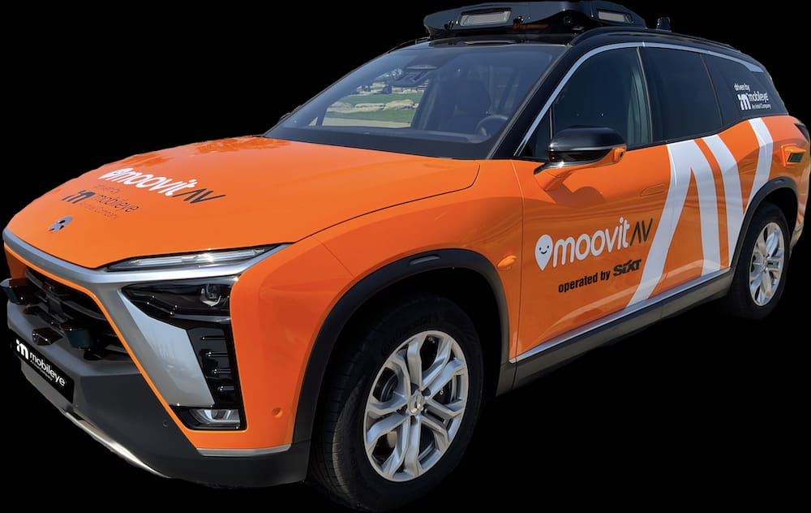
Sixt RoboTaxi App
A new way of traveling living

Slide 2
Team
Khadim Fall: Informatics Student, Main Front-End
Tristan Kaupa: Computer Science, Main Back-End
Dennis Gölitz: EI – Student, Front-End, Organisation
Aiden Saulick: 204 – Content not found

Slide 3
Features
Login and Settings Menu
Four Modes to choose:
Solo RoboTaxi Drive
Social Drive
Sightseeing Mode
Delivery Mode
Search for pickup location or use geopositioning of Mobile device
Autofilling the destination based on last rides and input

Slide 4
Features
Visualization of your Geoposition and the one from the car
Waiting time calculation and sending car to pickup place
Starting the ride once you and all baggage is in
Dropping you of at the choosen place

Slide 5
Demo Time !

Slide 6



