Slide 1
Confined strain waves in SrRuO₃ Probing the interfacial bonding
Notes:
I'm Mattias, from Caviglia Lab, and I’m sharing with you today the outline of a project we recently began. It involves enhancing the coupling between light and matter by use of small planar optical cavities. I’ll be explaining the ideas behind it and showing some preliminary results.

Slide 2


Time-resolved reflectometry
SRO (55 u.c.) // CaF₂
640 or 1560 nm
$$ΔR$$
$$Δt$$
800 nm
Notes:
[Intrigue]
This technique makes use of broadband pulses with frequencies around 1 THz, meaning they span a few meV in terms of photon energy.
The idea is that you measure the pulse waveform before and after interacting with the sample. The interaction causes some reshaping of the waveform, which encodes the electrodynamic response of the sample.
In the spectral domain, you divide out the incident pulse from the outgoing pulse, which gives you the sample's transmission function. From this you can extract the conductivity (or, alternatively, the permittivity) over all the frequencies contained in your pulse.
This technique has become quite popular, because it offers a way to measure conductivity without ever touching the sample with any electrodes, and it integrates nicely into a pump-probe scheme where you can measure the time dynamics of your frequency-dependent conductivity.

Slide 3
Epitaxy vs. vdW bonded
SRO
SRO
CaF₂
STO
Supported film / flake
Epitaxial film
Notes:
[Intrigue]
This technique makes use of broadband pulses with frequencies around 1 THz, meaning they span a few meV in terms of photon energy.
The idea is that you measure the pulse waveform before and after interacting with the sample. The interaction causes some reshaping of the waveform, which encodes the electrodynamic response of the sample.
In the spectral domain, you divide out the incident pulse from the outgoing pulse, which gives you the sample's transmission function. From this you can extract the conductivity (or, alternatively, the permittivity) over all the frequencies contained in your pulse.
This technique has become quite popular, because it offers a way to measure conductivity without ever touching the sample with any electrodes, and it integrates nicely into a pump-probe scheme where you can measure the time dynamics of your frequency-dependent conductivity.

Slide 4
Unstable level
55 uc
SRO
CaF₂
SRO
STO
Notes:
[Intrigue]
This technique makes use of broadband pulses with frequencies around 1 THz, meaning they span a few meV in terms of photon energy.
The idea is that you measure the pulse waveform before and after interacting with the sample. The interaction causes some reshaping of the waveform, which encodes the electrodynamic response of the sample.
In the spectral domain, you divide out the incident pulse from the outgoing pulse, which gives you the sample's transmission function. From this you can extract the conductivity (or, alternatively, the permittivity) over all the frequencies contained in your pulse.
This technique has become quite popular, because it offers a way to measure conductivity without ever touching the sample with any electrodes, and it integrates nicely into a pump-probe scheme where you can measure the time dynamics of your frequency-dependent conductivity.

Slide 5
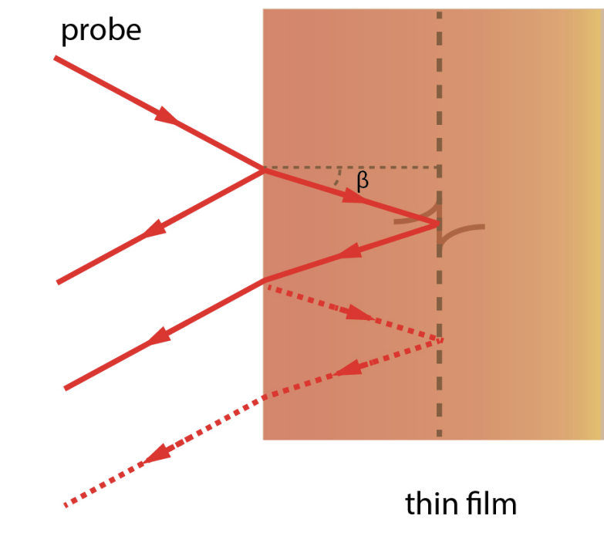
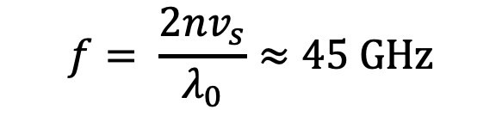
Travelling pulse
Brillouin scattering
$$f= \frac{2nv_{s}}{λ_{0}}≈45 GHz$$
Notes:
[Intrigue]
This technique makes use of broadband pulses with frequencies around 1 THz, meaning they span a few meV in terms of photon energy.
The idea is that you measure the pulse waveform before and after interacting with the sample. The interaction causes some reshaping of the waveform, which encodes the electrodynamic response of the sample.
In the spectral domain, you divide out the incident pulse from the outgoing pulse, which gives you the sample's transmission function. From this you can extract the conductivity (or, alternatively, the permittivity) over all the frequencies contained in your pulse.
This technique has become quite popular, because it offers a way to measure conductivity without ever touching the sample with any electrodes, and it integrates nicely into a pump-probe scheme where you can measure the time dynamics of your frequency-dependent conductivity.

Slide 6
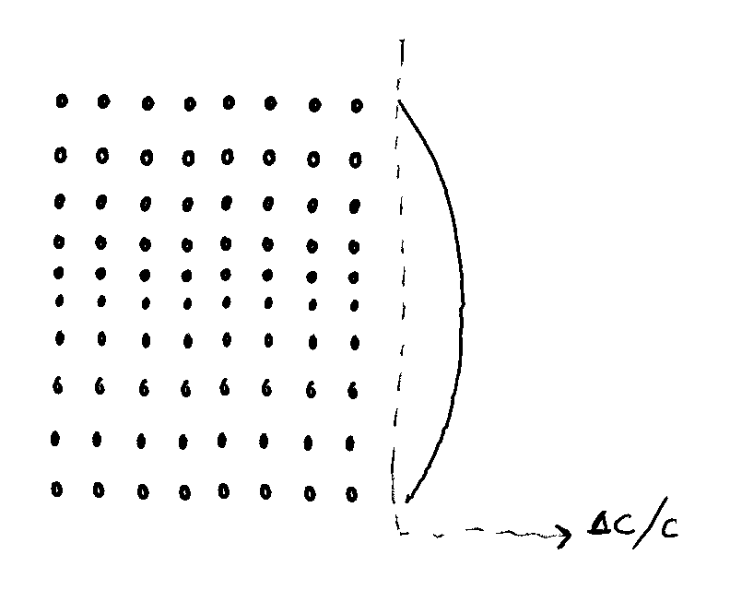
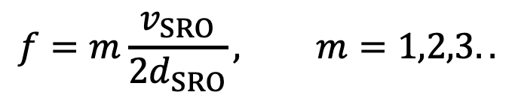
Confined waves
$$f=m\frac{v_{SRO}}{2d_{SRO}}, m=1,2,3..$$
Notes:
[Intrigue]
This technique makes use of broadband pulses with frequencies around 1 THz, meaning they span a few meV in terms of photon energy.
The idea is that you measure the pulse waveform before and after interacting with the sample. The interaction causes some reshaping of the waveform, which encodes the electrodynamic response of the sample.
In the spectral domain, you divide out the incident pulse from the outgoing pulse, which gives you the sample's transmission function. From this you can extract the conductivity (or, alternatively, the permittivity) over all the frequencies contained in your pulse.
This technique has become quite popular, because it offers a way to measure conductivity without ever touching the sample with any electrodes, and it integrates nicely into a pump-probe scheme where you can measure the time dynamics of your frequency-dependent conductivity.

Slide 7
Epitaxy vs. vdW bonded
55 uc
SRO
CaF₂
SRO
STO
Notes:
[Intrigue]
This technique makes use of broadband pulses with frequencies around 1 THz, meaning they span a few meV in terms of photon energy.
The idea is that you measure the pulse waveform before and after interacting with the sample. The interaction causes some reshaping of the waveform, which encodes the electrodynamic response of the sample.
In the spectral domain, you divide out the incident pulse from the outgoing pulse, which gives you the sample's transmission function. From this you can extract the conductivity (or, alternatively, the permittivity) over all the frequencies contained in your pulse.
This technique has become quite popular, because it offers a way to measure conductivity without ever touching the sample with any electrodes, and it integrates nicely into a pump-probe scheme where you can measure the time dynamics of your frequency-dependent conductivity.

Slide 8
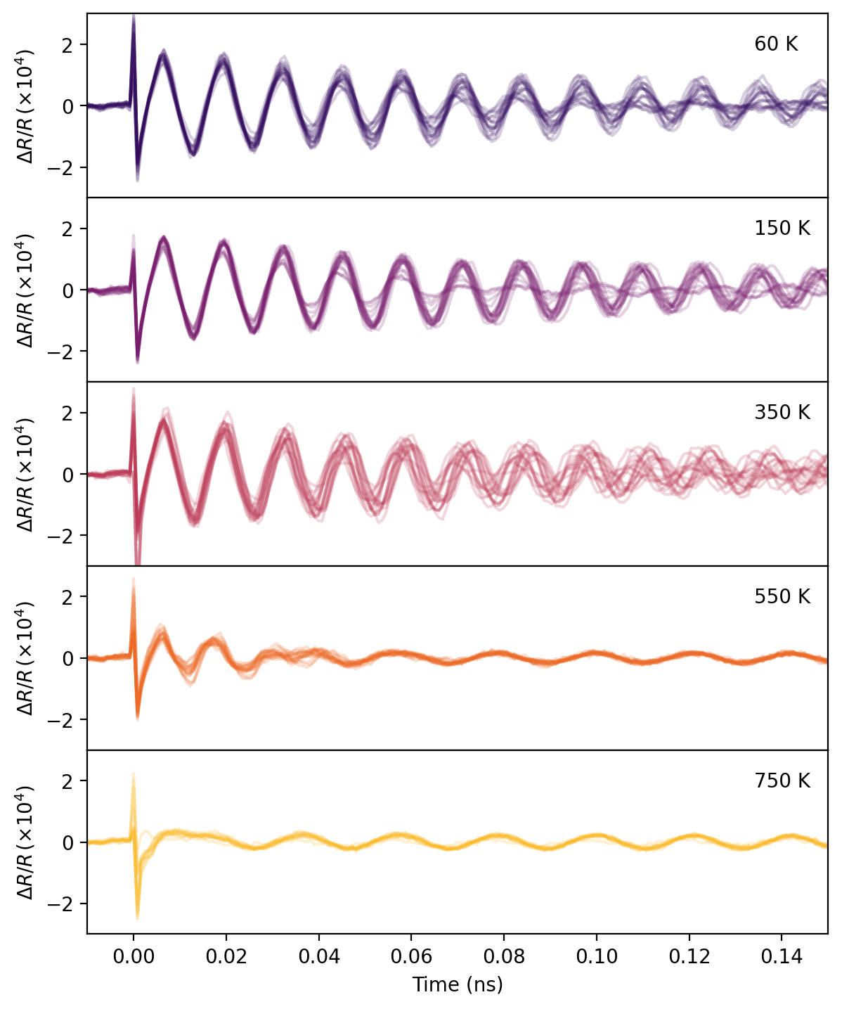
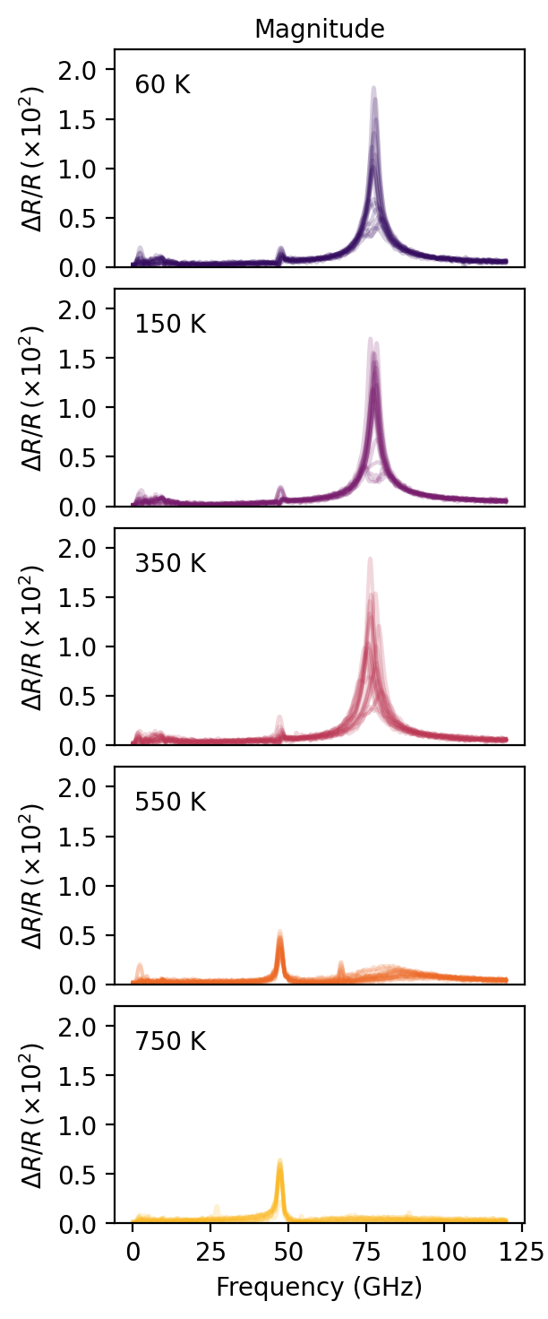
Can you reform epitaxy?
Notes:
[Intrigue]
This technique makes use of broadband pulses with frequencies around 1 THz, meaning they span a few meV in terms of photon energy.
The idea is that you measure the pulse waveform before and after interacting with the sample. The interaction causes some reshaping of the waveform, which encodes the electrodynamic response of the sample.
In the spectral domain, you divide out the incident pulse from the outgoing pulse, which gives you the sample's transmission function. From this you can extract the conductivity (or, alternatively, the permittivity) over all the frequencies contained in your pulse.
This technique has become quite popular, because it offers a way to measure conductivity without ever touching the sample with any electrodes, and it integrates nicely into a pump-probe scheme where you can measure the time dynamics of your frequency-dependent conductivity.

