Slide 1

Student Name : | M.Manoj
Naan Mudhalvan ID: | au713921106027
Student Mail ID: | manojisac68@gmail.com
Project Title: | Environmental Monitoring

Slide 2
Overview of Project
This project based on the Internet Of Things that’s Environmental Monitoring. How we can detect the Environmental this is our project.
Apparatus Required for Software:
Github
Visual code

Slide 3
Major Hardware devices Used
Input Components Temperature sensor LM 35
Humidity sensor – ESP 8266 Arduino UNO microcontroller –Power supply
Communication Interfaces
Wired USB Connectors Wireless Fidelity (Wi-Fi) module Output Components IoT device smart phone LCD (Optional

Slide 4
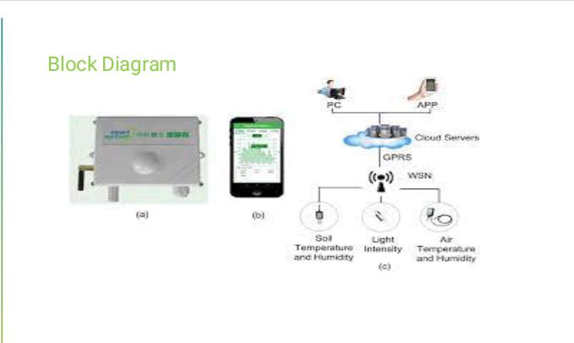

Slide 5
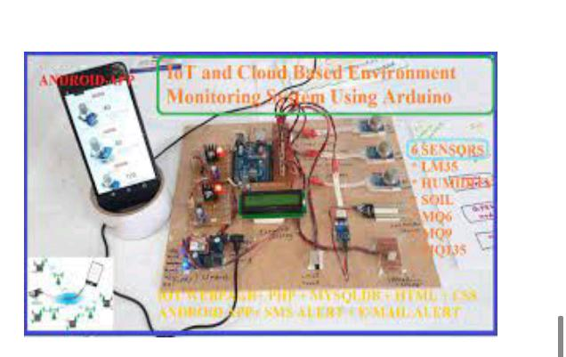

Slide 6
Environmental Monitoring
The project involves setting up IoT devices to monitor environmental conditions in public parks, including temperature and humidity.
The primary objective is to provide real-time environmental data to park visitors through a public platform, enabling them to plan their outdoor activities accordingly.
This project includes defining objectives, designing the IoT sensor system, developing the environmental monitoring platform, and integrating them using IoT technology and Python.

Slide 7
Much of commercial farming, like weather monitoring, suffers from a lack of precision and requires human labor in the area of monitoring. Its automation also remains limited.
loT allows operations to remove much of the human
intervention in system function, farming analysis, and monitoring. Systems detect changes to crops, soil, environment, and more.
They optimize standard processes through analysis of large, rich data collections. They also prevent health hazards (e.g., e. coli) from happening and allow better control.

Slide 8
Environmental Monitoring Framework
In the context of the envisaged environmental monitoring framework, therefore, the evaluation objectives are the key NFR which were identified for these variants of IT architectures.
In this framework these objectives are Reliability, Functional Suitability, Maintainability, Security, and Usability.

Slide 9
An loT environmental monitoring solution is following objectives could be used:
IoT environmental sensor systems should possess a constant rate of resource utilization. ‘Smart’ sensors should gather environmental data accurately.
Such-and-such a system needs to support different communication modules.
Expected rates of breach of access and confidentiality in our network need to be low. The user interface should be attractive to users (sensor data should be easy to find and navigate).

Slide 10
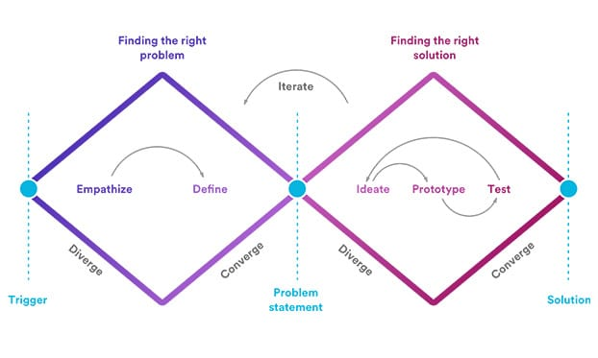
Thinking methods to create a successful IoT product

Slide 11
3 key results come out of Design Thinking process
Theory, Prototypes, Testing and Refinement Focus on need Eliminate the repetitive or unnecessary steps to make it simple.
Design thinking for above scenario for a smart solution.
Identify the actors. Form ideas Prototype Test Return to step 1 or step 2 until the desired result is obtained.

Slide 12
CONCLUSION
Design Thinking process Integrate future users with design process from the day one .Agile process helps Design thinking to provide insights into the problem which customer was not aware of. Once the prototype is tested successfully design team will hand over the solution to the implementation team for the bigger landscape implementation.

