Slide 1
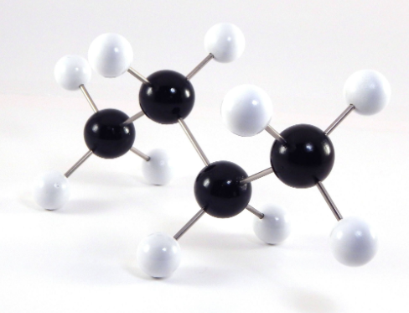
Molecular-fragments-based feature engineering for surface tension prediction
Feature engineering 0 (fe0)
Feature engineering 1 (fe1)
Fragments: C, H, C=C, C#C, benzene ring, O-alc, O-eth, O-ald, O-ket, O-acid, O-ester, R3-R8 (3-8 membered rings)
Others: molecular weight, density (subject to availability)
Fragments: C, CH, CH2, CH3, C-ring, CH-ring, CH2-ring, C=C, C#C, Ar, OH, CHO, CO, COOH, COOR
Others: molecular weight, density (subject to availability)
Dataset 1:
Organic liquids
Dataset 2:
Organic polymers
Dataset 3:
Evonik CAD
292 data points, 268 after exclusion of 16 Si-containing samples, 5 carbonates, 1 anhydride, Furan and formic acid
Structure + measured surface tension
Density data was manually retrieved from SciFinder + Chemspider + vendors (TCI, Sigma-Aldrich, Alfa Aesar, etc.)
Used to test predictive power of fragments towards surface tension and molar volume in small molecules
23 data points
Structure + measured molar volume
Used to test predictive power of fragments towards molar volume in polymers
19 data points, 6 contains unwanted diol 1
Structure + composition + surface tension
Used as final test of models

Slide 2
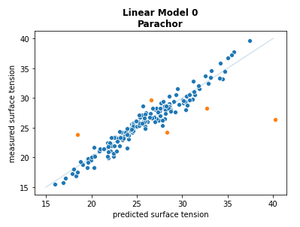
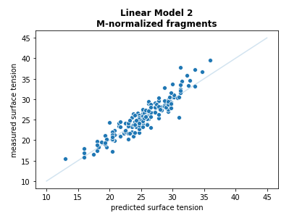
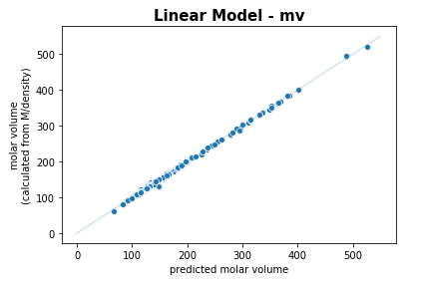
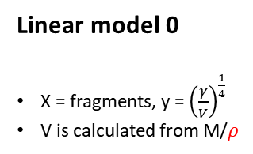
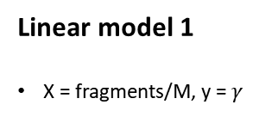
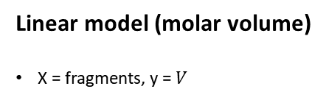
Dataset 1: Organic liquids
Linear Models with fe0
Linear model 0
X = fragments, y = ${\left(\frac{γ}{V}\right)}^{\frac{1}{4}}$
V is calculated from M/$ρ$
Linear model 1
X = fragments/M, y = $γ$
Linear model (molar volume)
X = fragments, y = $V$
rmse = 1.525
mae = 0.875
rmse = 1.600
mae = 1.203
rmse = 2.546
mae = 1.760
Fragments used = C, H, C=C, Ar, O-eth, O-ester, R5, R6

Slide 3
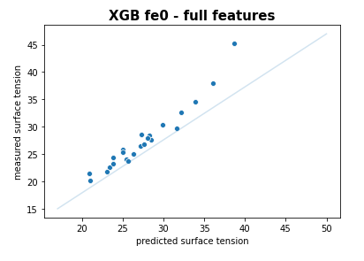
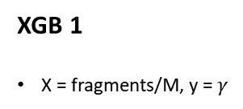
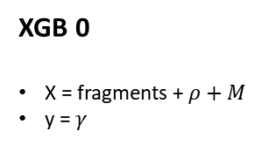
Dataset 1: Organic liquids
XGB with fe0
XGB 0
X = fragments + $ρ+M$
y = $γ$
XGB 1
X = fragments/M, y = $γ$
Dataset 1
263 data points (C#C, R3, R4, R7, R8 – containing samples were excluded due to underrepresentation)
204 train, 36 validation, 23 test
The 23 test datapoints are picked based on literature’s test allocation (for comparison)
rmse = 1.699
Fragments used = C, H, C=C, Ar, O-alc, O-eth, O-ald, O-ket, O-acid, O-ester, R5, R6

